Slide 1

Conference PowerPoint
Sustainability in the Hospitality Industry
Mohammed muddasar
2121682
BMIH6001

Slide 2

Abstract
Overview of sustainability's growing importance in the hotel sector.
Focus on energy efficiency, water conservation, waste management, and sustainable sourcing.
Highlight successful case studies and challenges faced by some hotels.

Slide 3
Introduction
Definition of sustainability in the hospitality industry.
Importance due to resource consumption and environmental impact.
Increasing consumer demand for eco-friendly options.

Slide 4

Key Themes in Sustainability
Energy Efficiency
  Importance of reducing energy costs.
  Example: Hilton’s goal to reduce energy consumption by 30% by 2030.
Water Conservation
  Strategies: Low-flow fixtures, recycling.
  Example: IHG’s commitment to a 20% reduction in water use by 2025.

Slide 5

Key Themes Continued
Waste Reduction
  Implementing recycling and composting.
  Example: Accor’s "Planet 21" initiative aims to cut food waste by 50%.
Sustainable Sourcing
  Local and organic products to reduce carbon footprint.
  Example: Ritz-Carlton’s Farm-to-Table movement.
Certifications and Standards
  Importance of certifications like LEED.
  Example: Proximity Hotel’s LEED Platinum certification.

Slide 6

Successful Case Studies
Proximity Hotel, USA: LEED Platinum, energy-saving technologies.
Oberoi Group, India: Water conservation and local sourcing.
Accor Hotels: Global sustainability initiatives and performance improvements.

Slide 7

Challenges in Sustainability
Economic constraints for smaller hotels.
Lack of knowledge and resources.
Impact of COVID-19 on sustainability initiatives.

Slide 8
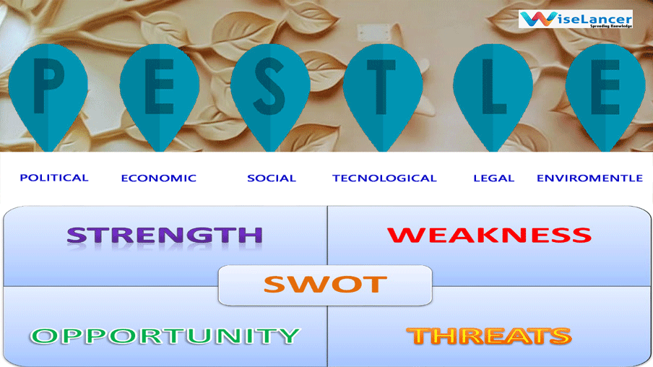
Pestle and Swot analysis

Slide 9
Conclusion
Sustainability as a strategic necessity for the hospitality industry.
Need for collaboration among stakeholders.
Long-term benefits for both the environment and hotel profitability

Slide 10

References
Accor. (2021). Planet 21: Our Sustainable Development Programme. Available at: https://group.accor.com/en/commitment-to-sustainable-development (Accessed: 15 October 2024).
Benavides, C. and Benavides, A. (2020). 'Sustainable hotel management: Strategies for the implementation of sustainable practices', Journal of Sustainable Tourism, 28(7), pp. 947-964. Available at: https://doi.org/10.1080/09669582.2020.1794557 (Accessed: 20 October 2024).
Bohdanowicz, P. (2006). 'Energy and water consumption in the hotel sector', International Journal of Hospitality Management, 25(2), pp. 195-210. Available at: https://doi.org/10.1016/j.ijhm.2005.09.002 (Accessed: 19 October 2024).
Chechi, R. and Bruni, M. (2021). 'Sustainable sourcing in the hospitality industry: Challenges and opportunities', International Journal of Hospitality Management, 97, 102982. Available at: https://doi.org/10.1016/j.ijhm.2021.102982 (Accessed: 22 October 2024).
González-Rodríguez, M.R., Buxó, L. and Magrini, A. (2020). 'The role of local sourcing in sustainable hospitality management', Journal of Cleaner Production, 255, 120148. Available at: https://doi.org/10.1016/j.jclepro.2019.120148 (Accessed: 22 October 2024).
Graci, S. and Dodds, R. (2008). 'Sustainable tourism in the hospitality industry: A review of the literature', International Journal of Hospitality Management, 27(2), pp. 230-242. Available at: https://doi.org/10.1016/j.ijhm.2007.10.008 (Accessed: 17 October 2024).
Hilton. (2021). Travel with Purpose: Our 2030 Goals. Available at: https://esg.hilton.com/ (Accessed: 17 October 2024).
IHG. (2021). Water Conservation at IHG. Available at: https://www.ihgplc.com/en/responsible-business/sustainable-development (Accessed: 19 October 2024).

Slide 11

thank you

