Slide 1
Module Name : Electronics I
Module Code : ACDB5002
Lecture : 10
Topic : Single, Split and Multi- rails
Power supply
Lecture By,
Mrs. Jenifer Prince Devaraj,
Lecturer - Embedded Electronics,
Faculty of Applied Computing,
UWTSD
Email:j.prince-devaraj@uwtsd.ac.uk

Slide 2
Power Supply Rails
Power Supply Rails
Converts AC (Alternating Current) from the wall socket into DC (Direct Current) used by the PC.
Provides stable and regulated power to all internal components.
Uses power rails to supply different voltage levels.
Common output voltages include +12V, +5V, and +3.3V.
Ensures each component receives the appropriate voltage and current for safe operation.
Notes:
The power supply units which are used in PC converts the energy that comes from the socket (alternating current) into direct current that the PC can use.
PSU can use rails to operate different components by having different voltages.
Example Voltages can be +12V, +5V, +3.3 V etc…

Slide 3
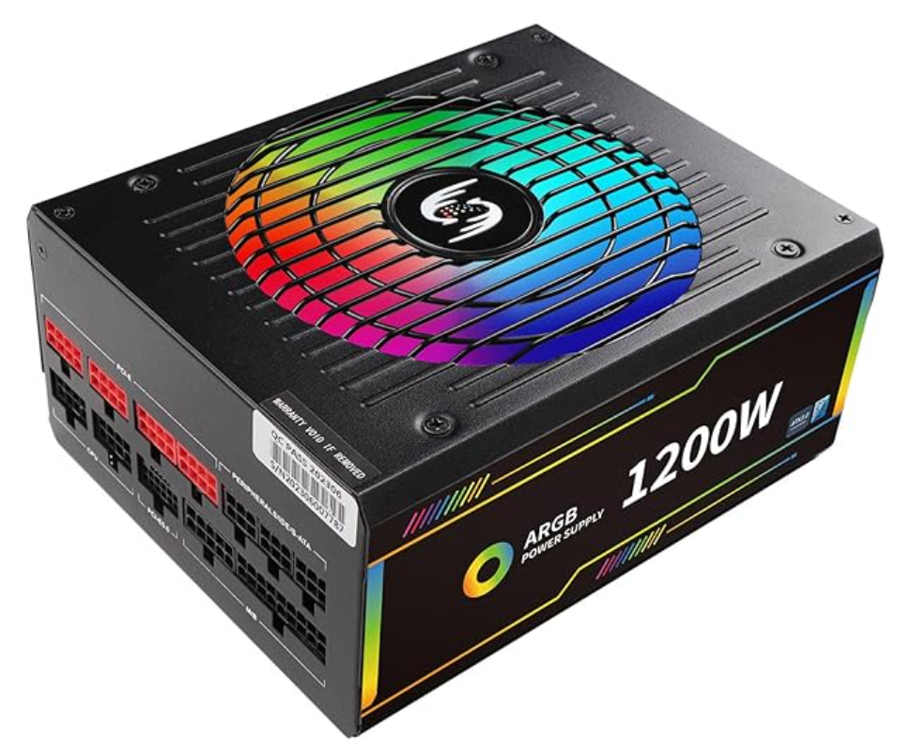
Power Supply Rails
Example: ATX Power Supply Unit (PSU)
Converts AC → DC and regulates voltage precisely.
Provides multiple DC outputs : +12V, +5V, +3.3V.
Built-in safety : OVP, OCP, SCP, UVP, OTP.
Cooling Function.
Customizable lighting through motherboard RGB software.
Notes:
Power Conversion: Converts AC → DC and regulates voltage precisely.
Voltage Rails: Supplies multiple DC rails: +12 V (main), +5 V, +3.3 V.
Protection Circuits: Includes OVP (Over Voltage), OCP (Over Current), SCP (Short Circuit), UVP (Under Voltage), and OTP (Over Temperature).
Cooling: Has a large fan (in this case RGB-lit) to cool internal components.
Efficiency: Rated for 80+ certification (often Gold/Platinum) - wastes less power as heat.
ARGB Lighting“ARGB” stands for Addressable RGB : the lighting colours can be customized and patterns via your motherboard’s RGB software.

Slide 4
Power Supply Rails
ATX Power Supply Unit Output (separate regulated voltages)
Power Rail Voltage (Vdc) | Typical Use | Wire Color
+12.0 V | CPU, GPU, fans, pumps, drives (motors) | Yellow
+5.0 V | USB ports, logic circuits, storage | Red
+3.3 V | Motherboard logic, RAM, SSD (NVMe), sensors | Orange
−12.0 V | Legacy serial ports (rarely used) | Blue
+5.0 V standby | Power for USB charging, wake-on-LAN | Purple
Ground: 0 V (return path) | All circuits | Black
Power Good (signal) : +5 V logic | Tells motherboard power is stable | Gray
PS_ON (control) :+5 V logic | Turns PSU on/off from motherboard | Green

Slide 5
Power Supply Rails
Types of Power Supply Units
Single Rail PSU
Multi- Rail PSU
Split – Rail PSU

Slide 6
Power Supply Rails
Single Rail PSU
A single-rail PSU has one +12 V rail with a single monitoring/protection channel.
No current split; entire +12 V capacity available on one rail.
can supply high current for modern GPUs
Example: Corsair RMx series.
Notes:
A single-rail PSU comes with a single voltage monitoring channel.
This prevents any form of power split in the middle.
Every power we have ever seen is a single-rail PSU.
Eg:Corsair’s RMx series
The main advantage of a single rail + 12V power supply is
It can supply a higher current intensity (Amps), that is required to service modern graphics cards.
If the source is multi rail it is likely to use several cables connected to different rails of the source to reach the same current value.

Slide 7
Power Supply Rails
Multi Rail PSU
Several independent +12 V rails.
Different connectors fed by separate rails (GPU, CPU EPS, 24-pin)
Common in workstations/servers.
Load is divided across rails → easier to avoid overloads.
each rail has its own OCP (over-current protection) that can shut down only the faulty rail quickly.
Notes:
A multi-rail PSU have multiple +12V rails for different connectors.
For example, each PC connector that goes to the GPU has a separate rail/trace, the CPU power cable has a trace, the 24-pin motherboard has a separate rail.
Multi-rail power supplies are used in workstations and server hubs.
The load is distributed along multiple rails makes it safer and is preferable since it can identify a localized issue and shut down the PSU faster.
The advantage of multi-rail sources is that they divide the load.
This allows overloads to be avoided more easily.
Each of the multiple rails has its own independent safety mechanism (OCP

Slide 8
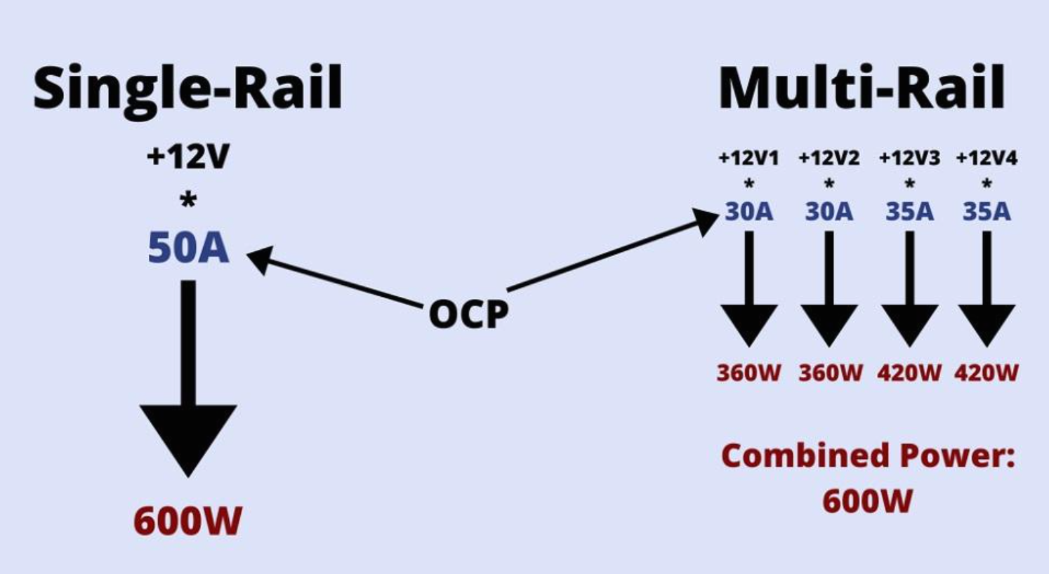
Power Supply Rails
Single Vs Multi Rail PSU
Features | Single Rail PSU | Multi-Rail PSU
+12V Power Delivery | All power flows through one rail. | Power is distributed across multiple rails.
Overcurrent Protection | OCP applies to the entire +12V rail. | Each rail has its own OCP.
Safety | Less safe if a short circuit occurs, as high current can flow unchecked. | Safer, as OCP limits current per rail.
Simplicity | Easier to manage and set up, no need to balance loads. | Requires balancing load across rails.
High-Power GPUs | Suitable for GPUs needing very high current. | May require using multiple connectors from separate rails.
Cost | Less expensive. | Can be more expensive due to added circuitry.
Notes:
The single rail model supplies 50 amps of current, which makes it capable of delivering these 600 watts with this single rail.
Multi Rail have a power supply with several rails, two of them that supply 30 amps (360W) and another two that can deliver up to 35 amps (420W), delivering a combined power of 600 watts.

Slide 9
Power Supply Rails
Exercise 1
Design a multi-output regulated power supply that provides three independent DC voltage outputs: +12V, +8V, +5V and 3.3V. The supply should use a single AC input source, step it down using a transformer, and convert it to DC using a bridge rectifier. Include voltage regulation using appropriate linear regulators and LDO regulators and ensure proper filtering and stability with capacitors and load resistors.
Notes:
3.3V from the 5v and not from raw DC→ to avoid heat dissipation.
0.33uf→ prevents oscillation
0.1uf→ improves transient response when load steps

Slide 10
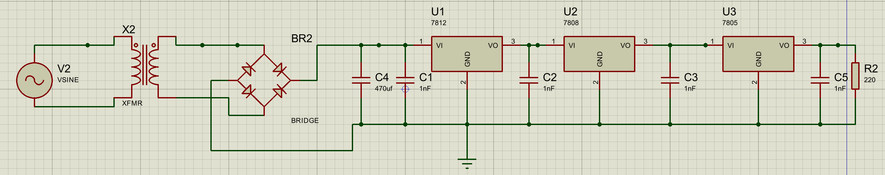
Power Supply Rails
Exercise 1
Notes:
3.3V from the 5v and not from raw DC→ to avoid heat dissipation.
0.33uf→ prevents oscillation
0.1uf→ improves transient response when load steps

Slide 11
Power Supply Rails
Split Rail PSU
Split-rail PSU → provides +V and −V rails (e.g., ±12 V) from one AC source.
Uses a single transformer, rectifier, and regulators to create positive and negative DC rails.
Common where audio/analog circuits need a true ground-centered supply (e.g., headphone amps, op-amp stages)
Often built with all-in-one split-rail converters or paired positive/negative regulators.
Supports bipolar signal swing around 0 V without large coupling capacitors.
Notes:
A split-rail power supply is a circuit that provides positive and negative DC voltage rails from a single AC transformer, and step-down voltage regulators. Example : Headphone amplifiers usually require positive and negative voltages. Both voltages are generated from a single input voltage with an all-integrated split-rail converter.

Slide 12
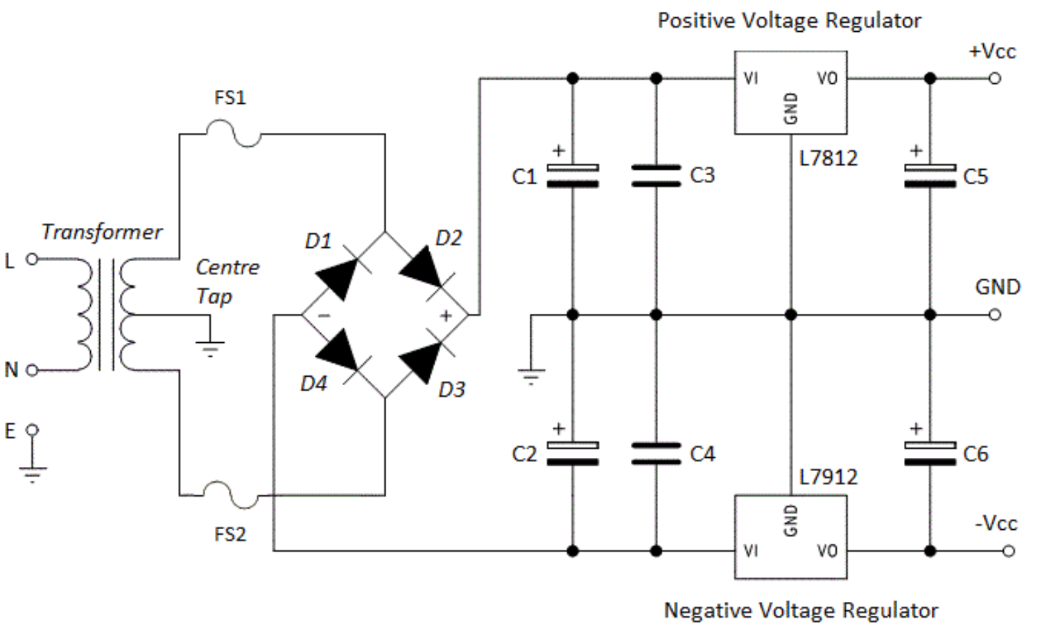
Power Supply Rails
Split Rail PSU
Notes:
A split-rail power supply is a circuit that provides positive and negative DC voltage rails from a single AC transformer, and step-down voltage regulators. Example : Headphone amplifiers usually require positive and negative voltages. Both voltages are generated from a single input voltage with an all-integrated split-rail converter.

Slide 13
Power Supply Rails
Exercise 2
Design a split power supply circuit capable of providing both +5V and -5V DC outputs using a single AC input source. The circuit should include a step-down transformer, a bridge rectifier, filtering capacitors, and voltage regulators that produce +5 V and – 5 V. Ensure proper decoupling and load stabilization with suitable components.

Slide 14
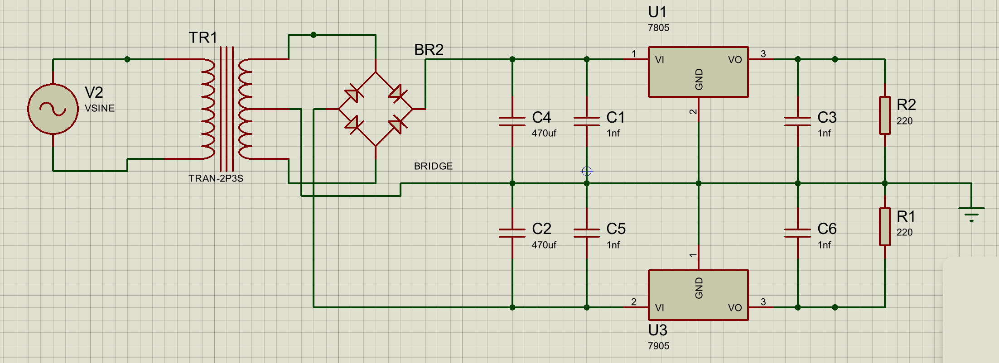
Power Supply Rails
Exercise 2

Slide 15
Power Supply Rails
References
[1] P. Horowitz and W. Hill, The Art of Electronics, 3rd ed. Cambridge, UK: Cambridge University Press, 2015.
[2] Tech4Gamers, “Single Rail vs Multi Rail PSU: Which One to Choose?,” Tech4Gamers, Jan. 13, 2023. [Online]. Available: https://tech4gamers.com/single-rail-vs-multi-rail-psu/.
[3] MSI, “5 Things to Pay Attention to When Choosing a Power Supply,” MSI Blog. [Online]. Available:https://www.msi.com/blog/5-things-to-pay-attention-to-when-choosing-a-power-supply.
[4] "High current dual power supply," Electronics Stack Exchange. [Online]. Available: https://electronics.stackexchange.com/questions/389772/high-current-dual-power-supply.
[5] "An Attempt at Explaining Single and Multi-Rail in Power Supplies," Cultists Network. [Online]. Available:https://cultists.network/11658/an-attempt-at-explaining-single-and-multi-rail-in-power-supplies/.

Slide 16
Thank You

