Slide 1

Profit Decline of T.M Lewin
Name of the Student: Ivaylo Georgiev
Student’s ID:2128090
Module: Problem Solving and Decision Making
Lecturer name:Dr Chijioke D Uba

Slide 2
Table of Contents
Content | Slide Number
Nature and Impact of T.M Lewin on the Company and Employee | 04
Causes of Profit Decline in T.M Lewin | 05
External Environmental Causes for the Problem | 07
Fishbone Diagram | 08
Possible Solutions for T.M Lewin | 09
Evaluation of Solutions | 11

Slide 3
IdIdentification of causes of profit decline in TM Lewinof causes of profit decline in TM Lewin
Any problem could only be solved by identifying its causes.
In TM Lewin case study are used PESTEL and Fishbone diagram.
“PESTEL analysis is a tool used for analysis and monitoring of external environmental
factors with an impact on the organization”(Christodoulou & Cullinane, 2019)
“Insufficient depth of analysis leads to insufficiently good strategic decisions, and missed business opportunities” (Matovic, 2020)
A Fishbone diagram is helpful in identifying different possible causes of a problem and classifying ideas.
It helps to do cause and effect analysis of the particular problem
“Fishbone diagram, also called as ‘cause-and-effect’ diagram, is a tool used to identify the root cause of problems which represents the effect and the factors or causes influencing it” (Shinde et al., 2018)

Slide 4

Nature and Impact of T.M Lewin on the Company and Employees
The profit decline caused T.M Lewin to face challenges with a huge debt in the market from the secured creditor “Torque” as well as the unsecured creditors.
The lockdown caused the work-from-home facility and served some difficulties with the demands from the company which led to a profit decline.
A loss of 600 employees caused the other employees to face some challenges with huge work pressure and hampered their health

Slide 5

Causes of Profit Decline in T.M Lewin

Slide 6
One of the major causes of the profit decline of T.M Lewin is the pandemic situation as said by the critiques.
The uncertainty of the market and the choice of business strategy was a greater challenge for the company to maintain the business properly.
Fast-growing business organisations put greater competition for the company to make a better approach to its business.
56

Slide 7
External Environmental Analysis
(PESTLE)
Factors | Analysis
Political | The newer policies and rules during the pandemic made the situation more challenging (Cooper, 2020). The lockdown caused the company to face a huge challenge in the market.
Economic | The UK economy faced a huge decline during the pandemic which caused a challenge for the company. According to the reports, the total GDP of the UK fall by more than 19% during the pandemic (Beatrix and Irwan, 2022).
Social | Great unemployment during the pandemic caused a devastating change in the UK society which made the situation more challenging. This affected the company to change in demands.
Technological | The huge technological outburst in the UK helped the company to manage the business properly. This helped in the work-from-home facility of the company (Shergill et al., 2022).
Legal | Employee health was one of the most important factors during the pandemic situation which caused a challenging situation for the company. Newer health-safety rules caused the company more difficulties to manage the business.
Environmental | The pandemic situation caused a change in the environment of the UK which helped in the business development of the company in near future. However, a lower customer number caused a challenge for them to run the retail business.

Slide 8
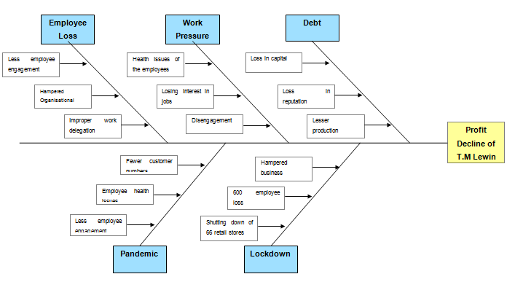
Fishbone Diagram

Slide 9

Possible Solutions for T.M Lewin

Slide 10
The company must follow the changes in the market and launch a proper marketing campaign to attract customers.
The company must use the important technologies properly to make a greater approach to the online business set-up.
Innovative and creative business ideas are important to the company to make a greater approach with the problem.
910

Slide 11
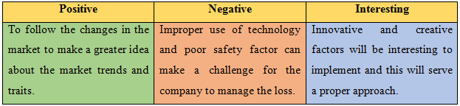
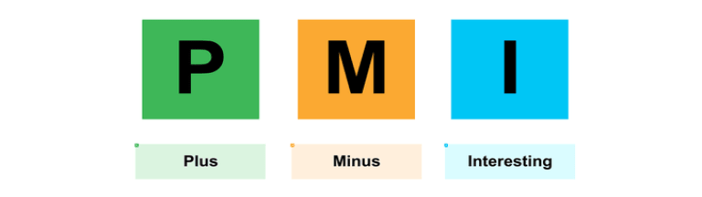
Evaluation of Solutions
(PMI Analysis)

Slide 12
References
Beatrix, M. and Irawan, A.P., 2022, April. PESTLE Analysis for Indonesia’s MSME during Covid-19. In 3rd Tarumanagara International Conference on the Applications of Social Sciences and Humanities (TICASH 2021) (pp. 1907-1910). Atlantis Press.
Cooper, R.J., 2020. Pestle and mortal: the demise of community pharmacy in the UK. International Journal of Pharmacy Practice, 28(3), pp.205-206.
Lipton, B. and Basu, S., 2022. COVID casual in the Australian public sector: Professional attire in the age of remote working.
Shergill, R.S., Farlow, A., Perez, F. and Patel, B.A., 2022. 3D-printed electrochemical pestle and mortar for identification of falsified pharmaceutical tablets. Microchimica Acta, 189(3), pp.1-10.
Yu, P., Hao, R., Cai, Z., Sun, Y. and Zhang, X., 2022. Does emission trading system achieve the win-win of carbon emission reduction and financial performance improvement?—Evidence from Chinese A-share listed firms in industrial sector. Journal of Cleaner Production, 333, p.130121.
Matovic, I.M., 2020. PESTEL analysis of external environment as a success factor of startup business. ConScienS, p.96.
Shinde, D.D., Ahirrao, S. and Prasad, R., 2018. Fishbone diagram: application to identify the root causes of student–staff problems in technical education. Wireless personal communications, 100(2), pp.653-664.

Slide 13

Thank You

