Slide 1
BMSK6005 Coaching & Mentoring Skills of the Workplace
Online Session 4

Slide 2

Agenda
Review and discussion of Activity findings
Approaches to mentoring
Types of mentoring
A mentoring process
Summary
Activity for next session

Slide 3

Mentoring
A sound working definition was offered by Eric Parsloe:
‘Mentoring is to support and encourage people to manage their own learning in order that they may maximise their potential, develop their skills, improve their performance and become the person they want to be.’
Parsloe, E. (1995). Coaching, Mentoring and Assessing: A Practical Guide To Developing Competence. London: Kogan Page Ltd

Slide 4
Let’s look at this further…
There are particular words and phrases in this quote that draw our attention:
'Supporting' and 'encouraging' suggest it is non-directive.
'Manage their own learning' suggests that the responsibility for this lies with the mentee.
'Maximise potential, develop their skills, improve their performance' identifies the spirit of growth and development.
'The person they want to be' clarifies that this is about an individual establishing their own goals with help.

Slide 5

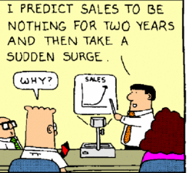
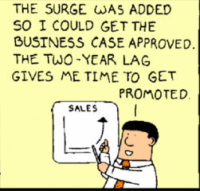
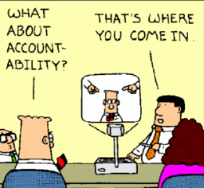
Key similarity?
Accountability lies with the mentee or coachee

Slide 6
The CIPD view
Mentoring in the workplace tends to describe a relationship in which a more experienced colleague shares their greater knowledge to support the development of an inexperienced member of staff. It calls on the skills of questioning, listening, clarifying and reframing that are also associated with coaching.

Slide 7
CIPD view (cont.)
One key distinction is that mentoring relationships tend to be longer term than coaching arrangements.
In a succession planning scenario, for example, a regional finance director might be mentored by a group level counterpart over a lengthy period to develop a sound approach to dealing with the board, presenting to analysts and challenging departmental budgets.

Slide 8
CIPD view (cont.)
Mentoring relationships work best when they move beyond the directive approach of a senior colleague ‘telling it how it is’, to one where they both learn from each other.
An effective mentoring relationship is a learning opportunity for both parties, encouraging sharing and learning across generations and/or between roles.

Slide 9

Approaches to mentoring
Executive mentoring – enables the mentee (the executive) to identify the purpose and focus of the development. This type of mentoring is commonly linked to talent management programmes and leadership development.
Diversity mentoring – common application of mentoring, aimed not just at redressing perceived inequalities in the workplace but also at recognizing and valuing difference.
Mentoring in education – multifaceted approach including educator’s development, developing mentoring skills in and between school/ college/ university learners as well as pastoral relationships between staff and learners and sometimes between peers in schools.
Voluntary-sector mentoring – often undertaken to help vulnerable members of society, for example ex-offenders or young drug takers.

Slide 10

Modes of mentoring
Traditional Dyadic Mentoring
Peer Mentoring
Co-mentoring
E-mentoring

Slide 11



Traditional dyadic mentoring
To what extent is mentoring needed in order to make effective life transitions?
How important is age/experience asymmetry in mentoring?
Notes:
Dyadic or Multiple- Multiple mentoring might take the form of multiple dyadic relationships, or can be thought of more in terms of a shared responsibility for graduate student success such as the dissertation committee often represents

Slide 12
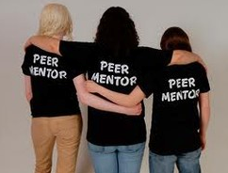
Peer mentoring
How important is it for successful mentoring that participants can relate to each other as peers?
To what extent is mentoring a two-way process?

Slide 13

Co-mentoring
To what extent should mentoring be mutually beneficial to both mentor and mentee?
What role does friendship play in mentoring?
Notes:
Co-mentoring: A Mutually Beneficial Learning Relationship. ... Jone Rymer in her article “Only Connect” defines a co-mentorship as “a mutual mentorship of a pair of close, collegial friends committed to facilitating each other's development.”

Slide 14

E-mentoring
What are the advantages and disadvantages of face-to-face mentoring?
What are the key factors which influence the effectiveness and strength of a mentoring relationship?
Notes:
E-mentoring is a means of providing a guided mentoring relationship using online software or email. It stemmed from mentoring programs with the invention of the internet, and began to gain popularity around 1993.
Online mentoring is a supportive, structured relationship which helps mentees to develop their skills and achieve their goals. Mentees communicate with their mentor through a safe and secure online platform, and the mentoring relationship is supported by a wide range of online resources and activities relating to education and career pathways

Slide 15
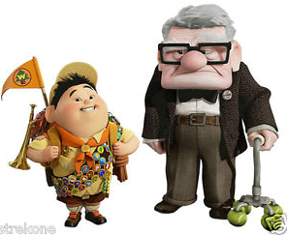
Reverse mentoring – reflective questions
How far is it helpful to place ‘experience’ as the differentiator in a mentoring pair rather than status or age?
What might be the challenges of operating such an arrangement in a company?
Notes:
Reverse mentoring refers to an initiative in which older executives are paired with and mentored by younger employees on topics such as technology, social media and current trends

Slide 16
The Mentoring Process
Establishing rapport (initiation)
Direction setting (getting established)
Progress making (development)
Moving on (finalising/maintenance)
Each phase has its own tasks, dynamics and skill requirements…

Slide 17



In more detail….
Establishing Rapport
Tasks
Work out whether they can get on and respect each other
Exchange views on what the relationship is and is not
Agree a formal contract
Agree a way of working together…..and so on
Dynamics
Impatience to get going
Tentativeness and unwillingness to commit
Politeness
Testing out and challenging
Skill requirement
Suspend judgement
Be open to hints and unarticulated wishes or concerns
Be clear about what needs establishing and open about what can be left out
Establish a formal contract
Agree a way of working together
Set up details of future meetings
Achieve rapport

Slide 18
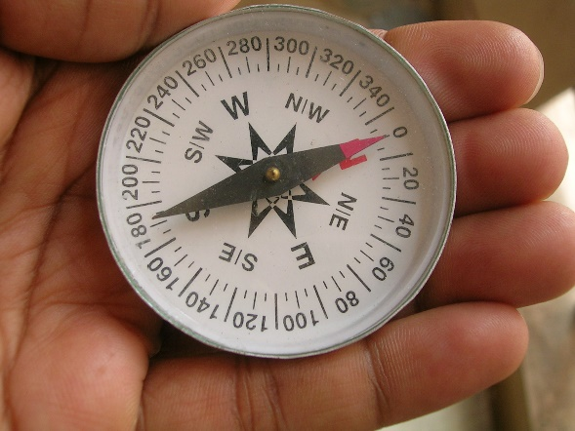
Direction Setting
Dynamics
Over-inclination to shut down on possibilities
Unwillingness to set goals
Reluctance to open up on possibilities for diagnosis
Tasks
Learn abut the mentee’s style of learning
Think through the implications of their style for how they will work together
Diagnose needs
Determine mentee’s goals and initial needs
Set objective measures
Identify priority areas for work
Keep open spaces
Clarify focus of their work
Begin work
Skill Requirement
Using and interpreting diagnostic frameworks and tools
Encouraging thinking through of implications of diagnoses
Setting up opportunities for diagnosis to be informed by third parties
Give feedback/set objectives/plan
Adopt developmental approach to goal setting for the mentee
Help the selection of the initial area for work
Have clarity about the next step

Slide 19

Progress Making
Tasks
Create a forum for progressing the mentee’s issues
Use each other’s expertise as agreed
Establish a means for reviewing progress and adapting the process in the light of this review
Identify new issues and ways of working that are required
Be ready for the evolution of the relationship
Dynamics
Period of sustained productive activity
Dealing with a change in the relationship or the mentee’s circumstances
Reviewing and adapting the relationship
Preparing for moving on
Skill Requirement
Monitoring progress of the mentee
Relationship review and renegotiation
Recognising achievements/objectives attained
Timing and managing the evolution of the relationship

Slide 20

Moving on………..
Tasks
Allow the relationship to end or evolve
Move to maintenance
Review what can be taken and used in other contexts
Dynamics
Dealing with loss
Major renegotiation and continuation
Evaluation and generalisation
Skill Requirement
Address own and other’s feeling of loss
Develop next phase and/or..
Orchestrate a good ending
Think through and generalise learning
Establish friendship

Slide 21

For the next session
Carry out research into the knowledge, skills, attitudes and behaviours of a successful, professional Coach, and Mentor, then write 500 words on the following:
Critically explore the knowledge, skills, attitude and behaviours needed by an effective workplace coach, and also an effective workplace mentor
Fully reference the evidence you provide

Slide 22

Summary
Take 5 minutes to reflect upon tonight – what have you learnt?
Any key areas you want to research further?
What can help you with your assignment?
What can help you in your career?

