Slide 1
Addysg: Ddoe, Heddiw, Yfory
Education: Past, Present, Future
Cyflwyniad i'r Modiwl, Asesiad ac Addysg cyn 1930 – Addysg i'r Ychydig
Module Introduction, Assignment and Education before 1930 –
Education for the Few

Slide 2

Session overview
Module overview
Important information
Module timetable
Learning outcomes
Module assignments

Slide 3

Aims
Provide a background historical context to many of the major aspects of modern education from the 18thcentury to the present time.
Illustrate how progress has been fought for and opposed by various interest groups with different policy agendas, at the school, local and national level.
Notes:
Check these are the same

Slide 4
Learning Outcomes
Understand key periods and reforms in the history of education in Wales and the UK.
Analyse the contested nature of educational perspectives.
Identify values which underpin education, teaching and learning in Wales, UK and the world.
Organise their knowledge and learning through the use of a range of information sources, including ICT and present their work at the appropriate level.

Slide 5
Timetable
Tuesday
Face to Face Module introduction, Assignment, Education for the few. | Teams The Butler Act and the Tripartite System | Asynchronous Circular 10/65, the William Tynedale affair and The Secret Garden
Face to Face The Warnock Report The Education reform act and Marketisation | Teams Academies | Asynchronous The Learning Country
Face to Face Devolution Successful Futures | Asynchronous Values and the Aim of education | Teams Teaching and the teaching professional. Tutorials

Slide 6
Assignment
Changes in education policy are never universally welcomed.
Write an academic Scrapbook reflecting on two key contested issues in education in Wales or the UK since 1840.
Your Scrapbook must include two contested issues of your own choice.

Slide 7
Moodle
Cynllun marcio Lefel 4
Turnitin ar Moodle
Level 4 marking scheme
Turnitin on Moodle

Slide 8
What is an academic scrapbook?
Powerful classroom tool
Provides opportunity to engage with the subject content in a more personal and practical way.
Uses reading, writing, research and critical thinking skills
Encourages greater retention of the module content

Slide 9
Academic Scrapbook
Size?
Digital or by hand?
Content?
Word count

Slide 10



Politics

Slide 11

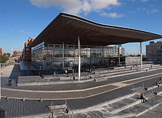

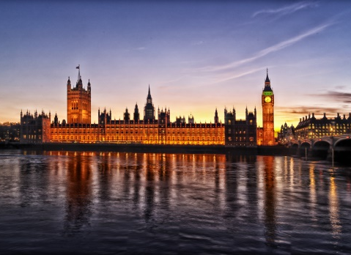
The government’s role
Each government in power presents educational changes as reform because they believe that they are making improvements on that which is currently in place
Make a list of some educational reforms that you are aware of.

Slide 12
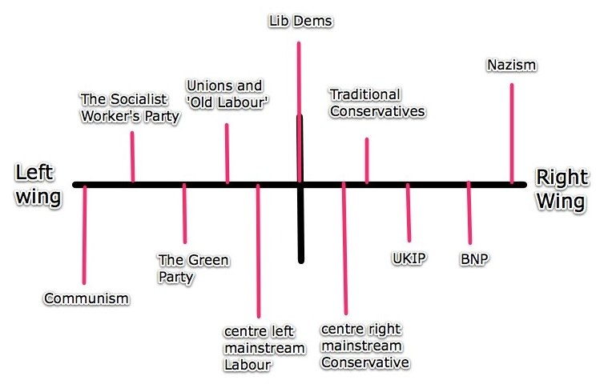
Education policy
Education policy is a reflection of the ideas of the political party in power
http://media-cache-ak0.pinimg.com/originals/54/9a/46/549a46e5ab37ce0c29e004e5167b67c2.jpg

Slide 13
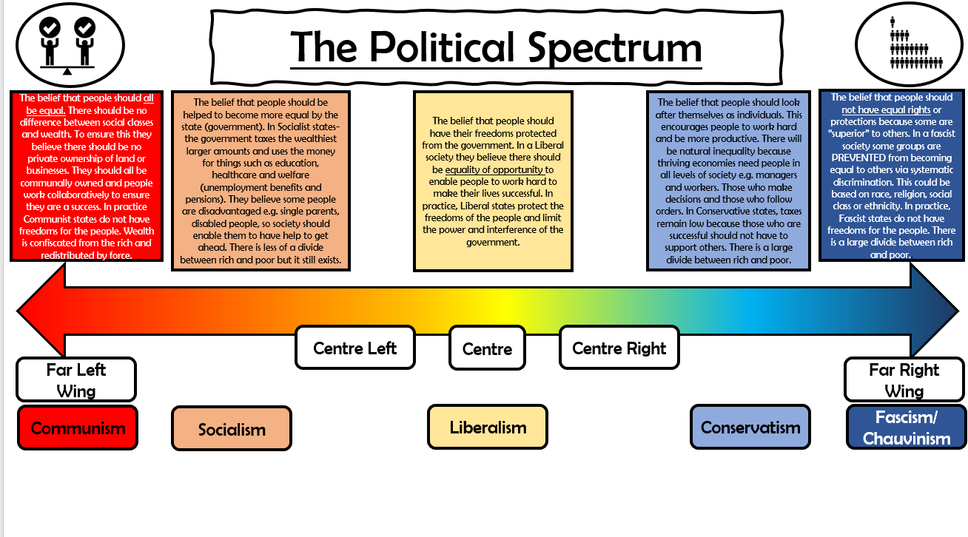

Slide 14
Education for the few

Slide 15
Before 1870
1802 Factory Act (Peel)
1807 Parochial Schools Act
National Society
British and Foreign School society
Home and Colonial Institution
Central Society of Education
Notes:
The year is 1800 the industrial revolution is in full swing, the population is growing at an unprecedented rate and new innovations in agricultural technology and practices free up more people to work in the new factories and mills. This rapid pace of change results in low wages, poor sanitation and conditions and the increasing use of child labour. The government took a very laisse fair attitude to the conditions of the poor and in particular the children of the poor. In 1802 however this changed the factory act required an employer to provide secular instruction in reading, writing and arithmetic.
This was followed in 1807 by the hotly contested Parochial schools act. This act made provision for the education of the labouring classes through a series of parish schools based on Anglican principals.
These schools were initially set up by the national society a church of England organisation and then in 1814 the British and foreign school society was founded by liberal Anglicans, Catholics and Jews as an alternative to the national society. The home and colonial institution and central society were founded in 1836, home and colonial to establish infant schools and central society to try and keep religion out of education all together.
In all cases these schools were set up by individuals who believed in mass education and was funded either by rates paid direct by the parents of the pupils or through the employers of the child or through charitable contributions from local wealthy patrons.
Central Government provided little to no funding for education. Though did make provision for county and parish councils to raise money for buildings and land through rates and provided small grants to support this. Key point education provision was informal or semi formal at best and the quality of provision was patchy

Slide 16

Who did and did not want mass education?
From the reading consider which groups did want a mass education system and which groups did not.
Consider their motivation in context (i.e. do they have a vested interest?)
Notes:
Sub groups then discuss as a group
Use the whiteboard to do notes
Poss give reading before module starts?
https://branchcollective.org/?ps_articles=florence-s-boos-the-education-act-of-1870-before-and-after#:~:text=Critics%20of%20the%20Education%20Act,government%20support%20for%20sectarian%20schools

Slide 17
Why did we need a mass education system?
In groups consider how mass education may have benefitted one of the following:
  Industry/Agriculture
  Electoral Reform
  Morality
  Empire

Slide 18
Education in Wales

Slide 19
Bilingualism in Wales
Strong oral and written traditions
Originally the dominant language throughout the entire region that is now the British Isles
The Act of Union (1536) joined England and Wales, bringing Wales officially under the rule of England

Slide 20
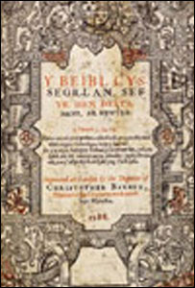
Chronology of key developments in education
Welsh continued to be recognised in the Church
In 1563, to help the Welsh assimilate into English society and culture, Elizabeth I authorized the translation of the Bible into Welsh

Slide 21

Treachery of the Blue Books 1847
William Williams (1788-1865) from Llanpumsaint, MP for Coventry
Asked for a Government enquiry into the state of education in Wales

Slide 22
Treachery of the Blue Books 1847
3 commissioners appointed – Robert Wheeler Lingen, Jelinger Cookson Symons and Henry Vaughan Johnson
Seminal moment in the history of education in Wales

Slide 23
Treachery of the Blue Books 1847
Drunk teachers and illiterate teachers
Teachers who could not understand English
Learning by rote
Most schools considered ‘truly worthless’

Slide 24
Treachery of the Blue Books 1847
“The Welsh language is a vast drawback to Wales and a manifold barrier to the moral progress and commercial prosperity of the people. It is not easy to overestimate its evil effects.” (Lingen, Symons and Johnson 1847)

Slide 25
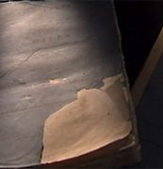
Treachery of the Blue Books
Chapel people considered the report a judgement on Nonconformity
Fights outside schools between Nonconformists and Anglicans
Notes:
Alternative view – is liberal report designed to help the welsh to achieve their full potential in Britain.

Slide 26
Time Line

Slide 27
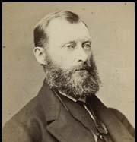
1860 - 1879
1861 Newcastle Report
1870 Elementary Education Act (Forster Act)
1873 Agricultural Children Act
1873 Elementary Education Act
1876 Elementary Education Act
Notes:
The Newcastle commission was set up in 1858 to report on the state of education in the UK. It found that on the whole many children were enrolled in some form of school, however of these nearly 800,000 of the 1.6 million children in denominational schools attended for less than 100 days and less than 20% attended after their 12th Birthday. The report was highly critical of the education the pupils actually received. Much of the teaching at the time was conducted on the monitoring system with 1 teacher dealing with up to 120 pupils whilst being supported by either senior pupils or pupil teachers. Rote learning was standard and therefore little understanding was actually gained. From the findings of the Newcastle report the 1870 Forster Act was proposed and passed. The act was wide ranging in its scope covering everything from school fees to employment of managers and included a number of significant provisions;
Sufficient local school places
The formation of school boards to ensure provision was in place
The right of parents to remove their child from religious instruction
School boards were also given the power to pay school fees for those who could not afford them due to poverty
School attendance was also provided for, though this was not made compulsory unless the school board passed a byelaw.
In all cases though whilst the act was passed by government local school boards retained responsibility for the enforcement of the act and set many of the costs or times contained in it.
The 1873 Agricultural Children act made provision for preventing farmers from employing children and ensuring these children attended school, however if the child’s parent was the farmer and they were working on their own land they could still be employed.
The 1873 and 1876 Elementary acts largely tweaked the 1870 act amending the amount of fees that could be charged and the rates available to schools.

Slide 28
Task
In pairs. Consider the compromises that were made between the report's recommendations and the final legislation as passed.
Use a PESTLE analysis to consider the reasons for the compromises:
Political
Economic
Social
Technological
Legal
Environmental
Notes:
Use AI to summarise

Slide 29
Feedback

Slide 30
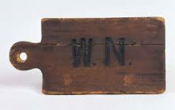
Contested nature of educational developments
1870 Education Act: English-medium schooling compulsory throughout Wales.
Welsh Not
Notes:
Add discussion

Slide 31
1880 - 1900
1880 Elementary Education Act (Mundella Act)
1891 Elementary Education Act
1899 Board of Education Act
1900 Elementary Education Act
Notes:
The Mundella Act finally made provision for compulsory elementary education proposed in the Forster act by imposing the requirement on school boards to pass byelaws requiring children to attend school and setting fines for those who illegally employed 10 to 13 year olds.
The 1891 Act was another significant step on the road to universal elementary education as it scrapped school fees and provided 10 shillings per year for each child over three and under 15 attending a public elementary school.
The board of education act set up a government department responsible for education and provided for a legislative framework for a teachers register.
The 1900 Elementary education act was largely technical in nature adjusting the penalties imposed for non attendance by a child and dealing with grants payable for attendance.

Slide 32
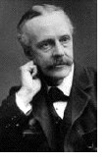
1901 - 1909
1902 Education Act (Balfour Act)
1904 Regulations for Secondary Schools
1906 Education (provision of meals) Act
1906 Dyke Report
1907 Education Administrative Provisions Act
1908 Acland Report - School Attendance of Children Below the Age of Five
1909 Acland Report - Attendance, Compulsory or Otherwise, at Continuation Schools
Notes:
Following on from the 1870 Elementary Education act some of the more enterprising school boards had been using rates and grants to set up additional school provision for both gifted children and evening classes for adults. This didn’t go down well with the churches who were already seeing a decline in worshippers and by older Grammar schools who’s finances were not in the best of health. This led to leading conservatives particularly Sir John Gorst vice president of the committee for education to attack the school boards for their inappropriate use of rates and even formed a committee specifically to combat the school boards and undermine the advanced work they were promoting.
Gorst and his secretary Morant had two objectives;
Prevent school boards from funding anything but Elementary education
Secondly create all encompassing local education authorities and provide much needed funds for church schools.
In 1899 a test case was engineered between a school of art who complained about the competition from a London school board’s evening classes. The district auditor (Cockerton) ruled that school boards could not use rates to fund higher grade classes in science or the arts. This achieved Gorst and Morant’s first objective their second was achieved through the 1902 Education act. This act created the LEAs based on county and county borough councils. The LEAs had responsibility for the secular curriculum and provided grants for building maintenance but if a school wanted to provide denominational teaching building maintenance had to be paid for by the church. The act also combined higher elementary schools and fee paying secondary schools. This created two types of secondary schools, endowed grammar and municipal or county secondary schools. This laid the basis for a national system of secondary education. The Balfour act laid out a clear distinction between elementary school and secondary school with the vast majority of pupils remaining in elementary school until they reach the end of compulsory schooling.
The 1904 regulations for secondary schools was published by the board of education and provided a four year instructional subject-based course leading to a certificate in English language and literature, geography, history, a foreign language, mathematics, science, drawing, manual work, physical training, and, for girls, housewifery. It did not, however, specify the content of the courses merely that these were desirable and that these subjects offered a breadth and richness in the curriculum.
The provision of meals acts in 1906 and 1914 allowed LEAs to provide meals for undernourished children and is another indication of the governments growing sense of obligation to those too poor to adequately support themselves.
The 1906 Dyke report was tasked to consider the he curriculum of Higher Elementary Schools at the time this was expected to be predominantly scientific interestingly the report made several recommendations that could be seen as progressive even by todays standards
a good general education is of paramount importance;
a Higher Elementary School should educate for life as well as for livelihood;
the curriculum should have a practical bias, with subjects illustrated by practical examples that are familiar to the children;
the course should be planned with the school's context in mind, especially in rural areas;
in small towns Higher Elementary Schools should not be established - the need for higher primary instruction should be met by Supplementary Courses in elementary schools;
in large towns there is a need for Higher Elementary Schools;
Higher Elementary Schools should be staffed by good elementary school teachers with an interest in science and technology and the training colleges should offer appropriate courses for them.
The 1907 Education administrative provisions act allowed LEAs to provide scholarships for promising pupils to attend secondary schools and also gave them the responsibility for pupils health requiring a medical inspection for all children in elementary school.
Interestingly Acland’s report in 1909 recommended that LEAs be empowered to require under 17’s to participate in some form of post elementary education.
So far education has moved from being the preserve of charitable individuals to school boards managing individual schools to now LEAs responsible for all the schools in a county area, but apart from bestowing grants for buildings or providing some regulation the national government is very hands off in the educational sector.

Slide 33
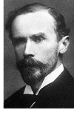
1910 - 1920
1911 Acland Report - Examinations in Secondary Schools
1913 Acland Report - Practical Work in Secondary Schools
1914 Education (provision of meals) Act
1917 Lewis Report
1918 Education Act (Fisher)
1920 Young Report - Report of the Departmental Committee on Scholarships and Free Places
Notes:
The 1917 Lewis report was tasked to specifically consider what steps should be taken to make provision for the education and instruction of children and young persons after the war, regard being had particularly to the interests or those
who have been abnormally employed during the war;
who cannot immediately find advantageous employment;
who require special training for employment.
The Lewis report was highly critical of half time schooling, where children attend school for some of the day and are employed for the remainder. The state of apprenticeships and the conditions of child labour, they argued for a complete overhaul of both legislation and attitude, changing peoples views of juveniles from that of a little wage earner to a workman and citizen in training. The report proposed a school leaving age of 14 with no exemptions, followed by attendance for at least 8 hours a week or 320 hours a year at 'day continuation' classes up to age 18. The Lewis report also made 22 other recommendations.
The Fisher Act did enact most of the Lewis reports recommendations with the exception of the raising of the school leaving age that didn’t occur until 1921. The act also extended the powers and responsibilities of the Board of Education.
The act required LEAs to ensure that elementary schools included both practical instruction and more advanced instruction for older or more gifted pupils. They were also required to cooperate with other LEAs to prepare pupils for education in settings other than elementary. LEAs were also required to submit schemes of work to the board of education, for those deemed inadequate the board of education would discuss them with the LEA concerned and if no agreement was made a public enquiry would be held.
The Young report made a number of recommendations regarding school places provision these included
Increasing the proportion of free places from 25 to 40 per cent;
Increasing the number of secondary schools to provide at least 20 school places for each thousand of population;
Selection for secondary education should be by tests in English and arithmetic plus an oral examination;
Transfer to secondary schools should be at around age 11;
Maintenance allowances should be available for 'all free-place pupils who show need'; and
The abolition of all fees in secondary schools should be the long-term aim.

Slide 34
1921 - 1926
1921
Education Act
1923
Hadow Report
1923
Secondary Education for all became Labour Party policy
1924
Hadow Report
1926
Hadow Report
Notes:
The interwar years are seen as a period of consolidation in UK education, the great depression made funding for any significant public programs difficult. The 1921 education act consolidated and tidied up all previous legislation and finally raised the school leaving age to 14 this would be raised again, to 15, in 1936.
The Hadow reports are seminal works in relation to the development of the education system in the UK and in many ways are extremely progressive for their time The 1931 report, for example, suggests that 'a good school, in short, is not a place of compulsory instruction, but a community of old and young, engaged in learning by cooperative experiment‘.
The 1923 report - Differentiation of the Curriculum for Boys and Girls was tasked to investigate 'whether greater differentiation is desirable in the curriculum for boys and girls respectively in secondary schools' this report made 24 recommendations including greater freedom in the curriculum of both boys' schools and girls' schools, more especially the latter; for more time for pupils - especially senior girls - to develop their own individual interests, for more flexibility in advanced courses and for the relaxation of some university entry requirements. The report also concluded that 'the various subjects of the curriculum should be taught in closer correlation with one another' and that school work should be more practical and vocational
The 1924 report : Psychological Tests of Educable Capacity considered 'What use can be made in the public system of education of psychological tests of educable capacity?' The committee does not appear to be have been entirely convinced of the value of widespread testing and recommends that only experts be allowed to conduct test such as intelligence or scholastic noting that there is little firm evidence of their validity.
The 1926 report: The Education of the Adolescent was set up to consider and report upon the organisation, objective and curriculum of courses of study suitable for children who will remain in full-time attendance at schools, other than Secondary Schools, up to the age of 15'; and to advise on arrangements for testing pupils' attainments at the end of their course and for facilitating 'in suitable cases' the transfer of pupils to Secondary Schools 'at an age above the normal age of admission‘ This report makes 38 recommendations including;
Primary education, should end at about the age of 11+ and all 'normal children should go forward to some form of post-primary education' which should be designated 'secondary education' (Hadow 1926:173).
In non-selective schools there should be an emphasis on 'opportunities for practical work ... closely related to living interests' (Hadow 1926:174) and staffing ratios in these schools should be at least as favourable as those in grammar schools (Hadow 1926:177).
The school leaving age should be raised to 15+, if possible by 1932 (Hadow 1926:178), and new forms of leaving examinations should be developed (Hadow 1926:179).
The structure of local education authorities should be rationalised to take account of the new arrangements (Hadow 1926:180).
1928: Books in Public Elementary Schools inquired as to the selection and provision of books for public elementary schools and to make recommendations for the improvement of their quality and supply' (Hadow 1928:iv). In this report the committee argued that all schools must provide sufficient books of sufficient quality for children to learn from them and that for gifted pupils they should be allowed to take these books home.
1931: The Primary School investigated and reported as to the courses of study suitable for children (other than children in Infants' Departments) up to the age of 11 in Elementary Schools, with special reference to the needs of children in rural areas.' (Hadow 1931:iv) This report is perhaps the most significant in terms of educational structure and curriculum design. It made 70 recommendations including
primary education should be regarded as ending at the age of eleven' and that 'primary education falls into two well-marked stages - one extending up to the age of seven plus, and the other the period between the ages of seven plus and eleven plus' It recommends separate infant schools where this is possible but urges close cooperation between the stages.
It stresses differentiation in the curriculum for specially bright and children with ALN to ensure their needs are met and approves of mixed primary schools ‘as long as the differing needs of the boys and girls in the matter of games and physical exercises is taken in to account'
The report also noted research on children's learning and suggests that, up to the age of eleven, 'school subjects and their presentation should be kept closely related to the children's concrete knowledge and their own immediate experience. And that at this stage any teaching should be based directly upon what the pupil can perceive or recollect at first hand. To achieve this a 'project' or 'topic' approach to the primary curriculum should be used, though this is subject to sufficient 'provision should be made for an adequate amount of "drill" in reading, writing and arithmetic. The report also states that the committee are of opinion that the curriculum of the primary school is to be thought of in terms of activity and experience, rather than of knowledge to be acquired and facts to be stored.
The report also made a number of recommendations on staffing in schools including that no class should contain more than 40 children and that the practice of employing uncertificated teachers as heads should be ended
Despite being sceptical about the benefits of testing in 1924 the committee does seem to accept that it is necessary recommending that seven year olds should be assessed on entry to junior schools by means of intelligence tests, school records and consultation between teachers, but it warns that 'the classification of these young children should be regarded as merely provisional, and should be subject to frequent revision though it warns that 'in our opinion it would be inadvisable to rely on such tests alone. It also recommends that a 'continuous record of each child's progress should be kept in primary schools'
1933: Infant and Nursery Schools considered and reported on the training and teaching of children attending nursery schools and infants' departments of public elementary schools, and the further development of such educational provision for children up to the age of 7+.‘ this report makes the largest number of recommendations of any of the Hadow reports and makes recommendations on the importance of detecting ALN early, provision of ALN schooling, the importance of outdoor learning to children’s development
The 1936 education act was much watered down by fears of an impending war with Germany and a generally sickly economy still struggling to recover from the great depression it did however raise the school leaving age to 15 and authorise grants for new denominational special agreement senior schools.

Slide 35
1927 - 1936
1928
Hadow Report
1928
The New Prospect in Education
1931
Hadow Report
1933
Hadow Report
1936
Education Act

Slide 36
Did we meet our Objectives?
Can you:
  identify the key early acts and reports that shaped educational policy?
  analyse the key early acts and identify compromises that were made when they were formed?

Slide 37
Questions?
Cwestiynau?

