Slide 1
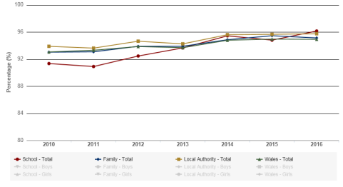
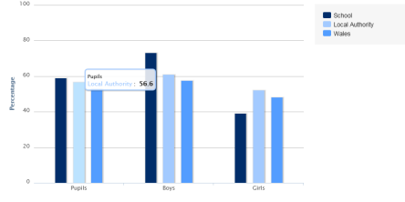

The Hidden Curriculum
Absence
“The National Curriculum is a set of subjects and standards used by primary and secondary schools so that children learn the same things””
(Gov.uk,2017).
The school had 91.3 % of pupils in attendance during 2010,however the table shows the figure has now risen to 96.1%.This is above Wales’ national average of 94.9%
“The process of giving or receiving systematic instruction, especially at school or university” Oxforddictionaries.com (2017)
Seven Core Aims
The Welsh Government derived the main points of the Children’s Act (2004) and produced the Rights to the Action Paper, it’s aim is to ensure all children in Wales have their basic needs met.
Have a flying start in life
Have a comprehensive range of education and learning opportunities
Enjoy the best possible health and are free from abuse, victimisation and exploitation
Have access to play, leisure, sporting and cultural activities
Are listened to, treated with respect and have their race and cultural identity recognised
Have a safe home and community which supports physical and emotional well-being
Are not disadvantaged by poverty
The Welsh government figure for Wales show that 9% of pupils had an agreed family holiday, however 10.5% of pupils in Wales had a holiday not agreed by the school. This is an area we are trying to tackle by emphasizing how important attendance is in our school. Children are rewarded by a 100% attendance certificate each month if they have not missed a day
Welsh Government (2016).
A psychologist how believed the principle of receiving reward and recognition for achievement was B.F Skinner(1966) who emphasized the fact that children were more likely to display positive behaviour in the future if they received a reward for displaying it, he referred to this as Operant Conditioning cited in Grigg (2015, pg.136)
Lunchtime Clubs
At our school , we offer a range of free clubs including sports club, dance club and running club, which are available to children aged 7 years and over. Participating in sport encourages social skills, raises confidence and encourages children to lead a healthy lifestyle.
Give Me 5
School A reinforces this throughout the establishment but it begins in nursery reception class, and is one of the first schemes that is introduced to a child on enrolment. We use it at many periods throughout the day when we need the children to sit and listen to instructions as to what is happening next and emphasize the importance of listening to adults and each other.
Children use each finger on their hand to represent a behaviour, gradually they learn that when the teacher holds up their hand displaying 5 fingers, the children need to ‘give me 5’ this helps engage young learners in the learning process. Webster-Stratton (1999, pg 56).
The table shows the percentage of children who enjoy doing sport at lunchtimes or afterschool clubs in School A (2015).
Jean Piaget (1936) studied cognitive development and highlighted the importance that our children are encouraged to be creative thinkers. He stressed the importance of educators providing a stimulating environment in which children can interact with others, learning as they go through different stages (schemas) to build on previous knowledge. Cited in Grigg (2015)
Vygotsky’s Theory (1978) suggested that each child has a ‘zone of proximal development’ an area of learning which they cannot yet carry out independently but could tackle with the help of older peers, putting this method into practice would mean that children whom find it difficult to sit for longer periods, will be encouraged to do so by observing others around them doing the same . Cited in Fletcher-Campbell,Soler and Reid (2009)

Slide 2
References
Definition of Education(2017)
Available at: https://en.oxforddictionaries.com/definition/education (Accessed 10.12.17)
Fletcher-Campbell,F.,Soler,J and Reid,G. (2009) Approaching Difficulties in Literacy Development Assessment, Pedagogy and Programmes.London:Sage.p.300
Forest Schools(2017)
Available at: http://forestschools.com/what-are-forest-schools/ (Accessed 19.11.17)
Gov.uk(2017) The National Curriculum
Available at : https://www.gov.uk/national-curriculum (Accessed 19.11.17)
Grigg,R.(2015) Becoming an Outstanding Primary School Teacher.2nd edn.Oxon:Routledge.p.137
My Local school(2017) Percentage of children who enjoy doing sport at lunchtimes or after school clubs
Available at: http://mylocalschool.wales.gov.uk/School/6663036?lang=en#fsmFPI0 (Accessed 8.12.17)
My Local School(2017) Percentage of half day sessions attended by pupils of statutory school age during the academic year
Available at: http://mylocalschool.wales.gov.uk/School/6663036?lang=en (Accessed 10.12.17)
TES(2017) Give me 5 (image)
available at : https://www.tes.com/teaching-resource/give-me-5-good-listening-skills-6119301 (Accessed 18.11.17)
Webster-Stratton,C.(1999) How to Promote Children’s Social and Emotional Competence.London:SAGE Publications,pp.56.
Welsh Government (2013) National Literacy and Numeracy Framework available at http://learning.gov.wales/docs/learningwales/publications/130415-lnf-guidance-en.pdf (Accessed 19.11.17)
Welsh Government (2016) Absenteeism from Primary School 2015/16
available at : http://gov.wales/docs/statistics/2016/161215-absenteeism-primary-schools-2015-16-en.pdf (Accessed 10.12.17)
WJEC (no year) Welsh Assembly Government Seven Core Aims for Children and Young people
available at: http://www.wjec.co.uk/uploads/publications/14641.pdf (Accessed 19.11.17)

