Slide 1

Report for Prosecution & Postal Charge Requisition
Notes:
Objectives:
Outline what a PCR is and its process
State the difference between PCR and RFS
Outline the sequence of events leading to the issue of a summons
Identify the stages in the process of reporting for summons

Slide 2
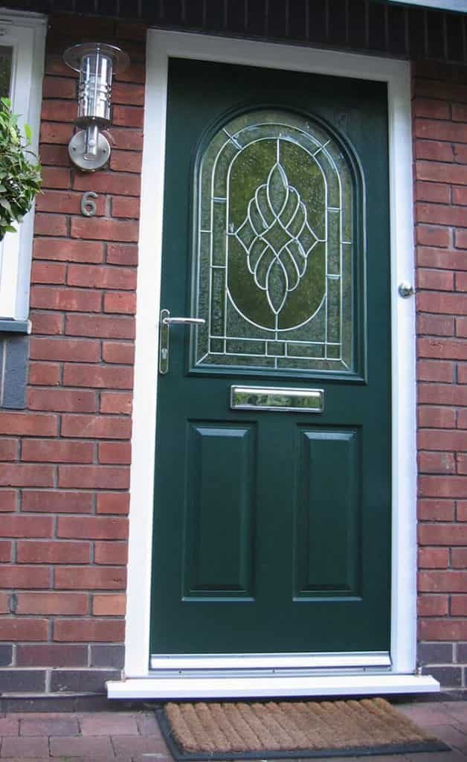

Postal Charge Requisition (PCR)
Notes:
From April 2017, Postal Charge & Requisition was introduced. These replace the summons process, ending the requirement to lay information before the court to issue a summons.
Section 29 and 30 of the Criminal Justice Act 2003
PCR is used for crime detections, and most traffic offences
No requirement for offender to attend court and can plead guilty by post or can prosecute in absence known as ‘proof in absence’ in most cases
South Wales Police use this process – Please see Handout

Slide 3
Postal Charge Requisition
South Wales Police Process
At scene or Released Under Investigation/Bail/VA
Decision made to charge for offence/s
Hub or Shift Sergeant to update rational to charge
Custody based Sergeant to authorise charge
Work flow case file through NICHE to Criminal Justice Unit
Gwent Police Process
Released Under Investigation/VA/Bail
OIC to notify one of two sergeants of circumstances; they will build the charge
Admin team will send out PCR and notify the OIC
OIC to submit file via NICHE
Traffic has a 4D process (See Handout)
Notes:
GWENT: ***Hand Out PDF/WORD
Postal Charge Requisition - PCR is used only for crime when a person attends a police station as a Voluntary Attendee or whether a person is Released Under Investigation or for CPS advice for minor crime. These would be known as Green case files, which are slow time and are enough for a PCR.
The process involves the officer in case will notify PS Steve O’Brien or PS Tom Delaney of the case they have. The Sergeants will build the charges (once the OIC has stated the circumstances of the offence), they will pass this to their admin team who will notify the OIC that a PCR has then been sent to suspect. The OIC will then submit a PCR file through Niche. If the suspect is a youth, then the OIC will have to carry out a personal service of the PCR, this will include the OIC attending at the offender’s address and personally serving the PCR upon the offender and then completing the PCR file. All youth offences are now PCR.
A point to note is that there are Traffic offences that fall into the crime bracket, which are known as the 4 D’s to the department.
Drink Driving (mostly a charge in the custody unit, but certain circumstances may apply).
Disqualified Driving.
Dangerous Driving.
Drug Driving.
The PCR process is being reviewed in September, allowing LPU Sergeants authorising the OIC to refer the file to the PCR Team. This will allow the LPU Sgts to authorise a PCR when one of their officers completes the VA process.
SOUTH WALES POLICE:
Examples:
Following ‘Released Under Investigation’ (RUI) if decision is made to charge (this could include those taken from custody to hospital for treatment)
Following RUI, if suspect does not take up offer of an out of court disposal (e.g. voluntary attendance, caution Restorative Intervention etc.)
Following voluntary attendance
Following ‘Released on bail’ if decision to charge is made prior to bail return date
Following offence being witnessed by a police officer and no need to interview
TOR
The wording on Traffic Offence Reports now states PROSECUTION instead of Summons, and the wording has been changed recently.
Give PCR Handout - Explain that Gwent and SWP have a variance in process and that there is further information on their Intranet e.g. BOB

Slide 4

What is a Summons?
It is a written order signed by a justice, magistrate or clerk of the court addressed to the accused person, directing them to appear at a specified time and place to answer the offence(s) detailed in it
(or to give evidence or to produce exhibits)
It is a written order signed by a justice, magistrate or clerk of the court addressed to the accused person, directing them to appear at a specified time and place to answer the offence(s) detailed in it
(or to give evidence or to produce exhibits)
Notes:
WHAT IS A SUMMONS?
A summons orders a person to attend court and in some cases, it is used as an alternative to arrest.
A summons does not necessarily indicate that an individual has committed an offence - they may not be accused or suspected of an offence, or the offence may only be minor.
It is a written order signed by a Magistrate (Justice of the Peace) or Magistrates Clerk,
Addressed to the accused person,
Directing them to appear at a specified time and date to answer the offence(s) or in relation to PCR paperwork to plead by post and consequences of failing to do so

Slide 5
POCLAROC
P O | Point out the Offence | Use simple language Do not use act & section
C | Caution | Use ‘When’ caution Note reply
L | Legals | Tell them, they are not under arrest Not obliged to stay with you
A | Admin | Obtain details, name & address etc. Complete paperwork
R O | Report for Offence
C | Caution | Use ‘Now’ caution, No more questions
If you conduct an interview, record questions and answers verbatim here!
Notes:
POCLAROC is a best practise model used for reporting for summons
A person is seen committing offence or information / allegation is received that they have committed offence. When pointing out offence use simple language don’t quote Act & Section
After when caution comply with PACE “You are not under arrest - do not have to remain with me.”
Make a note of the reply person makes after caution
Deal with the offence as you see fit & having regard for the offence being dealt with I.e. FPN VDRS HO/RT1 Summons
Questions - may constitute an interview
Report - Caution - Note reply in PNB
DO NOT ASK ANY FURTHER QUESTIONS - NOT EVEN “Do you understand?”

Slide 6
Obtaining a Summons
Summary Offence occurs
Report Offender (‘now’ caution)
Complete process file
Decision made to prosecute
Information laid for summons
Summons issued
Notes:
The sequence of events leading to the issue of a defendant summons can be broken down as follows:
A person is seen committing an offence, or an allegation is made that the person has committed an offence
A police officer informs the offender that he or she will be reported for the offence
A police officer completes a pocket notebook entry
A written report is submitted to a supervisory officer.
A decision is made whether to prosecute, caution or take no further action. If the decision is made to prosecute, an application is made for a summons
The information required for a summons includes: full name & address (including post code), date of birth, wherever possible, a national insurance number.
The address can be a private or business address - it must be where person will be for a sufficiently long period to enable summons to be served, or at which another specified person will accept the summons on behalf of the accused.

Slide 7
Service of Summons
Posting it to the last known or usual place of abode or any other address given by the person for this purpose
Personal service
Leaving it with another person at his/her last known or usual place of abode
Notes:
A summons for an offence committed by a corporation may be served by delivering it at, or sending it to, the registered office of the corporation
If a court has no proof that the person named in the summons has received it and they do not appear at court then the process has to be repeated

Slide 8

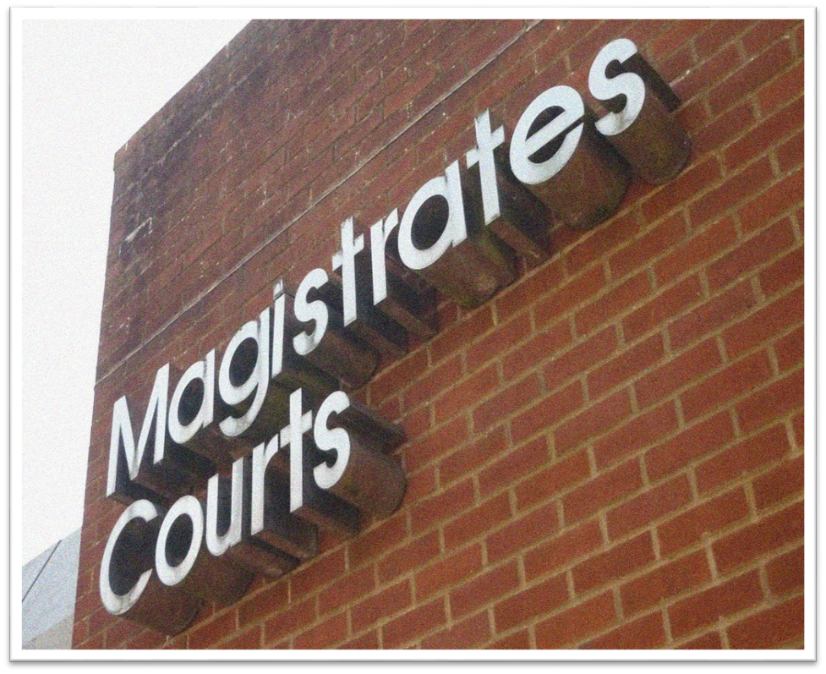
The difference between RFS and PCR
Notes:
There is not much difference:
The wording to the suspect: Instead of ‘I AM REPORTING YOU FOR SUMMONS…’ you say ‘I AM REPORTING YOU FOR PROSECUTION FOR THE OFFENCE OF…’
Admin is different: The Prosecutor does not lay the case before the Magistrate for the Magistrate to authorise the suspect attend court
The police CJU will send a letter telling the suspect to attend court
This process will cut down on court and CPS/Police time, and make the process more cost effective and more work effective.
Ultimately, the end result is the same.
Officers are required on BCU to use the PCR process

Slide 9
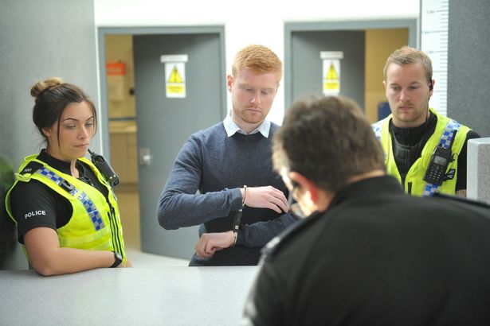
Considerations
Notes:
Trainer to ask:
What things do you need to be aware of when dealing with suspects for anything we have learnt today?
List will not be exhaustive, and trainer to lead discussion:
Vulnerability
Understanding
Language barrier
Legal requirements
Appropriate adults
Addictions
File process

Slide 10


