Slide 1
Problem solving and Decision-Making Analysis of Basil's Bakery
Module Code: LCLM004
Student Name : Adil Amjad
Student ID:2513825
Lecturer: Annamarie Dufficy
Component 1: Basil's Bakery

Slide 2
Business: Basil's Bakery , Coventry retail Park, Opened in 2015
Provides: Handmade organic breads, cakes and pastries
Customer base: Shoppers, retail/office/warehouse staff
Sales Trend: Grew 2015-2019, since 2020 sales have stayed at 25% lower than 2019 levels
Goal: Identify the main causes and challenges that the business is currently facing.
Today's presentation will be able about my analysis of Basil's Bakery looking at the problems the business is facing and how we can solve them

Slide 3
Main Issues and challenges
Retail Park is quieter, other shops have closed down.
Regular customers have lost their jobs or work from home 2-3 days a week.
Sales have been stuck at 25% below 2019 levels
Misssing Services
There are Services which customers want that are missing;
No delivery Services ( too busy baking to answer calls
Long wait times during busy periods.
Costs keep rising
Rent, bills, taxes and insurance are much higher than 2019
Organic ingredients cost more and prices change often.

Slide 4
Problem solving and Decision-Making Analysis of Basil's Bakery
Now I will use PESTEL to look at things that are causing problems for the business.
Economic: Prices have gone up everywhere. Rent, energy bills and costs are much higher and customers have less money to spend due to the living crisis.
Social: This is the biggest change. Many people now work from home part-time, so they visit the retail park less often.
Enviromental: As the business uses organic ingredients, costs are usually higher and prices can change suddenly.
Political and Legal: The business has to follow government rules, pay taxes and meet food safety which all add up to the costs to running the business.
Factor | What it means for Basil’s Bakery
Political | Government rules, business taxes, and local planning laws
Economic | Higher prices everywhere, expensive rent and energy bills, people have less money to spend
Social | People work from home more, shop less in person, still want good quality food
Technological | No online ordering or delivery service — missing out on sales
Environmental | Organic ingredients cost more, and supplies can change or run out
Legal | Must follow strict food safety laws and employment rules

Slide 5
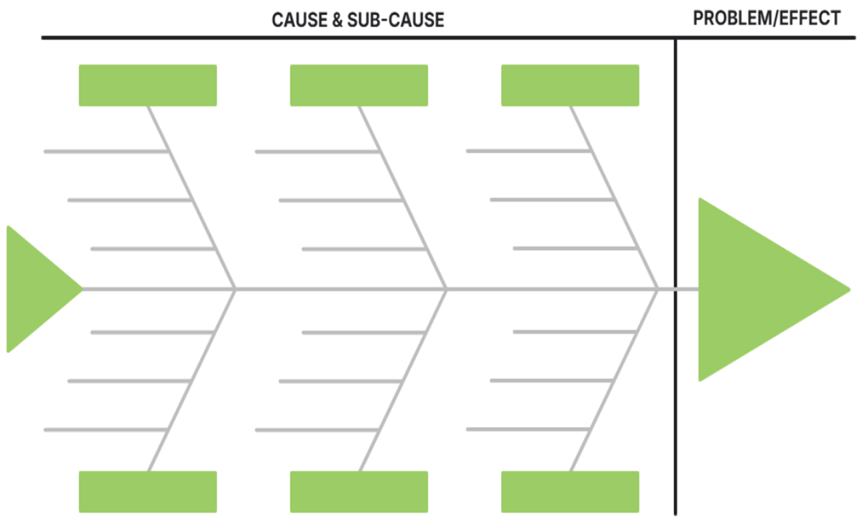
Customer & Demand
Service and Operations
Costs and Pricing
Fewer Customers ​
No delivery service
Higher rents and bills
More work from home
Hard to take pre-orders
Higher taxes and insurance
Nearby shops closed
Longer queues at busy time
Organic ingredients
Regular lost jobs
Missed phone calls ​
Prices often change
Sales Down 25% ​
Less in person shopping
People work from home
Buying habits
Less footfall overall
Market changes ​

Slide 6
Key Findings
To sum up what I found, Sales are stuck 25% lower than before. This is because fewer people come here, many people work from home and costs keep going up. Customers ask for delivery and pre-ordering , but we don’t offer them yet. The way the business is run right now it will be very hard to keep going long-term unless we make changes.
Sales are 25% lower than 2019 levels- not growing , not recovering.
Main causes: fewer visitors, shops closing, home working ,higher costs.
Customer clearly want delivery and pre-ordering these are missing
Organic ingredients costs more and prices change often
Current busimess model is hard to keep going without some changes.

Slide 7
    REFERENCES
Johnson, G., Whittington, R., Scholes, K., Angwin, D. and Regnér, P. (2023) Fundamentals of Strategy. 5th edn.
Harlow: Pearson.
Ishikawa, K. (1990) Introduction to Quality Control.
Tokyo: Asian Productivity Organisation.
British Retail Consortium (2024) UK Retail Footfall Report.
London: British Retail Consortium. Chartered Institute of Personnel and Development (2025) Hybrid Working Trends in the UK. London: CIPD.

