Slide 1
Professional Career Development within H&S C
( LCHS 4009 _LON)
Assignment No: Individual Presentation
Name: Muhammad Zubair Hamayo
Student ID: 2514993
Lecturer’s Name: Dr Christopher Mafuva

Slide 2

Introduction
Communication skills
Types of communication skills
Importance of communication skills in health and social care.
Benefits of Communication s and social care kills in health and social care
Practical example of communication in a healthcare
Communication Model
Reflection

Slide 3

Communication Skills
Communication skills are the ability
to share informations and ideas with
clarity and effectively through verbal,
non-verbal, written, and listening
skills (Nursing and Midwifery Council
2018).
Everyday Communication Practice
Speak clearly and confident,
Listen without interrupting,
Ask questions to understand better.
Use positive body language and eye contact.
Show empathy and respect.

Slide 4
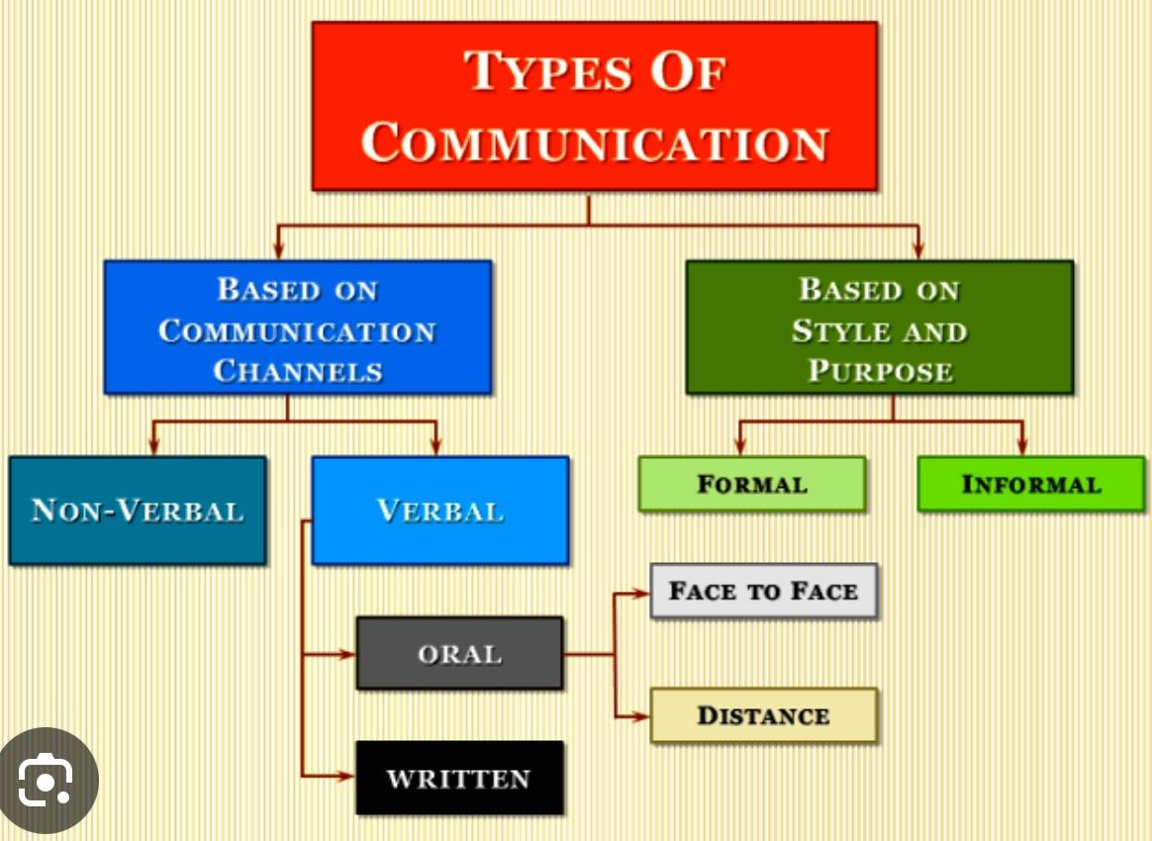
Verbal communication –
Speaking with a patient about medication and reports
Emergency services calls in an urgent situation
Providing health education or lifestyle advice to patients.
Asking and answering questions during patient interviews.
Non-verbal communication –
body language, eye contact, and facial expressions.
Active listening –
Paying attention and reacting correctly.
Written communication –
Accurate record keeping , appointment letter ,reports and email,documentation.

Slide 5

How I can Develop This Skills
Group projects at the university.
Presentations in class.
Employment experience and volunteer work.
Everyday communication with friends, family,
and key workers.
Customer service experience

Slide 6
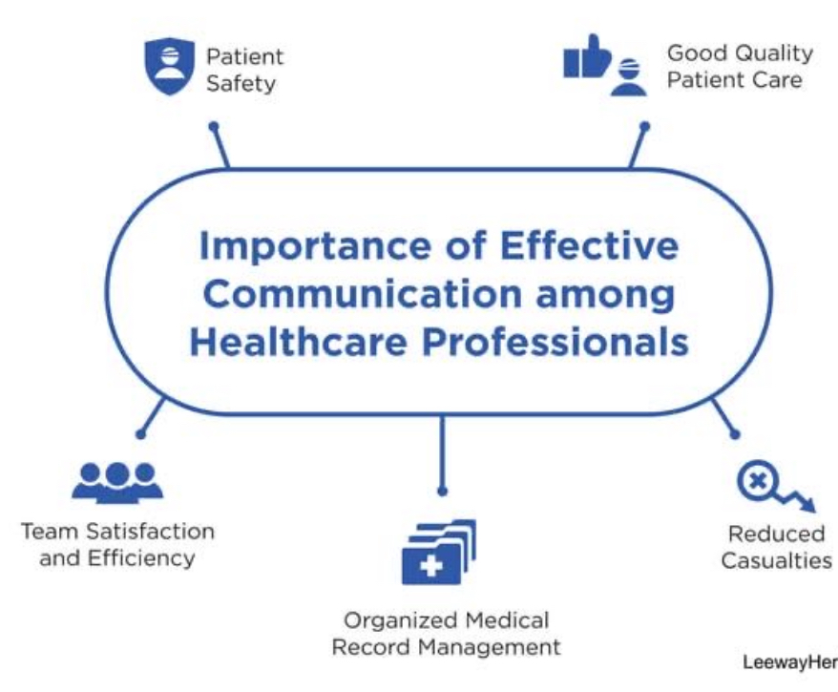
Effective communication between health and social care professionals is essential for delivering safe, coordinated, and high-quality care(NICE, 2015).
Importance of Communication Skills among Health Care Professionals

Slide 7
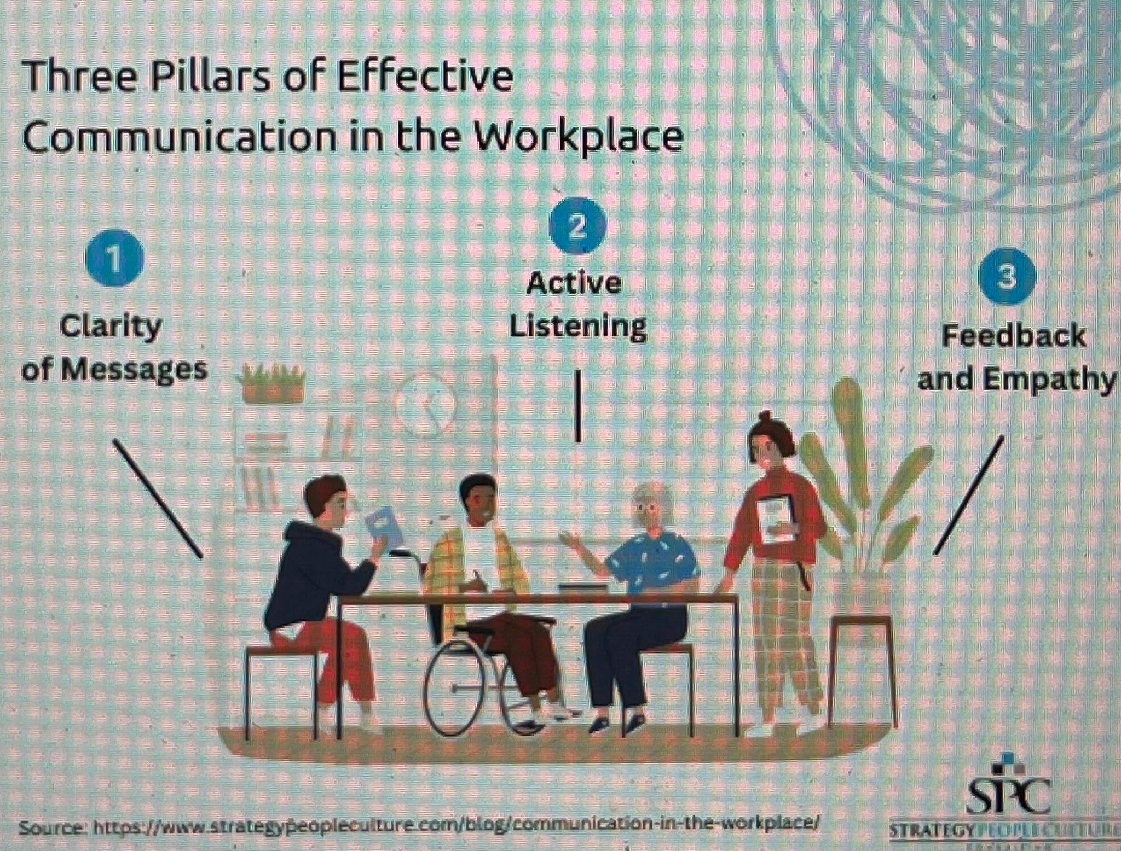
Benefits of Good Communication
For Service Users
Builds trust and positive relationships in healthcare professionals(NHS England, 2023).
Improves understanding of health conditions(NICE, 2021).
Encourages active participation in care and decision-making.
Reduces confusion and misunderstandings(NHS England, 2023).
Improves patient safety by reducing the risk of communication errors.
For Staff
Better teamwork.
fewer mistakes in communication.
Better decision making
Improves confidence, job satisfaction,(Skills for Care, 2023).

Slide 8

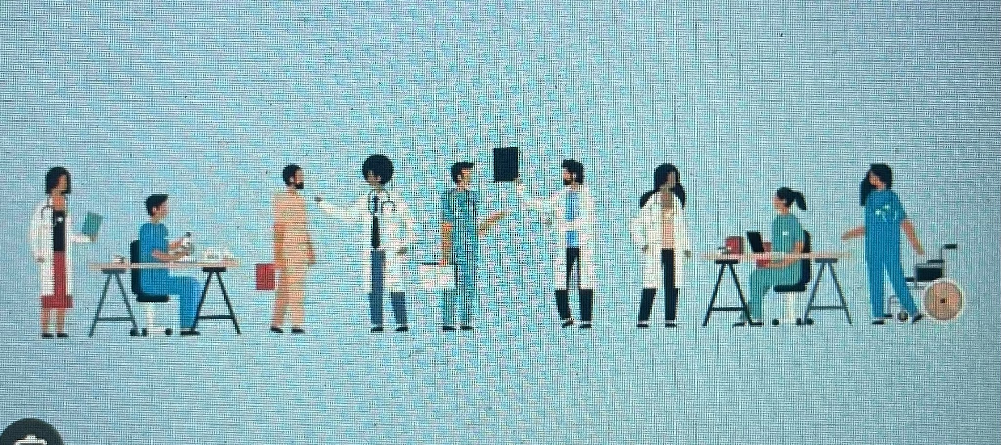
Benefits of Good Communication
For the Organisation
Better quality of care.
Higher patient satisfaction.
Fewer complaints and clinical errors(WHO, 2021).
If Communication is Poor
Medication mistakes.
Delayed treatment.
Poor teamwork.
Reduced patient safety.
Lower quality of care.

Slide 9

Practical Example in Health and Care
Job Role Healthcare Assistant in hospital medical ward
Situation A patient reports feeling dizzy after receiving medication.
How Communication is Used
Listen carefully
Ask simple questions
Observe the patient's condition
Report immediately to the registered nurse using clear and accurate information (NMC, 2018; WHO, 2021)
Reassure the patient
Impact on Care
Early identification of problem
Faster medical response
Improved patient safety
Better patient experience
Reduced risk of harm

Slide 10

Reflection and Future Practice
Communication helps me to:
Build professional relationships
Work effectively
Better quality care
Improve patient safety
Become a competent healthcare professional
Strengths
Good listener
Respectful
Friendly
Empathetic
Areas for Development
Speaking more confidently(Skills for Care, 2023).
Managing difficult conversations
Improving communication with people from different cultures

Slide 11
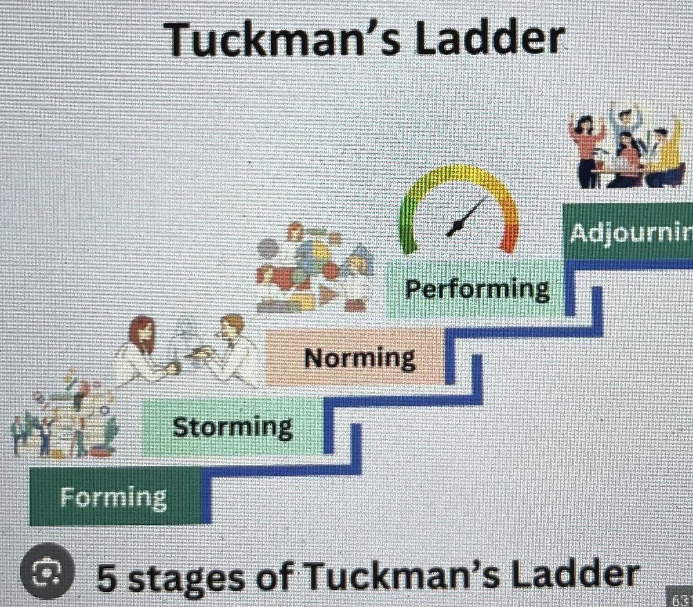
Communication Model
Tuckman's Team Development Model
Tuckman's Team Development Model describes how teams grow and how successful collaboration is facilitated by good communication (Tuckman, 1965).
Five Phases of Team Building
Forming: Members of the team get together and talk about their responsibilities.
Storming: Team members use good communication to settle disputes.
Norming: Communication becomes more transparent and cooperative as trust grows.
Performing: The group works effectively to achieve common objectives.
Adjourning: After finishing the assignment, the group evaluates its performance (Tuckman and Jensen, 1977)

Slide 12
Conclusion
Communication is essential in health and social care.
It improves patient safety.
It supports teamwork.
It improves patient outcomes.
Strong communication skills help healthcare professionals provide high-quality, person-centred care.

Slide 13
References
National Institute for Health and Care Excellence (NICE) (2015) Home care: Delivering personal care and practical support to older people living in their own homes (NG21). Available at: https://www.nice.org.uk/guidance/ng21 (Accessed: 14 July 2026).
National Institute for Health and Care Excellence (NICE) (2023) Patient experience in adult NHS services: Improving the experience of care for people using adult NHS services (CG138). Available at: https://www.nice.org.uk/guidance/cg138 (Accessed: 1 July 2026).
Nursing and Midwifery Council (NMC) (2018) The Code: Professional standards of practice and behaviour for nurses, midwives and nursing associates. London: NMC. Available at: https://www.nmc.org.uk/standards/code/ (Accessed: 1 July 2026).
Skills for Care (2023) Core skills for adult social care. Available at: https://www.skillsforcare.org.uk (Accessed: 1 July 2026).
Tuckman, B.W. and Jensen, M.A.C. (1977) 'Stages of small-group development revisited', Group & Organization Studies, 2(4), pp. 419–427.
World Health Organization (WHO) (2021) Global Patient Safety Action Plan 2021–2030. Geneva: World Health Organization. Available at: https://www.who.int/publications/i/item/9789240032705 (Accessed: 1 July 2026)

