Slide 1
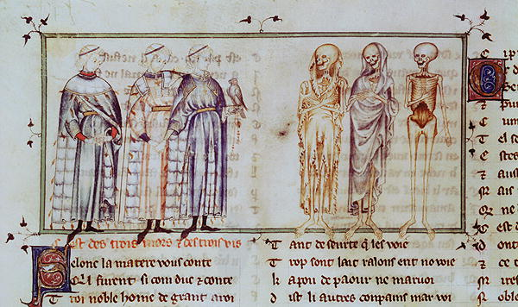
The Three Living and the Three Dead
Intimations of Mortality:
Animations of Morality

Slide 2
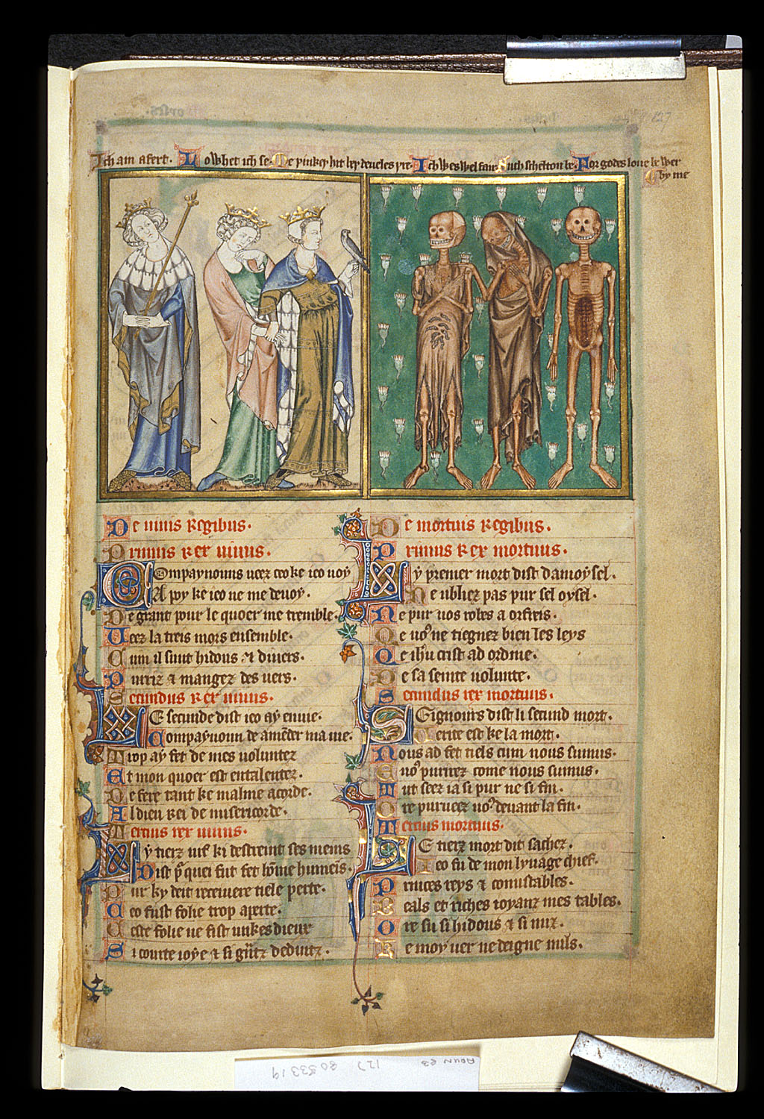
The de Lisle Psalter

Slide 3
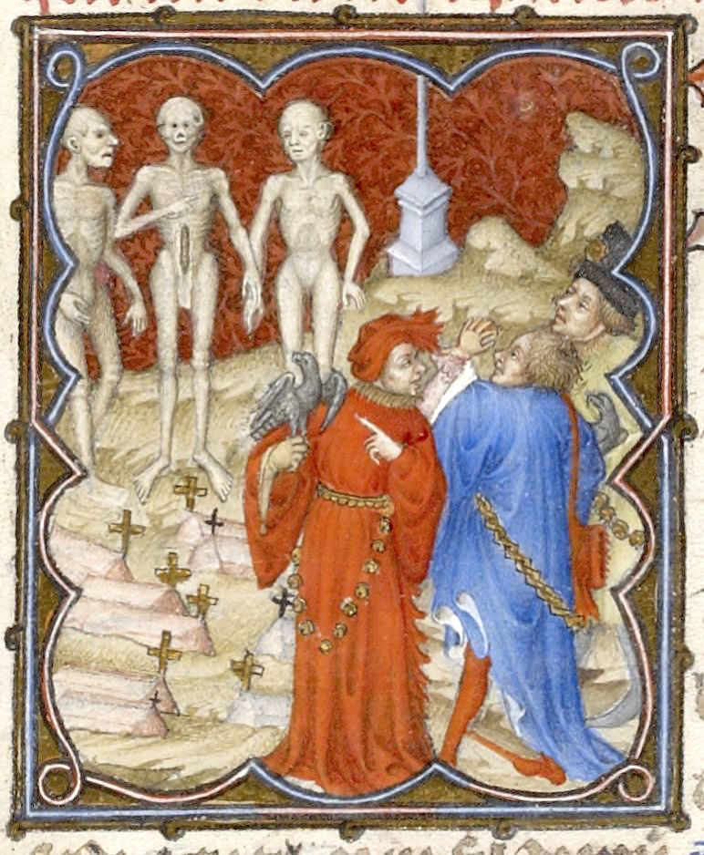
Duc de Berry
Hawk
Emotion
Graveyard

Slide 4
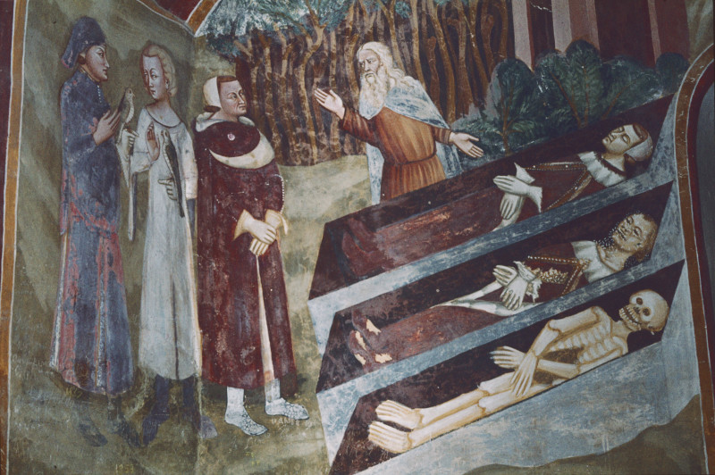
Sacro Speco, Scala Santa, Subiaco
14th century
Coffins
Hermit
Stages of decomposition

Slide 5
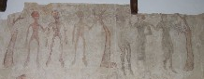
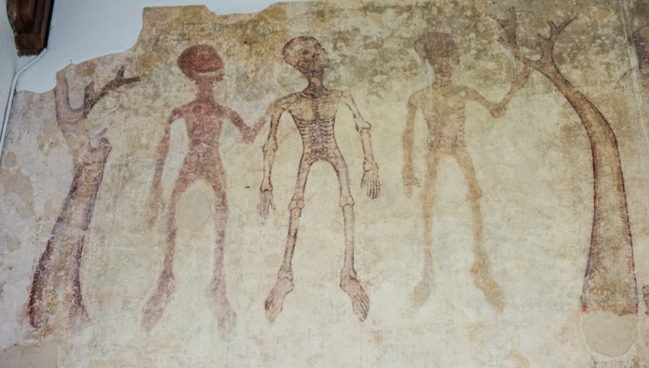
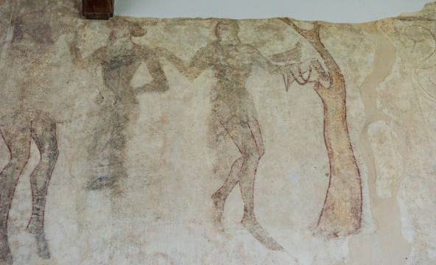
St Andrew’s
Wickhampton
Wall painting
Less accomplished
Poor preservation

Slide 6
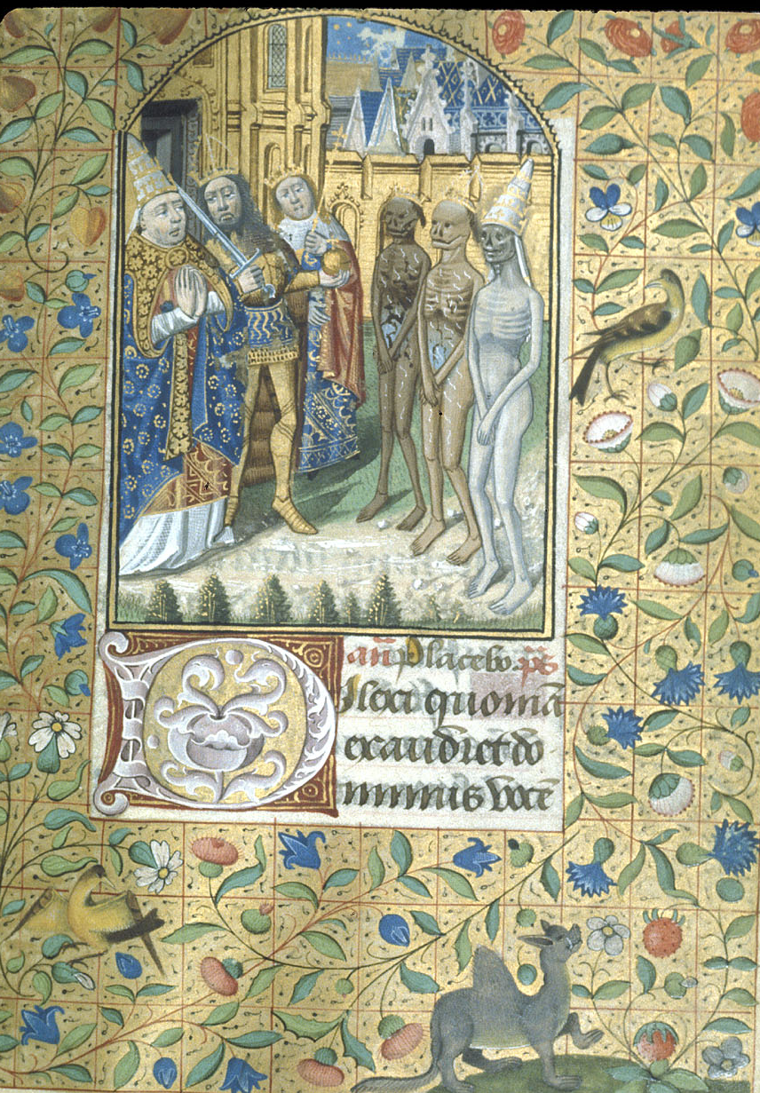
France 1480-90
Status
Stages of decomposition

Slide 7
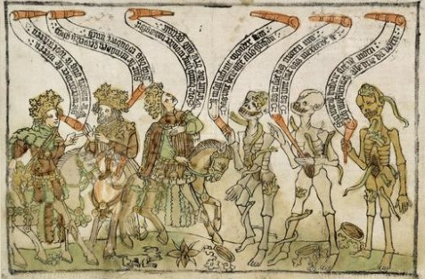
Staatliche Museen, Berlin.
Woodcut
Printed
Basic
Banderoles

Slide 8
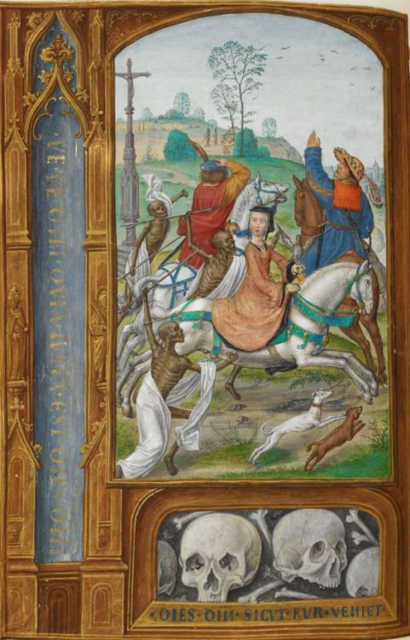
Joanna the Mad
Women
Horses
Aggression

Slide 9
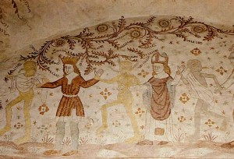
Norre Alslev church,
Denmark c. 1480
Later
More figures
Each living had profession

Slide 10
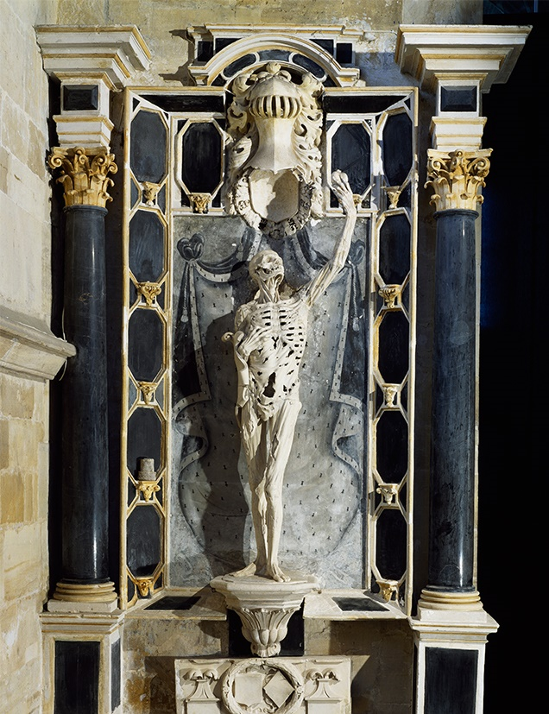
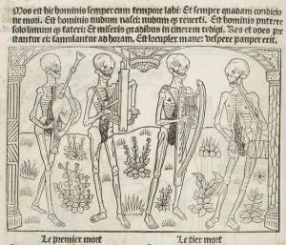
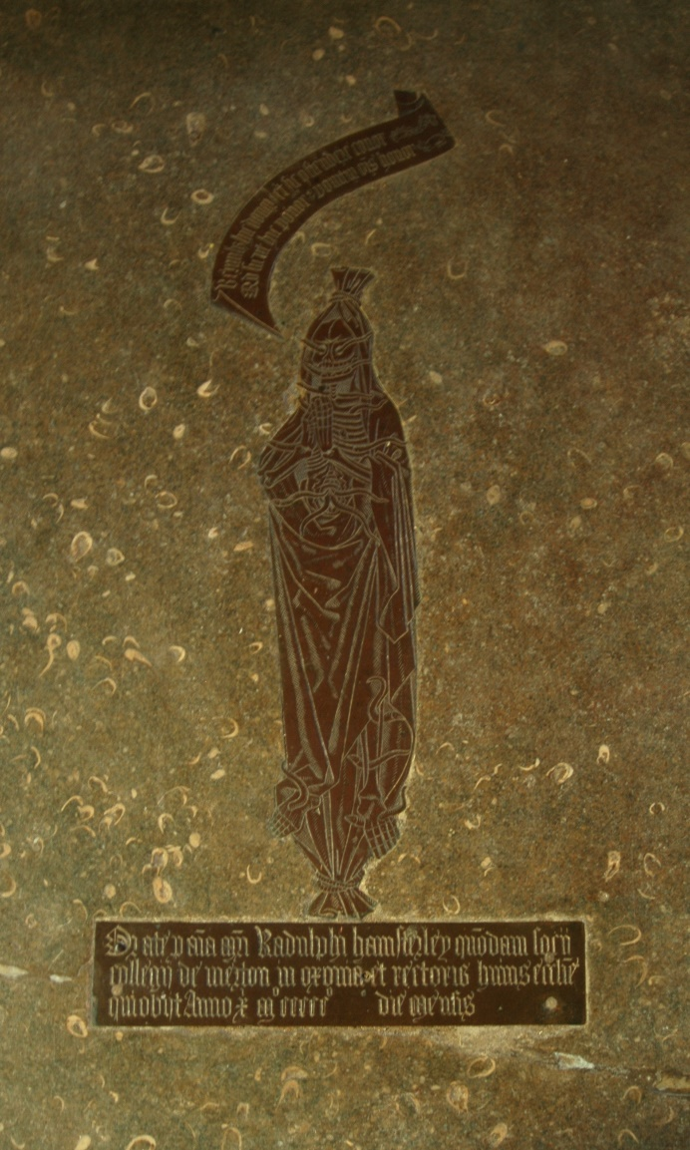
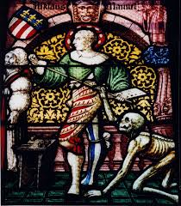
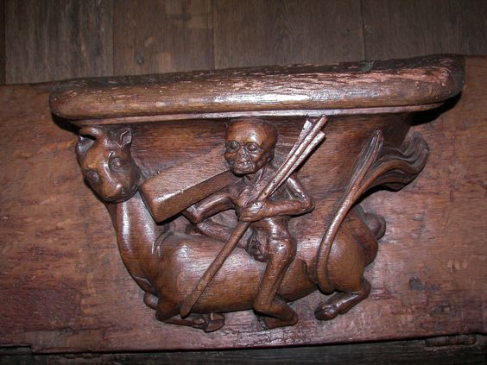
And finally…

