Slide 1
Cyber Security strategy
Networks and Cyber Security Essentials
Dylan Bell
2417050

Slide 2
Current Cyber Threats
AI Powered fishing and vishing attacks
Supply chain compromises
Insider threats and shadow IT
Cloud misconfiguration risks
Ransomware as a service (RaaS)

Slide 3
Impact on business
Operational impact
System downtime
Disrupted financial services
Reduced Productivity
Regulatory Impact
GDPR penalties
Legal Consequences
Compliance failures

Slide 4
Impact on business
Financial impact
Ransom payments
Loss of revenue
Recovery costs
Reputational impact
Loss of customer trust
Negative media coverage
Damage to brand reputation

Slide 5
Why security must change
Traditional perimeter security is no longer sufficient
Hybrid work has expanded the attack surface
Cloud and SaaS services increase exposure
Sophisticated phishing bypasses traditional email filters
Attackers use automation and AI-powered attacks
Solution
Adopt a zero trust security model

Slide 6

Zero trust framework
Never trust, always verify
Authentication and monitoring
Least privilege access
Network segmentation

Slide 7
Recommended security controls
Technology | Purpose
MFA | Prevent unauthorised access
EDR | Endpoint threats
PAM | Restrict admin privileges
SIEM | Monitor and analyse security events
SOAR | Incident response

Slide 8
Training and awareness
AI vishing simulations
Role based security training
Monthly phishing simulators
Reporting of suspicious activity

Slide 9
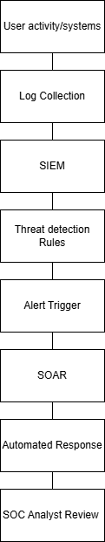
Monitoring and incident response
SIEM and SOAR process flow
VTAM incident response strategy
Detection
Analysis
Containment
Eradication
Recovery
Lesson Learnt

Slide 10
Strategic Benefits
Faster threat detection and response
Improved regulatory compliance
Reduced downtime and financial loss
Reduced cyber security risk
Stronger operational resilience
Increased customer trust

