Slide 1
M4X01917 - Business Skills for the International Hotel Industry
Student name: Benonia Ngwala
Student name: 1813797
Lecturer’s name: Dr Jahanzeeb Qurashi
Date 03/06/2020

Slide 2
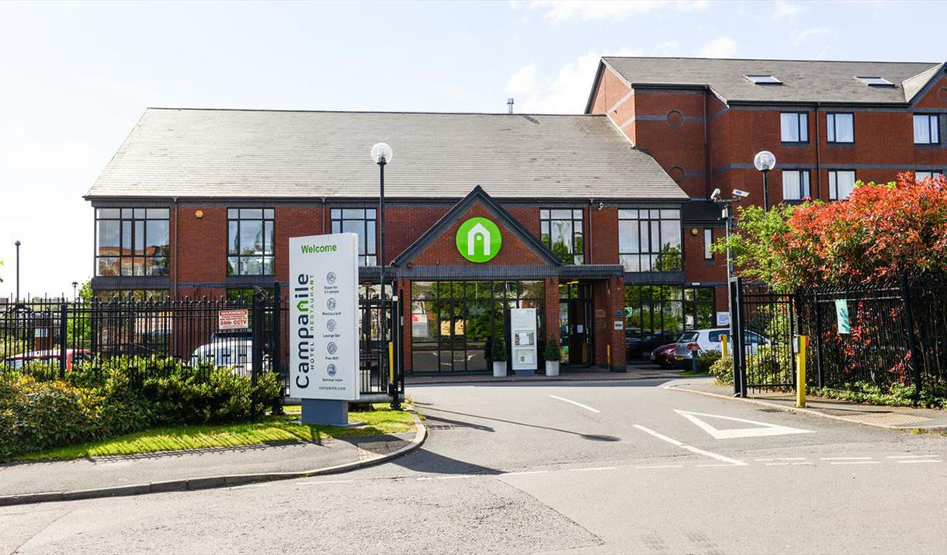
Campanile is a 3-star Hotel-Restaurants and started in 1976 by the Taittinger Family operated by Louvre Hotel Group as a French Business, the company has been growing successfully worldwide. In 2009, the company merged with Golden Tulip Hospitality. In February 2015, a Chinese Group by the name of Jin Jiang International bought Louvre Hotels Group. The Campanile Hotel has 388 hotels worldwide and is the 4th largest restaurant network in France.(Louvre Hotels Groups,2015)

Slide 3

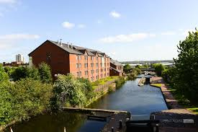
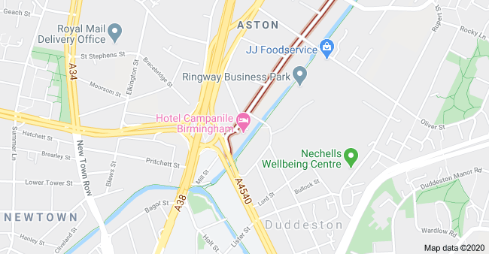
According to Hotel Campanile Birmingham (2019), the hotel is located within easy reach from the city centre about 0.6 mile, guests can enjoy a lovely walk.
There is also various train stations including grand central station, few minutes walk from the Hotel.
Birmingham International Airport is situated 5.5 miles from the Hotel.
There is an easy access to the motorway, M6 junction 6 is not far from the Hotel.
Birmingham

Slide 4
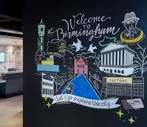
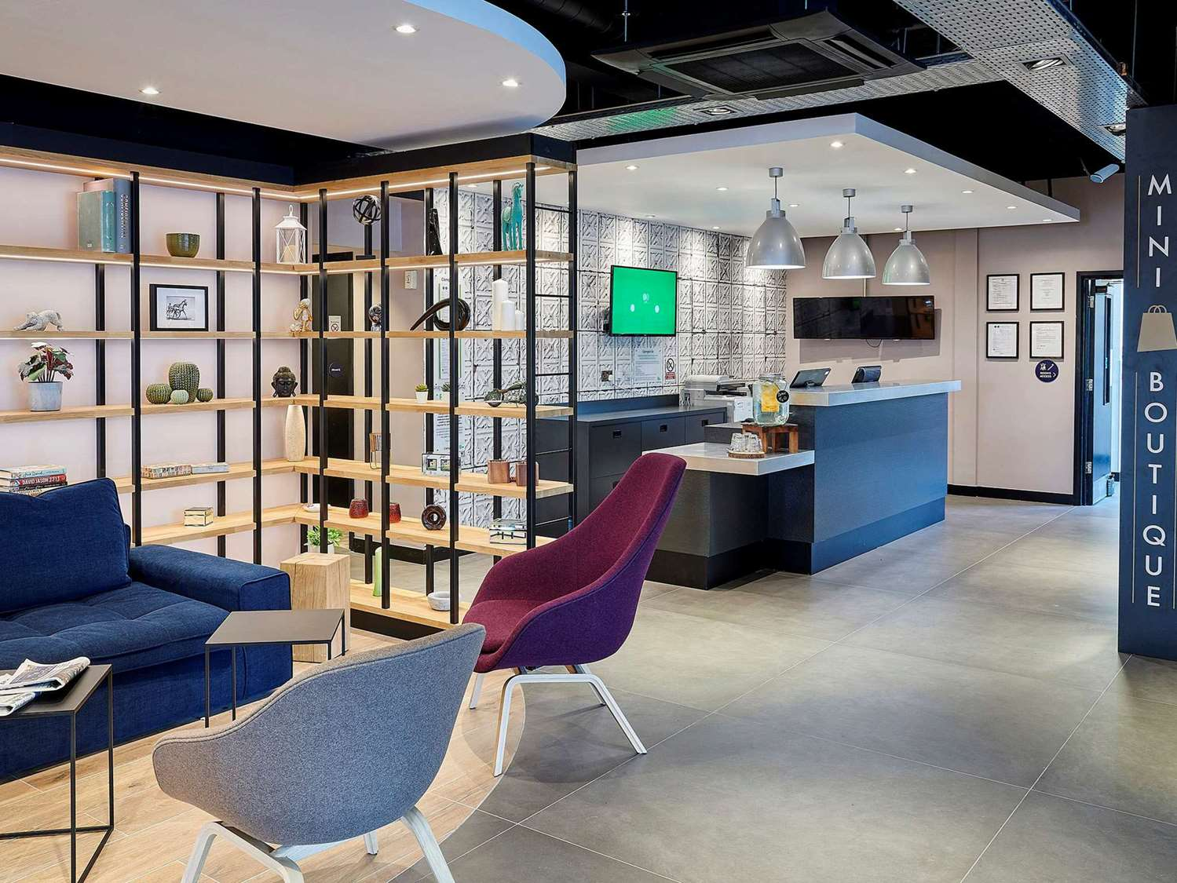
HOTEL LOBBY AREA
Very stylish lobby that offers features complimentary newspapers
(Hotel Campanile Birmingham 2019)

Slide 5
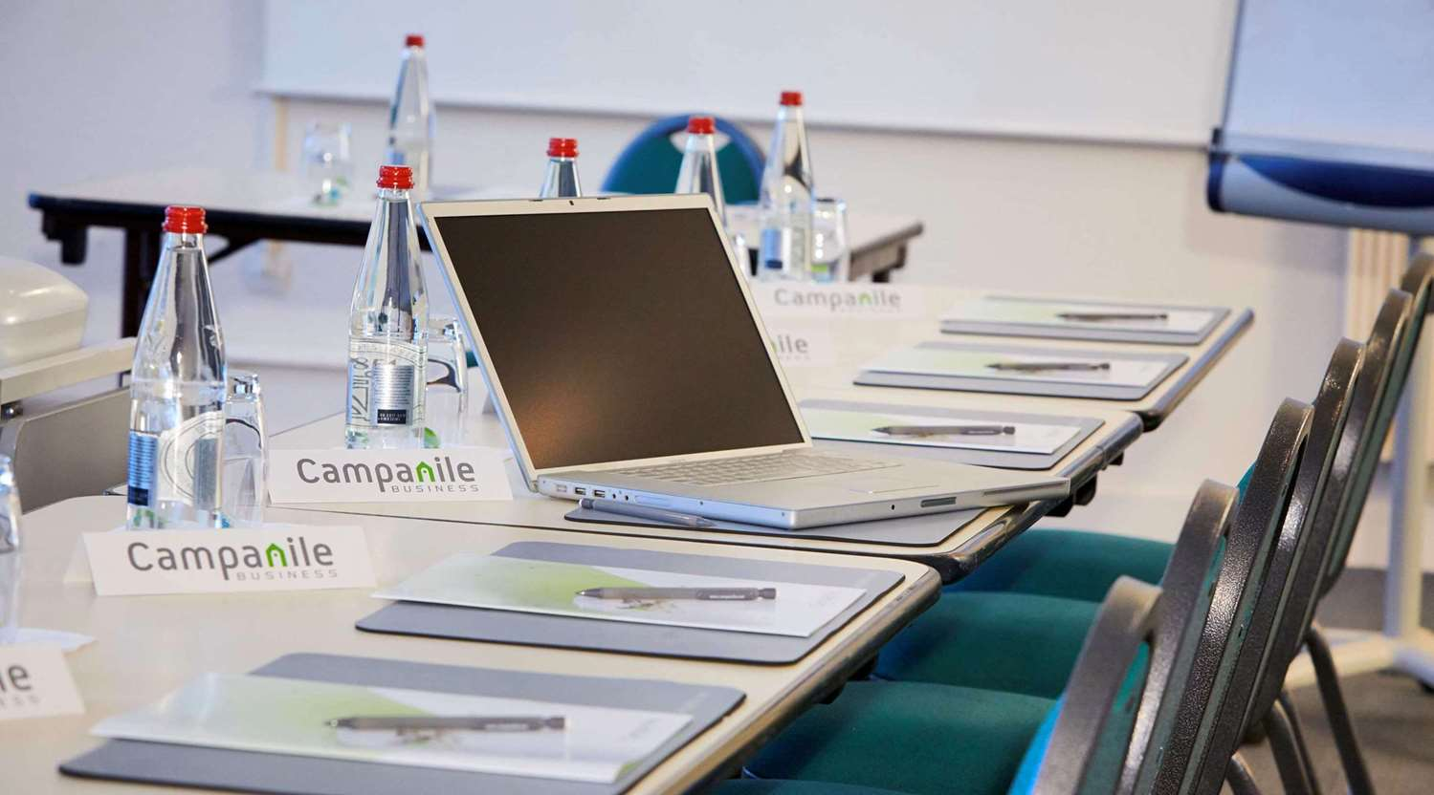
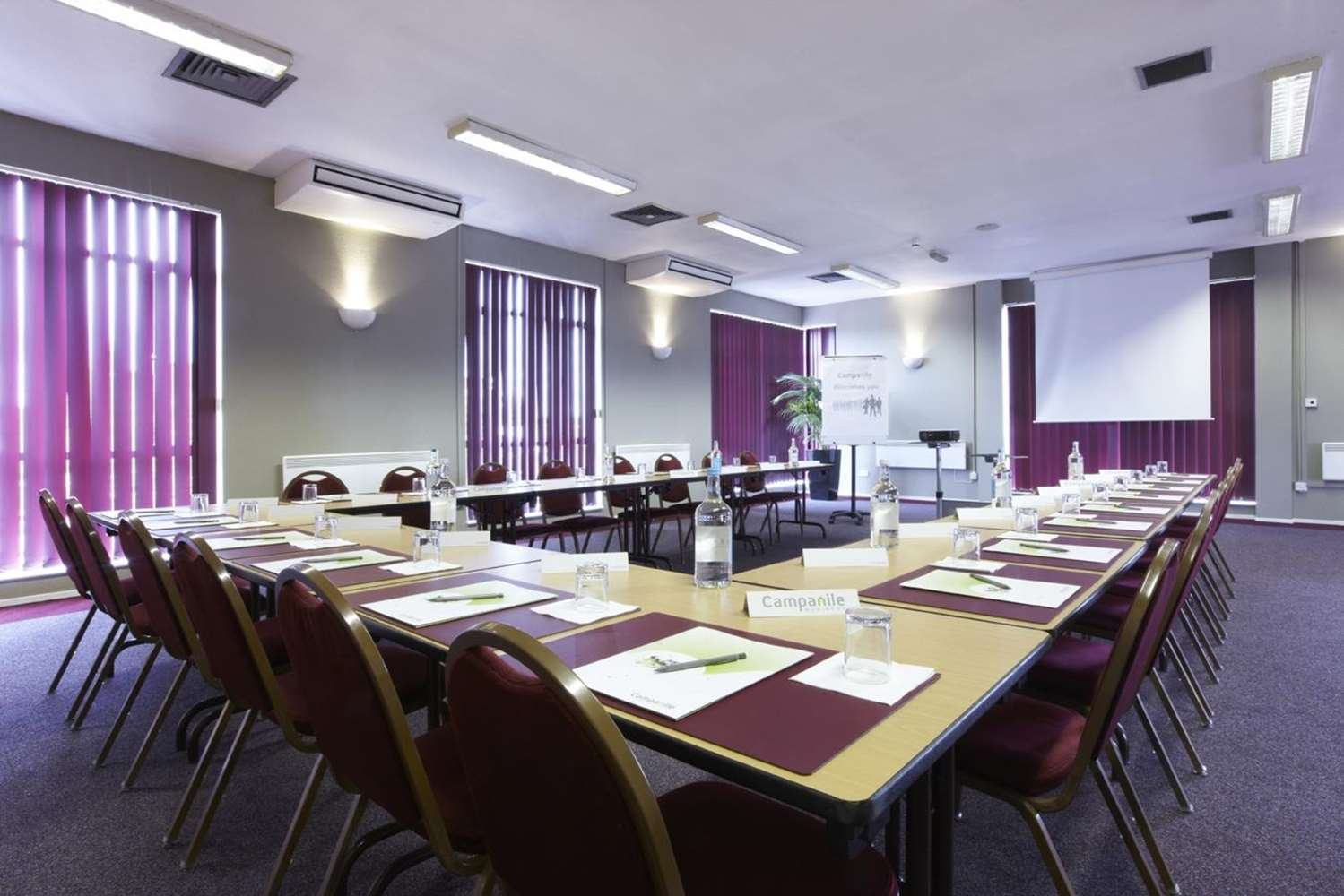
FUNCTION ROOM
The meeting and event room is well equipped. Ideal for hosting wedding, conference, seminar or banquet.
LCD projectors and other equipment available on request.
Air conditioning room.
(Hotel Campanile Birmingham 2019)

Slide 6
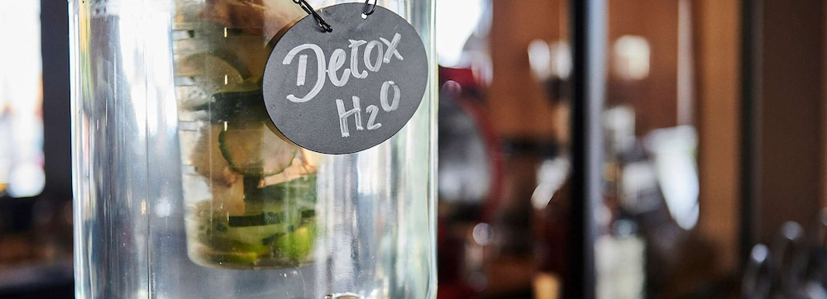
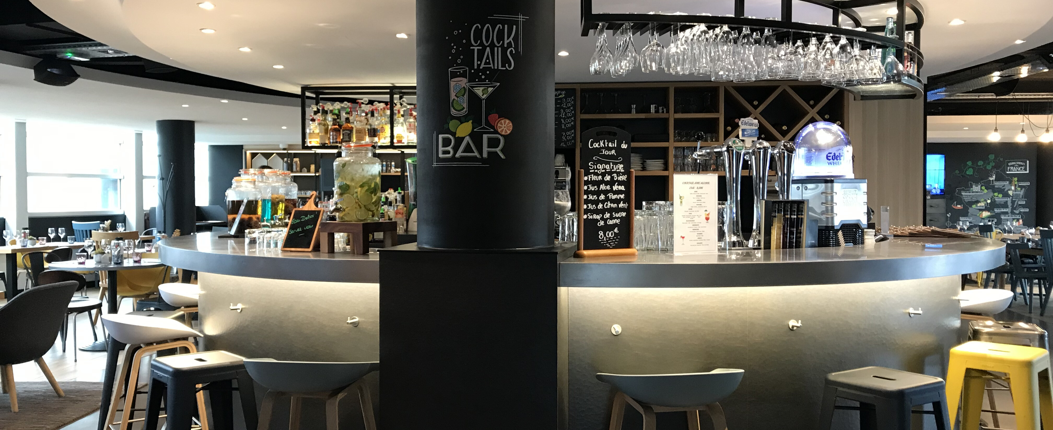
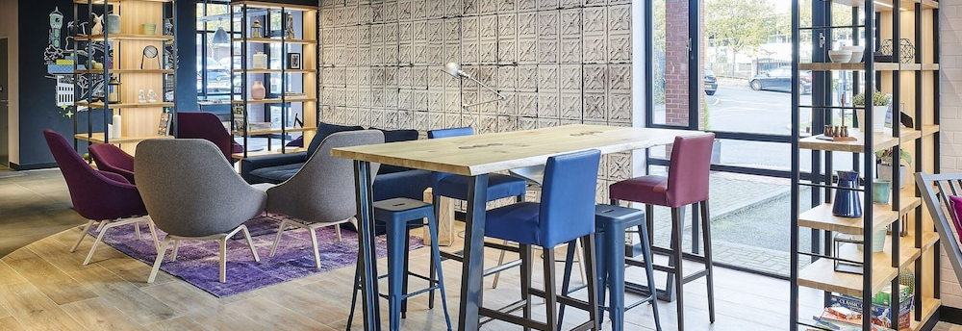
BAR AND LOUNGE
With our refurbished bar and lounge, guests can enjoy a quiet space to ,work, read, meet friends and family, eat and drink.
(Hotel Campanile Birmingham 2019)

Slide 7
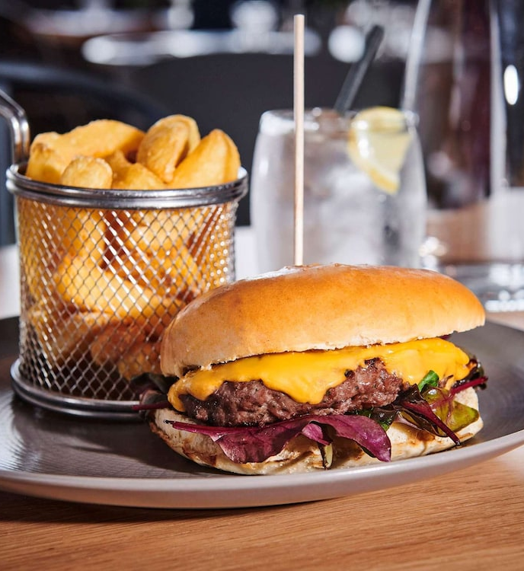
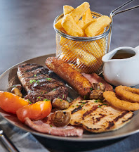
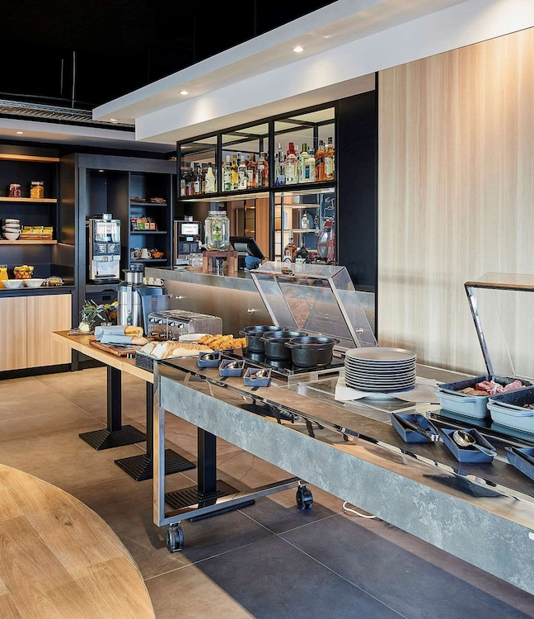
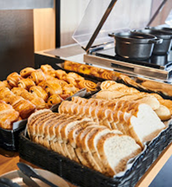
RESTAURANT
The restaurant offers various delicious dishes from different countries worldwide and some inspiration from French cuisine.
We offer freshly baked pastries, hot English cooked breakfast, traditional too.(Hotel Campanile Birmingham 2019)

Slide 8
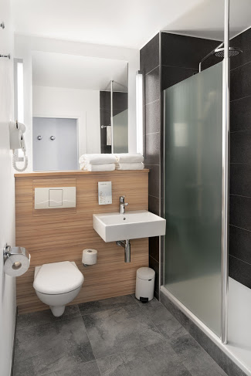
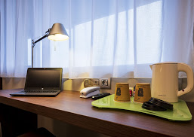
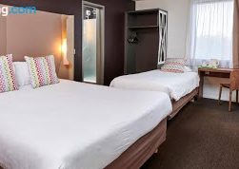
ROOMS
According to Hotel Campanile Birmingham (2019), Campanile Hotel offers 111 rooms with an option to choose double or twin and family rooms. And a bathroom included with a shower.
Daily housekeeping done
Free newspapers
Breakfast delivered to the room
Fresh tea, coffee and biscuits available
Fresh towels available
Toiletries available for customer use
Every rooms all include a flat screen tv, a telephone and hair dryer.

Slide 9
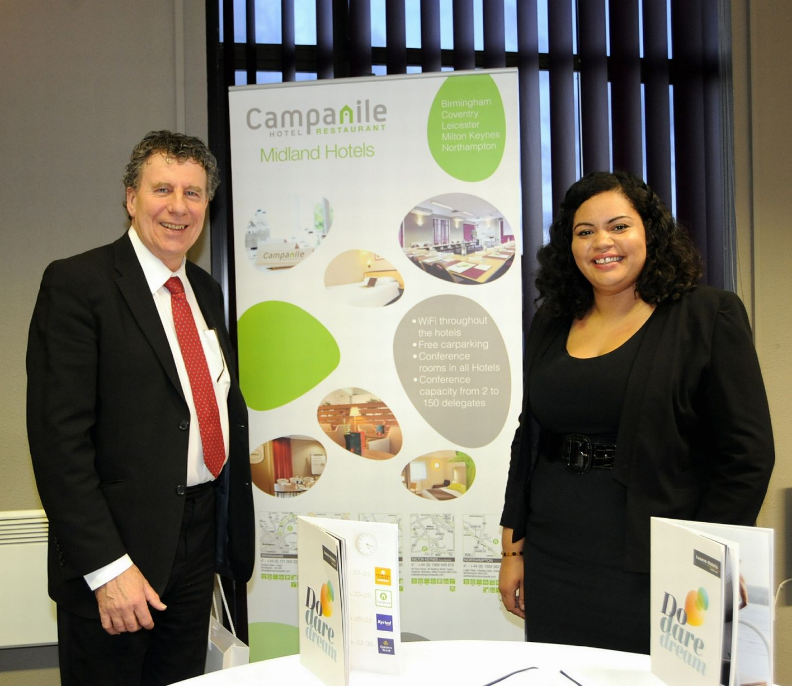
According to BusinessLive article (2015),Campanile Hotel Birmingham hosted a business exposition where local companies, suppliers and hotel booking agents were invited to check out its facilities.
Campanile Hotel Birmingham offer a discount to its guests at the time of booking known as the Program. Bookings are made online using a digital platform and using the phone. Most of the adverts are done using social media such Facebook, tweeter, and their own websites. (Campanile 2019)
MARKETING

Slide 10










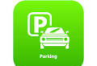

HOTEL FEATURES
MINICOMPTOIR PET FRIENDLY ACCESSIBILITY BAR
LAUNDRY 24 HOUR RECEPTION WIFI RESTAURANT
ROOMS BUSINESS AND EVENTS FREE PARKING KID FRIENDLY

Slide 11

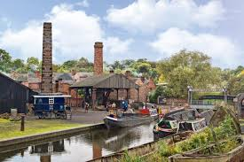
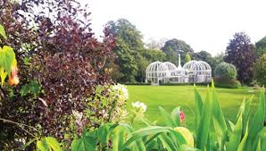

PLACES TO VISIT
Cadbury world
National Sea Life Centre Birmingham
Black Country Living Museum
Birmingham Botanical Gardens
According to Visit Birmingham (2020), Hotel Campanile Birmingham receive lots of visitors from all over the UK and the rest of the world. Most of guests are attracted by the Aston Villa football ground and Edgbaston Cricket ground. Also the N E C which is Birmingham UK No 1 venue for shows, exhibitions, meetings and events.

Slide 12
REFERENCES
Campanile, (2019), Terms And Conditions, available at https://www.campanile.com/en-us/terms-of-service/, accessed [29/05/2020]
Campanile, (2019), Hotel Campanile Birmingham, available at https://birmingham.campanile.com/en-us/, accessed [29/05/2020]
Hicks, D., (2015), BusinessLive, Campanile Hotel Birmingham hosts business to business expo, available at https://www.business-live.co.uk/economic-development/gallery/campanile-hotel-birmingham-hosts-business-9155081, accessed [29/05/2020]
Louvre Hotels Groups,(2015), An ongoing growth for the past 10 years,
available at https://www.louvrehotels.com/en/international-group, accessed [28/05/2020]
Visit Birmingham,(2020), Campanile Birmingham, available at https://visitbirmingham.com/where-to-stay/campanile-birmingham-p200151, accessed [28/05/2020]
Visit Birmingham,(2020),Things to See & Do , available at
https://visitbirmingham.com/things-to-see-and-do/attractions, accessed [29/05/2020]

