Slide 1
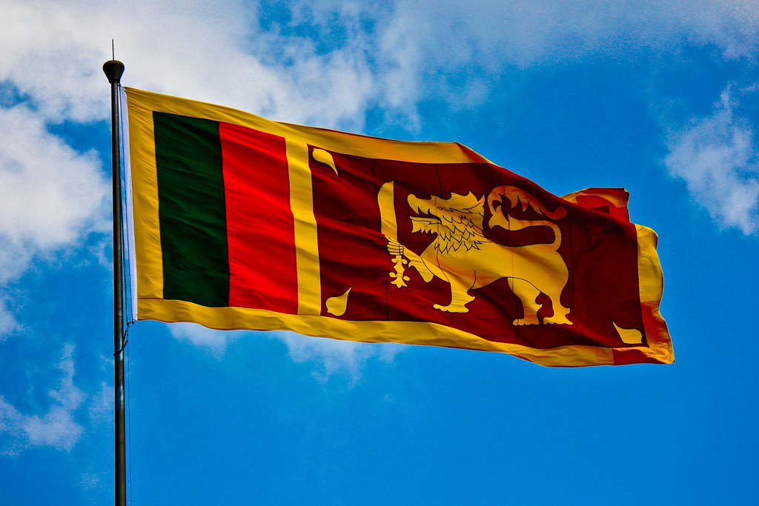
CONTEMPORARY THEME OF CRISIS MANAGEMENT IN THE
SRI LANKAN HOSPITALITY INDUSTRY
BMIH6001 – LEVEL 6
STUDENT : PRIYANITHA COORAY
LECTURER : DR. ERNEST BALUTIE WAVEI
(PowerPoint, 2024)
ACKNOWLEDGEMENT:
I HAVE NOT USED AI TO GENERATE THE CONTENT OF THE WORK.

Slide 2

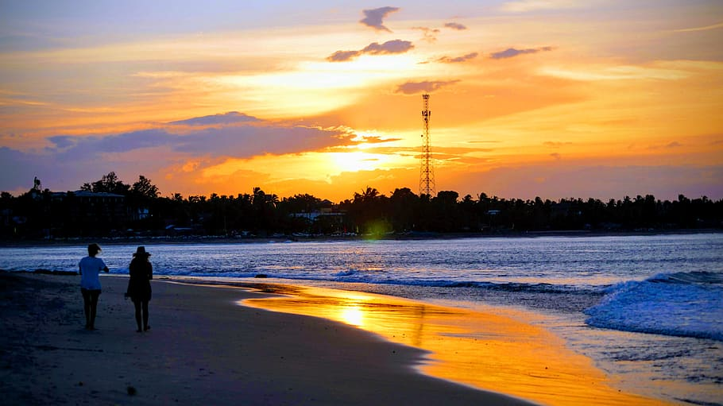
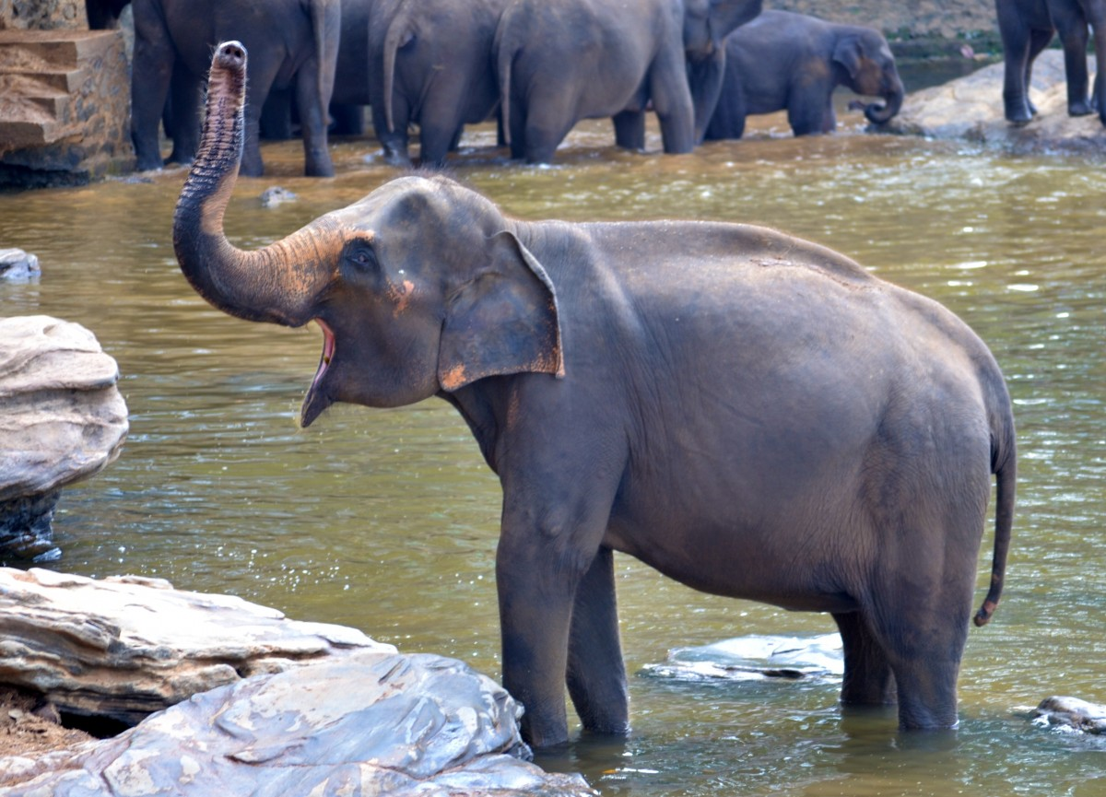
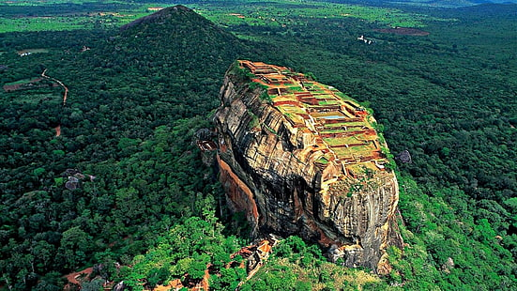
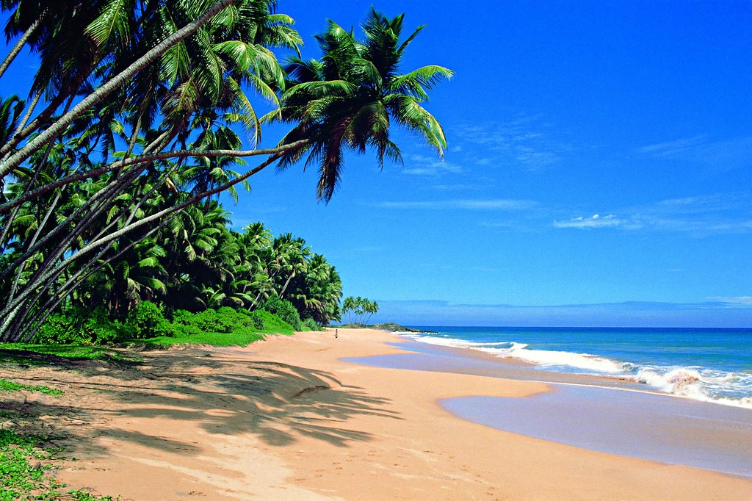
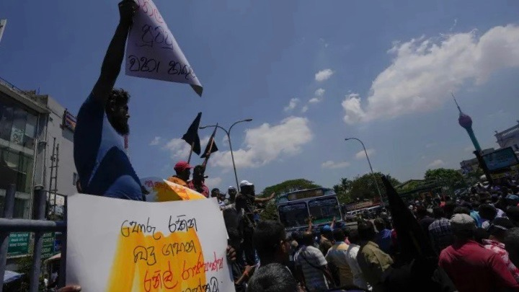
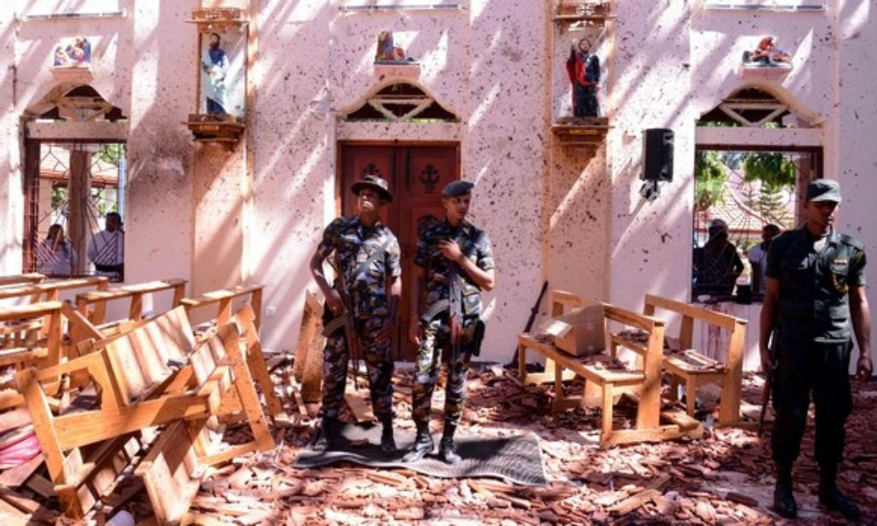
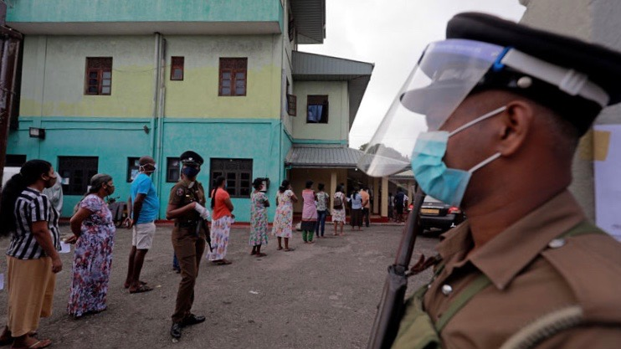
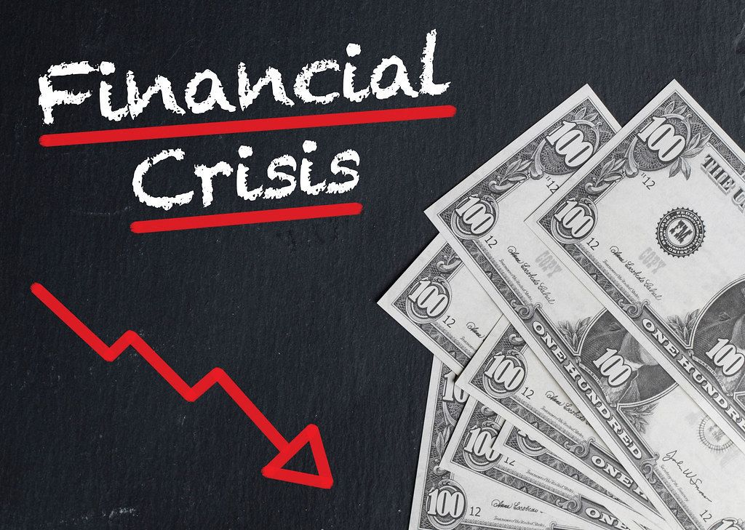
HOSPITALITY INDUSTRY IN SRILANKA
(PowerPoint, 2024)
(PowerPoint, 2024)
Tourism is a vital component of the Sri Lanka's economy
(PowerPoint, 2024)
(PowerPoint, 2024)
(PowerPoint, 2024)
SRI LANKA IS CURRENTLY STRUGGLING WITH MANY CRISIS THAT ARE TREATHNEING ITS GROWTH AND STABILITY
Political instability
Health related crisis
Economic downturns
(PowerPoint, 2024)
(PowerPoint, 2024)
(PowerPoint, 2024)
(PowerPoint, 2024)

Slide 3

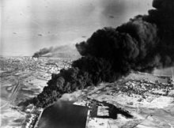
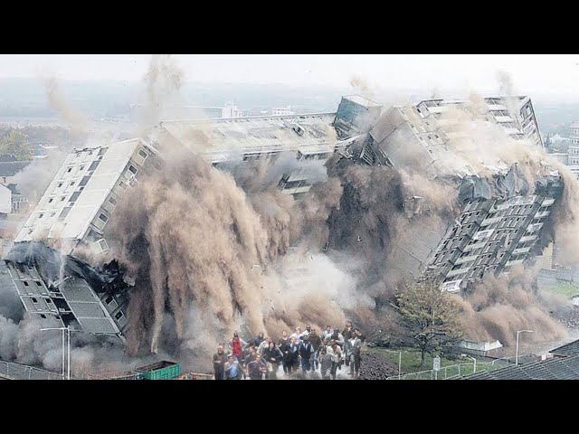
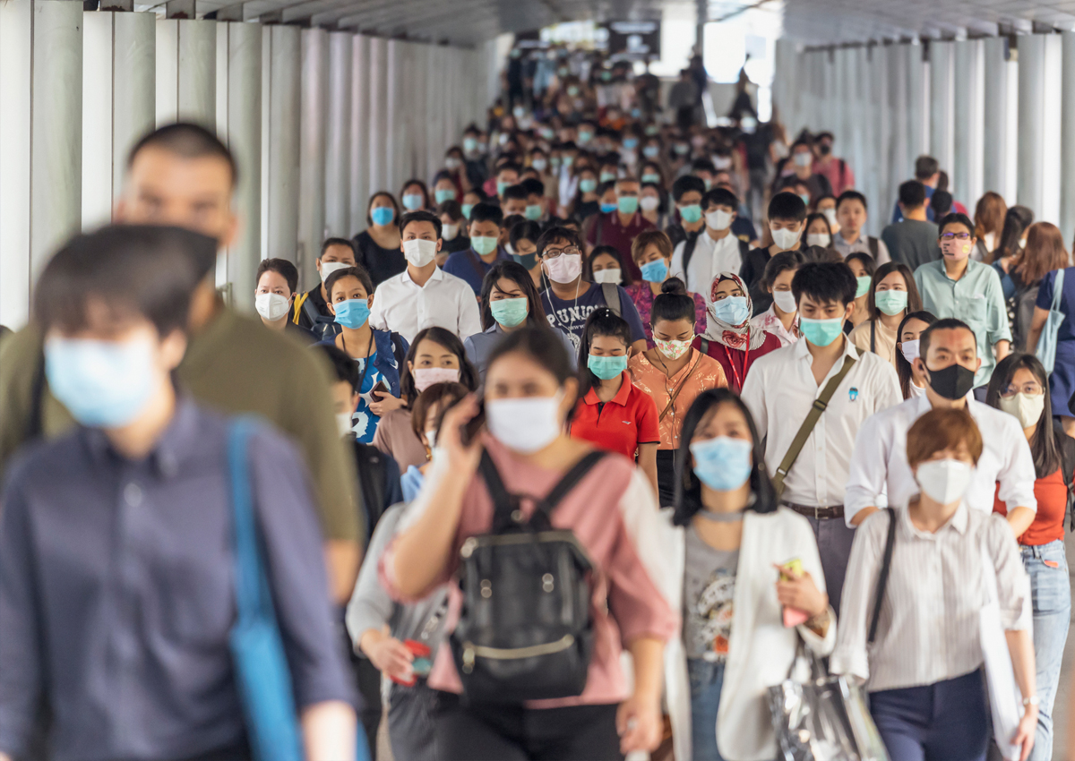
LITERATURE REVIEW: Understanding crises…
What exactly defines a crisis?
A crisis is an unexpected event that causes disruption
(Coombs, 2020).
(PowerPoint, 2024)
(PowerPoint, 2024)
(PowerPoint, 2024)
(PowerPoint, 2024)
(PowerPoint, 2024)
Fast and effective responses are essential to manage the situation and mitigate any harm to people and organizations

Slide 4


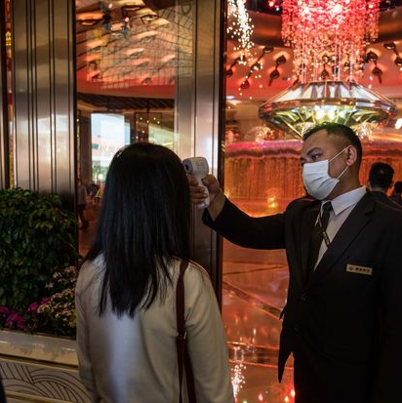
EFFECTIVE CRISIS PREPARATION AND MANAGEMENT
Preparedness, adaptability and clear communication are crucial (Timmis and Brussow, 2020)
Effective crisis management can protect a brand’s reputation and ensure customer loyalty (Birkland et al.,2008)
RESILIENCE
DYNAMIC APPROACH
(PowerPoint, 2024)
(PowerPoint, 2024)
(PowerPoint, 2024)

Slide 5

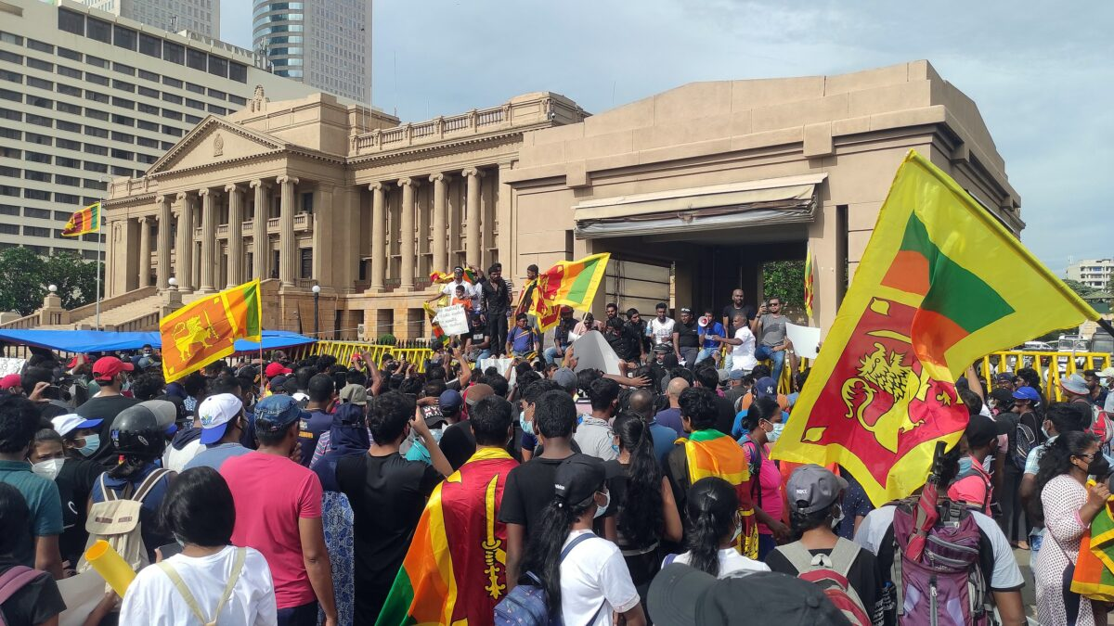
PESTEL ANALYSIS
POLITICAL FACTORS
Political turbulence. Leading to decreased tourism arrivals (STDA, 2024).
ECONOMIC FACTORS
Impact of COVID-19, inflation, and operational cost increases affecting profitability (Central bank of Sri Lanka, 2023).
(PowerPoint, 2024)
SOCIAL FACTORS
Shift in health expectations due to COVID-19, requiring transparent practices (Kim and Han, 2022).
Technological factors
The hospitality industry in Sri Lanka has seen an acceleration in technology due to the pandemic. These advancement improved operational efficiency as well as guest safety and satisfaction (Gretzel et al., 2020).
Environmental factors
Hospitality businesses need to implement eco-friendly initiatives to meet guest expectations, as guests are now more conscious of ecological impacts (Bethell-Bennett et al., 2022).
Legal factors
Post-pandemic legal frameworks surrounding health and safety standards have become more stringent, therefore, compliance
with these regulations is vital to avoid liabilities and ensure safety environment for everyone (Nicolaides and Kearney, 2012) .
BUSINESSES MUST BE AWARE OF THESE FACTORS IN ORDER TO DEVELOP EFFECTIVE STRATEGIES

Slide 6
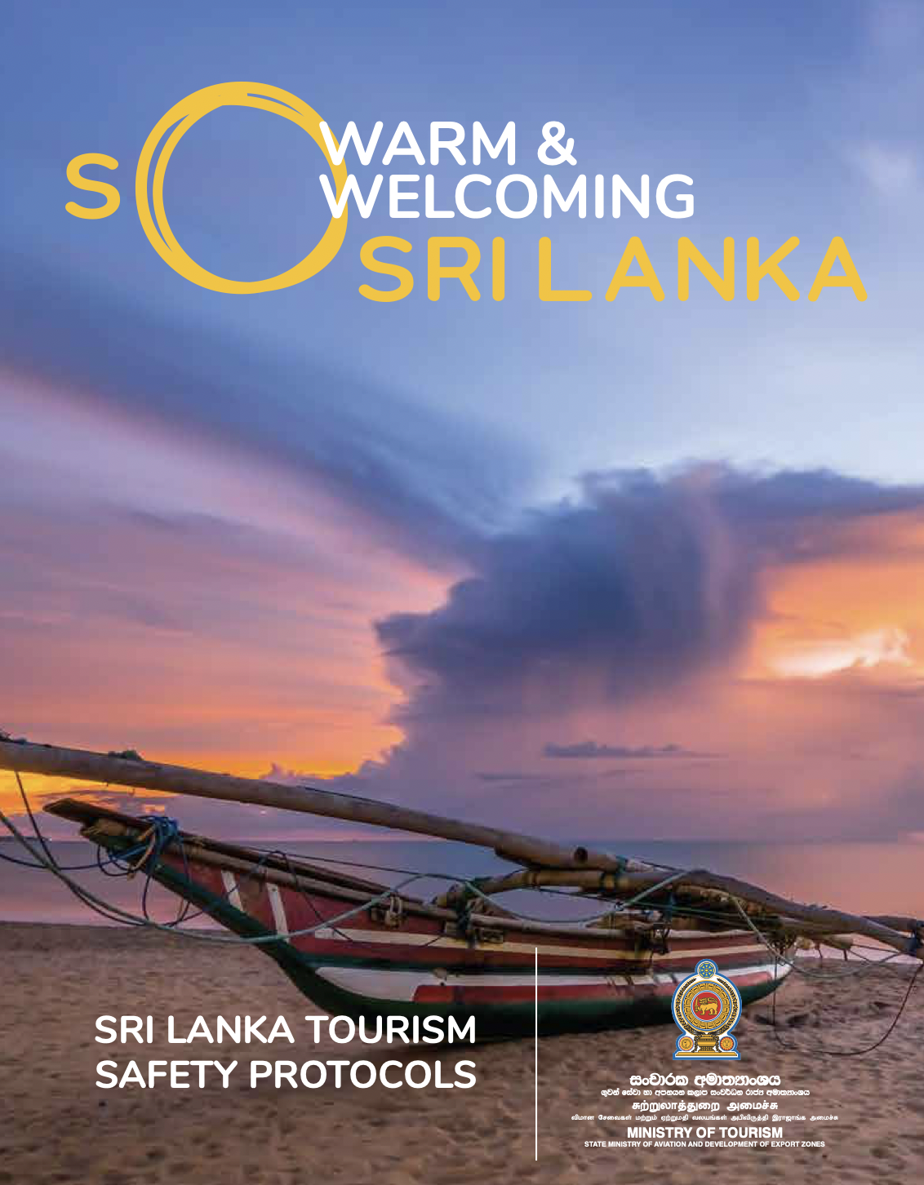
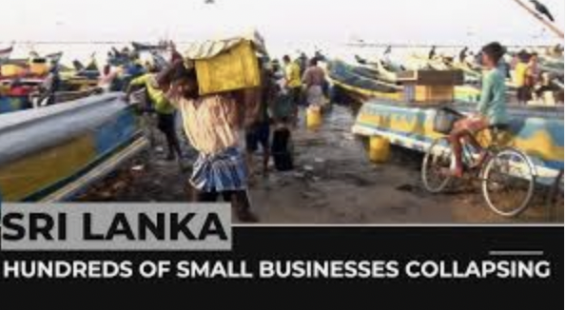
SRILANKA HOSPITALITY INDUSTRY RESPONSES
ADAPTATION STRATEGIES:
Health protocols in line with World Health Organization guidelines to reassure guests
STRENGTH OF
RESILENCE
GOVERNMENT ACTION:
The Sri Lnkan Government is negotiating with IFM to seek assistance (Economic and Political Weekly, 2022)
Google, 2024)
LIMITATIONS
However, due to limited resources, small businesses are still struggling
(Priyanath and Samarathunga, 2024)
(YouTube, 2024)

Slide 7



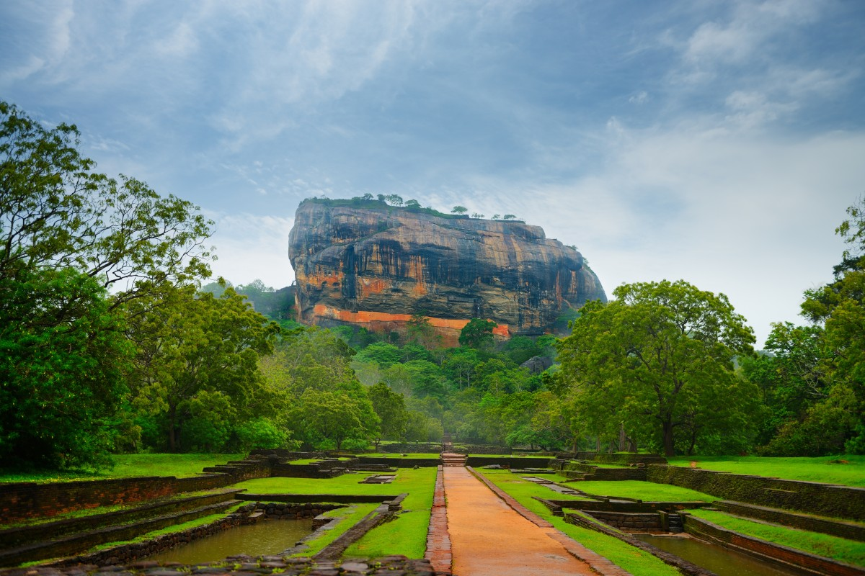
FUTURE POLICY AND MANAGEMENT OPTIONS
(PowerPoint, 2024)
(PowerPoint, 2024)
(PowerPoint, 2024)
(PowerPoint, 2024)
Sharing knowledge
to develop strategies
To ensure preparedness
Boost local
hospitality business
Improve efficiency and
enhance guest experience
THESE STRATEGIES CAN HELP THE SECTOR NAVIGATE FUTURE UNCERTAINTIES WITH CONFIDENCE!

Slide 8
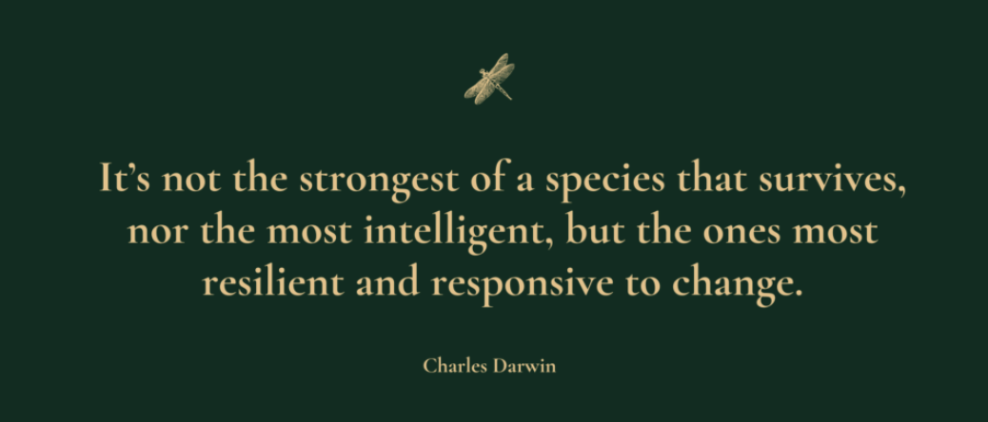
(Google,2024)
Effective crisis management isn’t just a luxury, it is essential for survival!

Slide 9
THANK YOU!
FEEL FREE TO HAVE A LOOK AT THE
FOLLOWING REFERENCES
FOR FURTHER READING ON THE TOPICS DISCUSSED.

Slide 10
REFERENCES:
A. Nicolaides, & J. Kearney. (2012). Promoting awareness of legal requirements and liabilities in food and beverage operations. African Journal of Hospitality, Tourism and Leisure, 2(1).
Bethell-Bennett, I., Rolle, S., Minnis, J., & Okumus, F. (Eds.). (2022). Pandemics, disasters, sustainability, tourism : an examination of impact on and resilience in Caribbean small island developing states. Emerald Publishing Limited.
Birkland, T. A., Sylves, R. T., & Lindsay, B. (2008). Lessons of disaster: policy change after catastrophic events [Review of Lessons of disaster: policy change after catastrophic events]. Public Administration Review, 68(2), 402–403. https://doi.org/10.1111/j.1540-6210.2007.00875.x
Central Bank of Sri Lanka, Annual Economic Review of the Central Bank 2023
Available at: https://www.cbsl.gov.lk/sites/default/files/cbslweb_documents/publications/aer/2023/en/Full_Text.pdf
(Accessed on the 26^{th of} September 2024)
Coombs, W. T. (2020). Public Sector Crises: Realizations from Covid-19 for Crisis Communication. Partecipazione e Conflitto, 13(2), 990–1001. https://doi.org/10.1285/i20356609v13i2p990
Economic and Political Weekly, 2023,’ The unravelling of the Global Political Economy. And Sri Lanka’s IMF Solution.
Available at: https://www.epw.in/journal/2023/1/perspectives/unravelling-global-political-economy-and-sri.html
(Accessed on the 25^{th of} September).
Google (2024) STDA, “Sri Lanka tourism safety protocols”
Available at: https://sltda.gov.lk/storage/common_media/Sri%20Lanka%20Tourism%20Safety%20Protocols%20-%202nd%20February%2020214177318528.pdf
(Accessed on the 5^{th of} November 2024)
Gretzel, U., Fuchs, M., Baggio, R., Hoepken, W., Law, R., Neidhardt, J., Pesonen, J., Zanker, M., & Xiang, Z. (2020). e-Tourism beyond COVID-19: a call for transformative research. Information Technology & Tourism, 22(2), 187–203. https://doi.org/10.1007/s40558-020-00181-3
Kim, J., Han, H., 2022. Saving the hotel industry: Strategic response to the COVID-19 pandemic, hotel selection analysis, and customer retention. Int. J. Hosp. Manag. 102, 103163.
Priyanath H.M.S. and Samarathunga S.R.M. (2024) The Impact of Business Uncertainty on the performance of small Enterprises During the Economic Crises in Sri Lanka. Wayamba Journal of Management. ResearchGate
Available at: https://www.researchgate.net/publication/384341269_The_Impact_of_Business_Uncertainty_on_the_Performance_of_Small_Enterprises_During_the_Economic_Crises_in_Sri_Lanka
(Accessed on the 07 October 2024).
Sri Lanka Tourism Development Authority (2024), Growth Scenario 2024 (NEW)
Available at: https://www.sltda.gov.lk/storage/common_media/Growth%20Scenario%202024.pdf
(Accessed on the 25^{th of} September 2024)
Timmis, K., & Brüssow, H. (2020). The COVID‐19 pandemic: some lessons learned about crisis preparedness and management, and the need for international benchmarking to reduce deficits. Environmental Microbiology, 22(6), 1986–1996. https://doi.org/10.1111/1462-2920.15029
YouTube (2024) “Sri Lanka crisis: Hundreds of small businesses collapsing”
Available at: https://www.youtube.com/watch?v=rtrWlaOAtCo
(Accessed on the 5^{th of} November 2024)

