Slide 1

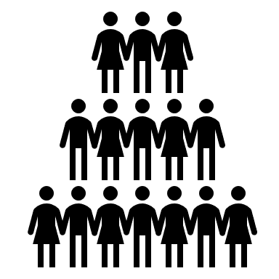
Project management for sustainability
ASSIGNMENT 2
TUTOR: GLENN BEHENNA
STUDENT: CLAIRE DAVIES

Slide 2
What is a Project?
“Planned set of interrelated tasks to be executed over a fixed period and within certain cost and other limitations.”(Businessdictionary,2019).
What is Project Management?
“Project Management is the application of knowledge, skills, tools and techniques to a broad range of activities in order to meet the requirements of a particular project.”(Eby, 2018).
What is a Project Manager?
“A project manager is the person responsible for leading a project from its inception to execution. This includes planning, execution and managing the people, resources and scope of the project.”(Techopedia,2019).
Notes:
A project is an activity that has an end product in sight, it will have a start, middle and end. The project will be planned and structured to be able to meet all the criteria necessary to get to the end goal.
Project Management, this is the means to an end. There are usually 5 stages. Initiating, Planning, Execution, Monitoring/Performance and Closure. All team members will need to work together to enable the project to be completed successfully.
Project Manager, this is the person that will oversee all aspects of the project, they will ensure that it is running smoothly. They would be the main point of contact should a problem arise.

Slide 3

Who is involved in a Project?
The business/organization
Stakeholders: Internal and External
Project Team
“Edward Freeman’s stakeholder theory holds that a company’s stakeholders include just about anyone affected by the company and its workings.”(Smartsheet,2019).
Notes:
A project will be made up of many people. You have the main business/organisation that the project will be for, you then have the stakeholder, these have a vested interest in the progress and the completion of a project, they are anyone that is affected by the project and then you have the project team, this is everyone that will be involved in making the project happen, and the success of the project.

Slide 4
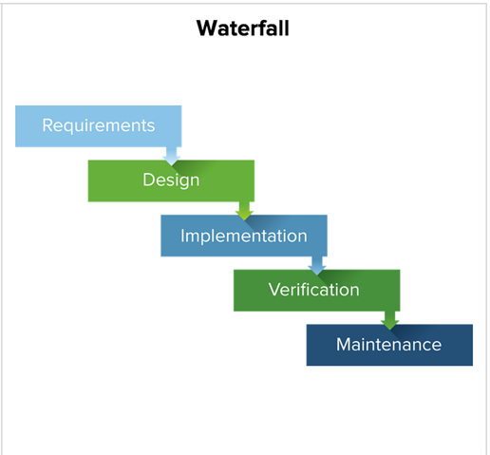
METHODOLOGIES
Waterfall
With the Waterfall Methodology each stage must be completed before moving on to the next.
This is best suited for simple, unchangeable projects.
If a mistake has been made in a previous stage, you cant just go back and change it, you will need to start over the whole process from the beginning.
Can be time consuming if mistakes are made.
“First introduced by Dr. Winston W. Royce in a paper published in 1970.”(Airbrake,2019).
(Centriq,2019).
Notes:
This methodology was introduced back in 1970 by Dr Winston Royce. This breaks down each stage of a project, then each stage must be completed without a mistake to allow you to move onto the next stage, should this not be the case and a mistake is made in a previous stage then the whole Waterfall method must be started again from the beginning. There is no room for change or mistake with this method, and because of this, it would be more suited to a small and simple project, or used along side another methodology.

Slide 5
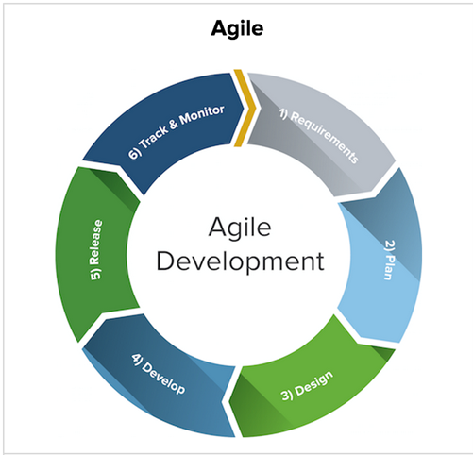
Agile
Designed in 2001 by a small group.
Was found to be an improvement on traditional methodologies.
Faster delivery of a project
Allows for small changes to be made.
“Agile is a process that helps teams provide quick and unpredictable response to the feedback they receive on their project. It creates opportunities to assess a project’s direction during the development cycle. Teams assess the project in regular meetings called sprints or iterations.”(Goncalves,2019).
(Centriq,2019).
Notes:
This methodology has everyone working together and interacting with each other throughout the project. The Agile process use a sprint process, this process is a set period and during this time tasks and activities will be finalised an d reviewed. It was found to be an improved methodology, but again not necessarily suited to all project, but can be used along side another methodology. It’s a nice one to use as it does allo for small changes to be made throughout the process of the project, so if a mistake is made it would be easily rectified.

Slide 6
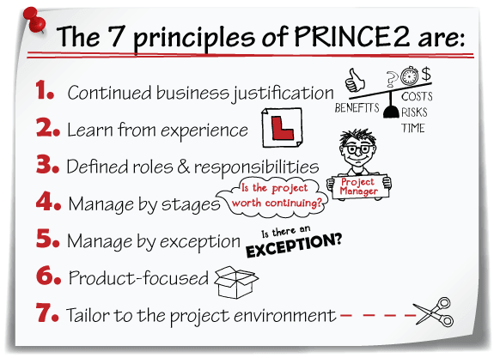
PRINCE2
“The PRINCE2 framework says that a project should have:
An organised and controlled start, i.e. organise and plan before leaping in.
An organised and controlled middle, i.e. keeping projects organised and controlled.
An organised and controlled end, i.e. when you've got what you want and the project has finished, tidy up the loose ends.
To describe what a project should do and when, PRINCE2 has a series of processes. These cover all the activities needed on a project, from starting up to closing down.”
(PRINCE2.com,2019).
PRINCE2
Established 1996
(KnowledgeTrain, 2018).
Notes:
PRINCE2 was released in 1996, this is an updated version of PRINCE that was released in 1989. Many projects can fail because they haven’t been organised very well, but PRINCE2 is a more controlled methodology, and therefore if the method is followed correctly there is less chance that the project will fail. PRINCE2 is a great method whether you are starting a small or large project, it can be used along side other methodologies, improvement are continuously being made to this method and it can be used and adapted to a variety of different projects. PRINCE2 requires you to have the relevant experience or qualifications to be able to use this method, therefore may not be suitable for a project where your team don’t have either of these.

Slide 7
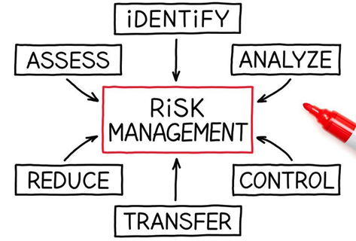
Risk Assessment
5 | 5 | 10 | 15 | 20 | 25
4 | 4 | 8 | 12 | 16 | 20
3 | 3 | 6 | 9 | 12 | 15
2 | 2 | 4 | 6 | 8 | 10
1 | 1 | 2 | 3 | 4 | 5
 | 1 | 2 | 3 | 4 | 5
PROBABILITY
Low High
Low High
SEVERITY
(ProjectManagement,2019).
Notes:
Any project has the potential of risks happening throughout the stages of the project. Risks can be minimised or prevented by running a risk assessment, above I have made a table that show you how to work out a severity and probability of a risk happening, this then enables you to be able to put relevant measures in place to minimise or prevent a risk happening. There are many risks involved, for example: COST, the project could end up costing more than you first thought, TIMING, you may run out of time as the project took longer than expected, this are just a couple of risk that could jeopardise a project and his is why all projects should run a risk assessment.

Slide 8
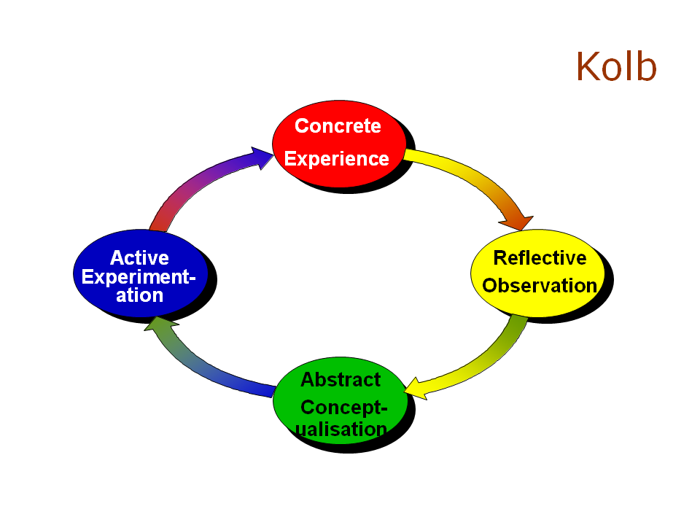
Kolb’s Reflective Cycle
“Learning is the process whereby knowledge is created through the transformation of experience.”(Kolb, 1984, p. 38). (McLeod,Saul,2017).

Slide 9

What I have learnt from Project Management
for Sustainability!
A project if using the correct methodology or a combination of methodologies stands a good chance of success.
There are many people involved in the success of a project, and each and every one is equally as important.
A risk assessment should be done before carrying out a project, this could save a lot of time and money.
Stakeholders, internal and external, not all stakeholders are directly involved, but they still have a vested interest of in the success of the project.
All projects have a start, middle and end, and each stage needs to be completed for a successfully completed project.
Notes:
What I’ve learnt is that a lot more goes into a project that I first thought. I never imagined that so many people would be involved, but now that I know this it makes a lot more sense. A Project Manager from my point of view is one of the more influential people in a project as they over see everything that the project involves. So great team work and communication skills are a must. I’ve learnt that there are many methodologies out there but the 3 main ones used in Project Management are Waterfall, Agile and PRINCE2, and they are all different, but they can be used along side another methodology or on it’s own. All of this is part of the Life Cycle of a Project.

Slide 10
References
http://www.businessdictionary.com/definition/project.html
Eby, Kay(2018, May 29th). Smart Sheet. Retrieved from:
https://www.smartsheet.com/blog/demystifying-5-phases-project-management
https://www.techopedia.com/definition/677/project-manager-pm
https://www.centriq.com/blog/why-it-professionals-need-to-learn-agile-project-management/
https://airbrake.io/blog/sdlc/waterfall-model
https://www.smartsheet.com/what-stakeholder-theory-and-how-does-it-impact-organization
https://www.project-management.pm/wp-content/uploads/2017/03/Portfolio-Risk-Management-3.jpg
https://www.knowledgetrain.co/en/resources/qualifications/prince2-guide-for-pmp-and-capm-credential-holders
PRINCE2.com. (2019). Retrieved from https://www.prince2.com/uk/prince2-methodologies
https://www.simplypsychology.org/learning-kolb.html

