Slide 1
Scriptwriting
M4X01654

Slide 2
Short Film Analysis
Good things come in small packages

Slide 3
Stories as metaphor & ritual
Stories are metaphors for life
Stories are rituals
Stories use symbols and metaphor
Stories dramatise change and transformation

Slide 4
The monomyth
Ordinary world
Extraordinary world
Face challenges
Receive a gift
Return to ordinary world, transformed

Slide 5
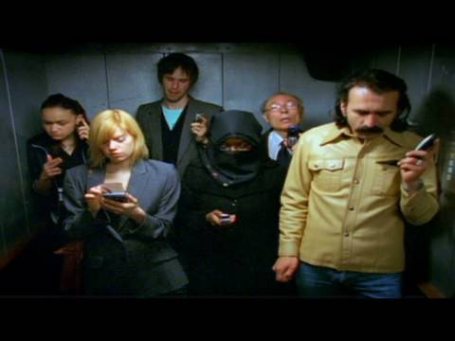
Elevator Music (2006)
Notes:
https://www.youtube.com/watch?v=j1-LXJHOQ4g

Slide 6
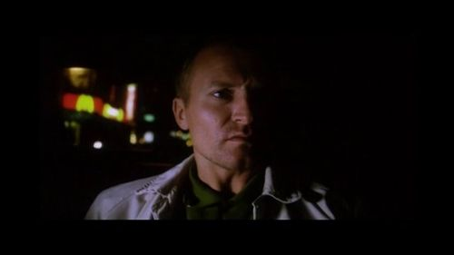
Election Night (2000)

Slide 7
Election Night (2000)
What is the ordinary world?
What is the extraordinary world?
What challenges does the main character face? (External/internal)
How is the main character transformed?
What gift does he receive?

Slide 8
Conflict
Protagonist struggles
Has goal(s) to achieve
Opposed by forces of antagonism
Without struggle, achievement lacks merit
Notes:
In a classical screen story, the protagonist is struggling to do something, they have a goal. Stopping them from achieving this goal are the forces of antagonism, often another person, the antagonist. Without this struggle, any achievement of the character lacks real merit (and real interest for a mainstream audience, it is argued).

Slide 9
Obstacles
Characters struggle against obstacles
Obstacles can be external or internal
Obstacles increase in magnitude
Notes:
Characters struggle against obstacles. The most immediate are physical ones that put the life of the character at risk; if they are killed they cannot achieve their goal. Because there is so much at stake, genres that have this form of conflict are always popular, although they can quickly lapse into cliché.

Slide 10
External conflict
Outside the character
Physical (such as, threat to survival)
Other people (such as threat to survival/rivals/barriers)
Notes:
Physical obstacles are an example of external conflict and can be used for comic and other purposes as well as for action/suspense.
Other people can embody different concepts, to help add meaning to conflct

Slide 11
Internal conflict
Entirely within a character
Self doubt
Moral dilemma
Madness
Notes:
By contrast, internal conflict is entirely within a character. It is self doubt, a moral dilemma, madness. The internal conflict of the screen story will often carry the underlying themes of the story, the film's argument, which we'll come back to in a bit.
In many successful mainstream stories, the main character deals with both an external and internal conflict. In Titanic (1997), Rose DeWitt Bukater is facing the external conflict of surviving the iceberg-scuppered ship and the attentions of her mother, her fiance, Cal, and her new beau, Jack. She is also facing the internal conflict of whether to do her duty and marry Cal or follow her heart and choose Jack. When the internal and external conflicts climax at the same time, it can be a powerful story design. And a cheap sexual innuendo.

Slide 12
Designing conflict
Conflict works across all structural units
Mutually incompatible goals
Notes:
Conflict works across all the structural units of film: beats, scenes, sequences, acts and the whole film.
Strong story design often features protagonists and antagonists with mutually incompatible goals; they both cannot have the same thing. Rose and Cal have mutually incompatible goals. As do Jack and Cal. And Rose and her mother. As do the ship's designer and the White Star Line – enough lifeboats versus making the deck look crowded.

Slide 13
Meaning in conflict
Conflict is symbolic/metaphorical to the audience
Conflict is about something
Conflict can represent a moral argument
Notes:
Conflict is about something, it is symbolic or metaphorical to the audience. In Titanic, this is represented by Rose's internal dilemma, is about class and gender divides, and about the opportunity to
transcend these offered by new world of liberty, the USA, in contrast to the old world, Europe. It can help to think about this aspect of conflict as a moral argument, the protagonist and antagonist representing different sides. This can apply to any genre of narrative film.

Slide 14
Character
Artificial construction
Serve function(s) in screen story
Notes:
A character, even one based closely on a real person, is an artificial creation, constructed to serve a function or functions in a screen story. There are a number of ways of approaching character, these different techniques and analyses will prove useful in your own work. But be warned, character is a thorny issue and as with other story elements, there’s a lot of give and take between character, conflict, structure and metaphor/symbol in the creation and development of a story. Today, we’ll look at some terms and concepts that will help you understand character and the story form and give you some basic tools to start exploring this.

Slide 15
Character - Robert McKee
Characterization – surface details
Character – what they do
Notes:
Robert McKee distinguishes between what he terms characterization and character. For McKee, characterization refers to the surface dctails, such as how they look and dress, how they express themselves, race, creed, accent. This extends to personal history, such as family background, education, love life and career. It's all the stuff that's happened to make them who they are at the start of the story. Distinct from this, is what McKee terms character. This is what someone does, and they reveal who they truly are, what they stand for, by what they do, by the actions they take during the course of a story.

Slide 16
Character
Goal – symbolic struggle
Goal can represent an outlook on the world
Divergent wants and needs (perceived goal versus actual goal)
Conflicting conscious & unconscious desires
Notes:
In addition to the attributes that McKee and Field outline, a main character in a mainstream film will have a clear goal, and their struggle for that goal not only drives the film but symbolises what it is about.
Other characters can personify concepts that the main character (and their goal) are in conflict with – when creating stories considering how characters might represent conflicting ideas can be a very useful tool.
Main characters will often have divergent wants and needs, the conflicting conscious and unconscious desires.

Slide 17
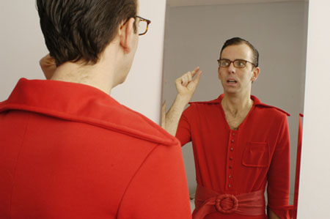
The Delicious (2001)
Notes:
https://www.youtube.com/watch?v=ZVXxInHyyjY
https://www.youtube.com/watch?v=niwOfWKw0BA

Slide 18
The Delicious (2001)
What is the ordinary world?
What is the extraordinary world? What is main character’s goal?
What obstacles do they face?
What examples of external & internal conflict are there?
What is conflict a metaphor for?
What disctinction is there between character & characterization?
How is the main character transformed?
What gift does she receive?

Slide 19
Workshop exercise
You will work in pairs to analyse the scriptwriting of one of the following short films:
  Thunder Road (2015)
  Tight Jeans (2009)
  Gasman (1999)
  I Am Syd Stone (2016)

Slide 20
Workshop exercise
Create a short Powerpoint presentation, illustrated with relevant screencaps, that addresses the following questions:
  What is the ordinary world?
  What is the extraordinary world? What is main character’s goal?
  What obstacles do they face?
  What examples of external & internal conflict are there?
  What is conflict a metaphor for?
  What disctinction is there between character & characterization?
  How is the main character transformed?
  What gift does she receive?
You have 30 minutes

Slide 21
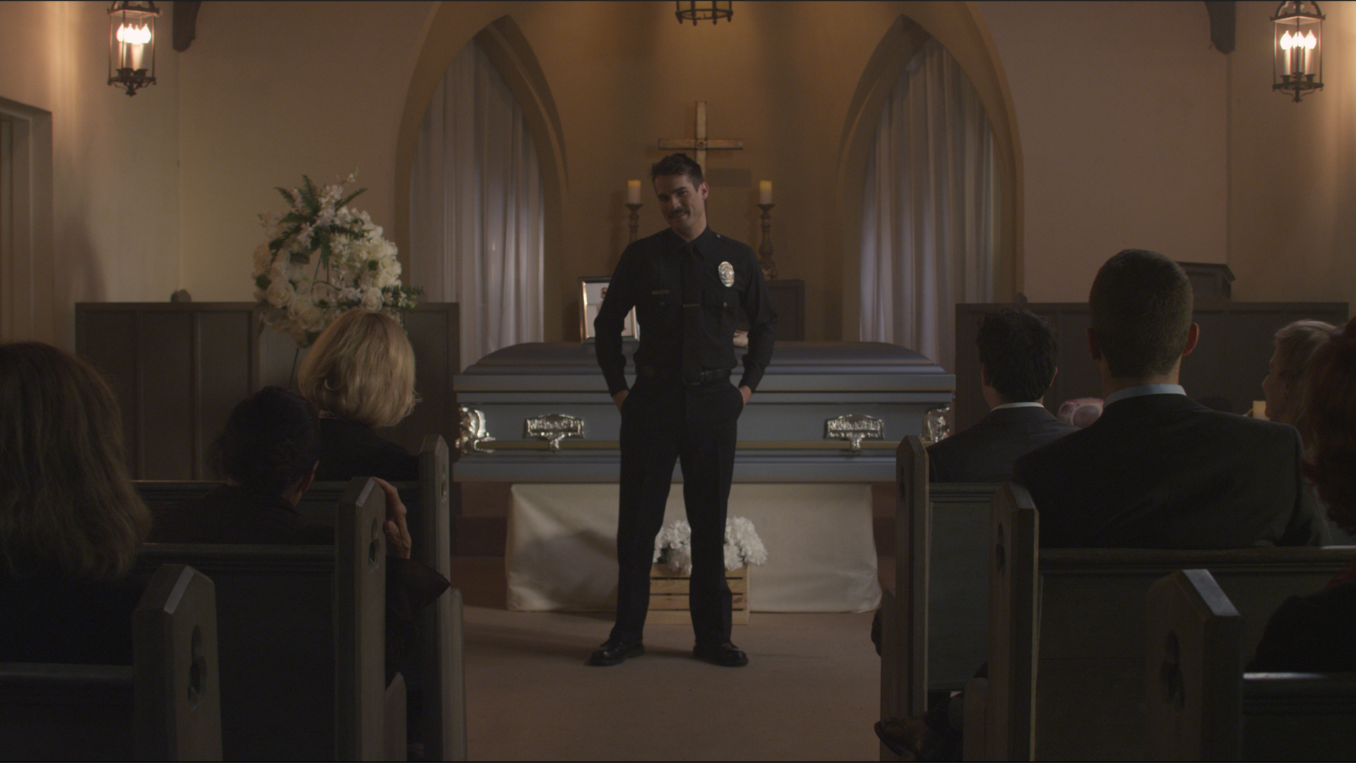
Thunder Road (2015)
Notes:
https://vimeo.com/174957219

Slide 22
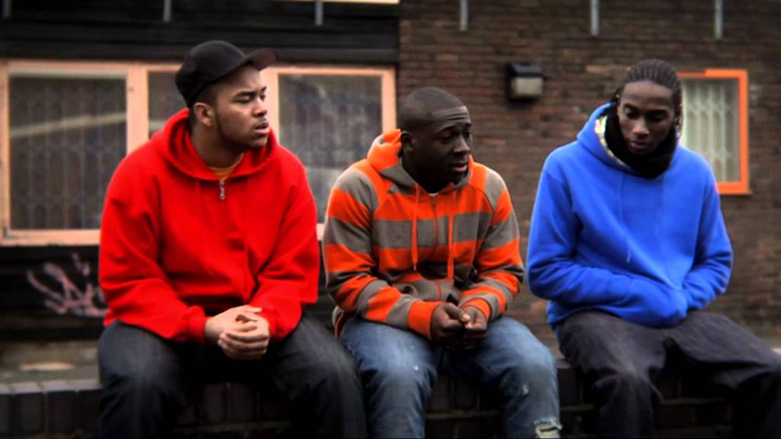
Tight Jeans (2009)
Notes:
https://www.youtube.com/watch?v=BcPBCrUc8YI

Slide 23
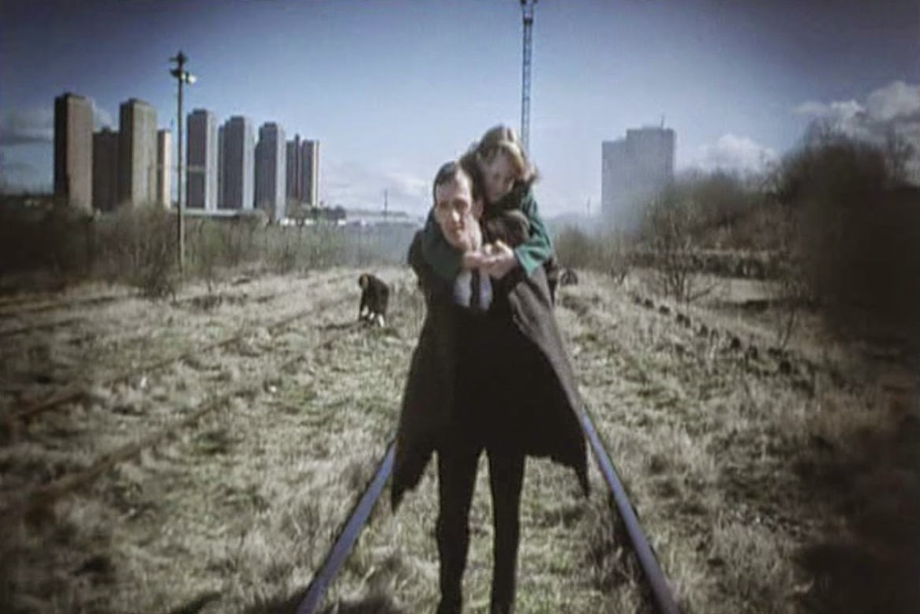
Gasman (1998)
Notes:
https://www.youtube.com/watch?v=aM-93ZDlVF0

Slide 24
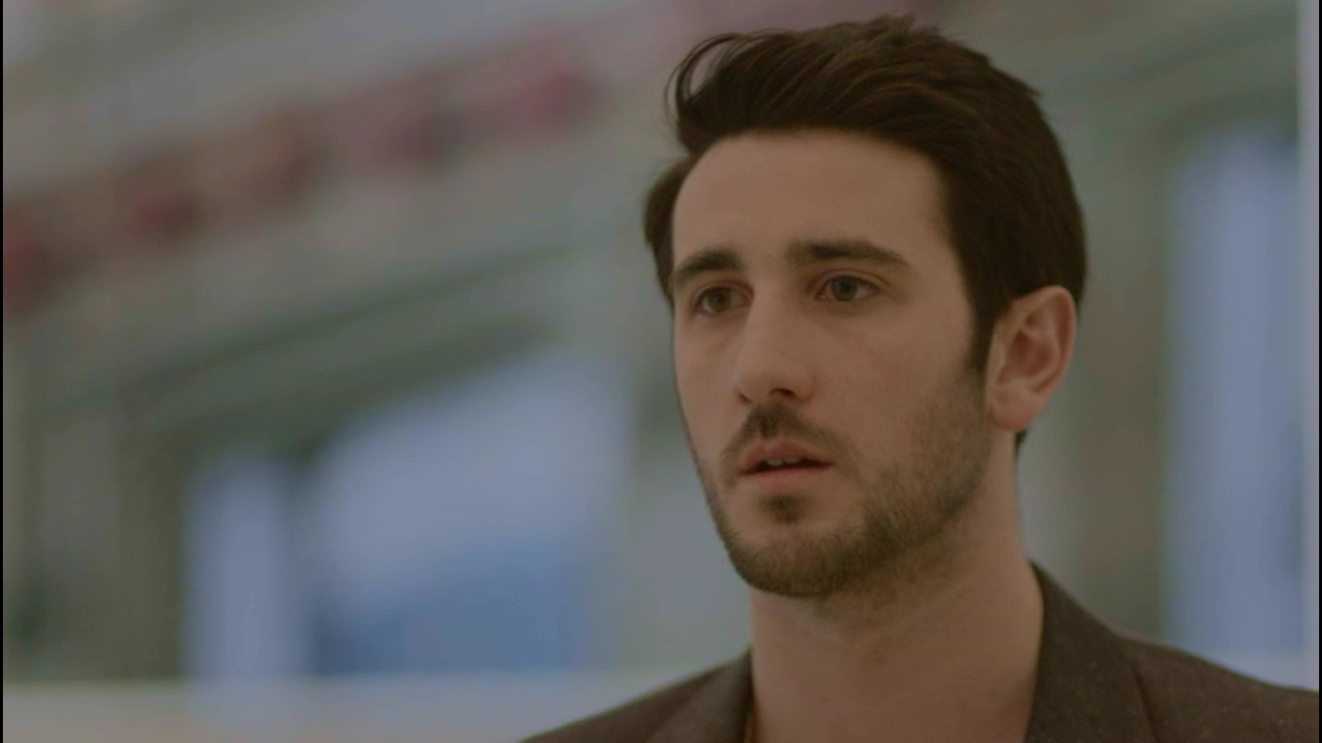
I Am Syd Stone (2016)

