Slide 1


Programme: MSc Public Health and Social Care in Practice
Module: Community Care and Management of Longer-term Conditions
Module code: LCHS7003
Student Name: Prernaben Parmar
Student Id: 2543491
Lecturer’s Name: Muhammad Khan
Assignment Title: Component 2
Individual Presentation

Slide 2
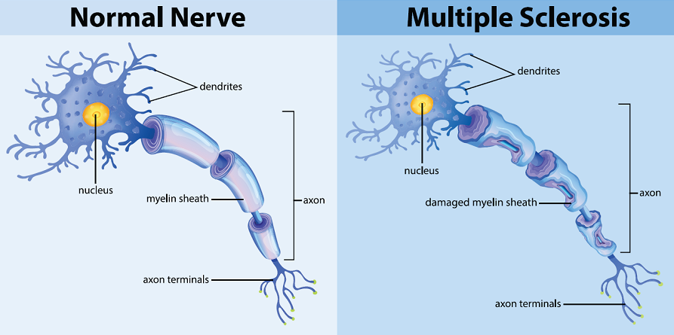
Introduction
The purpose of this presentation is to increase awareness among health and social care professionals about Multiple Sclerosis (MS).
MS is chosen as a long-term condition because it is a chronic, incurable disease that requires ongoing medical treatment and support (Cleveland Clinic, 2024).
In particular, this presentation will explore the overview, prevalence, diagnosis, management, treatment, comorbidities and prevention approaches of MS.
Healthcare and social care professionals will gain crucial insights by exploring evidence-based approaches to the assessments and personalised care of MS patients, supporting better decision-making.
Figure 1: Multiple Sclerosis (MS)
Source: National Multiple Sclerosis Society (2026)

Slide 3
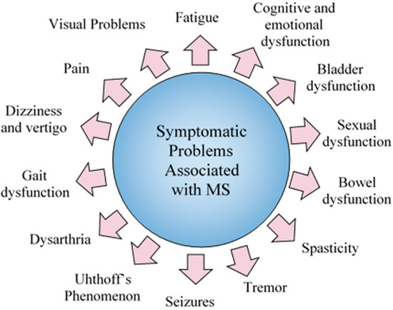
Overview of the Multiple sclerosis
Definition
  Multiple sclerosis (MS) is a chronic neurodegenerative disease that attacks the myelin sheath surrounding nerve fibres in the central nervous system (Portaccio et al., 2024).
Symptoms
  This condition manifests diverse symptoms, including dizziness, vision impairments, fatigue, balance problems, bladder dysfunction, seizures, tremor and paralysis (Ajdacic-Gross et al., 2021; Arredondo-Robles et al., 2025).
Aetiology (Causes)
  Vitamin D deficiency and Epstein-Barr virus (EBV) are recognised as key determinants of developing MS (van Rensburg et al., 2025).
  Smoking, obesity during adolescence, and low UV exposure are major environmental risk factors, increasing the chance of developing MS (Rival and Thouvenot, 2026).
Figure 2: Symptoms associated with MS
(Source: Arredondo-Robles et al., 2025)

Slide 4
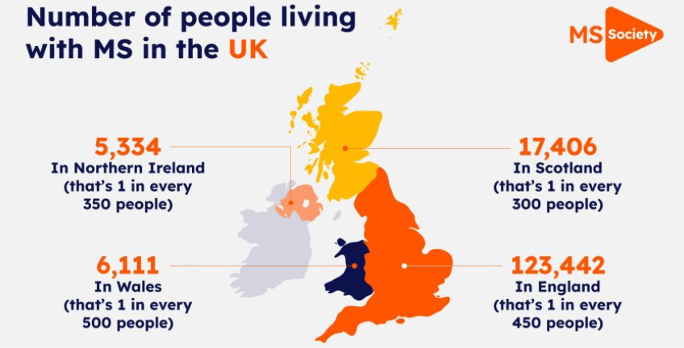
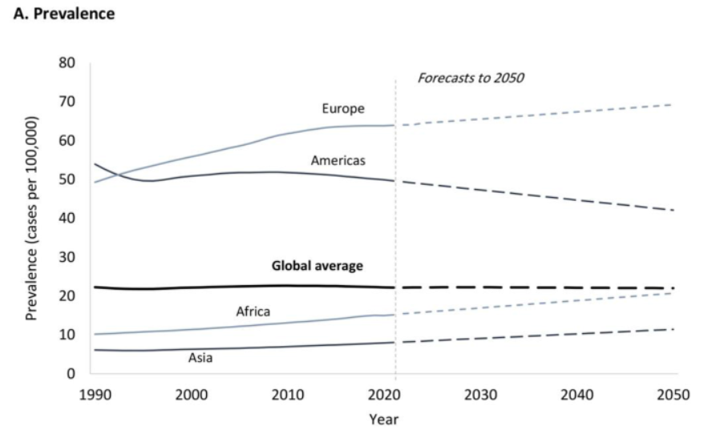
Prevalence of condition in UK and worldwide
MS has become a major problem as approximately 150,000 people are living with MS in the UK (MS Society, 2024).
More than 7,100 new cases are diagnosed each year in the UK, highlighting the ongoing burden of the disease (MS Society, 2024).
Women are approximately 2 and a half times more likely to have MS than men, as 71% of people living with MS in the UK are women (Gov. UK, 2020; MS Society, 2024a).
More than 1.8 million people are affected by MS worldwide, equivalent to 23.9 cases per 1000,000 population, with nearly 16,000 MS-related deaths reported annually (Khan and Hashim, 2025).
Europe has the highest prevalence, while America, Africa, and Asia have lower prevalence (Khan and Hashim, 2025).
Figure 3: Prevalence of Multiple Sclerosis (MS)
(Source: MS Society, 2024)
Figure 4: Prevalence of MS globally
(Source: Khan and Hashim, 2025)

Slide 5

Economic and social burden of the condition
Economic Burden
  Unplanned hospital admissions for people with MS cost the NHS £113.5 million during 2023 and 2024, reflecting significant economic burden (MS Society, 2026).
  Although the NHS funds nearly 80% of MS-related costs, people with MS and their families still bear direct non-healthcare costs such as transport and other services (around £5000) (Battaglia et al., 2022).
  In the UK, the annual treatment cost ranges from around £11,400 for mild diseases to £36,500 for advanced diseases due to greater healthcare needs (MS Society, 2024).
Social Burden
  Progressive disability due to MS limits mobility, independence and their ability to perform regular activities and requires assistance with personal care.
  MS significantly affects employment, with nearly 50% of people with MS leaving their jobs because of disease-related challenges, signifying the social challenges (MS Society, 2025).
Figure 5: Hospital Admission due to MS
(Source: MS Society, 2026)

Slide 6
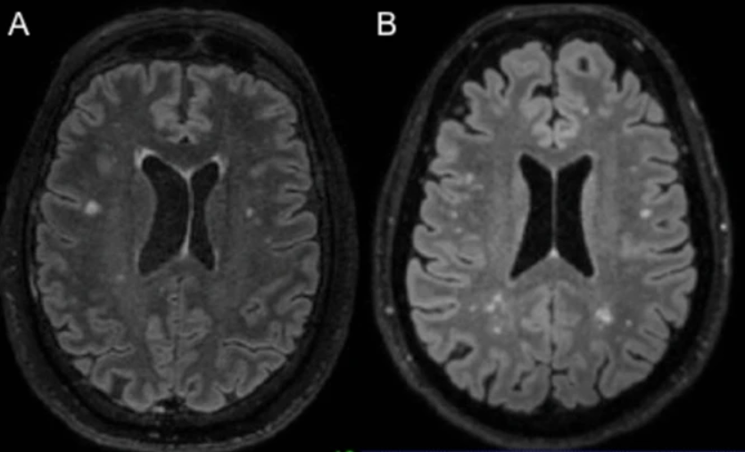
Diagnosis and Initial Assessment
Healthcare professionals use a combination of medical history and neurological examination to diagnose MS, which helps to assess sensory and coordination functions (Mayo Clinic, 2026).
MRI is considered a diagnostic tool that recognises demyelinating lesions in the brain, and Lumbar puncture is used to detect oligoclonal bands (OCBs) in cerebrospinal fluid, which support the diagnosis (Marastoni et al., 2025).
Approximately 0.22% of the UK population (nearly 1 in 450 people) have been diagnosed with MS annually (MS Society, 2024).
As per initial assessment, the Expanded Disability Status Scale (EDSS) are widely used to assess the disease severity and progression of MS (MS Society, 2026a).
The diagnosis of MS is often delayed due to non-specific symptoms, restricted access to specialist investigation and requirements to meet the McDonald criteria (MS Trust, 2026).
Figure 6: MRI of MS
(Source: Marastoni et al., 2025)

Slide 7

Management of Multiple sclerosis
Early detection and regular monitoring are important factor to identify the MS disease progression (Meca-Lallana et al, 2022).
Multidisciplinary care (MDT) facilities through a neurologist, occupational therapists, and specialist nurse for managing Multiple Sclerosis (Savio et al., 2025).
From the perspective of the Biopsychosocial model of health, NICE NG220 recommends disease-modifying therapies (DMTs) to address the biological aspects of MS by decreasing relapse frequency and slowing disease progression (NICE, 2022).
However, implementing the Biopsychosocial Model can be challenging as it requires multidisciplinary collaboration and sufficient time to address patients' needs (Kovačević et al., 2024).
Figure 7: Early detection and regular monitoring
(Source: ICAMS, 2026)

Slide 8

Management of Multiple sclerosis (CONTD..)
Balanced nutrition and good sleep behavior help to manage MS by reducing inflammation and boosting energy (MS Society, 2026b).
Empowering people with MS through healthy lifestyle behaviour encourages regular exercise, which enables patients to handle their daily challenges (Pilutti and Donkers, 2024).
According to the House of Care model, the NHS supports self-management for people with MS through personalised care planning and neurorehabilitation, which enables patients to actively manage their condition (MS Society, 2025a).
Nearly 43% of people with MS responded that they are receiving enough support to self-manage (MS Society, 2026c).
However, the House of Care model may be difficult to implement as it requires adequate healthcare resources and time constraints.
Figure 8: House of Care Model
(Source: Alliance, 2026)

Slide 9
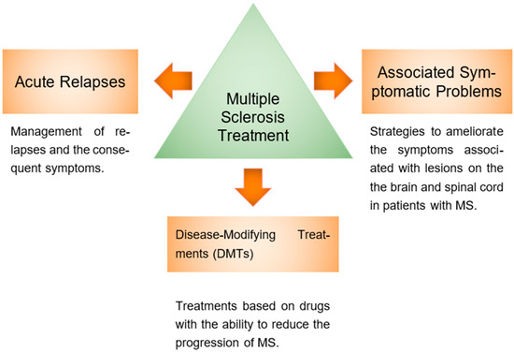
Treatment options
In the UK, MS is primarily managed by the NHS, which suggests disease-modifying therapies (DMTs) that include medication such as ocrelizumab, natalizumab and dimethyl fumarate, which reduce relapse frequency (Cohen, 2025; NICE, 2022).
Accurate relapses of MS are treated with high-dose methylprednisolone to decrease inflammation in the central nervous system (Pfeuffer et al., 2022).
NHS also recommends steroids (corticosteroids) to decrease swelling and help nerves function better while also promoting mobility equipment and psychotherapy to help with regular activity (NHS, 2026).
Hence, this integrated treatment approach helps to improve functional ability and quality of life of MS patients.
Figure 9: Clinical management of multiple sclerosis
(Source: Arredondo-Robles et al., 2025)

Slide 10
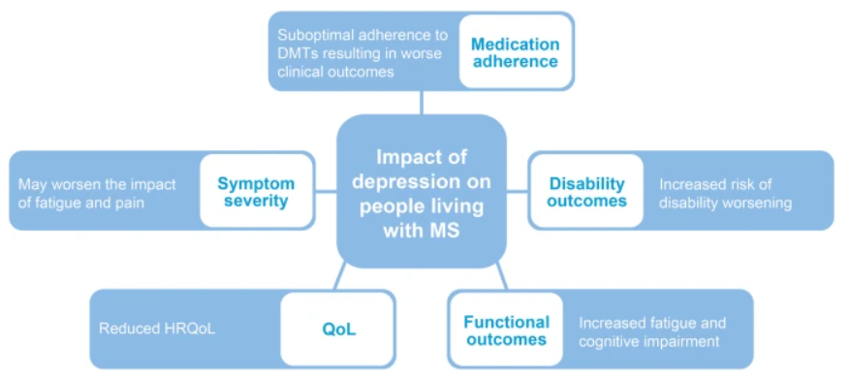
Comorbidity of the condition
Multiple sclerosis (MS) is a widely comorbid mental health disorder, like depression and anxiety, which worsen symptom severity and functional outcomes (Sullivan et al., 2025).
As seen, nearly 50% of the people with MS in the UK experience depression at some point in their life (MS Trust, 2026).
Hypertension and hyperlipidaemia are common coexisting conditions along with MS (Bezzini et al., 2022).
Additionally, chronic lung diseases and autoimmune diseases are associated with MS, which increases the risk of symptoms (Nociti and Romozzi, 2022).
Figure 10: Impact of depression in MS
(Source: Sullivan et al., 2025)

Slide 11

Prevention of the condition
Although MS is considered an LTC, it can be completely prevented as it requires several strategies to reduce its associated risk.
Maintaining adequate vitamin D levels through sunlight exposure is strongly linked to reducing the risk of developing MS (Mayo Clinic, 2025).
Avoiding smoking, engaging in regular physical activity, and maintaining healthy body weights are other crucial factors suggested for a healthy lifestyle (Mittl and Agrawal, 2026).
Limiting saturated fats, ultra-processed foods, and excessive salt may support overall health in people with MS.
Figure: 11: Avoiding smoking, engaging in regular physical activity
(Source: Tobacco Free Life, 2016)

Slide 12

Required skills, values and behaviour for Co-productive care
To ensure co-productive care, Healthcare professionals require strong communication skills and collaborative working to encourage decision-making.
Healthcare professionals must have specialised training in MS to improve early diagnosis, manage complex symptoms of MS and guide a safe lifestyle (Learmonth and Motl, 2021).
Healthcare professionals should demonstrate respect, empathy and person-centered values by involving MS patients in decisions about their treatment.
Build trusting relationships by identifying the physical, emotional, and social challenges associated with MS.
However, without adequate knowledge and skills, healthcare professionals can struggle to implement co-productive care effectively, which limits patients' treatments.
Figure 12: Strong communication among healthcare professional
(Source: News Medical, 2026)

Slide 13

Recommendation For Managing Multiple Sclerosis Condition
Healthcare professionals need to focus on a comprehensive model of personalised care which can be integrated through six evidence-based components.
Shared decision-making is a crucial component for healthcare professionals to involve patients in choosing treatments according to their preferences (Hoffmann et al., 2022).
Developing personalised care plans based on disease severity and symptoms, Healthcare professionals help to improve the quality of life of people with MS (M.P. and Filippi, 2025).
Healthcare professionals must provide enabling choices that support informed treatment decisions for people with MS.
Figure 13: Multiple sclerosis care
(Source: WHO, 2023)

Slide 14
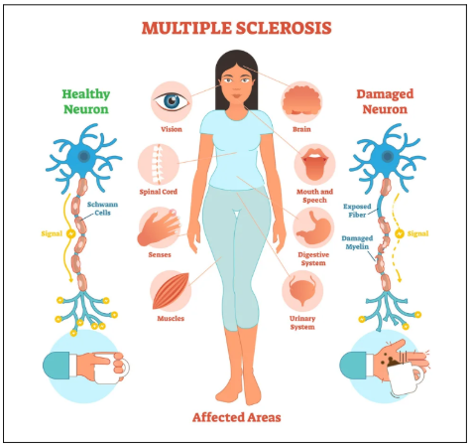
Recommendation For Managing Multiple Sclerosis Condition (CONTD..)
Social prescribing connects people with MS to community-based programs, which help to manage symptoms like isolation and depression (Simpson et al., 2021).
Self-management support by empowering patients through education and lifestyle advice can help to improve MS patients' confidence.
Lastly, healthcare professionals should facilitate access to personal health budgets to assist people with MS in reviewing personalised care that improves their health.
Figure 14: Multiple sclerosis
(Source: St Wulfstan, 2021)

Slide 15
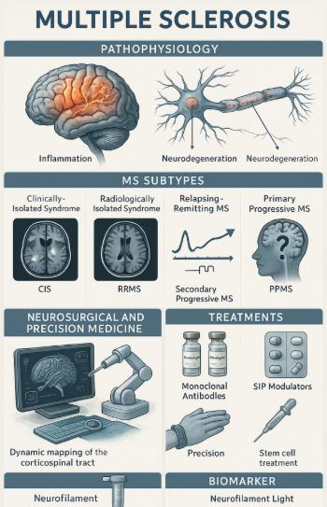
Conclusion
This presentation has illustrated the long-term condition Multiple sclerosis, including outlining its treatment, prevalence, and management.
With a high prevalence rate in the UK and globally, it demonstrates the seriousness of MS, which needs further attention.
As per the Biopsychosocial models of health, the NHS manages the biological condition of MS patients.
Disease-modifying therapies (DMTs) and replacement management are the key treatments of MS, while steroid medication helps to reduce swelling.
Overall, it is suggested that implementation of shared decision-making, personalised care, and social prescribing would help improve the health quality of people with MS.
Figure 15: Multiple sclerosis disorder
(Source: Msheik et al., 2025)

Slide 16
References
Ajdacic-Gross, V., Steinemann, N., Horváth, G., Rodgers, S., Kaufmann, M., Xu, Y., Kamm, C.P., Kesselring, J., Manjaly, Z.M., Zecca, C. and Calabrese, P., (2021) Onset symptom clusters in multiple sclerosis: characteristics, comorbidities, and risk factors. Frontiers in neurology, 12, p.693440. Available at: https://doi.org/10.3389/fneur.2021.693440 (Accessed: 1 August 2026)
Alliance (2026) The House of Care Model. Available at: https://www.alliance-scotland.org.uk/past-work-and-projects/scotlands-house-of-care/the-house-of-care-model/ (Accessed: 1 August 2026)
Arredondo-Robles, A.V., Rodríguez-López, K.P. and Ávila-Avilés, R.D., (2025). ‘Clinical management in multiple sclerosis’. Neuroglia, 6(1), p.6. Available at: https://doi.org/10.3390/neuroglia6010006 (Accessed: 1 August 2026)
Arredondo-Robles, A.V., Rodríguez-López, K.P. and Ávila-Avilés, R.D., (2025) ‘Clinical management in multiple sclerosis’. Neuroglia, 6(1), p.6. Available at: https://doi.org/10.3390/neuroglia6010006 (Accessed: 1 August 2026)
Available at: https://www.mssociety.org.uk/living-with-ms/physical-and-mental-health/eating-and-drinking/healthy-eating (Accessed: 1 August 2026)
Battaglia, M.A., Bezzini, D., Cecchini, I., Cordioli, C., Fiorentino, F., Manacorda, T., Nica, M., Ponzio, M., Ritrovato, D., Vassallo, C. and Patti, F., (2022) ‘Patients with multiple sclerosis: a burden and cost of illness study’. Journal of neurology, 269(9), pp.5127-5135. Available at: https://doi.org/10.1007/s00415-022-11169-w (Accessed: 1 August 2026)
Bezzini, D., Gualdani, E., Razzanelli, M., Battaglia, M.A., Cortese, R., Francesconi, P. and Ulivelli, M., (2022) Prevalence of chronic comorbidities in people with multiple sclerosis: descriptive study based on administrative data in Tuscany (Central Italy). Neurological Sciences, 43(11), pp.6407-6414. Available at: https://doi.org/10.1007/s10072-022-06345-9 (Accessed: 1 August 2026)
Cohen, B.A., (2025) ‘Choosing initial MS therapy; personal, disease, and medication factors’. Neurotherapeutics, p.e00582. Available at: (Accessed: 1 August 2026)
Gasperini, C., Centonze, D., Conte, A., Gallo, P., Lugaresi, A., Patti, F., Trojano, M., Amato, M.P. and Filippi, M., (2025) ‘Personalized therapy in multiple sclerosis: an Italian Delphi consensus’. Journal of Neurology, 272(6), p.428. Available at: https://doi.org/10.1007/s00415-025-13173-2 (Accessed: 1 August 2026)
Gov. UK (2020) Multiple sclerosis: prevalence, incidence and smoking status - data briefing Available at: https://www.gov.uk/government/publications/multiple-sclerosis-prevalence-incidence-and-smoking-status/multiple-sclerosis-prevalence-incidence-and-smoking-status-data-briefing (Accessed: 1 August 2026)
Hoffmann, T., Bakhit, M. and Michaleff, Z., (2022) ‘Shared decision making and physical therapy: what, when, how, and why?’. Brazilian journal of physical therapy, 26(1), p.100382. Available at: https://doi.org/10.1016/j.bjpt.2021.100382 (Accessed: 1 August 2026)
ICAMS (2026) Vital Checks & Monitoring. Available at: https://icamshealthcare.in/injection-medical-procedures-at-home/vital-checks-monitoring/ (Accessed: 1 August 2026)
Khan, G. and Hashim, M.J., (2025) ‘Epidemiology of multiple sclerosis: global, regional, national and sub-national-level estimates and future projections’. Journal of epidemiology and global health, 15(1), p.21. Available at:https://doi.org/10.1007/s44197-025-00353-6 (Accessed: 1 August 2026)
Learmonth, Y.C. and Motl, R.W., (2021) ‘Exercise training for multiple sclerosis: a narrative review of history, benefits, safety, guidelines, and promotion’. International journal of environmental research and public health, 18(24), p.13245. Available at: https://doi.org/10.3390/ijerph182413245 (Accessed: 1 August 2026)
Marastoni, D., Sicchieri, M., Pizzini, F.B., Scartezzini, A., Virla, F., Turano, E., Anni, D., Bertolazzo, M., Ziccardi, S., Camera, V. and Tamanti, A., (2025) ‘Multiple sclerosis diagnosis and its differential diagnosis in patients presenting with type four ‘mirror pattern’CSF oligoclonal bands’. Journal of Neurology, 272(3), p.207. Available at: (Accessed: 1 August 2026)
Mayo Clinic (2025) Vitamin D and MS: Is there any connection? Available at: https://www.mayoclinic.org/diseases-conditions/multiple-sclerosis/expert-answers/vitamin-d-and-ms/faq-20058258 (Accessed: 1 August 2026)
Mayo Clinic (2026) Multiple sclerosis Available at: https://www.mayoclinic.org/diseases-conditions/multiple-sclerosis/diagnosis-treatment/drc-20350274 (Accessed: 1 August 2026)
Meca-Lallana, J.E., Casanova, B., Rodríguez-Antigüedad, A., Eichau, S., Izquierdo, G., Durán, C., Río, J., Hernández, M.Á., Calles, C., Prieto-González, J.M. and Ara, J.R., (2022) Consensus on early detection of disease progression in patients with multiple sclerosis. Frontiers in neurology, 13, p.931014. Available at: https://doi.org/10.3389/fneur.2022.931014 (Accessed: 1 August 2026)
Mittl, K. and Agrawal, D.K., (2026) ‘Promoting Exercise as a Therapeutic Intervention in Multiple Sclerosis: Barriers, Efficacy, and Social Prescribing Strategies’. Cardiology and cardiovascular medicine, 10(1), p.6. Available at: https://doi.org/10.26502/fccm.92920478 (Accessed: 1 August 2026)
MS Society (2024) Number of people living with MS in UK increases Available at: https://www.mssociety.org.uk/research/news/number-people-living-ms-uk-increases (Accessed: 1 August 2026)
MS Society (2024a) MS in the UK Available at: https://www.mssociety.org.uk/sites/default/files/2024-05/MS%20in%20the%20UK%20-%20FAQs.pdf (Accessed: 1 August 2026)
MS Society (2025) Half UK workers living with MS felt forced to stay in jobs that made their MS worse Available at:https://www.mssociety.org.uk/research/news/half-uk-workers-living-ms-felt-forced-stay-jobs-made-their-ms-worse?utm_source=chatgpt.com (Accessed: 1 August 2026)
MS Society (2025a) What does the NHS 10-Year Plan mean for people with MS? Available at: https://www.mssociety.org.uk/research/news/what-does-nhs-10-year-plan-mean-people-ms (Accessed: 1 August 2026)

Slide 17
References (CONTD..)
MS Society (2026) A different path: Rethinking MS hospital care Available at: (Accessed: 1 August 2026)
MS Society (2026a) Expanded Disability Status Scale (EDSS) Available at: https://www.mssociety.org.uk/living-with-ms/treatments-and-therapies/getting-treatment-for-ms/expanded-disability-status-scale (Accessed: 1 August 2026)
MS Society (2026b) Healthy eating
MS Society (2026c) My MS My Needs Available at: https://www.mssociety.org.uk/about-us/how-we-work/our-evidence/my-ms-my-needs (Accessed: 1 August 2026)
MS Trust (2026) Depression Available at: https://mstrust.org.uk/a-z/depression (Accessed: 1 August 2026)
Msheik, A., Al Mokdad, Z., Hmede, R. and Atat, R., (2025) ‘Advances in the understanding and management of multiple sclerosis phenotypes’. Health Sciences Review, 16, p.100232. Avaialble at: https://doi.org/10.1016/j.hsr.2025.100232 (Accessed: 1 August 2026)
National Multiple Sclerosis Society (2026) How MS Affects the Brain Available at: https://www.nationalmssociety.org/understanding-ms/what-is-ms/how-ms-affects-the-brain (Accessed: 1 August 2026)
News Medical (2026) Effective Communication in Primary Care Teams. https://www.news-medical.net/health/Effective-Communication-in-Primary-Care-Teams.aspx (Accessed: 1 August 2026)
NHS (2026) Multiple sclerosis Available at: https://www.nhs.uk/conditions/multiple-sclerosis/ (Accessed: 1 August 2026)
NICE (2022) Multiple sclerosis in adults: management Available at: https://www.nice.org.uk/guidance/ng220/chapter/Recommendations#disease-modifying-therapies (Accessed: 1 August 2026)
Nociti, V. and Romozzi, M., (2022) ‘Multiple sclerosis and autoimmune comorbidities’. Journal of Personalized Medicine, 12(11), p.1828. Available at: https://doi.org/10.3390/jpm12111828 (Accessed: 1 August 2026)
Pfeuffer, S., Rolfes, L., Wirth, T., Steffen, F., Pawlitzki, M., Schulte-Mecklenbeck, A., Gross, C.C., Brand, M., Bittner, S., Ruck, T. and Klotz, L., (2022) ‘Immunoadsorption versus double-dose methylprednisolone in refractory multiple sclerosis relapses’. Journal of Neuroinflammation, 19(1), p.220. Available at: https://doi.org/10.1186/s12974-022-02583-y (Accessed: 1 August 2026)
Pilutti, L.A. and Donkers, S.J., (2024) ‘Exercise as a therapeutic intervention in multiple sclerosis’. Multiple Sclerosis Journal, 30(5_suppl), pp.30-35. Available at: https://doi.org/10.1177/13524585241301613 (Accessed: 1 August 2026)
Portaccio, E., Magyari, M., Havrdova, E.K., Ruet, A., Brochet, B., Scalfari, A., Di Filippo, M., Tur, C., Montalban, X. and Amato, M.P., (2024) ‘Multiple sclerosis: emerging epidemiological trends and redefining the clinical course’. The Lancet Regional Health–Europe, 44. Available at: https://doi.org/10.1016/j.lanepe.2024.100977 (Accessed: 1 August 2026)
Rival, M. and Thouvenot, E., (2026) ‘Non-infectious environmental risk factors of multiple sclerosis: Mechanisms and intervention windows for prevention’. Revue Neurologique. Available at: https://doi.org/10.1016/j.neurol.2026.03.010 (Accessed: 1 August 2026)
Savio, M., Kearney, H. and Giunti, G., (2025) ‘Evaluating the evidence behind multidisciplinary roles for a multiple sclerosis unit: A systematic literature review’. Multiple Sclerosis and Related Disorders, 95, p.106342. Available at: https://doi.org/10.1016/j.msard.2025.106342 (Accessed: 1 August 2026)
Shapiro, L (2025) Available at: https://multiplesclerosisnewstoday.com/neurontin-gabapentin-for-pain-management-in-ms/ (Accessed: 1 August 2026)
Simpson, S., Furlong, M. and Giebel, C., (2021) ‘Exploring the enablers and barriers to social prescribing for people living with long-term neurological conditions: a focus group investigation’. BMC health services research, 21(1), p.1230. Available at: https://doi.org/10.1186/s12913-021-07213-6 (Accessed: 1 August 2026)
St Wulfstan (2021) MS Awareness Week Available at:https://www.stwulfstan.co.uk/news/ms-awareness-week (Accessed: 1 August 2026)
Sullivan, A.B., Davis, B., Kidd, J. and Chiong-Rivero, H., (2025) ‘Understanding depression in people living with multiple sclerosis: a narrative review of recent literature’. Neurology and Therapy, 14(3), pp.681-710. Available at: (Accessed: 1 August 2026)
Tobacco Free Life (2016) How To Get Back In Shape After Quitting Smoking. Available at: https://tobaccofreelife.org/get-back-shape-quitting-smoking/ (Accessed: 1 August 2026).
van Rensburg, S.J., Van Toorn, R., Jaftha, M., Kemp, M.C., Engel-Hills, P. and Kotze, M.J., (2025) ‘Epstein-Barr virus infection and vitamin D deficiency are both “causal” for multiple sclerosis (MS)-could the common denominator be their effects on hepcidin levels?’. Metabolic Brain Disease, 40(7), p.279. Available at: https://doi.org/10.1007/s11011-025-01678-8 (Accessed: 1 August 2026)
WHO (2023) Multiple sclerosis Available at: https://www.who.int/news-room/fact-sheets/detail/multiple-sclerosis (Accessed: 1 August 2026)

