Slide 1

Digital Skills And Research Methods LCHS4007
Group Presentation
Group Members
Zara Farooq 2525293
Reda haider- 2521599
Sanira ghafar- 2242271
Lecturer Biance Dodgen

Slide 2
Microsoft 365 in Greenfield Home care Agency
Microsoft 365 Productivity Application
Microsoft 365 Communication or Collaboration Tool
Digital Safety Action Plan for Greenfield Home care Agency

Slide 3


Microsoft 365 Productivity Application
MS EXCEL
EXCEL Helps to
0ragnise
Calculate
Analyse
DATA
Improves
Record Keeping
Scheduling
Reporting
In Home Care Agencies

Slide 4



Current Admin Tasks
Inefficiency
Now the staff first write things down and then enter into the computer, this doubles the work and more chances for mistakes
No Real Time Update
In manual data handling real time updates like staff absences are not instantly updated
Administrative Burden
Daily Records like Staff Rotas, Medication logs and Care plans are manually updated using paper files, cards or logbooks

Slide 5

IMPROVEMENTS AFTER EXCEL
Easy and Accurate scheduling and tracking of staff rotas and attendance
Team communicates and shares data in a proper and easy ways
Easy calculation of hours worked, wages and income and expenses
Proper management of medication and care plans

Slide 6




BENEFITS OF EXCEL
Reduces Data Storage space
Can store and access large quantities of data in small spaces safely
Reduces Data Entry Time
Using Excel will reduce the manual data entry time by 94%
Easy Calculations
Formulas in Excel makes calculations quick easy and helps avoid human mistakes
Clear Presentations
Data can be presented as charts and diagrams to better understand the reports

Slide 7

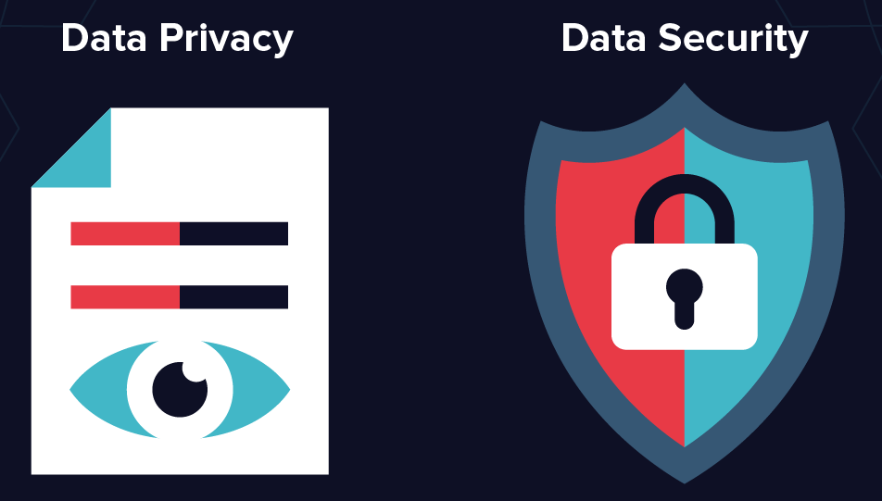

LIMITATIONS OF EXCEL
Human Error
If a wrong entry or a formula was entered the whole file will give the wrong information
Skill Gaps
If the staff are not properly trained, they will prefer using the paper filings because it is easier
Safety and Security
It is easy to accidently share the data with wrong person or even delete it. Risking safety of personal data

Slide 8
REFERENCES
Health Education England (2023) Digital Literacy Capability Framework for Health and Social Care. London: HEE.
Information Commissioner’s Office (2024) Guide to the General Data Protection Regulation (GDPR). Available at: https://ico.org.uk (Accessed: 4 February 2026).
NHS England (2022) A digital-first health and social care system. Available at: https://www.england.nhs.uk (Accessed: 4 February 2026)
Panko, R.R. (2016) 'What we know about spreadsheet errors', Journal of End User and Information Systems, 10(2), pp. 15-46.

Slide 9


Slide 1 – Introduction to OneDrive at Greenfield Home Care Agency – Lecturer Bianca Dodgen
Samira Ghafar: 2242271
Microsoft OneDrive is a cloud-based storage and file-sharing tool within Microsoft 365 that supports secure access to files from any device (Microsoft, 2026.).
Greenfield Home Care Agency operates across multiple locations, making digital collaboration essential (CMSWire, 2026).
OneDrive enables staff to store, share, and collaborate on documents in real time (CNLTD, 2024).
Cloud storage solutions are increasingly adopted by organisations to improve workflow efficiency (Aazam et al, 2016).
Group 1
Reda Haider: 2521599
Zara Farooq: 2525293

Slide 10

How OneDrive Improves Communication Across Locations
Visiting carers can upload care notes and reports remotely, allowing office staff instant access (Microsoft, 2020).
Shared folders enable care coordinators to distribute schedules and policies centrally (Ingenio Technologies, 2024).
Real-time collaboration reduces delays between field carers and administrative teams (CMSWire, 2026).
Version control ensures staff always work on the latest documents, preventing duplication (CNLTD, 2024).

Slide 11

Benefits of Using OneDrive in Greenfield
Improves productivity by reducing paperwork and manual processes (Strategix, 2019).
Centralised cloud storage supports flexible working and faster decision-making (Ingenio Technologies, 2024).
Integration with Microsoft Word, Excel, Outlook and Teams enhances collaboration (Microsoft, 2020).
Automatic syncing and backup reduce the risk of data loss (CNLTD, 2024).
Organisations using OneDrive report improved teamwork and efficiency (CMSWire, 2026).

Slide 12


Digital Safety and Data Protection
OneDrive uses encryption and access controls to protect sensitive data (Microsoft, 2026.).
Permission settings help ensure only authorised staff can view patient records (CNLTD, 2024).
Audit trails and secure sharing support GDPR compliance (Ingenio Technologies, 2024).
Cloud platforms reduce risks linked to lost paper files and unsecured local storage (Aazam et al, 2016).

Slide 13

Challenges and Conclusion.
Challenges:
Staff may lack confidence with digital tools, requiring training (CMSWire, 2026).
Dependence on internet connectivity can affect field workers (Strategix, 2019).
Risk of human error when sharing files incorrectly (CNLTD, 2024).
Conclusion:
OneDrive can significantly improve efficiency, communication, and data security at Greenfield (Microsoft, 2020).
With appropriate training and policies, challenges can be minimised (Ingenio Technologies, 2024).
Overall, OneDrive supports person-centred care through faster information sharing and better collaboration (CMSWire, 2026).

Slide 14

Digital Safety Action Plan for Greenfield Home Care Agency
This presentation specifys a digital safety action plan created for Greenfield Home Care Agency.
As a home care provider staff work remotely handle highly confidential patient data and rely on digital systems daily.
This makes strong digital safety essential to protect service users,staff, and the organisation from cyber threats and data breaches.

Slide 15
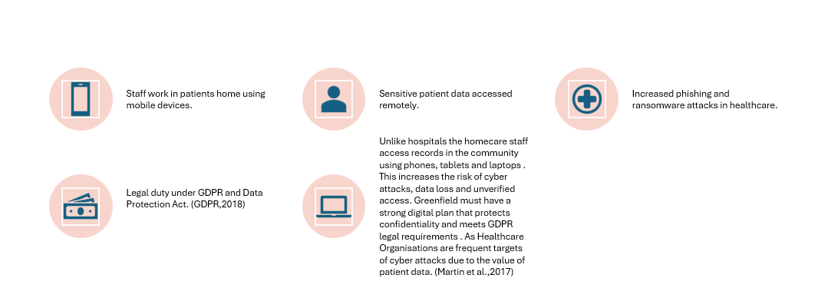
Why Digital Safety is Critical in Home Care?

Slide 16
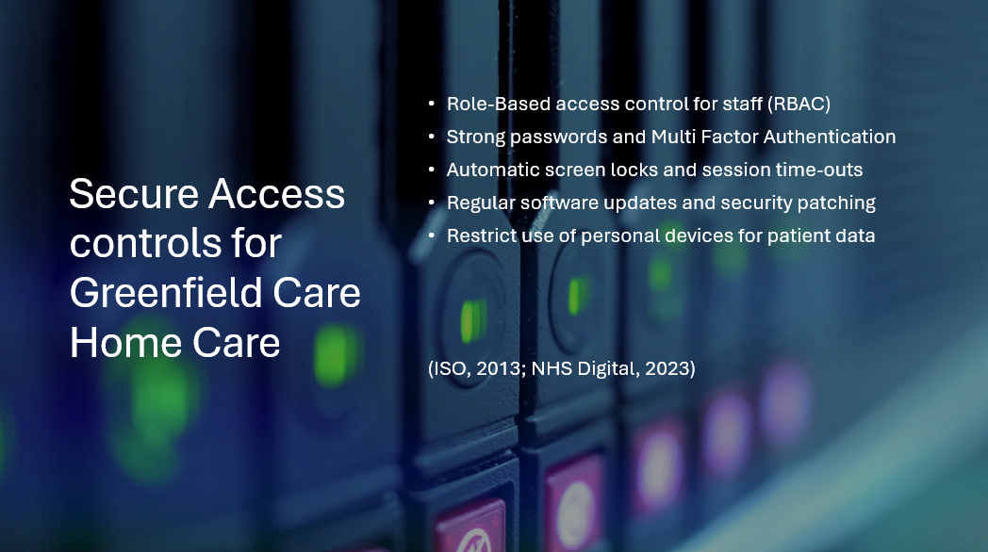

Slide 17

Email Awareness and Phishing Protection
Staff training to recognise phishing emails
Regular simulated phishing tests
Use of encrypted email for patient information
Clear reporting process for suspicious emails
Regular email security reminders for staff
(Mcleod and Dolezel, 2018; NSSC,2023)

Slide 18

Secure Data Management Practices
Data classification,retention and secure deletion policy
Encrypted storage and encrypted backups
Regular audits of data access logs
Incident response plan for data breaches
Use of secure, approved cloud systems only
(Coventry and Branley, 2018; GDPR, 2018)

Slide 19
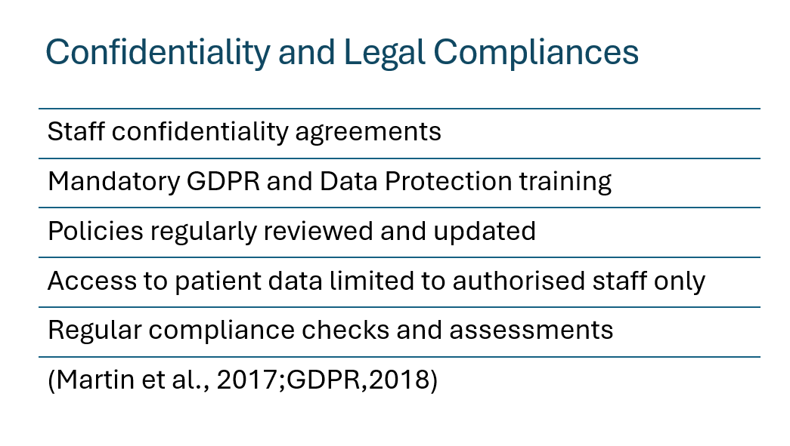

Slide 20
Protect Patients
Protect Staff.
Protect Greenfield.
Digital safety is essential for safe and ethical care delivery
In conclusion this digital safety checklist provides Greenfield with practical steps to reduce cyber risks ensure legal compliance and maintain patient confidentiality by implementing secure access controls , improving email awareness , managing data safely, and following confidentiality regulations. The organisation can protect sensitive information and deliver safe, ethical care in the community.

Slide 21



