Slide 1
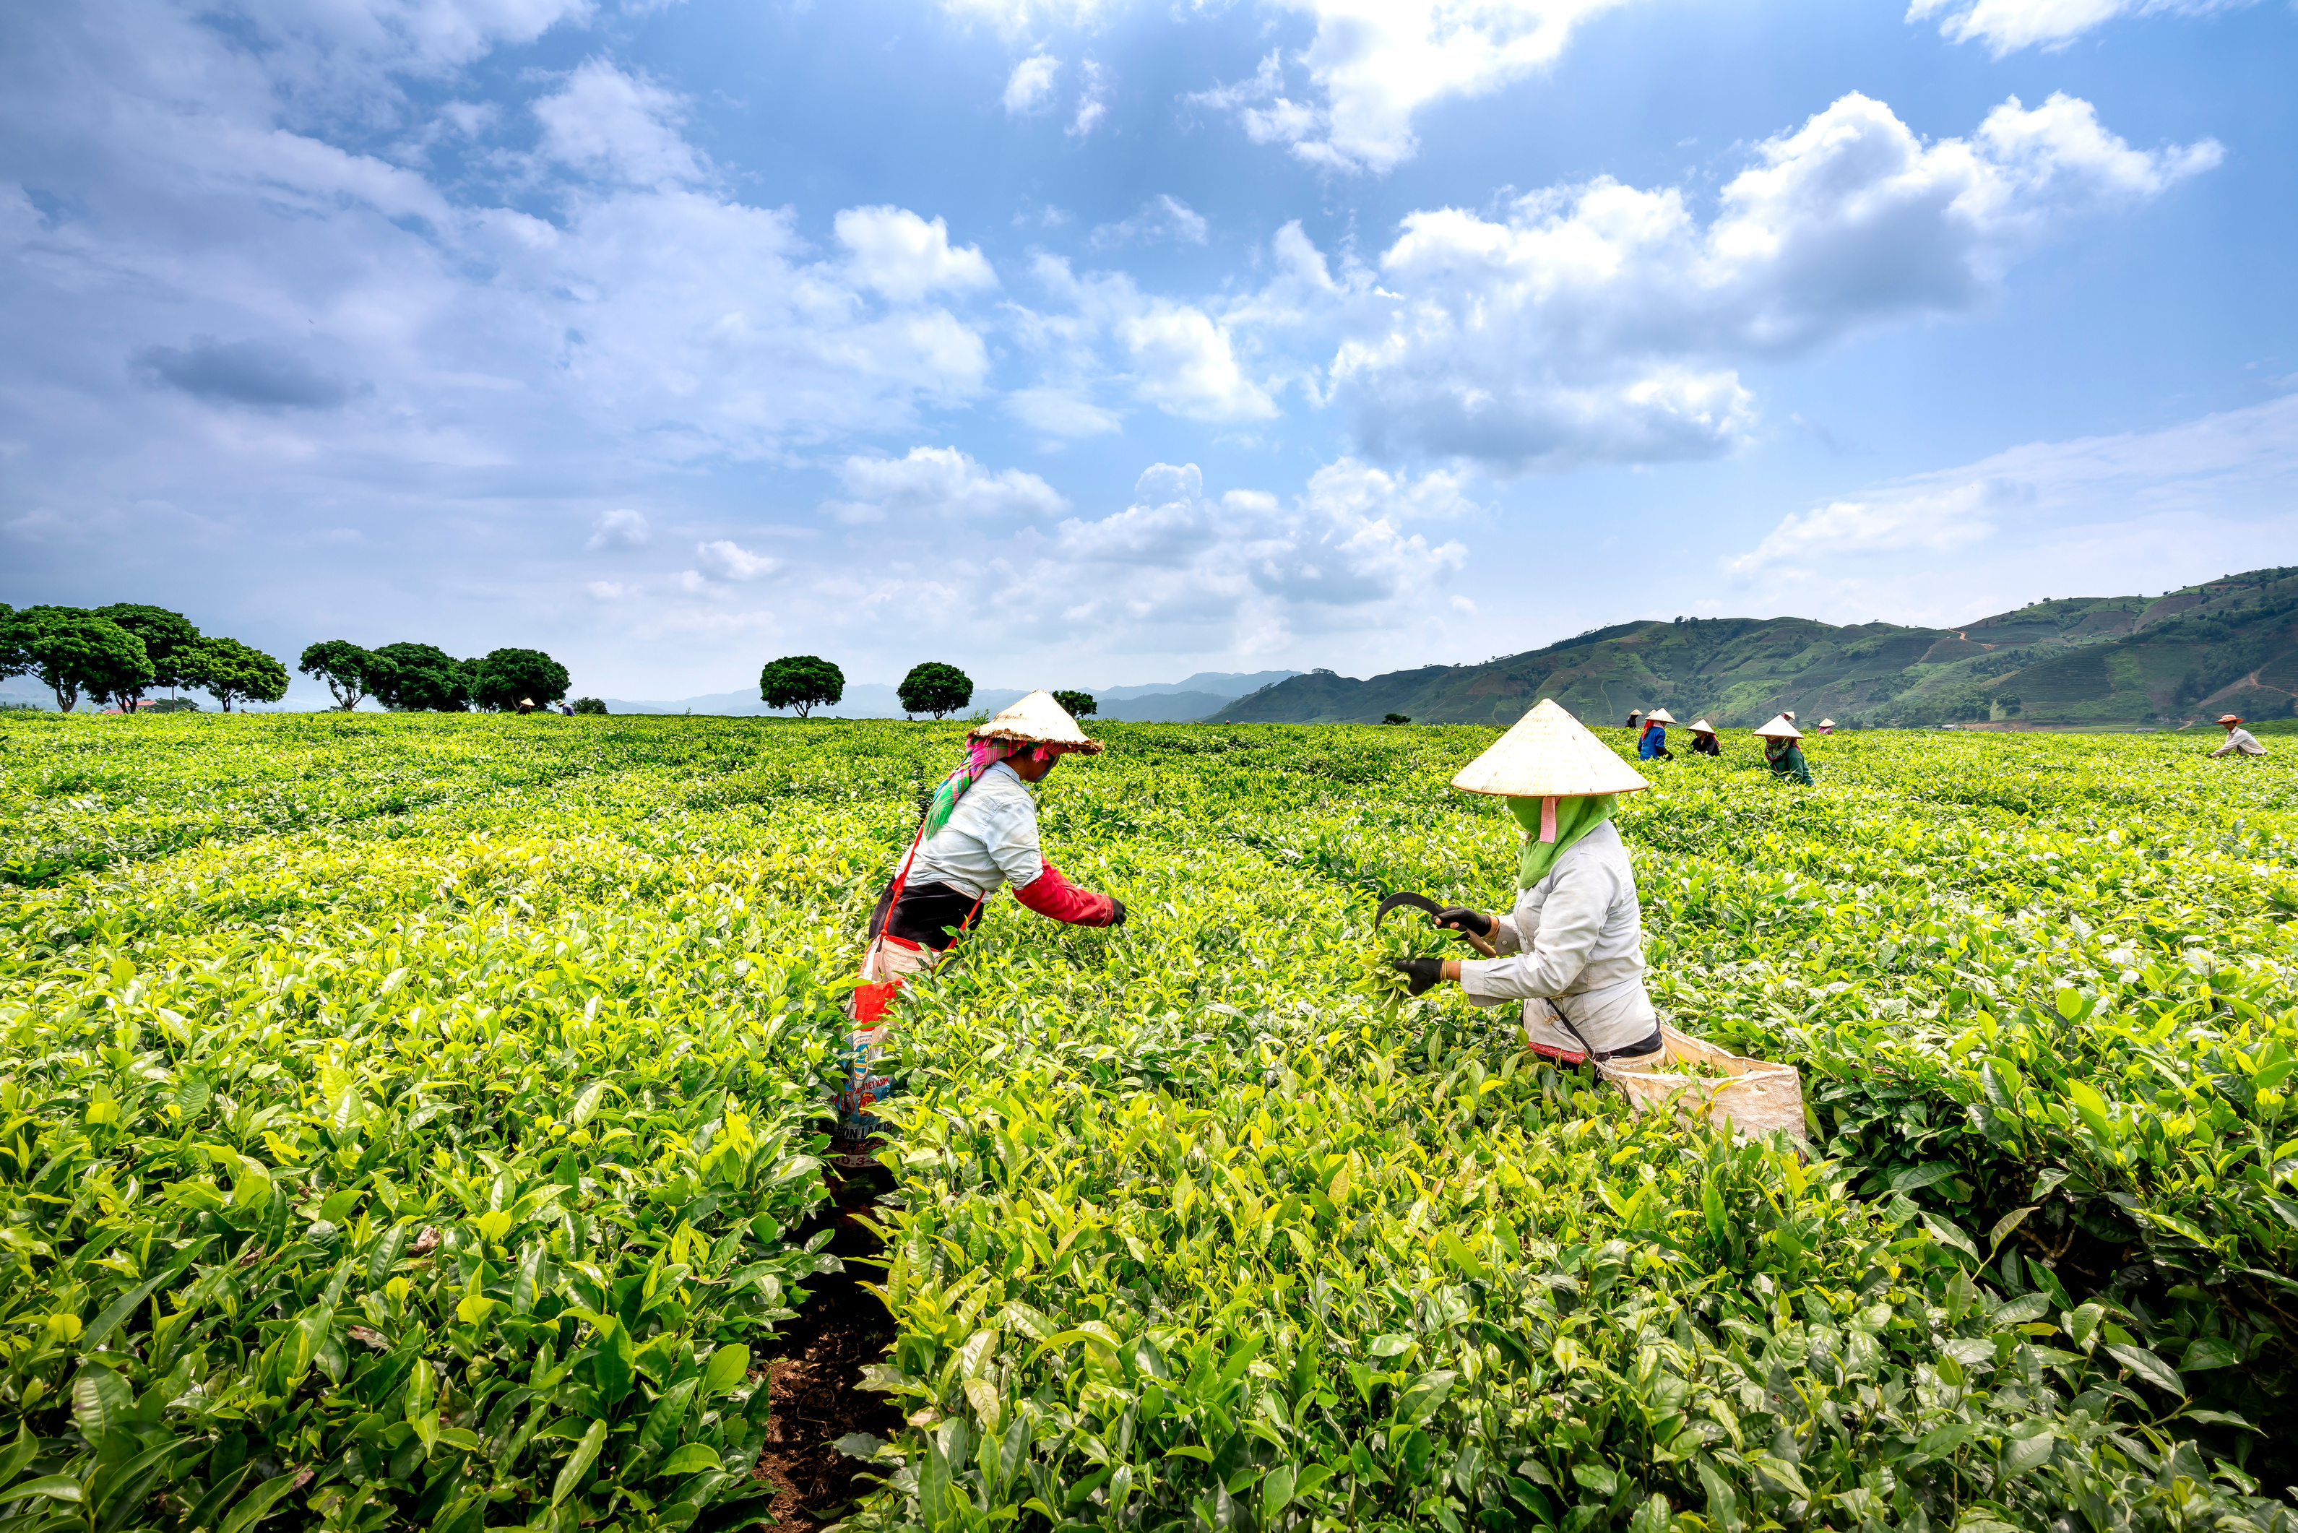

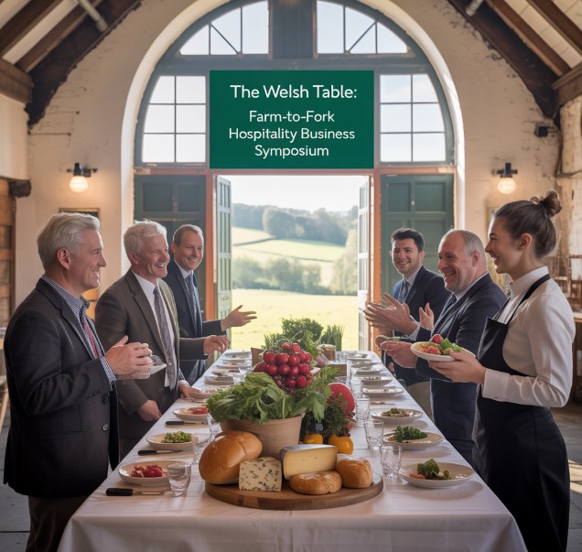
The Welsh Table: Farm-to-Fork Hospitality Business Symposium
Location: Hay-on-Wye, Town in Wales
12–14th June 2026
Module Name: International Meetings Management for the Hotel Industry
Module Code: BMIH6007
Module Lead : Kathryn Flynn
Student Name: Iulian Vasile Girtu
Student ID: 2133038

Slide 2
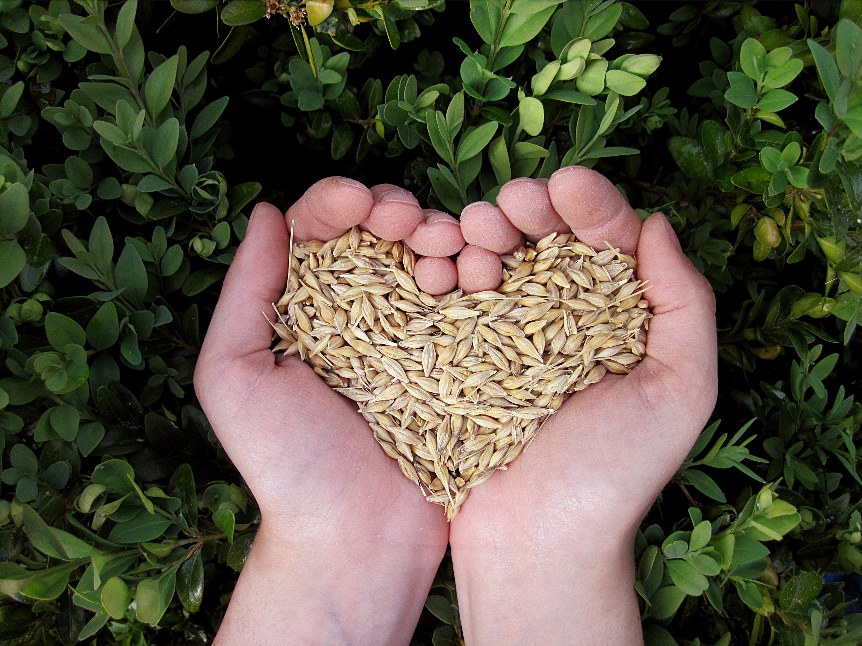
AI Declaration
I confirm that I have not used any AI tools in the research and creation of this assignment. I confirm that I have not presented any AI generated materials as my work. I confirm I have copies of my drafts, notes, and other resources I used, which I may be asked to provide in evidence.
-

Slide 3
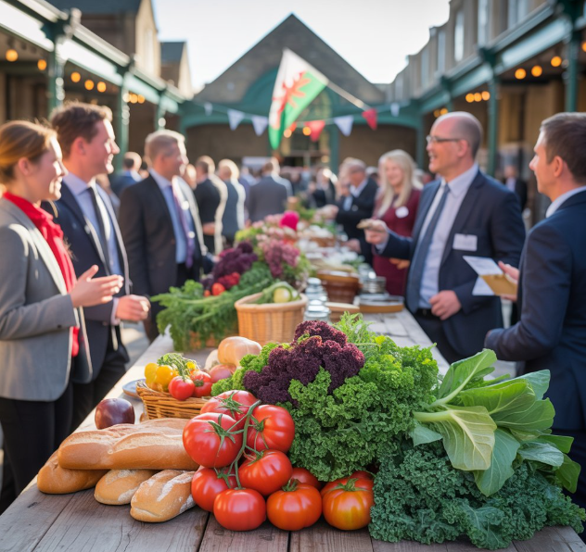
Event Content and Context
The Welsh Table is a farm-to-fork hospitality business symposium.
It aims to connect Welsh farmers, chefs, and global hospitality leaders.
The event will focus on local sourcing, sustainability, and agri-tourism development.
It aligns with Visit Wales’ “Year of Croeso 2025” and local development goals.
Location: Hay-on-Wye, Market Hall and surrounding local farms.
Notes:
The Welsh Table is a B2B hospitality conference which promotes sustainability in the farm-to-fork movement. It will unite Welsh farmers, hospitality practitioners, and food innovators in a dialogue regarding local procurement and agri-tourism strategies. The attendees will undergo thought leadership discussion forums, networking sessions, and immersive experiences, including cookery demos and farm visits. This format extends Wales' food heritage and sits within global hospitality movements and Visit Wales' "Year of Croeso" 2025. Hay-on-Wye, the literary festival town and beautiful countryside, offers a unique backdrop for The Welsh Table. Using both the Market Hall and local farms allows us to showcase the best of the area's hospitality in a truly real-life setting. The venue invites engagement between delegates and local culture, perfectly reflecting the Year of Croeso theme of Welsh welcome, identity, and sustainability. It also assists with agritourism potential and local producers.

Slide 4
Market Analysis – Target Audience
International hospitality professionals: chefs, hôteliers, restaurateurs
Local Welsh farmers, producers, and culinary entrepreneurs
Agri-tourism and sustainable food advocates
Food media, influencers, and culinary education institutions
Notes:
The Welsh Table speaks to a broad but complementary group. The principal delegates are global hospitality leaders who want to learn about sustainable sourcing and cultural culinary trends (Gössling and Hall, 2021). Welsh farmers and food producers benefit through exposure and networking with potential buyers and partners. The event will also attract food influencers, media, and educational institutions focused on sustainability and cuisine. This mix ensures valuable knowledge transfer, strategic partnership, and promotional value for Wales' food and tourism sectors.

Slide 5
Market Factors- Competitors Analysis
Competitor Event | Location | Key Features | Limitations Compared to The Welsh Table
Abergavenny Food Festival | Abergavenny, Wales | Public food festival, showcases producers, chef demos | Consumer-focused, lacks B2B business symposium structure
Sustainable Food Conference (Soil Assoc.) | Various UK locations | Expert panels, sustainable food policies, academic focus | High-level academic, less focus on Welsh producers and tourism
Hay Festival (Food Programme) | Hay-on-Wye, Wales | Includes talks on food and culture, celebrity chefs | Literature-driven event, limited hands-on or trade-focused food events
IMEX Frankfurt (Global MICE event) | Frankfurt, Germany | Large-scale MICE industry expo, global networking | International scope, lacks rural Welsh identity or food focus
Notes:
The Welsh Table is specially positioned in the hospitality events industry. Although events like the Abergavenny Food Festival are well-attended by the public, they are not centred on B2B discussion or sustainable sourcing in hospitality companies (Mrusek et al., 2021). Similarly, the Sustainable Food Conference provides rich learning but is academically and policy-centred, not commercially oriented collaboration (Legrand et al., 2022). Hay Festival occasionally talks about food matters, but is literature-centred. Globally, IMEX caters to broad MICE interest but omits regional or food interest (Getz and Page, 2024). The Welsh Table fills this gap by connecting professional hospitality involvement with participatory Welsh food experiences. It is a niche, upscale symposium intended to promote local sourcing and agri-tourism from Wales's farm and community bases. This combination of strategic debate and actual environment positions it firmly in the competitive space of a high-end player (O'Toole, 2010).

Slide 6
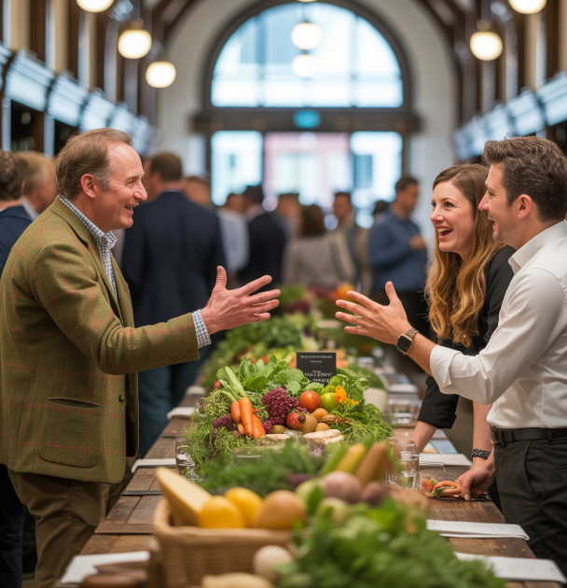
Market Demand and Trend Analysis
Rising global demand for farm-to-fork and sustainable sourcing in hospitality (Rogers and Wynn-Moylan, 2022).
Growth of agri-tourism and culinary experiences in post-COVID travel trends (Cheunkamon et al., 2022).
Strong alignment with Visit Wales' goals for rural development and cultural tourism (Manglik, 2023).
Increased consumer interest in authentic food origins and ethical practices (Legrand et al., 2022).
Notes:
The hospitality sector has an apparent and growing demand for sustainability-led events. Customers are more conscious than ever of where their food comes from, fueling the trend of farm-to-fork consumption (Rogers and Wynn-Moylan, 2022). Hotels and restaurants increasingly seek trusted, local supply chains that enhance guest experience (Cheunkamon et al., 2022). At the same time, agri-tourism is rapidly expanding as tourists look for authentic, off-the-beaten-path experiences, something rural Wales has in abundance (Manglik, 2023). Post-COVID recovery trends stress open air and the meaningful connection between food, people, and place. The Welsh Table precisely responds to this demand with its blend of immersive learning and local product encouragement. It feeds directly into Visit Wales' goal to establish rural economies through tourism, also focusing on the Welsh farm potential for being producers and destinations. Trend-oriented direction ensures relevance and marketability of the event (Legrand et al., 2022).

Slide 7
Market Factor- PESTLE Analysis
Factor | Analysis
Political | The Welsh Government’s support for rural development enhances the event's credibility and relevance within the national tourism strategy (Clapp, 2021).
 | Alignment with Visit Wales' “Year of Croeso” 2025 initiative will ensure political backing and create greater international visibility for the event.
Economic | Supporting local farmers and suppliers boosts regional economies while reducing costs related to importing products.
 | The event encourages sustainable business models, fostering long-term economic stability in Wales’ hospitality and tourism sectors, especially during post-COVID recovery (Lahsen and Ribot, 2022).
Social | Growing consumer demand for sustainable, ethical food sources aligns with the event’s focus on local produce and agritourism.
 | The trend toward wellness and experiential tourism enhances the appeal of the event, which focuses on authentic local experiences and health-conscious culinary practices (Susanto, 2023).
Technological | Use of digital platforms for marketing and registration expands the event’s reach and facilitates global participation.
 | Post-event content sharing, such as recordings of panels and live demonstrations, allows for continued engagement and increases the event's longevity (Otopah et al., 2024).
Legal | Compliance with food safety standards and public liability regulations will ensure the event’s integrity and attendee safety.
 | Ensuring appropriate business licenses and health permits for food vendors and live cooking sessions reduces legal risks and ensures smooth operations (Fortin, 2022).
Environmental | Local sourcing minimises food miles, reducing the event’s carbon footprint and supporting sustainable farming practices.
 | Promoting eco-conscious practices among hospitality businesses, such as waste reduction and sustainable packaging, encourages attendees to adopt environmentally friendly practices in their own businesses (Rogers and Wynn-Moylan, 2022).
Notes:
A PESTLE analysis advises on the broader environment shaping The Welsh Table. Politically, the occasion aligns with Visit Wales' "Year of Croeso" and further rural development policies supported by the Welsh Government (Clapp, 2021). Economically, it supports local producers and creates value for the hospitality sector through direct supply chain promotion, highly important during sustained economic recovery (Lahsen and Ribot, 2022). Social trends strongly support this model. Consumers today want sustainable, authentic food experiences representing a region's culture, especially when travelling (Susanto, 2023).
Technologically, the event will use digital tools for marketing, registration, and even content sharing after the symposium, enhancing its reach and engagement (Otopah et al., 2024). Legally, it will meet all food handling, health and safety, and public liability standards, particularly during live demos and tastings (Fortin, 2022). Lastly, environmental concerns are central to the event, local sourcing reduces carbon impact, and the format promotes eco-conscious business models (Rogers and Wynn-Moylan, 2022). This model reaffirms that the Welsh Table is viable, compliant, and highly relevant to today's hospitality and tourism.

Slide 8
Market Factors – SWOT Analysis
Strengths
Strong alignment with Visit Wales' "Year of Croeso”
Threats
Competition from larger, established food and hospitality events.
Weaknesses
Opportunities
Unique focus on farm-to-fork and sustainability.
High demand for authentic, sustainable food experiences.
Potential logistical challenges in coordinating a rural event.
Limited capacity of local venues to host large international crowds.
Potential challenges in balancing international and local attendee needs (Manglik, 2023).
Growing trend of agri-tourism and sustainable travel.
Potential for international media coverage and partnerships (Weber and Lugosi, 2021).
Development of strong relationships with international hospitality leaders.
Economic uncertainties affecting attendee budgets and travel (Getz and Page, 2024).
Risk of weather disruption for outdoor farm tours.
Notes:
The SWOT analysis for The Welsh Table highlights several strengths, including co-branding with Visit Wales' "Year of Croeso" and a sole focus on farm-to-fork sustainability, which appeals to consumers' current interests. Local procurement benefits Welsh farmers and reduces the environmental impact. A few weaknesses, including potential logistical challenges in hosting a rural event and limited capacity of spaces like the Market Hall, challenge the event. Some of the opportunities are taking advantage of the growing popularity of agri-tourism and securing media sponsorship for international appeal (Manglik, 2023). Threats are competition from bigger food festivals and economic downturns that may affect attendance (Weber and Lugosi, 2021). Bad weather that prevents outdoor farm tours is also a factor to consider (Getz and Page, 2024). All these must be balanced to make the event a success.

Slide 9
Operational factors
(Skills requirement)
(Venue availability)
Location: Hay-on-Wye, Market Hall and surrounding local farms.
Venue suitability: Market Hall offers intimate, versatile space for discussions; local farms provide authentic, immersive farm-to-fork experiences (Getz and Page, 2024).
Venue capacity: Market Hall accommodates up to 200 attendees; farms offer smaller, more tailored group experiences.
Availability: Venues are available during the proposed event dates, but early booking is essential due to local event scheduling (Lekgau et al., 2023).
Event Planning Team: Skilled in logistics, vendor management, and coordination (Clapp, 2021).
Culinary Experts: Chefs and food specialists for live demos and farm-to-fork cooking showcases.
Farm Guides: Knowledgeable staff for conducting farm tours, explaining sustainability practices (Susanto, 2023).
Technical Support: IT staff for event registration, audio-visual setups, and live streaming (Manglik, 2023).
Notes:
The Hay-on-Wye Market Hall provides a functional space for panel sessions and networking, with seating for up to 200 attendees, offering an informal yet functional setting. The nearby farms surrounding the venue will provide guided farm tours and cooking demonstrations to complement the farm-to-fork ethic (Getz and Page, 2024). The availability of both venues is synchronised with the event dates, but booking the venues is necessary in case of scheduling conflicts with other local events (Lekgau et al., 2023). Both venues are ideally suited to the event's immersive experience goals.
Depending on the success of The Welsh Table, there is a range of specialised expertise. Logistics, vendor coordination, and event management will call for skills from the event planning team to perform well (Bowdin et al., 2023). Chefs and food specialists will be front and centre in live cooking demonstrations and showcases of local, sustainable food (Clapp, 2021). Farmers' guides must join farm tours and provide information on sustainable farming practices. Technical support will also be needed to host event registration, audio-visual setups, and live streaming facilities for online attendance (Susanto, 2023). A capable team in these areas will be essential to ensure a glitch-free, engaging experience for the attendees.

Slide 10
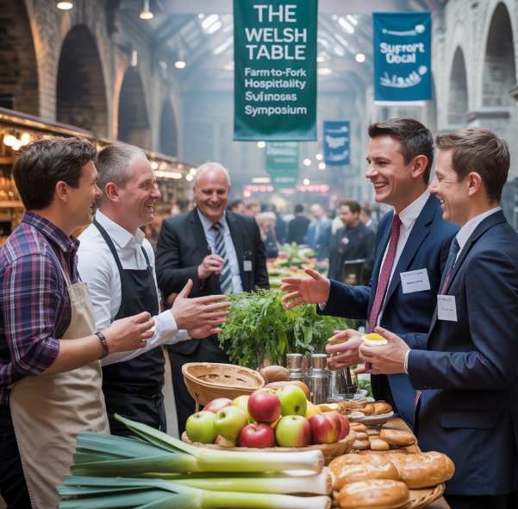
Operational Requirements and Logistics
Catering and Equipment: Locally sourced catering, mobile kitchen units, AV equipment (Lahsen and Ribot, 2022).
Transportation and Access: Shuttle services between venues; clear signage and accessibility provisions (Hammon and Goralnik, 2025).
Seating and Setup: Flexible seating for panels; outdoor arrangements for demos and tours (Fortin, 2022).
Health and Safety: On-site first aid, risk assessments, food hygiene compliance.
Notes:
Operational logistics will be carefully planned to ensure smooth delivery. Local catering will be arranged, with mobile kitchen units supplementing live demonstrations (Lahsen and Ribot, 2022). AV facilities will enable presentations and panel discussions. Shuttle services will link the Market Hall to surrounding farms to facilitate easy mobility for participants. Seating will be flexible for indoor and outdoor sessions (Hammon and Goralnik, 2025). Safety and health precautions will include first aid arrangements, complete risk assessments, and food hygiene to the required levels by law, as well as to protect visitors (Fortin, 2022).

Slide 11
Financial Factors – Costs and Predicted Revenues
Estimated Costs | Amount (£)
Venue Hire (Market Hall & Farms) | 2,000
Catering (Local Producers) | 3,500
Marketing & Promotion | 1,200
Staffing & Volunteer Support | 1,000
AV Equipment & Tech Support | 1,300
Transportation (Shuttles) | 800
Contingency Fund (10%) | 980
Total Estimated Costs | 10,780
Estimated Revenue Sources | Amount (£)
Ticket Sales (150 @ £60) | 9,000
Sponsorship & Partnerships | 3,000
Merchandise & Local Vendor Fees | 1,000
Total Estimated Revenue | 13,000
Projected Profit | 2,220
Notes:
The event is affordable with a budget of £10,780 and a projected income of £13,000. The main expenses are venue hire, catering, staff, and technical support. Income will be generated from ticket sales, sponsorships, and vendor charges (Shonk and Weiner, 2021). A contingency fund has been included to cater for unforeseen expenses (Brunet et al., 2021). With a projected profit of over £2,200, the event is viable and generates local economic growth through strategic partnerships and community engagement.

Slide 12
Financial Factors – Funding Sources
Funding Source | Description
Ticket Sales | Primary revenue stream; estimated 150 delegates at £60 each
Sponsorship | From hospitality brands, tourism boards, and sustainable food initiatives
Visit Wales Grant Support | Potential funding through Year of Croeso 2025 initiatives
Vendor Participation Fees | Fees from local producers and food businesses showcasing at the event
In-kind Support | Local farms may provide space/resources in exchange for publicity and exposure
Notes:
Funding to cover The Welsh Table will be derived from ticket sales, sponsorships, and vendors' contribution fees. Grant funding will be sought on a focused basis with Visit Wales, specifically about the "Year of Croeso" 2025 initiative. In-kind contributions by local farmers, e.g., access to areas or fruit, can assist in minimising costs and fostering stakeholder unity (El-Amin et al., 2025). Financial input diversification results in a total budgeted capital while simultaneously encouraging stakeholder buy-in and sustainability in locally focused hospitality (Fortin, 2022).

Slide 13
Conclusion
In conclusion, The Welsh Table is a well-planned farm-to-fork symposium that drives the "Year of Croeso 2025" vision forward by promoting place, sustainability, and community. With Hay-on-Wye being its natural countryside setting, the event offers an authoritative voice to Welsh farmers, chefs, and international hospitality visionaries to gather, learn, and innovate alongside each other. The feasibility study demonstrates high market demand, operational viability, and financial sustainability. This activity will improve Wales' agritourism appeal, enhance local economies, and emphasise the hospitality, welcome and gastronomic richness that define the Welsh experience.
-
Notes:
In conclusion, The Welsh Table is a well-planned farm-to-fork symposium that drives the "Year of Croeso 2025" vision forward by promoting place, sustainability, and community. With Hay-on-Wye being its natural countryside setting, the event offers an authoritative voice to Welsh farmers, chefs, and international hospitality visionaries to gather, learn, and innovate alongside each other. The feasibility study demonstrates high market demand, operational viability, and financial sustainability. This activity will improve Wales' agritourism appeal, enhance local economies, and emphasise the hospitality, welcome and gastronomic richness that define the Welsh experience.

Slide 14
References
Bowdin, G. A., Allen, J., Harris, R., Jago, L., O'toole, W., and McDonnell, I. (2023). Events management. Routledge.
Brunet, J., Cuadro-Sáez, L., and Pérez, J. J. (2021). Contingency public funds for emergencies: the lessons from the international experience. Banco de Espana Occasional Paper, (2032).
Cheunkamon, E., Jomnonkwao, S., and Ratanavaraha, V. (2022). Impacts of tourist loyalty on service providers: Examining the role of the service quality of tourism supply chains, tourism logistics, commitment, satisfaction, and trust. Journal of Quality Assurance in Hospitality & Tourism, 23(6), 1397-1429.
Clapp, J. (2021). Explaining growing glyphosate use: The political economy of herbicide-dependent agriculture. Global Environmental Change, 67, 102239.
El-Amin, A., Tyler, K., and Marks, Q. L. (Eds.). (2025). Building Health, Resiliency, and Unity in the Black Community. IGI Global.
Fortin, N. D. (2022). Food regulation: law, science, policy, and practice. John Wiley & Sons.
Getz, D., and Page, S. J. (2024). Event studies: Theory and management for planned events. Taylor & Francis.
Gössling, S., and Hall, C. M. (2021). The sustainable chef: The environment in culinary arts, restaurants, and hospitality. Routledge.
Hammon, A., and Goralnik, L. (2025). Barriers and bridges: contributions of mobile farmers markets to fresh food access for low-income and minority consumers. Local Environment, 30(4), 447-462.
Lahsen, M., and Ribot, J. (2022). Politics of attributing extreme events and disasters to climate change. Wiley Interdisciplinary Reviews: Climate Change, 13(1), e750.
Legrand, W., Chen, J. S., and Laeis, G. C. (2022). Sustainability in the hospitality industry: Principles of sustainable operations. Routledge.
Lekgau, R. J., and Tichaawa, T. M. (2023). Dynamic Changes and Recovery in Event Venues: Perspectives from MICE Event Planners and Venue Managers. Studia Periegetica, 44(4), 139-158.
Manglik, M. R. (2023). Tourism Fundamentals:[9789369020195]. EduGorilla Community Pvt. Ltd.
Mrusek, N., Ottenbacher, M. C., and Harrington, R. J. (2021). The impact of sustainability and leadership on the innovation management of Michelin-starred chefs. Sustainability, 14(1), 330.
O'Toole, W. (2010). Events feasibility and development. Routledge.
Otopah, A. A., Dogbe, C. S. K., Amofah, O., and Ahlijah, B. (2024). Digital marketing and purchase intention of bank services: the role of trust and engagement. International Journal of Bank Marketing, 42(7), 1920-1945.
Rogers, T., and Wynn-Moylan, P. (2022). Conferences and conventions: A global industry. Routledge.
Shonk, D. J., and Weiner, J. F. (2021). Sales and revenue generation in sport business. Human Kinetics.
Susanto, E. (2023). From Taste to Travel: Exploring the Behavioral Drivers of Local Food Engagement and Revisit Intention in Food Tourism. Journal of Tourism, Hospitality and Travel Management, 1(2), 46-61.
Weber, L., and Lugosi, P. (2021). The event experiences of attendees with food allergies, intolerances and coeliac disease: risk loaded value-creation/destruction. International Journal of Event and Festival Management, 12(2), 184-202.

