Slide 1

UNIVERSITY OF WALES TRINITY SAINT DAVID
BA (Hons) Leadership and Management Skills for the Workplace
Different Information Systems
A group consulting briefing for a growing business that wants to modernise how it uses information.
Mick Lowe
Ana-Maria Ismail
Alex Valentin Ismail
Ryan Rehman
Student ID 2434734
Student ID 2435354
Student ID 2435353
Student ID 2309123
Introduce different information systems
Analyse and compare systems
Ethical considerations
Real-world case studies
Module LCLM 5004 · Dr Amer Kareem and Dr Chinomso Nwagboso

Slide 2
CONTENTS
How the briefing is organised
01
Introduce information systems
Mick Lowe
What an information system is from a technical view and a business view. Why it matters for efficiency, decisions and advantage. A map of the main types.
02
Analyse and compare three systems
Ana-Maria Ismail
Transaction Processing System, Customer Relationship Management and Enterprise Resource Planning — function, benefit, limit and fit.
03
Ethical considerations
Alex Valentin Ismail
Privacy, security, employee monitoring, Artificial Intelligence decisions and bias, and how to reduce those risks.
04
Real-world case studies
Ryan Rehman
Tesco Clubcard, Rolls-Royce SAP, and the British Airways 2018 breach — challenge, result, ethics and lesson.
02 / 12

Slide 3
MICK LOWE · INTRODUCE DIFFERENT INFORMATION SYSTEMS
Two ways to define an information system
TECHNICAL PERSPECTIVE
BUSINESS PERSPECTIVE
An information system is a set of interrelated components that collect, process, store and distribute information to support decision-making, coordination, control, analysis and visualisation (Laudon and Laudon, 2020).
It is not just software. It is people, processes and technology working together so the firm can operate, serve customers and compete. Managers who treat it as an IT purchase only usually fail (Laudon and Laudon, 2020).
Why leadership should invest
Efficiency
Decision-making
Competitive advantage
Capture a sale, a delivery or a wage payment once. Share it. Cut re-keying, stock-outs and the cost to serve.
Turn raw events into reports and models so managers act on what is happening, not on habit.
Customer insight, faster fulfilment and better planning are difficult for rivals to copy (Porter and Millar, 1985).
03 / 12

Slide 4


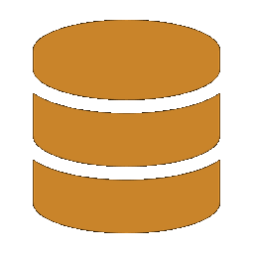



MICK LOWE · INTRODUCE DIFFERENT INFORMATION SYSTEMS
The main types a growing firm will meet
TPS
MIS
DSS
Transaction Processing System
Management Information System
Decision Support System
OPERATIONAL
TACTICAL
TACTICAL / STRATEGIC
Records daily events: sales, payments, stock and payroll. This is the data that every later system uses.
Turns Transaction Processing System data into regular summary reports for middle managers.
Interactive models and ‘what-if’ analysis for problems that are not routine.
ERP
CRM
SCM
Enterprise Resource Planning
Customer Relationship Management
Supply Chain Management
WHOLE FIRM
FRONT OFFICE
PARTNERS
One shared system for finance, people, stock and operations so departments stop working in silos.
One record of each customer across sales, service and marketing, used to raise loyalty.
Coordinates suppliers, production, logistics and retailers so goods and information move together.
04 / 12

Slide 5
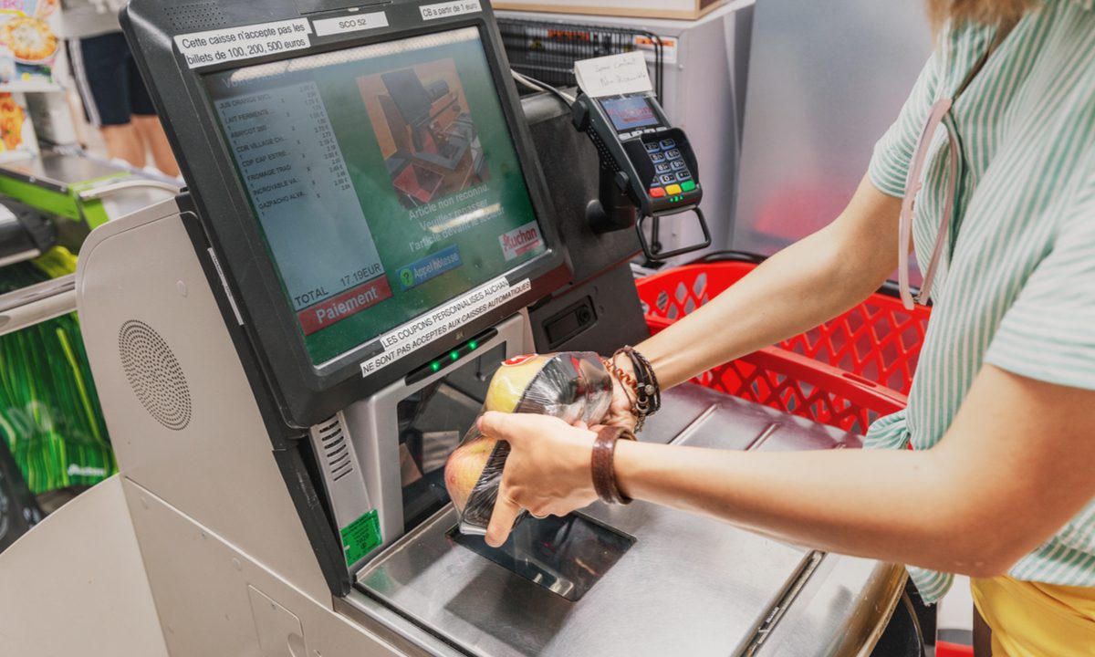


ANA-MARIA ISMAIL · ANALYSE AND COMPARE SYSTEMS
Three systems in depth
TPS · Transaction Processing System
CRM · Customer Relationship Management
ERP · Enterprise Resource Planning
Job: capture each business event as it happens.
Job: keep one living record of every customer.
Job: run finance, stock, people and operations on one platform.
Users: cashiers, warehouse staff, payroll clerks.
Users: sales, service, marketing and commercial leads.
Users: almost the whole organisation.
Strength: speed and accuracy at high volume.
Strength: retention, personal offers, lifetime value.
Strength: one version of the numbers.
Limit: it stores facts; it does not explain them (Stair and Reynolds, 2018).
Limit: weak data or aggressive contact destroys trust (Laudon and Laudon, 2020).
Limit: cost, disruption and culture — not the software — usually decide success (Davenport, 1998; Yusuf, Gunasekaran and Abthorpe, 2004).
05 / 12

Slide 6
ANA-MARIA ISMAIL · ANALYSE AND COMPARE SYSTEMS
Which system fits a growing business — and when
Question | Transaction Processing System | Customer Relationship Management | Enterprise Resource Planning
What does it improve? | Daily accuracy of orders, stock and pay | Repeat custom, service quality and targeted offers | Cross-department planning and a single set of numbers
What can go wrong? | Downtime, or dirty data flowing into every later report | Privacy harm and customers feeling watched | Overrun cost, staff resistance, operations freezing at go-live
Relative cost | Lowest of the three | Medium — licence plus data clean-up | Highest — software plus training plus change
Buy it when… | Spreadsheets and paper can no longer keep up | Growth depends on keeping existing customers | Silos are blocking growth and processes can be standardised
Judgement: the three systems stack. A weak Transaction Processing System poisons the other two. For this client, lock transactions first, add Customer Relationship Management to protect revenue, and only then consider Enterprise Resource Planning (Davenport, 1998; Laudon and Laudon, 2020).
06 / 12

Slide 7




ALEX VALENTIN ISMAIL · ETHICAL CONSIDERATIONS
Four risks that sit inside the systems
Data privacy
Security
Customer Relationship Management and Transaction Processing Systems hold names, cards, addresses and buying history. Current UK law — the UK General Data Protection Regulation and the Data Protection Act 2018 — requires a lawful basis, a clear purpose, data minimisation and security.
Enterprise systems put high-value data in one place. Weak supplier logins, no multi-factor authentication and payment details stored in plain text are how attackers move from a vendor into the core network (Information Commissioner’s Office, 2020).
Employee monitoring
Artificial Intelligence and bias
Workforce tools inside Enterprise Resource Planning can log keystrokes, location and idle time. Without a stated purpose and staff notice this fails fairness and necessity tests (Information Commissioner’s Office, 2023).
Scoring tools inside Customer Relationship Management and Decision Support Systems can copy old prejudice. Amazon stopped a recruiting engine that marked CVs down for the word ‘women’s’ because it had learned from a male-heavy past (Dastin, 2018).
07 / 12

Slide 8

ALEX VALENTIN ISMAIL · ETHICAL CONSIDERATIONS
How to use the systems responsibly
1
2
3
Privacy by design
Security as standard
Fair monitoring
Collect only what the stated purpose needs. Set a deletion date. Complete a Data Protection Impact Assessment before any new Customer Relationship Management or monitoring tool goes live.
Multi-factor authentication on every remote and supplier account. Encrypt card data. Keep a till or a vendor laptop off the finance network.
Tell staff what is collected, why, and for how long. Use team-level dashboards for planning. Individual tracking only where it is lawful and necessary.
4
5
6
Human review of Artificial Intelligence
Clear ownership
A 72-hour breach plan
No automated decision on a job, a credit line or a customer penalty without a named person who can overturn it. Test models for bias before and after launch.
Name an accountable owner, and a Data Protection Officer where the law requires one. Train every user. Most incidents start with a person, not a firewall.
Practise containment, Information Commissioner’s Office notification and customer wording. Speed after a breach is a duty, not a public-relations choice.
08 / 12

Slide 9
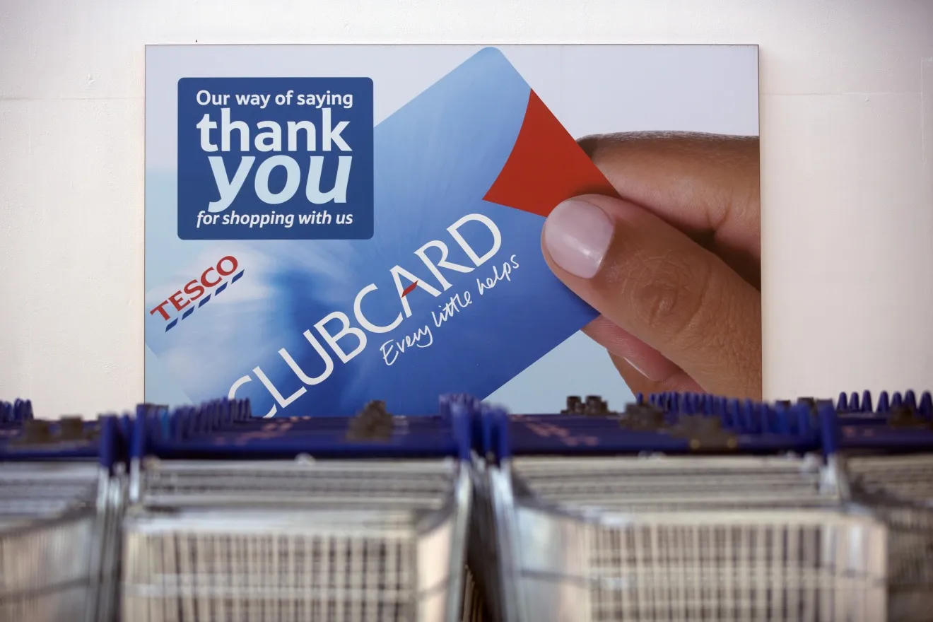
RYAN REHMAN · REAL-WORLD CASE STUDIES
Two implementation stories
TESCO · Customer Relationship Management
ROLLS-ROYCE · Enterprise Resource Planning
WHAT THEY BUILT
WHAT THEY BUILT
Clubcard launched in 1995 with dunnhumby. Each basket became a customer record, not only a till receipt (Humby, Hunt and Phillips, 2008).
A multi-year SAP programme to replace many locally built systems across a complex manufacturing group (Yusuf, Gunasekaran and Abthorpe, 2004).
THE PROBLEM
THE PROBLEM
Rivals said personal offers could not work on grocery margins. Data quality and the cost of rewards had to be proved.
Legacy systems did not talk to each other. Goals between sites conflicted. Training and culture were as hard as the software.
THE RESULT
THE RESULT
Tesco overtook Sainsbury’s. More than 20 million people still use the card, used in more than 82 per cent of sales (The Times, 2025).
A phased go-live reduced the chance of a single big failure. Full benefits arrived only after the new ways of working stuck.
THE ETHICAL ISSUE
THE ETHICAL / PEOPLE ISSUE
Purchase histories are intimate. Profiling must stay lawful, explained and optional.
Enterprise Resource Planning changes jobs. Ignoring users is both a project risk and a fairness issue.
09 / 12

Slide 10
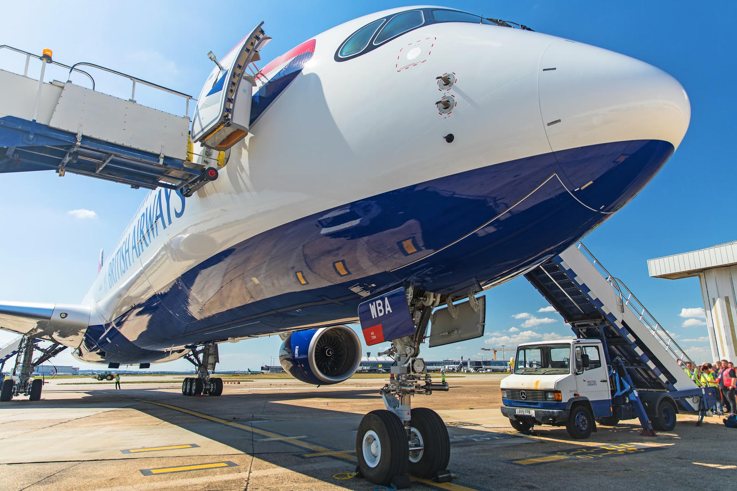
RYAN REHMAN · REAL-WORLD CASE STUDIES
British Airways 2018: a security and ethics failure
429,612
244,000
People whose data could be reached
Card numbers and security codes exposed
2 months
£20 million
Attack ran before BA was told
Final ICO fine (from ~£183 million)
What went wrong
What the client should take from this
Attackers used a third-party supplier account, moved through remote access, found payment data stored in plain text, and copied details from the booking pages. The regulator found no multi-factor authentication, weak internal permissions, and no self-detection (Information Commissioner’s Office, 2020).
1. A Transaction Processing System that takes cards is a high-risk asset.
2. Supplier access is part of the information system.
3. A fine is smaller than lost trust.
4. Two silent months is a governance failure, not only a technical one.
10 / 12

Slide 11
RECOMMENDATION · WHOLE TEAM
Do not buy one giant system on day one
Fix the Transaction Processing System first
1
Clean product, customer and stock codes. Put a reliable order or point-of-sale system under the business before anything else is built on top.
Add Customer Relationship Management next
2
For a growing firm the expensive problem is lost customers. A focused Customer Relationship Management system usually pays back faster than a full Enterprise Resource Planning suite.
Treat Enterprise Resource Planning as a later step
3
Start it only when processes can be standardised. Limit customisation. Spend more on training than on licences (Davenport, 1998; Yusuf, Gunasekaran and Abthorpe, 2004).
Make ethics a go-live test
4
Privacy by design, supplier multi-factor authentication, a named data owner and a practised breach plan should be required before any system is switched on.
11 / 12

Slide 12
REFERENCES · UWTSD HARVARD
Sources cited in this briefing
Dastin, J. (2018) ‘Amazon scraps secret AI recruiting tool that showed bias against women’, Reuters, 11 October.
Laudon, K.C. and Laudon, J.P. (2020) Management information systems: managing the digital firm. 16th edn. Harlow: Pearson.
Davenport, T.H. (1998) ‘Putting the enterprise into the enterprise system’, Harvard Business Review, 76(4), pp. 121–131.
Porter, M.E. and Millar, V.E. (1985) ‘How information gives you competitive advantage’, Harvard Business Review, 63(4), pp. 149–160.
Humby, C., Hunt, T. and Phillips, T. (2008) Scoring points: how Tesco is winning customer loyalty. 2nd edn. London: Kogan Page.
Stair, R. and Reynolds, G. (2018) Principles of information systems. 13th edn. Boston: Cengage Learning.
Information Commissioner’s Office (2020) ICO fines British Airways £20m for data breach affecting more than 400,000 customers. Available at: https://ico.org.uk (Accessed: 27 September 2026).
The Times (2025) ‘Tesco Clubcard at 30: the loyalty scheme that changed retail’, 10 February.
Information Commissioner’s Office (2023) Employment practices and data protection: monitoring workers. Available at: https://ico.org.uk (Accessed: 27 September 2026).
Yusuf, Y., Gunasekaran, A. and Abthorpe, M.S. (2004) ‘Enterprise information systems project implementation: a case study of ERP in Rolls-Royce’, International Journal of Production Economics, 87(3), pp. 251–266.
12 / 12

