Slide 1


ACCA4031: Software Applications for Business
Collaboration Tools and Email
Part One
Mr. David A Williams
BSc. Hons, MSc., PGCert (TfHE), FHEA, ADG FE/HE, MBCS

Slide 2
Introduction

Slide 3

Definition
With COVID-19 disrupting businesses everywhere, having a remote communication tool is now more essential than ever.
Owing to the quantity of information on this topic, this set of slides has been bisected with Teams, Skype and Zoom (along with alternatives) being covered in this session and Email, File-sharing and Internet technologies being covered next week

Slide 4


Definition
Synchronous & Asynchronous communication
Synchronous communication occurs in real time and can take place face-to-face, and as technology has evolved, can take place irrespective of distance (eg. telephone conversations and instant messaging)
Asynchronous communication is not immediately received or responded to by those involved (eg. emails and message board forums which allow people to communicate on different schedules)

Slide 5
Aims

Slide 6







Aims: collaboration tools
Ways of working in a remote environment
File share
  OneDrive and SharePoint
  Google drive
  Dropbox
Communication
  Skype
  Teams
  Zoom
  Social media platforms

Slide 7

Aims: Emails & communication
Microsoft outlook (Application and web interface)
  Sending and receiving emails
    CC, & BCC
  Automation
    Mail forwarding
    Automatic replies
    Signatures
  Junk mail and email filters
  Search filtering
  Creating folders
Other available alternatives
Suspicious emails

Slide 8



Aims: Browsing the internet
Web browsers
Search engines
Specialist repositories
Meta crawlers
Refining searches

Slide 9
Collaboration tools

Slide 10

communications
With COVID-19 disrupting businesses everywhere, having a remote communication tool is now more essential than ever.
Communications software is the loose category of systems and apps that allows users to exchange files and text, audio, and video messages via the cloud or local network from various devices.
The most common tools are email, chat, and messaging apps.

Slide 11
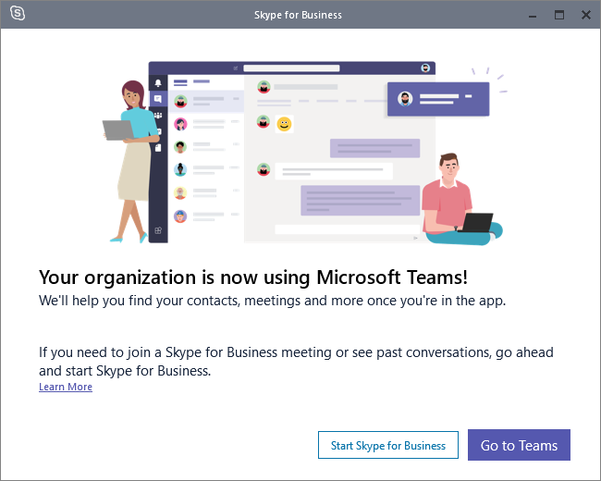
communications
With COVID-19 disrupting businesses everywhere, having a remote communication tool is now more essential than ever.
While Microsoft Skype for Business is a good option to collaborate with your co-workers, it doesn’t look like it’s going to be there for the long run.
That’s why it makes sense to switch to other platforms like Microsoft Teams or Zoom instead!

Slide 12
skype

Slide 13


Skype
Skype, the popular Internet calling app, has been around for quite some time.
The (mostly) free service launched in 2003, and has become one of the easiest and cheapest ways to stay in touch with others across the world

Slide 14
Skype: How is Skype for Business different from Skype?
Skype for Business and Skype are both used for virtual communication.
Skype:
Meant for small businesses (~20 people). It’s free to use, but if you want services like mobile or landline calls, then you would have to go for the paid plans.
Skype for Business:
Meant for larger businesses (~250 people). It offers enterprise-level security, account management and integrates with other Office 365 applications like Microsoft Outlook, PowerPoint, SharePoint, etc.

Slide 15
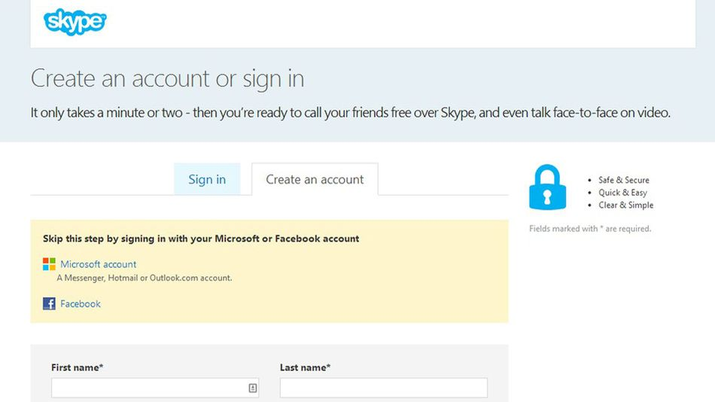
Skype personal
Skype has become a great option because it's accessible through computers, phones, tablets, home phones, TVs and even devices like your Xbox One.
If you choose to connect with your Facebook account, the benefit is that you’ll be able to view your Facebook News Feed and contact your Facebook friends in Skype.

Slide 16
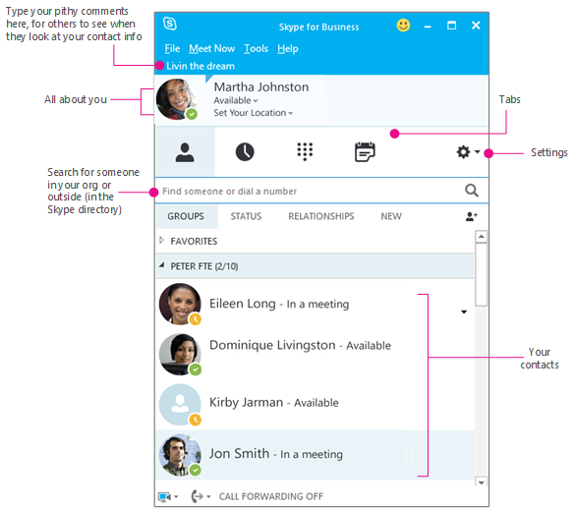
Skype for business
Skype for Business is enterprise instant messaging software developed by Microsoft as part of the Microsoft Office suite.
It supports text, audio, and video chat, and integrates with Microsoft Office components such as Exchange and SharePoint.
Microsoft announced that it would phase out Skype for Business in favour of Microsoft Teams.
As Microsoft Teams is replacing Skype for Business, new Office 365 users can no longer download Skype for Business.

Slide 17
Skype for business
Skype for Business (previously known as Microsoft Lync) is a popular communication platform developed by Microsoft.
It supports remote communication through various channels like text, audio and video chat.
Key features of Skype for Business include:
Instant messaging
HD video conferencing
Voice calls
Call recording
File sharing
Whiteboard collaboration
Broadcasting online meetings

Slide 18
Skype for business
Skype for Business has two versions:
Skype for Business Server
An on-premise application used by highly regulated large organisations.
It requires specialised hardware and dedicated IT support and maintenance.
Skype for Business Online
A cloud-based application that can be accessed by users anytime, anywhere
There are no additional hardware or maintenance costs

Slide 19
Skype for business
How to set a presence status in Skype for Business
Setting an availability status makes it easier for team members and business clients to communicate efficiently.
Skype for Business lets you display your availability (or presence) with various statuses like Available, Busy, Away, etc.
Step 1: Sign in to your Skype for Business account.

Slide 20
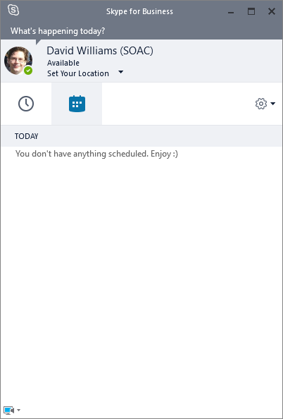
Skype for business
Step 2: In the new window that appears, click on the drop-down arrow in the status menu under your name.
Here, you can choose from a list of status options, like:
Available: online and active.
Busy: shouldn’t be interrupted.
Away: logged on, but away from the computer for a long time.
And more!
You can also use “Reset Status” for Skype to automatically set your presence status based on your app activity.
*****(On Mac, use the “Automatic” option instead.)

Slide 21
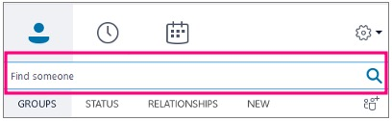
Skype for business
How to set up contacts in Skype for Business
Skype for Business lets you add people to your contact list from within and outside your organization.
Step 1: Click on the “Add a contact” icon to access various options to add contacts. The “Create New Group” option lets you create groups that you can add your contacts to.
Step 2: To add people, type their name into the search box in the main Skype for Business window.
Step 3: Right-click on their picture, select “Add to Contacts List” and choose the right contact group.
Now you’re all set to communicate with your contact list!

Slide 22
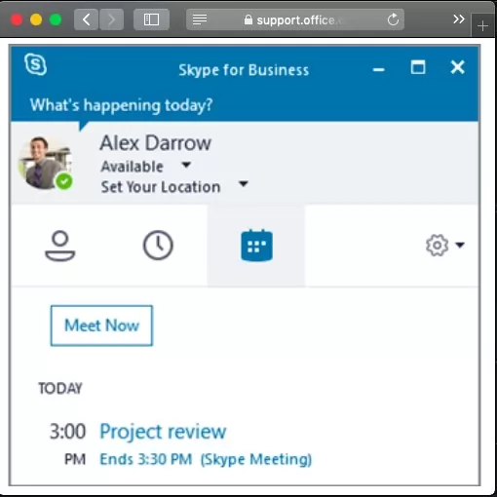
Skype for business
How to use Skype for Business for Video Conferencing
Skype for Business’ video conferencing features combat the lack of face-to-face interaction when working remotely.
Skype for Business users can share their screen with attendees during a call or even conduct a webinar easily.
Step 1: Launch your Skype for Business application and set your presence status to Available.
Step 2: Go to the “Meetings” tab and click on the “Meet Now” option.
Step 3: The meeting screen will immediately appear as a pop-up. Here, you can add participants by clicking on the “Invite” button at the top right corner.

Slide 23
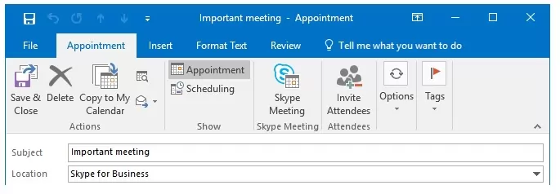
Skype for business
How to schedule a Skype for Business meeting
As Skype for Business Online works with Microsoft Outlook, follow these steps to schedule a meeting :
Step 1: Open Microsoft Outlook.
Step 2: Go to the “Appointments” tab.
Step 3: Click “Skype Meeting”.
This will add the call info to the meeting invite.
Fill in the required meeting details and hit “Send.”
The recipients will receive Outlook calendar reminders and a “Join Meeting” pop up when the meeting is about to start.
Simply click on it to join the conference call!

Slide 24
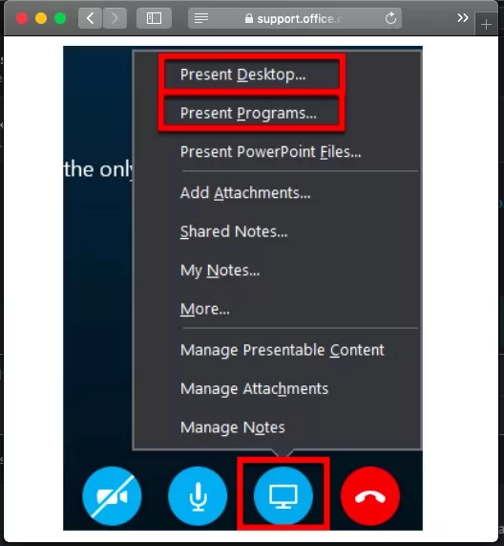
Skype for business
How to share your screen during Skype for Business calls
If you need to discuss a presentation with another individual, or how to perform a specific task.
As a presenter, you can easily share your screen via Skype for Business
Step 1: Click on the “Present” icon (shaped like a monitor) in the meeting window.
This will give you several options to share your screen:
Present Desktop: Share your entire screen.
Present Programs: Share an open Word or Excel file.

Slide 25
Skype for business
How to share your screen during Skype for Business calls
Step 2: When you share your screen, the “Now Presenting” tab will appear on your device.
Your presence status will change to “Presentation” to restrict other Skype users’ alerts.
Step 3: Each participant will receive a request to accept your shared screen/content.
If you want another attendee to demonstrate something, you can give them control over the sharing session by clicking “Give Control”. You can click on “Take back control” anytime you want.
Step 4: Use “Stop Presenting” to stop sharing your screen.

Slide 26

Skype for business
How to use Skype for Business for instant messaging
Skype for Business lets you communicate with your contacts list in real-time via instant messaging (IM). This is faster than a phone call and less formal than an email.
Step 1: Hover over the contact you want to start IM with and click the “Message” icon. Their chat box will appear, where you can start conversation instantly.
Step 2: When someone starts an IM conversation with you, a pop up appears on your screen.
To respond, click on their photo and type in your message, to reject the message, click “Ignore.”
Step 4: You can add more people to your IM conversation window by dragging their contact picture into your IM conversation. Or, click “Invite More People” at the top of the window
Step 5: To send an IM to all the contacts in a group, right-click on the group in your contact list and click on “Send an Instant Message” to deliver the message to all group members.

Slide 27
Microsoft Teams

Slide 28

Microsoft Teams
Microsoft Teams is a collaboration app that helps your team stay organised and have conversations all in one place.
Meant for larger businesses (>250 people), it lets you host large audio or video conferences with individuals within or outside your company.
Allows one-on-one or group audio and video calls. You can share screens during web conferencing, schedule meetings, and record meetings. In addition, each user has up to 1TB of storage space.

Slide 29
Microsoft Teams
How to transition to Microsoft Teams
As many teams are now working remotely due to COVID-19, they’ve been forced to use virtual communication tools like Microsoft Teams to collaborate effectively!
Whether you’re using Skype for Business or not, it’s best to switch to Microsoft Teams as early as possible.
This way, you won’t face any difficulties when Skype for Business is rolled back!

Slide 30
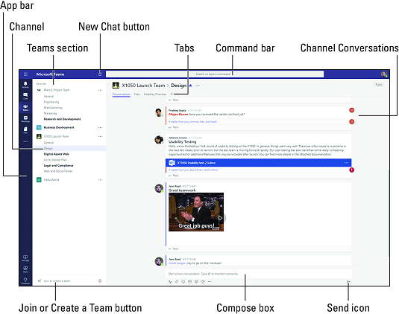
teams
Microsoft Teams is a collaboration app that helps your team stay organised and have conversations all in one place.
Allows one-on-one or group audio and video calls. You can share screens during web conferencing, schedule meetings, and record meetings. In addition, each user has up to 1TB of storage space.

Slide 31
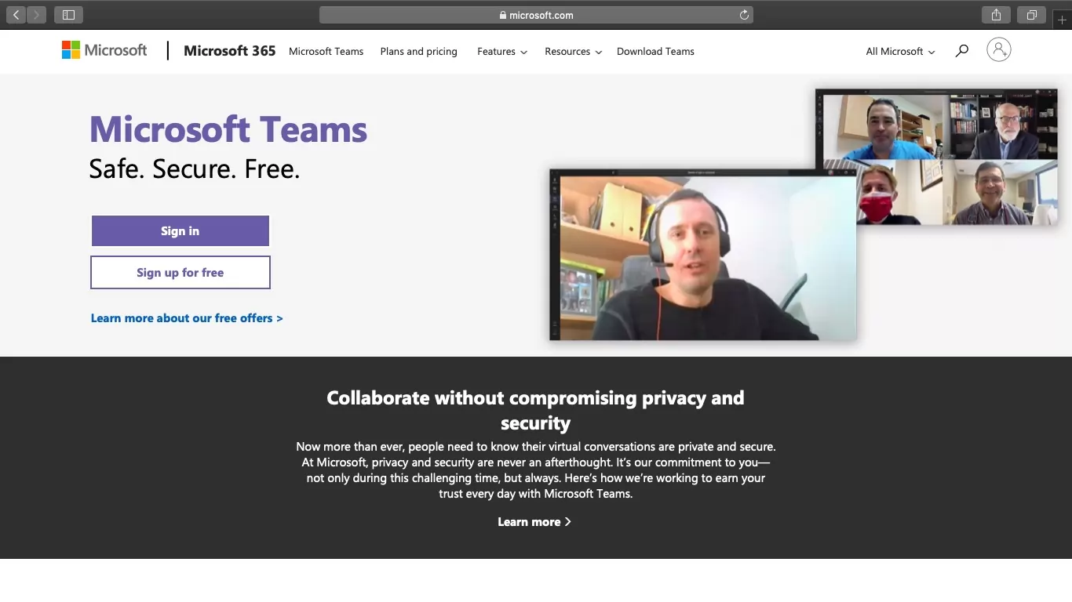
teams
Key Features of Microsoft Teams:
Centralised hub for all Office 365 applications
Enhanced security and compliance
File creation, sharing and editing within the application
Can be accessed easily via desktop, a mobile device or web browser
Audio and video calls (with VoIP support)
Instant messaging (IM)

Slide 32
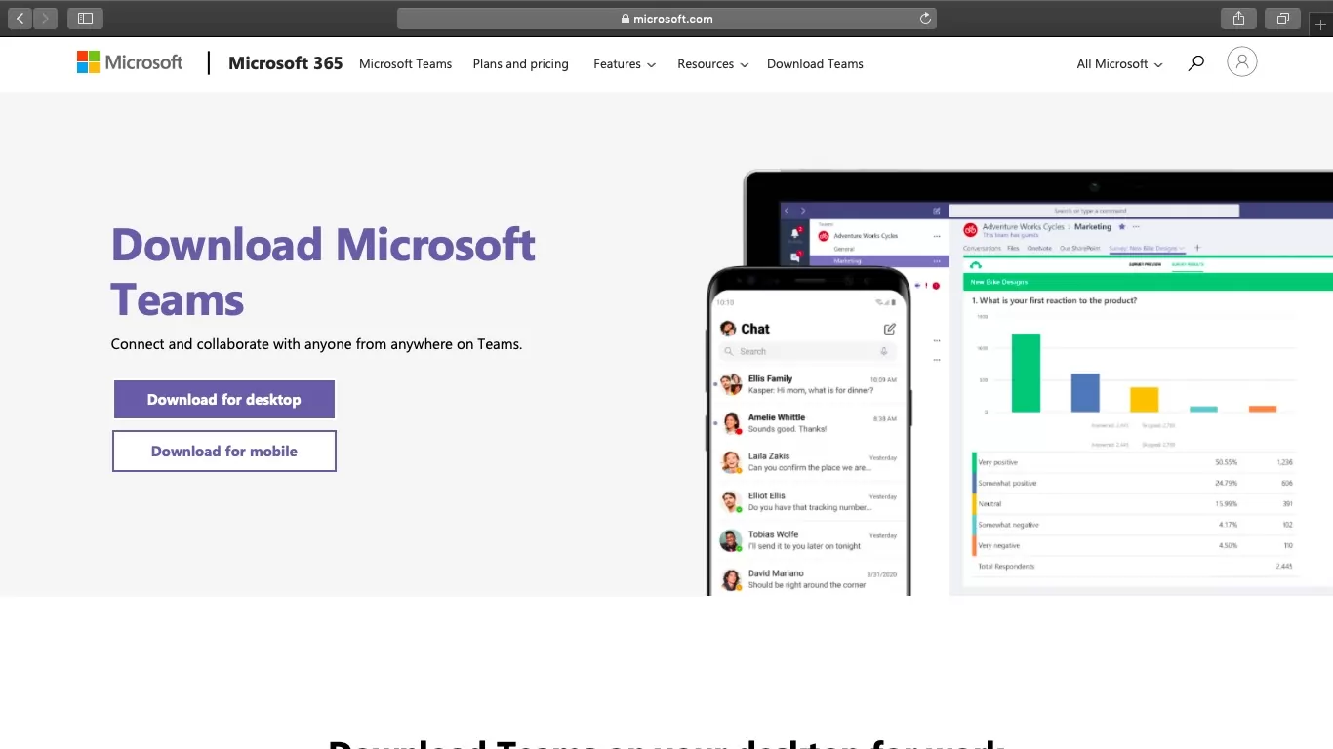
teams
Download the Microsoft Teams app
For desktop
Step 1: Visit the Microsoft Teams homepage and click on “Download Teams.” (for UWTSD purposes, the whole 365 package can be downloaded from your Outlook university account- this will include the whole office 365 suite)
Step 2: Click on “Download for Desktop.” (Based on your operating system, you will get a download link for either Mac or Windows).
Step 3: Once downloaded, follow the on-screen instructions to install Microsoft Teams.

Slide 33
teams
Download the Microsoft Teams app
Mobile version
Step 1: Based on your phone, you can download the Microsoft Teams app from the Google Play Store for Android or the iOS App Store for Apple.
Step 2: After installing the app, log in to Teams via your Microsoft account.
NB the mobile application lacks some of the functionality that is present in the desktop app or web interface!!!

Slide 34
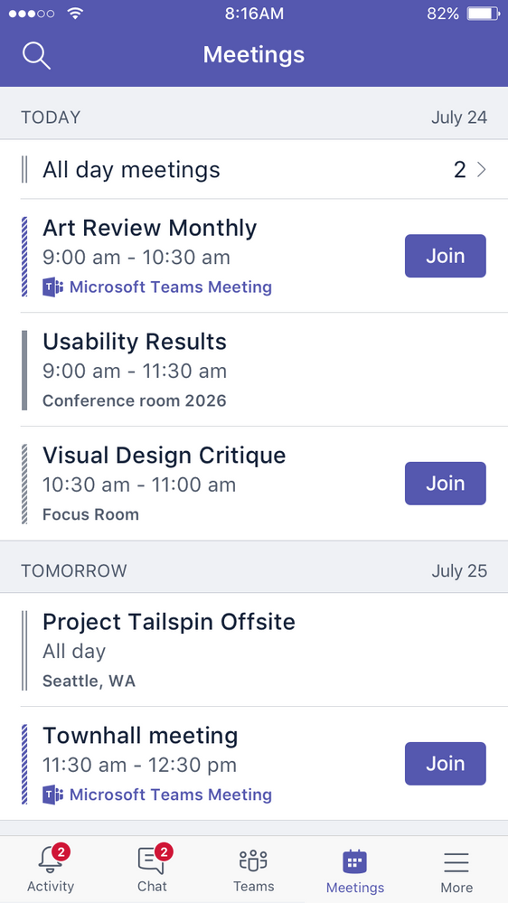
teams
Microsoft Teams was updated in December 2018 for Android users. This update brought the following improvements:
Team members can seamlessly schedule channel meetings right from the mobile app.
Users now need a team code to join a team.
The search tool now lets users search for files across all channels.
Microsoft is also planning to make Teams the default app for scheduling meetings in Office and Microsoft 365.

Slide 35
teams
Microsoft Teams mobile app vs. desktop version
Now that Teams is available on mobile and desktop, you may be wondering which option is right for you. Here’s a quick look at the main differences:
For business use, the Microsoft Teams desktop version work well if you have regular access to your computer. But when you’re traveling, you can hop right on your mobile app and stay in touch with your team.
The Microsoft Teams mobile app is a great way to build a digital, on-the-go workplace where team members can communicate, collaborate, meet, share and do much more right from their mobile devices.
 | Microsoft Teams desktop | Microsoft Teams mobile app
Features | All features present | Everything except desktop sharing
Convenience | Limited to your desktop device | Accessible from any iOS or Android mobile device for on-the-go convenience
System requirements | Minimum 1.6 GHz processor, 32-bit or 64-bit; 2.0 GB RAM; 3.0 GB hard disk space Minimum 128 MB graphics memory; OS: Windows 10, Windows 8.1, Windows 8 or Windows 7 Service Pack; 1024×768 screen resolution; Requires .NET 4.5 CLR or later; USB 2.0 video camera (Check here for additional requirements) | Few—just iOS 10.0 or later or Android 4.4 or later

Slide 36
teams
£
Microsoft Teams pricing
Microsoft Teams offers four different plans that you can choose from as per your business needs:
1. Microsoft Teams (Free)- Offers features like instant messaging, audio and video call, file sharing and file storage.
2. Microsoft 365 Business Basic: $5/user per month- Offers all “Free” features along with video conferencing (up to 250 people).
3. Microsoft 365 Business Standard: $12.50/user per month- Offers “Microsoft Teams Business Basic” features + desktop versions of Office apps like Excel, Word, etc.
4. Office 365 E3: $20/user per month- Includes “Business Standard” features + unlimited file storage per user on OneDrive + enterprise-level video service to hold video conferences across the organisation for $20.00 user/month.

Slide 37
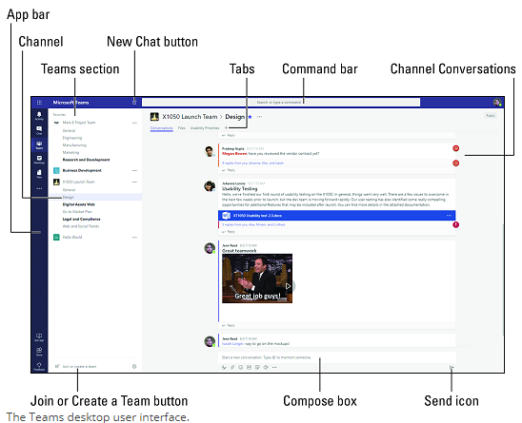
Microsoft Teams interface

Slide 38
teams
Teams and Channels
To start your teamwork collaboration, you need a team.
Setting up Teams is easy and done in a few clicks, requiring a Team name and a description; this then allows team members to be added.
As mentioned, a new Team will create a matching Office 365 Group, OneNote, SharePoint site and Plan—so this does need to be done with some caution to avoid ambiguity.

Slide 39
teams
Teams and Channels
Each Team has subsections, which are called Channels, and a General Channel will automatically be created.
You can have multiple Channels within a Team; for example, you could have a 'Marketing' Team and then Channels such as 'Social Media', 'Product Launch', 'Blogs' etc.
Or a Company could be a Team and Channels can relate to departments - you can choose whatever suits your organisation's way of working.
Whenever there is a new notification or activity, the Channel will become bold.

Slide 40
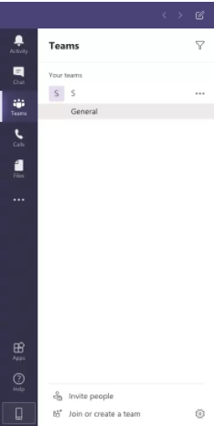
teams
How To Create Teams And Channels
In Microsoft Teams, a Team is a group of people who collaborate together, usually consisting of the entire organization.
Meanwhile, Channels are segregated conversations, where each one can be dedicated to a department, project or even a task.

Slide 41
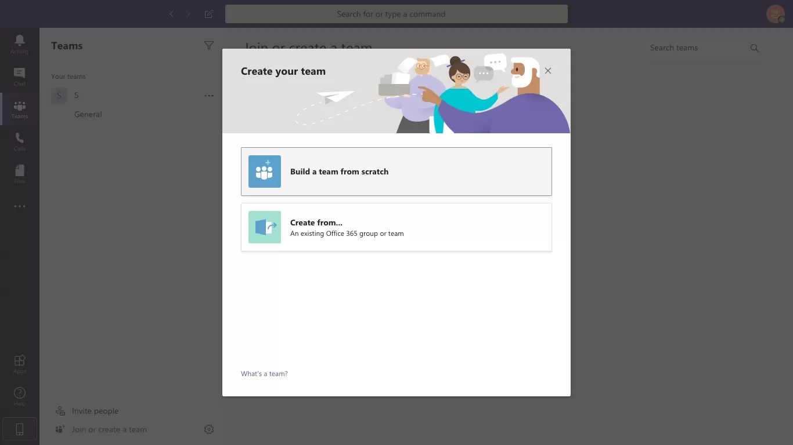
teams
1. Create a team- For desktop
Step 1: Open the Microsoft Teams app and click on the “Join or create a team” option at the bottom of the Teams sidebar on the left.
Step 2: On the new screen that appears, click on the “Create team” button.
Step 3: On the following screen, you can choose:
Build a team from scratch
Create from an existing Office 365 group or team
If your team was using Office 365 before signing up for Teams, you may have existing groups that can be added using the “Create from…” option.
Otherwise, Build a team from scratch.

Slide 42
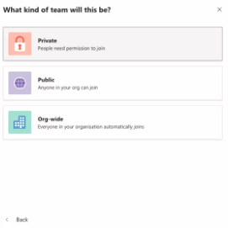
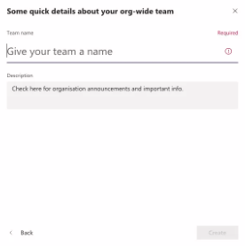
teams
1. Create a team- For desktop
Step 5: Once you’ve chosen the type of team you want to create, you need to give it a name.
Choose an appropriate team name, like “Marketing” or “Social Media”, and then click the “Create” button at the bottom right.
Step 6: Your new team will now appear on the left sidebar of your Teams app (“Marketing” in the image below).
To add members to the team, click on the three dots next to the team name and select “Add member.”
Step 7: Type in the names of the members you want to add.
In case these are “guests” such as external users from outside your organisation, you can give them guest access through their email address instead.

Slide 43
teams
1. Create a team- For desktop
Step 5: Once you’ve chosen the type of team you want to create, you need to give it a name.
Choose an appropriate team name, like “Marketing” or “Social Media”, and then click the “Create” button at the bottom right.
Step 6: Your new team will now appear on the left sidebar of your Teams app (“Marketing” in the image below).
To add members to the team, click on the three dots next to the team name and select “Add member.”
Step 7: Type in the names of the members you want to add.
In case these are “guests” such as external users from outside your organisation, you can give them guest access through their email address instead.

Slide 44
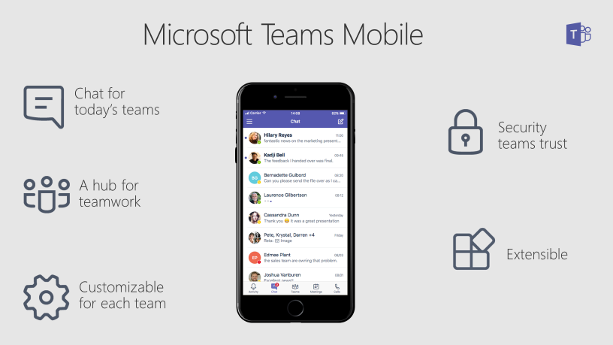
teams
1. Create a team- For mobile
Step 1: Open the Microsoft Teams app.
Step 2: Tap on the “Teams” icon at the bottom of the screen, then an icon of “two people and a plus sign” in the top right. You should reach the Manage teams page.
Step 3: To create your new team, give it a name, add a description and set the privacy settings.
Once you’ve created the team, tap the “More options” icon with three dots and select “Add members.” Type in the names of your team members to add them.
Note: To add groups of people/multiple individuals simultaneously, you need to use the desktop or web app.

Slide 45
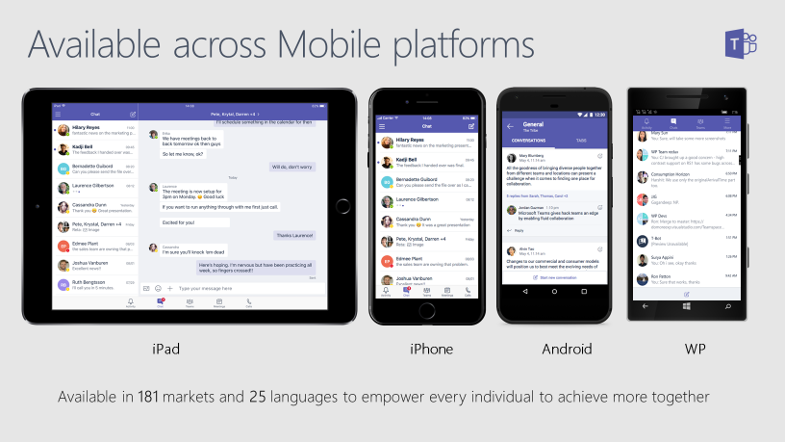
teams

Slide 46
teams
Teams and Channels
To start your teamwork collaboration, you need a team. Setting up Teams is easy and done in a few clicks, requiring a Team name and a description; this then allows team members to be added. As mentioned above, a new Team will create a matching Office 365 Group, OneNote, SharePoint site and Plan—so this does need to be done with some caution.
Each Team has subsections, which are called Channels, and a General Channel will automatically be created. You can have multiple Channels within a Team; for example, you could have a 'Marketing' Team and then Channels such as 'Social Media', 'Product Launch', 'Blogs' etc. Or a Company could be a Team and Channels can relate to departments - you can choose whatever suits your organisation's way of working. Whenever there is a new notification or activity, the Channel will become bold.

Slide 47
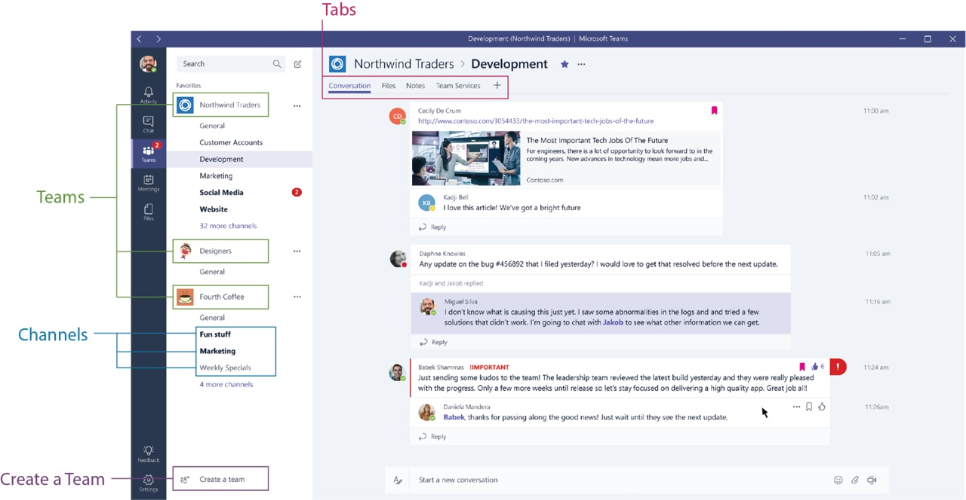
teams
Channel Tabs
Each Channel all have their own tabs along the top. Conversation (group chat), Files (shared documents) and Notes (shared OneNote) are automatically created and you can then add your own tabs.

Slide 48
teams
Conversation
Conversations are one of the key features of Teams, allowing each Team to have a centralised discussion that is saved and easily searchable. Conversations are the central component where all teamwork is recorded—from file sharing to video calls.
The use of @mentions allows you to tag participants or even whole teams to notify others. Users that look at Conversations will easily see where they have been mentioned through the red @ symbol to highlight areas of importance to them. On top of this, your desktop app will notify you through an alert. As well as tagging, users can 'like' content and share emoticons or GIFs.

Slide 49
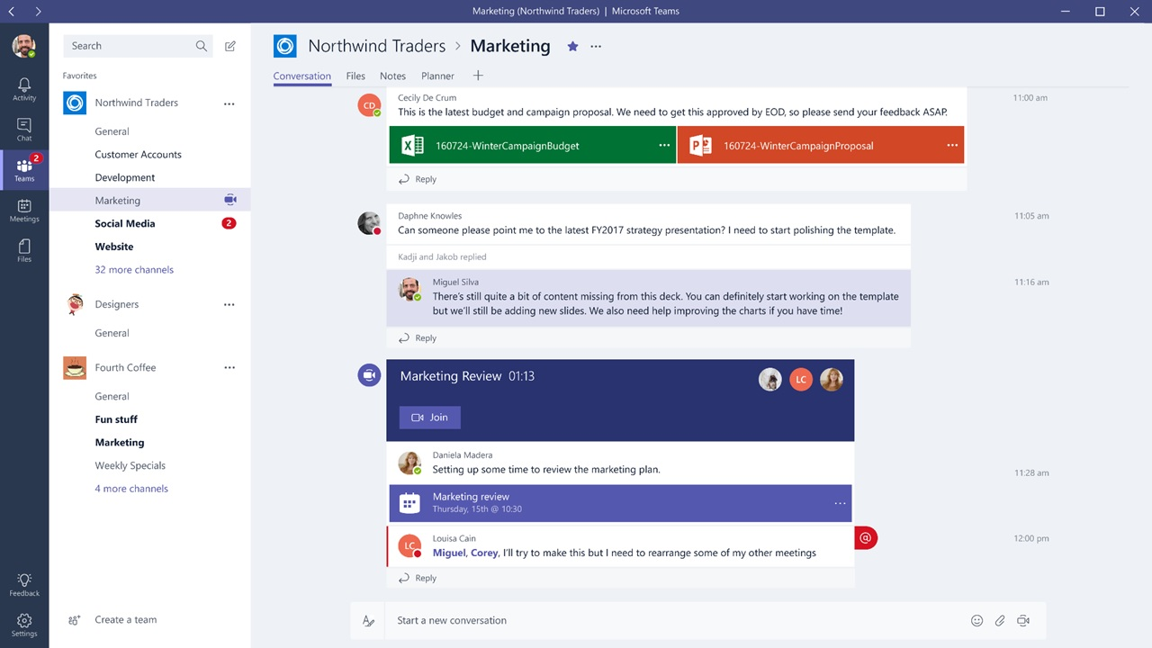
teams

Slide 50
teams
Files
In your Teams window, you can perform a variety of tasks directly within that window or browser, so that you avoid flicking between different applications. These tasks include the ability to delete, download, move files, open, copy, edit or get a link to share with others – giving you all the key features you would get in the native apps.
You can also start a Group chat alongside the file, to allow team discussions while all working on the files - and this conversation will appear in your Conversation thread.

Slide 51
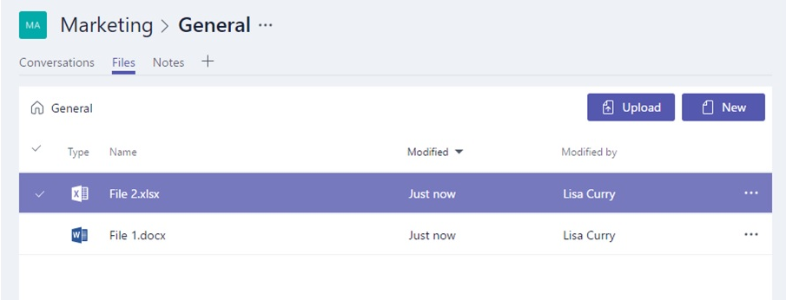
teams

Slide 52
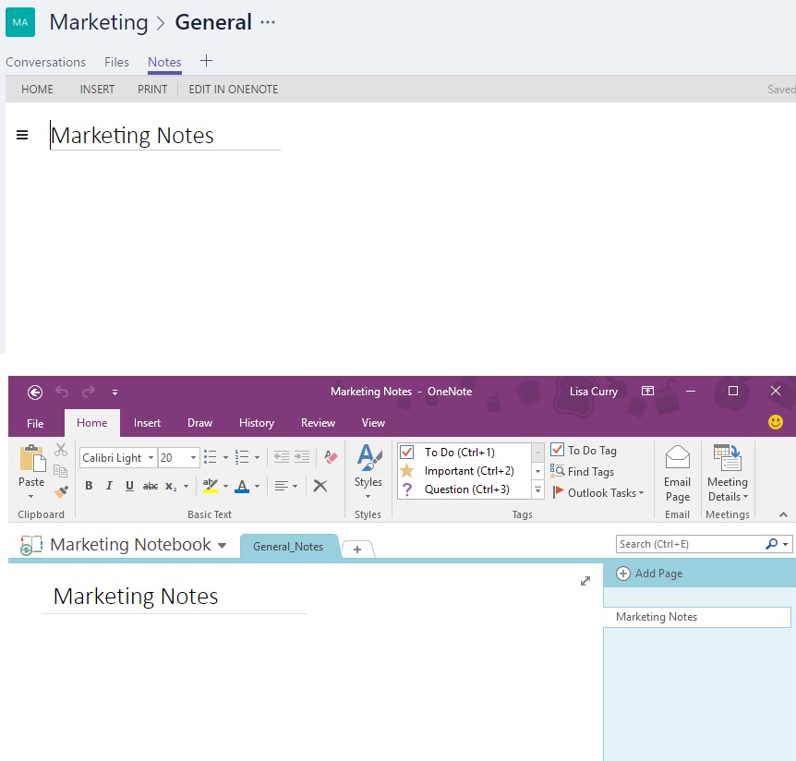
teams
Notes
Notes takes you to the Team shared OneNote.
Within Teams you can view and edit your OneNotes (directly within the Teams window) or you can click to edit in the OneNote app.

Slide 53
teams
Adding Tabs
As mentioned, as well as these three automatic tabs you can also add your own, which currently include Planner, Excel spreadsheets, Word documents, Power BI dashboards and more.
Microsoft products can easily be added now, but there are also many future integrations coming to Teams, such as Asana integration. With integration between systems being so vital to teamwork, we can expect to see many more partnerships and out-of-the-box integrations

Slide 54
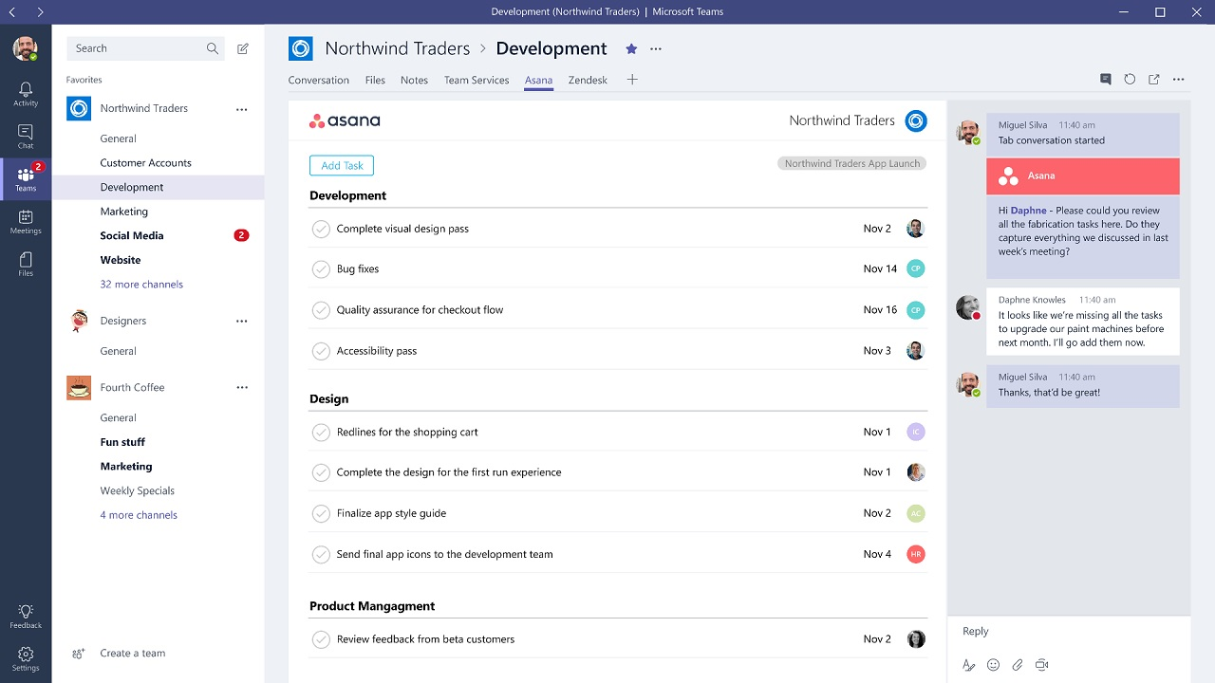
teams

Slide 55

teams
Menu
Along the left-hand side you can navigate to different areas within Teams, such as Chats, Meetings, Files and Activity. Most of these are fairly self-explanatory:
Activities: Shows you the last activities of the Teams that you are part of.
Chat: This holds your Skype for Business conversations, providing a complete chat history. However, for a chat within a Team you should use the Teams menu and hold the group chat in 'Conversation'.
Teams: An overview of all your Teams that you are part of and allows you to drill-down into each Channel within the Teams. This is also where you can create Teams.
Meetings: The Meetings tab pulls your meetings in from Outlook and also allows you schedule meetings within the Meetings tab that are sent to a Team. If you want to schedule other meetings with external users or individuals, you will still need to use Outlook, as the Teams Meeting tab is only to schedule a meeting with a Team. (Remember the aim is team collaboration, not calendar management).
Files: Within Files you can quickly find and view files across OneNote, OneDrive and within Teams (stored in their own SharePoint sites). There’s also a very helpful ‘Recent’ tab so you can quickly access the latest documents you were working on, as well as a shortcut to your Downloads.

Slide 56
teams
Let’s not forget one of the most useful features in Teams; the ability to video conference and make VoIP calls. Don’t forget Microsoft bought Skype some time ago and now Skype for Business has morphed fully into an impressive component of Teams.
We suspect Microsoft is doing it’s usual dominance by stealth in this field. It is not something to be cynical about or ignored. It may be the case that Microsoft ends up completely dominating all forms of communication

Slide 57
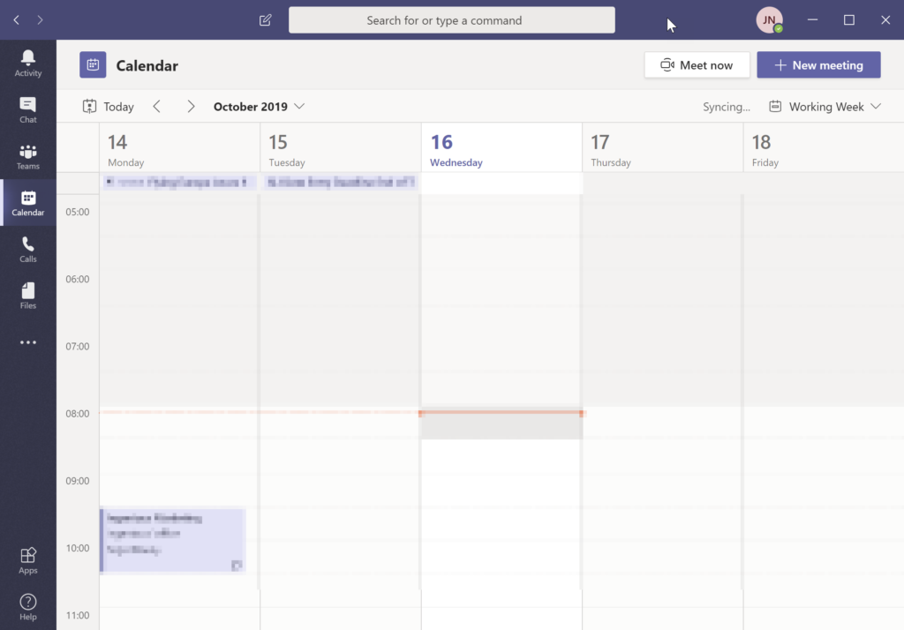
teams
Calendar, Meetings & Video Conferencing
Teams Calendar that fully integrates with your Office 365/Exchange Online calendar. This is where you set up a ‘Meet now’ or schedule a ‘New meeting’ video conference with all the bells and whistles you expect from this technology including recording.

Slide 58
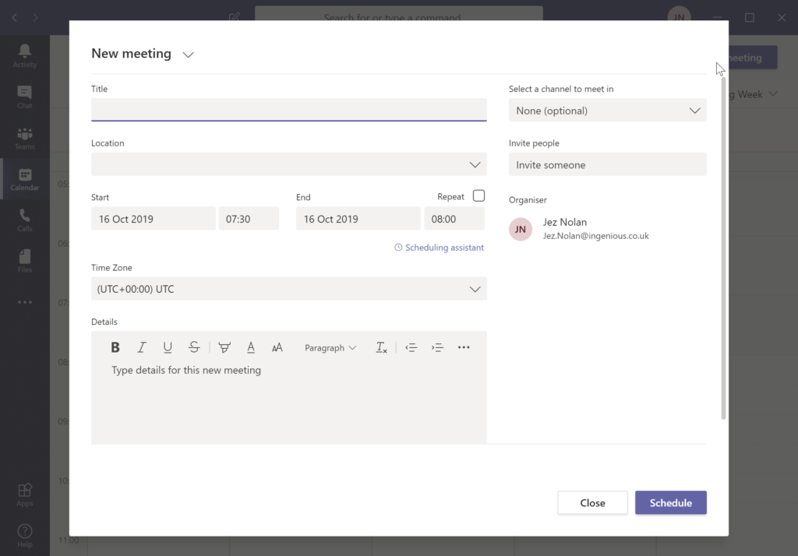
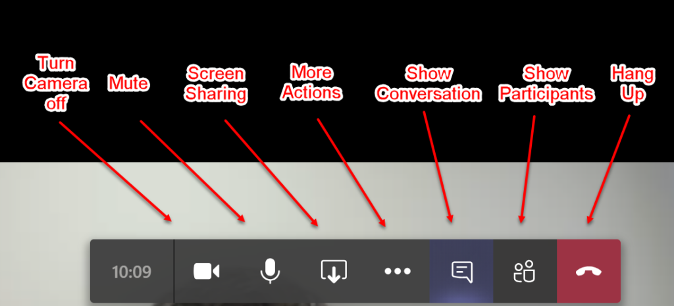
teams

Slide 59
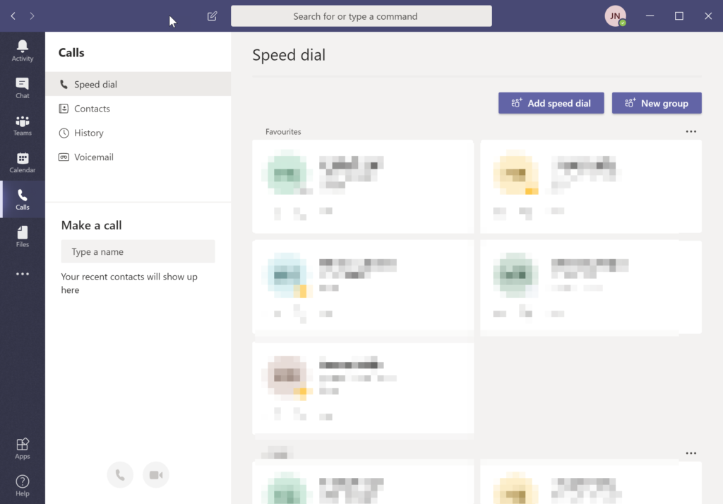
teams
VoIP Calls…Making a call:

Slide 60
Alternative packages

Slide 61

zoom
There are four plans available; the most popular now likely being the free tier, in which virtual meetings can be held with up to 100 participants
1-on-1 meetings without a time limit are possible, and meetings with multiple participants can be held for up to 40 minutes.
(When your time is up, you can simply restart a meeting if need be.)

Slide 62

zoom
The free option also allows users to conduct meetings in HD video and with audio, participants can join via their PC or a telephone line, and both desktops and apps can be shared.

Slide 63

zoom
Zoom's Pro, Business and Enterprise packages come with additional features, including an increase in meeting duration limits, cloud recording and storage, Skype for Business interoperability, single sign-on options, and company branding.
It is possible to join a meeting just from your browser, but in the interests of longevity and avoiding browser limitations, you should download the application

Slide 64
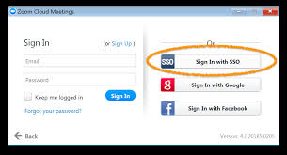
zoom
To start using Zoom, make your choice (browser or a direct download) and then sign up. You will be prompted to type in your work email -- but any will do -- or sign in through either Google or Facebook.
At the next prompt, Zoom will ask for permission to send resources including product videos and how-to guides your way.
Either click "confirm" or "Set Preferences;" the latter option being to receive emails once a week, once a month, or never. Make your selection.

Slide 65
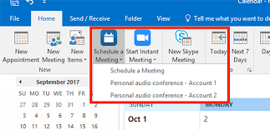
zoom
Now you can choose to create a test meeting if you like, as well as add Zoom as an extension.
There are various plugins available including
  Google Chrome extension
  Mozilla Firefox extension
  Microsoft Outlook plugin
  IBM Notes plugin.
If you will be using Zoom for the foreseeable future for work purposes, you may want to select and install appropriate add-ons.

Slide 66
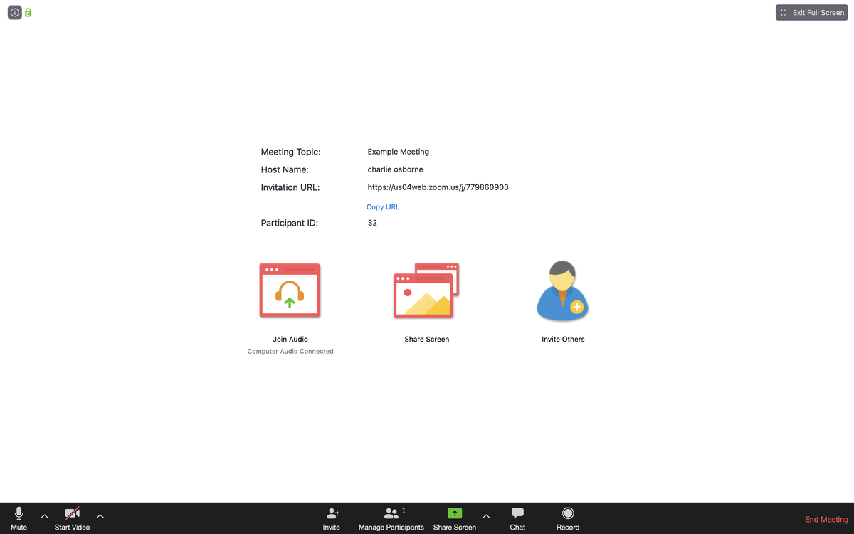
zoom
Once you've launched your test meeting, you will be met with a screen similar to below, containing the meeting's URL and the option to invite others.
make sure that the correct settings are enabled -- and that you know how to create and launch a meeting.

Slide 67
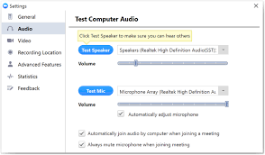
zoom
THE WEB PORTAL
On the Zoom website, head to "Your Account" in the top-right to manage your profile.
You can change details under the "Profile" tab such as your name, picture, default meeting ID, password and time zone.
Next, head to "Settings." Here, you can adjust settings implemented by default, including whether or not video is automatically enabled when you -- or participants -- join a meeting; and whether or not participants can join a scheduled meeting before the host arrives.

Slide 68
zoom
In the interests of security and to prevent scammers from hijacking a meeting, you should make sure you use strong passwords.
Passwords were not always enabled by default, but after Zoom founder Eric Yuan apologised for "falling short of the community's -- and our own -- privacy and security expectations," a rush of security changes were made, including the enabling, by default, of passwords for scheduled, instant, and personal meetings.

Slide 69
zoom
Next up is audio type. You can pick telephone and computer audio or one or the other to be automatically permitted. However, given the rapid rise of users, Zoom has warned:
"Due to increased demand, dial-in by phone audio conferencing capabilities may be temporarily removed from free Basic account[s]. During this time, we strongly recommend using our computer audio capabilities."

Slide 70
zoom
You can also decide whether or not to allow public and private chats when you host a meeting; you can give permission for files to be transferred, and who can share their screen -- just the host, or participants, too.
There are other, more advanced controls, but these are the main settings you should be aware of for now.

Slide 71
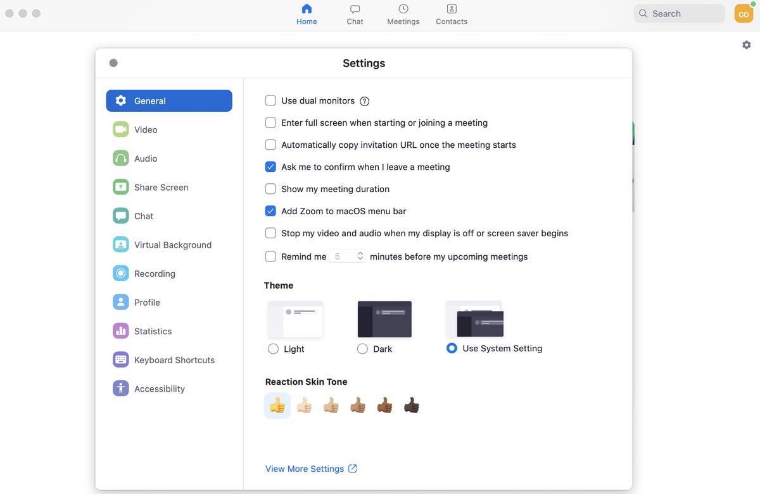
zoom
The Zoom desktop app has a similar layout, with "Settings" accessible from the top-right corner. The options you can access here are related to your PC, such as whether or not you want to use dual monitors or automatically enter a full-screen mode when a meeting starts.
You can also test your microphone and speaker setup, choose a color theme, select a default location for recordings, and tweak accessibility controls, among other functions.

Slide 72
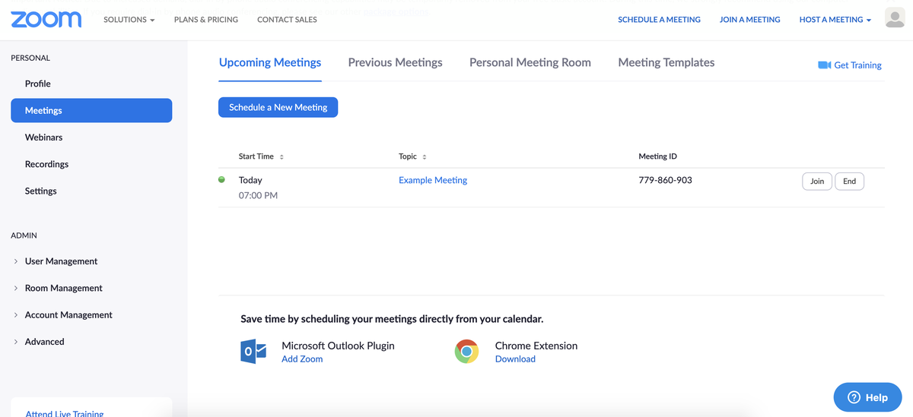
zoom
SCHEDULING AND HOSTING A MEETING

Slide 73
zoom
The first screen you will see reveals any scheduled meetings in your diary. Click "schedule a new meeting" and a new screen will appear, in which you can name your meeting, add a description if you want, and choose the date or time.
If this is to be a continual meet up with colleagues, there is a handy "recurring meeting" checkbox under the timezone tab. If you select it, you can then choose how often the meeting needs to be repeated -- whether daily, weekly, and monthly.

Slide 74
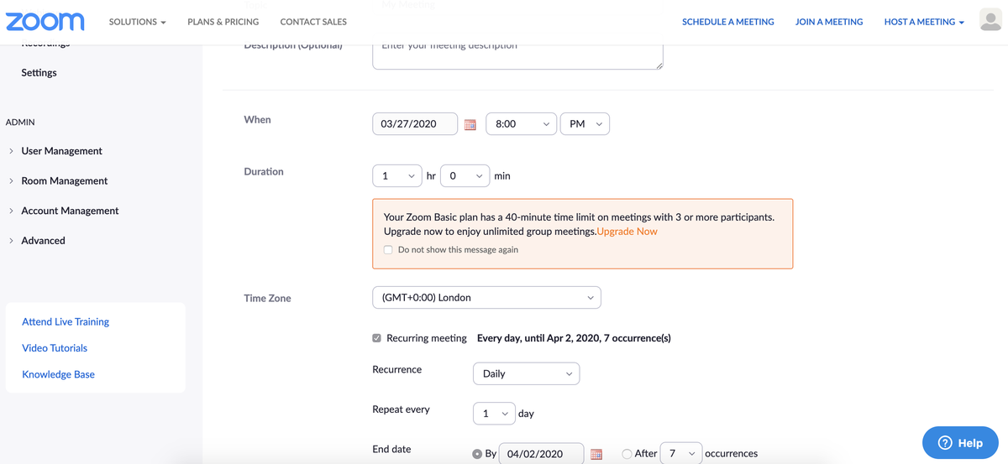
zoom
SCHEDULING AND HOSTING A MEETING

Slide 75
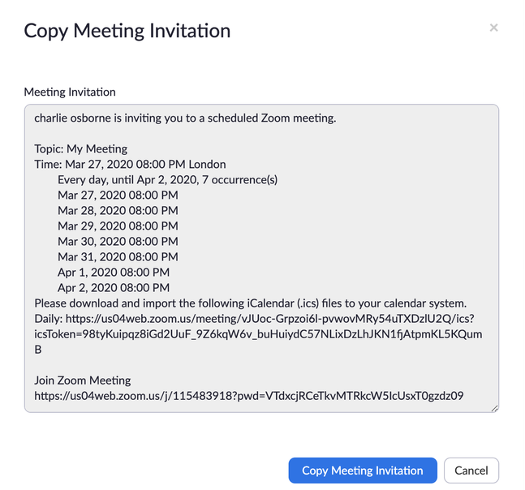
zoom
THE MEETING IS SET, BUT HOW DO YOU INVITE OTHERS?
The short answer is: you must do so manually. There are two ways to do this: through calendar invites, or via your own email account.
If you wish to invite others through a calendar, links to Google Calendar, Outlook Calendar, and Yahoo Calendar are displayed once your meeting has been saved.
Alternatively, next to the "join URL" link on this screen, there is an option to "copy this invitation."

Slide 76
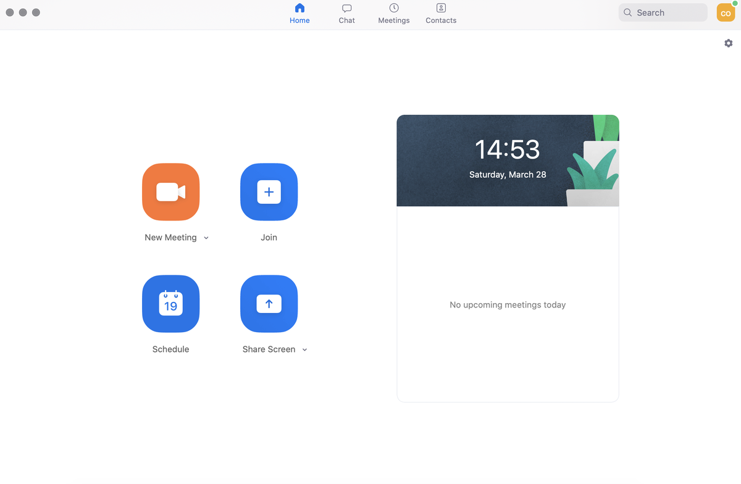
zoom
If you want to try out features before bringing other people in, create a test meeting at this stage and select "Start this meeting."
Alternatively, you can do exactly the same within the first page of the Zoom desktop app:

Slide 77
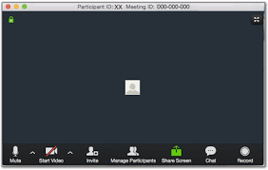
zoom
The first prompt, in either case, will ask you to join with computer audio if you are on PC, and will also give you the option to test your speaker and microphone. At the top right of the meeting window, you can choose to go full screen.
We are now going to go over the basic settings you need to know about in meetings for management purposes.
Two fundamental options can be found in the bottom-left part of the black menu tab: the option to mute/unmute your microphone and either start/stop your camera.
If you are using an external microphone, speaker, or camera, open up the arrow tabs next to these options to choose which equipment you want to use (external or inbuilt).

Slide 78
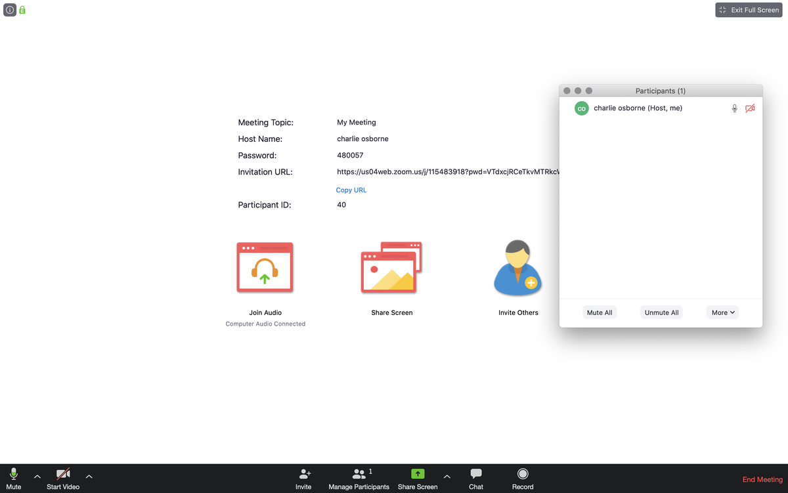
zoom
Moving on, the "Manage Participants" tab is particularly important. Under this tab, you can find "invite," which is useful if you've forgotten to bring someone into a session.

Slide 79
zoom
Clicking this option will bring up a box with everyone connected to the meeting. If you hover over a name, you can mute/unmute them, and at the bottom, there are options for doing the same for every participant. In the interests of privacy, however, hosts and other participants cannot control individual camera feeds.
A handy feature to note here under "More" is "lock," which stops anyone else from joining an active session.

Slide 80
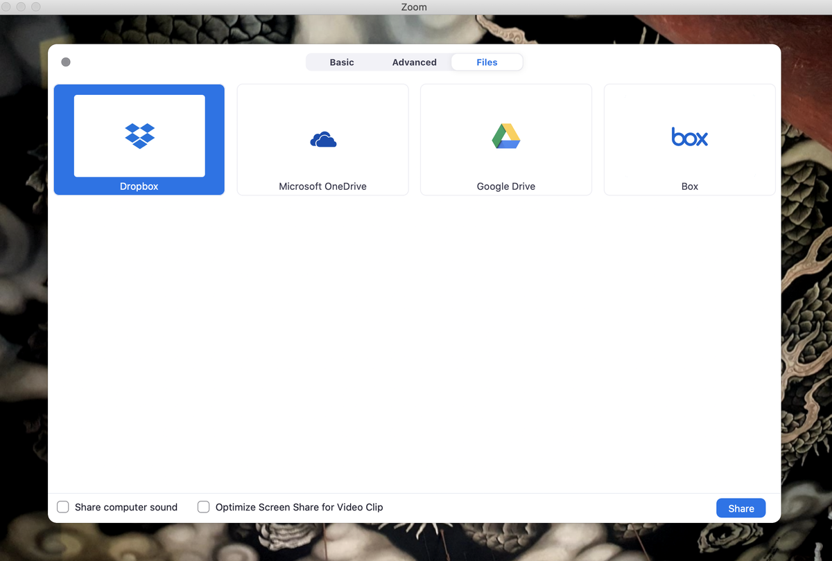
zoom
The "Share Screen" tab has a number of interesting features. When selected, under "Basic," you can choose to share your PC screen with others, including your full desktop, browser, or open applications. There is also a whiteboard option that can be annotated -- we will talk about this more shortly -- and it is possible to share iPhone screens if you are on the move, too.
Under "Advanced," you can share a screen portion, music or sound only, or content from a second, connected camera.
There is also a file-sharing tab under "share screen" (shown under "Files"), which includes application links to Dropbox, Microsoft OneDrive, Google Drive, and Box.

Slide 81

zoom
As a host, you can also use the arrow next to the "Share Screen" tab to control whether participants are limited to one screen share at a time, or alternatively, you can give permission for multiple screens to be shared at once.
Now, let's talk about messaging. The "Chat" tab on the main bar is designed for users to type out questions and messages, as well as share files either hosted by cloud storage providers or stored directly on your PC.

Slide 82
zoom
As a host, you can also select the "..." button to save a chat session and control who participants can talk to -- no one, the host alone, everyone publicly, or everyone publicly and privately.
The final tab of note is the "Record" option, which you may want to use if you are discussing work matters and want to save the session in order to email a copy of it to others later. By default, no one except the host can record a session unless the host gives permission to do so.
Finally, the "End Meeting" tab finishes the session. If the host needs to leave but the meeting should carry on, they can assign the host status to another participant -- but enabling co-hosts has to be selected first in the "Meetings" tab and can only be selected by subscription holders. Alternatively, you can leave the meeting or end the meeting for all.

Slide 83
zoom
THE SECURITY TAB
The company added a "Security" icon for meeting hosts to more easily access settings including lock, waiting room, and remove participants.
Under this tab, scattershot security settings are now clustered together. This includes the "lock meeting" function, whether or not to enable the "waiting room," and participant control -- allowing or disabling screen sharing, chat functions, renaming, and annotating. In addition, you can quickly remove gate crashers or disruptive participants

Slide 84
zoom
ADVANCED TIPS AND TRICKS
Now that the basics have been covered, there is a range of settings and features that more experienced users might want to use.
Let's head back over to the web portal to run through a few options. If you are using the desktop application, you can quickly access this area by going to "Settings" -- > "View More Settings."

Slide 85
zoom
Under "Settings," select "In Meeting: Advanced," to find features including:
Breakout room: split meeting participants into separate, smaller rooms. This can also be done before a meeting begins to prevent logistical problems
Remote support: allows a host to provide 1:1 support to a participant
Camera control: you can allow a participant to take remote control of your camera
Show a "Join from your browser" link: a workaround for users that can't download Zoom software
Invitation languages: You can choose from a variety of languages for meeting invitations, including English, Spanish, French, and Russian.
Virtual backgrounds: enabling/disabling
Waiting room: a feature to keep participants in a 'waiting area' until the host is ready for them -- particularly handy for remote interviews or office hours. This feature is now on as default for education, Basic, and single-license Pro accounts.

Slide 86
zoom
WEBINARS
If you have a Pro, Business, or Enterprise plan, you can take advantage of the webinars option. Webinars can be set up that broadcast to up to 10,000 view-only attendees at a time.
Screens, video, and audio can be shared; chat sessions between attendees and panelists can be hosted, and webinars can be run on either a pre-registration or open basis.

Slide 87
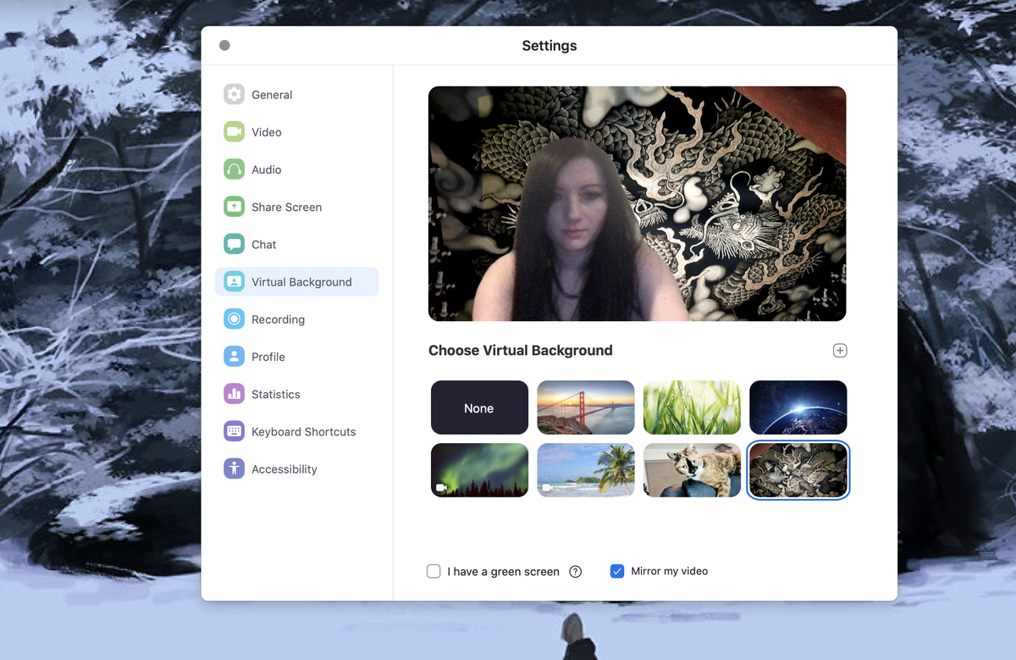
zoom
VIRTUAL BACKGROUNDS
Virtual backgrounds can be used to hide the chaos and clutter of your home. There are specific hardware requirements, which can be accessed here. Most modern PC setups should be able to manage -- but the virtual background works best with a green screen and uniform lighting.
To set up a virtual background, go to the desktop app, "Settings," and choose "Virtual Background." You will be prompted to download a virtual background package -- just once -- and then you can try out different screens or add your own image/video instead. You may see a warning that says your hardware isn't good enough -- but give it a go, anyway.
Once you've enabled and selected a virtual background, while in a meeting, you can toggle them off/on next to the "Stop Video" tab.

Slide 88
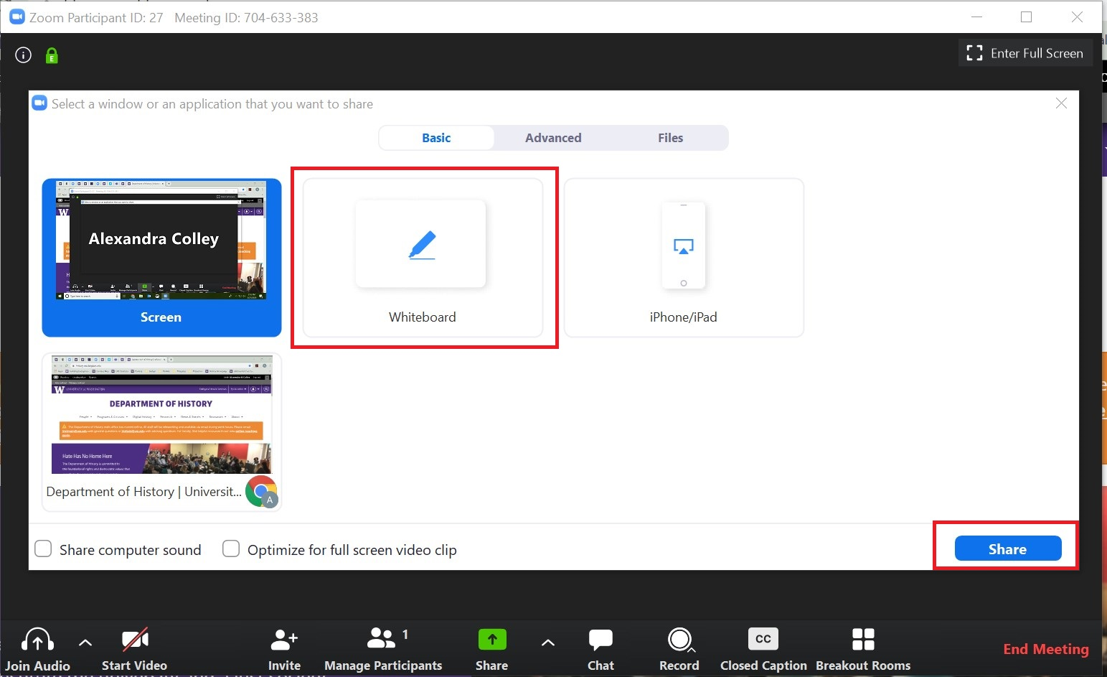
zoom
WHITEBOARDS
Earlier, we mentioned the "whiteboard" option under the "Share Screen" tab.
This is a useful option if you are canvassing ideas or soliciting feedback and it comes with different annotation options, including text boxes, arrows, and more.
The "spotlight" is a form of highlighter which can be used to bring user attention to a particular area or point.

Slide 89
zoom
ADDITIONAL POINTS
When screen sharing, the "optimize option" is especially useful when sharing YouTube and other online videos as it can prevent distortion, lagging, and buffering issues.
Hot Keys and keyboard shortcuts are available for Mac and Windows machines. A full list can be found here.
Meeting times: If you are experiencing connection issues at peak times, consider scheduling a meeting at times other than on-the-hour or on a half-hour.
Need training for specific purposes, such as for education? Zoom offers over 30 live training sessions per week.
If you need additional technical support, Zoom has an online help center.

Slide 90

zoom
ZOOM'S BEST PRACTICES
Double-check meeting default settings
Test your audio and video as you join
Use a USB-connected headset
Mute your microphone when not speaking
Position your webcam properly
If hosting, connect from a large screen
For best results, use the app and not a browser
Use a stable/wired connection
Join meetings in quiet areas

Slide 91

Google Hang outs
Google launched Google Hangouts in May 2013. This platform replaces Google Talk, Gchat, and Google Messenger as well as the Google Plus Video Chat feature.
The free chat service allows people to chat one-on-one or in groups.
You can have up to 10 people in a video call (or with a corporate account, up to 15)
Up to 100 people in a text chat hangout.

Slide 92

Google Hang outs
Google Hangouts is super simple to use. From friendly chatting and long-distance movie nights to work meetings and video conferencing, it allows for an easy way to collaborate and share.
Google Hangouts is easy to use.
After using it a handful of times, it will be like second nature.

Slide 93
Google Hang outs
What Do I Need To Use Google Hangouts?
You can access Hangouts via desktop and laptop computers and iOS and Android powered smartphones and tablets.
To get started with Google Hangouts, you must have a Google account and download the Hangouts app.
The Hangouts app is free and very quick to download. If you’re using Hangouts on a computer, you can view it in your browser.

Slide 94
Google Hang outs
What Do I Need To Use Google Hangouts?
If you're going to use Google Hangouts for video calls, it's ideal to have a camera so that people can see you during calls.
You can use the internal camera in your computer or mobile device or you can use an external camera.
You'll also want to think about the microphone that you're using.
You have the option to use the internal microphone or you can purchase a separate device.

Slide 95

Google Hang outs
Open Hangouts in Gmail or go directly to the Hangouts site:
You can start or join a hangout straight from hangouts.google.com, Gmail or literally anywhere that you see the green speech marks on Hangout.
Simply click on the speech marks to open up the chat section of Hangouts. Then start typing where you see “+ new conversation.”

Slide 96
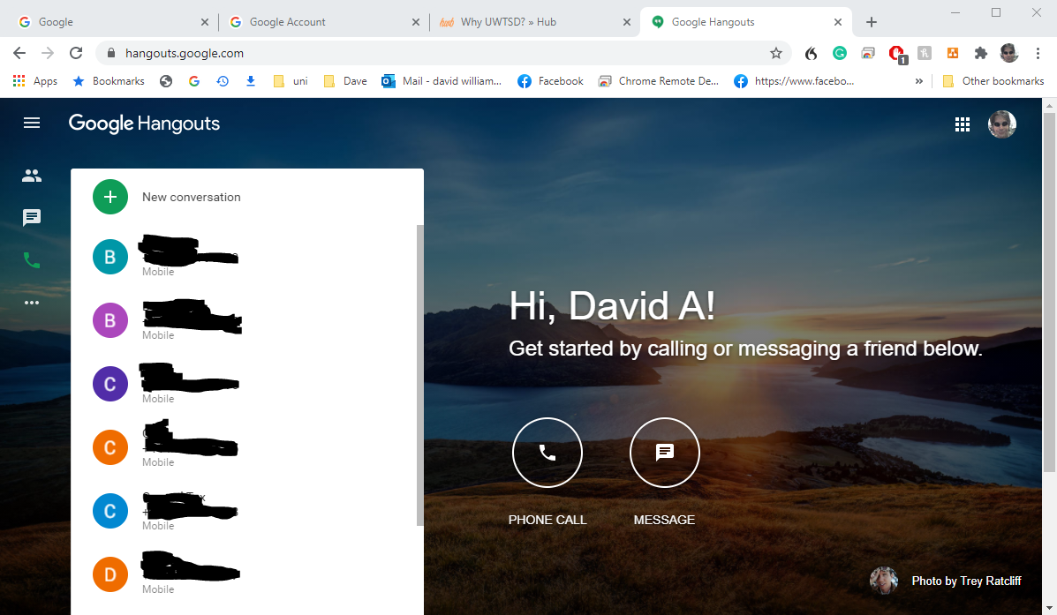
Google Hang outs
Choose Video, Phone Call, or Message:
You can choose do a Hangout on
video
audio only
through text

Slide 97
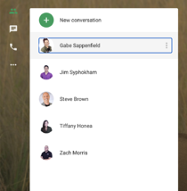
Google Hang outs
Choose Person to Hangout With: For video, you'll need to click "Join or Start a Meeting." Then, you'll be asked to enter a meeting code. You can leave it blank if you're starting your own call. Once you hit "continue," hangouts will automatically start the meeting.
All that's left to do is invite the rest of the party. If you want to have a video call with one specific person, you can enter their email into the contacts on the first screen, click the three dots to the right of their name, and click "Start a video call."
To call someone, click the phone icon on the left side of the screen. You'll need to enter a name or phone number to continue.
Sending a message is simple. Find the person you want to connect with in your contacts. Then, click their name. A record of all your conversations will instantly pop up. You can also click "New Conversation" to start a message board with multiple people.
There are additional ways to start a hang out from Gmail

Slide 98


Google Hang outs
How Is Google Hangouts Different Than Skype Or FaceTime?
There are several similar services available, including Zoom, Skype, FaceTime, and Facebook Video Chat.
However, Hangouts are focused on group conversations more than one-on-one chatting and use more sophisticated technology to switch focus on the person currently chatting.
One reason that people choose Hangouts is for the capacity to share documents, photos, and videos while they're chatting.
There are endless applications for sharing media via a text or video conversation from sharing personal experiences with family and friends to conducting business while viewing the same material.

Slide 99
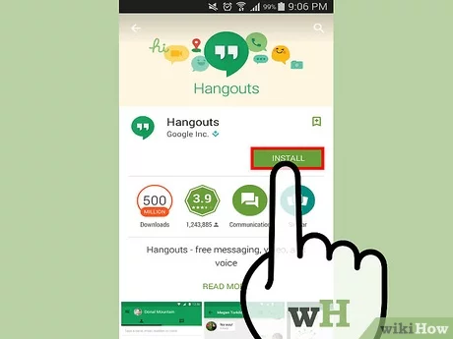
Google Hang outs
How Is Google Hangouts Different Than Skype Or FaceTime?
Hangouts isn't as fancy as Zoom or Microsoft Meetings. This might seem like a con, but it has benefits.
It's ideal for more secure industries, as you're at a slightly smaller risk of unexpected visitors joining your private chat.
Compare that to Zoom, who has been in the news recently for having some unpleasant visitors drop into calls with young children.
You can also use Hangouts to contact people within your company without having to send texts or emails, keeping all your communications in one place.

Slide 100
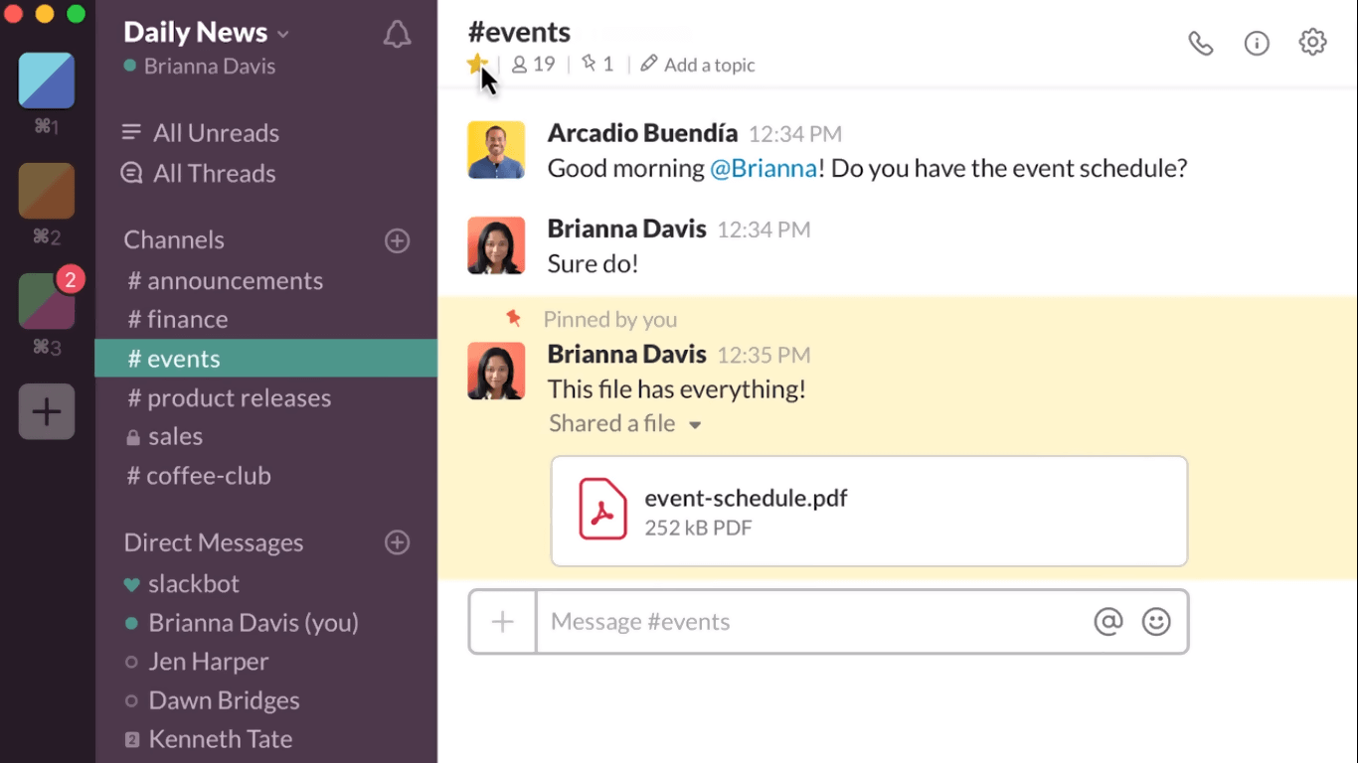
Slack
Slack is a smart collaboration tool that is available in both desktop and mobile versions.
It allows teams to send direct messages to each other as individuals as well as groups.
You can also organise conversations into various channels for specific initiatives or projects, and integrates with the best Slack apps like Google Docs, Box and Dropbox for a more unified experience.

Slide 101
Slack
Pros
Hosted in the cloud so no need for costly installations
Messages are fully searchable
Supports private group communication
Allows for external sharing

Slide 102
Slack
Cons
Has a message visibility limit
Pretty expensive on a per user basis
Is slower to load than other apps such as Flock or Brief
It can be cumbersome to sign into each workspace to communicate with different teams

Slide 103
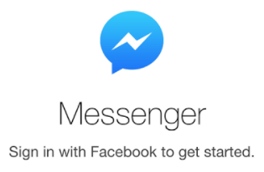

Social media platforms
Messenger
While Messenger is appropriate for having fun with friends, it’s viability as a collaborative tool is undermined by the sheer number of things that can be done within the app.
Those using Messenger for collaborative purposes may find some features to be distracting by nature—there may not be a legitimate use for a collaborative team to play games or send stickers.
As an instant message or chat application, Messenger’s purpose is to facilitate private conversations between users.

Slide 104
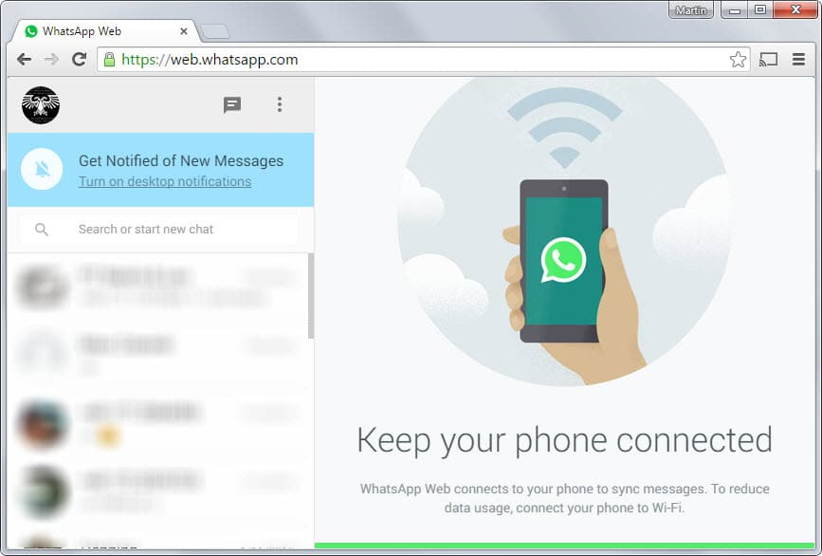
Social media platforms
WhatsApp
With many employees using WhatsApp as a messaging tool in their personal life, it’s understandable why this platform might easily blend into workplace communications
Most people think of WhatsApp as their social app to talk to their family and friends. Because of this, using it for work causes inefficiencies in communications, as its interface mixes all your conversations in one platform.
This can create confusion in your communication as you sift through chat topics from both your personal and professional contacts.
WhatsApp serves solely as a chat platform without any functions for task management, project collaboration, HR processes, shift reporting, auditing and more.
Because of this, it’s likely that you will need to juggle it along with other platforms to get work done efficiently.

Slide 105
Tasks

Slide 106
Tasks- work in pairs\small groups
One
Download and\or make accounts for each of the collaboration tools discussed in class, where multiple interfaces are available e.g., desktop, mobile or browser. Experiment with each
Two
Within your pairs or groups attempt the various functions of the application to meet and share information – collect screen-shots
Three
Construct a table for each application explored analysing the elements that were difficult and those that went well in your investigation for discussion in class

