Slide 1
Noise
Professor Ian Wells

Slide 2
Noise in a Channel
A typical communications channel may be represented as below:
Noise in
Receiver
Natural noise
Transmitter
Receiver
Interference
Spurious
Emissions

Slide 3
Noise Types
All channels are subjected to some form of unwanted interference that we usually categorise as noise.
Typically this noise signal can be divided into two general forms which are
  Deterministic
  Random

Slide 4
Deterministic noise
Deterministic means that there is some degree of prediction possible about the behaviour of the signal.
The deterministic noise form is then by its nature predictable and can thus be modelled accurately with a view to reduction or eradication of the effects on a given message signal.
A good example of a deterministic noise signal is ‘mains hum’ (induced from standard single phase power supplies) which appears as a 50Hz sinusoid, super imposed on the signal. It usually occurs as result of poor earthing installations.

Slide 5
Random noise
This is the most common form of noise but because it is random and not deterministic in nature it cannot be easily modelled or therefore predicted.
For this reason random noise is analysed by using statistical methods such as probability theory.
Some sources of thermal noise would include the thermal excitement of electrons in semi-conductor junctions and also electromagnetic radiation.

Slide 6
Random noise
Random noise is theoretically composed of an infinite number of frequencies and each frequency can have the same power contribution.
It is characterised by:
  A probability density function (more on this later)
  Its spectrum

Slide 7
Random noise
Basically this means that we can only give an expectation of its future effect based on past behaviour in a system. This is known as a casual relationship.
We can measure:
  Average power
  Frequency bandwidth

Slide 8
White noise (AWGN)
This is random noise having equal power density at all frequencies. For true white noise the spectrum is infinite however the physical system will impose bandwidth restrictions.
A good model for noise is provided by the Gaussian or normal distribution. A plot of noise frequency of occurrence against amplitude for many instantaneous values of the noise gives a frequency distribution as shown next.
Often called Additive White Gaussian Noise (AWGN)

Slide 9
A Gausssian Distibution
Frequency of occurrence
x
x
x
x
x
x
x
x
x
x
x
x
x
x
x
-ve
0
+ve
Amplitude

Slide 10
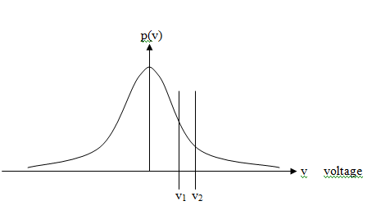
Probability Distribution Function (PDF)
The mean and standard deviation (variation from the mean) are useful measurements.
When the number of samples approaches infinity then the curve becomes continuous, described by the probability density function (PDF).

Slide 11
Maths
The probability that a value is within a range is given by:

Slide 12
More maths
Most noise has the Gaussian or normal distribution for which the p.d.f. is:
Where µ is the mean or average voltage and σ is the standard deviation (r.m.s. deviation from the mean).
Note that the average noise power is given by:

Slide 13
Rayleigh and Rician noise
In communications systems two other noise models are often encountered.
They are:
  Rayleigh noise
  Rician noise

Slide 14
Rayleigh and rician noise
These occur in wireless network and mobile communications systems.
Rician noise occurs where there is line of sight between the transmitter and receiver.
Rayleigh Noise occurs where there is no line of sight between the receiver and the transmitter.
Probability density functions also exist for these noise sources as they do for Gaussian noise models but with different shapes.
This means that the manifestation of the noise on the signal will ultimately have a different contribution to that of Gaussian noise and at different signal levels

Slide 15
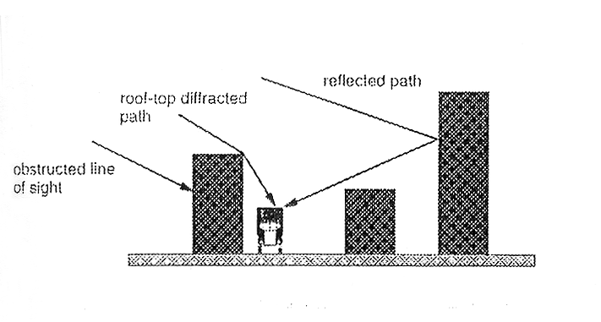
Multipath Signals
As well as the line of sight signal, not shown in this diagram, a signal can have components from
  Reflection
  Refraction
  Diffraction

Slide 16
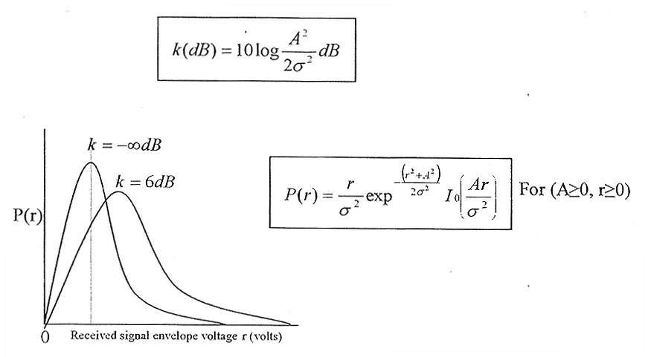
Rician PDF

Slide 17
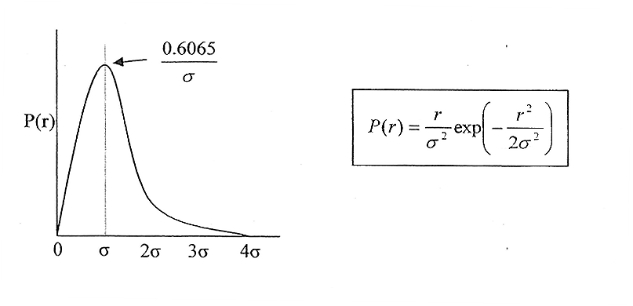
Rayleigh PDF

