Slide 1
Classical myth and art
5-6

Slide 2
Theseus
Mythical founder of Athens: foundation myths are v. common
Had two fathers (Poseidon and Aegeus), just like Heracles
Just like Heracles, had epic fights, mainly centred on the notion of preserving or protecting the social order.
He is said to be responsible for the unification (sunoikismos) of Attika because of his 6 labours
A major source for the myth is Plutarch’s Life (http://classics.mit.edu/Plutarch/theseus.html)

Slide 3
Early life
Lived in Troezen with his mother Aethra
Only learned his true identity when a young man
Had to return his father’s weapons to him in Athens to claim his birthright

Slide 4
The six labours
On his journey from Troezen to Athens, Theseus performed his six labours.
1. He killed a son of Hephaestus, PERIPHETES (“club-man”), from the club that was his weapon.
2. He killed SINIS (“pine-bender”), by tying him to two bent trees, which he then released; this had been the way in which Sinis killed his victims.
3. He killed the monstrous Sow of Crommyon.
4. He killed SCIRON, who kicked travellers on the narrow path on the sea-cliffs into the sea, where a huge turtle devoured them. Theseus killed him in the same way.
5. He wrestled to the death with CERCYON at Eleusis.
6. He killed PROCRUSTES (“the stretcher”), who would kill travellers by making them lie on a bed. He would hammer out those who were too short, until they fitted the bed, and he would shorten with a saw those who were too long. Theseus killed him by his own methods.

Slide 5
The story continues…
Nearly killed by Medea, Aegeus’ new wife, but he recognises his own weapons just in time.
Captured and sacrificed the bull of Marathon
His most significant exploit is killing the Minotaur (c.f. Heracles) who is imprisoned in the labyrinth of Daedalus
https://www.youtube.com/watch?v=OgLAz3HOg7I

Slide 6
Themes and issues
Overlapping nature of myth and history: myth to explain the dominance of one culture over another and its eventual reversal
Overlapping nature of myth – you tell one, you end up telling another
Cultural reinforcement of a shared identity
The extreme: think of the way the minotaur is created
‘Folk tale’ nature of the help of Ariadne and the thread
The palace of Knossos itself as the labyrinth?
https://www.youtube.com/watch?v=0W1VnONayvc

Slide 7
The minotaur myth as a male initiation ritual?
In one tradition, Theseus arrives dressed as a woman. In an initiation, you start as less than a man.
Men are removed from their villages to be sacrificed
Theseus is doomed to die at the hands of the minotaur, but the death is the opposite
The others who are meant to die are saved
Theseus returns with the men and becomes king.

Slide 8
Psychological Theories
The minotaur at the heart of the labyrinth can be seen as displaying the deeper desires of the human subconscious.
The way the minotaur was created was itself a transgression of socially accepted moral practices.
The labyrinth itself has been seen as the difficult path to enlightenment.
The encounter with the minotaur leads to the death of T’s father: a version of Oedipal desires (black/white sails); T later destroys his own son Hippolytus: the same desire in reverse?
Daedalus: his son Icarus dares too much and so drowns in the sea.
What do we make of Ariadne?

Slide 9
What do we make of the myth?
https://www.youtube.com/watch?x-yt-ts=1422579428&v=G7rogJaLfpU&x-yt-cl=85114404
Sir Arthur Evans in Knossos
Rule over the sea? Crete, then Athens…
T joined Heracles fighting the Amazons
T was married to Helen, the one who went to Troy, while T was in the underworld to snatch Persephone to be the bride of his friend Pirithoüs…
T protected Oedipus in his old age.
T offered refuge in Athens to Heracles after he killed his wife and children, as well as the Seven Against Thebes.

Slide 10
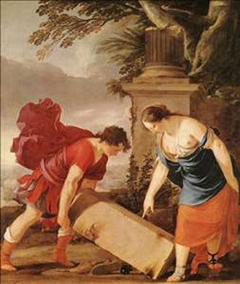
Laurent de La Hyre, Theseus and Aethra

Slide 11
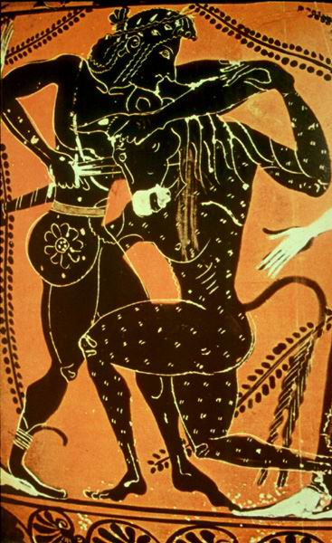
Theseus and the minotaur

Slide 12
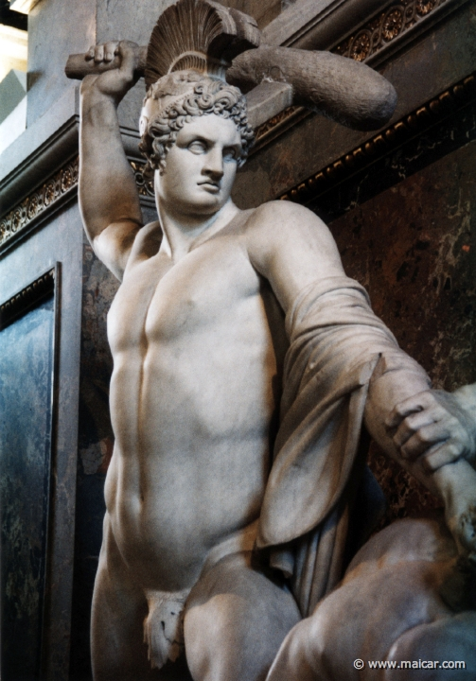
Theseus (Roman copy)

Slide 13
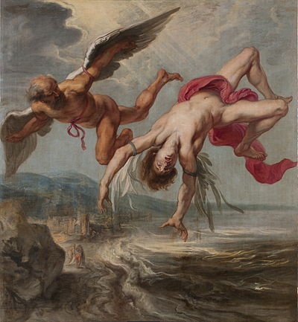
Jacob Peter Gowy, The flight of Icarus

Slide 14
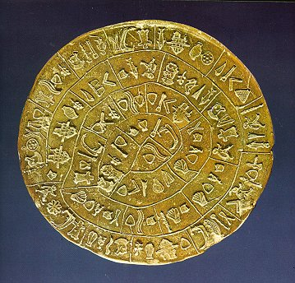
Phaistos disk, Linear A

Slide 15
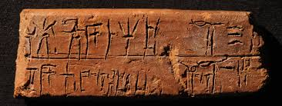
Linear B

Slide 16
In the movies…
https://www.youtube.com/watch?v=akUhoJ1oUIA

Slide 17
Later uses of the myth
Mary Renault, The King must die; The Bull from the sea.
Suzanne Collins, The Hunger games (inspired by Theseus)
Theseus is the Duke of Athens in Shakespear’s A Midsummer Night’s Dream and The Two Noble Kinsmen.
Chaucer, Theseus is Duke of Athens.

Slide 18
What is a hero?
https://www.youtube.com/watch?x-yt-cl=85114404&x-yt-ts=1422579428&v=vVtl8NA1ea4#t=50
(deeply entertaining)

