Slide 1
ECYW6004
Young people and society 3:
Trauma, Exploitation and Toxic Childhood
Lead lecture: 2nd March 2021

Slide 2
Aim of module
To equip students with the in-depth knowledge and understanding of issues which impact upon the lives of children and young people in contemporary society within the themes of trauma, exploitation and toxic childhood.

Slide 3
Learning outcomes
Upon the successful completion of this module, the student should be able to:
  Demonstrate a critical understanding of the social factors which impact upon children and young people in contemporary society, and the consequent impact upon youth work practice and wider services for young people.
  Critically consider the ways that youth work and practitioners can best support young people who are facing these challenges.
  Organise their knowledge and learning through use of a range of information resources, and present their work appropriately.

Slide 4
Indicative content
An exploration of a range of issues which affect young people in contemporary society, which include Child Sexual Exploitation, homelessness, addiction, poverty, obesity, toxic childhood, and County Lines.
Understanding how trauma can affect young people’s future life chances.
Understanding society, the how this shapes and impacts upon both young people and the services that support them.
An exploration of the range of ways young people can be supported through these challenges including the foundational relationship building as a means of buffering young people and promoting transformational change.
Self-care – its place within practice.

Slide 5
Assessment
Mode of assessment | Volume | Weighting
Individual Presentation | 20 minutes | 100%

Slide 6
Submission date
Thursday 25th March 2021
(Provisional Grades and Feedback: 14th May 2021)

Slide 7
Seminar Question
Incorporating issues studied in this module, students are required to design an advisory leaflet for parents and guardians focusing on an issue faced by young people in contemporary society. Students will be required to ‘present’ their advisory leaflet, ensuring they demonstrate how youth workers and other young people practitioners can best support at risk young people. Your presentation should be supported by wider reading, and linked to the Youth Work National Occupational Standards (CLD Standards Council Scotland, 2019).

Slide 8
Guest lecturers
Child Sexual Exploitation/Child Criminal Exploitation (11th March)
Homelessness (16th March)
Trauma (18th March)

Slide 9
Expectations…

Slide 10
Group Task
In your groups, discuss and respond to the following:
  What is life like for a young person today?
  What are the social factors which impact upon young people in contemporary society?
  What do you think is the most important problem that needs to be tackled for young people?

Slide 11
Feedback…

Slide 12
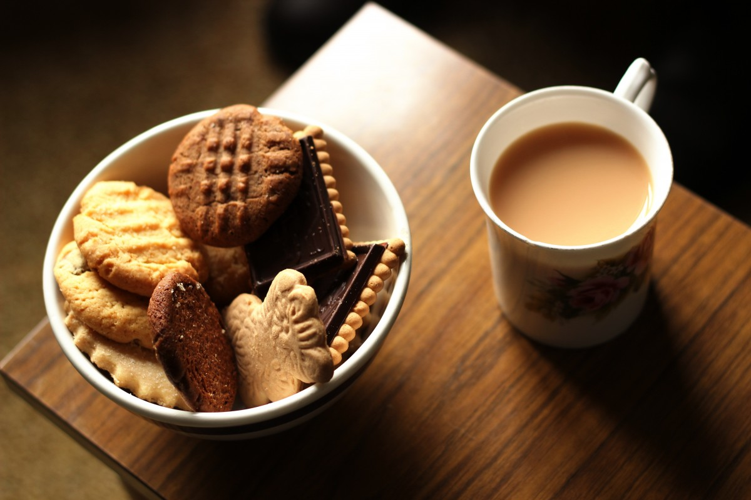
Break

Slide 13
Self-Care: its place within practice
Group Task:
  What is meant by self-care – can you offer a definition?
  Do you practice self-care?
  Can you share suggestions for self-care practices? For example,
      some you may have used yourselves?
      some you may have used with young people?
      some you’ve heard of but not tried?
  Feedback

Slide 14
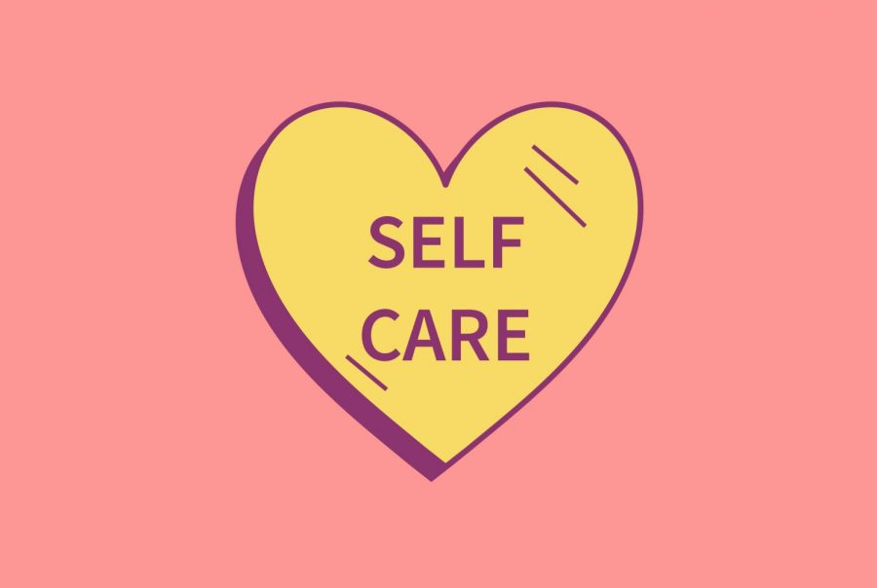
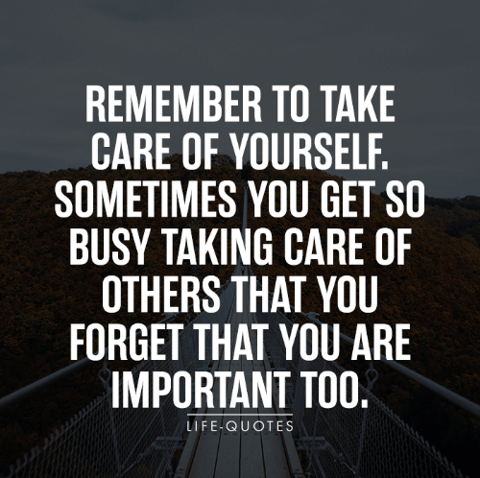
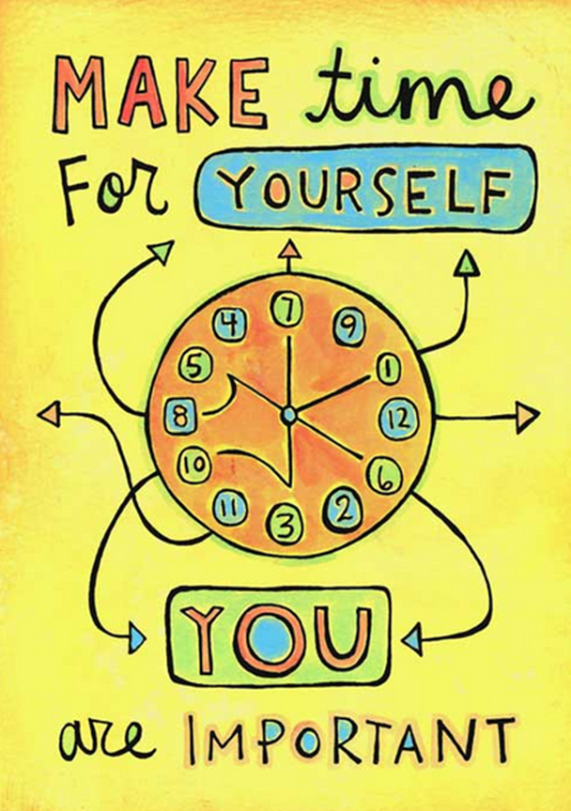
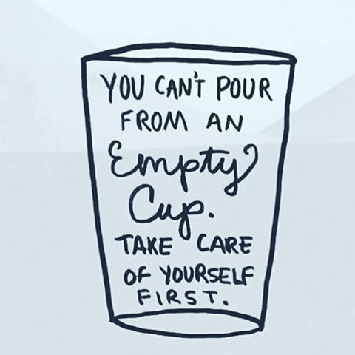
Self-care
Self-care can be defined as “anything that we deliberately do (or refrain from doing) with our own well-being in mind. It means giving ourselves the same grace, compassion, and care that we give to others” (Suleman, 2019, no page number)
It can mean “anything from seeking treatment when you're ill to staying clean, fit and healthy - but it's also nice things we can do for ourselves. Candles, chocolate, bubble baths, a good cup of tea… all the stuff that makes you go ‘ooh’ ”(BBC Bitesize, 2021, no page number).

Slide 15
Self-care
As youth workers, we show a selfless concern for the well-being of young people
However we also need to ensure that we look after ourselves…

Slide 16
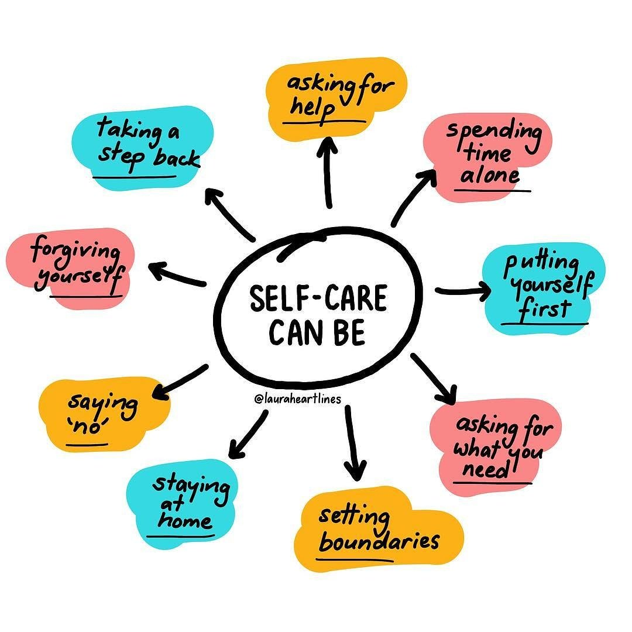

Slide 17
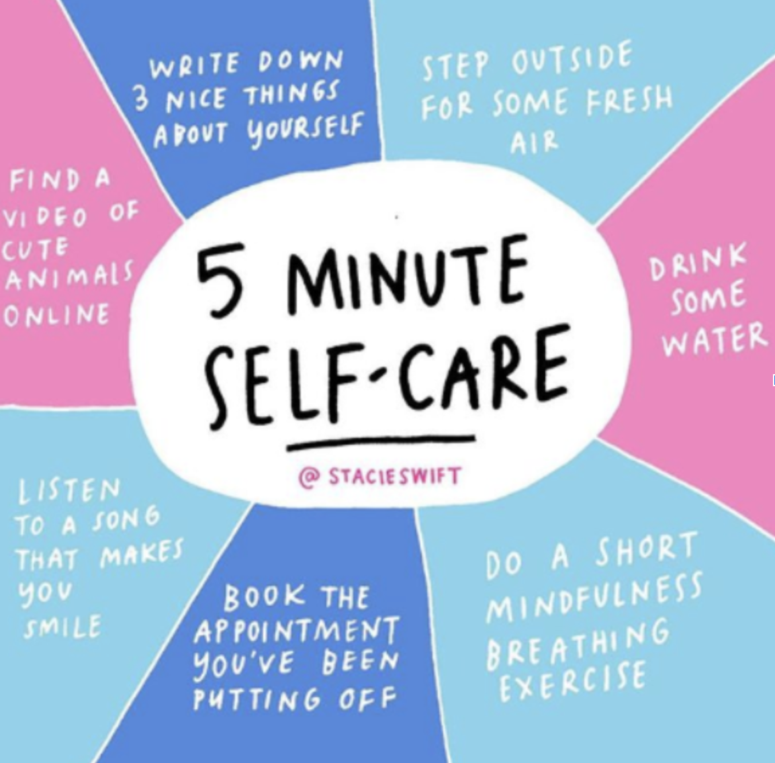

Slide 18
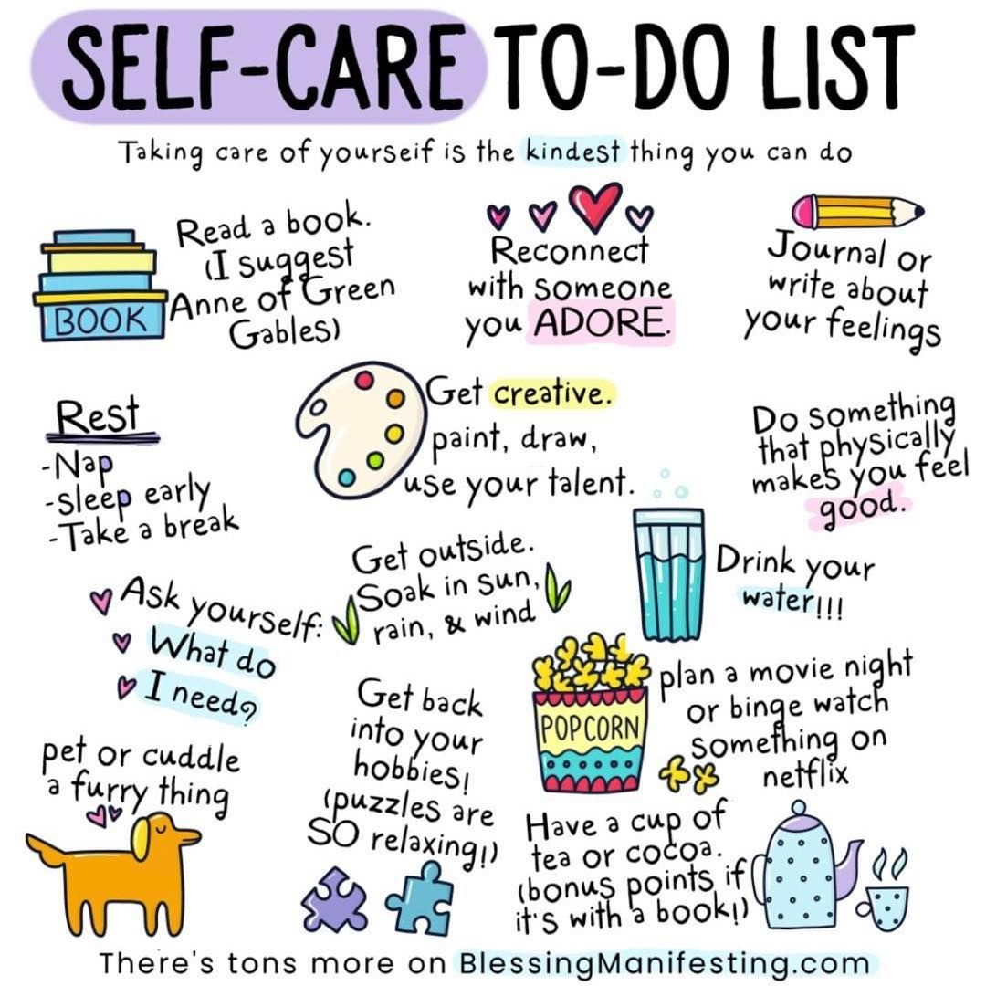

Slide 19
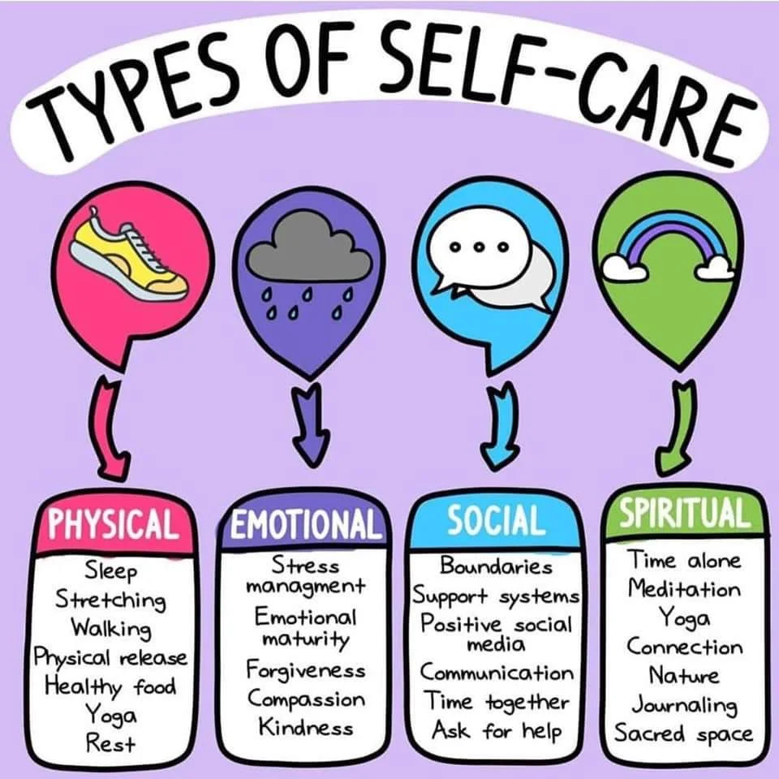

Slide 20
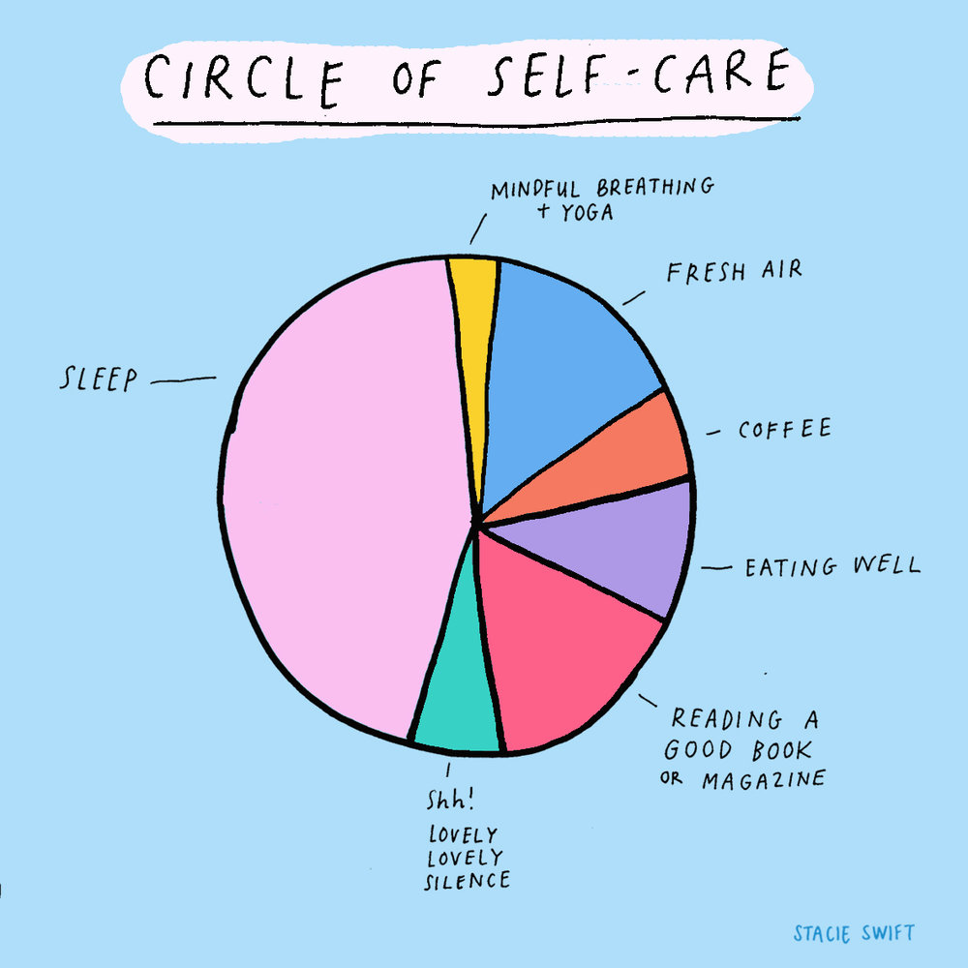

Slide 21
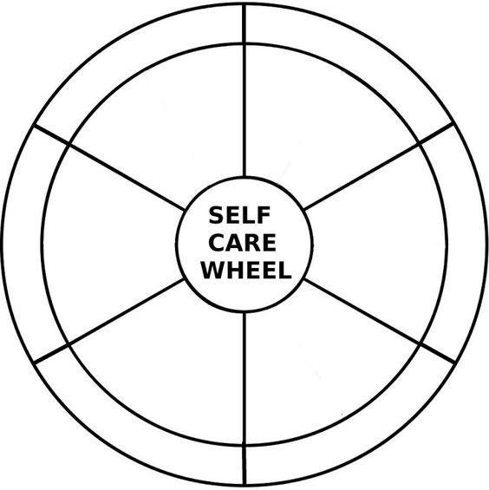

Slide 22

Maslow’s Hierarchy of Needs:
Can we connect this to Self-Care?
Physiological Needs
Have you eaten today? Do you eat a balanced diet? Are your meals nutritionally balanced?
Are you drinking enough water? Have you washed today?
Are you warm enough? Are you too warm?
How well do you sleep? How many hours of sleep do you have? Do you have opportunities to relax during the day?

Slide 23
Maslow’s Hierarchy of Needs:
Can we connect this to Self-Care?
Safety Needs
Do you feel a sense of security and stability in your life? If not, what can you do to help you?
If you don’t feel safe, do you know who you can turn to? Do you have coping strategies?

Slide 24
Maslow’s Hierarchy of Needs:
Can we connect this to Self-Care?
Belongingness and Love Needs
Have you caught up with friends/loved ones recently? Are there ways in which you can connect with them?

Slide 25
Maslow’s Hierarchy of Needs:
Can we connect this to Self-Care?
Esteem Needs
Reflect on your achievements – list them down. What have you achieved today? Yesterday? This week/month/year. Are you proud of these achievements? Have you developed new skills?
Plan ahead for the future and set goals. Set a number of short-term goals that are easily accomplished so that you can celebrate these. As Cottrell (2008, p. 86) notes, “set yourself small, short-term goals so that you are able to have lots of small successes. In time these add up to greater achievements”.
Be proud of your achievements, and be proud of the compliments you receive from others!

Slide 26
Maslow’s Hierarchy of Needs:
Can we connect this to Self-Care?
From a self-care perspective, ask yourself – which level of the hierarchy will you focus on today…?

Slide 27
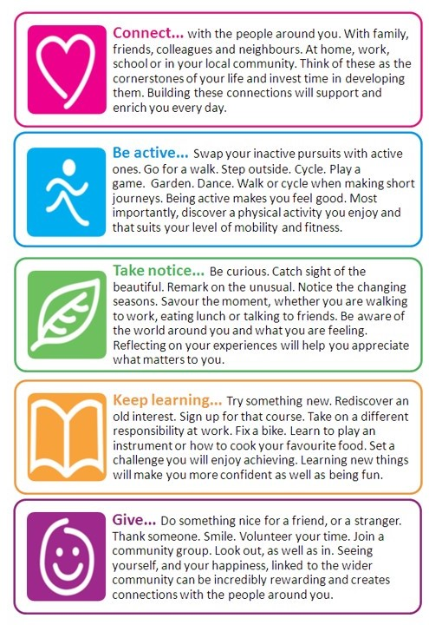
5 ways to wellbeing
https://hduhb.nhs.wales/healthcare/services-and-teams/five-ways-to-well-being/

Slide 28
Group Task/directed study
From a self-care perspective, research the support that is available for people. Knowing the support that’s out there may benefit you currently/in the future. In addition, it will add to your ‘toolkit’ of knowledge to support your youth work practice.
Engaging in this task will mean you have already made a start on your preparation for your assessment!
Here are some initial ideas to get you started:
  Meic Cymru - Information, advice and advocacy helpline for children and young people; https://www.meiccymru.org/
  Headspace - A meditation app that acts as a personal guide to health and happiness - https://www.headspace.com/

