Slide 1
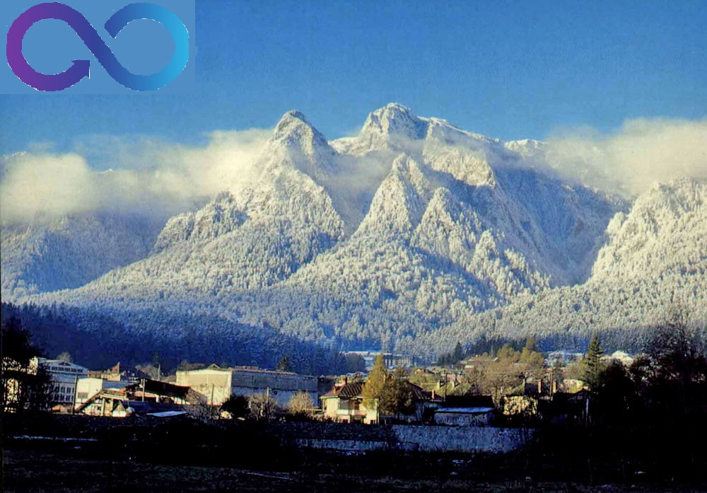

Slide 2
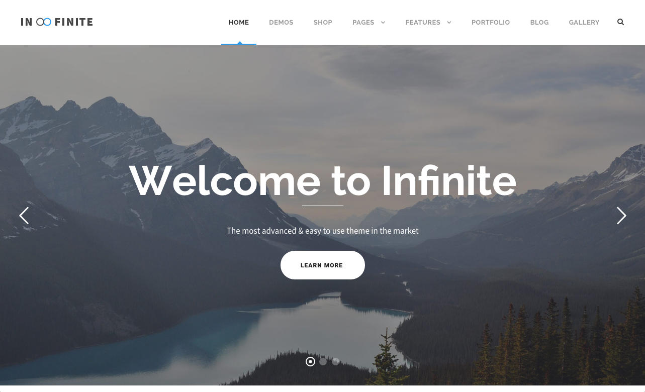


Slide 3
MARKETING ENVIRONMENTAL AUDIT TO ”INFINITE MOUNTAIN” INN
PRESENTED BY ..
Emoke
Carmina
Emma
Erol.

Slide 4
THANK YOU FOR BEING HERE TODAY
WE ARE THE ”INFINITE MOUNTAIN” INN LEADERSHIP TEAM FROM BRASOV, ROMANIA.
WE ARE HERE TODAY TO TALK TO YOU ABOUT OUR NEWLY OPENED GUEST HOUSE LOCATED IN POIANA BRASOV, WHICH IS IN NEIGHBOURHOOD OF BRASOV, POPULAR AMONG TOURISTS FROM SEVERAL EUROPEAN COUNTRIES.

Slide 5
IN THIS PRESENTATION WE WILL UNDERTAKE A MARKETING ENVIRONMENTAL AUDIT RELATING TO OUR NEW BUSINESS, PROVIDING JUSTIFICATION FOR OUR PROPOSAL, UNDERTAKING A SEGMENTATION EXERCISE WHICH INCLUDES A COMMUNICATION MIX STRATEGY FOR EACH SEGMENT

Slide 6
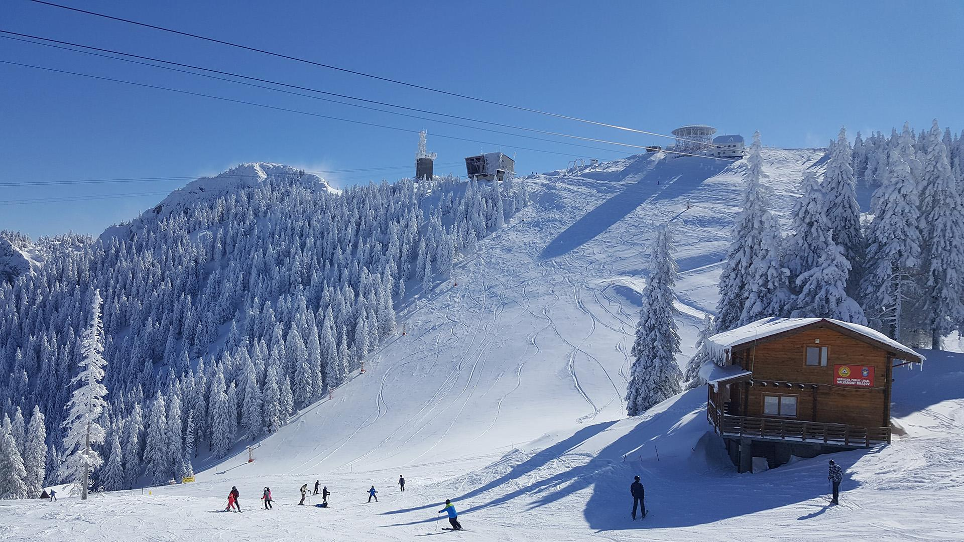
POIANA BRASOV IS..
THE BIGGEST AND MOST LUXURIOUS MOUNTAIN RESORT INTHE HEART OF TRANSYLVANIA IN ROMANIA
WAS VOTED THE MOST REASONABLY PRICED SKI RESORT BY TELEGRAPH.CO.UK IN 2008
POSITIONED IN THE CARPATHIANS, STILL VERY CLOSE TO THE MAIOR CITY, BRASOV (14KM), FOR EASY ACCESS
THE CLOSEST AIRPORT IS JUST 188KM AWAY IN THE CAPITAL CITY BUCHAREST
CLOSE TO MAJOR TOURISTS ATTRACTIONS LIKE DRACULA’S CASTLE (23KM)..

Slide 7
„INFINIT MOUNTAIN” INN LOCATED IN A QUIET AND PEACEFUL ENVIRONMENT IN POIANA BRASOV, TRANSYLVANIA IN ROMANIA, HAS BEEN ESTABLISHED IN MID JULY 2018
15 KM AWAY FROM BRASOV CITY, SURROUNDED BY BEAUTIFUL FORESTS AND HIGH MOUNTAINS
NEWEST 4 STARS GUEST-HOUSE IN TRANSYLVANIA

Slide 8
15 UNIQUE AND ELEGANT ROOMS FOR RELAXATION(SUITE, DOUBLE, TRIPLE)
ALL ROOMS HAVE BALCONY, AIR CONDITIONING, BATHROOM, LCD TV AND FREE WI-FI
PRIVATE PARKING
LOCAL AND ORGANIC CUISINE
SAUNA/SPA/WELLNESS
SHORT PRESENTATION OF PRODUCTS AND SERVICES

Slide 9
OUR PRODUCTS AND SERVICES CORRESPOND TO THE EXPECTATION OF EACH CONSUMER GROUPS
SWIMMING POOL
GIFTSHOP
AFFORDABLE PRICES FOR ALL OUR REMARKABLE PRODUCTS AND SERVICES
PRICE ADVANTAGE OVER COMPETITORS

Slide 10
HORSE-RIDING
MOUNTAIN-CLIMBING
...RELAXATION GUARANTEED
WE CREATE ENTERTAINING PROGRAMS TO MAKE PEOPLE AT ALL AGE GROUPS HAPPIER
HIKING
SKIING/SNOWBOARDING
....

Slide 11
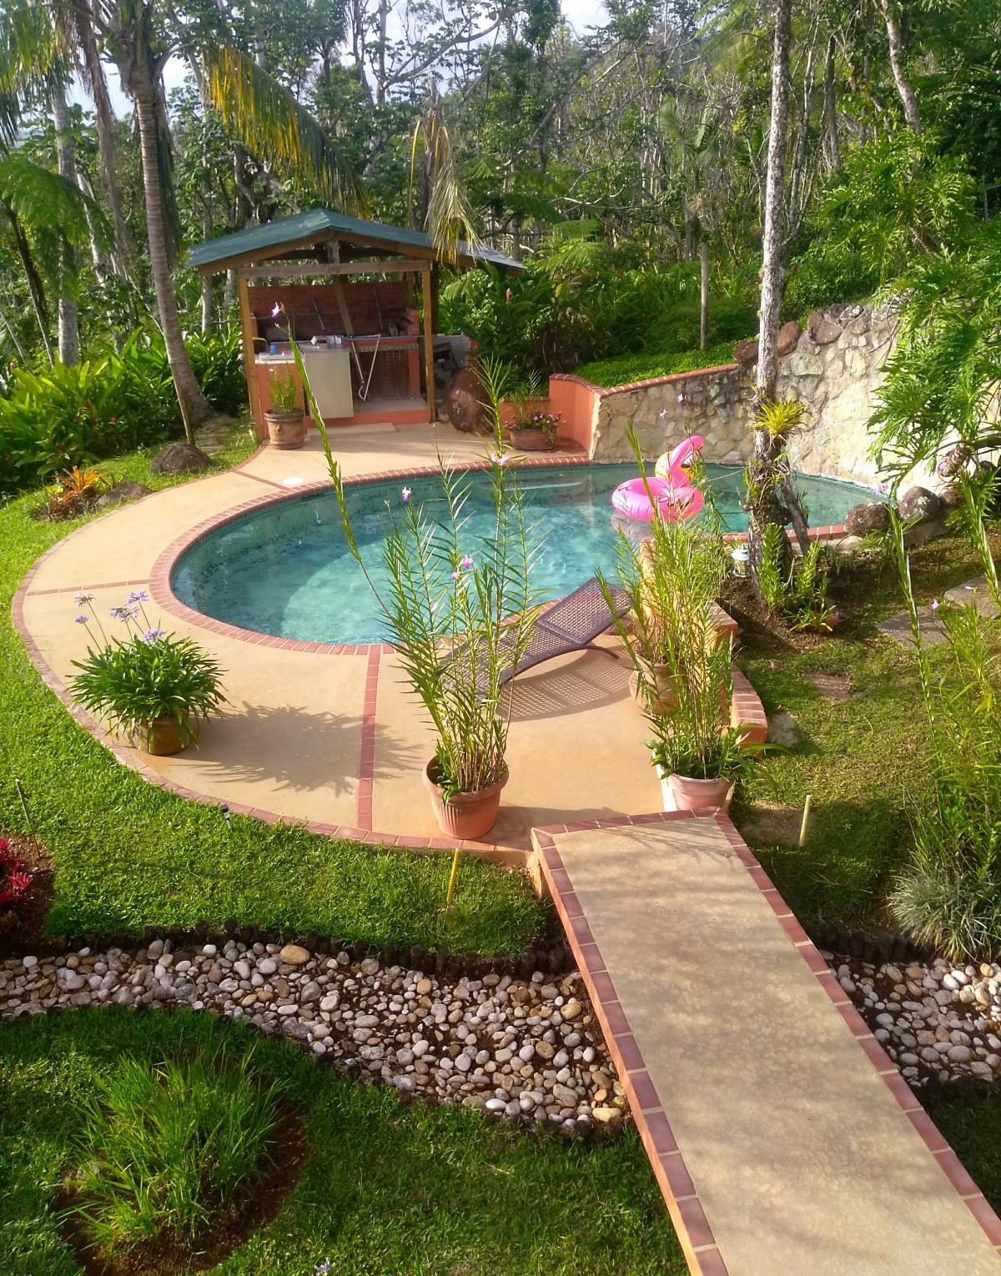
SWIMMING POOL

Slide 12
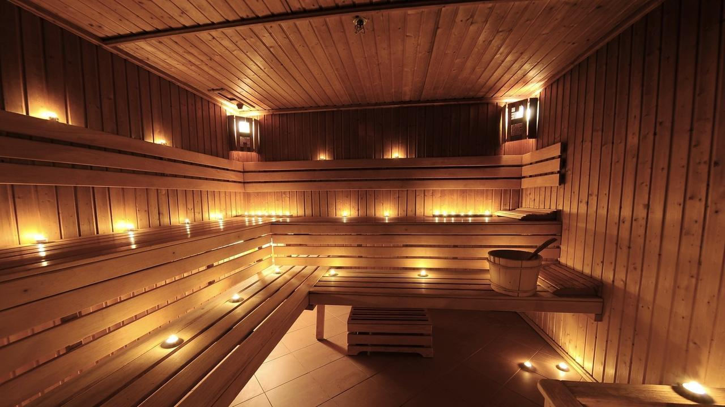
SAUNA

Slide 13

SPA
WELLNESS

Slide 14
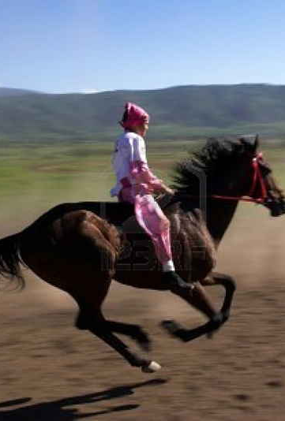
HORSE-RIDING
Cím: Fénykép, készítette: Ismeretlen a készítő, licenc: CC BY-SA

Slide 15
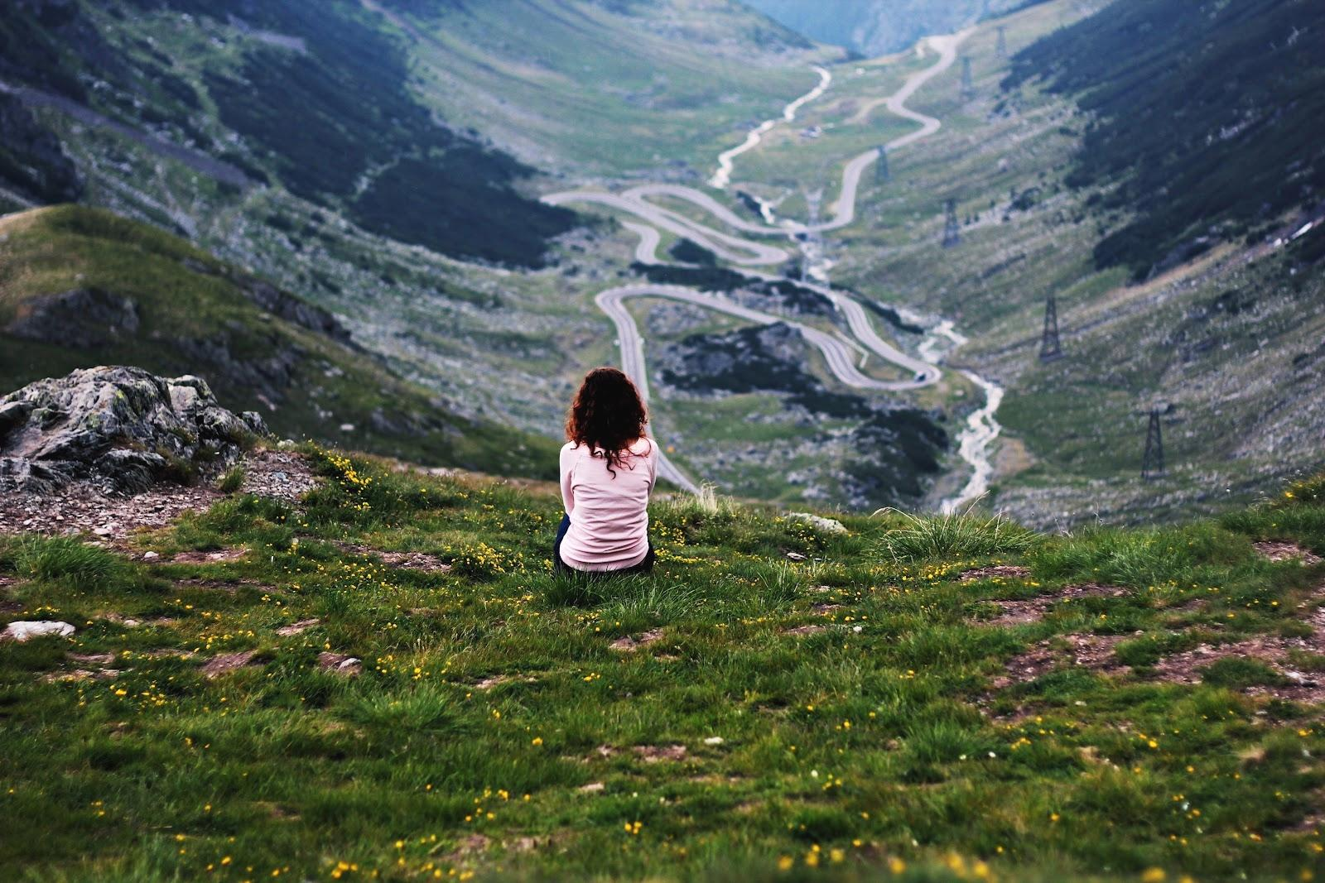
HIKING
MOUNTAIN-CLIMBING

Slide 16
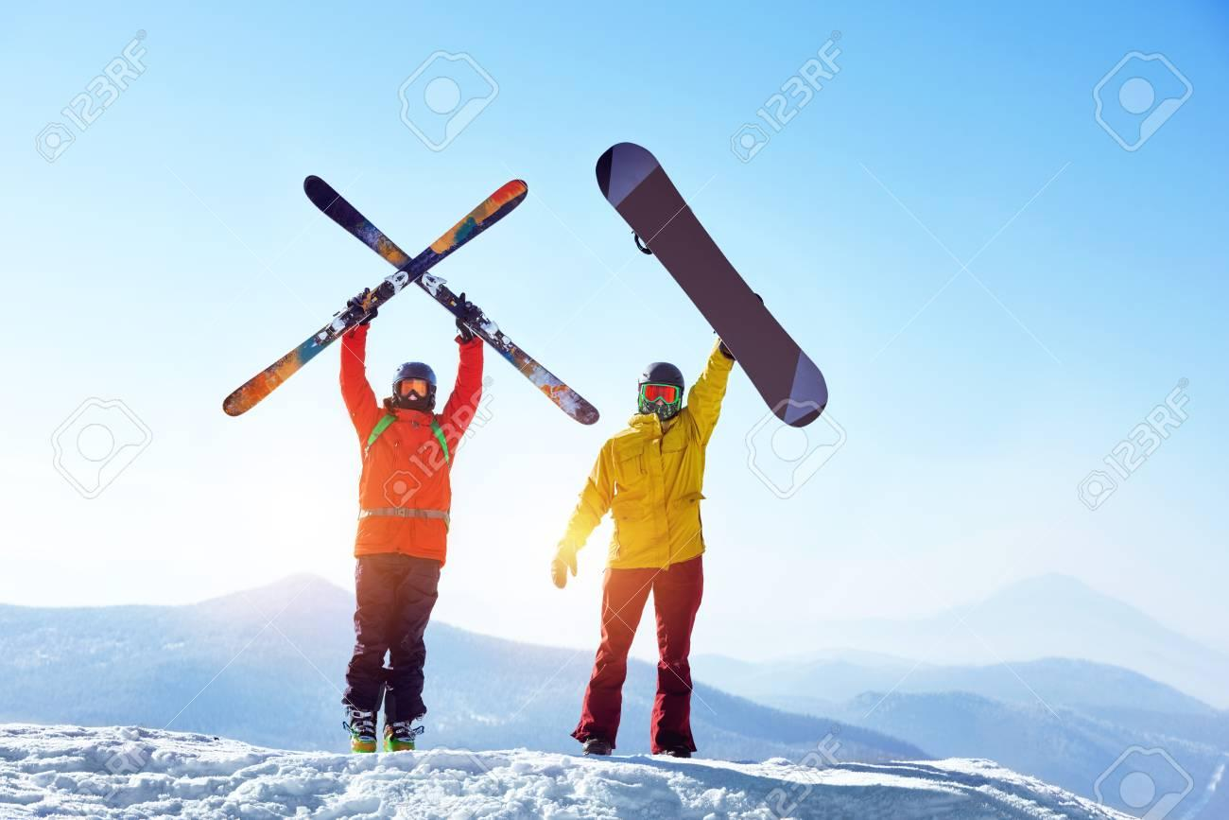
SKIING
SNOWBOARDING

Slide 17

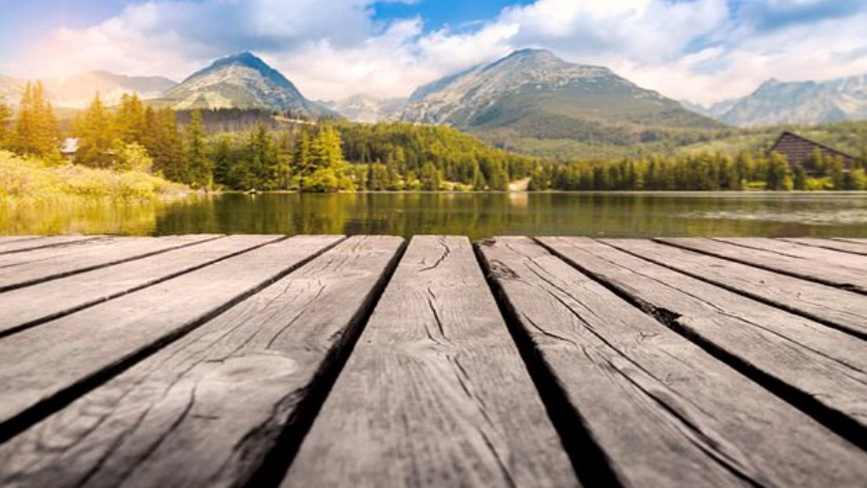
Marketing Mix​
Our business is at the beginning, ,we must keep in mind how to do the best strategies to achieve satisfactory results and in the future we can expand our business.​
Each part of Marketing Mix is important for our business to identify the right target and to find the right strategy to success.​

Slide 18
Products ​
We are offering traditional Romanian breakfast,lunch,dinner,deserts and drinks made from our local organic products. Upon request we also serve Halal and Kosher meals for our Muslim and Jewish guest.Also we offer ski storage rooms,free parking,24-hours reception,safe,laundry and ironing facilities,children’s playground and tennis courts,relaxin massage and free WiFi.We organise games,barbecue and campfire on evenings,and guided tours. For Christmas,New Year and Easter we do also festive parties with Romanian dishes,mulled wine,Romanian brandy and music.​
​

Slide 19

Price​
We will try to offer the best prices for our products and services to our costumers,considering the local competitors and the general business costs.​The costumers can make cash payments, cards payments,mobile payments and online payments also.​

Slide 20
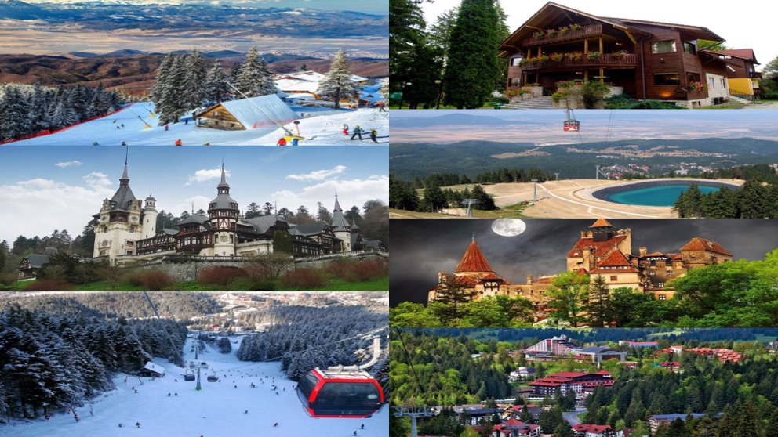

Slide 21


Slide 22

Promotion ​
Because we are new on the market the promotion is most important for us now and we need to attract customers.​
We create special offers for customers which are visiting us online or offline.​
The offers are: rewards on social media and for our loyal customers and their friends,free meal for kids,discounts for students and special offers on special events.​

Slide 23
Marketing Strategy ​
Our strategy is to build an online presence because this days that is vital for any business,and we can attract customers from other countries also.​
To advertise our business we have created a social media platforms , electronic media,press,website page and promoting on the travel sites also.​
WWW.FACEBOOK.COM/INFINITEMOUTAIN
www.TWITER.COM/INFINITEMOUTAIN
WWW.BOOKING.COM/INFINITEMOUTAIN

Slide 24
TARGET MARKETING
THE TARGET MARKET IS A GROUP OF CONSUMERS OR ORGANIZATIONS WHO WILL BUY PRODUCTS OR SERVICES FROM THE COMPANY. THAT IS WHY THE ACTIVITY MUST BE CARRIED OUT IN SUCH A WAY THAT EVERY EFFORT IS MADE TO REACH THIS AUDIENCE.

Slide 25
TARGET MARKET
The main target are mountain lovers, Romanian and foreign tourists;
Tourists that do not have mountainous regions (from the south of the country, especially from Bucharest);
Adventure tourism enthusiasts;
Tourists from business environments who want to organize mountain meetings or contract services for their employees;
Families with children;
Young married couples;
Small group of people who want to spend a weekend together;
People who want to practice winter sports or hiking;
Older people, retirees, who love the mountain and want to relax by breathing fresh air.

Slide 26
MARKET SEGMENTATION
GEOGRAFICS | DEMOGRAFICS | PSYCHOGRAFICS | BEHAVIOR
Romanians Foreigners Rural Urban | All ages All gender All races All religion Income medium to high | Active lifestyle Medium to high social class Those who practice winter sports and hiking | Tourists who come for the first time Loyal tourists, those who have been and have been pleased with the service Tourists attracted by offers

Slide 27
Competitors
MICRO ENVIRONMENT
Public
Customers
Suppliers
Distribution channels

Slide 28
COMPETITORS
In Poiana Brasov there are many hotels and hostels that attract tourists, being one of the most beautiful resorts in Romania.
The tourist units with seniority, the ones that have been operating in the area for longer, are the true competitors of Infinite Mountains Inn****. The only advantage of these hotels would be their seniority, with loyal customers. The competitive advantage of the Infinite Mountains Inn is that it is a 4 star category offering great comfort and relaxation, it also offers breakfast and the prices are not very high compared to those of the competitors. As a 4-star Inn the reception service is personalized, the rooms have a private bathroom, smart TV, hairdryer, coffee and tea making facilities as well as high speed internet. Breakfast will be fresh ingredients from local households.

Slide 29
CUSTOMERS
Being a high end inn, the guests will be those with at the least a mid level income people who can afford a higher price for a privileged treatment. Among the clients will be:
those who want to relax over the weekend;
those who want to organize a festive meal;
families with children on vacation;
people who practice winter sports ,or hiking lovers;
foreign clients will be in large numbers because the resort is known and appreciated internationally.

Slide 30
DISTRIBUTION CHANNELS
by booking the room directly on the inn’s website, booking at the hotel's or phone's reception by the tourist.
through online booking portals:
tripadvisor.com
booking.com
travel.ro
priceline.ro
social media platforms
travel agencies in Romania and abroad.

Slide 31
SUPPLIERS
For breakfast, the products will be purchased from locals who have their own gardens or own small farms, especially organic products;
other products, hygiene, consumables, bed linen, towels, to be purchased from supermarkets in the area.
Halal and Kosher food vendors certified and pre-approved

Slide 32
PUBLIC
groups of friends or work colleagues;
foreign tourists;
families with children;
people who practice sports as a hobby;
weekend tourists.
elderly people

Slide 33


PESTLE ANALYSIS:

Slide 34


Slide 35
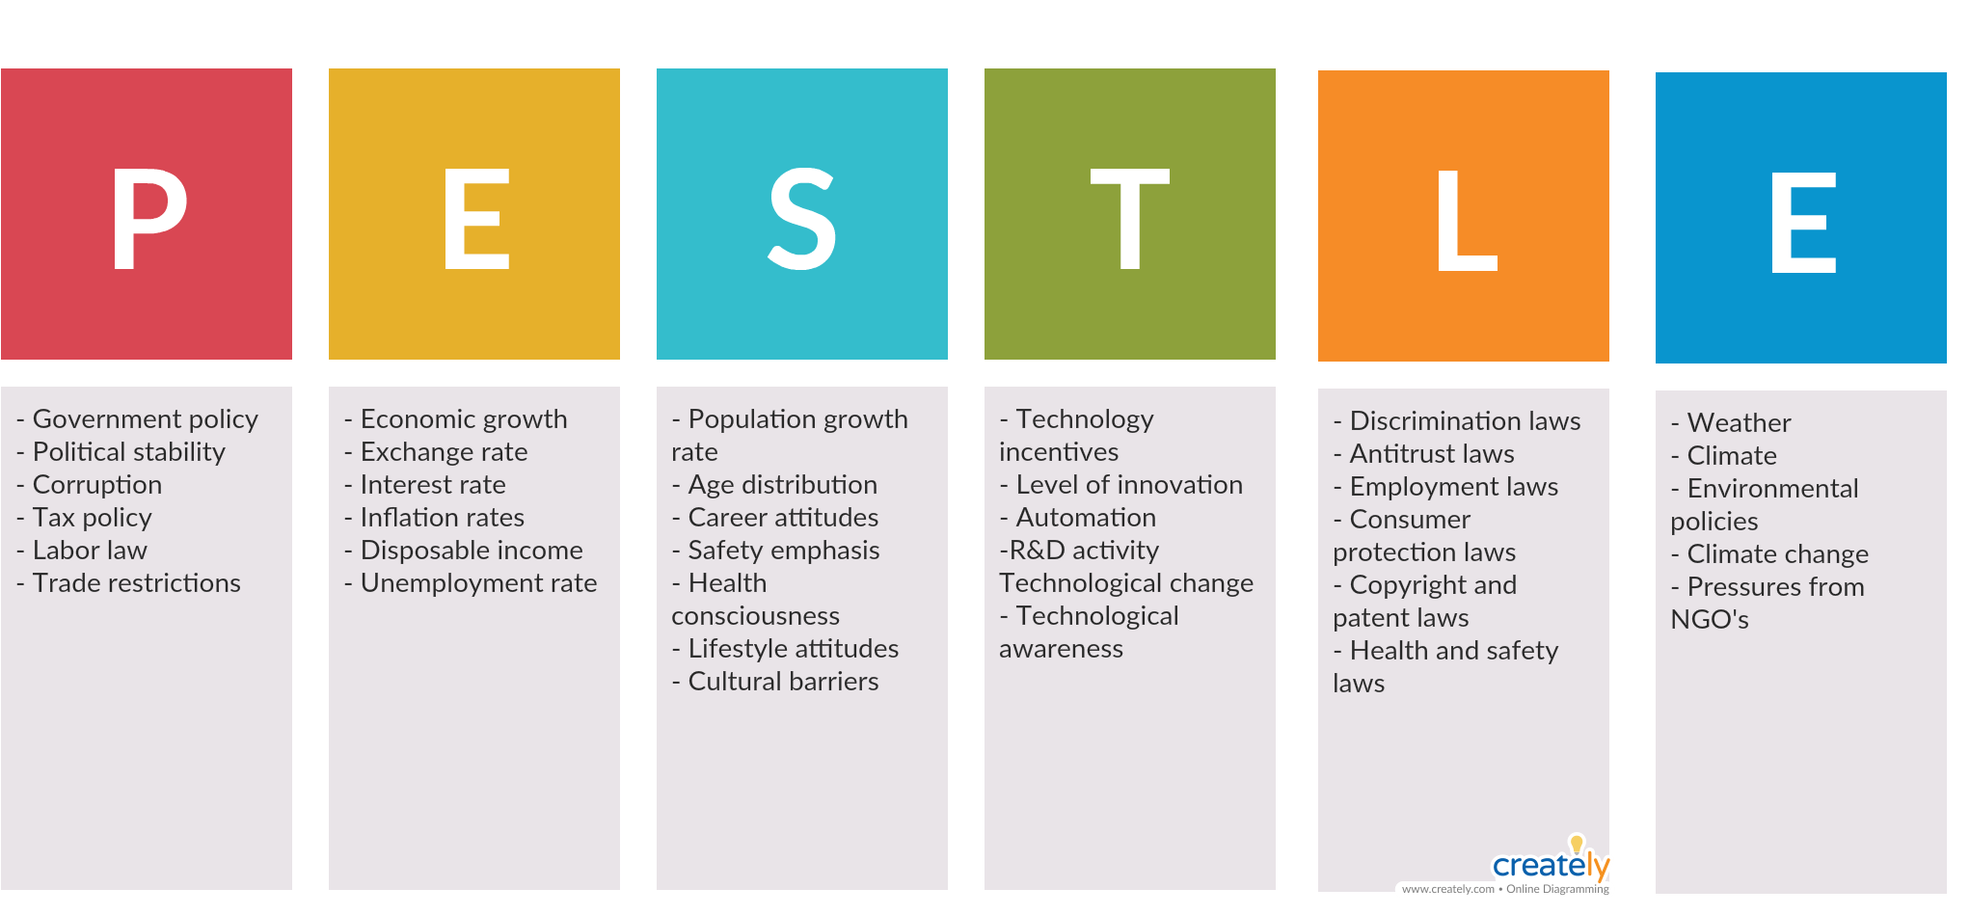
PESTLE ANALYSIS:

Slide 36
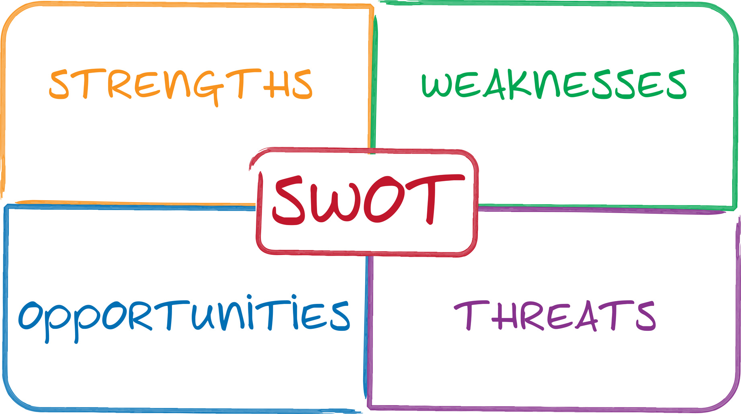
SWOT ANALYSIS:
( Thompson, 2007) “SWOT Analysis is a simple but powerful tool for sizing up an organization’s resource capabilities and deficiencies, its market opportunities, and the external threats to its future” A SWOT analysis helps our organisation asses attributes and resources, in order to maximize potential and profit

Slide 37

Present:
Strengths:
Tourist friendly area, filled with many attractions.
Eco Friendly supply of goods necessary for the good functioning of the business.
Low pollution, raw nature, ideal for attracting people from the big cities.
Traditional cuisine, with traditional and all natural ingredients from surrounding suppliers.
Climate is perfect all year, winter snow assures the attraction of people that seek winter sports and activities. The rest of the year sees cool temperatures, for people looking to get away from the high temperature cities.

Slide 38
Weaknesses:
Lack of government support for the areas development.
High level of competition with other local businesses.
High taxes.
Difficulties in sustainable profitability during the first year
During powerful storms the area might be inaccessible to some guests/ people will also be blocked in, so contingencies need to be put in place.

Slide 39
Future:
Opportunities:
Availability of European Union funds for growth.
Collaborations with turism agencies would assure a large number of guests.
Business retreat option.
Development and/ or promotion of rural turism as well as eco friendly targeted marketing promoting ethnic/ folk atracted base of clients.
Holliday retreat possibilities.
Recurring guests.

Slide 40
Threats:
Competition in the area.
Lack of governmental involvement in the areas promotion internationally.
Implementation of new technologies in the area might increase functioning costs.
Access roads are vulnerable to weather conditions.
Insufficient marketing campaigns to attract business both locally and internationally.

Slide 41
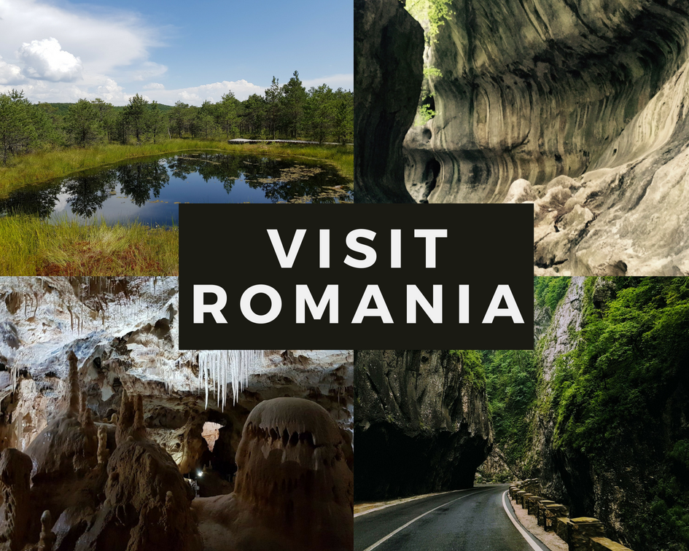


Slide 42
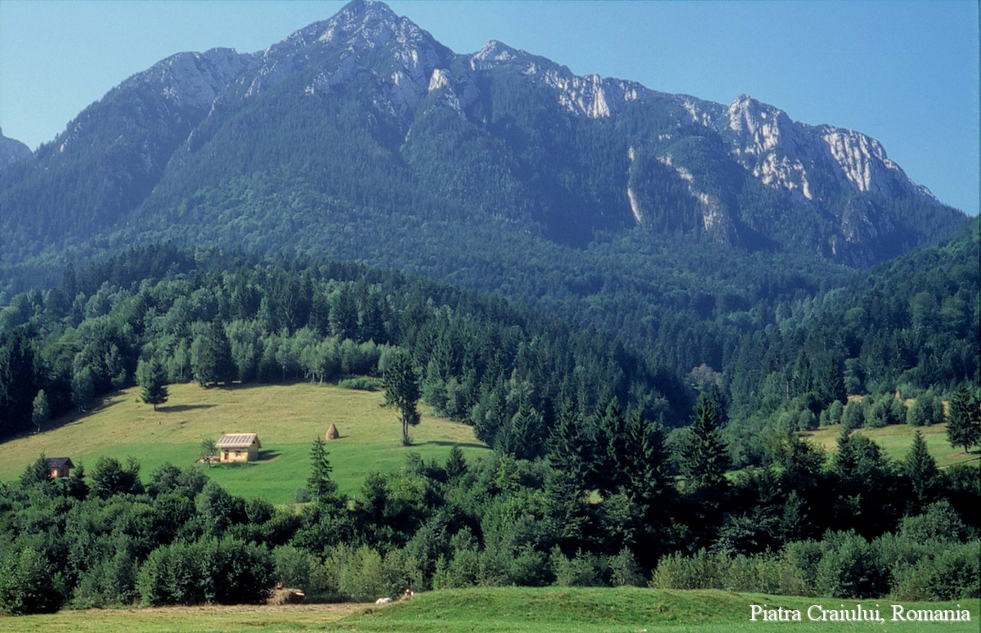
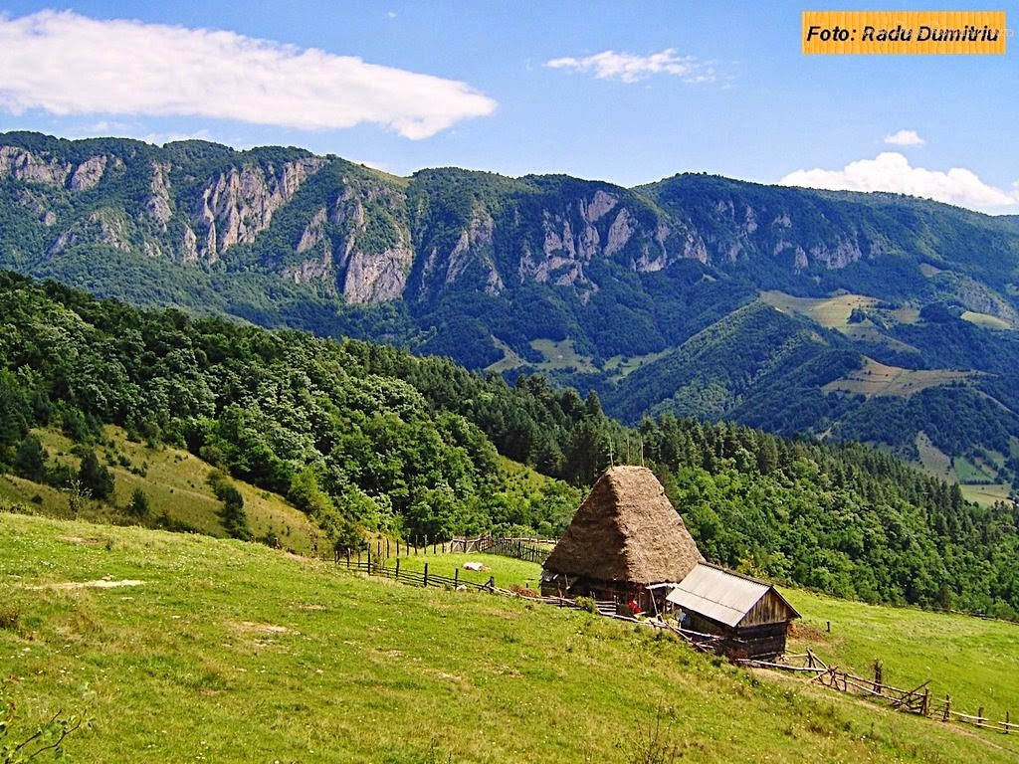

Slide 43
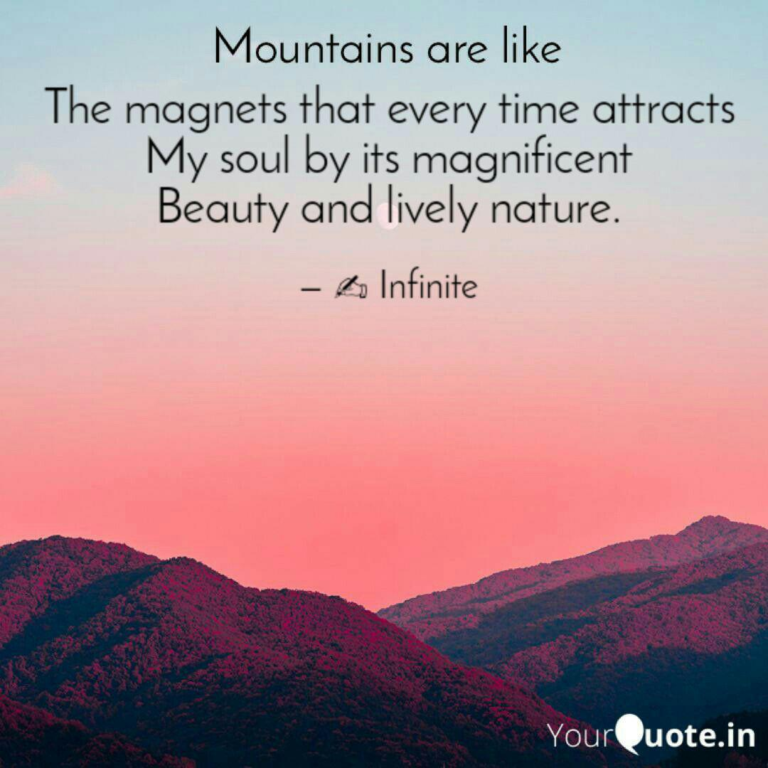

Slide 44
Conclusion:
Simple enough, right?

Slide 45
References:
Mc Murtry, J M. (2017) Marketing for Dummies. 5th Edition edn. Hoboken: John Wiley & Sons, Inc.. (Mc Murtry, 2017)
(2018) Poiana Brasov Resort [online] Available at <http://www.PoianaBrasov.com> [Accessed 24 MARCH 2019].
White,C.(2004). Strategic Management:Palgrave Macmillan, 26-33 and 669-679.​
THOMPSON, A. A., STRICKLAND, A. J. & GAMBLE, J. E. (2007). Crafting and Executing Strategy-Concepts and Cases, (15th Edition), USA: McGraw-Hill/Irwin.
Tribe,J. (1997). Corporate Strategy for Tourism. London:Thomson,Chapter 2.​
Investopedia. (2019). Know How to Target Specific Markets to Bring in a Large Profit. [online] Available at: https://www.investopedia.com/terms/m/marketsegmentation.asp [Accessed 19 Mar. 2019].

Slide 46
Management team:
Erol Asan ………………………….. 1814997
Emoke Gego…………………. …. 1815061
Carmina Lorena Cornea…………...1815046
Mihaela Costea…,..........................1815099

