Slide 1
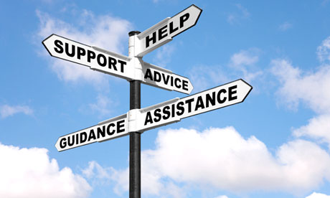
Lisa-Marie Manning 0901086
How Carl Rogers contribute to our understanding of the role of ‘helping’ and support, especially in an educational setting.
Source: Clearing 2012: help and advice at university | Clearing | The Guardian

Slide 2
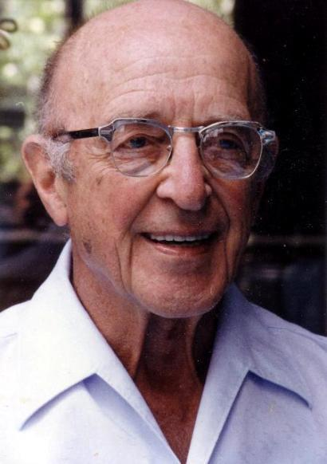
Introduction
Carl Rogers (1902-1987) was an American psychologist and one of the founders of the humanistic, person-centred approach, as well as a pioneer of psychotherapy research.
“Rogers was an American psychologist and one of the founders of the humanistic, person-centred approach. He is also considered to be a pioneer of psychotherapy research. The person-centred approach, based on Roger’s theory of self, has found wide application in multiple domains, including education, psychotherapy and counselling.”
Firstdiscoverers, 2020.
Available at: CarlRogers1.jpg (410×582) (depsicologia.com)

Slide 3
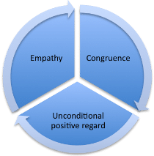
Roger’s Core conditions
These are the three core conditions identified by Carl Rogers;
Empathy
Congruence
Unconditional Positive Regard (UPR)
Puskar, 2020.
Rogers first wrote about the core conditions in 1957 in his paper "The Necessary and Sufficient Conditions of Therapeutic Personality Change".
Available at :Carl Rogers' Core Conditions Carl Rogers' Core Conditions Counselling Tutor
3 hidden conditions;
Psychological contact
Client’s perception of the therapist
Client incongruence
Counselling tutor, 2020.

Slide 4
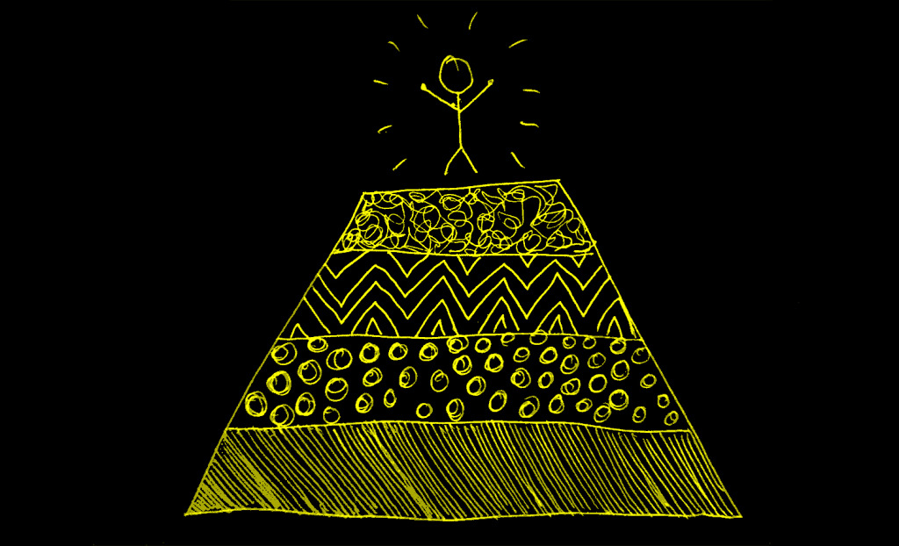
Self Actualisation
Rogers believed humans are primarily driven by the motivation to self-actualise or achieve their full potential. However, people are influenced by their environments so can only achieve self actualisation if their environment supports them. Vinney, 2019
Rogers also believed everyone
possesses a natural need to
grow and develop their full potential.
Considered this drive to achieve
self-actualisation to be one of the
primary forces influencing behaviour. Firstdiscoverers, 2020
Available at: Abraham Maslow and Becoming a Self-Actualized Person - Living Meanings

Slide 5
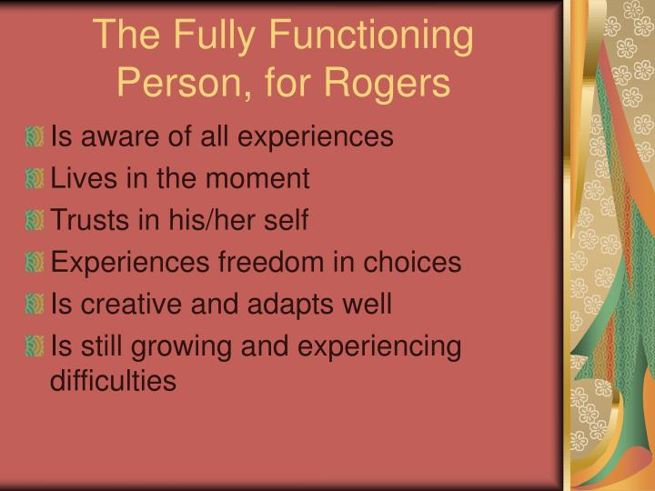
The fully-functioning person
Rogers called a person who had achieved self-actualisation a fully-functioning person which is;
Person who is fully congruent
Living in the moment
As with other components of his theory, unconditional positive regard plays a key role in the development of full functionality
PPT - Humanistic Psychology PowerPoint Presentation, free download - ID:378208 (slideserve.com)
Firstdiscoverers, 2020 says: “Individuals who receive loving, non- judgmental support have the best chance of developing self-esteem and confidence required to live to their full potential.
Important for children to have this type of support in school to enable them to thrive and achieve their full potential. Teaching assistants must make a conscious effort to not be critical of pupil’s thoughts or actions to be able to do their job effectively.

Slide 6
Unconditional Positive Regard
Unconditional Positive Regard is a term Rogers used to describe a technique used in his client centered therapy.
It shows complete support and acceptance of a person no matter what the person says or does
The therapist supports the client regardless of if they are expressing good or bad behaviours or emotions. Cherry, 2020.
Cherry, 2020 says
“Rogers believed that it was essential for therapists to show unconditional positive regard to their clients. He also suggested that individuals who don't have this type of acceptance from people in their life can eventually come to hold negative beliefs about themselves.”

Slide 7
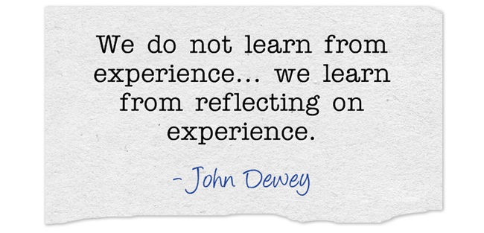
Reflection
Rogers used reflection
in therapy;
Mirroring of emotional
communication means
the client understands the
therapist is listening and
cares enough to understand
Available at: 4 tactics for promoting reflection at work | LearnGeek
This theory can be used in education;
Children learn by doing as well as reflection
Encourages personal growth and change

Slide 8

Empathy
According to Rogers being empathetic is not putting yourself in others shoes.
Empathy takes a lot of work as well as reflection and knowledge about how the other person experiences the world around them
It is not just what you would say or do in the other person’s situation but rather how you would react in that situation. Exploring your mind, 2018.
Available at: September 2017 Student of the Month-Empathy | Horizon Elementary School (phmschools.org)

Slide 9
Conclusion
Rogers theories contribute to our understanding of the role of helping and support in an educational setting in many ways
Remember child/ren is at the centre
Positively encourage the children
Awareness of what is said, can affect the child
Each individual develops in different ways depending on their personality and environment
Children are unique and should always be treated as such
Thank you

Slide 10
Reference List
Cherry, K. (2020, May 10). Unconditional Positive Regard in Psychology. Retrieved January 02, 2021, from Very well mind: http://www.verywellmind.com
Exploring your mind. (2018, February 04). 7 of the Best Quotes from Psychologist Carl Rogers: Empathy, Tolerance, and More. Retrieved January 02, 2021, from Exploring your mind: https://exploringyourmind.com/the-7-best-phrases-from-carl-rogers/
First discoverers. (2020). First discoverers. Retrieved December 27, 2020, from Child Development Theories: Carl Rogers: https://www.firstdiscoverers.co.uk/child-development-theories-carl-rogers/
Puskar, M. (2020, May 21). Better help. Retrieved December 27, 2020, from Carl Rogers’ Psychology Contributions: An Overview: https://www.betterhelp.com/advice/psychologists/carl-rogers-psychology-contributions-an-overview/
River, C. (n.d). Humanistic Psychology. Retrieved December 28, 2020, from Slide serve: https://www.slideserve.com/cliff/humanistic-psychology
Vinney, C. (2019, May 20). Carl Rogers: Founder of the Humanistic Approach to Psychology. Retrieved December 28, 2020, from Thoughtco: https://www.thoughtco.com/carl-rogers-4588296

