Slide 1
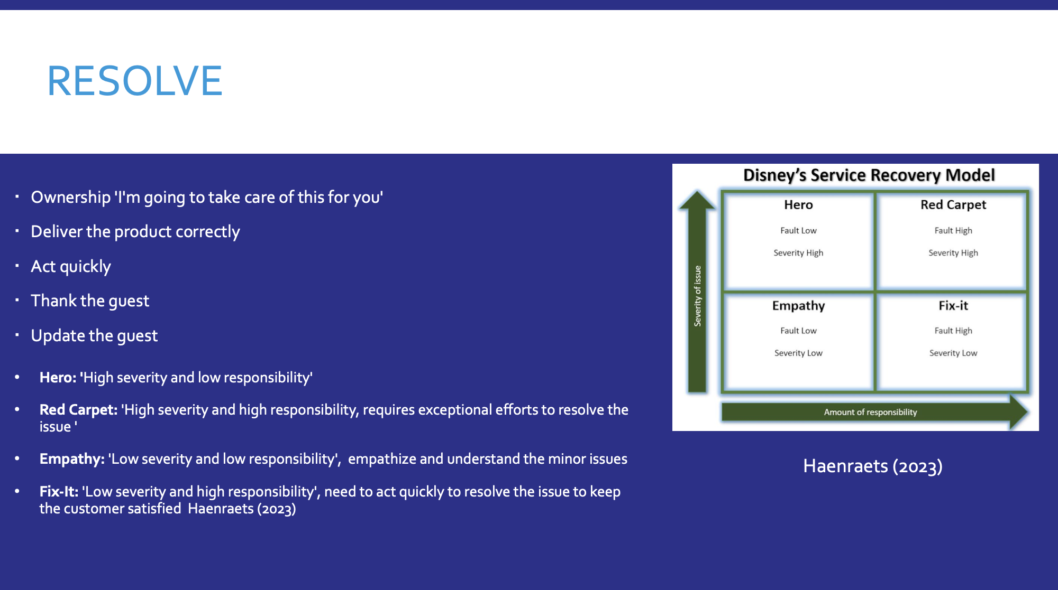

Slide 2
Reference
Haenraets, B. (2023). Viqal Blog | The Future of Hotel Service Recovery. [online] www.viqal.com. Available at: https://www.viqal.com/blog/the-future-of-hotel-service-recovery. [Accessed 5 May 2024]

