Slide 1
MODULE CODE: ECSS6002
Current Political and Ethical Landscape
Phillip Morgan & Matthew Philpott
DATED: September 2017

Slide 2
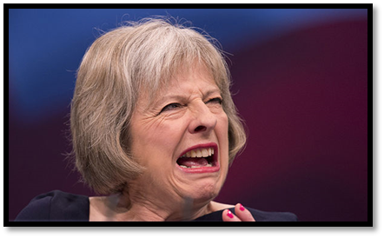

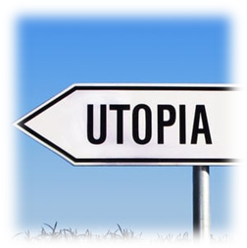
What does politics involve?
1.Who should rule? : Monarch, Government, People’s representatives…
2.What areas of life should it have control over?
3.What kind of society do we want? / What is “Human Nature” like?

Slide 3

What is/are Politics?
Task:
In your own words define Politics

Slide 4
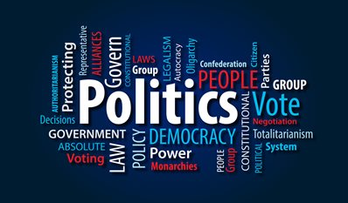
Definitions
From the Greek: ‘Politikos’ i.e. of or relating to citizens
A process
Use of Power
The exercise of governance
Control over human activity
Modernity-The study of the distribution of power
Hierarchical
Interrelationships

Slide 5
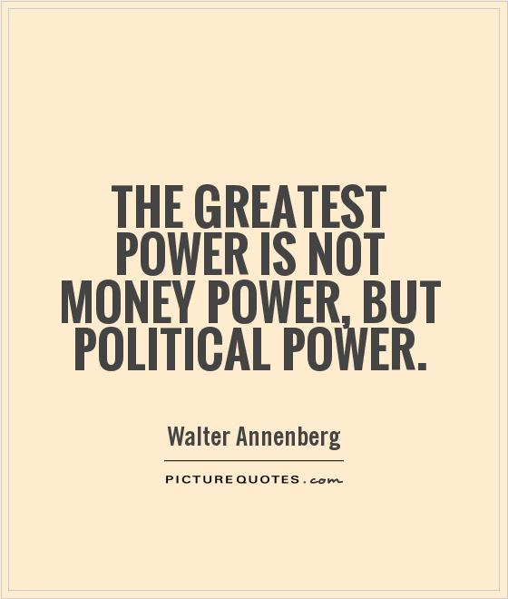
Politics is defined by Giddens & Sutton, 2016 as:
‘The means by which power is employed and contested to influence the nature and content of government activities. The sphere of the ‘political’ includes the activities of government and also those of social movements and other groups’.

Slide 6
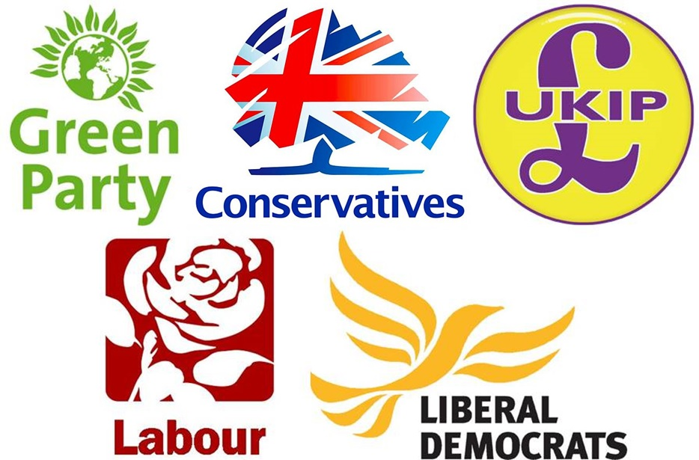
What is/are Political Parties?
Task:
In your own words define the term Political Party

Slide 7
A Political Party as:
‘An organisation established with the aim of achieving governmental power by electoral means and using that power to pursue a specific programme’.

Slide 8
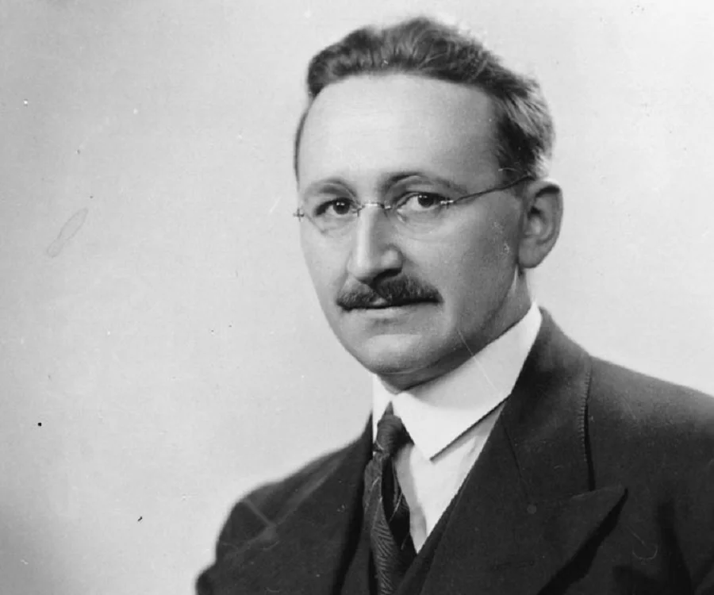
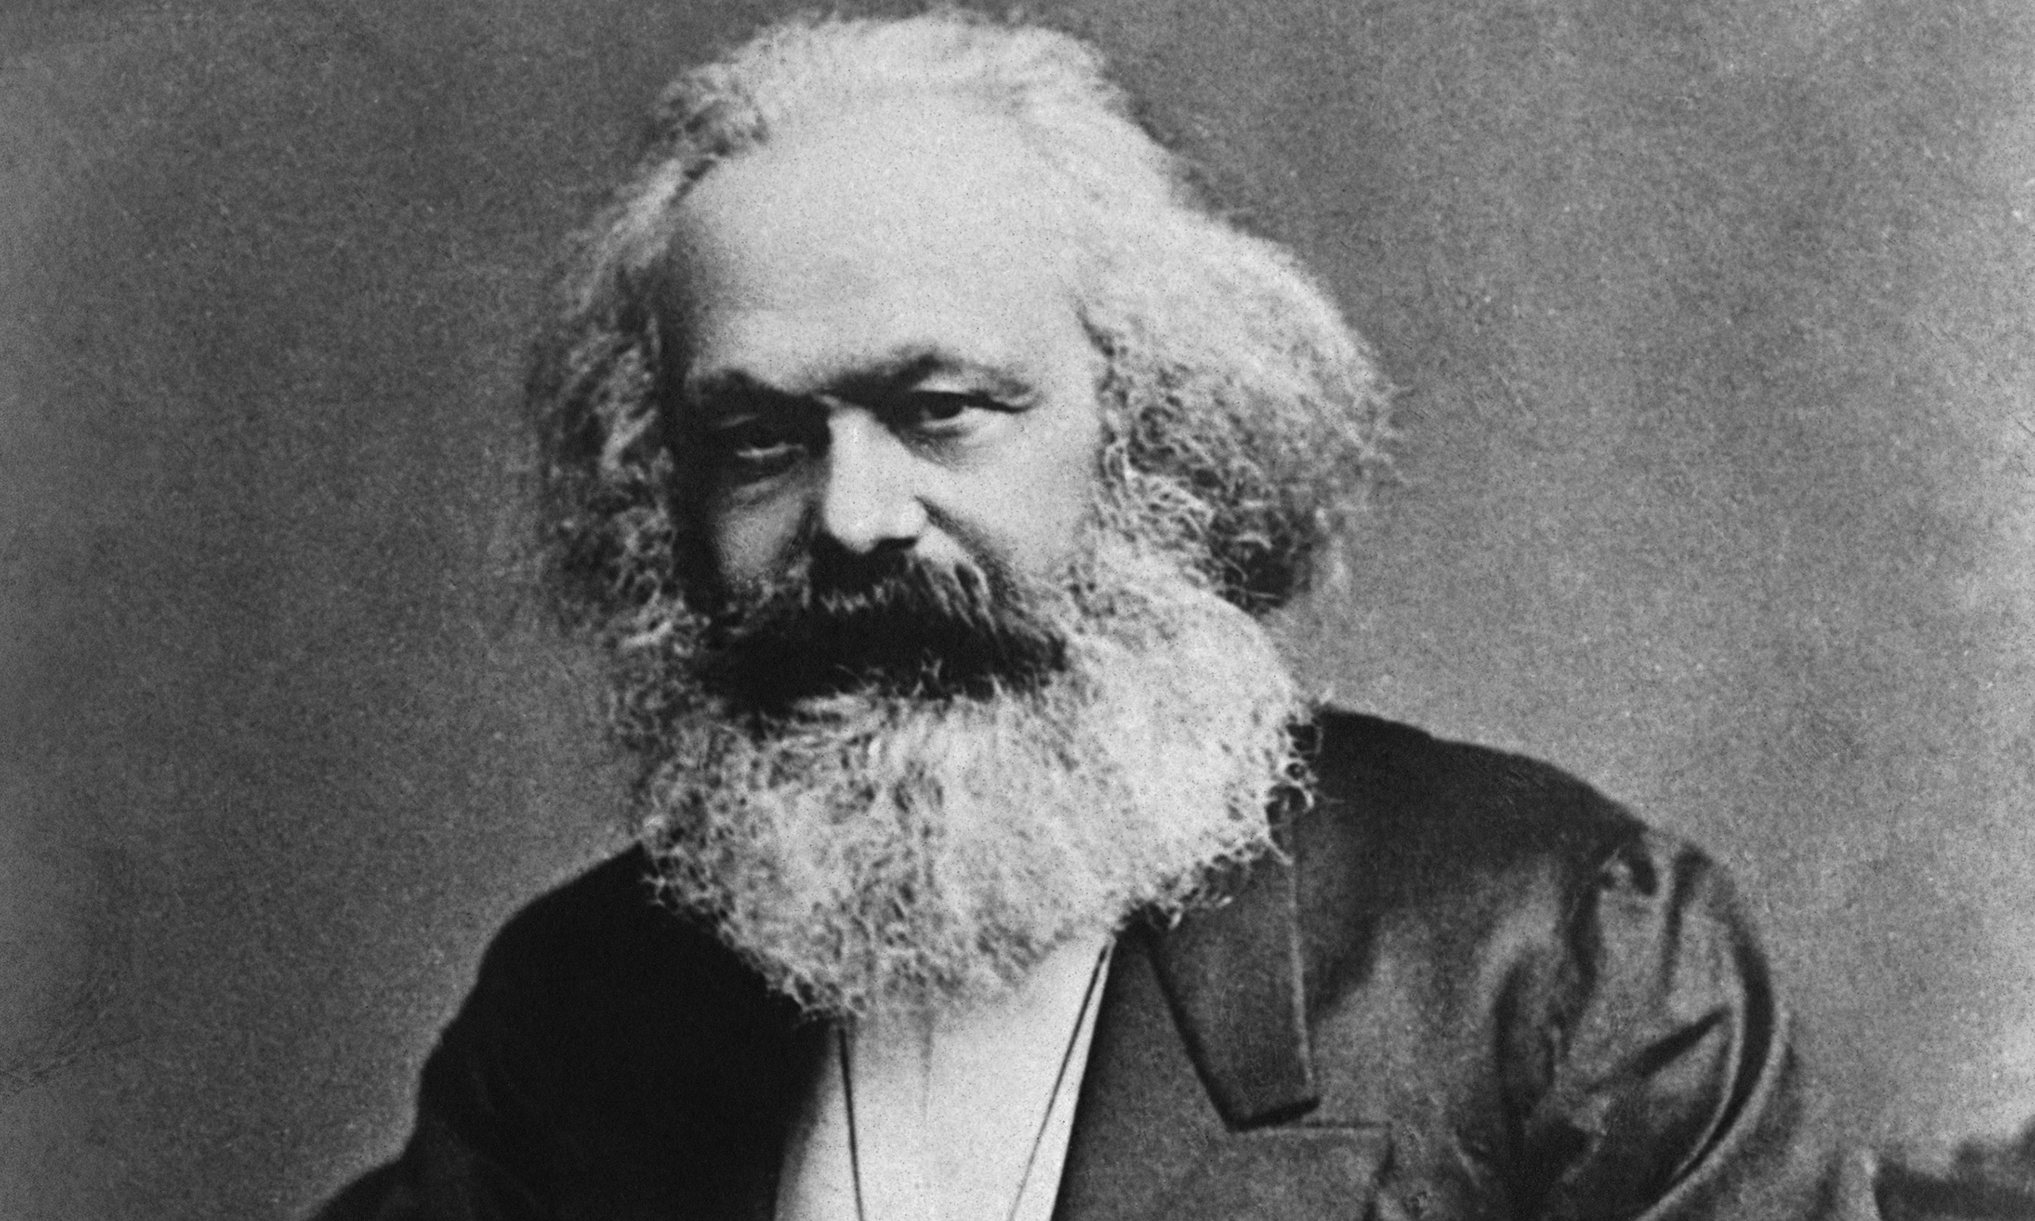
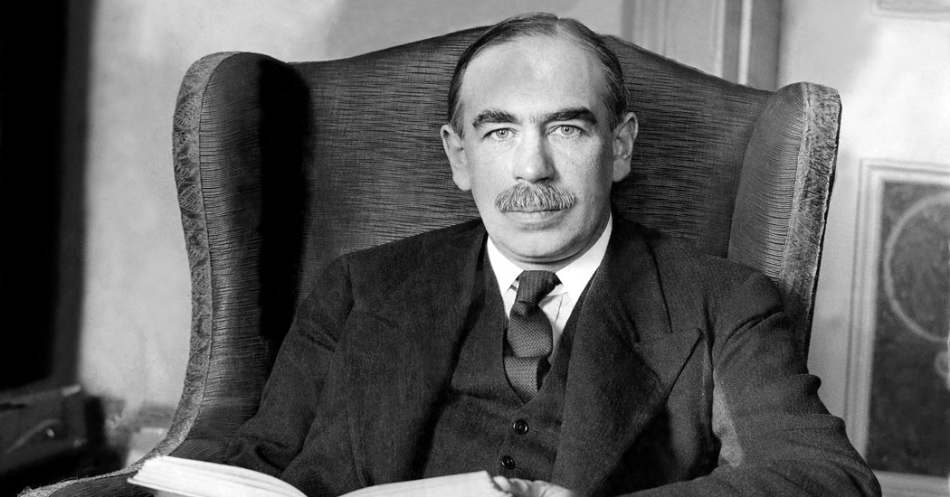
What is a Political Economy?
Task:
In your own words define the term Political Economy
Karl Marx
John Maynard Keynes
Friedrich Von Hayek

Slide 9
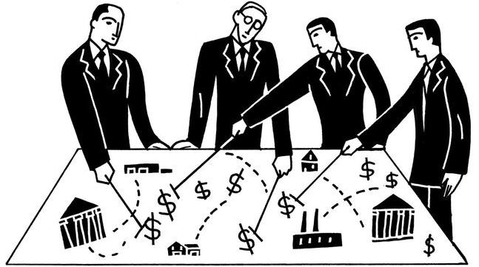
With a Political Economy being defined as:
‘The study of the ways in which political institutions of government and economy systems influence each other’.

Slide 10
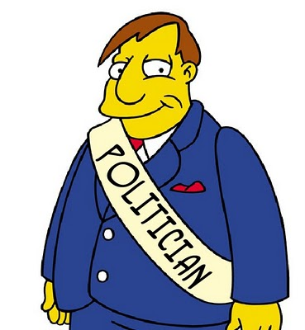
Politics as a Process

Slide 11
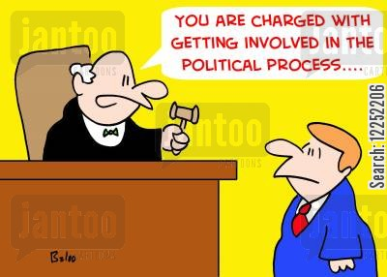
Process
A means of making uniform decisions
Then applying them to…
ALL group Members

Slide 12
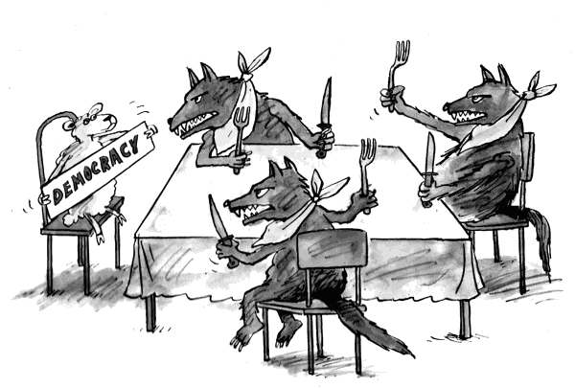
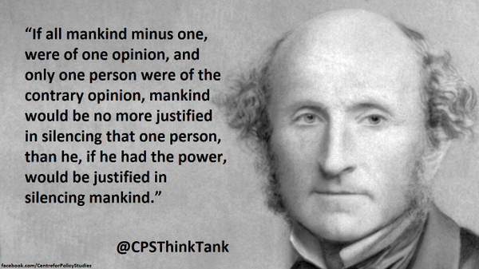

Question: Is this fair?
John Stuart Mill

Slide 13
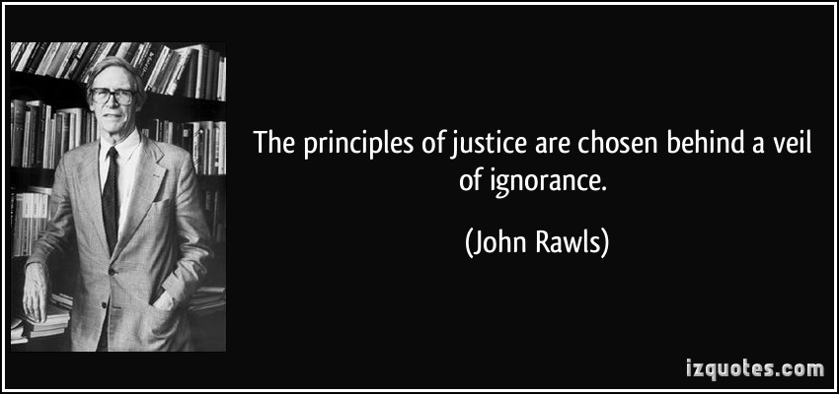
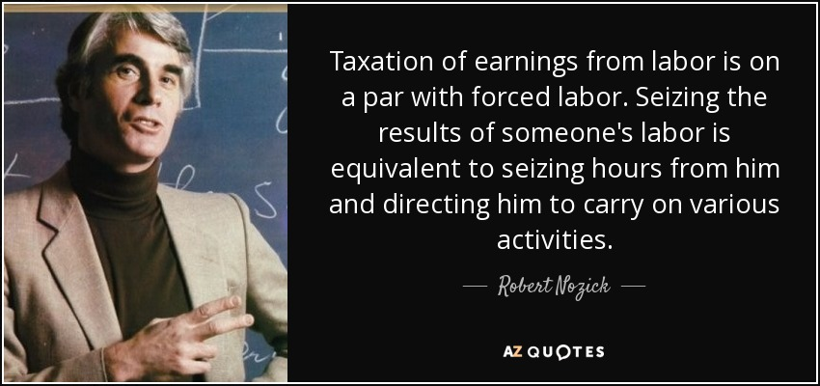
What do we mean by fairness?
A means of making uniform decisions
Then applying them to ALL group Members
Is this fair?

Slide 14
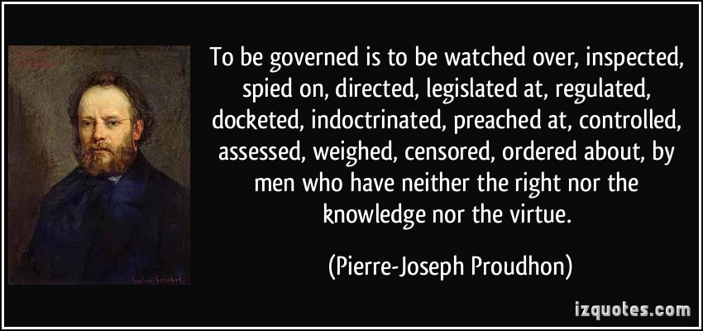
What then is the purpose of the State?
Does the State exist to:
Provide social welfare?
Guarantee the security of its members?
Provide a moral and social function?
Purely exercise its power and authority over me?

Slide 15
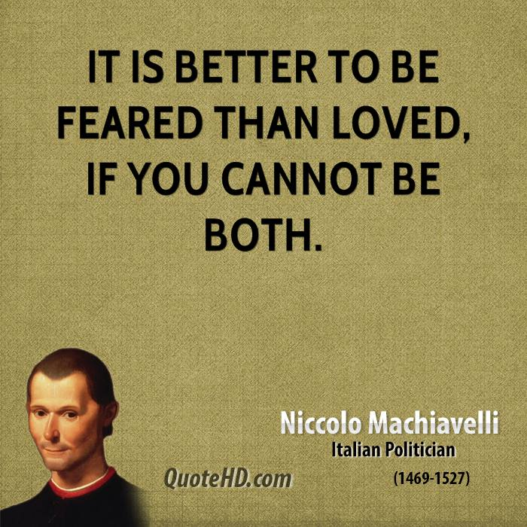
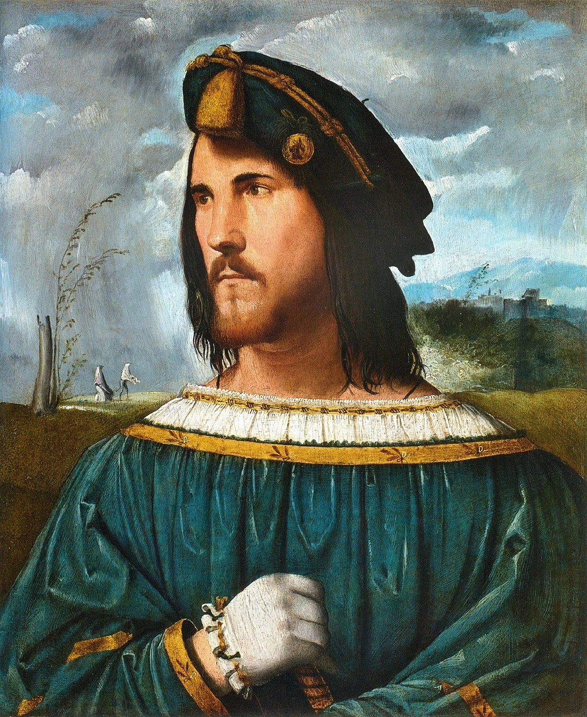
The use of power
Cesare
Borgia

Slide 16

What is Power?
Task:
In your own words define Power
Does such a thing as ‘Background Power’ exist?
https://www.youtube.com/watch?v=YQ8d39xQBUg

Slide 17
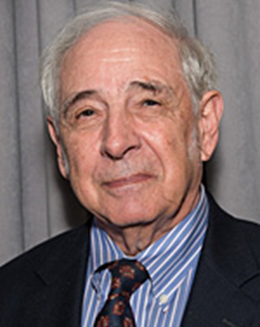
Power
It is designed to affect the behaviour of ‘others’
Questions
What is Political power?
Who has it?
How do you get it?
Can you retain it?
What does it look like?
John Searle

Slide 18

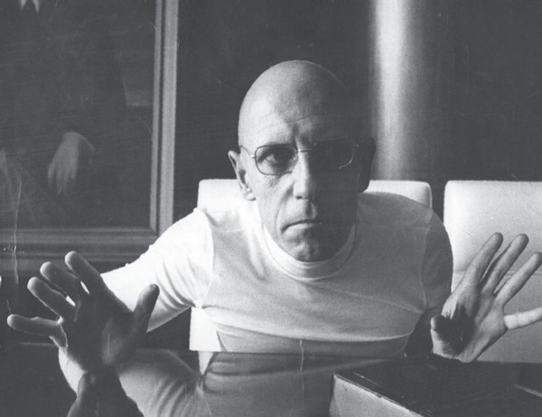
What is Political power?
John Searle
Michel Foucault
‘It is a matter of the achievement of control over the bodies of human beings by subjecting them to the normalizing practices of society’

Slide 19
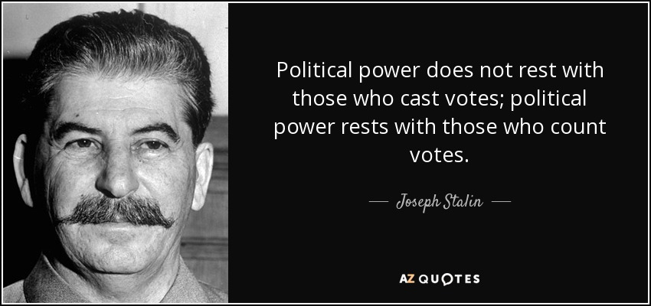
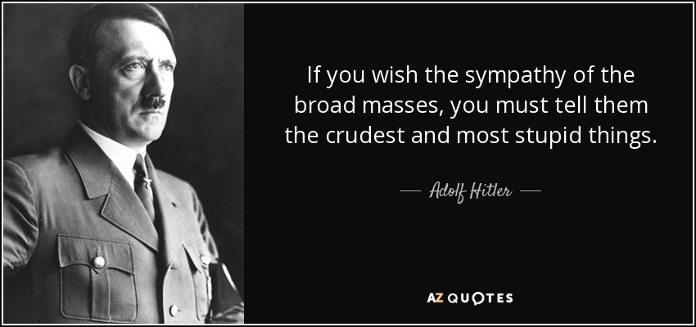
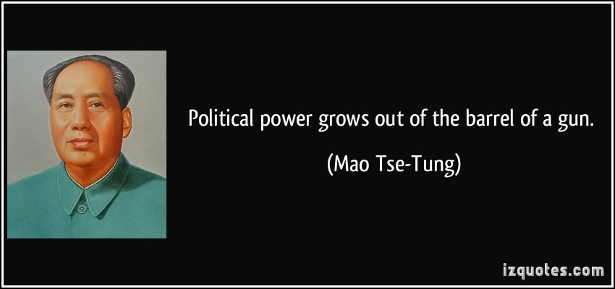
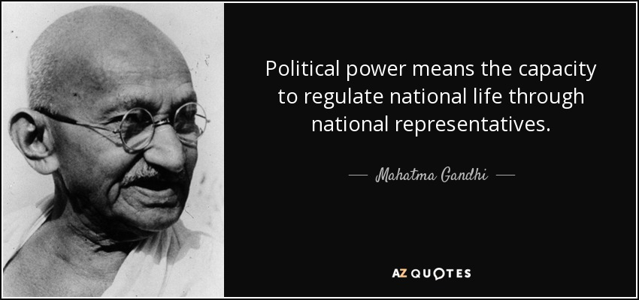
Who has it?

Slide 20

Power
‘Power’ - How do you get it?
How do you control it?
Can you retain it?
Who monitors if it is used wisely?
Can you think of Examples where:
      Power has been used well?
      Power has been abused?

Slide 21
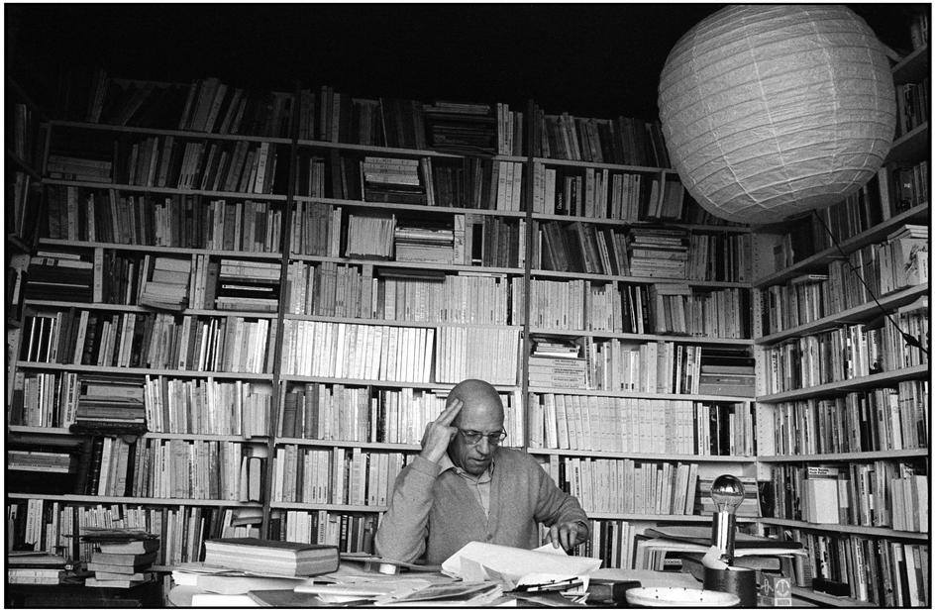
Types of Political Power
Reward Power
Coercive Power
Legitimate Power
Referent Power
Expert Power
Michel Foucault’s ‘shelfie..’

Slide 22
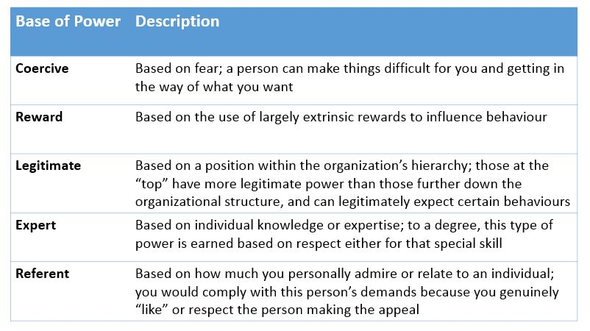

Slide 23
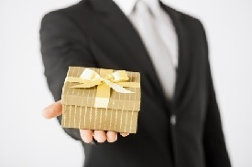
Reward Power
Exists when:
  ‘Others’ are influenced by promises granted
  Or desirable consequences
Can you think of any examples where this might have occurred recently?
  What is President Trump currently being investigated for?
  Russian involvement in US Political process

Slide 24
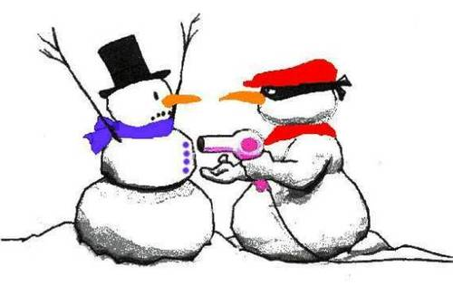
Coercive Power
Derived from:
  Having the ability/position or authority to punish or penalise someone either for an action or against an action
  In order to affect a result, action or circumstance
What current examples of ‘Coercive Power’ can you think of-discuss?

Slide 25
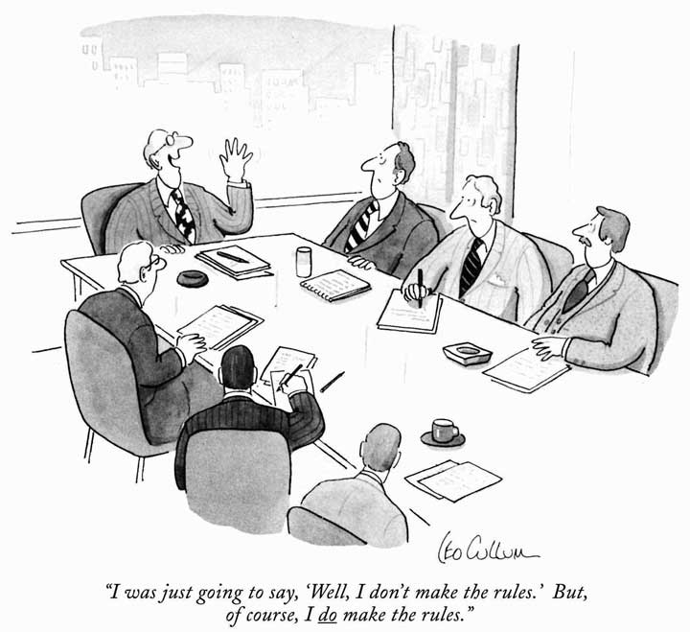
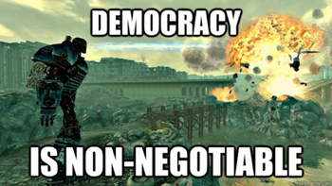
Legitimate Power
Generally linked to:
  Status
  Accepted or compliance with an authority
  A judge or administrator
Who legitimises this power?
  The voter?
  Did you vote for democracy in its present form?
  Or perhaps…

Slide 26

Legitimate Power
Power held within derived hierarchy office or formal rules of existence
Certain power because of status or office
Based on perception and reality position held
Employee accepts authority over them (implicitly or explicitly)

Slide 27


Legitimate Power
John
Searle

Slide 28
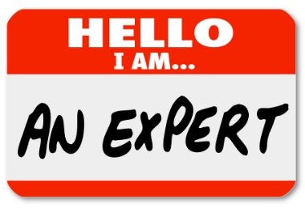
Expert Power
Involving areas of concern around:
Stakeholders
Management
Macro-environment
Organisations aims and objectives
Business (control versus free-trade or state versus market economy)
Market confidence(s)

Slide 29
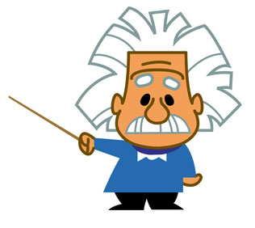
Expert Power
Definitions…
‘…the ability to influence other parties based on expertise and knowledge…’
‘…expert knowledge in an organisation is the ability to influence the behaviour of others within the organisation, based solely on past experience and expertise within a specific area…’

Slide 30

Referent Power
Highly Significant Relations between
  Functional Behaviour
  Social Power
  Leadership Perceptions
Leadership
  Traits
  Style
  Charisma

Slide 31
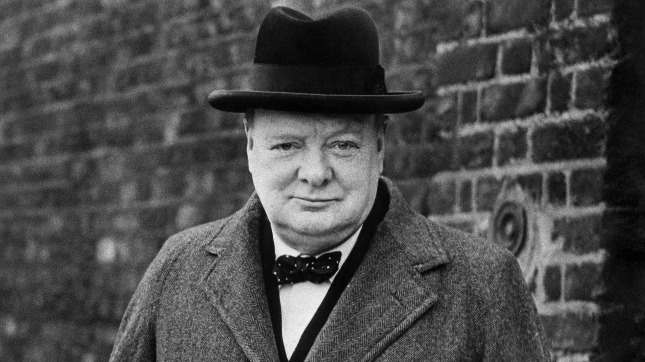
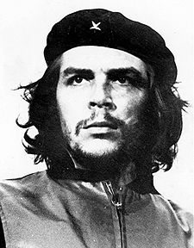
Referent Power
From: Conceptions of Leadership: Charles de Gaulle and Max Weber
Monique Clague
Political Theory http://www.jstor.org/stable/190838

Slide 32
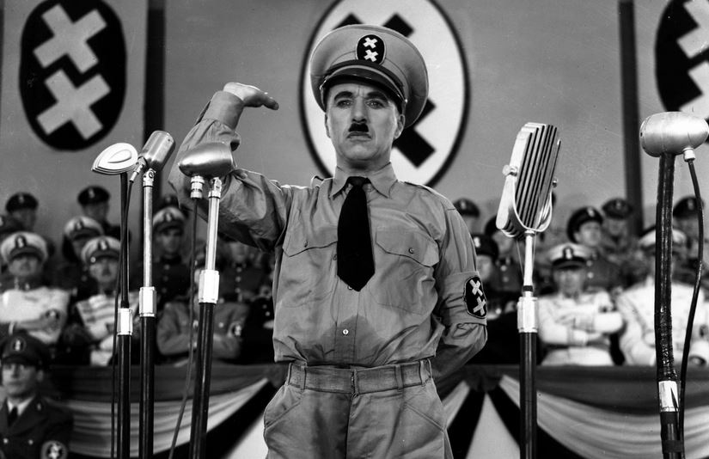
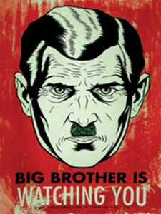
Types of Political Power
Reward Power
Coercive Power
Legitimate Power
Referent Power
Expert Power
Can different types of Political systems use a combination of these types of power?
What about fascism?
What about democracy?

Slide 33

Does any of it matter?!

