Slide 1





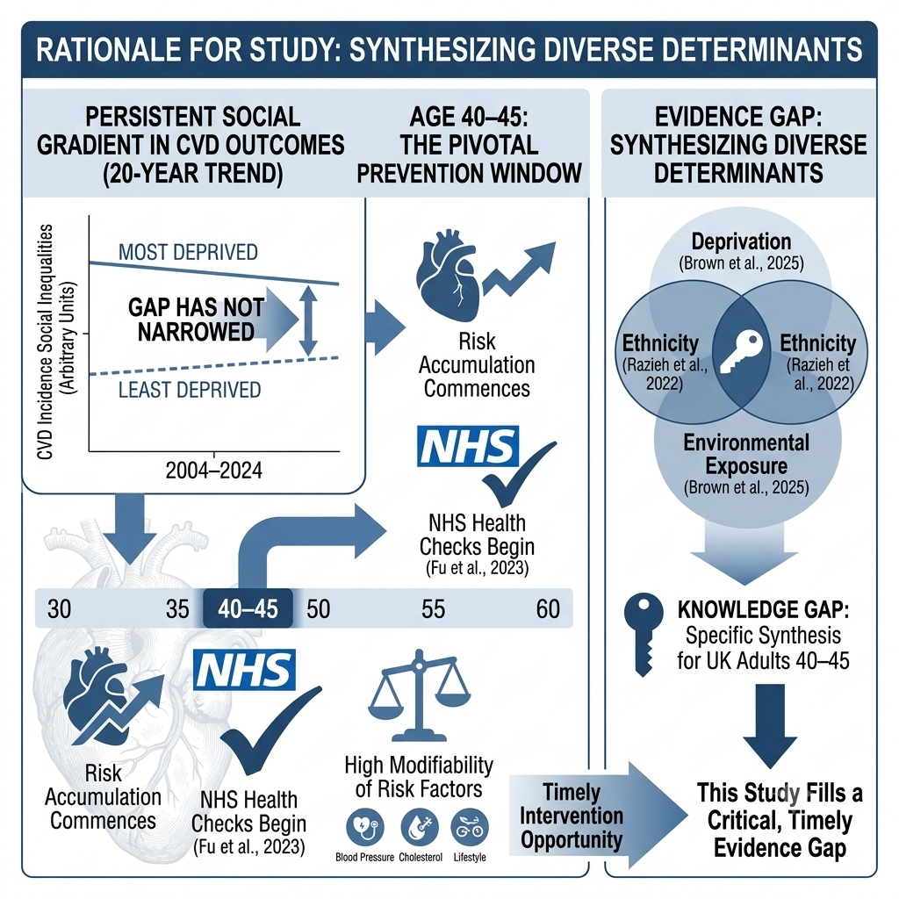
Social Determinants of Cardiovascular Disease Among Adults in the United Kingdom
A Systematic Review of Adults Aged 40–45
Student: Md. Shohel Hossen Email: 2433869student@uwtsd.ac.uk Supervisor Name: Caroline Salami Programme: MSc Public Health & Social Care in Practice (LCHS7008)
Prevalence
Figure 1 – Premature CVD Death Rate by Deprivation Decile, England
Question, Aim & Objectives
7.6 million people in the UK live with heart & circulatory disease
Research Question
How do social determinants influence the development and outcomes of cardiovascular disease among adults in the UK?
Aim
To systematically review and synthesise existing evidence on the influence of social determinants on CVD among UK adults.
1 in 4 UK deaths are caused by CVD – about one death every three minutes
£12bn / £28bn annual NHS cost and wider economic cost of CVD
Source: House of Commons Library / OHID Fingertips (2022). Most deprived 10% >2× the rate of the least deprived.
Objectives
Identify the major social determinants associated with CVD in UK adults.
Examine how income, education, employment and deprivation relate to CVD outcomes.
Explore how ethnicity, housing and access to healthcare affect CVD risk.
Evaluate interventions that reduce social inequalities in CVD.
Over 4 million men and 4 million women in the UK are affected (BHF, 2025).
CVD accounts for 25% of the life-expectancy gap between the most and least deprived areas of England (BHF, 2025).
Two pieces of data visualisation are provided on the poster to show the extent of social inequality in the outcomes of the major public health burden: CVD. The rates of premature CVD death are shown by deprivation decile in England in Figure 1.
Rationale
Figure 2 – Relative CVD Risk by Social Determinant (vs reference group)
References
Brown, J.R.G., Baptiste, P.J., Hajmohammadi, H., Nadarajah, R., Gale, C.P. and Wu, J. (2025) ‘Impact of neighbourhood and environmental factors on the risk of incident cardiovascular disease: a systematic review and meta-analysis’, European Journal of Preventive Cardiology, 32(18), pp. 1903–1912.
Conrad, N., Molenberghs, G., Verbeke, G., Zaccardi, F., Lawson, C., Friday, J.M. et al. (2024) ‘Trends in cardiovascular disease incidence among 22 million people in the UK over 20 years: population based study’, BMJ, 385, e078523.
Fu, Y., Yu, G., Maulana, N. and Thomson, K. (2023) ‘Interventions to tackle health inequalities in cardiovascular risks for socioeconomically disadvantaged populations: a rapid review’, British Medical Bulletin, 148(1), pp. 22–41.
George, J., Mathur, R., Shah, A.D., Pujades-Rodriguez, M., Denaxas, S., Smeeth, L. et al. (2017) ‘Ethnicity and the first diagnosis of a wide range of cardiovascular diseases: associations in a linked electronic health record cohort of 1 million patients’, PLoS ONE, 12(6), e0178945.
Kimenai, D.M., Pirondini, L., Gregson, J., Prieto, D., Pocock, S.J., Perel, P. et al. (2022) ‘Socioeconomic deprivation: an important, largely unrecognized risk factor in primary prevention of cardiovascular disease’, Circulation, 146(3), pp. 240–248.
Ramsay, S.E., Morris, R.W., Whincup, P.H., Subramanian, S.V., Papacosta, A.O., Lennon, L.T. and Wannamethee, S.G. (2015) ‘The influence of neighbourhood-level socioeconomic deprivation on cardiovascular disease mortality in older age: longitudinal multilevel analyses from a cohort of older British men’, Journal of Epidemiology and Community Health, 69(12), pp. 1224–1231.
Razieh, C., Zaccardi, F., Miksza, J., Davies, M.J., Hansell, A.L., Khunti, K. and Yates, T. (2022) ‘Differences in the risk of cardiovascular disease across ethnic groups: UK Biobank observational study’, Nutrition, Metabolism and Cardiovascular Diseases, 32(11), pp. 2594–2602.
British Heart Foundation (2025) Heart & Circulatory Disease Statistics 2025 Compendium. London: BHF.
House of Commons Library (2024) Premature Deaths from Heart and Circulatory Disease. London: UK Parliament.
Marmot, M., Allen, J., Boyce, T., Goldblatt, P. and Morrison, J. (2020) Health Equity in England: The Marmot Review 10 Years On. London: Institute of Health Equity.
NHS England (2019) The NHS Long Term Plan. London: NHS England.
Office for National Statistics (2024) Deaths Registered by Cause, Sex and Age, 2023. Newport: ONS.
World Health Organization (2025) Cardiovascular Diseases (CVDs) Fact Sheet. Geneva: WHO.
Sources: Ramsay et al. (2015); Razieh et al. (2022); Brown et al. (2025). Values are adjusted odds/hazard/risk ratios.
Research Impact
Provides UK-specific, synthesised evidence to target prevention at mid-life adults (40–45).
Informs equitable commissioning of NHS Health Checks and community CVD services.
Supports policymakers in addressing deprivation, ethnicity and environmental drivers together.
Equips HSC professionals to identify and act on social risk in routine practice.
Addresses the 20-year stagnation in health inequalities by prioritizing communities most impacted by socioeconomic disadvantage.
Highlights pathways to reduce the £28 billion annual economic burden of CVD through early, socially targeted prevention strategies.
Source: Author’s Creation
CVD is the UK’s leading cause of premature death, yet a steep social gradient persists and has not narrowed over two decades (Conrad et al., 2024).
Adults aged 40–45 are a pivotal prevention window: risk factors accumulate and the NHS Health Check begins at 40, making mid-life determinants highly modifiable (Fu et al., 2023).
Deprivation, ethnicity and environment independently shape risk, but UK evidence remains fragmented across separate studies (George et al., 2017).

