Slide 1

Module Name: Contemporary Themes in the Hotel and Hospitality Sector.
Module Code: BMIH6001
Assignment Title: Assignment 2: Conference Presentation
Option one: Artificial Intelligence and human collaboration
Student Name: Shereen Garraghan
Student Number: 2242394

Slide 2

Introduction
AI (Artificial Intelligence) provides the scope for hospitality businesses to enhance the rate of customer satisfaction and leverage productivity (Ruel and Njoku, 2021).
In the UK hospitality sector, the use of AI tools is used to provide personalised accommodation services to improve guest experience (Jiwnani, 2024).
Notes:
In the hospitality sector, AI (Artificial Intelligence) holds a paramount status in improving productivity in the hospitality business. It is seen that the suite of AI technology provides the scope to hospitality businesses to enhance the rate of customer satisfaction using AI. The use of AI technology helps in analysing the behaviour of customers and guests. This helps in redesigning the business operations related to hospitality. In addition, the use of AI in HRM (Human Resource Management helps in developing resilience in the workforce by assessing employees' performance and offering solutions to bridge gaps in personality. This, in turn, helps in boosting customers' expenses in the hospitality sector (Ruel and Njoku, 2021). In the hospitality sector of the UK, AI-driven personalisation in hospitality services and preserving human touch in AI helps in enhancing guest experience. In luxury hospitality services, AI is used to offer personalised hospitality services by automating accommodation services for guests. The use of human touch in AI algorithms, such as emotions and warmth, helps in improving guest experience (Jiwnani, 2024).

Slide 3
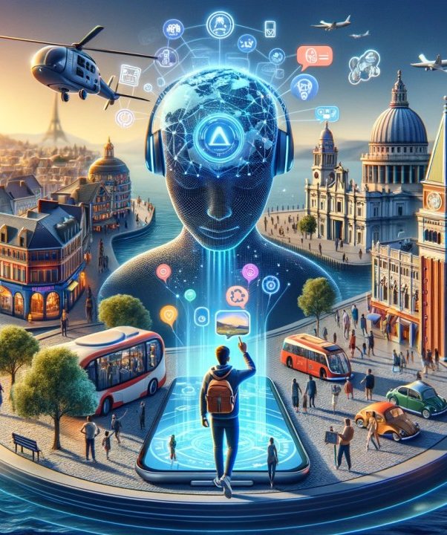
Literature Review:
Artificial Intelligence (AI) has been a part of collaborating humans with machines through various features such as NLP (Tribe, 2009).
The optimal quality of guest services has been a part of the satisfaction level of the guests. It has an optimal impact on increasing the retention level of the guests in businesses (Costa and Costa, 2022).
Notes:
AI and Its Concept
As stated by Tribe (2009) Artificial Intelligence provides the aspects of the maintenance of human intelligence through a human-driven data system, valuing the automation of a particular process. It has been effective with different features such as Natural Language Processing (NLP), aiming at various systems to communicate for decision-making, and to enhance problem-solving. It has impacts on human collaboration regarding the aspects of analysing data of certain things related to their needs and the overall aspects of managing problem-solving related tasks.
Guest Experience and Its Concept
According to the study of Costa and Costa (2022) guests have needs in the service of various businesses regarding their growth needs as per the optimal quality of behavioural aspects. The touchpoints of the guests have been pivotal as part of their experiences. It has been effective to align the services to their satisfaction level as part of managing the growth in the case of service quality.

Slide 4

Literature Review:
AI has significance to personalise the guest service by aligning their needs to the aspects of services (Sharma et al. 2024).
Cybersecurity and skill-related threats have been issues for the stakeholders of a business regarding personalisation through optimising guest services (Walsh, 2021).
Notes:
AI’s Significance for Increasing Guest Experience
Based on the study of Sharma et al. (2024) AI has aligned its features with automating the service quality of a business according to the guests’ choice. The overall management of the personalised service has an impact on the overall satisfaction level of the guests by aligning with the way to increase their motivation to be part of a business activity. It helps to increase the value of the customers as per the value creation in AI-related growth for customers.
Impediments with AI Use to Enhance Guest Experience
As opined by Walsh (2021) the lack of skill sets among employees, as well as the cybersecurity issues, have been the challenges regarding the utilisation of AI in terms of enhancing guests' experiences. The optimisation of AI and human collaboration has also been one of the impediments to aligning with the needs of the guests as per their changing behaviours. It creates challenges for the employees and other stakeholders of a business to provide personalisation as per the needs of the guests.

Slide 5

Literature Review:
Effective training and infrastructural growth have been a part of aligning the needs of guests with AI implementation (Cramarenco et al. 2023).
The focus on the Technology Acceptance Model (TAM) has been a part of growth as per the management of the services with customers’ value (Mugo, 2017).
Notes:
Suggested Ways for Mitigating Challenges Related to AI to Enhance Guest Experience
As stated by Cramarenco et al. (2023) the training of employees has been recommended as per the value of the stakeholders to maintain focus on the issues regarding the security issues associated with AI. In that case, the overall alignment of the guests’ needs has also been a part of the need to mitigate the risks related to the issues. The technological development with a focus on the infrastructure of a business has also been one of the pivotal suggested ways to create alignment with the impediments regarding AI-based personalisation.
Theoretical Perspectives
Based on the study of Mugo (2017) the way to assess the overall satisfaction rate of the customers of a business has been included in the theoretical model, Technology Acceptance Model (TAM). It has been effective for food tech stakeholders to value the personalisation needs of the guests regarding their value needs. It has also been effective to provide the core concepts of the model through the collaboration of the employees and customers of a business.

Slide 6

Method:
Political, economic and social factors
Real estate development initiatives taken by the government of the UK help the hospitality industry grow further (Rahman, 2023).
The hospitality sector of the UK is responsible for employing 3.2 million people in 2023 (Rahman, 2023).
The negative aspect of the social factor involves issues in people management practices in the hospitality sector, resulting in skill development issues of employees (Rahman, 2023)
Notes:
Political: Political factors, positive aspects involve real estate development initiatives taken by the government of the UK, which would help the hospitality industry to grow further. The negative aspect of the political factor is that strict rules laid by the government of the UK during the Covid 19 lockdown period hampered the growth of the hospitality sector significantly (Rahman, 2023).
Economical: The positive aspect of the economic factor is that the hospitality sector of the UK has generated 6% of jobs. The industry is responsible for employing 3.2 million people in 2023 (Rahman, 2023).
Social: The positive aspect of the social factor is that the hospitality sector provides quick services to customers to satisfy irate customers. This helps the hospitality sector to add more customers to its base. However, the negative aspect is that due to a lack of management of people in hospitality sector of the UK, there are issues of skill shortage (Rahman, 2023).

Slide 7

Method:
Technological, ecological and legal factors
The technological aspects of hospitality sector in the UK involves availability of mobile technology and IT (Information Technology which is used to leverage productivity and guest experience (Rahman, 2023).
The negative side of ecological factors is the development of different types of waste products by the hospitality sector in the UK, which puts the sustainability of the hospitality sector in question (Rahman, 2023).
The availability of worker safety laws and food safety laws in the UK helps hospitality companies to align with legal norms (Rahman, 2023).
Notes:
Technological: The availability of mobile technology and IT (Information Technology) in hospitality businesses helps in reducing business costs and leveraging operational efficiency. The use of such technology to provide a personalised customer experience helps in increasing profits of the hospitality sector in the UK. However, there are issues of tech management, like data management, due to the use of digital technology (Rahman, 2023).
Ecological: The negative aspect of ecological factors is that the generation of different waste materials like furniture, food, electronics and paper waste results in raising questions related to sustainability in the hospitality sector of the UK (Rahman, 2023).
Legal: The availability of food safety laws in the UK guides the hospitality sector to provide best in class experience to customers in terms of hygiene and environment. In addition, the presence of workers' safety laws, such as the Safety at Work Act 1974, guides the hospitality sector of the UK to protect the human workforce (Rahman, 2023).

Slide 8
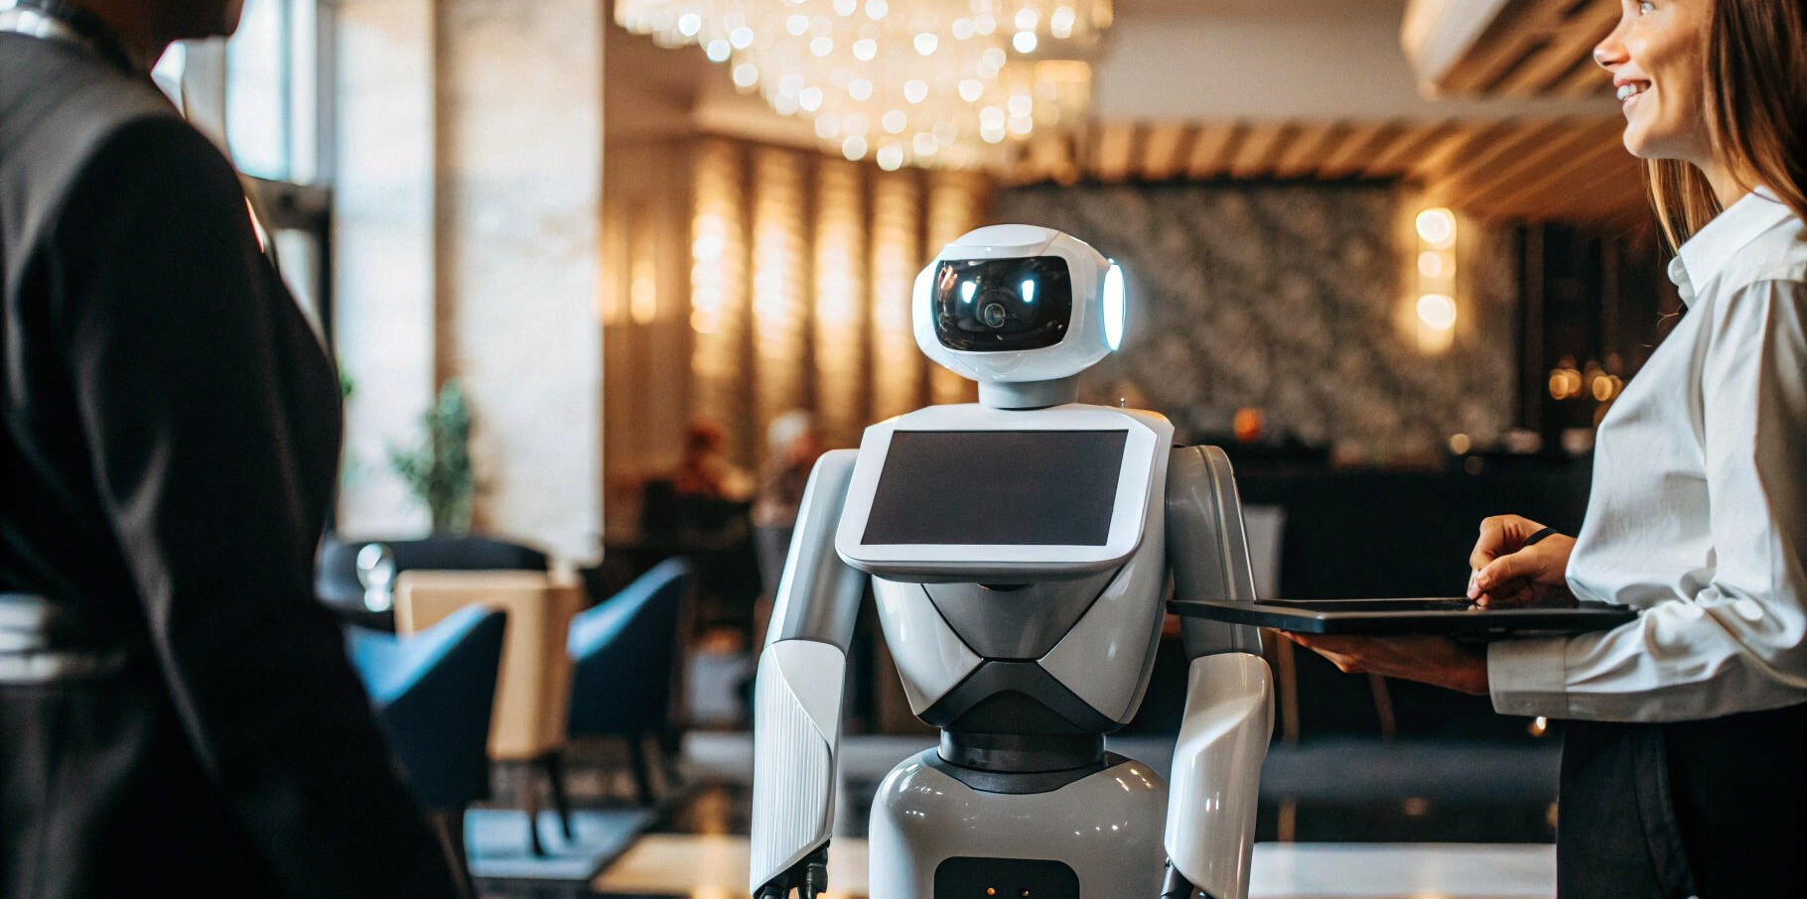
Conclusion:
The presentation has concluded the ideas related to AI and human collaboration aspects in the hospitality industry by discussing theoretical perspectives.
It has showcased the future scope of AI use to maintain optimal guest experience in the case of personalising the guest service by valuing the mitigation strategies.
Notes:
The implementation of AI with effective human collaboration in the case of optimal hospitality services has been a part of the discussion of the presentation, showcasing the impediments and the benefits. The concepts of guest experiences and AI have been interrelated by using the Technology Acceptance Model (TAM) to enhance the quality of the discussion. The discussion of the theme by interrogating the impediments of AI use in the case of the hospitality industry has been utilised through PESTEL analysis as a part of the assessment of the impact of the themes with their significance to maintain growth in the industry for optimal guest experience.

Slide 9

Recommendations
The value of adaptability among the stakeholders of the hospitality industry has been one of the effective ways to provide growth, as per the value creation for the management of the hospitality services (Kim et al. 2025).
In the case of managing the stakeholders’ growth in AI adaptation, the stakeholders’ performance has been pivotal, as per the quality of skills among the stakeholders to mitigate the issues regarding the risks (Kim et al. 2025).
Notes:
The implementation of AI in the hospitality industry requires collaboration among the stakeholders, as per the ways to mitigate the risks related to the adaptation in the case of technological adaptation. The ways to align with the stakeholders' objectives have been part of recommendations in the case of AI and human collaboration, valuing the productivity needs of the stakeholders to motivate the employees to increase performance regarding technological innovation related to AI. The effective way to provide guest experiences has been the value aspects in creating growth, as per the mitigation of risks in the case of cybersecurity, and the overall management of technological skill sets among the stakeholders. It has been pivotal for the stakeholders of the hospitality industry to align the AI-related adaptability with the guests' needs and the collaboration with the personalisation needs of the guests to make them optimal for the quality of understanding of the AI-related recommendations (Kim et al. 2025).

Slide 10
References
Costa, V. and Costa, C. (eds) (2022) Sustainability and competitiveness in the hospitality industry. Hershey, Pennsylvania: Business Science Reference.
Cramarenco, R.E., Burcă-Voicu, M.I. and Dabija, D.C., (2023). The impact of artificial intelligence (AI) on employees’ skills and well-being in global labor markets: A systematic review. Oeconomia Copernicana, 14(3), pp.731-767. https://bibliotekanauki.pl/articles/19901816.pdf
Jiwnani, L. (2024) Ai’s transformative role in the hospitality industry: Deloitte UK, Deloitte United Kingdom. Available at: https://www.deloitte.com/uk/en/Industries/consumer/blogs/embracing-the-future-ais-transformative-role-in-hospitality.html (Accessed: 27 January 2026).
Kim, G.Y., Lee, W.J., Choi, B. and Lew, Y.K., (2025). Fostering collaborative opportunities for AI start-ups: The case of a hybrid business incubator in Seoul. The Journal of Technology Transfer, 50(2), pp.552-581. https://www.researchgate.net/profile/Yong-Kyu-Lew/publication/382178990_Fostering_collaborative_opportunities_for_AI_start-ups_The_case_of_a_hybrid_business_incubator_in_Seoul/links/66909f09af9e615a15e0a73d/Fostering-collaborative-opportunities-for-AI-start-ups-The-case-of-a-hybrid-business-incubator-in-Seoul.pdf
Mugo, D., (2017). The technology acceptance model (TAM) and its application to the utilization of mobile learning technologies. British Journal of Mathematics & Computer Science. https://www.academia.edu/download/110588752/MTc3NTBAQHBm.pdf
Rahman, M. (2023) Pestel analysis of the hospitality industry, www.howandwhat.net. Available at: https://www.howandwhat.net/pestel-analysis-hospitality-industry/ (Accessed: 27 January 2026).
Ruel, H. and Njoku, E., (2021). AI redefining the hospitality industry. Journal of Tourism Futures, 7(1), pp.53-66. https://www.emerald.com/jtf/article-pdf/7/1/53/1691082/jtf-03-2020-0032.pdf
Sharma, M., Singh, A.K. and Tyagi, P. (2024) Proceedings of the International Conference on Innovation and Regenerative Trends in Tourism and Hospitality Industry (IRTTHI 2024). 1st ed. Dordrecht: Atlantis Press Zeger Karssen.
Tribe, J. (2009). Philosophical issues in Tourism (Aspects of Tourism), Channel View
Walsh, B., (2021). Cyber security skill requirements from the Irish job market. https://www.theseus.fi/bitstream/handle/10024/512741/Skills%20in%20CS%20thesis.pdf?sequence=2

