Slide 1
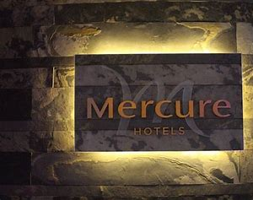
Hospitality and guest services by katie evans.
mercure hotel cardiff - Bing images2023

Slide 2
INDURDUCTION
The Mercure Cardiff Holland House Hotel stands as a prominent establishment in the vibrant city of Cardiff, offering a combination of modern amenities, sophisticated design, and a central location. Whether you're a leisure traveler exploring the city or a business professional attending a conference, the hotel aims to provide a comfortable and memorable experience.
https://mercure.accor.com/gb/united-kingdom/2023​

Slide 3
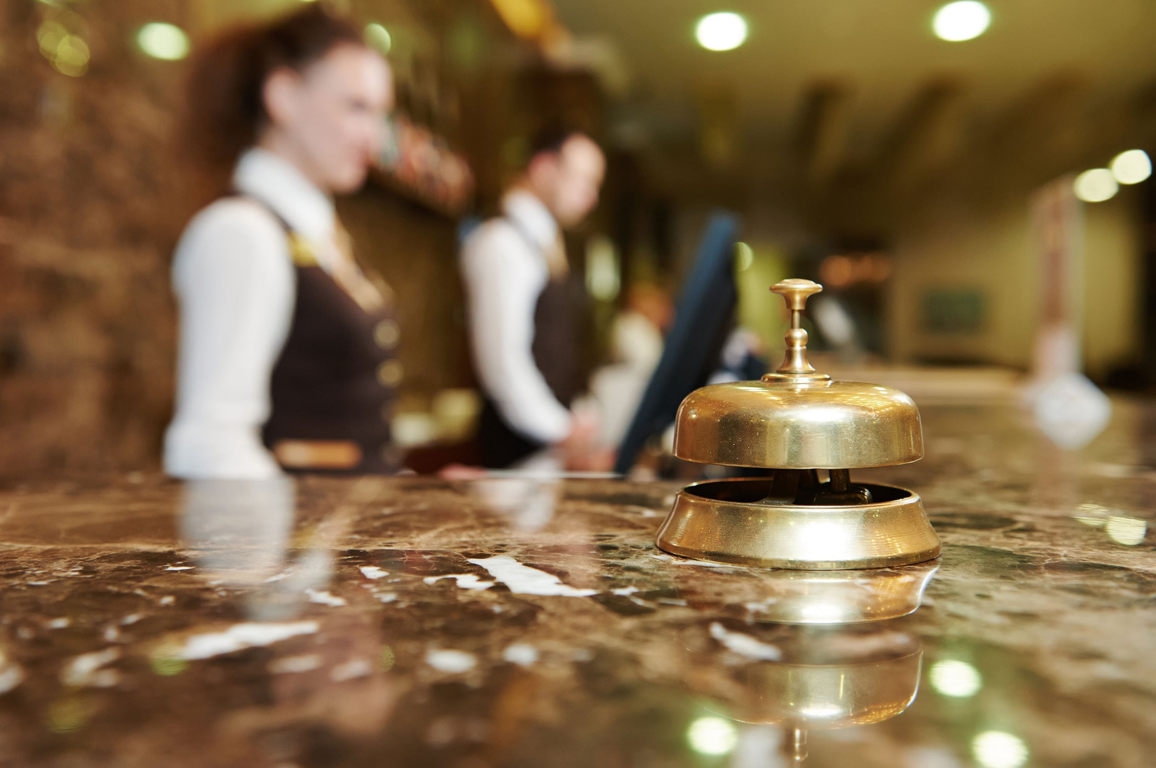
https://www.bing.com/images/search?

Slide 4
GUEST SERVICES
Check-in and Check-out Services:
Nature: Efficient and personalized check-in and check-out procedures.
Scope: Ensuring a smooth arrival and departure experience.
Role: Front desk staff plays a key role in facilitating the check-in process, providing information, and addressing guest queries.
Accommodation Facilities:
Nature: Well-appointed rooms and suites with modern amenities.
Scope: Providing a comfortable and contemporary living space.
Role: Housekeeping staff maintains cleanliness, and maintenance teams address any issues to ensure a pleasant stay.
Dining and Culinary Services:
Nature: On-site restaurants and possibly room service.
Scope: Offering a range of dining options to cater to diverse preferences.
Role: Culinary staff and servers ensure the quality of meals, and room service staff cater to in-room dining needs.
https://mercure.accor.com/gb/united-kingdom/2023

Slide 5
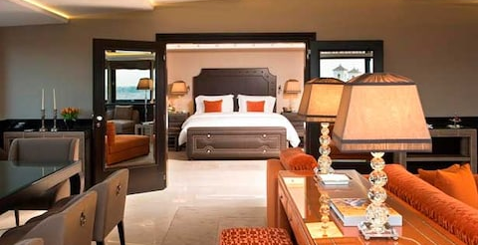
https://www.bing.com/images/search?2023

Slide 6
ORGANISATION
Personalized Service:
Guests appreciate individualized attention and service that caters to their specific needs and preferences.
Attention to Detail:
Small details contribute significantly to the overall guest experience, creating a sense of care and consideration.
Welcoming Atmosphere:
A warm and inviting atmosphere helps guests feel comfortable and at home during their stay.
Quality Dining Experience:
Culinary excellence contributes significantly to overall guest satisfaction.
Mercure Holland House: If the hotel offers on-site dining, it may focus on providing high-quality meals and accommodating diverse culinary preferences.
https://mercure.accor.com/gb/united-kingdom/2023​

Slide 7
SERVICE MANAGERMENT
Technological Integration:
Modern consumers increasingly expect seamless technological integration throughout their stay, from online booking to mobile check-in and smart room controls.
Flexible Booking Options:
Flexible booking options, including easy cancellations and changes, have become more important, especially in the post-pandemic era.
Health and Safety Considerations:
Post-pandemic, guests are more conscious of health and safety measures. They expect rigorous cleanliness standards and protocols.
https://mercure.accor.com/gb/united-kingdom/2023

Slide 8

https://www.bing.com/images/search?

Slide 9
CASE STUDYS
Personalized Service:
Guests appreciate individualized attention and service that caters to their specific needs and preferences.
Attention to Detail:
Small details contribute significantly to the overall guest experience, creating a sense of care and consideration.
Welcoming Atmosphere:
A warm and inviting atmosphere helps guests feel comfortable and at home during their stay.
Efficient Check-in and Check-out:
Streamlined processes during check-in and check-out enhance guest satisfaction and contribute to a hassle-free experience.
https://mercure.accor.com/gb/united-kingdom/2023​

Slide 10
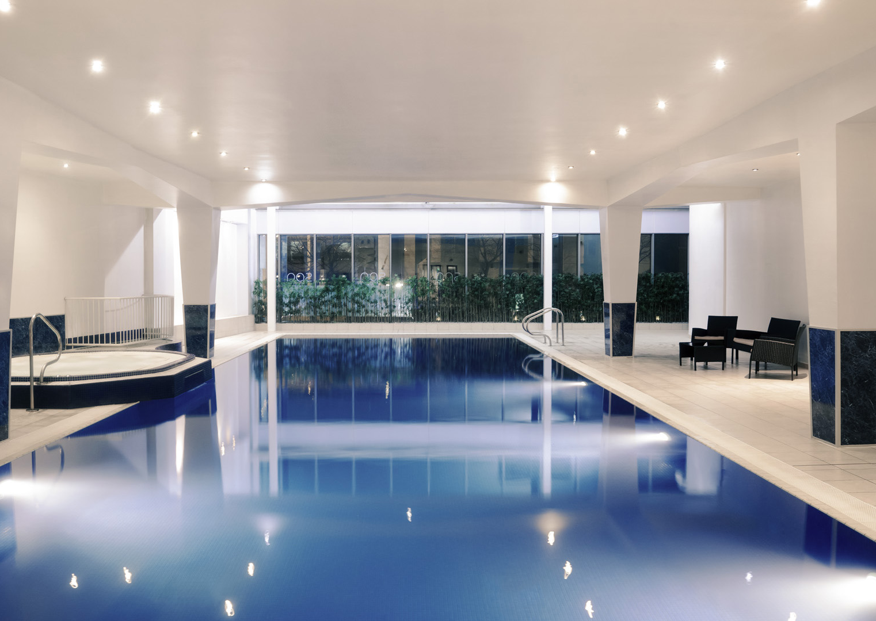
https://www.bing.com/images/search?​

