Slide 1
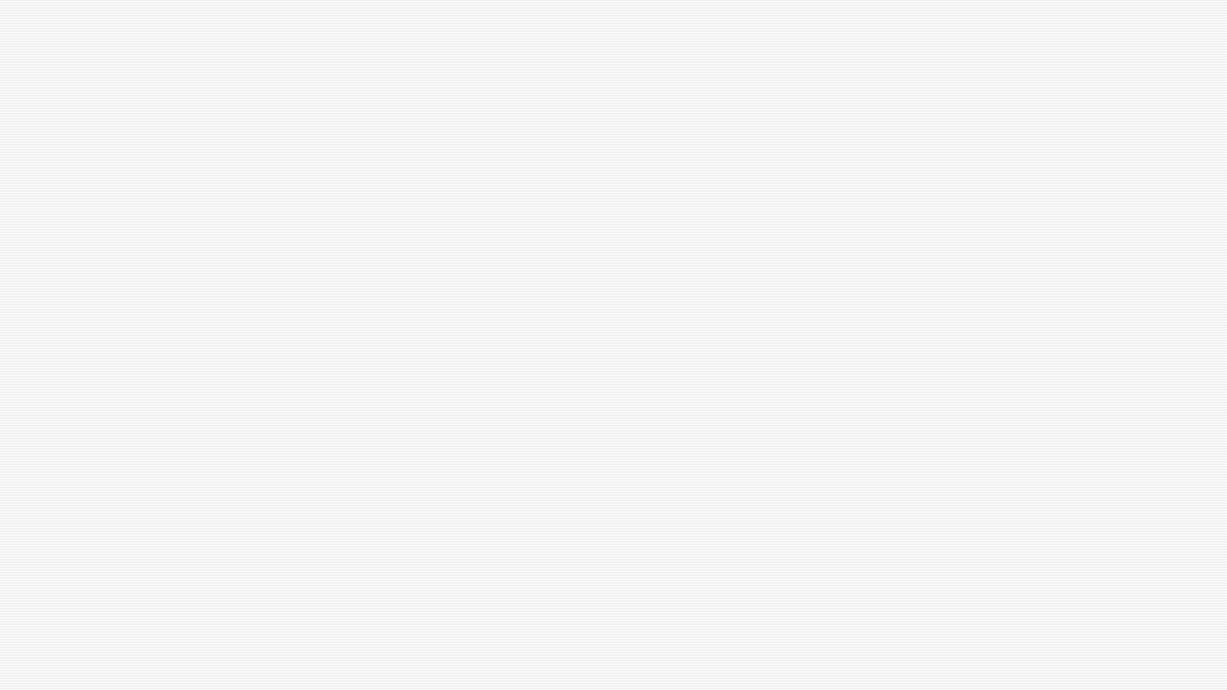

Business digital skills reflection
my learning journey over the past 8 weeks at University of Wales Trinity saint David
This presentation outlines the key digital skills and business knowledge I have learned and developed throughout this term.
By Sophie frost
Student number – 2537014

Slide 2
Introduction
Over the past eight weeks, I have learned new digital skills, including how to use Microsoft apps, work better with others, communicate more effectively, and build my LinkedIn profile
When I started university I felt overwhelmed because everything was new and I didn’t know if it was right for me now after my first term I feel much more confident and settled. I understand how things work better and have improved my time management and feel more comfortable in this environment .

Slide 3
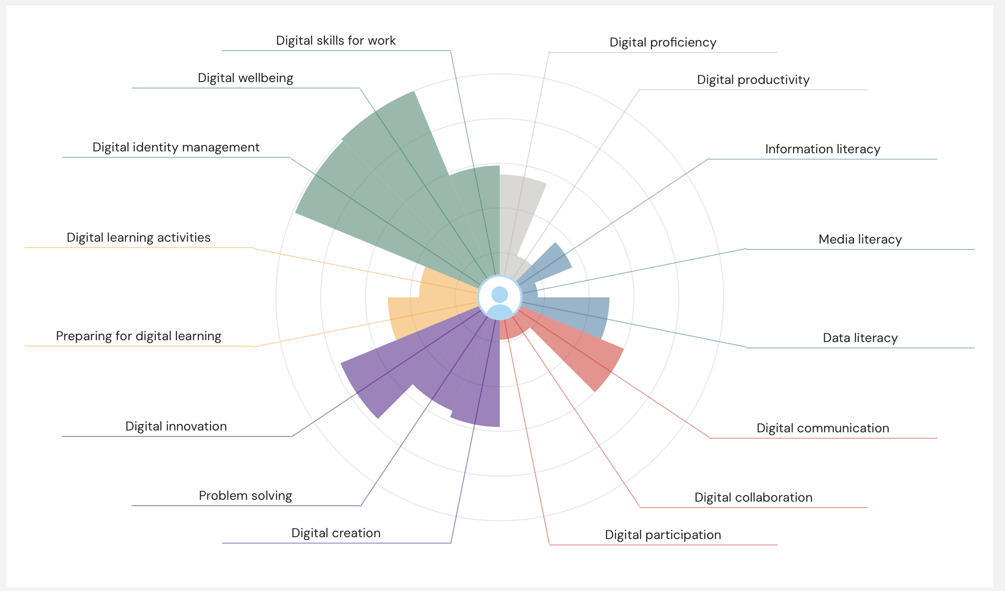
JISC
After analysing my results I’ve discovered my strength and weakness
Strength-Digital identity management is one of my strengths because I know how to protect my personal info and use digital tools responsibly. I know how important it is to stay safe online and manage what I share.
Weakness-Digital collaboration - I’m working on my digital collaboration skills by keeping my team updated more often, sharing my work more clearly, and using collaboration tools better.
These are my results from the JISC survey

Slide 4



MICROSOFT TEAMS
Communicating professionally with classmates and tutors.
Scheduling and joining online meetings.
Working effectively as part of a team.

Slide 5

MICROSOFT EXCEL
Creating spreadsheets.
Using formulas such as SUM and AVERAGE.
Organising and analysing data.
Creating charts to present information clearly.

Slide 6

MICROSOFT POWER POINT
Making slides that look clear and neat
Using pictures, icons, and basic design
Organising information so it’s easy to follow

Slide 7

MICROSOFT OUTLOOK
Sending and replying to professional emails
Organising emails into folders
Using the calendar to set up meetings and reminders
Managing messages so nothing gets missed

Slide 8
How will these skills help me in the future?
LinkedIn Learning – help me keep learning new skills to grow my business
Excel – help me track money, bookings, and stock
Outlook – help me manage emails and customer bookings
PowerPoint – help me present ideas and promote my business

Slide 9
SMART GOAL
Improve my time management for future assignments and deadlines
Practise Excel formulas a few times a week to get better
Set up and update my LinkedIn by the end of term
Attend all classes
Going to give myself a week to complete Microsoft word

Slide 10
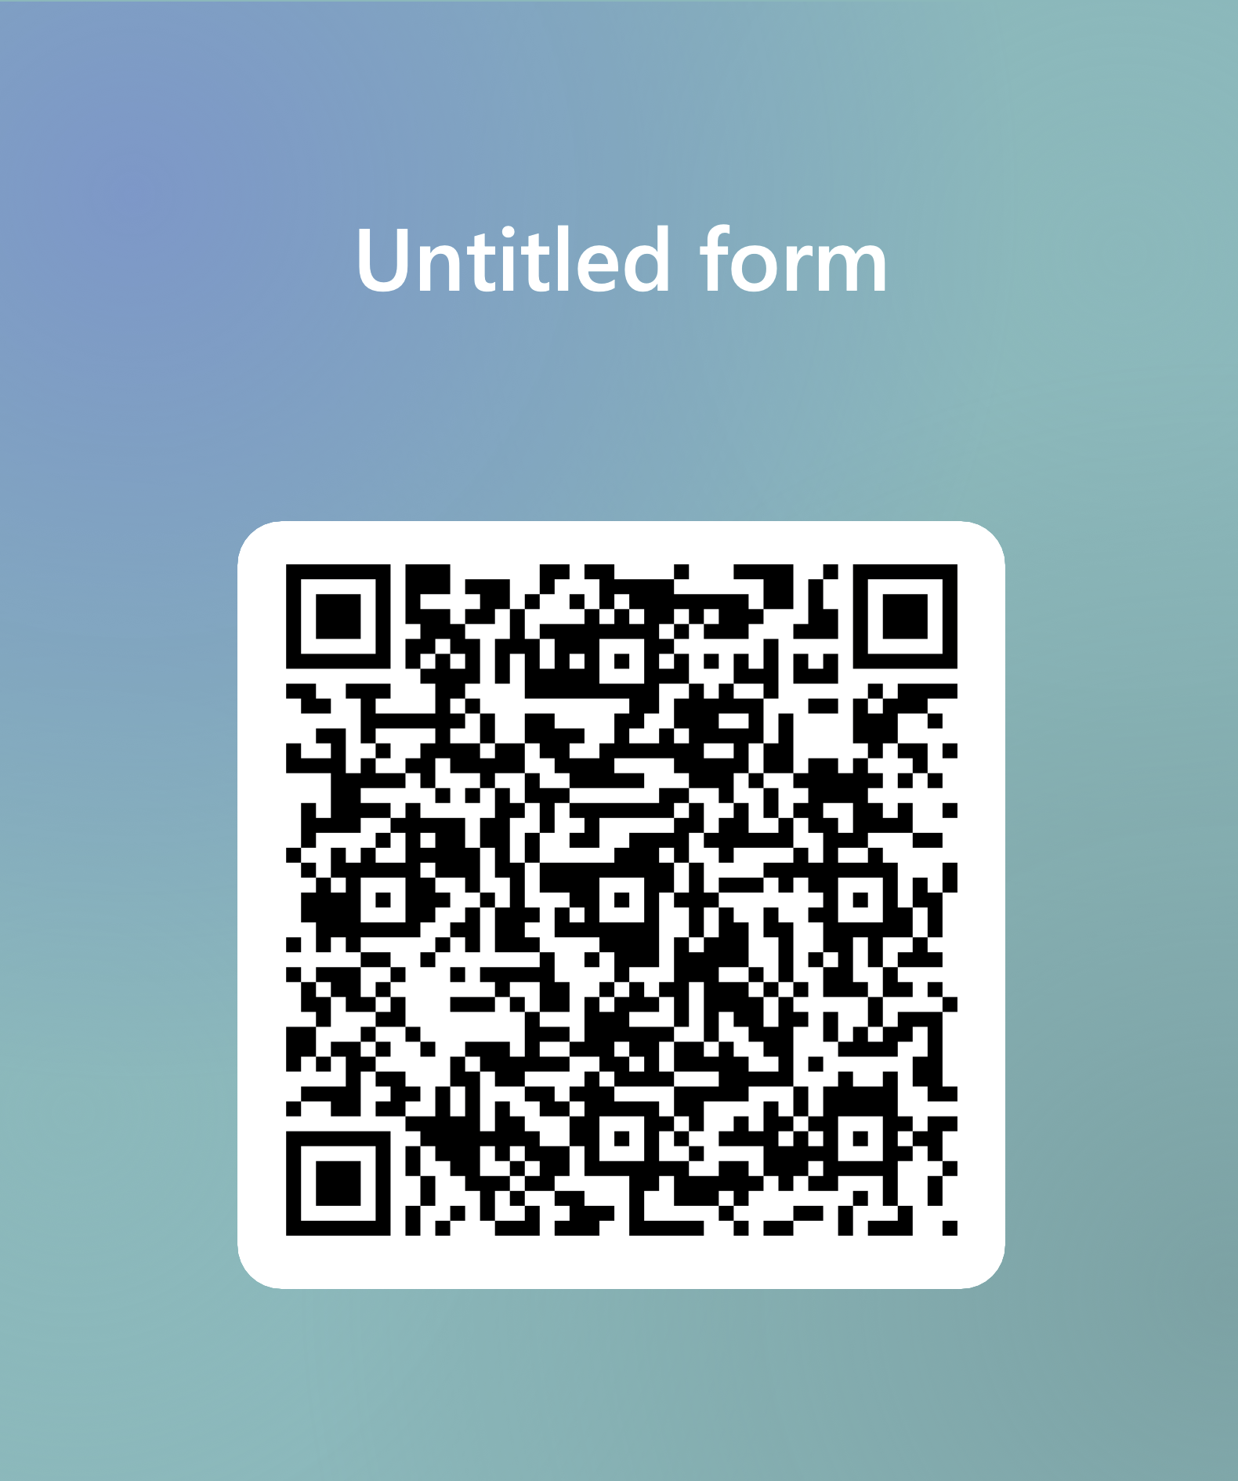
CONCLUSION
Overall this reflection has shown me how much my digital skills have grown and where I can still improve. I’ve learned a lot from the lectures and feel more confident using different tools in my business. Going forward I want to keep building on these skills and use them more effectively in real situations.
Thanks for listening. I have attached a QR code could you please scan and complete the survey then we can answer any questions you may have about my presentation.

