Slide 1
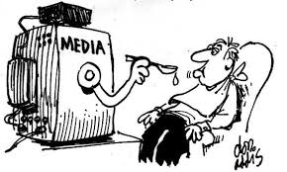
Media and New Technologies

Slide 2
Key Themes
The politics of new media production
How is global media consumed
How are new technologies appropriated by marginalised groups
  And at what cost?
What can the production and consumption of new media technologies tell us about the processes of deterritorialization and the (re)embedding of place

Slide 3
Contemporary Globalisation
‘the intensification of global interconnectedness, suggesting a world full of movement and mixture, contact and linkages, and persistent cultural interaction and exchange’ (Inda & Rosaldo 2002: 2)
‘the intensification of world-wide social relations which link distant localities in such a way that local happenings are shaped by events occurring many miles away and vice-versa’ (Giddens 1990: 64)

Slide 4
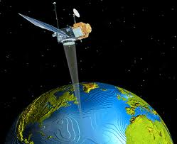

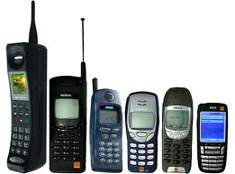
‘Intensification’
Intensification defines contemporary globalisation
New technologies
  Telephones, satellites and the internet
  Instantaneous lines of communication across space
  Enable participation in global events

Slide 5
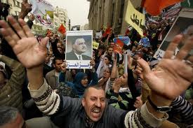
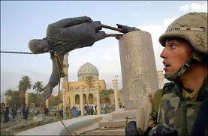
Space Time Compression
Harvey in Inda & Rosaldo (2002: 6)
Almost instant interactions with other people across time and space
Experience geographically distant events
We are ‘there’ as it happens
24hr news culture

Slide 6
Disembedding Mechanisms
Giddens (1991: 18)
Disembed us from a sense of being tied to a local context
Create new economic and social relations
Old notions of belonging become eroded and new ones are created
Engage with a multiplicity of different cultural and social systems which transcend established geo-political boundaries

Slide 7



TV Audiences and Virtual Networks as ‘Imagined Communities’

Slide 8

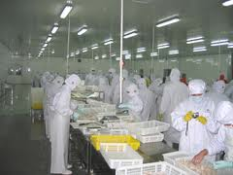


Are new technologies alienating?

Slide 9
Observation & Mediation
New information technologies have radically altered the nature of social engagement
But how does ‘place’ continue to play a role?
  Availability of access
  Political and economic relations of media production
The ways cultures and events are represented are often highly mediated and directed
Growing dominance of western-dominated media; cultural imperialism and cultural homogeneity?

Slide 10
Globalisation as a one-way street?
US export of TV programmes and the lack of reciprocal arrangements
Adoption of Western values?
  The desire to be ‘modern’
  Dichotomy between modernity ‘The West’ and tradition ‘the Other/the Rest’
Media as a form of social control
  but ‘if the whole world is watching, are we all watching the same world?’
  Ways in which non-Western cultures consume, watch, interpret and position Western media presents a more complex picture

Slide 11
The Iraq War Never Happened
24hr News Society and News programming as a competitive market
  CNN’s coverage of the 1991 Gulf War led to a massive increase in fees for screening commercials (rising from $3,500 to $20,000)
Impartial reporting is problematic; the pressure is on for increasingly sensationalised and partial stories
CNN established themselves as ‘the voice’ of the 1991 Gulf War
Other voices thus lost their legitimacy

Slide 12
Al Jazeera
Channel was vilified for;
  showing graphic images of actual human suffering
  screening footage of captured US soldiers being interviewed by the Iraqi media.
Condemned by the allied forces as being the mouthpiece of Saddam Hussein
Condemned by the Iraqi regime as the mouthpiece of American imperialism.
Their approach represented a shift in reporting of the Iraq war
  demonstrated the human cost of the conflict - a cost that Western news agencies had obscured by showing the war as being akin to a vast, technologised and dehumanised computer game in which no one was really hurt

Slide 13
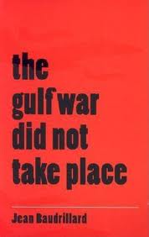
Baudrillard (1995)
‘Hyper-reality’ and simulation
The reality of the war had been replaced by a 'copy' war that is delivered to televisions across the world where no fighting is taking place.

Slide 14
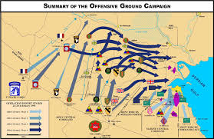
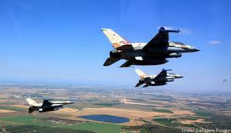
America was engaged in an illusion that it was fighting, much as the mind engages with a video game
While the combat may have been real, only a few people experienced it and they were on the other side of the world.
The 'war' that was broadcast on television, and therefore the war as it was understood by the majority of people, was not actually ‘real’.

Slide 15
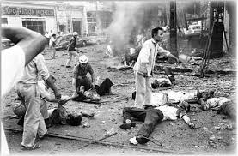

Slide 16
American soldiers fought solely within the system of military technology
  face-to-face combat was much less in relation to earlier conflicts.
The video screen-mediated concept of the precision strike became an advertisement for American technology
  an advertisement for military hardware.
The problematic element in this is that the actual deaths involved were obfuscated.
We were being presented with was a ‘authorised’, ‘clean’, sanitised and simulated version of the actual war

Slide 17
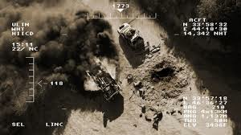
A Video Game War?
Both the Iraqis and the Pentagon ran computer simulation models of their respective strategies before implementing them.
  Rather than represent something that happens in the real world, simulation calls actual events into being according to its models .

Slide 18
Conclusions
War is much about media and communications as it is about actual physical conflict
  military force exerts control over geographical space only insofar as it is able to cast a network of communication over that space.
  the military controls public information about war through journalists, news channels, etc.
    ‘embeds’ as a joint Western media-military strategy.
Both Gulf Wars occurred in an ‘imaginary’ place which presented Western viewers with an orientalist fantasy of fanatical and dehumanised Arabs, contrasted with the CGI and Hollywood heroics of the the Allied forces.

Slide 19
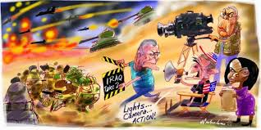
The Media Set the Agenda for War

Slide 20
Soap Operas in Egypt
Is the global media driven by the West?
Abu-Lughod (2002) argues that, in Egypt, TV is related to modernisation, but audiences are not passive
Situated and local readings differed significantly from producers’ intended message
Comparison of the Bold and the Beautiful (a USA import) and Hilmiyya Nights (a ‘nationalist, Egyptian serial).

Slide 21


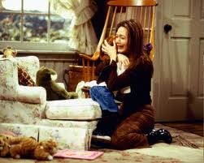

http://www.atvtoday.co.uk/index.php?option=com_content&view=article&id=758:a-few-memorable-moments-from-the-bold-and-the-beautiful&catid=14:eyespy&Itemid=19

Slide 22
The Attraction of Hilmiyya Nights
Hilmiyya Nights did attract an audience of poor and uneducated Egyptian women
Not because they recognised the import of the serial’s social and political message
It spoke to personal issues and concerns of the audience
The vicarious pleasure gained by watching female characters flaunt a moral system that constrained women.

Slide 23
Conclusions
Abu-Lughod argues that the power of the media to disseminate ideas may be less than we assume
  Hilmiyya Nights was viewed selectively by its audience who focused on points of intersection between their own lives and those of the characters
  Passed over the political content, and concentrated on the secularised and psychologised content.
Nationalist and moral messages are subverted by people’s local experience
  Nationalist values rested on a unity of rich and poor (via a shared love of Egypt) which is often not evident in every day life of rural villagers.
The anti-materialist messages of the serial were also subverted by prolific advertising and international narrative frameworks
  the vision of modernity offered rests on class position

Slide 24
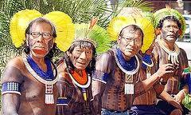
Indigenous Media: The Kayapo
In 1985, in a effort to preserve their culture, the Kayapo started to use video to document their life
Support from Terence Turner and Monica Frota
Helped Frota understand how the Kayapo constructed their identity
Opened up new avenues of investigation and ethnographic documentation

Slide 25
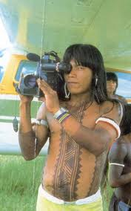
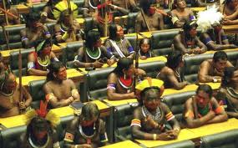
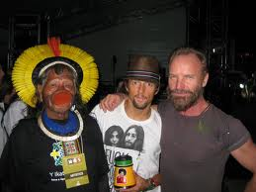
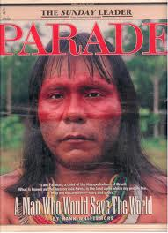
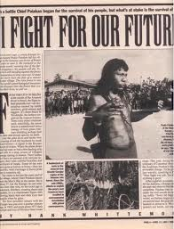

Slide 26
Reinforcing and reinventing culture
They performed their culture as a strategy in their opposition to the state
Turner suggests they also became more conscious of their own cultural practices, and its potential as a political resource
Led to the ‘rediscovery’ of ancient dances and rituals
Reinvented culture to appeal to Western audiences
Disguised some activities, e.g. logging and mining, which could damage their image – especially to environmental allies

Slide 27
Kayapo self-representation
Representation is a creative process
  Consent and obedience is created through symbolic performance
  Not mimetic of reality, but constitutive of it
Producing representations is imbued with the power to create and compel
Rather than just being subjects, the Kayapo appropriated video technology
Show they can master their own history if they can master their own representation

Slide 28
Ginsberg
Indigenous media among Australian Aboriginal groups
Media mediates and enables the representation of contemporary indigenous identities
Shouldn’t be seen as a simple recording of a ‘traditional’ past
Rather, groups take elements of tradition and modernity to represent and reinvent their indigeneity and social position

Slide 29
Survival International
Uncontacted Mascho-Piro group in Amazonian Peru and the use of the media
Survival Int. claim the Peruvian state deny the existence of these groups
They use media to counteract their claims
When challenged about their use of the images (Newsnight 1/2/11), they claimed they were responding to dominant media frameworks
http://www.survivalinternational.org/tribes/isolatedperu

