Slide 1
Basil's Bakery Case Study
Assignment Presentation: Basil's Bakery Case Study
Student Name: Saiqa Nisa Shah
Student ID: 2532490

Slide 2
Introduction
Introduce Basil's Bakery
Explain why sales have stopped growing
Use 5W2H, PESTEL and Fishbone
Give recommendations

Slide 3
About Basil's Bakery
Small independent bakery in Coventry
Opened in 2015
Sells cakes, bread and pastries
Uses organic ingredients

Slide 4
Problems
Fewer people visit the retail park
Unable to offer a pre-order service.
More people work from home
No delivery service
Organic ingredients price increasese
Overhead increase

Slide 5
5W2H
Who: Basil and employees
What: Issue with sales.
When: Since 2020
Where: Coventry Uk
Why: Lockdown restrictions
How: People working from home and footfall.
How much: 25% on average.

Slide 6
PESTEL
Political: Business rates and restrictions imposed during lockdown
Economic: Inflation, where shopping centre is quieter
Social: Working from home and change of lifestyle
Technological : No online ordering
Environmental: Organic ingredients cost more and vulnerable crop failure.
Legal: Lockdown became law

Slide 7
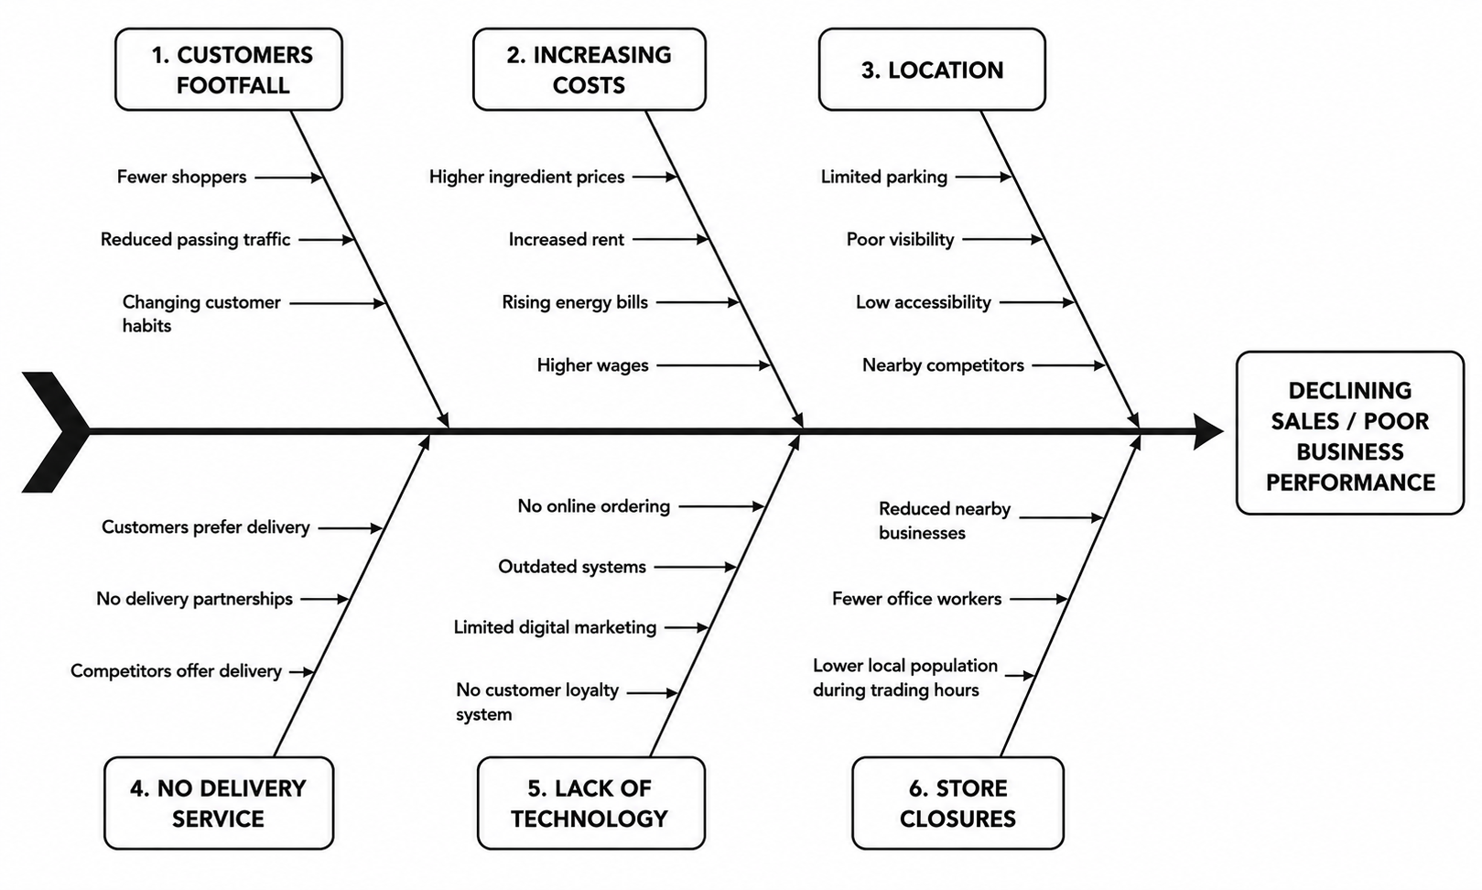
Fishbone

Slide 8
Conclusion
Sales have reduced because fewer customers visit.
Costs are increasing.
Basil should introduce online ordering, delivery and better marketing.
Convenient location
Offering new products and services
Opening new shops

Slide 9
References
Basil's Bakery Case Study
Kotler & Keller (Marketing)
PESTEL and Fishbone sources

