Slide 1
Sustainable Tourism:
Impacts of Development

Slide 2
Learning Outcomes
Be able to analyse the impacts of sustainable tourism development
Be able to identify factors that may prevent/hinder sustainability
Be able to analyse different stages in sustainable planning

Slide 3
Learning Outcomes
Understand the need for planning for sustainable tourism
Justify the introduction of the concept of sustainability in tourism development.
Analyse factors that may prevent/hinder sustainable tourism development
Analyse different stages in planning for sustainability

Slide 4
Sustainable Tourism?
Ecotourism
Nature tourism
Community-based tourism
Rural tourism
Wildlife tourism
Adventure tourism
High volume/ mass tourism
Notes:
ST diff from ecot, in the sense that it is broader and can include many other types of tourism so long as these follow sustainability guidelines.
Sustainable tourism development guidelines and management practices are applicable to all forms of tourism in all types of destinations, including mass tourism and the various niche tourism segments. Sustainability principles refer to the environmental, economic, and socio-cultural aspects of tourism development, and a suitable balance must be established between these three dimensions to guarantee its long-term sustainability.

Slide 5
Sustainable Tourism
Sustainability principles refer to the environmental, economic and socio-cultural aspects of tourism development. A suitable balance must be established between these three dimensions to guarantee its long-term sustainability.
UN World Tourism Organization

Slide 6
What do “sustainable travelers” look like?
  Younger. Average age is 39.
  Educated. 48% have a college degree.
  Wealthier. 13% higher income.
  Spender. £2,000 more on travel per year.
  Tech Savvy. Book online and value technology.
Notes:
Green Travelers are those that specifically travel for sustainability or consider sustainability at least half of the time.
“Dark Green” travelers – those on the forefront of the movement
- Tech savvy – resourceful, investigative and rely on the word of mouth experience of others

Slide 7


But what are they looking for?

Slide 8
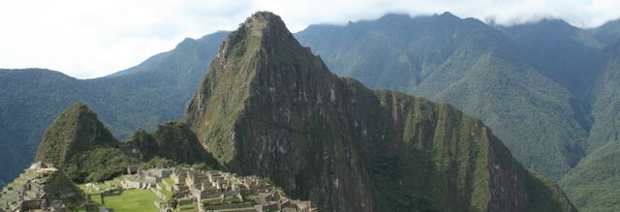
The things that you can probably guess…
Conservation of natural resources
Protecting biodiversity
Reduction of waste
Minimizing effects on climate change
Notes:
These are things typically associated with sustainability by the majority of people

Slide 9

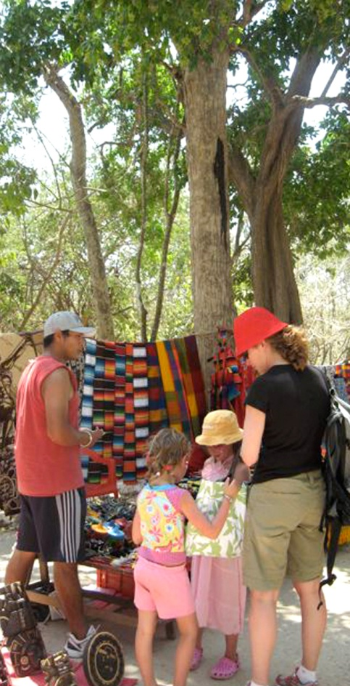
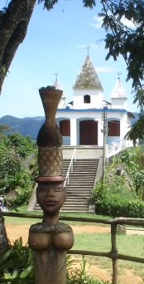
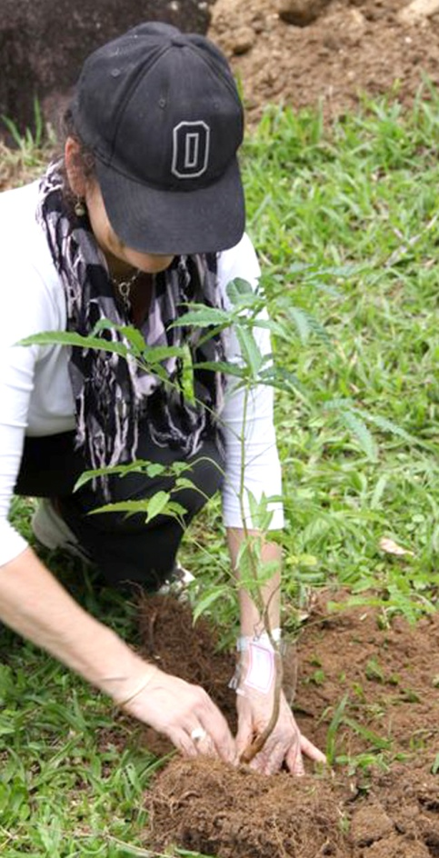
And some you didn’t know you knew...
Authenticity
Uniqueness
Quality
Participation
Bruno Maia/Naturezafotos.org
Bruno Maia/Naturezafotos.org
Notes:
Sustainable tourism goes beyond being obsessed with recycling and living in a treehouse.
High quality tourism that embraces the uniqueness of the destination, creates an authentic experience, and encourages interaction with the place and its people is also sustainable.
So, being a sustainable business is not JUST about the environment, being crunchy… but it’s about being a GOOD business and providing GOOD opportunities to clientele

Slide 10
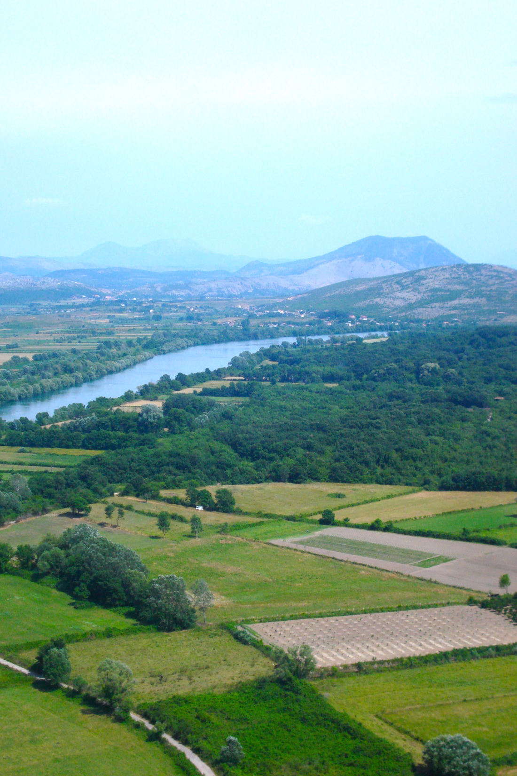
Sustainable tourism measures success in different ways
Type of Travel
Number of Visitors
How much money is spent
Quality of Travel
Length of Stay
Where the
money is spent
Notes:
Tourism as an industry has a fairly common set of indicators it uses
Ministries, CVBs, tour operators all use arrivals and income generators as a way to measure viability (These are all relevant – still a business)
Sustainable tourism goes one step further to look at impacts
Using these indicators whether building a business or a destination promotes healthier more long-term success that isn’t victim to economic trends or fads

Slide 11
Sustainable Tourism
“Sustainable tourism should:
Make optimal use of environmental resources that constitute a key element in tourism development, maintaining essential ecological processes and helping to conserve natural heritage and biodiversity.
Respect the socio-cultural authenticity of host communities, conserve their built and living cultural heritage and traditional values, and contribute to inter-cultural understanding and tolerance.
Ensure viable, long-term economic operations, providing socio-economic benefits to all stakeholders that are fairly distributed, including stable employment and income-earning opportunities and social services to host communities, and contributing to poverty alleviation.”
(UNWTO, 2004)
Notes:
Also requires the informed participation of all relevant stakeholders, as well as strong political leadership to ensure wide participation and consensus building. Achieving sustainable tourism is a continuous process and it requires constant monitoring of It should also maintain a high level of tourist satisfaction and ensure a meaningful experience to the tourists, raising their awareness about sustainability issues and promoting sustainable tourism practices amongst them.

Slide 12
Sustainability in Tourism
Environmental
  Minimal impacts on local biodiversity
  Sustainable use of resources (water, energy…)
  Waste reduction
  Environmental education
Social
  Empowerment of local people (e.g employment conditions, gender considerations, prevention of child exploitation)
  Protection of cultural heritage
Economic
  Improvement to local livelihoods as well as increase of foreign exchange earnings at the destination level
Notes:
Sustainability principles refer to the environmental, economic, and socio-cultural aspects of tourism development, and a suitable balance must be established between these three dimensions to guarantee its long-term sustainability.

Slide 13
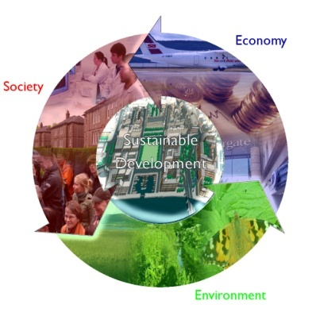
Sustainable Tourism Development
Three main principles (McIntyre, 1993):
Ecological sustainability
Social and cultural sustainability
Economic sustainability

Slide 14
Relationship between the 3 factors
Economic sustainability
Economic Development and
sociocultural protection
Economic growth
Private profit
Market expansion
Conservationism
Local self-reliance
Social accountability
Strengthen community identity
STD
Ecological process
Biological diversity
Biological resources
Carrying capacity
Social and cultural sustainability
Deep ecology
Ecological sustainability
http://www.trp.dundee.ac.uk/library/pubs/set.html

Slide 15
Ecological Sustainability
High altitude emissions from long distance air travel
Marine dumping of wastes from cruise ships
Little public information is available on the environmental and social impacts of long distance travel
Degradation of local water and soil quality into a vicious circle
Reduced access by local residents to land, housing and marine resources

Slide 16
Good Practices
Green tourism & Eco-tourism
Voluntary initiatives and self-regulation to address green tourism advocates and those calling for government regulation.
The establishment of formal environmental management systems (EMSs) in each business establishment
The establishment of waste reduction programs
Appropriate waste management systems and infrastructure
National governments and tourism businesses maintaining

Slide 17
The airport is characterized by:
An architectural concept of a symbiosis of buildings and nature
Eco-airport features that seek to preserve and foster the local eco-system
The commitment to co-exist harmoniously with the surrounding community

Slide 18

Cultural Sustainability
Revitalize local traditions
Stimulate cultural awareness
Bring cultural prosperity
Disrupt the original lifestyle.
The different cultural background may
result in a misunderstanding between
visitors & local community.
Leading to the increasing rate of crime,
decrease the public morality.
Physical damage of cultural properties

Slide 19
Tips for Cultural Sustainability
See traditions in the light of development
Keep the essence, discard the dross
Treat cultural differences with acceptance
Education
Emphasize the importance of treasuring
the heritages
Cultivate experts, protect the historical sites
with up-to-date theory
Balance the development and protection

Slide 20
Economic Sustainability
Increasing foreign exchange earnings
Leakage
Increasing income
Enclave tourism (cruise line)
Increasing employment
Infrastructure costs
Stimulation of infrastructure development
Increase in prices
Economic dependence of the local community on tourism
Seasonal character of jobs
Other industry impacts affecting tourism (economic crises)
Interdependance

Slide 21
The Global Sustainable Tourism Criteria: Background
Coalition of over 40 organisations to establish baseline criteria
Founded by Rainforest Alliance, UNEP, UNF and UNWTO to promote a common understanding of sustainable tourism
More than 60 existing certification and voluntary sets of criteria revised
Extensive consultation with sustainability experts, the tourism industry and other relevant stakeholders
Considered the “minimum standard that any tourism business should aspire to reach in order to protect and sustain the world’s natural and cultural resources while ensuring tourism meets its potential as a tool for poverty alleviation”.
Notes:
Life cycle analysis, Environmental Impact assessment, Environmental Management Systems, Monitoring and Evaluation, Sustainability Policies, CSR programmes, Codes of Conduct, Ecolabels, Certification, Awards, Supply Chain Management etc etc etc etc - All need to be based on sustainability criteria
Founded in 2007?
In all, more than 4,500 criteria have been analyzed and the resulting draft criteria have received comments from over 1000 stakeholders.
Launched in the WCC 2008
Some of the expected uses of the criteria include the following:
Serve as basic guidelines for businesses of all sizes to become more sustainable, and help businesses choose sustainable tourism programs that fulfill these global criteria;
Serve as guidance for travel agencies in choosing suppliers and sustainable tourism programs;
Help consumers identify sound sustainable tourism programs and businesses;
Serve as a common denominator for media to recognize sustainable tourism providers;
Help certification and other voluntary programs ensure that their standards meet a broadly-accepted baseline;
Offer governmental, non-governmental and private sector programs a starting point for developing sustainable tourism requirements; and
Serve as baseline guidelines for education and training bodies such as hotel schools and Universities.

Slide 22
The Global Sustainable Tourism Criteria
A set of 37 criteria intended to frame the main components of sustainable tourism
These are organized around the four pillars of sustainable tourism:
  effective sustainability planning
  maximizing social and economic benefits to the local community
  reduction of negative impacts to cultural heritage
  reduction of negative impacts to environmental heritage
Notes:
The criteria incorporates the triple bottom line of sustainability

Slide 23

The Global Sustainable Tourism Criteria
Demonstrate effective sustainable management
A.6.Design and construction of buildings and infrastructure
A.7. Information about and interpretation of the natural surroundings, local culture, and cultural heritage is provided to customers, as well as explaining appropriate behavior while visiting natural areas, living cultures, and cultural heritage sites.
Notes:
Management practices, training for staff, building and design regulations and interpretation for tourists,

Slide 24
The Global Sustainable Tourism Criteria
B. Maximize social and economic benefits to the local community and minimize negative impacts
B.1.The company actively supports initiatives for social and infrastructure community development including, among others, education, health, and sanitation.
B.3. Local and fair-trade services and goods are purchased by the business, where available.
B.6. The company has implemented a policy against commercial exploitation particularly of children
Notes:
CSR ty practices within the community (support to local school dev..) to employment of community members, purchasing policy for community goods, activities offered in communities, … policies against commercial exploitation…

Slide 25
The Global Sustainable Tourism Criteria
C. Maximize benefits to cultural heritage and minimize negative impacts
C.1.The company follows established guidelines
or a code of behavior for visits to culturally or historically sensitive sites, in order to minimize visitor impact and maximize enjoyment.
C.3.The business contributes to the protection
of local historical, archeological, culturally, and spiritually important properties and sites,
and does not impede access to them by local residents.
Notes:
Behaviour of tourists towards local heritage, protection of heritage…

Slide 26
The Global Sustainable Tourism Criteria
D. Maximize benefits to the environment and minimize negative impacts.
D.1.Conserving resources
D.1.3. Energy consumption should be measured, sources indicated, and measures to decrease overall consumption should be adopted, while encouraging the use of renewable energy.
D.2.Reducing pollution
D.2.1.Greenhouse gas emissions from all sources controlled by the business are measured, and procedures are implemented to reduce and offset them as a way to achieve climate neutrality.
Notes:
With regards to environmental criteria that are the bulk of the criteria, these cover waste/pollution, resource conservation, conservation in general

Slide 27
References
Holden, A. (2008). Tourism and Environment. London: Routledge
Butler, R.W. (1993). Tourism – an evolutionary perspective, in Nelson, J., Butler, R.W & Wall, G. (Eds.) Tourism and Sustainable Development: Monitoring, Planning and Managing (pp.27-43), Waterloo, Canada: University of Waterloo Press.
UNWTO (2005) Making Tourism More Sustainable - A Guide for Policy Makers, UNEP and UNWTO.
McIntyre, G. 1993. Sustainable Tourism Development: Guide for Local Planners. Madrid：World Tourism Organization
Swarbrooke, J. (1999). Sustainable tourism management. London: CABI Publishing
Christie Mill, R. & Morrison, A. (2006) The Tourism System. US: Kendall/Hunt Publishing Company.

