Slide 1

Name: Suranne aziz
Student number:2507554
Module code:LCHS4010
Module: Psychology in Health and Social Care
Title: presentation
Lectures name: Alice Clayton

Slide 2

Applying bowlby’s Attachment Theory to Isaac’s Development
Who is Issac?
4 years old
Attends a children’s centre
Lives with his mum
Mother has postnatal depression
Recent move to London
Language delay
Separation anxiety
Disrupted childcare arrangements
Simply psychology (2024)

Slide 3
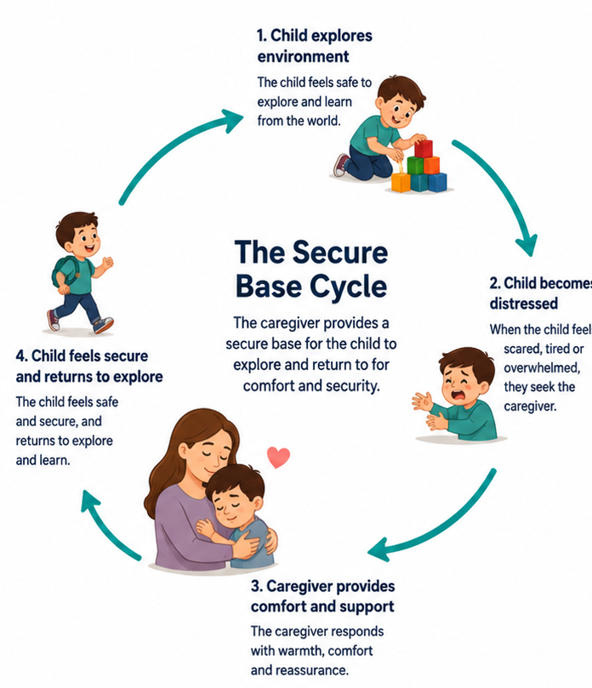
Bowlbys Attachment Theory
Emotional bond between child and caregiver
Provides security and safety
Caregiver acts as a secure base
Influences future relationships
Bowlby(1969)

Slide 4

Key concepts
Secure base
Internal working model
Separation anxiety
Maternal deprivation

Slide 5
Isaac’s behaviour
Distressed when mother leaves
Clingy behaviour
Withdrawn during activities
Difficulty joining groups
Limited independent play

Slide 6

Factors affecting development
Environmental influences
Mothers postnatal depression
Childcare disruptions
Recent move to London

Slide 7
Nature and nurture
Nature
Genetics
Temperament
Brain development
Nurture
Parenting
Relationships
Childcare experiences
Environment

Slide 8

Support plan
Support within the children’s centre
Key worker system
Predictable routines
Gradual separation support
Play based activities
Support for mother
Speech and language support
Multi-Agency Working

Slide 9
Evaluation Of Bowlbys Theory
Strengths
Highlights importance of early relationship
Influenced childcare practice
Supported by research
Limitations
X focuses heavily on mothers
X consideration of culture
X other factors influence development
(Bowlby,1988)

Slide 10
Conclusion
Bowlbys theory helps explain Isaac’s difficulties.
Early experience may have affected attachment security
Attachment based support could improve outcomes
Multi agency support is important

Slide 11
References
Bowlby,j.(1969) Attachment and Loss: Volume 1. Attachment. London: Penguin.
Bowlby, j. (1988) A Secure Base. London : Routledge.
Ainsworth, M. D.S. et al. (1978) Patterns of Attachment. Hillsdale: Erlbaum.
Howe,D. (2011) Attachment Across the Lifecourse. London : Palgrave MacMillan.
Prior, V and Glaser, D. (2020) Understanding Attachment and Attachment Disorders. London : Jessica Kingsley.
Goldberg, S. (2014) Attachment and Development. London: Routledge.

