Slide 1
Introduction To Character Animation- To Affinity and Beyond Assignment
Jessica Howells 1900594

Slide 2
My Project:
To show how emotion can be conveyed without the use of verbal communication or facial expressions.
To do this I will be exploring basic walk cycles and looking at different ways you can display a character's thoughts and emotions just by the way they convey their body language when they are walking.
My outcome is to produce a series of walk cycles using a bipedal model and have each one display a recognisable emotion. For example- a character walking that looks happy or sad.

Slide 3
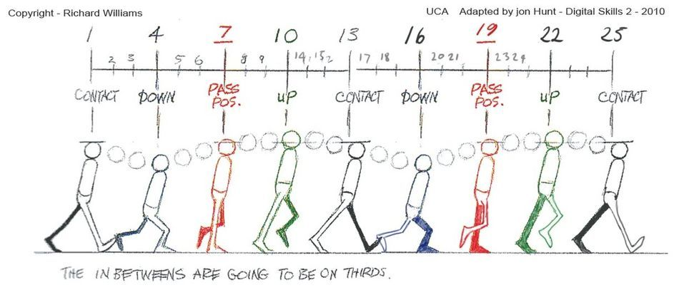
What is a Walk Cycle?
A walk cycle is a sequence that is very commonly used in animation. It is a looped sequence that when played back will create the motion of walking- this is an essential part of character animation and usually the first step needed in order to bring your character to life.
There are many ways a walk cycle could be created. They can from a very basic walking motion but can also be more emotive/expressive and complex.
Image from: https://www.schoolofmotion.com/blog/walk-cycle-inspiration

Slide 4
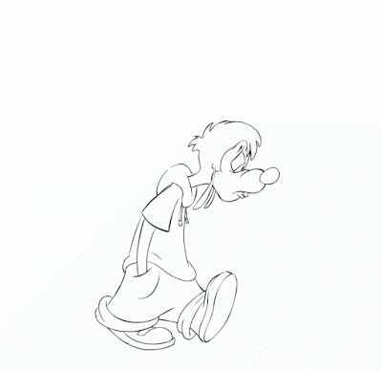
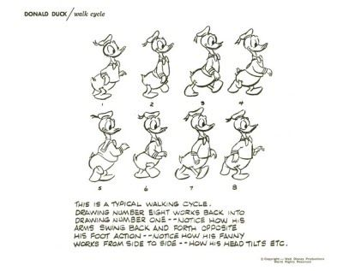
How is this used in media?
Essentially, every single character-centric piece of animated media (such as a film, series or a game) is going to feature a walk cycle. However, it is important that the animator is able to show off the personality or emotions of a character using walking- it's also good to have it match up with the general look of the character (are they weak or strong looking? Big or small?). The speed in which they are moving must also be shown correctly, are they walking or running?
Classic Disney animations make wide use of using these methods to add personality to their characters.
The animation above shows the walk cycle of a classic Disney character. By looking at different aspects of how this characters looks and moves- the viewer is able to determine that the character is feeling sad. Despite the fact that the main way of determining this would likely be through the facial expression of the character- it is also shown in the walk and general body language- slumped over, dragging feet, hands in pockets etc. The expressive walk cycle adds so much more compared to just having the facial expression- It's still possible the viewer would be able to tell the character is feeling a more negative emotion even if the characters face was hidden.

Slide 5
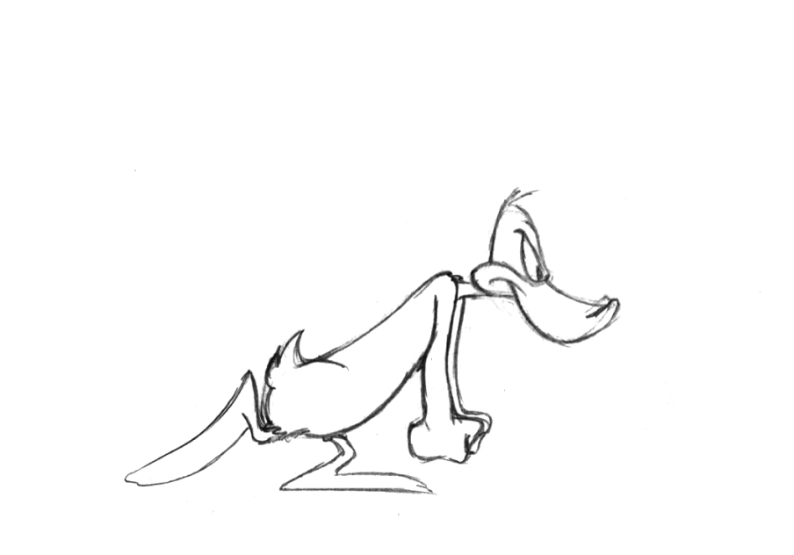
Used References
https://ak.picdn.net/shutterstock/videos/1020521620/preview/stock-footage-young-casual-man-walking-on-a-green-screen-chroma-key.webm
(Neutral walk)
https://www.behance.net/gallery/65456487/sad-walk-cycle
(Sad walk)
https://dribbble.com/shots/14322646-Happy-Walk
(Happy walk)
https://www.shutterstock.com/video/clip-27159868-business-man-sad-walk
(Sad walk)

Slide 6
2D Sketches
I have created different sketches that I will use as a reference to create each of my 3D animations/walk cycles.
Each cycle clearly shows variation and makes use of body language that will help display a different emotion

Slide 7
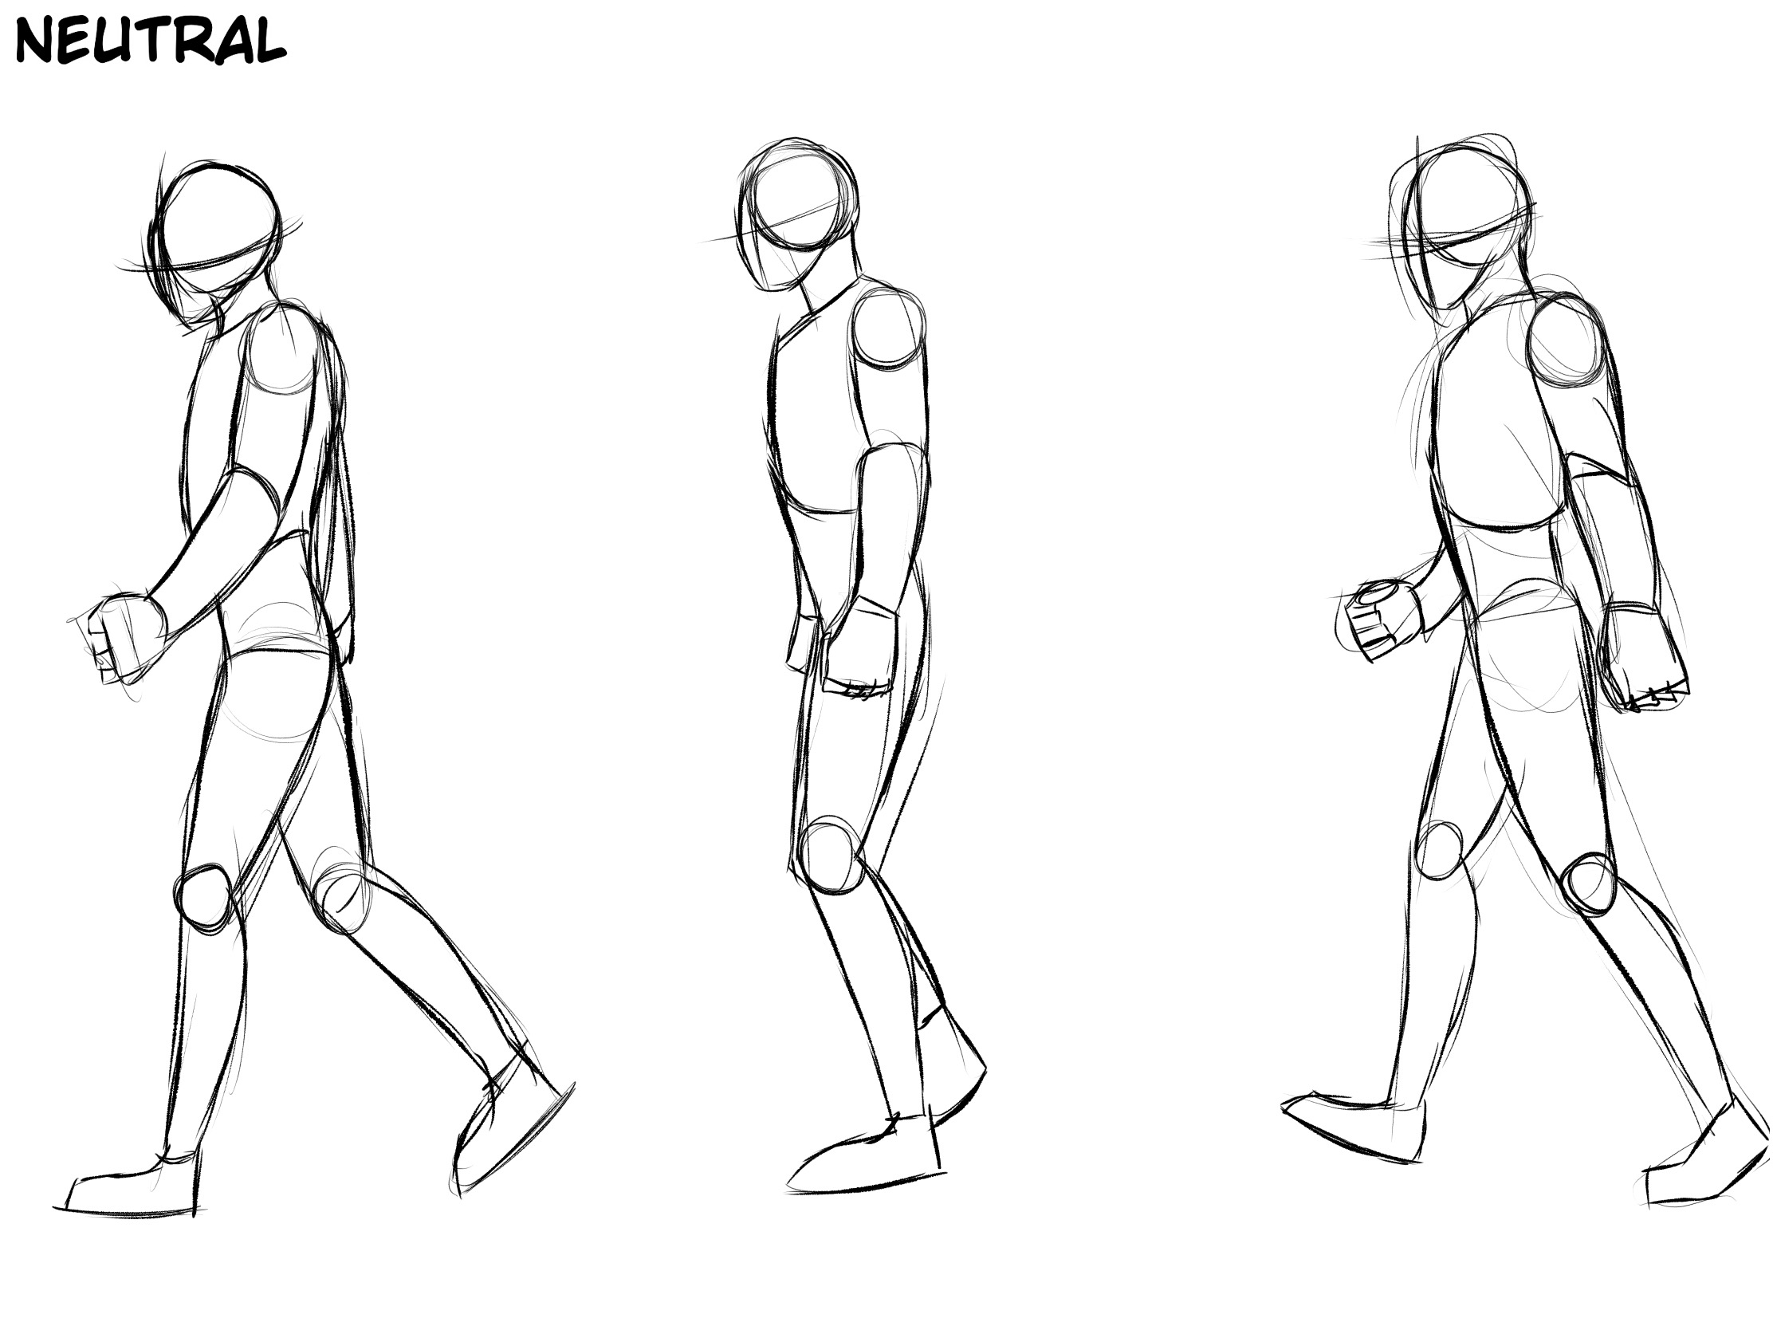
Doesn't read a specific emotion, body language is flat

Slide 8
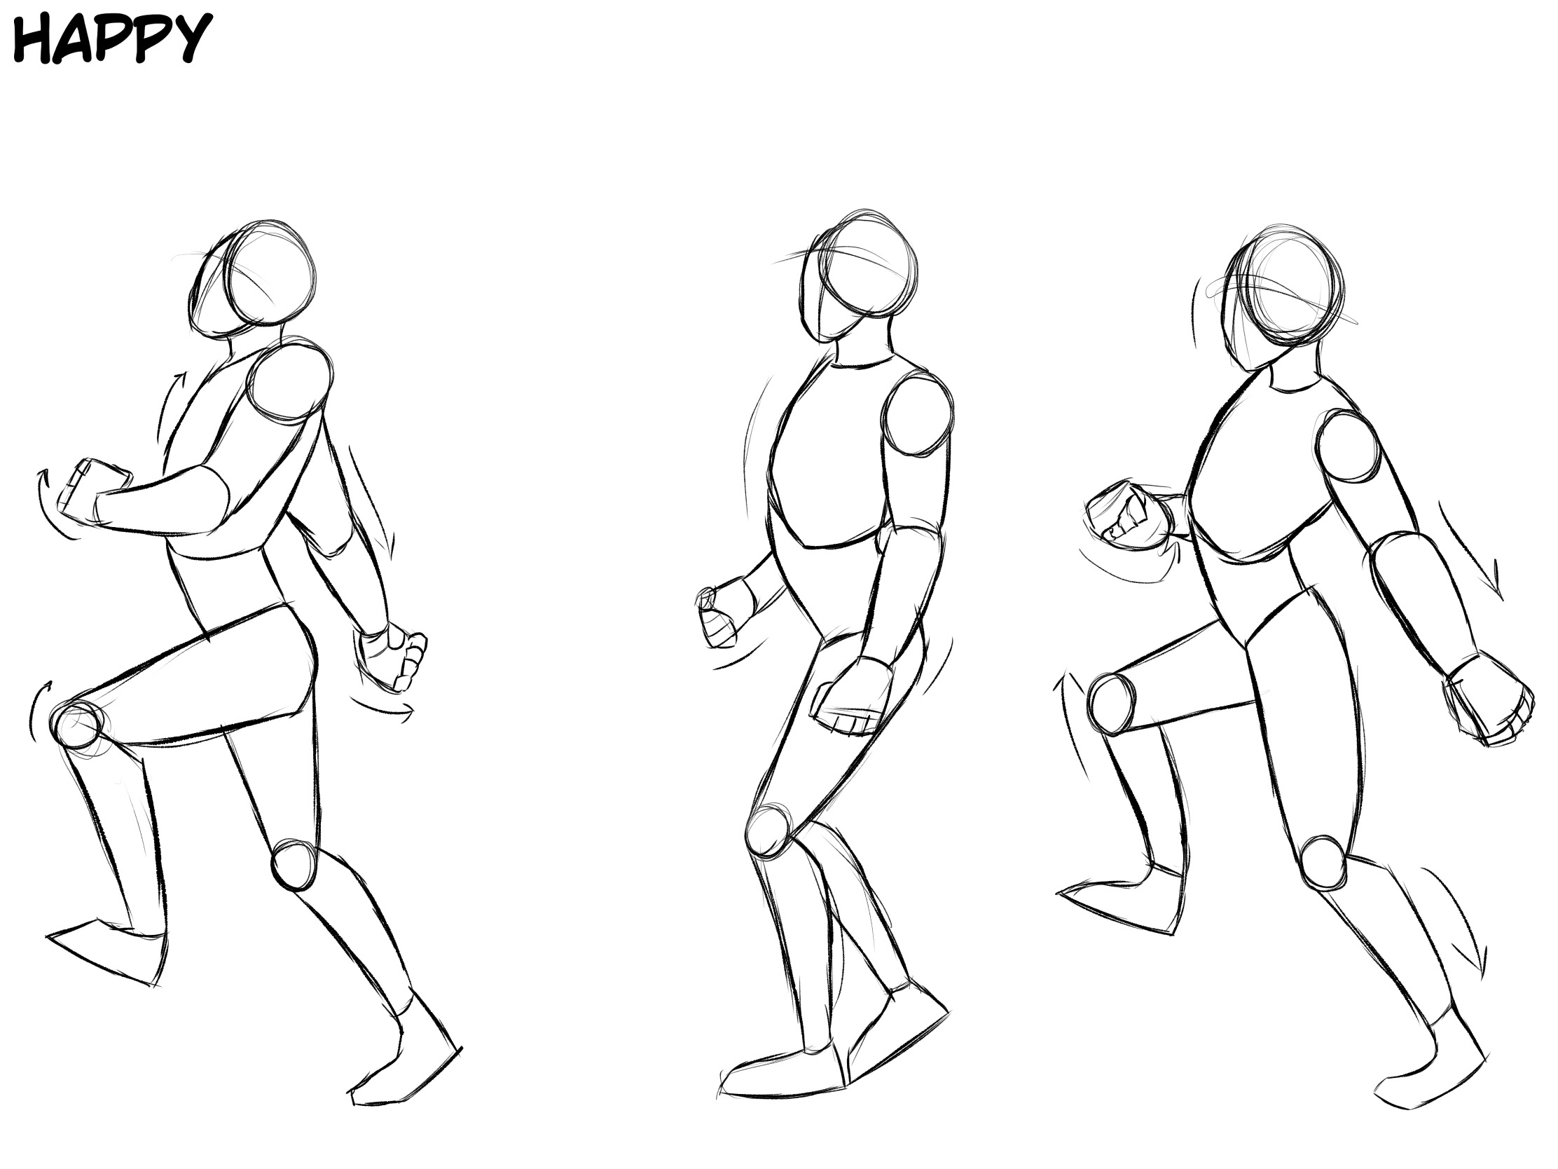
Head raised, arms swing high, legs move up higher, chest sticks out, gives off a high energy

Slide 9
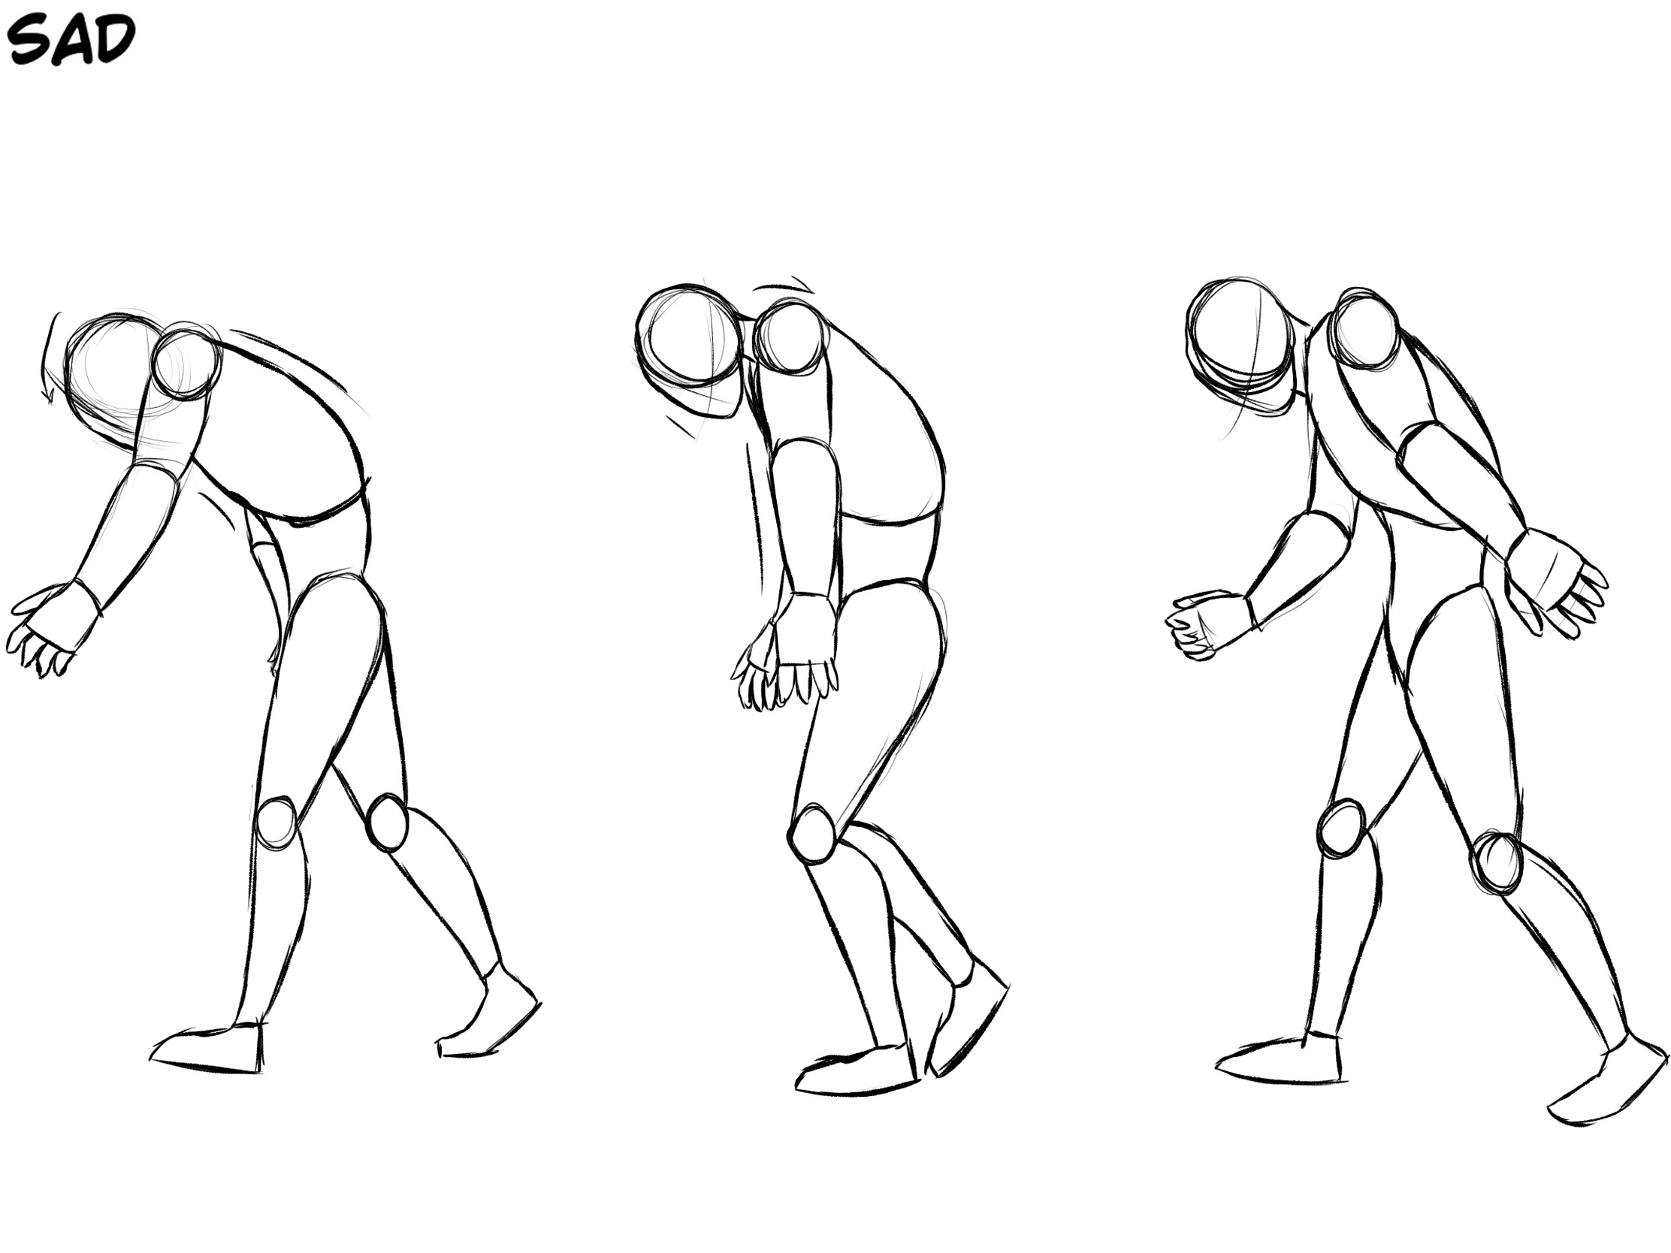
Slumped shoulders, arms hanging downwards, feet drag closer to ground, back arched over- less energy than other walks

Slide 10
Animatics
Compiled each sketch together to see how they look when they are moving and to help me convert them into 3D easier.

Slide 11
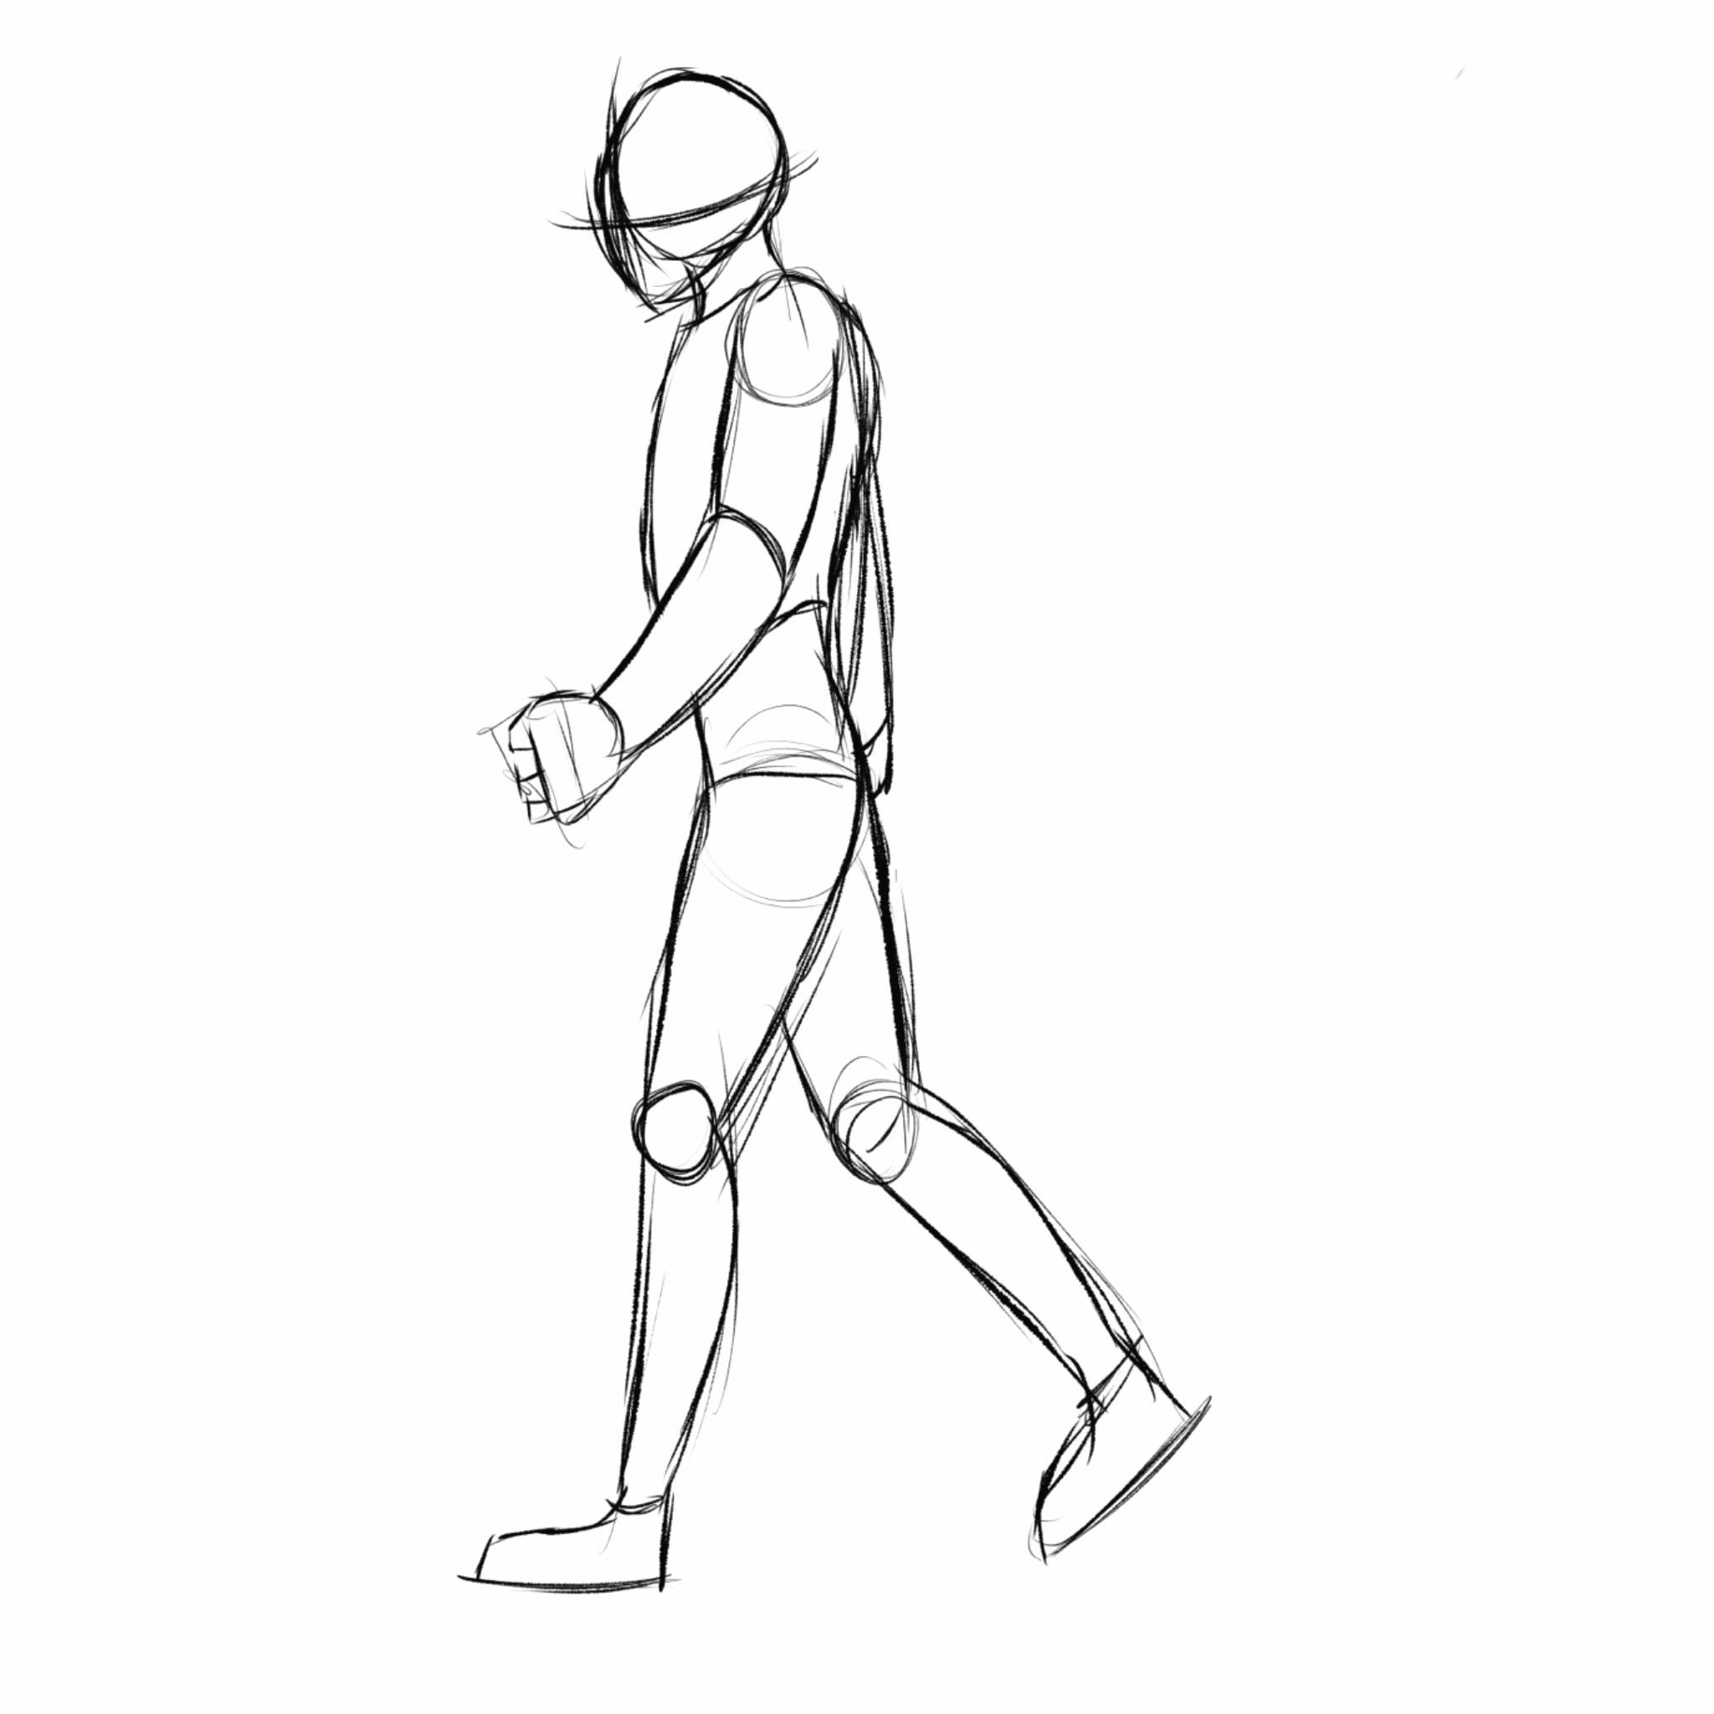

Slide 12
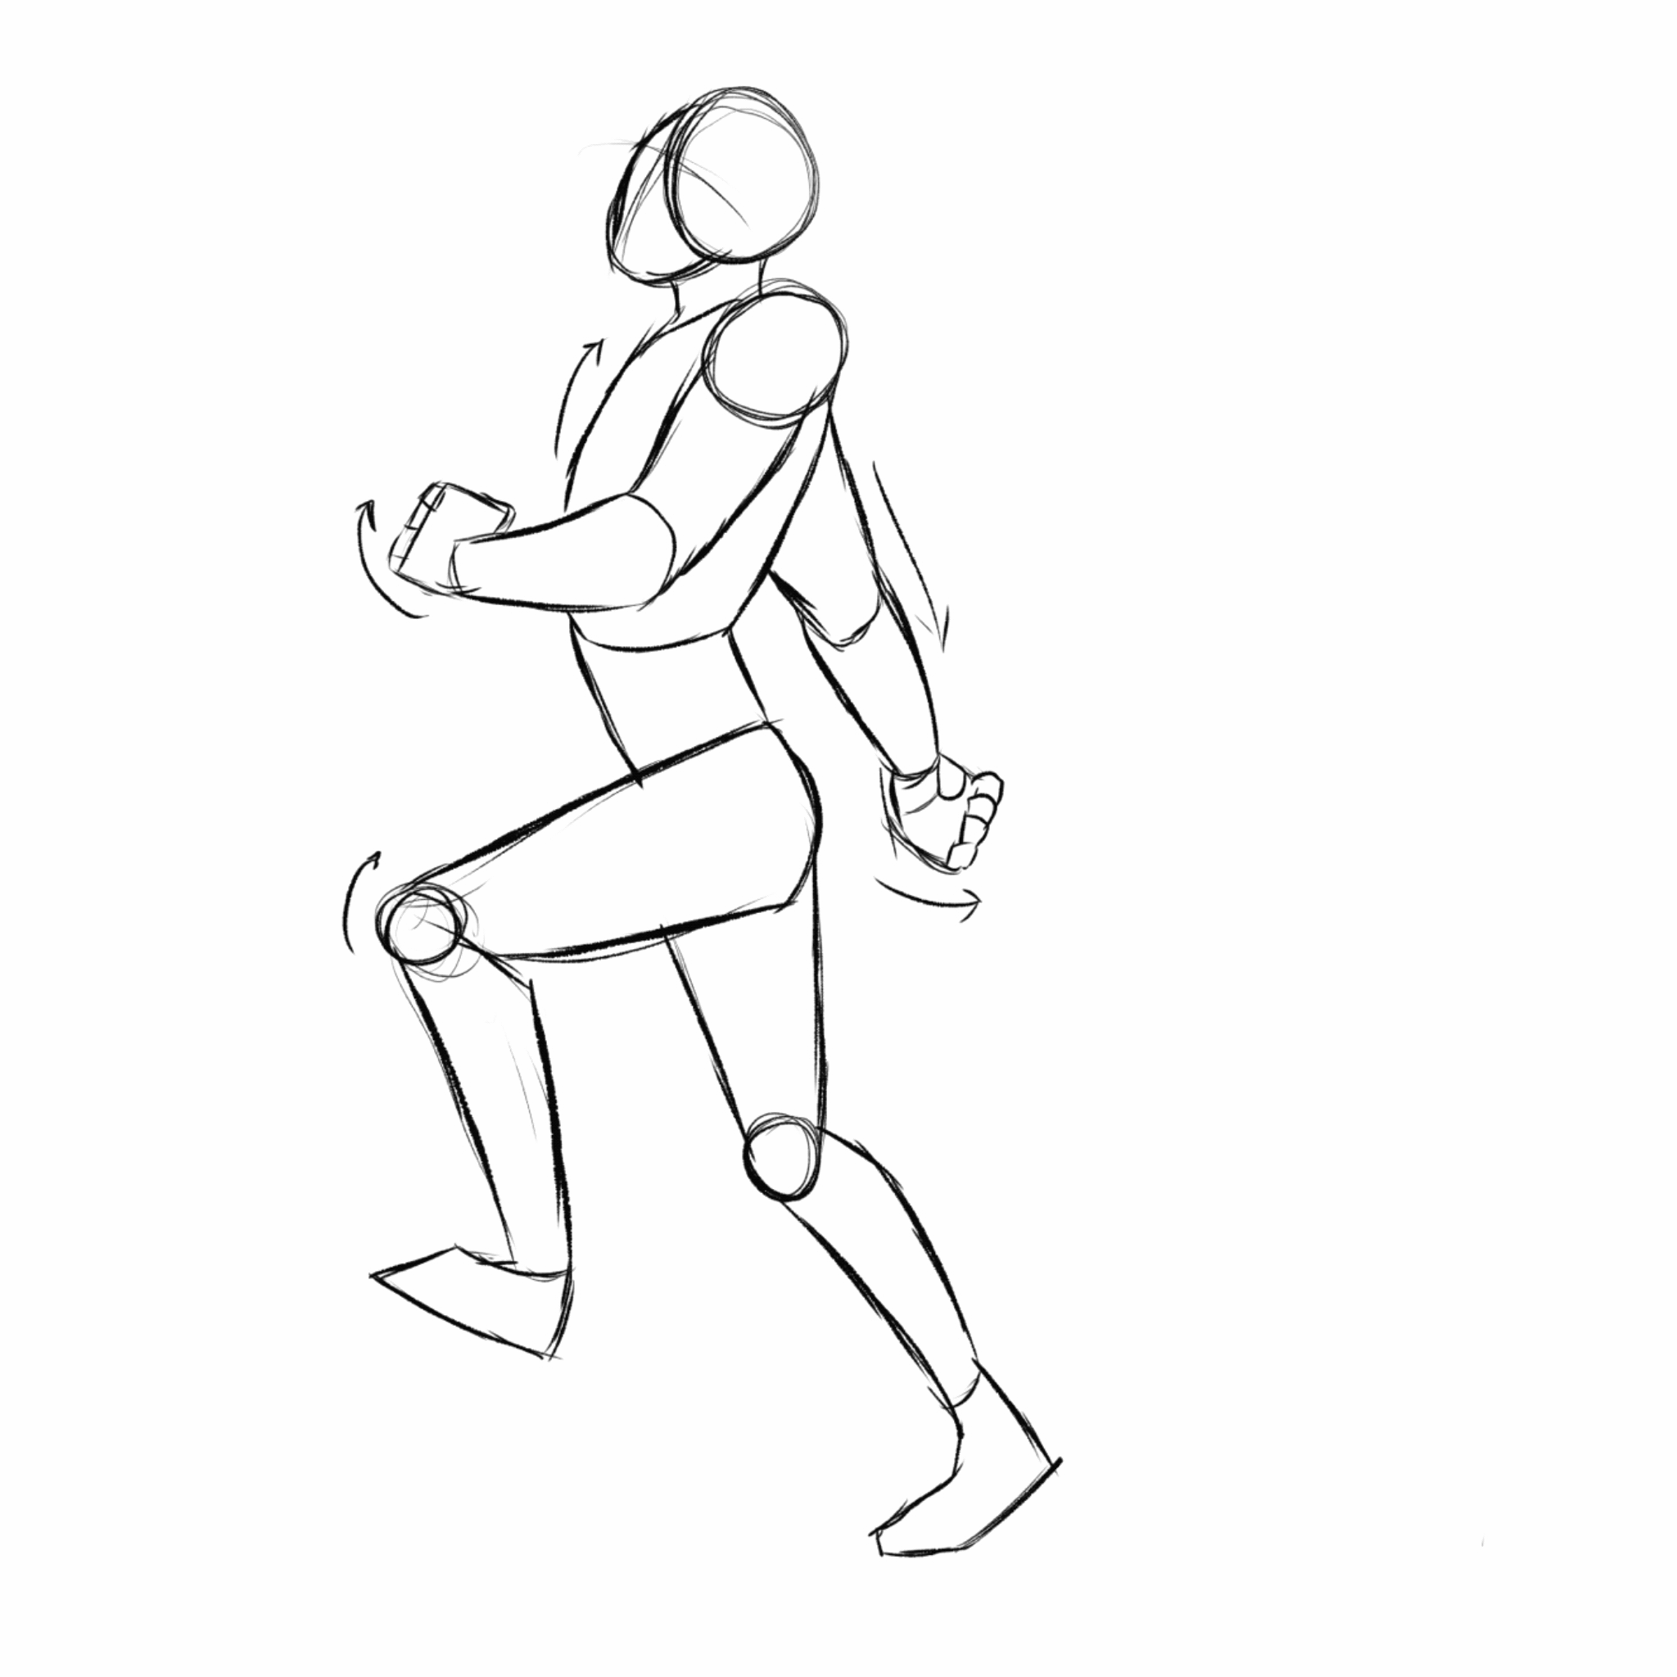

Slide 13
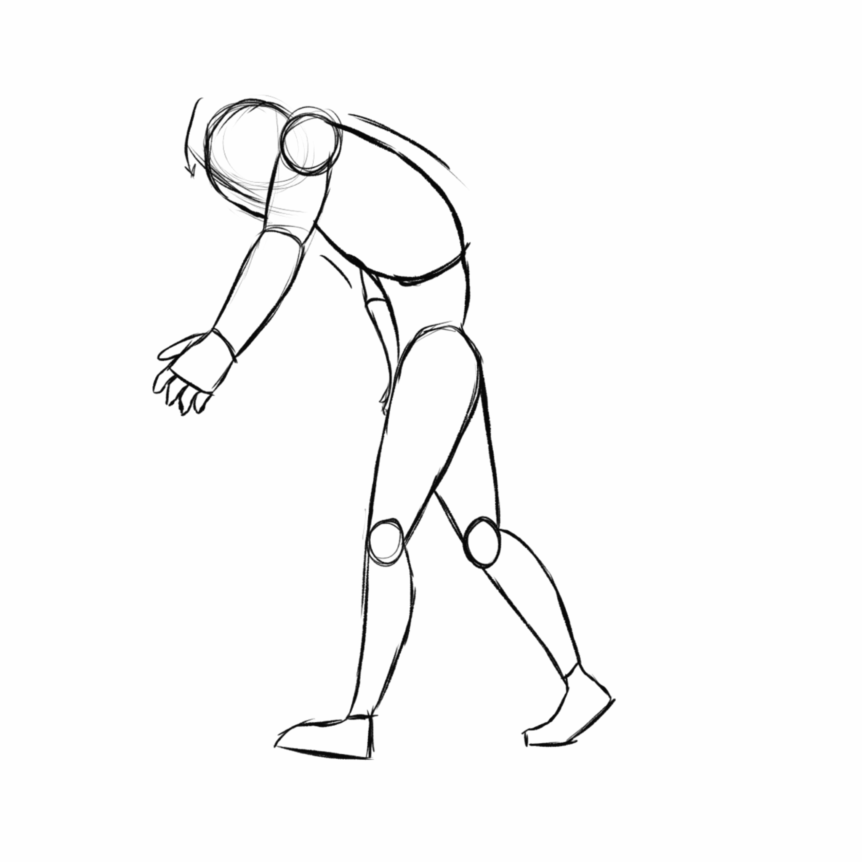

Slide 14
Rig From:
https://anim-matt.gumroad.com/?sort=page_layout#hcAMR

