Slide 1
Financial management for the hotel industry
Kissairy Valdez
1815098
Lecturer : Dale Clarke

Slide 2

Introduction
The goal of this assignment is to analyze how the financial ratios affect a hotel organization and the financial performance within the company.
The assignment includes a broader idea of the liquidity, profitabily and gearing from Ffion Limited, telling what is the meaning of the result from each ratio and what is needed to be done in order to get better and keep going with the most positive financial performance day per day.
This assignment is also done with the aim to examine how useful can be for hotel managers the information accrued to make future plans and strategies as well as to avoid any negative financial situation.

Slide 3

Financial Analysis
Ratio | 2018
Gross profit | 1850/9500*100 =19.47
Net profit | 307/9500*100 = 3.23
ROCE | 307+9/3014*100 =10.48
Total assets turnover | 9500/3014 = 3.15 times
Working capital turnover | 9500/1264 = 7.52
Current ratio | 2152/888 = 2.43
Quick ratio | 2152-750/888 = 2.43
Debtor days | 870*365/9500 = 33.43
Creditor days | 690*365/7700 = 32.71
Debt ratio | 888+150/2152+1750 = 0.27
Interest cover | 307+9/9 =35.1

Slide 4

Profitability

Slide 5


profitability
The return on capital employed is used to know how efficiently the organization is using the money to create more money. Or in other words the capital that is being used in order to get more profit. On this case, the researcher can say that the Ffion Limited has invested the double amount on 2017 which is a competitive amount for the market according to (Singh and Yadav, 2013). The researcher has notice a notable decrease on 2018 which shows that the investments have been re-evaluate and their expenses might not cover all this investment made.
The total assets turnover in the case of Ffion Limited shows to the researcher they have a slight decrease on the year 2018 and says the organization it can be struggling with the cleanliness of the room when the guest arrives, or even the need of refurbishment.
The working capital turnover has also decreased on Ffion Limited in 2018, showing to the researcher that they have decided to reduce their stock or maybe invest their excess cash in comparison to the previous year.

Slide 6

Liquidity
According to (Chadwick, 2001) it says the ability of the company to be quick in order to pay their debts. The current ratio is a proportion that in the case of Ffion Limited tell to the researcher they are on both years very capable to cover their expenses. The quick ratio on this case, also tell to the researcher the Ffion limited has the ability to pay its current liabilities as well.
Debtor days ratio it show us on this organization that on the year 2018 its debtors needed more time to pay to the company. Giving a total of more or less 1 month, on this case they can consider on creating new contracts that have a shorter time period or maybe keep tracking all the delayed debts that need to be done with the company modifying the terms and maybe giving them a fee more affordable.
The creditor days on Ffion limited has been reduced on the year 2018 and this is a good fact because they are paying their suppliers on time, but it should be still improved giving less than 30 days

Slide 7
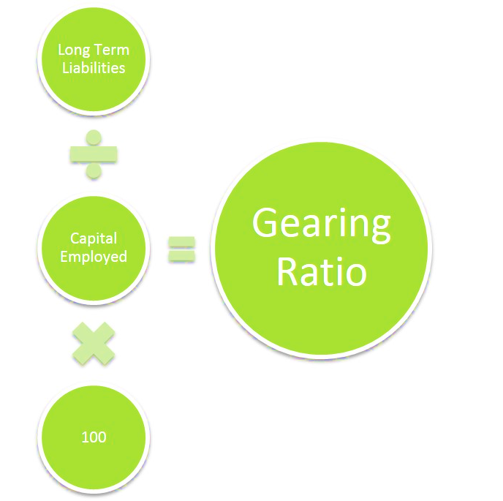
Gearing
On the case of Ffion Limited the debt ratio has decreased which says that they are
Financing their operation though investments or maybe they have facility to borrow money or being eligible for a lower interest rate. In other words, the risk financially talking is lower each year, which is good.
Finally, the last ratio interest cover on the case of Ffion Limited says they have decrease very remarkable on the year 2018, if they continue like this it might happen in the future they will not be able to pay their interest or long term loans giving them very huge and problematic situations in the financial field with the company.

Slide 8
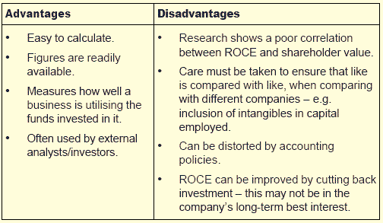
Benefits and limitation of Ratios
The main goal of the ratios is making a further plan but with the information provided for the historical data of the organization, this is why normally a proper financial analysis is done within the last 5 years, you can analyse if the trends are repeated and how to react to each of them. The limitation that the researcher can mention as more important is, that the market is always changing and the competitors have always the possibilities in hospitality to include different facilities as well as improve their service, or amenities given. This is why a hotel that wants to progress needs to be up to date in all the innovations provided to their guest and ensure they are always giving the best of the services.

Slide 9
conclusion
It is needed a deeper investigation with maybe the information of the last five years, to see if the trend noticed on the years 2017 and 2018 was a result of a decrease in sales or increase of the expenses. It would be useful for the Ffion Limited company to make use of KPI’s to have a more thorough investigation of what is directly affecting the profitability of the company which in these two years in question, has decreased. On the other hand, the liquidity ratios suggest that despite the reduction in profitability the organization is more than capable to cover all its debts, this is maybe happening because they ensure to have its stocks in a good level to assure the liquid assets are being used in a productive way. The gearing ratios are quite contradictory as per one hand is suggesting increased stability while on the other hand it suggest that if the trend is continuing like this they might run into financial problems. Finally, as the researcher said on introduction, the acknowledge of the ratios is crucial for hotel managers and beneficial for the company in order to have a very diverse number of plans for every situation.

Slide 10
references
Atrill, McLaney & McLaney, E. J., 2017. Accounting and finance for non-specialists Tenth.,
https://www.investopedia.com/terms/f/financialaccounting.asp
Jain, P.K., Singh, S., & Yadav, S.S. (2013). Financial Management Practices: An Empirical Study of Indian Corporates. Springer Science & Business Media
Ghosh, K.S., & Maji, S.G. (2003). Working capital management efficiency: A study on Indian Cement Industry.
Journal of International Finance and Economics, 2(3). 89-95.
Chadwick, L., 2001. Essential financial accounting for managers 3rd ed.]., Harlow: Financial Times/Prentice Hall.
Czyzewski, L., & Hicks, K. (1992). Liquidity management, operating leverage and Tobin’s Q ratio. Journal of Multinational Financial Management. 12
Dong, H.P., & Su, J.T. (2010). The Relationship between Working Capital Management and Profitability. International Research Journal of Finance and Economic, 3(5), 62-71

Slide 11


