Slide 1
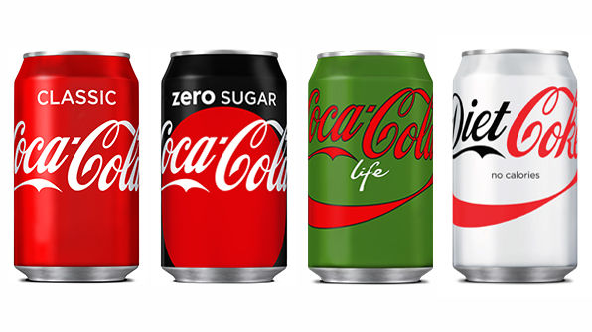

Contemporary Management
Approaches
Joanne Griffith-Thomas
Davina Evans
December, 2017, BMSP4002

Slide 2
Agenda
Name and title 1
Agenda 2
Introduction to Coca Cola- 3
What is Coca Cola’s Approach to strategy 4
Human rights 5
Mission & vision Statement 6
Coca Cola’s goals 7
Coca Cola using PESTLE 8
Coca Cola’s Swot Analysis 9
Communities & sustainability 10
Negative sustainability 11
Group and teamwork 12
Analysis 13
References 14,15

Slide 3
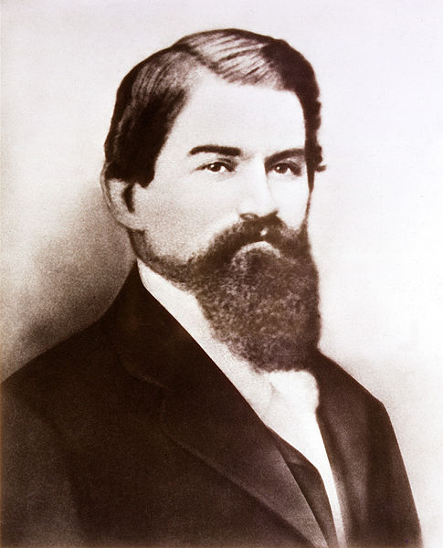
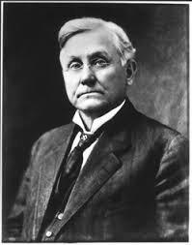
Introduction about
John Pemberton founded Coca Cola in 1886
Asa Griggs Candler bought the brand in 1989.
World’s best leading manufacturer and distributor of non alcoholic soft drinks.
John Pemberton
Asa Griggs
Notes:
Coca Cola was first invented in Columbia in 1886 by a pharmacist named John Stith Pemberton. The coke Recipe and brand were bought in 1989 by Asa Griggs Candler. Who incorporated the company in 1989
Coca Cola is a non alcoholic soft drink company. The name Coca Cola came from two main original ingredients which were kola nuts and coca leaves. Coca Cola main selling product is coke which comes in all forms from full sugar diet Coke, Coke zero as well as other well known soft drinks.
In 2010 Coke was the top selling brand and became the first brand to reach £1 million in the annual grocery sales. But in 2017 coke sales dropped down to 11% from 2016 due to people avoiding sugary drinks due to health risks.
In this presentation we will look at Coca Cola further and its approaches to management.
(En.wikipedia.org, 2017)

Slide 4
What is Coca Cola’s
Approach to Strategy??
Strategy is a course of action designed to achieve long term objectives.
Strategy to a company or business is what management decide about the future
Effective Management of people
Notes:
Coca Cola’s strategy is to become a independent company by supplying the customers with the drinks they want including low sugar options and to sell in many more locations across the world. The company want to build a portfolio of “consumer centric brands “which will show what the customers want and not what they currently buy. (president chief operating officer James Quincy) says “by putting customers first “on the next few slides we will go more into this by showing PESTEL/SWOT and the Goals of the company.

Slide 5
Human rights Approach
HUMAN RIGHTS
Notes:
At the Coca Cola company, they use the human relation approach in respect to the humans and the workplace. They make sure it’s culture and guides are in place with their employees, their bottling partners the suppliers and customers & consumers. Coca Cola have a human rights policy in place and it establishes a foundation for manging the businesses around the world in respect of human rights The policies are policies to meet the responsibility to human rights.
Identify prevent mitigate and be accountable for human right abuses. (Company et al., 2017)

Slide 6
Coca Cola’s
Mission & Vision Statement
“To refresh the world in mind, body and spirit”
“To inspire to others moments of optimism and happiness through our brands and actions”
“To create value and make a difference.”
Notes:
Coca Cola have decided on a set of goals to follow which will help them achieve there mission, Coca Cola company has a vision for each and every person working within the company and for them to inspire each other and to be the best they can by providing a great place to work. Coca Cola believe Building a portfolio of drink brands that satisfy peoples need will help, also having a network of partners that are nurturing and help each other by building up the loyalty between staff. And last but not least they believe that Being a global citizen will make a difference to the community by helping support sustainable communities. Coca Cola say that they like To Produce a highly effective work force and a learn fast approach which means people will learn faster and work faster. (Us et al., 2017)

Slide 7
Goals
2020
Goal
Serving 3m
A day
To reach
the world
$4 million
budget
Notes:
Coca Cola’s main goal by 2020 is to serve up to 3million a day to their consumers, they would like to reach everyone across the world.
Coca Cola aim to have a budget of £4 million for advertising and marketing to gain more for the company. (Ferrell, 2016)

Slide 8
Coca Cola using P E S T L E
Political factors
Economic factors
Social factors
Technological factors
Legal Factors
Environmental
Political
Social
Legal
Economical
Technological
Environmental
Notes:
Coca Cola Political Factors the products they have, and use need to meet the right regulations given to them from the government. For their products to be sold on store shelves. So, for instance is the government put their tax prices up coca cola could struggle. Changes in established laws could prevent coca cola from selling drinks.
Economical-their products are distributed to hundreds of countries, each country has different customs, tastes and cultures Coca need to update their products regular to suit their clientele.
Social factors-in japan Coca Cola have researched the demands of their customers and created 30 different flavours to appeal to their Japanese consumers. But as America are wrapped up in their health now they are swapping their sugary drinks for tea and water.so Coca Cola needs to keep on top and supply this demand by offering and creating new healthier products to the public.
Technological factors machinery help Coca Cola manufacture their products. In Britain they have a factory with top of the range machinery which helps ensure fast delivery and supplies.
Coca Cola use social media Facebook is a popular one they often do new things with the same product by putting real names on bottles and using Facebook to upload and tag the company in which boosts sales.
Legally coca cola owns all rights to their business including passed present and future.
Environmental Coca Cola are affected by water accessibility, water is needed for soft drink but if climate change happens coca Cola will be in trouble as without this they couldn’t continue.
This also affect competitor Pepsi but because Coca Cola is soft drinks only company this it affects them badly. Coca Cola needs to stick to new and old environmental laws as the produce their products if they miss anything put this can result in production being stopped.
(Free, 2017)

Slide 9
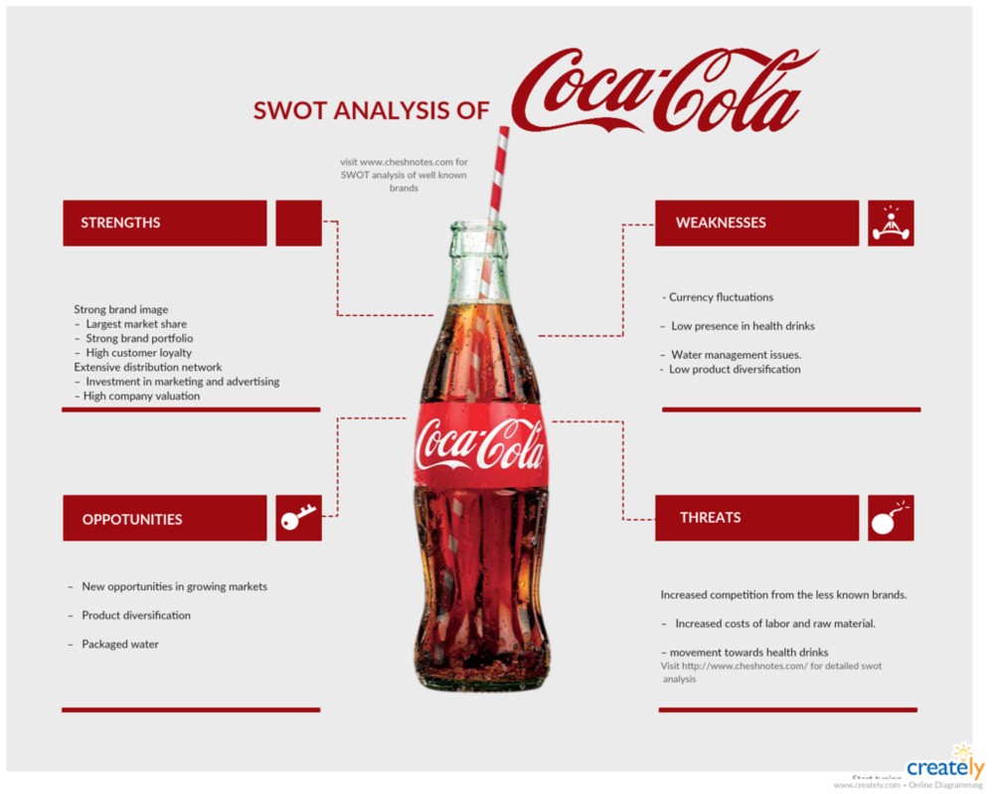
Swot ** Analysis
Strengths
Weaknesses
Opportunities
Threats
(DeviantArt, 2017)
Notes:
One of Coca Cola’s strengths are the fact they have really strong brand which are loyal to their customers, As the company offers more than 500 brands across the world and offer diet drinks, energy drinks sports drinks, juices and many others so they also have a great portfolio range. They sell around they own four of the main brand coke diet coke Fanta and sprite and they sell about 1.9 million out of the 59 billion servings of drinks consumed each day. Coca Cola have a really strong bottling distribution which helps the company in meeting there global customer needs. Coca Cola weaknesses
If coca cola were to have a lawsuit on their hands this could result in penalties and fines which would then increase the operating costs. January 2017 a non-profit firm called Praxis Project filed a lawsuit against Coca Cola. In the lawsuit Praxis alleged that coca cola and another company violated federal fair advertising and misled the customers about the health implications of sugary drinks, studies proved this could lead to type 2 diabetes as well as other diseases. As part of the settlement of the lawsuit coca cola are to mark their water products with “added sugars”. The launch of new products helps the company serve worldwide customers and expand their portfolio and presence.
Coca Cola stands to benefit from the growing consumption of soft drinks as it markets more than 200 countries worldwide. the consumption of soft drinks is growing and expected to help the company grow. They support their customers by offering new flavours. If Coca Cola to focus on expanding, it’s bottling capacity could help the company meet a better demand for products. The company has really tough competitors from both local and global operators. Good competition may force the company to increase its production. Health issues starting with obesity and water scarcity are main concerns for beverage companies. Water is a main ingredient that is used in soft drinks so if the water continues to deteriorate then this will play a major factor in the company’s products. (Advantage.marketline.com.ezproxy.uwtsd.ac.uk, 2017)

Slide 10
sustainability
& the community
Main Focuses
W
A
T
E
R
WO
M
E
N
H
U
M
A
N
R
I
G
H
T
S
P
A
C
K
A
G
I
N
G
C
L
I
M
A
T
E
A
R
G
R
I
C
U
L
T
U
R
E
Notes:
Coca cola features its CSR identification by focusing on the water, Women, Well being, human-rights, packaging, climate, agriculture and giving back. Their commitment is to create more long term sustainable value for everyone connected to the business or the community. (Laskin and Laskin, 2017)

Slide 11
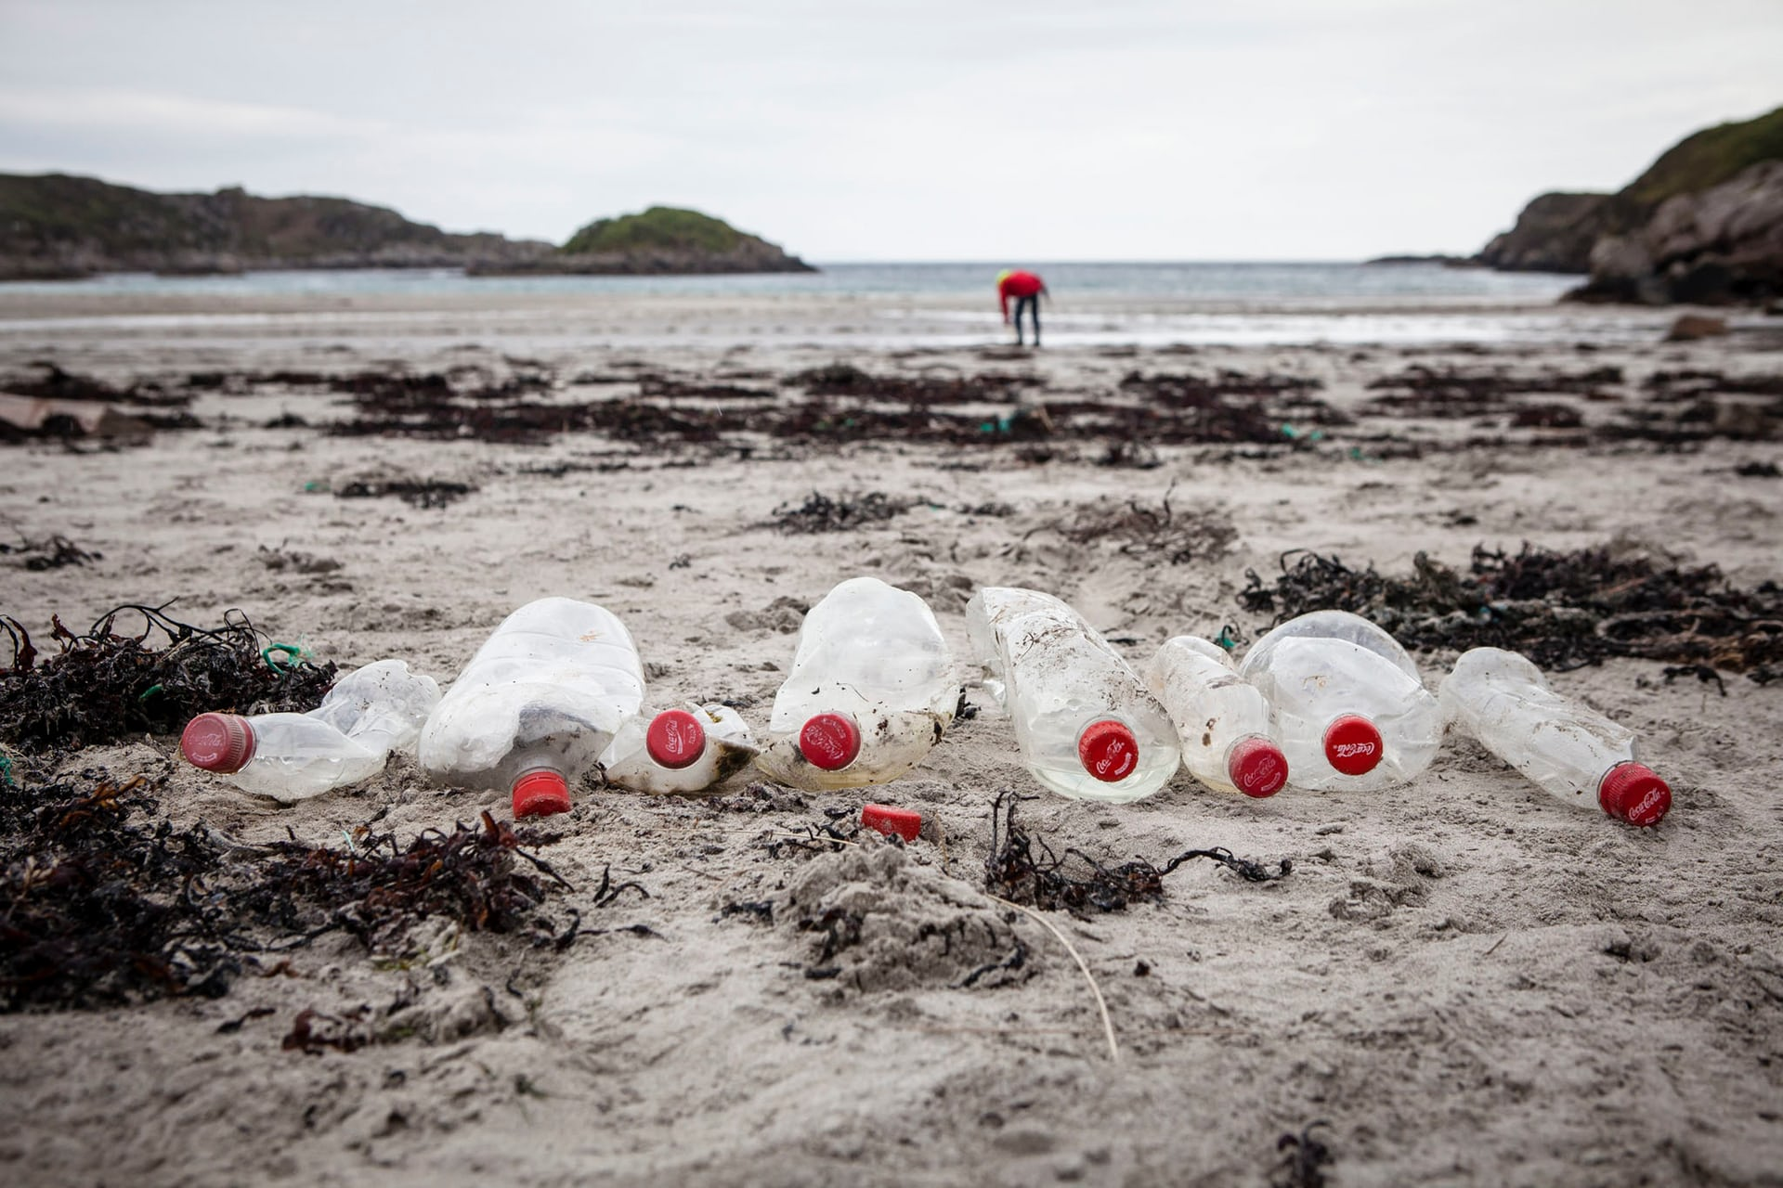
Coca cola’s negative sustainability
& the community
Is Coca Cola’s waste bottles causing the waste crisis?
(Boyd, 2017)
Coke bottles found during a beach clean in Mull, Scotland. Photograph: Will Rose/Greenpeace
Notes:
There are several news articles that show that plastic bottles are drifting into shore and the impacts on this is that by 2050 there will be more bottles in the sea than fish. Coca Cola generate more than 100 billion plastic bottles a year, Coca Cola promised that by 2020 they will recycle 50% of their plastic bottles and research using deposit return schemes where consumers will pay a small refundable deposit on cans or bottles. Coca Cola however have also launched a campaign to encourage people to recycle. So are the bigger companies to blame for the waste (group discussion)

Slide 12
Group and team work
Team work
2 or more people share to get there goals
Work together
Share good purpose
Share roles
Account ability
Work beyond boundaries
Problem solving
Group
3 or more individuals to organisational
Goals
Designated leader
Tasks set by others
Purpose of the organisation
Groups work within
Meeting delegation
Notes:
Coca Cola use the group approach in there business as there is a lot more than 3 individuals working in their workplace which then the goals are set by the leaders of the company.

Slide 13

Management Approach
(Simply Psychology, 2017)
Notes:
Working for the company has many benefits, the rewards scheme is an ongoing process that offers their employees rewards bonuses , praise and merits or merchandise for the work they do each year the employees have a performance review and if they have shown commitment and dedication to the job they are offered one of the rewards and also get to save for travel points with the company.
Coca Cola use Maslow's hierarchy of needs method, the company fulfil the basic needs by offering a decent wage and as they follow HSE guidelines this provides safety in the workplace. They then cover the psychological grid as they offer rewards, and incentives for hitting targets and have get togethers and as the group they work in coca cola believe this is one big team which allows the employee to feel they belong. Self actualization is when they’ve reached there full potential and as they use the merit system they are offered this to help progress as an individual.

Slide 14
Analysis
Have your say??
Notes:
Coca Cola seem like a good company to work for although they have some ups and downs, but there goals are possitive and they want to succeed in reaching their goals. However there can be a lot of negative experiences within the company and looking at reviews from past and present and future. The approach they use in their management as they continue to make a profit and produce new products and progressing each year.
And Coca Cola have low staff turnovers which indicate their a loyal company and employees are important to them.
Having looked at employee reviews these are my findings.
"Best Company I've ever worked for“
"Great company”
"Great company to work for and great place to work“
(Glassdoor.co.uk, 2017)

Slide 15
References
En.wikipedia.org. (2017). The Coca-Cola Company. [online] Available at: https://en.wikipedia.org/wiki/The_Coca-Cola_Company [Accessed 11 Dec. 2017].
Approach Human and Workplace Rights. [online] The Coca-Cola Company. Available at: http://www.coca-colacompany.com/our-company/human-workplace-rights [Accessed 12 Dec. 2017].
The Coca-Cola Company. (2017). Objectives. [online] Available at: https://thecocacolacompany-sabrinayang.weebly.com/objectives.html [Accessed 11 Dec. 2017].
Ferrell, O. (2016). Marketing strategy. [S.l.]: Cengage Learning.
Free, K. (2017). PESTLE Analysis of Coca Cola. [online] PESTLE Analysis. Available at: http://pestleanalysis.com/pestle-analysis-of-coca-cola/ [Accessed 11 Dec. 2017].

Slide 16
References
DeviantArt. (2017). Coca Cola SWOT analysis by cheshnotes. [online] Available at: https://cheshnotes.deviantart.com/art/Coca-Cola-SWOT-analysis-by-cheshnotes-702805716 [Accessed 11 Dec. 2017].
Advantage.marketline.com.ezproxy.uwtsd.ac.uk. (2017). Cite a Website - Cite This For Me. [online] Available at: http://advantage.marketline.com.ezproxy.uwtsd.ac.uk/Product?pid=37CB5616-D04E-49EE-9F5C-FFE75047D6FF&view=SWOTAnalysis#weaknesses [Accessed 11 Dec. 2017].
Laskin, A. and Laskin, A. (2017). The Handbook of Investor Relations and Financial Communications. Newark: John Wiley & Sons, Incorporated.
Boyd, O. (2017). Is it fair to blame Coca-Cola and big corporations for our waste crisis?. [online] the Guardian. Available at: https://www.theguardian.com/sustainable-business/2017/aug/02/coca-cola-big-corporations-waste-crisis-plastics-recycling-packaging-circular-economy [Accessed 12 Dec. 2017].
Srinivasan, D. (2016). The HRD Almanac. Notion Press, 2016.

Slide 17
References
Simply Psychology. (2017). Maslow's Hierarchy of Needs. [online] Available at: https://www.simplypsychology.org/maslow.html [Accessed 13 Dec. 2017].
Glassdoor.co.uk. (2017). Coca-Cola Company Reviews | Glassdoor.co.uk. [online] Available at: https://www.glassdoor.co.uk/Reviews/Coca-Cola-Company-Reviews-E161.htm [Accessed 13 Dec. 2017].

