Slide 1
entrepreneurship
Neil Dyer

Slide 2
Your groups!!!

Slide 3
Course Outline
Wk 1: 3rd Oct | Introduction & Assignment Self-Evaluation (CV, Application & Interviews)
Wk 2: 10th Oct | Business Planning – The Formal Stuff (Structure, Legal) Idea Generation (Getting started on the business idea) Introduction to Simply Do Ideas Portal (Canvas and Sign-up) STEP 1. Concept (including SWOT Analysis of idea, value proposition, features, benefits)
Wk 3: 17th Oct | STEP 2. Customer (market research, demographics, profiling) STEP 3. Competitors (competitor analysis with 5 Forces)
Wk 4: 24th Oct | Intellectual Property with Kath Penaluna Insight into Marketing (how to Get, Keep, Grow customers – marketing, self-promotion, elevator pitch, relationship marketing, networking, pricing strategy) STEP 4. Compatibility (going back to self-evaluation, roles and responsibilities, human resource, skills) Insight into Networks (the importance of networks, alliances, partnerships – support, advice and suppliers/customers)
Wk 5: 31st Oct | STEP 5. Contents (distribution, assets, resources, equipment, training) STEP 6. Cash (key costs and income, funding) Insight into Financial Planning and Projections (Income, expenditure and profit) Insight into Funding (Crowdfunding, loans, grants)
Wk 6: 7th Nov | Mission Statement, Objectives, Management Team (the remaining sections) Assignment Review – a round-up of all sections. Open Q&A – last chance to highlight trouble areas and revisit previous sessions.
Wk 7: 14th Nov | No session – ‘Enterprise Week’: GET INVOLVED
Wk 8: 21st Nov | 1-2-1 and Group Assignment Support Slots
Wk 9: 28th Nov | No session – Work on Assignments
Wk 10: 5th Dec | ASSESSMENT: Simply Do Presentations
Wk 11: 12th Dec | ASSESSMENT: Simply Do Presentations

Slide 4
Assessment
Venture/Business Plan (70%):
Groups of 3-4 students.
Venture Plan is due on 9/1/2019 at 4pm and is to be PRINTED and BOUND (NOT IN A POLY-POCKET), and handed in to your course Programme Staff AND SUBMITTED VIA TURNITIN.
Individual ‘Simply Do Ideas Pitch’ (30%):
To be completed individually.
PDF printout to be submitted by 3/12/18 (11:59pm)
Pitch/Presentations will take place on 5/12/18 and 12/12/18, and will last no longer than 10 minutes with Q&A.

Slide 5
Assessment
Venture/Business Plan
Cover Page
Contents Page
Executive Summary
Mission Statement (inc. Mission & Vision)
Objectives (SMART, short, medium and long-term)
The Management Team (Roles and responsibilities)
The Product or Service (Introduce your concept, description)
The Market (Customers, competitors, PEST analysis, trends)
The Marketing Strategy/Plan (4P’s or 7P’s, critical tasks)
Operations (Structure and formal considerations)
SWOT Analysis and Risk (Identify risks and opportunities)
Financial Forecasts (One year cash flow forecast)

Slide 6
Simply Do Ideas
The Simply Do Ideas Tool:
This online system works on 6 ‘business’ elements or steps.
The student is asked to analyse and complete necessary sections under each of these elements.
These are then automatically compiled and presented in an online or presentation format as seen in this example here: https://app.simplydo.io/idea/aDzkr9rC4SonrGawi/pitch

Slide 7
What do you have to do?
Turn up and take part!
Make notes
Contextualise
Complete home tasks
Start generating
Get out there
Use me!

Slide 8
Today’s Outline
Business Planning – The Formal Stuff (Structure, Legal)
Introduction to Simply Do Ideas Portal (Canvas and Sign-up)
Idea Generation
Step One: Concept

Slide 9
My Process with a Start-Up
Client Expectations – feasibility, reality check.
Legal Structure – sole trader, Ltd, SocEnt
Informing HMRC – when and how, and tax!
Business Plan – DO RESEARCH!!!
Financial Forecasting – funding, income, costs
Marketing Strategy – more specific objectives
... Insurance, bank accounts, policies, legal, IP, HR, governance, tenders, accreditations, etc.

Slide 10
First Steps
Before you pack in studying and/or quit your job...
You need a good ‘marketable, feasible and profitable’ idea!
Ask your ‘support network’ what they really think. And then ask those not in your ‘close’ network what they REALLY think.
Seek advice and find out the facts about self-employment.

Slide 11
The HMRC
When are you self-employed?
When do you need to tell the HMRC?
(after £1000, by 5th October or £100 fine upwards)
www.hmrc.gov.uk (self employment guide)
They are interested in tax, VAT, PAYE, credits and national insurance

Slide 12
BUSINESS STRUCTURE
Neil Dyer

Slide 13
Business Structure
(or models or set-up or formation)
What legal structures are there?
Sole Trader
Private Limited Company (Ltd)
Social Enterprise or Community Interest Co.
Partnership
Limited Liability Partnership
Public Limited Company
Charities or Clubs

Slide 14
Business Structure
(or models or set-up or formation)
What legal structures are there?
Sole Trader
Private Limited Company (Ltd)
Social Enterprise or Community Interest Co.
Partnership
Limited Liability Partnership
Public Limited Company
Charities or Clubs

Slide 15
Business Structure
Self-employed/Sole Trader
(or contractor or freelancer)
VS
Private Limited Company
(Director, and employee)

Slide 16
Sole Trader vs Ltd
Sole Trader (or partnership) | Limited Company (by shares) | My opinion...
You are the business (legally and for risk) | The business is a separate legal identity (you have ownership via shares) with Companies House (Reg No, Arts & Mems) | Bit more paperwork but risk of personal losses is greatly reduced
You are self-employed | You are a Director (and if you chose an employee) | Director/Ltd adds gravitas
Your salary is your profit (income minus expenditure – keep your receipts) | You can pay yourself a salary and take dividends from the profits the company make. | Much simpler as sole trader
You will pay national insurance and income tax (over allowance) on your profits after completing an annual self-assessment | The company will be charged corporation tax on all profits. Directors will be taxed on their dividends after allowance. Employees will be taxed via PAYE and NICS. | Corporation tax is less than income tax, and with dividends allowance you are generally better off as a company (but is it worth the extra hassle or the cost of using an accountant).
Must complete the Self-Assessment | Must complete annual accounts for HMRC and statement with Companies House. | This is a big consideration. Accounting is a specialism and is costly!

Slide 17
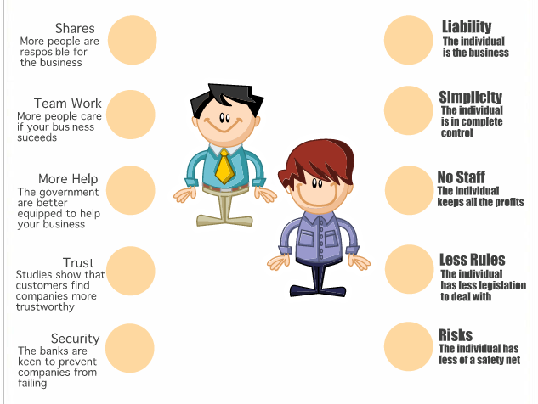
Limited Company vs Sole Trader

Slide 18
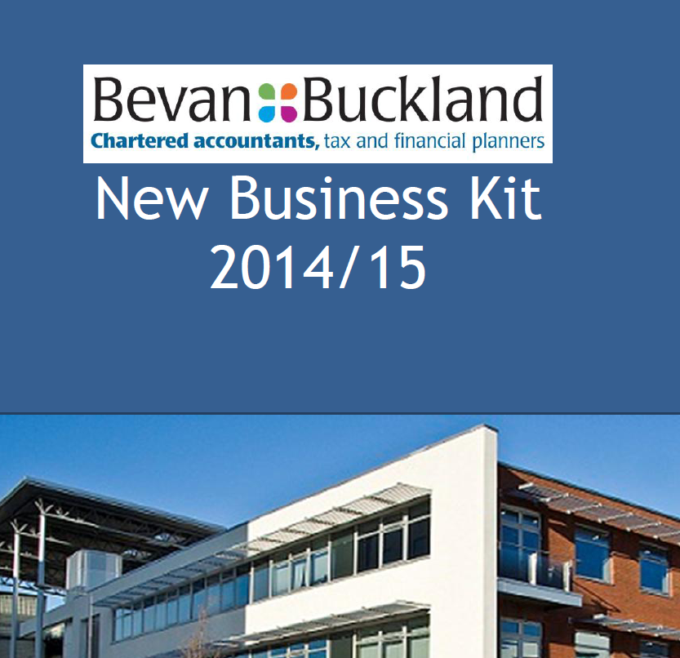
Available on request

Slide 19
Social Enterprise / Community Interest Companies (CIC’s)
A CIC is a special type of limited company which exists to benefit the community rather than private shareholders.
They are NOT-FOR-PROFIT businesses but can still be profitable! Profits are simply reinvested.
include a ‘community interest statement’, explaining what your business plans to do for the public good.
create an ‘asset lock’- a legal promise stating that the company’s assets will only be used for its social objectives,
BENEFITS:-
  Do something you love for little risk? Be creative!
  Access to significant levels of funding.
  Can pay yourself and others a ‘reasonable’ salary.
  Far easier service/product to sell - ‘Social responsibility’

Slide 20
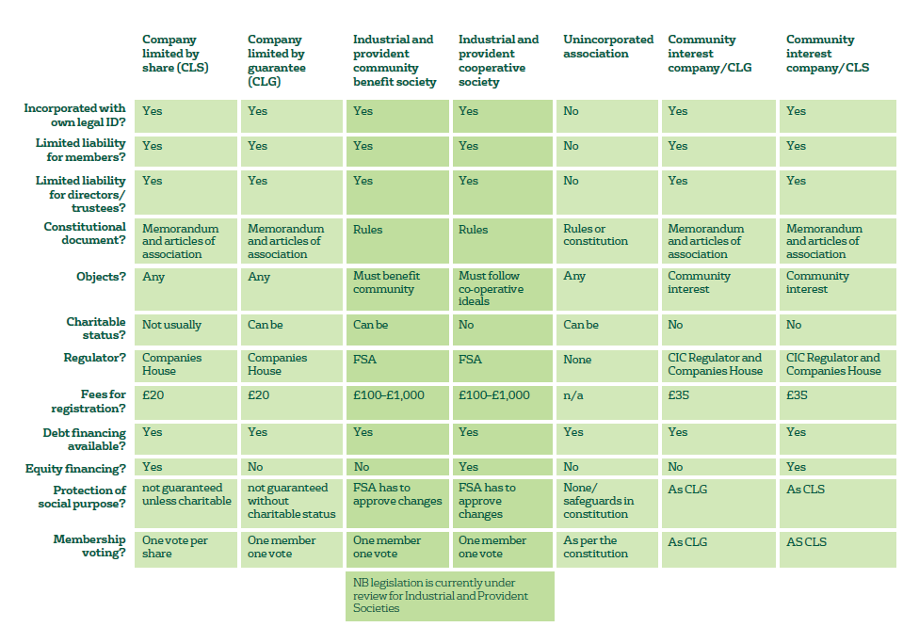
Social Enterprises
*Loads of material/info!*

Slide 21
A bit of both?
What if I work (employed) for a company but also do my own thing and earn extra money?

Slide 22
Self-Assessment
If you work or earn money through your own ventures then you are self-employed.
(if you’re employed and ‘doing your own thing’ then typically the employer will cover your PAYE taxes, you just need to work out your own tax from your own business)
Your tax system is known as “self assessment”
It relies on you keeping your own records of profits… and “allowable” expenses (keep receipts)
You will pay tax on any profits you make over £11,850
(personal annual allowance in 2018/19)
(plus national insurance contributions – few quid a week)

Slide 23

www.hmrc.gov.uk/startingup
*Seek professional help!*
Business Support
Legal Advice
Accountants

Slide 24
Business Structure
(or models or set-up or formation)
Other stuff...
VAT
Taking on staff
Allowable expenses, pensions, loans
Grants and funding
Insurance (PI/PL)
Bank accounts
Accreditations, Memberships & Unions
Tenders/Bids
Policies/Procedures
T&C’s, contracts, invoices, receipts, etc.

Slide 25
Business Structure
(or models or set-up or formation)
RECAP SCENARIOS!

Slide 26
The Business Plan

Slide 27
My Process with a Start-Up
Client Expectations – feasibility, reality check.
Legal Structure – sole trader, Ltd, SocEnt
Informing HMRC – when and how, and tax!
Business Plan – DO RESEARCH!!!
Financial Forecasting – funding, income, costs
Marketing Strategy – more specific objectives
... Insurance, bank accounts, policies, legal, IP, HR, governance, tenders, accreditations, etc.

Slide 28
Research indicates that about 50% of business start ups will fail within 3 years
a majority of failures are due to being ill prepared to meet the changes that influence the course of a business
in other words, a lack of planning.

Slide 29
Why should you write a business plan?
To gauge the viability of the business idea
To obtain investment
To attract business partners
To set targets so you can monitor progress
To discover any weaknesses in the idea
To identify areas for improvement
To keep the business on track

Slide 30
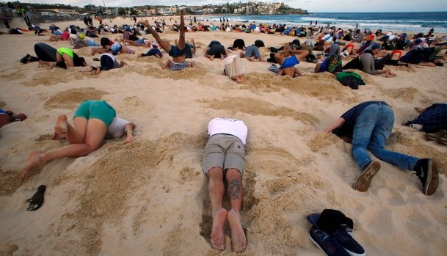
95% of my clients DO NOT complete a business plan
It is not a template, a script – it is analysis and research, a way of finding the truth and the possibilities
It does not guarantee success, but it does significantly increase your chances of NOT failing

Slide 31
How can a plan help your business?
The process involved in producing the plan is as valuable, if not more so, as the document it creates.
It forces you to distil your ideas, rank your priorities and clarify your objectives.
It stops you kidding yourself – gives perspective.
You ask questions you might otherwise ignore.
It gets you focused on the important issues.
It does not guarantee success, but it does
significantly increase your chances of NOT failing

Slide 32



The Truth!

Slide 33
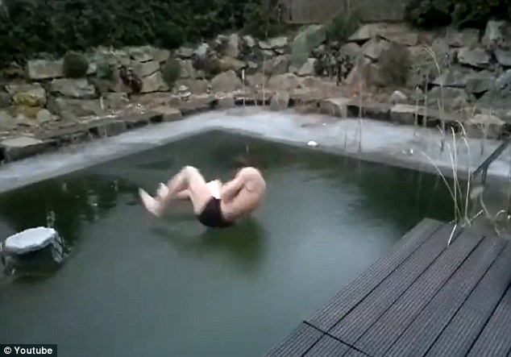
95% of clients DO NOT complete a business plan
WHAT ARE THEY RISKING?

Slide 34
Business Planning
BORING – The ‘Traditional’ Business Plan
POPULAR – The Business Model Canvas
CREATIVE – Simply Do Ideas

Slide 35
Business Planning
The ‘Traditional’ Business Plan
Used by banks and required by funders
Very formal and analytical
HEAVY document!
Excellent where risk or investment is HIGH

Slide 36
Business Planning
1. |  |  | Executive Summary | 4
 | 1.1 |  | Main reason for business plan | 4
 | 1.2 |  | A brief description of the project | 4
 | 1.3 |  | A summary of the benefits of the project to the community, region and Welsh economy | 4
 | 1.4 |  | A table of financial highlights | 5
 | 1.5 |  | Total cost of the project, including working capital | 5
 | 1.6 |  | Funding sought | 5
 | 1.7 |  | Case for SIF/LIF grants (where applicable) | 5
2. |  |  | Company Information | 6
 | 2.1 |  | Company details | 6
 |  | 2.1.1 | Name | 6
 |  | 2.1.2 | Company registration number | 6
 |  | 2.1.3 | Date of incorporation | 6
 |  | 2.1.4 | Registered office address | 6
 |  | 2.1.5 | Telephone | 6
 |  | 2.1.6 | Email | 6
 |  | 2.1.7 | Website address | 6
 | 2.2 |  | Professional Advisors | 6
 |  | 2.2.1 | Bankers | 6
 |  | 2.2.2 | Accountants | 6
 |  | 2.2.3 | Solicitors | 6
 | 2.3 |  | Standards Achieved | 6
3. |  |  | Introduction | 7
 | 3.1 |  | Mission Statement | 7
 | 3.2 |  | History | 7
 | 3.3 |  | Current Shareholdings | 7
 | 3.4 |  | Group Structure | 7
 | 3.5 |  | Key personnel | 7
 | 3.6 |  | Premises | 7
 | 3.7 |  | Description of current operations | 7
 | 3.8 |  | Background to the project | 7
 | 3.9 |  | SWOT Analysis | 8
 |  | 3.9.1 | Strengths | 8
 |  | 3.9.2 | Weaknesses | 8
 |  | 3.9.3 | Opportunities | 9
 |  | 3.9.4 | Threats | 9
 | 3.10 |  | Environmental Sustainability | 10
4. |  |  | Products and Services | 11
 | 4.1 |  | Product/Service Description | 11
 | 4.2 |  | Unique features | 11
 | 4.3 |  | Product Lifecycle | 11
 | 4.4 |  | Research and Development | 12
 | 4.5 |  | Intellectual Property Rights | 12
 | 4.6 |  | Production Methods | 12
 | 4.7 |  | Health and Safety issues | 12
 | 4.8 |  | Costs of production | 12
 | 4.9 |  | Suppliers | 12
 | 4.10 |  | Capacity | 12
 | 4.11 |  | Stock Holding Policy | 13
 | 4.12 |  | Quality | 13
 | 4.13 |  | Environmental considerations | 13
 | 4.14 |  | After sales service | 13
 | 4.15 |  | Distribution | 13
5. |  |  | Markets and Marketing | 14
 | 5.1 |  | General description | 14
 | 5.2 |  | Overall market size | 14
 | 5.3 |  | Market trends | 15
 |  | 5.3.1 | Political | 15
 |  | 5.3.2 | Economic | 15
 |  | 5.3.3 | Social | 15
 |  | 5.3.4 | Technological | 15
 |  | 5.3.5 | Legal | 15
 |  | 5.3.6 | Environmental | 16
 | 5.4 |  | Market Position | 16
 | 5.5 |  | Major/Potential customer | 16
 | 5.6 |  | Major competitors | 16
 | 5.7 |  | Competitive advantages | 17
 | 5.8 |  | Marketing Strategy | 17
 | 5.9 |  | Marketing Structure | 17
 | 5.10 |  | Advertising and promotion | 18
 | 5.11 |  | Selling methods | 18
 | 5.12 |  | Pricing Strategy | 18
 | 5.13 |  | Sales volumes | 18
6. |  |  | Management and Personnel | 20
 | 6.1 |  | Organisation | 20
 | 6.2 |  | Management team | 20
 | 6.3 |  | Non-executive directors | 20
 | 6.4 |  | Workforce | 20
 | 6.5 |  | Incentive Schemes | 20
 | 6.6 |  | Recruitment | 21
 | 6.7 |  | Disability discrimination | 21
 | 6.8 |  | Equal Opportunities | 21
 | 6.9 |  | Training & development | 21
7. |  |  | Future Developments | 22
 | 7.1 |  | Long range plans | 22
 |  | 7.1.1 | Growth Strategy | 22
 |  | 7.1.2 | Has consideration been given for potential to collaborate or enter into joint venture with other organisations? | 22
 |  | 7.1.3 | Proposed acquisitions | 22
 |  | 7.1.4 | Plans to develop new products or services | 22
 |  | 7.1.5 | Plans for stock exchange listing | 22
 | 7.2 |  | Contingency Plan | 22
8. |  |  | Finance | 24
 | 8.1 |  | Historic results | 24
 | 8.2 |  | Contingent liabilities | 24
 | 8.3 |  | Breakeven analysis | 24
 | 8.4 |  | Current funding structure | 24
 | 8.5 |  | Financial forecasts | 24
 | 8.6 |  | Sensitivity analysis | 25
 | 8.7 |  | Fixed assets | 25
 | 8.8 |  | Proposed funding | 25
 | 8.9 |  | Security plan | 25
 | 8.10 |  | Exit Plan (equity finance only) | 25
 | 8.11 |  | Likely value of business on exit (equity finance only) | 25
 | 8.12 |  | Tax implications for business and investors (equity finance only) | 25
9. |  |  | Appendices | 26
 | 9.1 |  | Product literature | 26
 | 9.2 |  | Organisation chart | 27
 | 9.3 |  | Management CV’s | 28
 | 9.4 |  | Policy documents | 30
 |  | 9.4.1 | Healthy and safety policy | 30
 |  | 9.4.2 | Equal opportunities policy | 33
 |  | 9.4.3 | Environmental policy | 34
 | 9.5 |  | Market analysis | 35
 | 9.6 |  | Letters of support | 36
 | 9.7 |  | Financial forecasts | 36
 | 9.8 |  | Other relevant documents | 37
 |  | 9.8.1 | TSDSU proposal – Submitted, awaiting response | 37
 |  | 9.8.2 | Skills Active: Response to Tender – Submitted, awaiting response | 37

Slide 37
Business Planning
The Business Model Canvas
Not heavy but still covers critical elements
A globally accepted format for sufficiently analysing and presenting a ‘snapshot’ business proposal
Not enough detail on its own but far better than nothing at all!

Slide 38
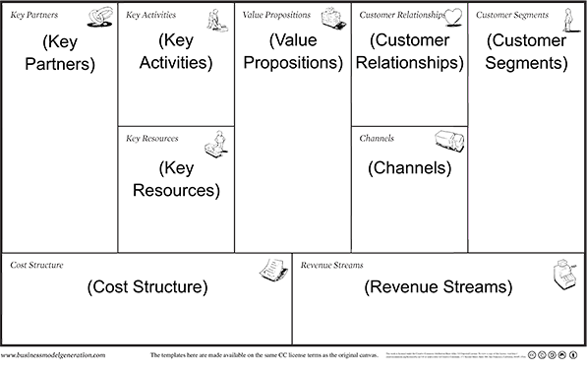
Business Planning
https://www.youtube.com/watch?v=QoAOzMTLP5s

Slide 39
Business Planning
‘Simply Do Ideas’
A re-working of the Business Model canvas that allows ‘a little more’ detail, but makes more sense.
Far more creative, user-friendly and useful.
Excellent tool to present a proposal (which is starting to be employed by Welsh Government)

Slide 40
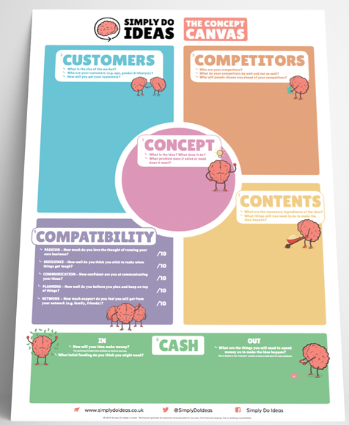

Slide 41
Idea generation
Neil Dyer

Slide 42
Intellectual Property (IP)
Intellectual Property (IP)
“It is creations of the mind, once expressed, that make up IP. No protection for ideas/concepts – MUST BE EXPRESSED!”
*** 31st October – IP Session
with Kath Penaluna, Enterprise Manager ***

Slide 43
Overview
How to come up with a business idea – watching trends
A process for generating ideas
New ideas from around the world
Ingredients for a good idea

Slide 44
New ideas from around the world

Slide 45

myUrbio.com Urban Vertical Garden

Slide 46

Take it a step further

Slide 47
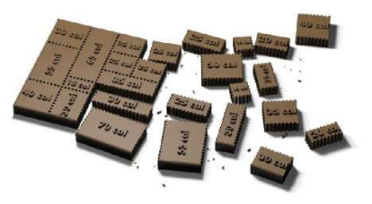
Rompicollo Calorie counted chocolate

Slide 48

SRS Energy: Solé Power Tile
Avoids covering a roof in unsightly solar panels The solar panels are shaped like clay tiles

Slide 49

Solve a problem…

Slide 50
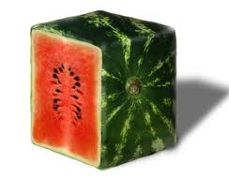
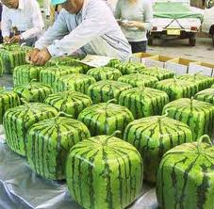
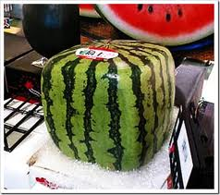

Slide 51
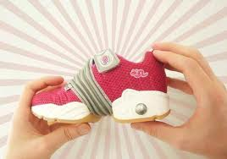
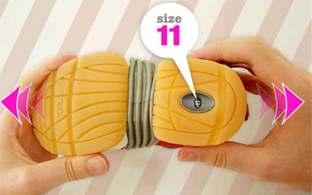
Inchworm.co.uk Recession product!!

Slide 52
Ingredients for a good idea

Slide 53
There are thousands of ideas out there
But what makes a good one?
Where do we find them?
Look for needs, watch trends, listen for complaints, problems or pains…. Then get creative about building a business around them

Slide 54
How to come up with a business idea – watching trends

Slide 55

Low Cost
Convenience
Wellbeing
Environment
Trends?
Grey Power

Slide 56


Low Cost…

Slide 57
Convenience…
Amazon/eBay/etc – online shopping
Audiobooks
Deliveroo
Just Eat
Supermarket home delivery, pick-up service...
Alexa and alternatives
Google voice
GPS

Slide 58
Wellbeing…
Holiday Inn - pedometer given out with every room key

Slide 59
Wellbeing…
AppStore Health & Fitness or Medical categories now contain more than 7,000 apps for iPhones
Health related apps for Android phones have so far achieved more than three million downloads

Slide 60
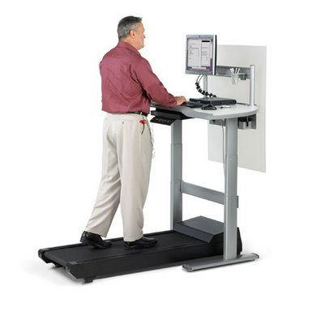
Details Ltd Walk-station Desk

Slide 61
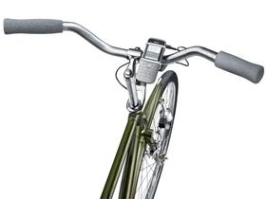
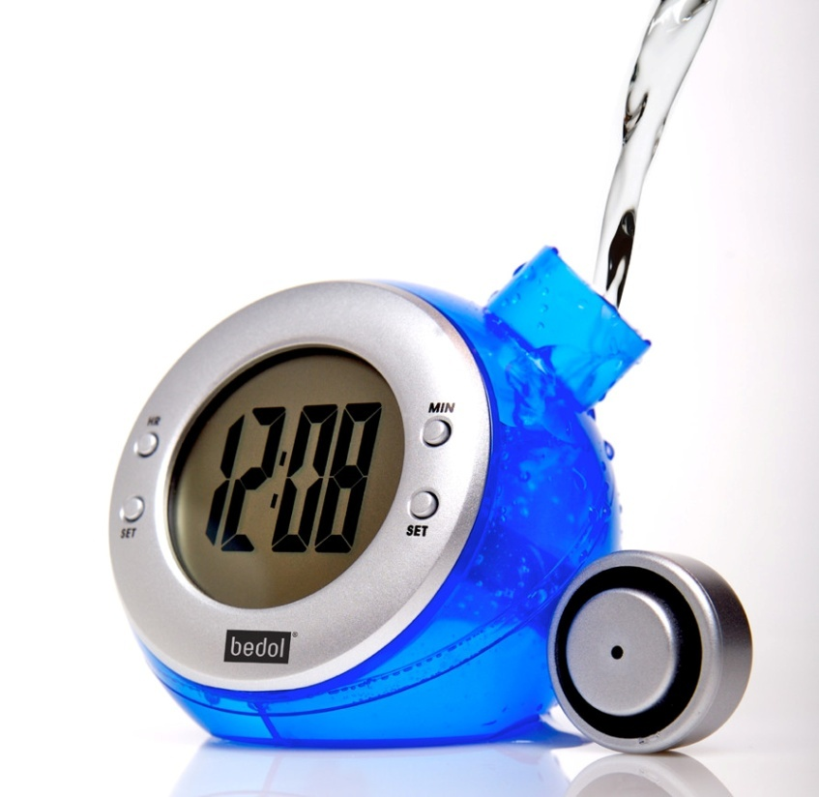
Environment
Bedol Water Powered Clock
Nokia Phone Dynamo

Slide 62
Environment…
“30% of US consumers are willing to pay up to a 20% premium on clean, green products over non-sustainable alternatives.”
SOURCE: Mintel 2010

Slide 63
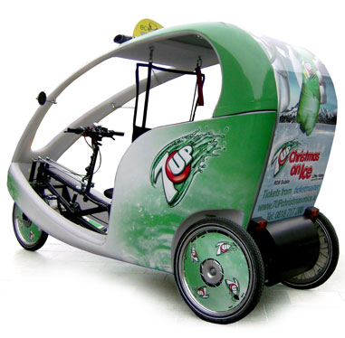
Ecocabs Ireland
What if cab fares were paid for by advertising?

Slide 64

Grey Power
“Between the year 2010 and 2040,
the global population age 65 and over
is expected to rise from 530 million
to 1.3 billion.”
“By the year 2040, 28% of Western Europe’s population is expected to be age 65 or older, the highest percentage worldwide.”
SOURCES: US Census Bureau & WHO 2010

Slide 65
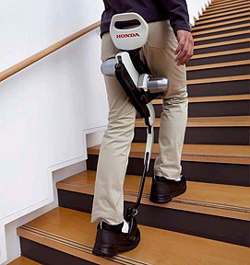
Honda’s Body Weight Support System

Slide 66
A process for generating ideas

Slide 67
Finding an Idea…
Find a trend, complaint, problem or pain
Get creative on how to capitalise on it

Slide 68
Mind map all the areas of interest in the group
Brainstorm all the complaints, problems or needs people have associated with each of these interests in turn
Brainstorm solutions to these problems
Remember, at this stage, it’s all about QUANTITY not QUALITY

Slide 69
KIDS
BEAUTY
SPORTS
INTERESTS
MUSIC
FITNESS

Slide 70
SAFETY
CHILDCARE
NUTRITION
CHILDREN
IT USE
ACTIVITIES

Slide 71
WALKIE-TALKIES
DOG
CLOTHING
SAFETY
ALARM
GPS

Slide 72

SAFETY
CHILDREN
GPS
Halloween Costumes for
Children with Inbuilt GPS

Slide 73
Work through your own ideas:
find a problem,
work a solution

Slide 74
CONCEPT
Neil Dyer

Slide 75
Your Ideas...
Introduce yourself and your idea!
(the grandparents version please)
... The Elevator Pitch ...
Stage 1 : Over a minute
Stage 2 : 30 seconds
Stage 3 : 17 seconds
Stage 4 : 7 seconds

Slide 76
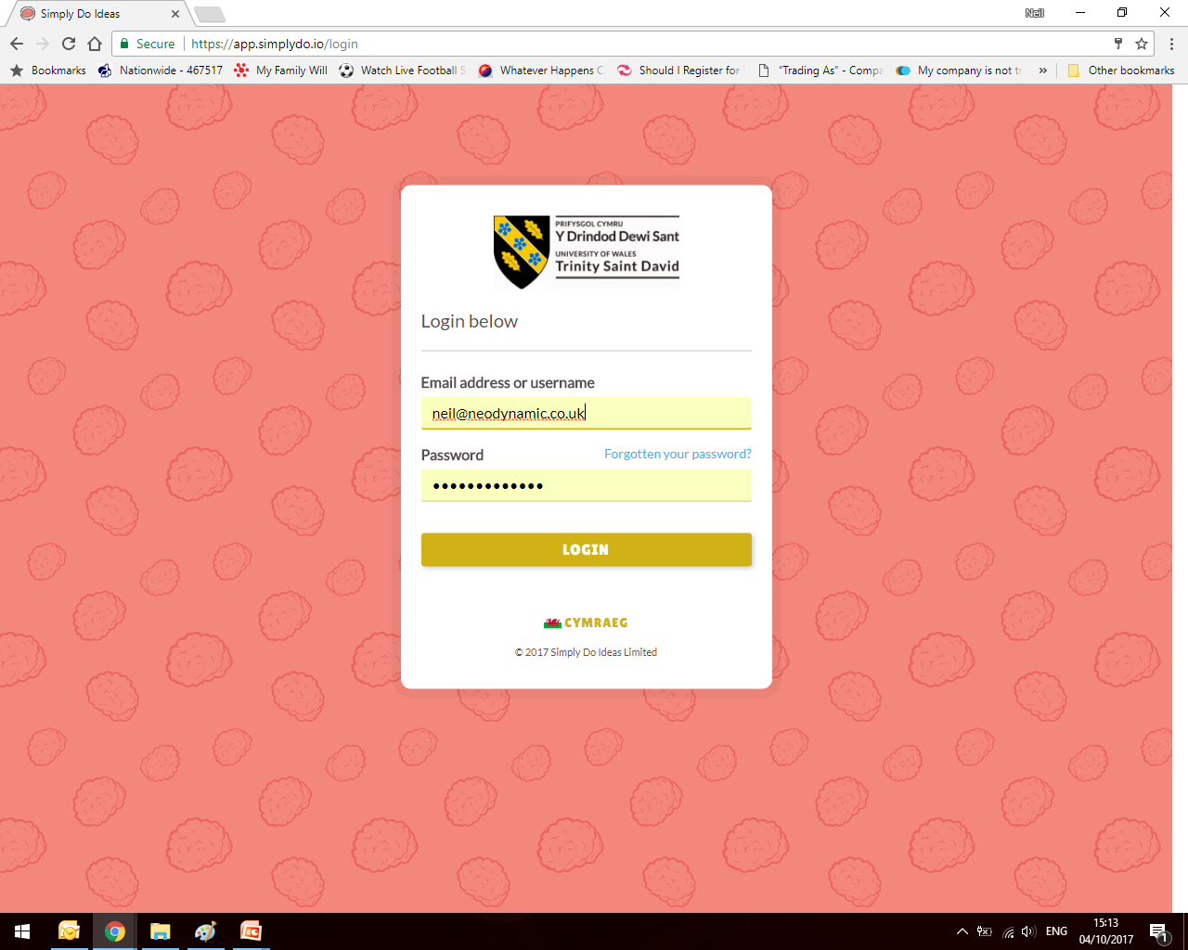
Simply Do Ideas
http://app.simplydo.io/new/uwtsd
(make sure you click and add yourself to our group:
‘Neil Dyer - UWTSD Entrepreneurship Semester One 2018’

Slide 77
STEP 1: Concept
Getting to grips with your idea!
What is the idea? What does it do?
What problem does it solve or need does it meet? (Or desire/want?)

Slide 78
STEP 1: Concept
Let’s explore...
‘What makes a good idea?’ [Discuss]
Different or better
Value (will it be valued? Must be better, must be wanted)
Feasible
Positive Cost-Benefit
(smartstorming.com)

Slide 79
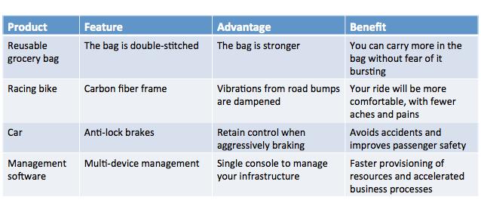
STEP 1: Concept
Features, Advantages & Benefits
Features: facts or characteristics
Advantages: what the features do
Benefits: what problem is solved or improved

Slide 80

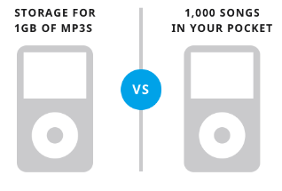
STEP 1: Concept
Features, Advantages & Benefits
Features: facts or characteristics
Advantages: what the features do
Benefits: what problem is solved or improved
People buy benefits, not features
FAB = Value Proposition

Slide 81
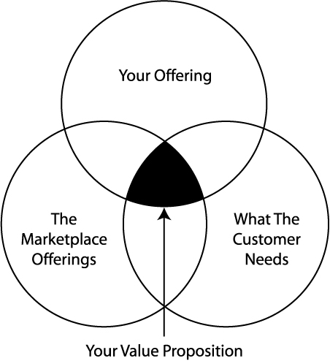
STEP 1: Concept
The Value Proposition
“Why should we buy/use your product/service?”
Clearly and simply define:
What pain does it ease or solve?
- What is the added benefit?
- Why is it better than the rest (the USP – Unique Selling Point)?
Should underpin your brand.
Should resonate in your slogan and/or mission statement.

Slide 82
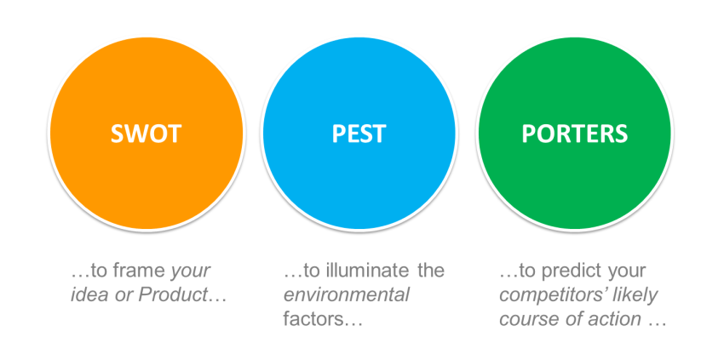
FURTHER ANALYSIS
or PESTEL

Slide 83
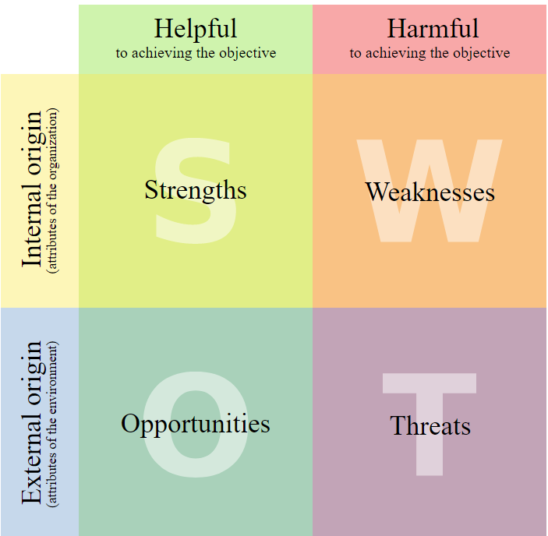
SWOT
IN
OUT

Slide 84
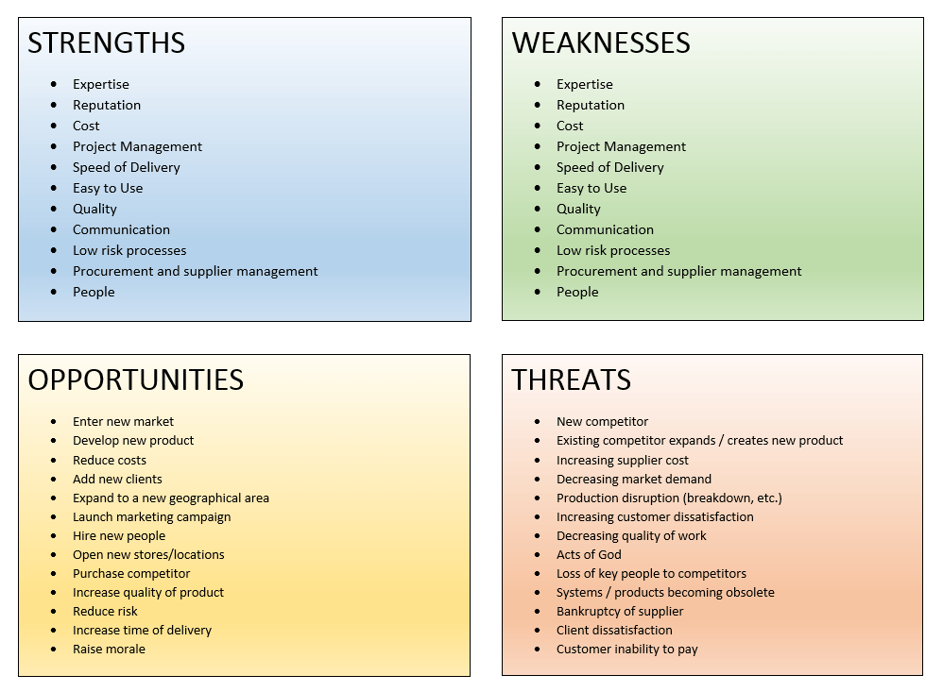
SWOT ANALYSIS
Let’s
give it a go!
Breathing/Organic Tool – keep reviewing!

Slide 85
SWOT ANALYSIS
So what???
It’s not what you’ve got, but what you do with it that counts?
DONE! :D

Slide 86
STEP 1: Concept
Putting it online:
A relevant cover image
Concept Overview
(help us understand your idea, the opportunities, the problems it solves, include any early research)
Keywords (industry, location, etc)
Logo/Design?
Brief Video (Yes!)
Watch the ‘Help’ video

Slide 87
What do you have to do?
Turn up and take part!
Make notes
Contextualise
Complete home tasks
Start generating
Get out there
Use me!

Slide 88
LET’S GIVE IT A GO!

Slide 89
Home tasks for next Wednesday:
NOTE: Will be emailed out to you.
Log into Simply Do Ideas portal (and join the correct group).
Decide on your best idea as a group.
Come up with some company names, product/service names (brand names) and slogan ideas.
Complete Step 1 on portal individually.
Complete a SWOT Analysis on your idea as a group.

Slide 90

ANY QUESTIONS?
Neil Dyer
neil@neodynamic.co.uk
Check Moodle and
your emails
Ask anything, any time!

