Slide 1


Applied Qualitative Business Research
ADS
2022

Slide 2
Learning Objectives
To become familiar with the process of data analysis
To understand how to go about coding
To grasp how to develop and use themes, sensitizing concepts, and generic social processes in your analysis

Slide 3
Introduction
All types of qualitative research yield mountains of data that need to be analyzed.
“Trust the process”
  Researchers use this phrase to remind themselves to have faith that there are important themes in their data and that they will have the insight and skill to find these themes.
Data analysis often involves routine, time-consuming activities, but the process is also open-ended and creative, with high points of excitement that accompany unexpected insights.

Slide 4
Introduction, cont’d
Data analysis requires qualitative researchers to be open to new insights, able to make connections to theoretical frameworks, and able to think reflexively about their position within the research process.
Reflexivity is the process through which qualitative researchers examine and explain how they have influenced a research project through their social status, situation (gender, age, etc.), and the experiences they bring to the project.
Notes:
Discussion question: Why does the author say that jumping into using qualitative analysis software too soon is like using a calculator before you learn to add?

Slide 5
Beginning with Memos
Analysis starts as soon as you begin to collect your data.
For this reason, you should regularly jot down memos throughout the research process.
Your memos should include anything that might help you understand your data later on:
  your own preliminary ideas
  connections you make while in the field
  references to articles or books that may contain useful information
Your memos, field notes, and/or transcripts will assist you when you begin the process of coding.

Slide 6
Coding Interview Transcripts and Field Notes
Analyzing qualitative data is labour intensive, and it requires time for you to think and let ideas percolate.
  There are no real shortcuts while interpreting data.
As you analyze your data, you will be refining your research questions.
  Remember that because analysis occurs throughout the research process, your research questions will change across the life of your study.

Slide 7
Coding Interview Transcripts and Field Notes, cont’d
Coding means systematically going through data, finding terms or phrases to categorize chunks of data, and organizing the data into a form the researcher can work with.
  Codes are simply names for the topics, activities, events, and people that come up in your transcripts or field notes.

Slide 8
Coding Interview Transcripts and Field Notes, cont’d
The first step in coding is called open coding and it involves labelling the themes that you find in your transcripts or field notes.
  Open coding is closely associated with grounded theory (we will return to this) a research approach that begins with collecting data about a particular phenomenon and constructs a theory to explain the phenomenon that is grounded in the data.

Slide 9
Coding Interview Transcripts and Field Notes, cont’d
While coding, researchers:
  should try not to narrow their focus too much in advance
  should investigate what is present in the data as well as what is missing
  should work with manageable pieces

Slide 10
Coding Interview Transcripts and Field Notes, cont’d
In the later stages of the coding process, you will want to explore ways in which you can bring all of your data back together.
Focused coding is a process in which the researcher further refines the codes used in the first stage of coding, open coding.

Slide 11
Stories in Western Cultures
Analyzing stories help qualitative researchers understand the participant’s situation from his or her point of view.
  A story is a refined version of events. Often, when someone tells a story, he or she has told that story before and has, with each telling, crystallized the meaning that the narrative holds for him or her.
Signature stories are tales people like to tell about themselves or situations that they like to narrate.
  Signature stories reveal something about what makes us tick, about turning points in our path, about why our life has turned out the way it has.
  They can also shed light on participants’ fundamental beliefs, convictions, and habits.

Slide 12
Stories in Cultural Research
Cultures have a more collective outlook on what it means to be a human being than Western cultures.
  This focus on the collective results in stories’ having a different purpose than a research participant’s telling a story about themselves to tell you what kind of person they are.

Slide 13
Sensitizing Concepts
Another approach to understanding participants’ perspectives in depth is analyzing sensitizing concepts, based on expressions used by research participants that allow the researcher to understand the empirical world of the research participants.
  Qualitative researchers often develop sensitizing concepts based solely on what emerges through their data.
  However, it can also be helpful to explore background literature for assistance.
  Background literature may help you discover previously identified sensitizing concepts that can help you to better understand the situation of your participants.

Slide 14
Bringing It All Together: From Codes to Generic Social Processes
In order to answer the “so what?” question, qualitative researchers often look to previous studies and their own data in order to identify generic social processes.
To identify such processes, look for commonalities in the ways your participants approach and interpret their situations.

Slide 15
Bringing It All Together: From Codes to Generic Social Processes, cont’d
Researchers also need to reflect on how their research connects to broader society and to your field in general.
Reading material related to your study can help you contextualize your data and uncover the wider implications of your findings.
Reading a variety of research studies can also help you find connections between your own findings and the findings of other researchers.

Slide 16
Innovations in Analysis of Research
Over the past few decades, there has been a great deal of innovation in how qualitative researchers go about interpreting data.
  Two of these innovations are discourse analysis and narrative analysis.

Slide 17
Discourse Analysis
Discourse analysis is an interpretive approach to research, influenced by the writing of Michel Foucault, that sees language as a social practice and therefore constitutive of social life.
Discourse analysis recognizes the ways in which language shapes and defines experience.
Foucault argues that discourse limits how we think, about phenomena, and that powerful components of society control the ways in which we talk about and define them (Rabinow 1984).

Slide 18
Discourse Analysis, cont’d
Since discourse constructs the possible definitions of the situation and, therefore, has real consequences, it shapes social realities and understandings of the self.
Discourse analysts often examine deeply rooted cultural discourses and the ways in which marginalized groups challenge taken-for-granted terms that are embedded with the power to define.
Discourse analysts explore more closely the way participants say things, not just the words they use.
Notes:
Discussion question: How would you design and conduct a discourse analysis of the experience and representation of student life at Canadian universities?

Slide 19
Narrative Analysis
Narrative analysis is an approach to qualitative research that recognizes the centrality of stories in the way people understand and talk about their own lives.
  In narrative analysis, the stories themselves are the object of research (Riessman 2001).
Narrative analysts:
  examine the ways in which stories can reinforce a group’s identity or values
  combine individuals’ narratives to build a collective story
  recognize that narratives always occur within a social context

Slide 20

Introduction to Grounded Theory and Grounded Methodology – What are they? How do they work? How can they be adapted?

Slide 21

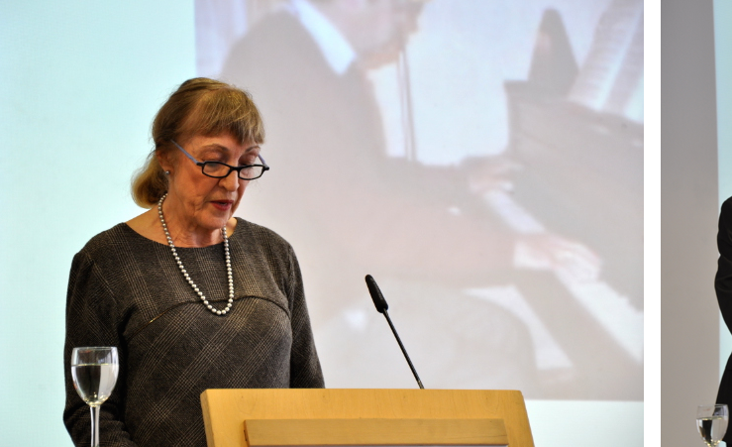

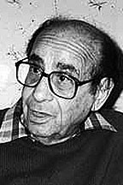
Grounded Theory: Sociology’s Shakespearian Drama?
Notes:
Glaser, Corbin, Strauss and Shakespeare

Slide 22
Two Throw-Away Messages
Grounded theory and grounded methodology are about relationships
  Relationships between data
  Most importantly, relationships between humans
In art we talk about performance and product
  In grounded theory and grounded methodology it is all about the process

Slide 23
Aspects of grounded theory
Context
Overview
Relevance
Developing Relationships

Slide 24
Context
Why did grounded theory happen?
Late 50s early 60s

Slide 25
Terminology: Methodology
Methodology
  The philosophical approach to research
  How we go about creating specific paradigms and systems of knowledge
Methodologies determine Methods
Methodologies include:
  Ethnography
  Grounded Theory

Slide 26
Terminology: Methods
Methods
  Usually associated with data collection methods
  Methods of going about the day to day business of research
Methods include:
  Observations
  Interviews

Slide 27
The problem with inductive logic – 1950s and 1960s
Child / Adult
Nurse
Teacher
Early Years Practitioner
Doctor
Social Worker
Psychologist
Inductive Logic – the belief theories need only be found
Leaves discrete paradigms
Little opportunity for joined up thinking

Slide 28
What existed at the time of the birth of Grounded Theory?
Two types of social / cultural theorist
  Anthropologists – writing interpretivist accounts
    Similar to what was later called “thick description” (Geertz, 1989)
  Experimental studies or studies of “big data”
    Inductive logic “king”
    Studies merely proved or disproved existing theory
  Geertz, C. (1989). Works and lives: The anthropologist as author. Palo Alto, CA: Stanford University Press

Slide 29
Philosophy of Science from this Era: Popper
Popper’s (1959, 1998) English translation of Logic of Scientific Discovery [1959] and the 1st edition of Conjectures & Refutations [1963] cast further doubt on induction
Later work suggested new ways of constructing deductive logic as problem solving (Popper, 1979)
P₁ → EE → TT →P₂
Popper, K. (1959). The logic of scientific discovery. London: Hutchinson & Co.
Popper, K. (1979). Objective knowledge: An evolutionary approach (Rev. ed.). Oxford: Clarendon Press.
Popper, K. (1998). Conjectures and refutations: the growth of scientific knowledge. London: Routledge.

Slide 30
Philosophy of Science from this Era: Kuhn
Kuhn (1996) published The Structure of Scientific Revolution [1964]
Science moved in deductive paradigms
Scientists acted tribally
  Developed their own cultures of theory [not his phrase]
Scientists had their own human logic
Kuhn, T. S. (1996). The structure of scientific revolution (3rd ed.). Chicago: Chicago University Press.

Slide 31
Overview
What was the solution?

Slide 32
Early 1960s – Berkeley California
Sociologists Glaser & Strauss
Started study of process of dying by patients who knew they were terminally ill in a hospital ward (Glaser & Strauss, 1965)
  UNIQUE: No real theory to test against this subject
  No methodology for studying empirically
Created (being inductive they called it “discovered”) their own methodology for conducting a study
Glaser, B. G., & Strauss, A. L. (1965). Awareness of dying. Chicago: Aldine Publishing Co.

Slide 33
“Discovery” of Grounded Theory
Grounded theory was initially “discovered” in order to simultaneously generate and test theories (Glaser & Strauss, 1967; Hayhoe, 2012)
  This technique of data gathering “induced” a grounded theory
This was recorded through memoing, as Glaser & Strauss researched
The memos recorded patterns and connections between different categories and characteristics of data
Glaser, B. G., & Strauss, A. L. (1967). The discovery of grounded theory: Strategies for qualitative research. Chicago: Aldine Publishing Company.
Hayhoe, S. (2012). Grounded theory and disability studies. Amherst, New York: Cambria Press

Slide 34
What Grounded Theory became
Glaser & Strauss created a methodology that could use anthropological techniques empirically
Tried, however, to focus on qualitative data
  Previously, sociological data largely quantitative
  Set-out the grounds for what would become empirical social / cultural anthropology
HOWEVER, they still fell into the pitfall of inductive logic

Slide 35
Forms of data collection
The statement used over and again is ‘All is data’ (Glaser, 1998, Glaser & Strauss, 1967)
Usually involves qualitative data collection, particularly interviewing
Grounded theory studies are generally field based, and also tend to feature observations
Statistical information is usually collected as secondary source data, but Glaser insists it can be used
Self reviews and field diaries are also – sometimes contentiously – used as data

Slide 36
“Natural” Triangulation: Three Phases of Analysis
In the beginning, researchers entered a field naively
System was circular and never ending
  New study ends at the beginning of previous
  Retesting of theories could continue
  It could take place in different studies over a period of years

Slide 37
Three stages of investigation
Open Coding
  Gathering data and searching for patterns
Axial Coding
  Reducing these patterns to classes and formal relationships
  Forming an initial hypothesis
Selective Coding
  Testing the hypothesis with new data
  Forming conclusions to begin new studies

Slide 38
Two Forms of Model of Emerge
Model of a single study
Model of studies overlapping and inter-twining
Open
Axial
Selective
Study 1
Study 2
Study 3

Slide 39
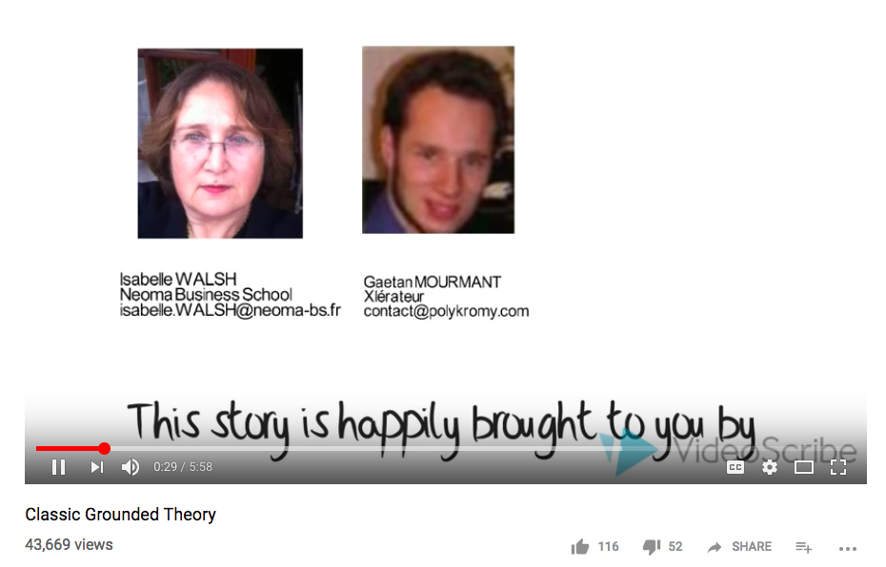
Classical Grounded Theory Introduced

Slide 40
Discussion
Form yourself into groups of optimally 4 or 5
Discuss the following questions
  What are the problems with grounded theory?
  Where is grounded theory is most effectively used?
  Where is grounded theory most ineffective?
Feedback to the whole group

Slide 41
6 Core Concepts of Traditional Grounded Theory
As per Glaser

Slide 42
Core Principles 1: Qualitative Math(s)
Glaser influenced by Lazarsfeld at Columbia University, NYC
There are elements of qualitative data that can be coded mathematically and vice versa
‘The definition of qualitative math[s] is circular… (1) there was no qualitative hypothesis or concept that could not have a mathematical concept developed for it and (2) … most mathematical formulas, particularly statistical can be stated qualitatively’ (Glaser, 1998, p. 22)
Glaser, B. G. (1998). Doing grounded theory: Issues and discussions. Mill Valley, CA: The Sociology Press.

Slide 43
Example of Qualitative Math(s)
Hume believed there was no understanding without sensory information
Hume
U₀ → M_{S} → I → U₁
U = understanding, M = medium, S = sensory, L = language, I = intelligence

Slide 44
Core Principles 2: Verification or Generation
Again, influenced by Lazarsfeld
Theory induced in field rather than generated then verified
‘In grounded theory I decided to… increase the relationships between the generated categories and properties. Verification hobbled the generation of theory and the generation of inducted hypotheses’ (Glaser, 1998 ibid., p. 23).

Slide 45
Core Principles 3: Index Formation and Constant Comparisons
During fieldwork, all instances should be constantly compared to all elements of the existing data
Theory induced
‘This constant comparison is a far richer yield of concepts and the relationships between them than is the yield from just summing. A theory is generated.’ (Glaser, 1998 ibid., p. 24)

Slide 46
Core Principles 4: Explication de text
Influenced by training at the Sorbonne, Paris IV, Glaser believed literature should be read as a part of the data
All text should be read line by line and devoid of influence from previous literature
‘[Reading] closely line by line to ascertain what exactly the author is saying without imputing what was said, interpreting it or reifying its meaning’ (Glaser, 1998 ibid., p. 24).

Slide 47
Core Principles 5: Interchangeability of indices
Glaser argues categories can also be developed, then evolve through the constant comparison of data
Concepts previously unseen rise up and are identified for future reference and comparison
‘When comparing incident to incident when coding his field notes, the researcher begins to see a pattern and a concept emerges that fits it. A category or its property has emerged’ (Glaser, 1998, p. 25).

Slide 48
Core Principles 6: Latent patterns & core category analysis
Glaser argued induced theories are:
  Connected concepts
  Categories they belong to
  Indexes that they refer to
‘[The] category soon becomes classified as the core category because most other categories are related to it. This core category provides and becomes the latent structure of the theory.’ (Glaser, 1998, p. 26)

Slide 49
Back of a fag packet grounded theory
Theory = core category + patterns
Comparison & validation
Categories emerge
Repeated phrases
Repeated phrases
Categories = reappearing phrases
Constantly compare data and categories
Robust categories and patterns are your theory

Slide 50
Relevance
What is useful and what not

Slide 51
Disadvantages of Traditional Grounded Theory in Research
Built on induction, which is now philosophically dated
  A theory from the past?
It is not developed to test initial hypotheses, and thus cannot be critical from the start
Inadequate for comparing two theses, as it assumes naivety on entering the field
Can be inadequate for projects with specific aims. However … (Hayhoe, 2012 ibid.)

Slide 52
Divorce of Grounded Theory -Strauss & Corbin’s Daughter of Grounded Theory
Glaser & Strauss split
Glaser got the theories & ideologies
Strauss ran-away with the applied Corbin (e.g. Strauss & Corbin, 1990)
  Formed social constructionist theory
  Constructivist Grounded Theory (Mills, Bonner & Francis, 2006)
Strauss, A., & Corbin, J. (1990). Basics of qualitative research (Vol. 15). Newbury Park, CA: Sage.
Mills, J., Bonner, A., & Francis, K. (2006). The development of constructivist grounded theory. International Journal of Qualitative Methods, 5(1), 25-35.
You’ve got another woman!!!
We were on a break!!!
Glaser
Strauss

Slide 53
Divorce of Grounded Theory -Strauss & Corbin’s Daughter of Grounded Theory
Glaser & Strauss split
Glaser got the theories & ideologies
Strauss ran-away with the applied Corbin (e.g. Strauss & Corbin, 1990)
  Formed social constructionist theory
  Constructivist Grounded Theory (Mills, Bonner & Francis, 2006)
Strauss, A., & Corbin, J. (1990). Basics of qualitative research (Vol. 15). Newbury Park, CA: Sage.
Mills, J., Bonner, A., & Francis, K. (2006). The development of constructivist grounded theory. International Journal of Qualitative Methods, 5(1), 25-35.
You’ve got another woman!!!
We were on a break!!!
Glaser
Strauss

Slide 54
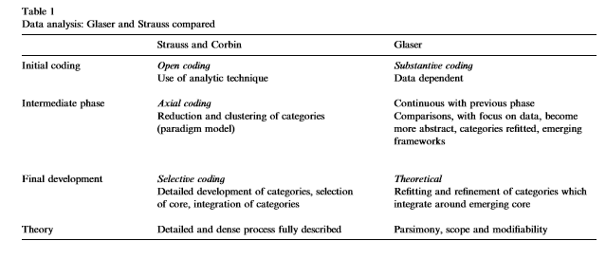
Schism Between Glaser & Strauss Heath, H. & Cowley, S. (2004).Developing a grounded theory approach: A comparison of Glaser and Strauss. International Journal of Nursing Studies 41, 141–150146

Slide 55
Where is it Appropriate to Use Grounded Theory?
You may be in an area where there is little or no theory
You may not agree with existing theories
You may want to evolve and take ownership of a theory over your lifetime
You may not want to test existing hypotheses
You may want to mix qualitative and quantitative data
You may want to collect a broad range of data beyond more structured methods, or not want to simply repeat another’s study (Hayhoe, 2012 ibid.)

Slide 56
The interloper! Hayhoe: Grounded Methodology
Instead of formal coding you develop narratives
All about the structure, not about the philosophy
Open coding: like choosing the characters and main events in your play
Axial coding: like choosing your plot
  Leave a cliff-hanger, or a twist
Selective coding: knitting the story lines, the plots and sub-plots together

Slide 57
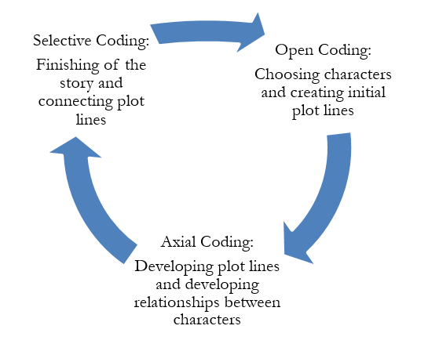
Grounded Methodology

Slide 58
Sampling people as casting your play
Becomes more about human relationships
Initial data gathering for open coding involves selecting a representative sample of subjects and variables
Axial coding finds representative subjects and researches plots in detail
Selective coding is researching a select sample according to their interactions with other actors and plots, to analyse stories that are being told in the play

Slide 59
Two Approaches that can be Employed
Thematic analysis
  Finding recurring themes in observations, the literature and interviews
  Finding “big issues” that stand out
Gestalt analysis
  Finding patterns that exist in the data
  Finding out how different people, things, classes, etc. are connected

Slide 60
Example
Reflexive Strategies Developed During Part Time Fieldwork in an English School for the Blind, Worcester, 2000-2001

Slide 61
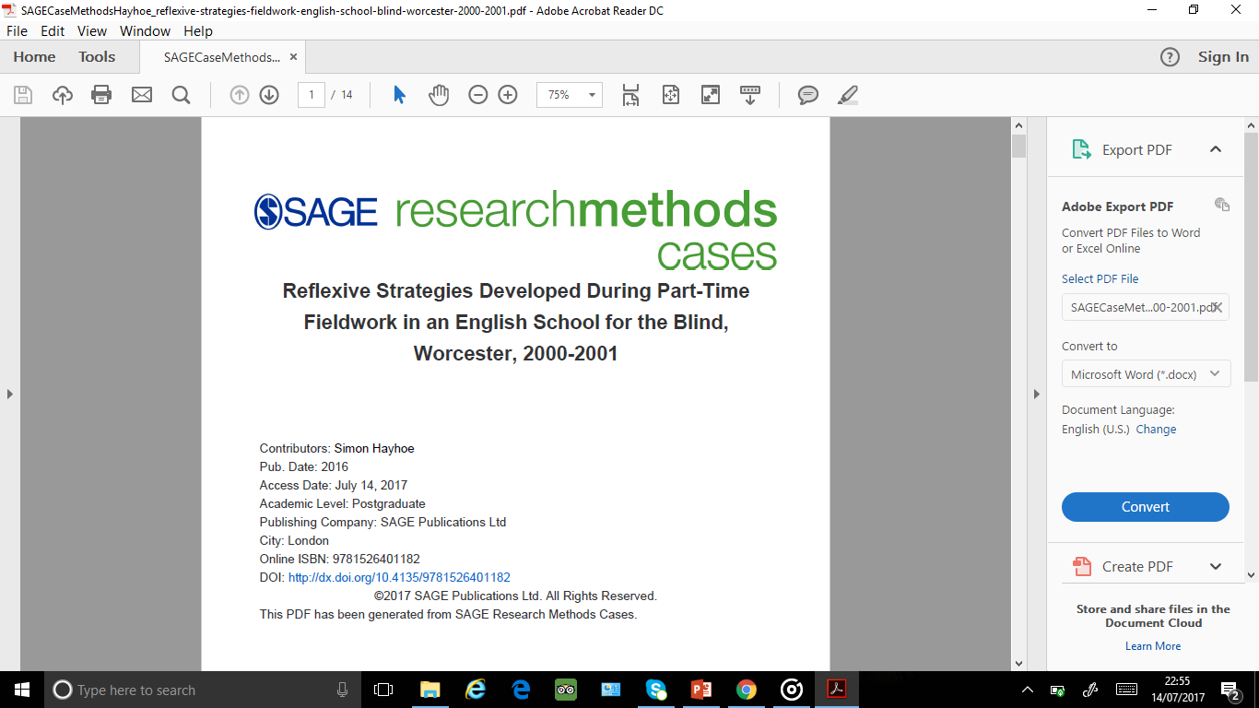

Slide 62
Aims & Objectives of the study
To understand art education for people who are blind
To understand pedagogies and identify problems
  Develop a critical analysis, as theories didn’t exist
To examine how understanding art education of students who were blind could help understand art education

Slide 63
Methods
All was data
Examined historical data
Examined studies in the field – mostly experimental psychology
Observed students – participant observation
Interviews – after and during observations
  Worcester College teacher was ‘informer’
Participant diaries

Slide 64
Exercise
In groups of three or four, discuss the following for 10 minutes and report back to group – one point on each to be reported:
  What problems arose in this situation?
  How did my being a teacher change my approach to research?
  Was being a teacher a good or bad thing eventually?
  Ethical issues?

Slide 65
Summary
What have we covered?

Slide 66
What have we covered
Began as a highly structured methodology of anthropology in order to study previously un-researched topics
It was originally based on inductive logic, but is now largely more inductive
Is traditionally based on 6 principles
Is largely based on qualitative data, but the data is coded in a structured way
Grounded methodology applies the methodology like a structured narrative

