Slide 1
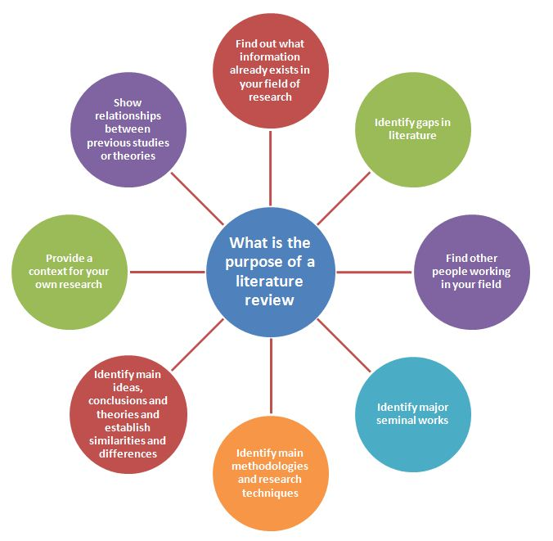


Conducting a Literature Review Dissertation

Slide 2
Types of Literature
Descriptive
Systematic Review
Meta Analysis

Slide 3
Descriptive Literature Review
shows your readers that you have an in-depth grasp of your subject; and that you understand where your own research fits into and adds to an existing body of agreed knowledge.
It reports on and surveys current evidence
It provides a theoretic overview of the topic
It critically analyses current information
Presents current literature in an organised manner

Slide 4
Purpose of a literature Review
Identifies gaps in current knowledge.
Avoids reinventing the wheel – i.e. it saves you wasting time researching something that’s already been done.
Allows you to show that you are building on a foundation of existing knowledge and ideas – i.e. carrying on from where others have already reached.
Identifies other people working in the same field. Knowing who’s already working in your area and getting in touch with them can be an invaluable source of knowledge and support.
Demonstrates the depth of your knowledge about your research.
Identifies the important works in your area and shows that you’ve read them.
Provides an intellectual context for your own work, and enables you to position your project in relation to others in the field.
Identifies opposing views.
Puts your own work in perspective – are you doing something completely new, revisiting an old controversy in the light of new evidence, etc?
Demonstrates your research skills – i.e. you not only know about work in your area, you also know how to access it.
Identifies information and ideas that may be relevant to your project.
Identifies methods that may be relevant to your project.

Slide 5
When to Use a Literature Review
To provide background information supporting qualitative or quantitative research.
Is specific to the topic area and research question but does not create a position statement in its own right.
Research findings are generally compared to this type of literature review.

Slide 6
Systematic Review
Focuses on a well defined research question and tries to identify, appraise, select and synthesize all high quality research evidence relevant to answer that question.
A systematic review must examine an exhaustive summary of current literature relevant to the research question.

Slide 7
Cochrane Collaboration
Very large group of specialists who systematically review randomises trials within health and medical research.
Intervention reviews
Diagnostic test accuracy reviews
Methodological reviews
Qualitative review
Prognosis reviews
Overview of systematic reviews

Slide 8
Equator network
To achieve accurate, complete and transparent reporting of health related research.
Brings together researchers, medical journal editors, peer reviewers, research funding bodies etc

Slide 9
Conducting a Systematic Review
Develop the research question
Exhaustive review of literature
Hierarchical evaluation of literature
Compiling the information
Clarifying current evidence
Developing a position statement.

Slide 10
Hierarchical Levels of Evidence
For example.
Evidence from other systematic reviews
Evidence fro well designed randomised studies
Evidence from a pseudorandomised trails
Evidence from comparative studies; non randomised, concurrent controls case-studies etc.
Evidence from historical comparative studies
Evidence from case series and cohort studies i.e. post-test or pre-test/post-test

Slide 11
Key facets of the Systematic Reviews
Need for a systematic review
Ask the right question
Team work
Literature searches – breadth v depth
Best available evidence
Currentness of information
Developing an effective hierarchy
Clarity of outcomes

Slide 12
Searching the Literature
Be
Systematic
Rigorous
Transparent
Reproducible
Don’t be
Chaotic
Random
Muddled
Creative

Slide 13
Finding the Evidence
Use a wide range of sources – not just journals
Minimise bias
Be aware positive outcome get published more often that negative outcomes.
Decide key words
Seek and yea shall receive!

Slide 14
Learn to use University data base search engines
Use Boolean Operators
AND
OR
NOT
Fitness AND training is not Fitness Training
and different from “fitness training”
To combine terms and narrow or broaden searches.
Truncate search terms
Teach* = Teach; teacher, teaching
Wildcard operator
behavio?r=behaviour or behavior

Slide 15
Searching
Web
Hand searching
Scan reference lists
Personal communication
Specialist data bases.
Conference proceedings
Dissertations
Abstracts
Unpublished studies
Newspapers

Slide 16
Provenance of research
Author credibility
Type of information provided i.e. supported by evidence or discussion conjecture?
Research objectivity
Value of research (impact factor?)

Slide 17
Source identification
Identify how many ‘articles’ are recovered from each source.
Include these within the hierarchical classification

Slide 18
Summarising your research studies
Produce a table that includes the key information and outcome and hierarchical position for each study used.
Rationalise why studies are rejected.

Slide 19
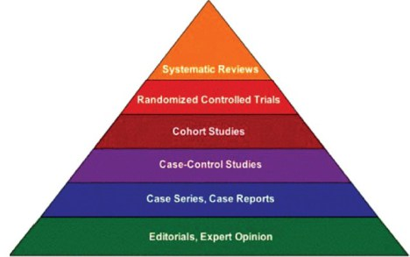
Writing a Systemic Review

Slide 20
Structure / heads of the Article
Title page & Summary
Introduction
Methods for systematic review
Results
Discussion
Conclusions
Acknowledgements
Conflicts of Interests Statement
References

Slide 21
Title page & Summary
Title
Author
Summary
Overview of the review including a statement, or more from each section.
Strong emphasis on findings or conclusions
Keywords

Slide 22
Introduction
Put your research into context
Consider it a standard literature review
Include any theoretical understanding required to understand the article.
State the scale and scope of the review.
Develop the specific research question.

Slide 23
Methods
Strategies and procedures for searches
Inclusion / exclusion criteria
Data Analyses
Summary of studies found
Categorisation of studies – including heirarchy structure.
Coding of findings into defined categories

Slide 24
Results
Summary of studies meeting the inclusion criteria.
Table summarising finding of key studies (each of these should directly be considered in the discussion).
Descriptive overview of the studies fulfilling inclusion criteria.
Further description of categorisation of studies.

Slide 25
Discussion
Evaluation and interpretation of the information collected leading to main finding/s.
Implications of the findings
Methodological challenges
Limitations of the review
Compelling questions and directions for future studies.

Slide 26
Conclusions
Main findings and implications
Main questions for further research / evaluations

Slide 27
Acknowledgements
Key contributors, other than you, to the research.
Anyone you would like to thank i.e. reader, helpers collecting research etc.

Slide 28
Conflicts of interest
No conflict of interest was declared.

Slide 29
References
Cite them Right

