Slide 1
MSc
Policing (O&SL)
11.12.24
Time management
MSc Plismona (AW&S)
11.12.24
Rheoli Amser

Slide 2

Time Management
Learning outcomes
Outline the benefits of time management
Identify the obstacles to time management
Suggest ways of addressing time-management obstacles

Slide 3

Time management for your dissertation
Notes:
Being able to manage your time to fit in everything is important – you may have to juggle commitments with family, friends or with your employers
But it is important that you have time planned for your studies and meeting deadlines associated with the dissertation module.
What you accomplish during a 24-hour period, a week or a month depends on your own motivation, your energy, your skills and abilities, and other resources.
Since there are always demands on your time, it may be helpful to think about what you will do with your time and to consider some strategies for more effective time management.
Time management is not a way to make you work harder and longer, but a means to help you work smarter to accomplish your work more easily and rapidly
Start to think about How will you manage your time over the next 7 months? Have you thought of any strategies to date?
Or What works best for you?

Slide 4
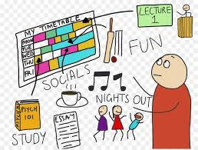
Organising yourself for study
1st important step - may seem obvious but often overlooked:
Suitable place
Suitable environment
Time management (when to study)
Organise your material
Support network
Notes:
Start very basic by organising yourself for the 7 months ahead.
How do you organise yourself with regards to your studying – you’ve done it over the last two years so use what worked best for you
Everyone is different!

Slide 5
Time-line - Deadlines
October 2024 – start Module
December 4 2024
Proposal submission
July 4th 2025
Submission deadline
Exam board
September 2025
Graduation
November 2025
Notes:
Know your deadlines.
For this module – you have only 2 key dates – one of which is this week and you are all on track to meet that one.
Your next big date is in 7 months time – so ist never too late to start thinking and planning that time around family events, holidays, social events, work, courses etc.

Slide 6
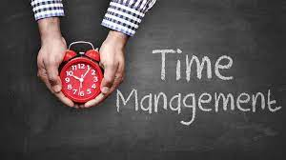
Benefits of time -management
Efficient
Success
Healthier
Notes:
So lets start by thinking about the benefits of time management – what do you think they are?
If you can manage your time more effectively, you will be rewarded in a variety of ways:
You will be more efficient in your studies and working environment
You will achieve greater success in your studies and working environment
On a personal level, you will certainly feel healthier, more energetic, and in a generally better mood as you will not be stressed
Examples from class

Slide 7

Obstacles to Time-management
Unclear objectives
Disorganised
Inability to say ‘NO’!
Interruptions
More interruptions
Inactivity
Too many things at once
Stress & tiredness
All work & no play
Notes:
There are a lot of things that make it difficult for us to manage our time effectively. Let’s consider some of the most common ones, and see if they apply to us:
Unclear objectives – It’s hard to hit a target with your eyes closed, and it’s just as hard to accomplish something when you aren’t exactly clear about what you want to achieve – so setting yourself some clear objectives will help you
Disorganisation – It’s easy to see when your desk is too messy, but sometimes you must step back and ask yourself if you are taking an organized approach in completing all of your tasks
Inability to say “no” – We all want to be as helpful as we can when others need us, but this can mean taking time away from other priorities to do something we may not have planned
Interruptions – Many times we are in the middle of accomplishing something important and the telephone rings. These calls not only take you away from your task, but sometimes they interrupt your train of thought and you can’t return to where you were without retracing your steps
More interruptions – We all like to visit with others, but conversations at inappropriate times can cost us time when we have to stop what we are doing and redirect ourselves from our plans
Periods of inactivity – As much as we think we are busy, there are times in our day when we are not really doing anything. Recognizing and making use of these times can have a positive effect on our efforts
Too many things at once – Many of our tasks are not routines. They require concentration to detail. When we are attempting to do too many different things at one time, each individual task suffers as a result
Stress and fatigue – Everyone experiences stress from time to time, and sometimes we actually operate a little better when there is some level of stress. Too much stress, on the other hand, causes our work to suffer and wears us down physically and mentally. Dealing with stress is an important part of time management
All work and no play – Most successful people know how to balance work and play. When work takes over your life, you not only give your body little time to re-energize, but you may end up sacrificing the important things in life like family and friends

Slide 8

What can we do?
Recognise that obstacles exist
Identify them
Strategies to overcome them
Notes:
So what can we do to overcome them?
1. Recognise that obstacles exist – The obstacles that we face are not insurmountable. Sometimes, the hardest thing to do is to identify that these obstacles exist and are affecting your ability to manage your time
2. Identify them - When you have identified your obstacles you can begin to overcome them
3. Think of strategies that will help us to overcome them – what strategies do you use?

Slide 9
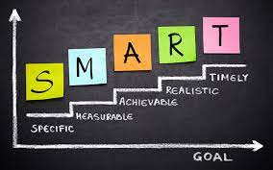
1. Set Goals
S – specific
M – measurable
A – achievable
R – realistic
T - timely
Notes:
The first, and most important strategy you can employ to manage your time is to set clear goals for yourself – you are all familiar with the SMART model within your professional roles and you can use this now to help you over the coming months.
You will want to, or may have to accomplish many things in your time over the next months . The best favor you can do for yourself is to determine what those goals are and make sure your efforts are always directed toward their achievement.
Effective goals share several characteristics in common. Effective goals are:
Specific – When a goal is too vague, you may never know how to reach it or even when you have reached it. Make sure that you know exactly what you hope to achieve
Measurable – When you have a goal that is measurable, you will know how far you must go to reach the goal, and when you know that you have arrived there
Achievable – It is common to set your sights high, but sometimes we try to accomplish more than we can do. Trying to complete your dissertation within a few weeks is challenging when you have nothing else to do, but working full time with family/caring responsibilities etc may make it difficult for a number of reasons, so breaking it down into achievable chunks would be better in the long run. Your goals should be such that, if you “extend yourself” you can just reach them.
Realistic – be realistic with regards to your time – make sure that you balance your studies alongside all your other commitments. Think about things like is it realistic to do all your interviews or focus groups in one day? ( from experience its hard going!)
Timely - Most of the goals that you set for yourself in relation to your dissertation will not be long-term. It is important to set time guidelines for your goals, so that you can keep track of your progress as you are going along and can be alert to when you are falling behind schedule. You have all produced a time line for your dissertation proposals - USE this as a framework for your goals and what you want to achieve at set times in the next 7 months.
When I did my masters – I sat down with a pen and paper and wrote down all the personal commitments I had during that period. I mapped them out on a table and then used a diary to highlight my days off from work, my a/l, any courses I had any major events with work etc. It was an exercise worth doing. I then looked to see where I could fit in my studies. Each week I’d review it. Especially the last 6 week. I planned out exactly what I would do It worked for me and I still use that system.

Slide 10
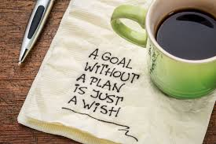
2. Prioritise
Address the urgent
Accomplish what you can early
Attach deadlines to the things that you delay
Notes:
It is important when you have prioritised your tasks that you:
Address the urgent – Take care of things with short-term consequences as soon as possible. ( e.g. getting your questionnaires written up/interview questions, documenting any consents required
Accomplish what you can early – requests that can be handled early should come next – getting your questionnaires out, getting interviews/focus groups in the diary Don’t put off until tomorrow what you can do today. Think of tasks that you can do whilst waiting for data to come back to you?
Attach deadlines to things you delay – When you have determined that something can wait, don’t just toss it aside until later. Establish a deadline for the task in your schedule and make a note to remind you to begin working on it.
Don’t forget the 20/80 rule - 20% of your tasks will take 80% of your time

Slide 11
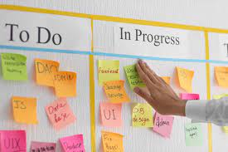
3. Organise
Calendars
Lists
Charts
whiteboard
Pen& paper
What suits you is the best way
Notes:
As you start to prioritise tasks and set deadlines, you will want to organise your plans and actions.
How you do this will come down to personal choice
There are lots of tools available to you.
Teams schedule
Outlook calendar
Lists
Ghantt charts
Whiteboards
Sticky notes
Old fashioned pen & paper
What ever suits you – use it!
What do you use now in your day job and can it be adapted for your studies?
I use pen and paper and my Teams schedule – it served me well during my MA and I use the same methods now whilst I am studying.
Note: This would be a good opportunity to share whatever tools you use to stay organized. If you use a planner, bring it out and show how you use it. If you use computer software, explain the program and how it helps you. You may also ask participants if they have any other organizational ideas, like reminder files for each week or month.

Slide 12

4. ‘Waiting Time’
Commuting
Personal family commitments
Early to work/meetings
Notes:
Another personal time management skill is to make good use of your “waiting time.”
Have you ever thought about how much time you spend doing nothing during an average day? Usually this is not a situation where you planned to do nothing…it just happened. Think about all the things you could accomplish if you could make use of this time. For instance:
Time you spend commuting to meetings on a train
Time you wait at personal appointment/family commitments – waiting o/s school
Time you spend when you arrive at work or at a meeting earlier than you had anticipated
There are two ways to look at these periods of time. You can either consider them as “wastes of time” or as “gifts of time.” If you choose to think of them as gifts of time, you can use them as opportunities to accomplish little reading tasks/writing notes that are necessary, but don’t require longer periods of time.
I carried a little note book with me – any ideas that came into my head I’d write them down – use your mobile phones ! If you’ve downloaded the Hwb app you can access library lists and can read on your phone. Listen to podcasts or audible books in the car when travelling to work etc.
Most successful people have already found that there are a number of things that they can accomplish while they wait.

Slide 13

5. Concentrate on the ‘task in hand’
Concentrate on current task:
Focus on your goal ( one at a time)
Minimise interruptions ( where possible) – but don’t isolate yourself all the time.
Notes:
You will be juggling many tasks. There is no way around this fact. But one important strategy to keep in mind is to concentrate completely on the current task. Concentration can be difficult when you have a lot on your mind. Your time will be better spent if you are able to:
Focus on your goal – You may have many commitments and many concerns, but you will accomplish more when you keep focused on the one task you are performing now
Tune out interruptions – You will find your concentration is at its highest level when you can set aside times during the day when you will not answer the phone or schedule visitors. You can’t isolate yourself all the time, but by avoiding interruptions for specific periods of time, you may find you can accomplish tasks successfully in far less time than you anticipated. When you must respond to phone calls, be assertive in minimizing interruptions by asking if you can call back at another time or meet another day.

Slide 14

6. Your ‘prime time’
Early morning
Evening
Late at night
Notes:
Every one of us has a ‘personal prime time’ – that time of day where you function the best , get your tasks done quickly
E.g. Are you one of those people who gets up before the sun rises and starts working? Is the early evening, after the evening meal, your time to work? Or are you someone who prefers to wait until the quiet of the late-night hours to do the hard tasks?
Everyone is different. Most research shows that tasks that take the most mental concentration are most effectively accomplished early in the day, but even these studies acknowledge that this is not always true”
When you plan your tasks, think about your own “prime time.” If you do your best work early, plan to do the routine tasks later in the day and concentrate on the more challenging tasks when you are at your best. If you don’t really get going until later, handle the routines in the morning and save the more difficult tasks for later.

Slide 15
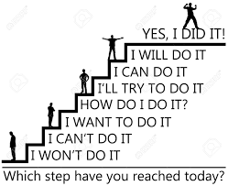
7. Celebrate success
Celebrate the achievement of your goals to maintain a healthy balance in life between work and play
Reward yourself when you complete a task
Time well spent!
Notes:
Celebrate the achievement of your goals to maintain a healthy balance in life between work and play.
Reward yourself when you complete a task or finish a project.
Celebration is a vital part of this process. No matter how tight your schedule looks, this is TIME WELL SPENT! As it will keep you motivated

Slide 16

Schedule for next 7 months
Suggested work to be completed and word counts

Slide 17
 | MSc Dissertation supervision - time-table October 2024 - July 2025
 | October | November | December | January | February | March | April | May | June | July
3hr lesson | *Intro to Dissertation *Research proposal *Literature review | *Methodology 1 *Formulating Research Q | * Methodology 2 *Supervision & time management | *Research Ethics *insider Research | *Analysis 1 & 2 | *writing up the dissertation * Introduction, abstract & conclusion | *Final document structure |  |  | Dissertation submission : Friday 4th July 2025 23:59hrs
1hr Group supervision x 6 |  |  | 1hr Advances Library research skills | 1hr Critical reading & writing | 1hr Referencing & Plagiarism | 1hr academic writing | 1hr academic editing | 1hr - open
1 to 1 supervision ( 4 hours max) |  | 30mins |  | 30mins | 15mins | 15mins | 30mins | 2 x 30mins | 2 x 30 mins
Work to be completed *suggested work to be completed (& word count) | Choosing research topic | * Proposal & Ethics form - draft | Research Proposal & ethics form to be submitted by 23:59hrs 04/12/24 | * Introduction (2000) & Literature review (4000) | *Literature review (4000) | *Methodology (2500) | *Methodology (2500) & Analysis (4000) | *Analysis (4000) | *Conclusion (2000) & abstract (750) | Final Formatting & editing

Slide 18
Activity Breakdown
November – Draft proposal
December – Proposal/Ethics submitted
January – Introduction/ Literature Review
February – Literature Review
March - Methodology
April – Methodology/Analysis
May - Analysis
July – Formal formatting & editing - submission
June – Conclusion/Abstract

Slide 19
Suggested Wordcount (+/-10%)
Suggestion 1 -
Abstract – 500 words
Introduction – 1750
Literature Review – 4250
Methodology – 2500
Analysis – 4250
Conclusion – 1750
Total - 15000
Suggestion 2
Abstract – 750 words
Introduction – 2000
Literature Review 4000
Methodology – 2500
Analysis – 4000
Conclusion – 2000
Total : 15000

Slide 20
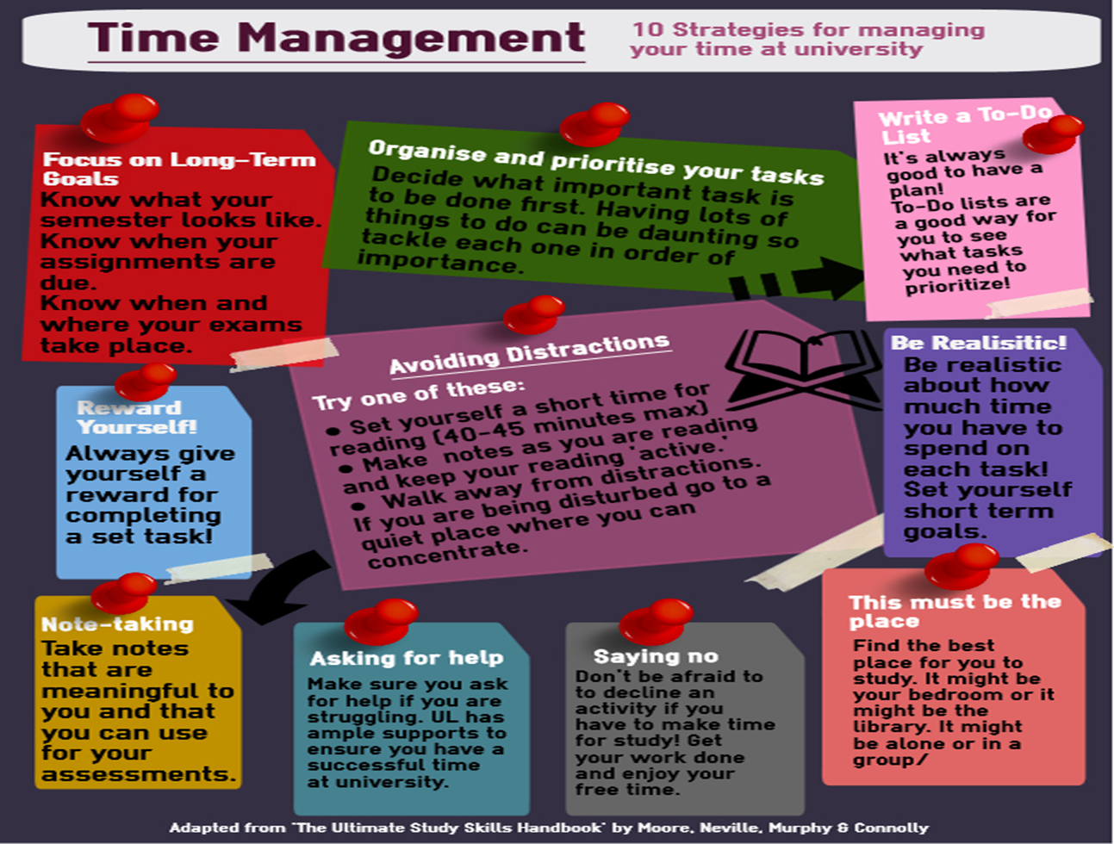
Notes:
Lots of tools and information on internet
DO WHAT SUITS YOU!

Slide 21


