Slide 1

Population Health and Digital Health Promotion
DiaBand UK App: A Wearable Digital Health Intervention for Adults Aged 25–65 Years in the United Kingdom
STUDENT’S NAME | STUDENT ID | TASK
Hetalben Patel | 2508644 | Introduction and Justification (Task 1)
Darshankumar Patel | 2515501 | Application (Task 2)
MD Aseiqur Rahaman | 2524402 | Barriers (Task 3)
Vignesh Kalsariya | 2525353 | Benefits (Task 4)
Acknowledgement of the use of AI tools
I confirm that I have not used any AI tools in the research and creation of this assignment. I confirm that I have not presented any AI-generated materials as my own work. I confirm I have copies of my drafts, notes, and other resources I used, which I may be asked to provide in evidence

Slide 2

TASK 1: Introduction and Justification
Name :Hetalben Sandipkumar Patel
Student Id :2508644

Slide 3
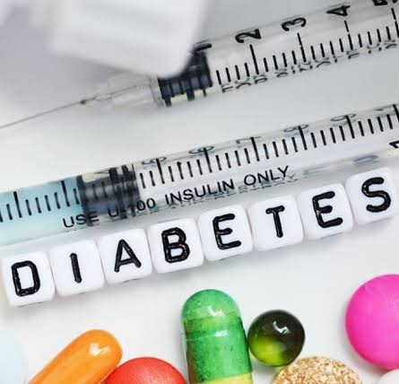
OVERVIEW
Target Group: Adults aged 25–65 years living with or at risk of Type 2 Diabetes Mellitus.
Setting: Community and primary healthcare settings across the United Kingdom.
Public Health Problem: Rising prevalence of Type 2 Diabetes Mellitus due to obesity, physical inactivity, unhealthy diet, and sedentary lifestyles.
(Healthline, 2026)

Slide 4
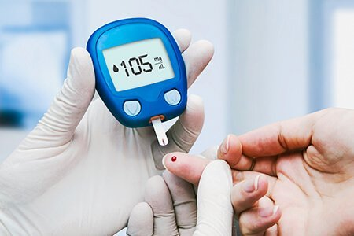

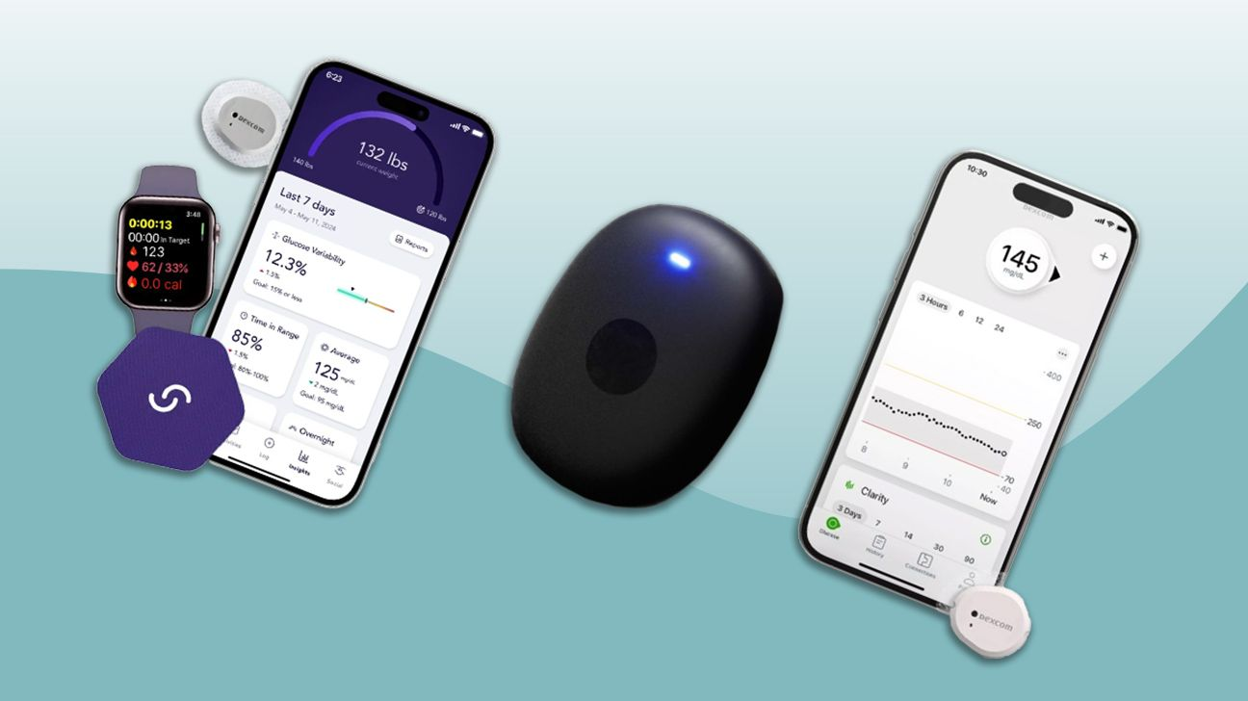
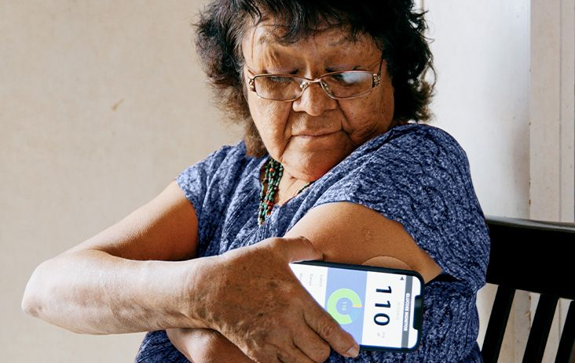
(Times of India, 2020)
(Dr Shubhashree Patil, 2025)
(Eileen Bailey, 2024)
(Healthline, 2026)

Slide 5
Introduction
Type 2 Diabetes Mellitus is one of the fastest-growing long-term conditions affecting adults in the United Kingdom (Zghebi et al, 2026).
Many cases are preventable through healthy lifestyle behaviours, early detection, and regular self-management (Zghebi et al, 2026).
Digital health technologies provide personalised support to improve physical activity, nutrition, medication adherence, and blood glucose monitoring (Kerr et al, 2024).
DiaBand UK mobile app combines artificial intelligence and wearable technology to encourage healthier behaviours and reduce diabetes-related complications.

Slide 6

Aim
To improve diabetes prevention and self-management among adults aged 25–65 years in the United Kingdom by using an AI-powered wearable device and mobile application that promote healthy lifestyle behaviours, personalised monitoring, and continuous digital support.
(Dreamstime, 2026)

Slide 7
Activities
Personalised Health Assessment: AI evaluates diabetes risk and creates individual health goals.
Physical Activity Challenges: Daily step targets and exercise programmes encourage active lifestyles.
Healthy Eating Support: Meal planning, barcode scanning, and nutrition advice promote healthier food choices.
Self-Monitoring and Feedback: Wearable technology tracks health indicators and provides real-time progress updates.
Health Education and Motivation: Interactive learning modules, reminders, and reward badges improve engagement and self-management.

Slide 8
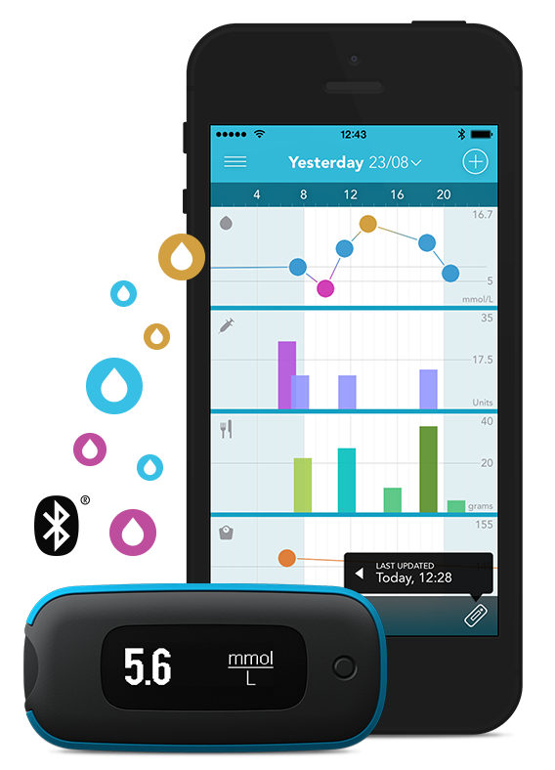
DiaBand UK App
DiaBand UK is an AI-powered digital health application integrated with a smart wearable device to support diabetes prevention and self-management through personalised monitoring, behaviour change, and real-time health feedback.
Key Features
AI Health Coach: Provides personalised lifestyle recommendations based on user data.
Smart Wearable Monitoring: Tracks physical activity, heart rate, sleep quality, and integrates with glucose monitoring devices.
Medication and Appointment Reminders: Supports treatment adherence through timely notifications.
Healthy Meal Planner: Offers personalised meal plans, calorie tracking, and healthy recipe suggestions.
Activity Tracker: Monitors daily steps, exercise duration, and calories burned.
Progress Dashboard: Displays health trends, personalised goals, and weekly performance reports.
Gamification: Rewards healthy behaviours with achievement badges and wellness challenges.
NHS Resource Hub: Provides reliable educational resources and self-management guidance linked to NHS recommendations.
(Li et al, 2026; Pektaş et al, 2021)
(AagMatrix, 2026)

Slide 9


Slide 10
Why Diabetes Mellitus ?
Type 2 Diabetes Mellitus (T2DM) is one of the fastest-growing long-term conditions in the UK and a major public health priority (Zghebi et al, 2026).
Around 5.8 million people in the UK are living with diabetes, with approximately 1.3 million people having Type 2 diabetes (NHS Foundation Trust, 2025).
Rising obesity, unhealthy diets, physical inactivity, and sedentary lifestyles continue to increase diabetes prevalence (Chatterjee et al, 2018).
Early prevention and effective self-management can reduce complications, improve quality of life, and lower NHS healthcare costs (Chatterjee et al, 2018).

Slide 11

Why Adults Aged 25–65 Years?
Adults aged 25–65 years represent the population at greatest risk of developing Type 2 diabetes due to modifiable lifestyle factors (Bellou et al, 2018).
This age group is more likely to experience obesity, physical inactivity, work-related stress, and poor dietary habits (Davies et al, 2026).
Many individuals remain undiagnosed until complications develop, making early intervention essential (Bellou et al, 2018).
Adults aged 25–65 years are frequent users of smartphones and wearable technology, making digital health interventions highly accessible and effective (Davies et al, 2026).
(Doral Health, 2026)

Slide 12
National Guidelines and Research Support
NICE Guideline recommends structured education, personalised self-management, and lifestyle modification for adults with Type 2 diabetes (Williams et al, 2022).
The NHS Long Term Plan promotes digital healthcare and technology-enabled services to improve prevention and long-term condition management (Williams et al, 2022).
The NHS Diabetes Prevention Programme (Healthier You) encourages behaviour change to reduce the risk of developing Type 2 diabetes (Ross et al, 2022).
Recent research shows that digital health applications and wearable devices improve physical activity, medication adherence, glycaemic control, and patient engagement (Ross et al, 2022).

Slide 13
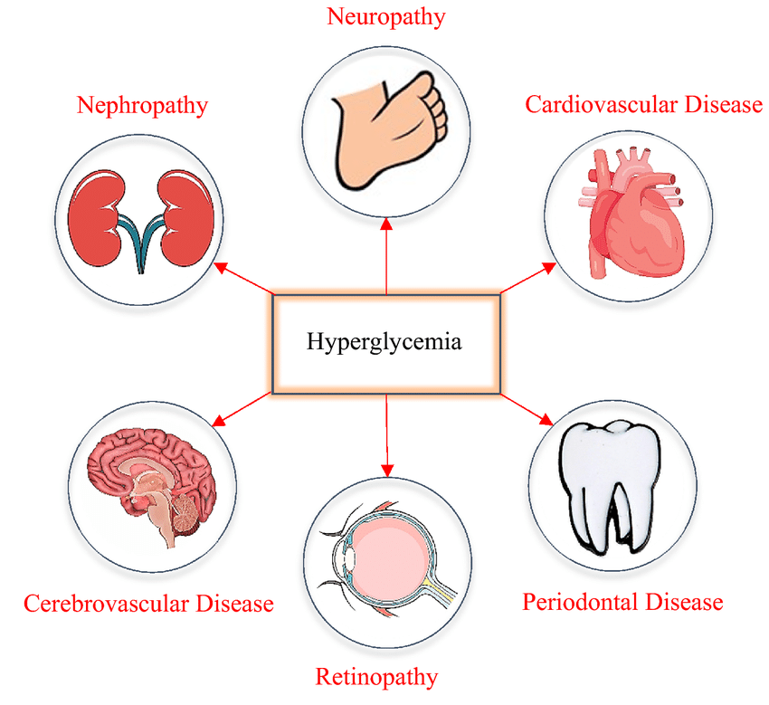
Consequences of Not Addressing Diabetes
(Maneze et al, 2019)

Slide 14
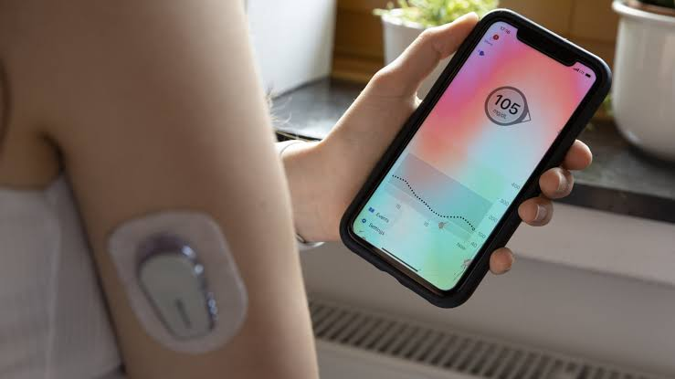
Why Choose DiaBand UK App?
Combines AI, wearable technology, and personalised coaching to support behaviour change.
Enables continuous monitoring of physical activity, sleep, heart rate, and glucose (where compatible with continuous glucose monitors).
Delivers real-time feedback, reminders, and educational resources to improve self-management.
Aligns with UK digital health priorities by promoting prevention, early intervention, and patient-centred care.

Slide 15
TASK 2: APPLICATION
Name :Darshankumar Sureshbhai Patel
Student Id : 2515501

Slide 16
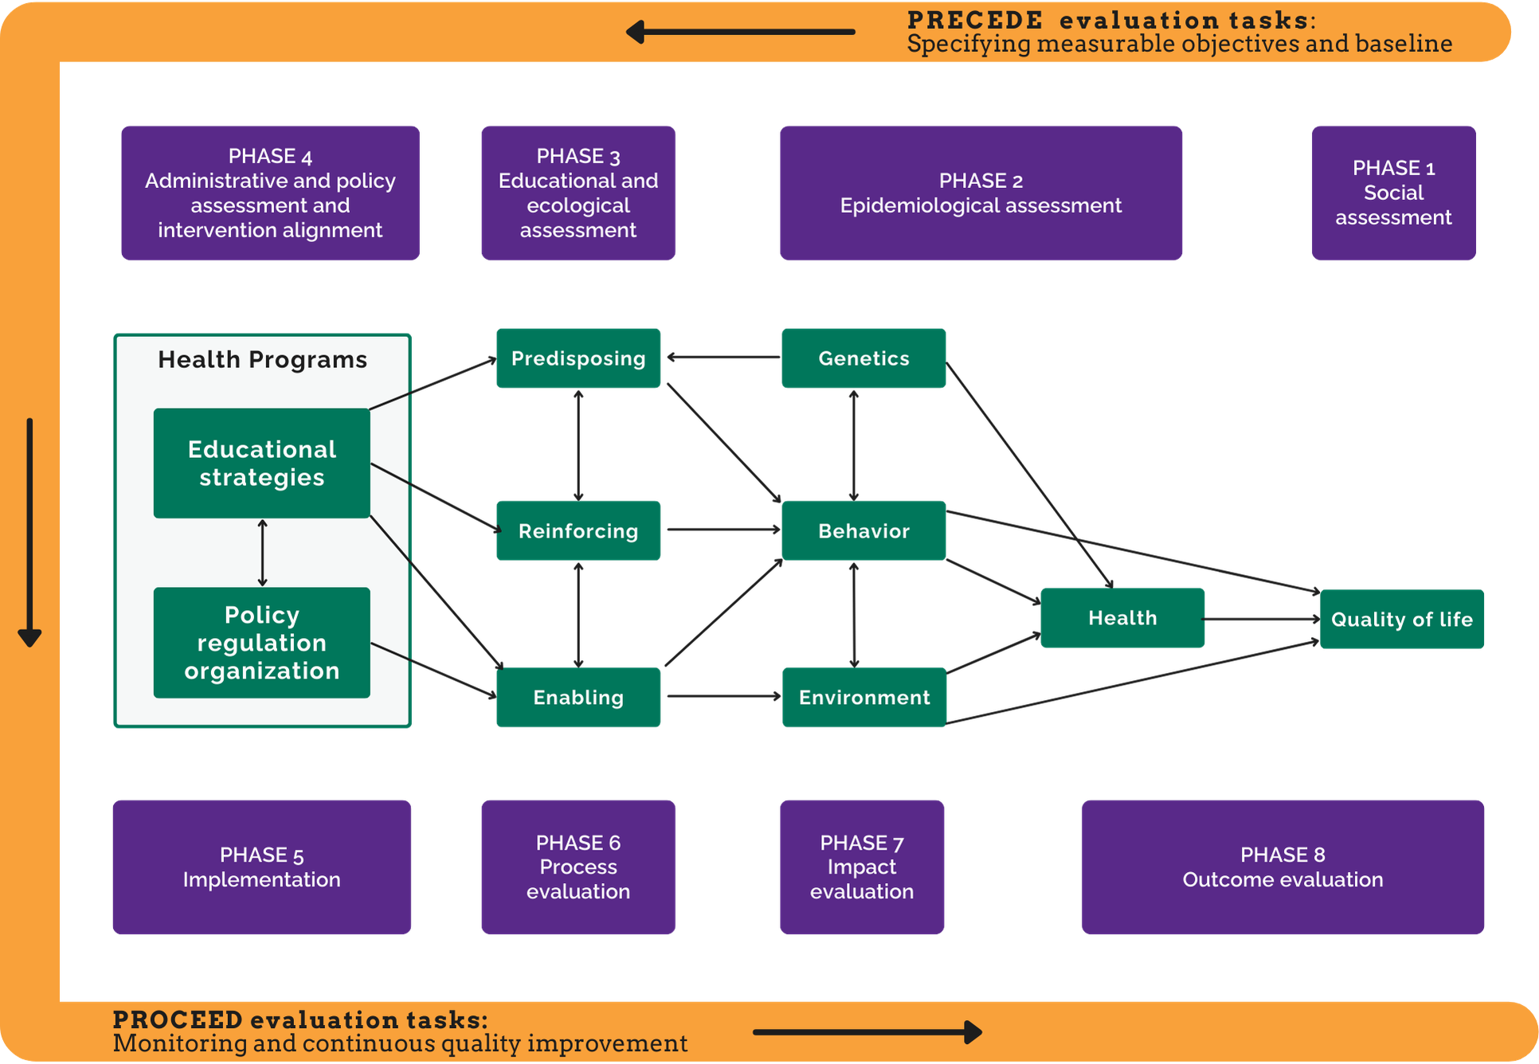
Chosen Planning Model: PRECEDE-PROCEED Model
The PRECEDE–PROCEED Model is a comprehensive health promotion planning framework that guides the systematic assessment, design, implementation, and evaluation of interventions to improve health outcomes.
(Kreuter et al, 2005)

Slide 17
PRECEDE-PROCEED Model
PRECEDE Phase 1: Social Assessment
Application to DiaBand UK
Identify how Type 2 diabetes affects the quality of life of adults aged 25–65 years in the UK (Tarver-Grover, 2017).
Gather community feedback on barriers to healthy eating, physical activity, and diabetes self-management (Omolade et al, 2022).
Explore users' preferences for digital health technologies and wearable devices (Tarver-Grover, 2017).
Use the findings to design an intervention that meets users' lifestyle and health needs (Omolade et al, 2022).

Slide 18

Phase 2: Epidemiological Assessment
Analyse UK data on Type 2 diabetes prevalence, obesity, and physical inactivity (Gold, 2022).
Identify adults aged 25–65 years as the priority population due to their higher risk of developing Type 2 diabetes (Gold, 2022).
Determine key health outcomes, including reducing HbA1c levels, obesity, and diabetes-related complications (Tang et al, 2025).
Establish measurable health objectives to guide the intervention (Tang et al, 2025).
(Future Learn, 2026)

Slide 19

Phase 3: Educational and Ecological Assessment
Identify predisposing factors, including limited knowledge and low motivation for healthy lifestyle behaviours (Nejhaddadgar et al, 2019).
Assess enabling factors, such as access to smartphones, wearable devices, and NHS digital services (Nejhaddadgar et al, 2019).
Identify reinforcing factors, including AI coaching, family support, healthcare professional feedback, and reward systems (Azar et al, 2017).
Design personalised education and behaviour change strategies within the DiaBand UK app (Azar et al, 2017).
(Shuterstocks, 2026)

Slide 20

Phase 4: Administrative and Policy Assessment
Ensure the intervention aligns with NICE guidance, the NHS Long Term Plan, and the NHS Diabetes Prevention Programme (Azar et al, 2017).
Assess funding requirements, digital infrastructure, staffing, and wearable technology availability (Tang et al, 2025).
Develop partnerships with GPs, diabetes specialist nurses, pharmacists, dietitians, and community organisations (Lei et al, 2025).
Provide training for healthcare professionals to support users in adopting the intervention (Azar et al, 2017).
(OECD, 2020)

Slide 21

Phase 5: Implementation
Introduce the DiaBand UK app and wearable device through GP practices, community health centres, and NHS diabetes services (Lei et al, 2025).
Register eligible adults aged 25–65 years and provide personalised onboarding and training (Nejhaddadgar et al, 2019).
Deliver AI-powered health coaching, physical activity tracking, nutrition guidance, medication reminders, and educational content (Nejhaddadgar et al, 2019).
Encourage continuous engagement through goal setting, progress monitoring, and digital reward challenges (Lei et al, 2025).
(IBM, 2020)

Slide 22
Phase 6: Process Evaluation
Monitor the number of app downloads, wearable registrations, and active users (Tarver-Grover, 2017).
Assess participation in physical activity challenges and educational modules (Tarver-Grover, 2017).
Collect user feedback on usability, accessibility, and satisfaction (Tang et al, 2025).
Identify implementation challenges and make improvements where required (Azar et al, 2017).
Phase 7: Impact Evaluation
Measure improvements in physical activity, healthy eating, and medication adherence (Tang et al, 2025).
Assess changes in diabetes knowledge, self-management skills, and confidence (Tang et al, 2025).
Evaluate user engagement with AI coaching and wearable monitoring (Lei et al, 2025).
Determine whether short-term behaviour change objectives have been achieved (Lei et al, 2025).

Slide 23

Phase 8: Outcome Evaluation
Evaluate reductions in HbA1c levels and diabetes-related complications (Gold, 2022).
Assess improvements in quality of life and long-term self-management (Omolade et al, 2022).
Measure reductions in hospital admissions and NHS healthcare costs (Gold, 2022).
Use the findings to inform future digital diabetes programmes, policy development, and service improvement (Omolade et al, 2022).
(Rachal Ramirez, 2020)

Slide 24
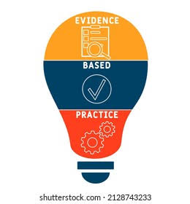
Why the PRECEDE-PROCEED Model?
Provides a systematic, evidence-based framework to assess health needs, plan, implement, and evaluate digital health promotion interventions (Cho et al, 2018).
Focuses on behavioural, environmental, and social factors influencing Type 2 diabetes, enabling tailored strategies for adults aged 25–65 years (Khademi and Kaveh, 2025).
Supports stakeholder involvement and continuous evaluation, ensuring the DiaBand UK intervention is effective, sustainable, and aligned with UK public health priorities (Khademi and Kaveh, 2025).
(European Research, 2026)

Slide 25

TASK: 3BARRIERS
Name : md Aseiqur Rahaman
Student id : 2524402

Slide 26

Potential Stakeholders for Implementation and Delivery
1. NHS and Primary Care Services
GP practices and primary care teams can identify eligible adults aged 25–65 years and refer them to the DiaBand UK mobile app.
NHS services can monitor patient progress and integrate digital health data into routine diabetes care (Leersum et al, 2024).
2. Healthcare Professionals
Diabetes specialist nurses, dietitians, pharmacists, and physiotherapists can provide personalised education and ongoing clinical support through the DiaBand UK app.
Healthcare professionals can use app-generated data to guide treatment decisions and encourage self-management (Gervilla-García et al, 2026).
(Technology Advice, 2026)

Slide 27
3. Community and Voluntary Organisations
Organisations such as Diabetes UK and local community groups can promote the DiaBand UK app and improve participation.
Community programmes can support healthy lifestyle activities and increase engagement among diverse populations (Modave et al, 2016).
4. Technology Partners and Employers
Digital health developers and wearable technology providers can maintain the DiaBand UK app, ensure interoperability with the DiaBand wearable, and provide technical support.
Employers can promote workplace wellbeing initiatives and encourage employees to participate in the intervention (Gervilla-García et al, 2026).

Slide 28

Potential Barriers to Successful Implementation
Limited Digital Literacy
Some adults may have difficulty using the mobile app and wearable device due to limited digital skills (Kruse et al, 2019).
Cost of Wearable Devices
The purchase and maintenance costs of wearable technology may reduce accessibility for low-income populations (Chong et al, 2025).
Privacy and Security Concerns
Concerns about the collection, storage, and sharing of personal health data may discourage user participation (Thies et al, 2017).
(Mac Fadden, 2025)

Slide 29
Low User Engagement
Maintaining long-term motivation and regular use of the app may be challenging for some individuals (Thies et al, 2017).
Technology and Internet Access
Limited internet connectivity or incompatible smartphones may restrict access to the intervention in some communities (Chong et al, 2025).
Healthcare Workforce Capacity
Healthcare professionals may require additional training, resources, and time to effectively support and monitor digital health interventions (Kruse et al, 2019).

Slide 30

Other barriers
Language and Cultural Barriers: The app may not fully meet the needs of people with different languages, cultures, or health beliefs (States, 2026).
Health Inequalities: Individuals from deprived communities may have less access to smartphones, wearable devices, or digital health services (LeSeure et al, 2024).
Accessibility Issues: People with visual impairments, hearing impairments, or other disabilities may require accessible design features (States, 2026).
User Trust in AI: Some users may be hesitant to rely on AI-generated health advice without reassurance from healthcare professionals (LeSeure et al, 2024).
Funding and Sustainability: Long-term funding is needed to maintain the app, update software, and provide technical support (LeSeure et al, 2024).
(Shutterstocks, 2026)

Slide 31
Legal and Ethical Issues
Data Protection: Personal health data collected through the DiaBand UK app and wearable, including activity, heart rate and glucose-related data, must be collected, stored, and shared securely in accordance with the UK GDPR and Data Protection Act 2018 (Rose et al., 2019).
Informed Consent: Users must clearly understand what information the DiaBand UK app and wearable collect, how it will be used, and who can access it before giving informed consent (Rothstein et al., 2020).
Confidentiality and Cybersecurity: Health information transmitted between the DiaBand wearable, mobile app, and healthcare professionals should be encrypted and accessible only to authorised users (Adu et al., 2018).
Equity and Accessibility: The DiaBand UK app and wearable should be affordable, accessible, and easy to use for people with different levels of digital literacy, disabilities, language needs, and socioeconomic circumstances (Rothstein et al., 2020).

Slide 32

Accuracy and Safety of AI: AI recommendations generated from DiaBand wearable and app data should be clinically validated, regularly reviewed, and used to support rather than replace professional clinical judgement (Adu et al., 2018).
Transparency and User Autonomy: Users should understand how DiaBand UK analyses wearable data and generates personalised recommendations, while retaining control over their health information and healthcare decisions (Rose et al., 2019).
Professional Accountability: Healthcare professionals should review information generated by the DiaBand app and wearable alongside clinical assessments and remain responsible for clinical decisions (Rothstein et al., 2020).
(Morris James, 2026)

Slide 33
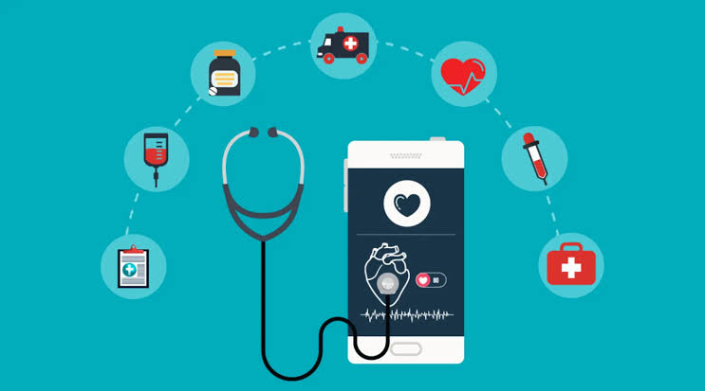
Task: 4 Benefits
Name : Vignesh Kalsariya
Student Id :2525353

Slide 34
Potential Benefits of DIABAND UK (Individual benefits)
Encourages healthier lifestyle behaviours through personalised AI coaching and daily reminders (Bonoto et al, 2017).
Improves self-management by enabling users to monitor physical activity, sleep, heart rate, and glucose levels (Brzan et al, 2016).
Promotes medication adherence through automated reminders and appointment notifications (Brzan et al, 2016)
Supports healthier eating with personalised meal planning and nutrition guidance (Wu et al, 2017).
Provides real-time health feedback to help users make informed lifestyle decisions (Bonoto et al, 2017).
Increases motivation through goal setting, progress tracking, and reward-based challenges (Wu et al, 2017).
Improves diabetes knowledge using interactive educational resources (Brzan et al, 2016)
Enhances users' confidence and independence in managing their long-term condition. (Bonoto et al, 2017).

Slide 35
Potential Benefits of DIABAND UK (healthcare and community benefits)
Supports early identification of individuals at high risk of Type 2 diabetes (Hartz et al, 2016).
Reduces the likelihood of diabetes-related complications through continuous monitoring (Hartz et al, 2016).
Improves communication between patients and healthcare professionals using shared digital health data (Wang et al, 2019).
Decreases avoidable GP visits and hospital admissions through proactive self-management (Hartz et al, 2016).
Supports the NHS shift towards preventive and digitally enabled healthcare (Wang et al, 2019).
Reduces long-term healthcare expenditure associated with diabetes complications (Hartz et al, 2016).
Helps reduce health inequalities by increasing access to personalised digital support (Wang et al, 2019).
Encourages healthier communities through behaviour change and health promotion (Hartz et al, 2016).

Slide 36

Implications on Policies, Research, and Education
(Girish Shevade, 2022)
Implications for Health Policy
Supports the NHS Long Term Plan by promoting digitally enabled prevention and long-term condition management (Fleming et al, 2020).
Aligns with NICE recommendations on diabetes self-management, structured education, and personalised care (Jeffrey et al, 2019).
Contributes to national strategies that encourage the use of artificial intelligence and wearable technologies within healthcare (Fleming et al, 2020).
Supports government initiatives aimed at reducing obesity, improving population health, and tackling health inequalities (Fleming et al, 2020).
Demonstrates how digital innovation can strengthen sustainable healthcare delivery across the UK (Fleming et al, 2020).

Slide 37

Implications for Research
Provides opportunities to evaluate the long-term effectiveness of AI and wearable technology in diabetes prevention (Adu et al, 2018).
Generates real-world evidence on user engagement, behaviour change, and clinical outcomes (Adu et al, 2018).
Supports research into digital health literacy, health inequalities, and technology acceptance (Fleming et al, 2020).
Encourages future studies comparing AI-supported interventions with traditional diabetes education programmes (Fleming et al, 2020).
Informs the development of more personalised and evidence-based digital health interventions (Adu et al, 2018).
(Healthline, 2026)

Slide 38

Implications for Education
Improves public awareness of Type 2 diabetes prevention and healthy lifestyle behaviours (Fleming et al, 2020).
Enhances digital health literacy by teaching users how to effectively use health technologies (Adu et al, 2018).
Supports continuous patient education through interactive learning modules within the app (Adu et al, 2018).
Enables healthcare professionals to strengthen digital health competencies and deliver technology-supported care (Adu et al, 2018).
Encourages lifelong learning and self-management for people living with or at risk of diabetes (Fleming et al, 2020).
(Nova Science, 2024)

Slide 39
Future Development of DiaBand UK APP
Integrate continuous glucose monitoring (CGM) with real-time AI risk prediction (Potyok et al, 2024).
Expand compatibility with NHS electronic health records for seamless information sharing (Dankwa-Mullan et al, 2019).
Develop multilingual features to improve accessibility for diverse UK communities (Potyok et al, 2024).
Introduce personalised mental wellbeing support to address diabetes-related stress and anxiety (Potyok et al, 2024).
Incorporate predictive analytics to identify users at increased risk of complications (Dankwa-Mullan et al, 2019).

Slide 40
Sustainability and Future Implementation
Expand the programme across GP practices, community health centres, and workplace wellbeing services (Potyok et al, 2024).
Establish partnerships with NHS organisations, Diabetes UK, local authorities, and technology providers (Dankwa-Mullan et al, 2019).
Regularly update AI algorithms using emerging clinical evidence and user feedback (Dankwa-Mullan et al, 2019).
Ensure long-term funding through NHS digital innovation programmes and public health partnerships (Potyok et al, 2024).
Continuously evaluate outcomes to improve effectiveness and maintain user engagement (Dankwa-Mullan et al, 2019).

Slide 41
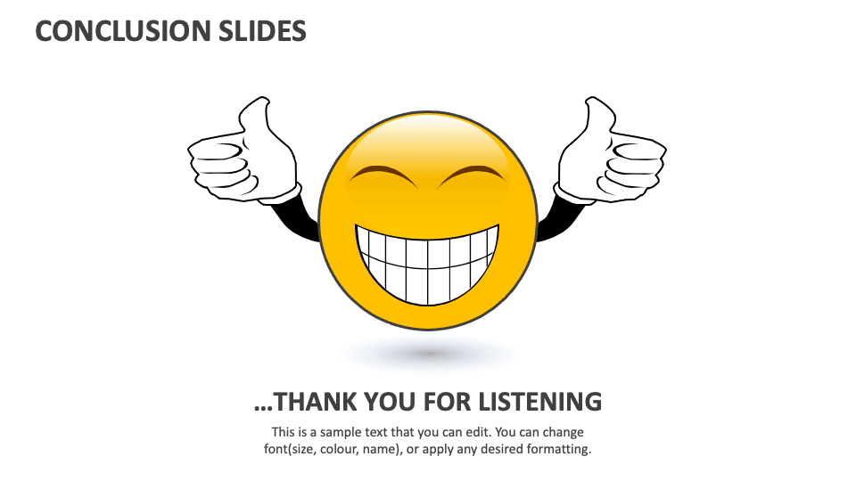
Conclusion
Type 2 diabetes remains a significant public health challenge among adults aged 25–65 years in the United Kingdom.
DiaBand UK combines artificial intelligence, wearable technology, and personalised health coaching to promote prevention and effective self-management.
The intervention supports healthier lifestyle behaviours, improves patient engagement, and aligns with current NHS and NICE priorities for digital healthcare.
Collaboration between healthcare professionals, policymakers, technology developers, and community organisations is essential for successful implementation.
Investing in innovative digital health interventions such as DiaBand UK has the potential to improve population health outcomes, reduce healthcare costs, and contribute to a more sustainable NHS.

Slide 42
REFERENCES
Bellou, V., Belbasis, L., Tzoulaki, I. and Evangelou, E., (2018). Risk factors for type 2 diabetes mellitus: an exposure-wide umbrella review of meta-analyses. PloS one, 13(3), p.e0194127. https://journals.plos.org/plosone/article?id=10.1371/journal.pone.0194127
Chatterjee, S., Davies, M.J., Heller, S., Speight, J., Snoek, F.J. and Khunti, K., (2018). Diabetes structured education programmes: a narrative review and current innovations. The Lancet Diabetes & Endocrinology, 6(2), pp.130-142. https://www.thelancet.com/journals/landia/article/PIIS2213-8587(17)30239-5/abstract
Davies, M.J., Lim, S., Slater, T., Goldney, J., Philis-Tsimikas, A., Franco, D.R., Lamptey, R., Yates, T., Tankova, T. and Lingvay, I., (2026). Type 2 diabetes mellitus. Nature Reviews Disease Primers, 12(1), p.13. https://www.nature.com/articles/s41572-026-00687-w
Kerr, D., Ahn, D., Waki, K., Wang, J., Breznen, B. and Klonoff, D.C., (2024). Digital interventions for self-management of type 2 diabetes mellitus: systematic literature review and meta-analysis. Journal of medical Internet research, 26, p.e55757. https://www.jmir.org/2024/1/e55757/
Li, J., Dong, W., Liu, S., Li, M., Chen, X., Chen, L., Wu, Y., Zhou, W., Ouyang, L., Tan, C. and Meng, H., (2021). Efficiency of an mHealth app and chest-wearable remote exercise monitoring intervention in patients with type 2 diabetes: a prospective, multicenter randomized controlled trial. JMIR mHealth and uHealth, 9(2). https://pdfs.semanticscholar.org/6e3e/cd96dec1bc182512af91eaef891d74690056.pdf
Maneze, D., Weaver, R., Kovai, V., Salamonson, Y., Astorga, C., Yogendran, D. and Everett, B., (2019). “Some say no, some say yes”: receiving inconsistent or insufficient information from healthcare professionals and consequences for diabetes self-management: a qualitative study in patients with type 2 diabetes. Diabetes research and clinical practice, 156, p.107830. https://www.sciencedirect.com/science/article/pii/S0168822719301676
NHS Foundation Trust (2025), https://www.wwl.nhs.uk/media/Research/WHCRF/2025%2005%20Locality%20Work%20and%20the%20Diabetes%20Programme%20Board.pdf
Pektaş, Ö., Köseoğlu, M., Muzny, M. and Hartvigsen, G., (2021). Design of an android wear smartwatch application as a wearable interface to the diabetes diary application. Academic Platform-Journal of Engineering and Science, 9(1), pp.126-133. https://dergipark.org.tr/en/pub/apjes/article/660490?issue_id=57735
Ross, J.A.D., Barron, E., McGough, B., Valabhji, J., Daff, K., Irwin, J., Henley, W.E. and Murray, E., (2022). Uptake and impact of the English National Health Service digital diabetes prevention programme: observational study. BMJ Open Diabetes Research & Care, 10(3). https://drc.bmj.com/content/10/3/e002736?trk=public_post_comment-text
Williams, D.M., Jones, H. and Stephens, J.W., (2022). Personalized type 2 diabetes management: an update on recent advances and recommendations. Diabetes, metabolic syndrome and obesity: targets and therapy, pp.281-295. https://www.tandfonline.com/doi/abs/10.2147/DMSO.S331654
Zghebi, S.S., Cotterill, S., Marsden, A., Paterson, L., Elliott, R.A., McMillan, B., Rutter, M.K. and Kontopantelis, E., (2026). Examining the uptake, retention, and effectiveness of a national online type 2 diabetes self-management intervention in England (Healthy Living): A retrospective cohort study. PLoS One, 21(6), p.e0348266. https://journals.plos.org/plosone/article?id=10.1371/journal.pone.0348266

Slide 43
References
Azar, F.E., Solhi, M., Nejhaddadgar, N. and Amani, F., (2017). The effect of intervention using the PRECEDE-PROCEED model based on quality of life in diabetic patients. Electronic physician, 9(8), p.5024. https://pmc.ncbi.nlm.nih.gov/articles/PMC5614287/
Cho, H., Porras, T., Baik, D., Beauchemin, M. and Schnall, R., (2018). Understanding the predisposing, enabling, and reinforcing factors influencing the use of a mobile-based HIV management app: a real-world usability evaluation. International journal of medical informatics, 117, pp.88-95. https://www.sciencedirect.com/science/article/pii/S1386505618301850
Gold, R.S., (2022). Applications in Communication Technology. Health Program Planning, Implementation, and Evaluation: Creating Behavioral, Environmental, and Policy Change, p.390. https://books.google.com/books?hl=en&lr=&id=OfZSEAAAQBAJ&oi=fnd&pg=PA390&dq=PRECEDE-PROCEED+Model+Application+to+diabetes+mobile+app++&ots=MYmR1A-CNr&sig=PjVRxEzak1NAxlMjV__Tb3sM8Ag
Khademi, K. and Kaveh, M.H., (2025). A pioneering health education strategy based on the PRECEDE-PROCEED model for women’s health challenges: a systematic review and logic framework. BMC Women's Health, 25(1), p.324. https://link.springer.com/article/10.1186/s12905-025-03883-0
Lei, A., Liao, X., Liu, L. and You, H., (2025). Mobile health management needs among infertile patients: a cross-sectional study based on the PRECEDE-PROCEED model. BMC Health Services Research, 25(1), p.1329. https://link.springer.com/article/10.1186/s12913-025-13538-3
Nejhaddadgar, N., Darabi, F., Rohban, A. and Solhi, M., (2019). The effectiveness of self-management program for people with type 2 diabetes mellitus based on PRECEDE-PROCEDE model. Diabetes & Metabolic Syndrome: Clinical Research & Reviews, 13(1), pp.440-443. https://www.sciencedirect.com/science/article/pii/S1871402118303278
Omolade, O., (2022). Digital Marketing and Brand Performance Analysis of Selected Diabetes Apps. https://www.theseus.fi/handle/10024/771152
Tang, Y., Soh, K.L., Gan, W.Y., Zhou, J. and Soh, K.G., (2025). The efficacy of PRECEDE-PROCEED model-based interventions on HbA1c and self-management in type 2 diabetes patients: a systematic review and meta-analysis. BMC Public Health, 25(1), p.1980. https://link.springer.com/article/10.1186/s12889-025-23073-9
Tarver-Grover, S., (2017). HEALTHEDASSIST©-DEVELOPING A FRAMEWORK FOR CREATING, USING AND EVALUATING A MOBILE HEALTH EDUCATION APP. FOR HEALTH EDUCATORS USING THE PREDISPOSING, ENABLING AND REINFORCING FACTORS OF THE PRECEDE MODEL. International Journal of Arts & Sciences, 10(2), pp.627-632. https://search.proquest.com/openview/358de258719f38c02f786767a1063f3e/1?pq-origsite=gscholar&cbl=626342

Slide 44
References
Adu, M.D., Malabu, U.H., Callander, E.J., Malau-Aduli, A.E. and Malau-Aduli, B.S., (2018). Considerations for the development of mobile phone apps to support diabetes self-management: systematic review. JMIR mHealth and uHealth, 6(6), p.e10115. https://mhealth.jmir.org/2018/6/e10115
Chong, C.J., Makmor-Bakry, M., Hatah, E., Mohd Tahir, N.A., Mustafa, N., Capule, F.R. and Hermansyah, A., (2025). Enhancing Mobile App Adoption for Type 2 Diabetes Mellitus Medication Adherence and Self-Management: A Grounded Theory Study. Journal of diabetes science and technology, p.19322968251349851. https://journals.sagepub.com/doi/abs/10.1177/19322968251349851
Gervilla-García, E., García-Pazo, P., Guillén-Solà, M., Leguizamo, F., Ricci-Cabello, I., Serrano-Ripoll, M.J., Bennasar-Veny, M., Fiol-deRoque, M.A., Angullo-Martínez, E. and Zamanillo-Campos, R., (2026). Stakeholder Perspectives on Implementing DiabeText: Exploring Barriers and Facilitators for a Personalized Diabetes Self-Management SMS Intervention in Spain. Diabetology, 7(1), p.17. https://www.mdpi.com/2673-4540/7/1/17
Kruse, C., Betancourt, J., Ortiz, S., Luna, S.M.V., Bamrah, I.K. and Segovia, N., (2019). Barriers to the use of mobile health in improving health outcomes in developing countries: systematic review. Journal of medical Internet research, 21(10), p.e13263. https://www.jmir.org/2019/10/E13263
LeSeure, P., Chin, E. and Zhang, S., (2024). A culturally sensitive mobile app (DiaFriend) to improve self-care in patients with type 2 diabetes: development study. JMIR diabetes, 9, p.e63393. https://diabetes.jmir.org/2024/1/e63393
Modave, F., Bian, J., Rosenberg, E., Mendoza, T., Liang, Z., Bhosale, R., Maeztu, C., Rodriguez, C. and Cardel, M.I., (2016). DiaFit: the development of a smart app for patients with type 2 diabetes and obesity. JMIR diabetes, 1(2), p.e6662. https://diabetes.jmir.org/2016/2/e5/
Rose, K.J., Petrut, C., L'Heveder, R. and de Sabata, S., (2019). IDF Europe’s position on mobile applications in diabetes. Diabetes research and clinical practice, 149, pp.39-46. https://www.sciencedirect.com/science/article/pii/S0168822717313566
Rothstein, M.A., Wilbanks, J.T., Beskow, L.M., Brelsford, K.M., Brothers, K.B., Doerr, M., Evans, B.J., Hammack-Aviran, C.M., McGowan, M.L. and Tovino, S.A., (2020). Unregulated health research using mobile devices: Ethical considerations and policy recommendations. Journal of Law, Medicine & Ethics, 48(S1), pp.196-226. https://www.cambridge.org/core/journals/journal-of-law-medicine-and-ethics/article/unregulated-health-research-using-mobile-devices-ethical-considerations-and-policy-recommendations/83E805BE0F53360347C37D8FA8ACD37B
States, D.G., (2026). Cultural and Technological Barriers to Telehealth Adoption for Type 2 Diabetes Management Among Asian American Patients: Qualitative Case Study. JMIR diabetes, 11, p.e75689. https://diabetes.jmir.org/2026/1/e75689
van Leersum, C.M., Bults, M., Siebrand, E., Olthuis, T.J.J., Bekhuis, R.E.M., Konijnendijk, A.A.J. and den Ouden, M.E.M., (2024). Exploring opportunities and challenges for the spread, scale-up, and sustainability of mHealth apps for self-management of patients with type 2 diabetes mellitus in the Netherlands: citizen science approach. JMIR diabetes, 9, p.e56917. https://diabetes.jmir.org/2024/1/e56917

Slide 45
REFERENCES
Adu, M.D., Malabu, U.H., Malau-Aduli, A.E. and Malau-Aduli, B.S., (2018). Users’ preferences and design recommendations to promote engagements with mobile apps for diabetes self-management: multi-national perspectives. PloS one, 13(12), p.e0208942. https://journals.plos.org/plosone/article?id=10.1371/journal.pone.0208942
Bonoto, B.C., de Araújo, V.E., Godói, I.P., de Lemos, L.L.P., Godman, B., Bennie, M., Diniz, L.M. and Junior, A.A.G., (2017). Efficacy of mobile apps to support the care of patients with diabetes mellitus: a systematic review and meta-analysis of randomized controlled trials. JMIR mHealth and uHealth, 5(3), p.e6309. https://mhealth.jmir.org/2017/3/e4/
Brzan, P.P., Rotman, E., Pajnkihar, M. and Klanjsek, P., (2016). Mobile applications for control and self management of diabetes: a systematic review. Journal of medical systems, 40(9), p.210. https://link.springer.com/article/10.1007/s10916-016-0564-8?wt
Dankwa-Mullan, I., Rivo, M., Sepulveda, M., Park, Y., Snowdon, J. and Rhee, K., (2019). Transforming diabetes care through artificial intelligence: the future is here. Population health management, 22(3), pp.229-242. https://journals.sagepub.com/doi/abs/10.1089/pop.2018.0129
Fleming, G.A., Petrie, J.R., Bergenstal, R.M., Holl, R.W., Peters, A.L. and Heinemann, L., (2020). Diabetes digital app technology: benefits, challenges, and recommendations. A consensus report by the European Association for the Study of Diabetes (EASD) and the American Diabetes Association (ADA) Diabetes Technology Working Group. Diabetes care, 43(1), pp.250-260. https://diabetesjournals.org/care/article-abstract/43/1/250/358
Hartz, J., Yingling, L. and Powell-Wiley, T.M., (2016). Use of mobile health technology in the prevention and management of diabetes mellitus. Current cardiology reports, 18(12), p.130. https://link.springer.com/article/10.1007/s11886-016-0796-8
Jeffrey, B., Bagala, M., Creighton, A., Leavey, T., Nicholls, S., Wood, C., Longman, J., Barker, J. and Pit, S., (2019). Mobile phone applications and their use in the self-management of type 2 diabetes mellitus: a qualitative study among app users and non-app users. Diabetology & metabolic syndrome, 11(1), p.84. https://link.springer.com/article/10.1186/s13098-019-0480-4
Potyok, C., Simon, B., Hartveg, Á., Siket, M., Dénes-Fazakas, L., Eigner, G., Balázs, M., Kovács, L. and Szilágyi, L., (2024), May. Mobile application development for diabetes patient. In 2024 IEEE 18th International Symposium on Applied Computational Intelligence and Informatics (SACI) (pp. 000559-000564). IEEE. https://ieeexplore.ieee.org/abstract/document/10619902/
Wang, Y., Li, M., Zhao, X., Pan, X., Lu, M., Lu, J. and Hu, Y., (2019). Effects of continuous care for patients with type 2 diabetes using mobile health application: a randomised controlled trial. The International journal of health planning and management, 34(3), pp.1025-1035. https://onlinelibrary.wiley.com/doi/abs/10.1002/hpm.2872
Wu, Y., Yao, X., Vespasiani, G., Nicolucci, A., Dong, Y., Kwong, J., Li, L., Sun, X., Tian, H. and Li, S., (2017). Mobile app-based interventions to support diabetes self-management: a systematic review of randomized controlled trials to identify functions associated with glycemic efficacy. JMIR mHealth and uHealth, 5(3), p.e35. https://mhealth.jmir.org/2017/3/e35

