Slide 1
Assessment for Learning
P146061

Slide 2
Overwiew
What is Assessment for Learning?
How is Assessment for Learning conducted?
My Three Assessment for Learning Strategies
Formative and Summative assessments
How it will advance student learning?
How it will impact the school?

Slide 3
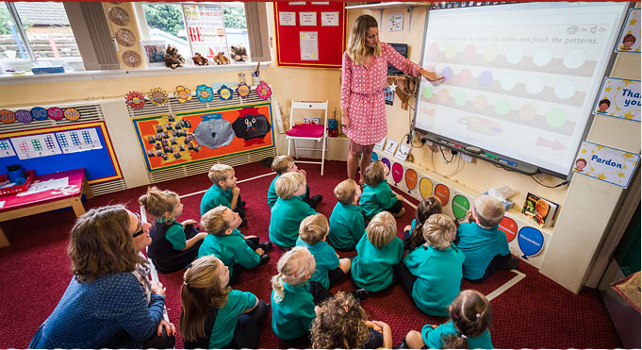
What is Assessment for Learning?
Teaching strategy
Adjustment for teachers and the learners
Teachers play a key role in the process of Assessment for Learning
Students, groups or a class as a whole
Assessment for Learning is modified according to children's needs and abilities in an appropriate style.
http://www.westbrettonschool.org.uk/classes/foundationstage.shtml

Slide 4
Why is Assessment for Learning Conducted?
Method to inform learners of their progress to allow them to take required action to improve.
Creating better learning opportunities for learners to learn at their own pace.
Helps teachers recognised strengths and weaknesses about their pupils.
Allows children to have an active role in their own learning.
Developing ‘confidence for learners to undertake in self evaluation and self assessment’.
(Jones, 2005)

Slide 5
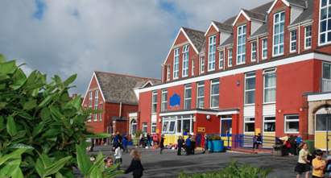
Why this school and this age group?
Brynmill Primary School
Foundation Phase
Three to Seven years old
Important to be able to reflect and self evaluate at a young age.
Great asset to possess for your education.
‘Resourceful, reflective children are more successful in examinations’
(Boyle & Charles, 2014).
https://Swansea-edunet.gov.uk/en/schools/Brynmill/Pages/Default.aspx

Slide 6
Formative and Summative Assessment
Formative Assessment | Summative Assessment
Ongoing basis to help students achieve the best of their abilities. | Participating in assessment which takes place at the end of a topic or unit.
Monitor student learning regularly to provide ongoing feedback. | Graded or Assessed
 | Example: Exams, Assignments or Projects.

Slide 7
Three Strategies
Exemplar Work
Lesson Target Setting
Learning Journal
All three strategies are conducted via formative assessments.
Providing ongoing feedback and support.

Slide 8
Strategy One – Exemplar Work
Fits perfectly within Foundation Phase.
Example of work shown to pupils.
Allows children to figure out the criteria for their work by observing this example.
Different Aspects
Asking relevant questions
Understanding the success criteria for themselves.
Being able to self evaluate what needs to be done.

Slide 9
Positives and Negatives
Positives | Negatives
Allows children to become more independent with their learning. | May not be resourceful to all young learners.
Valuable way for teachers to recognise capabilities of the young learners. | Learners at Foundation Phase learn differently and at different speeds.
Children can use it as help. | May not be understandable and useful for all learners.
Provides children to judge what they think is the criteria for that certain task.

Slide 10
Strategy Two – Lesson Target Setting
Understanding the aims and goals of the session from the outset.
Receive three daily goals to achieve.
Learners excel more when the learning objective is ‘made clear to pupils’ and when the ‘success criteria’ is clear (Hayes, 2012).
Important aspects such as:
Understanding what the young learners work criteria's are.
Provides motivation for the young learners.
Effective peer and self assessment.
Independent approach to learning
Easier for teachers to write reports because they are already tracking their pupils progress on a daily basis.

Slide 11
Positives and Negatives
Positives | Negatives
Makes it easier for teachers to track progress. | All the class mat not be able to maintain the same level of standards.
Helps children become highly motivated. | Could lead to children falling behind on their work.
Could lead to reaching aims and goals at a quicker pace for learners.

Slide 12
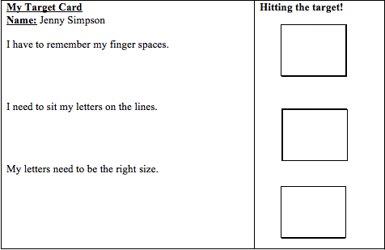
Example of Lesson Target Setting
http://www.hazelgrove-pri.stockport.sch.uk/wp-content/uploads/2016/03/TARGETS-FOR-WRITERS-YEAR-1-TO-6-PARENTAL-COPY.pdf

Slide 13
Strategy Three – Learning Journal
Journal which contains information about each pupil.
Behaviour, writing and reading.
Teachers will prove aims, goals and targets within the learning journal.
Suitable targets for each individual pupil abilities.
Key aspects:
Allows children to reflect and review on their own learning.
Effective way to learn to self evaluate and self assess.

Slide 14
Positives and Negatives
Positives | Negatives
Organised way for teachers to keep track of pupils progression in different skills. | Not all learners will progress at the same pace.
Allows children to recognise and reflect on their own progress. | It can cause learners to fall behind if they are not on track.
Keeps children motivated to reach their goals and targets. | Knock confidence
Different various type of journals, such as online journals for parents to access.

Slide 15
Conclusion
Impact school by advancing student learning.
Getting young learners to be highly motivated.
Improve Brynmill Primary School
Foundation Phase is an important time to become a good learner.
Domino Effect
Key to success in the future.
Importance of being about to self evaluate, reflect, motivate and have the willingness to improve is a great quality to possess.

Slide 16
References
Boyle, B., & Charles, M. (2014). Formative assessment for teaching & learning. London: SAGE.
Hayes, D. (2012). Foundations of primary teaching. Abingdon: Routledge.
Jones, C. A. (2005). Assessment for Learning. Vocational Learning, 16-19.
https://swansea-edunet.gov.uk/en/schools/Brynmill/Pages/Default.aspx
http://www.hazelgrove-pri.stockport.sch.uk/wp-content/uploads/2016/03/TARGETS-FOR-WRITERS-YEAR-1-TO-6-PARENTAL-COPY.pdf
http://www.westbrettonschool.org.uk/classes/foundationstage.shtml

