Slide 1

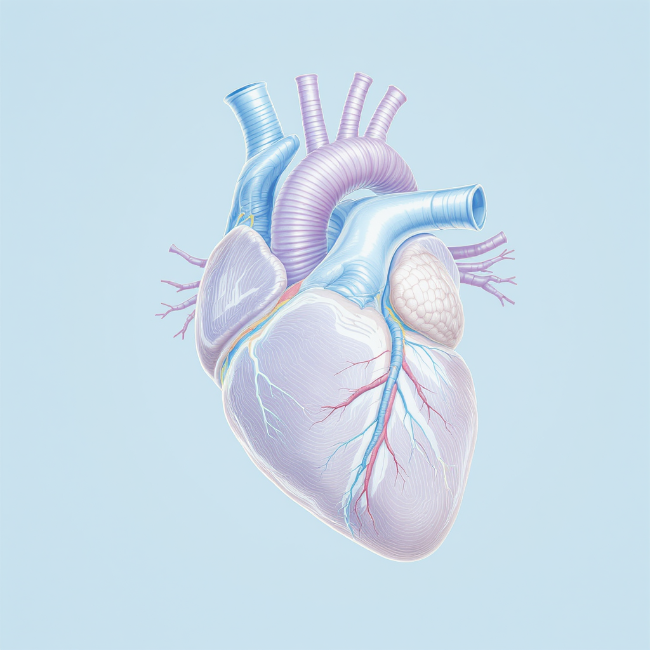
Topic: Cardiovascular Diseases, Including Stroke and Diabetes
Module: BMHP5023, Presentation
Student Name: Charles Amegor
Student ID: 2413450
Module Leader: Shaila Hussain

Slide 2
My presentation today focus on on cardiovascular diseases, specifically focusing on stroke and diabetes.
Overview of Cardiovascular Disease
Prevalence and Impact in the UK
Cardiovascular Anatomy and Physiology
Disease Development and Pathophysiology
Diabetes and Cardiovascular Risk
Fictional Patient Case
Care Planning and Prevention
References
The presentation will begin with an overview of cardiovascular disease, then discuss its prevalence and impact in the UK.
Following that, the anatomy and physiology of the cardiovascular system will be reviewed.
The presentation will then explore the development and pathophysiology of cardiovascular disease, with a focus on stroke. The connection between diabetes and cardiovascular risk will be examined next.
A fictional patient case will be introduced to apply the physiological concepts in a practical context. Finally, evidence-based care planning and prevention strategies will be covered, followed by a comprehensive list of references.

Slide 3
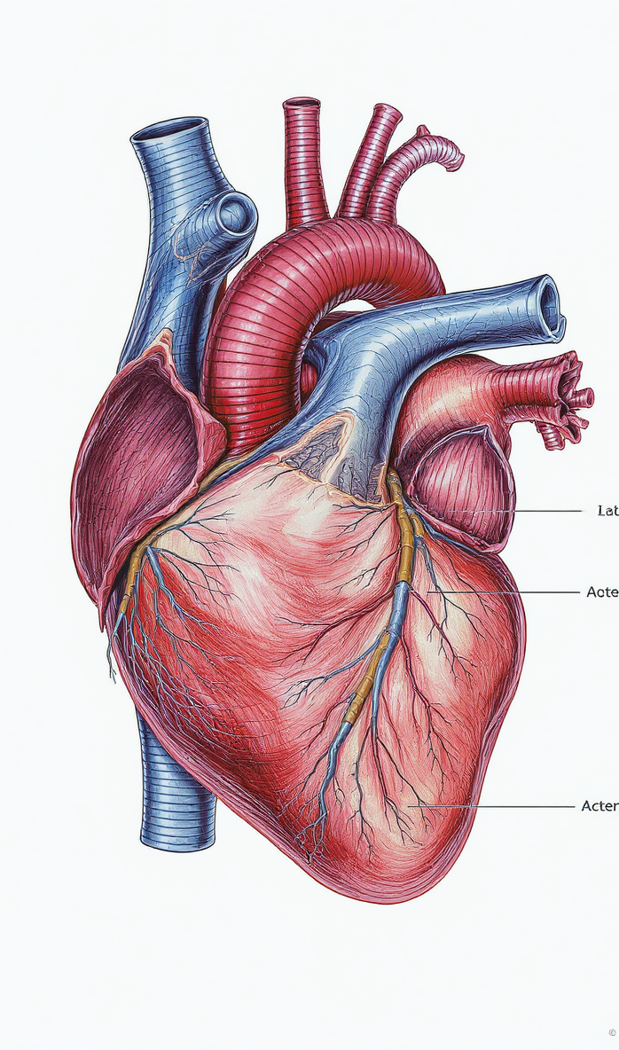



Overview of Cardiovascular Disease
Introduction
Disorders of the Heart and Blood Vessels
Cardiovascular disease includes various conditions affecting the heart and blood vessels, leading to impaired circulation and organ function.
Includes Heart Disease, Stroke, Hypertension
Common cardiovascular diseases are coronary heart disease, stroke, and hypertension, each with distinct mechanisms but often interconnected.
Diabetes Increases Cardiovascular Risk
Diabetes causes metabolic changes that damage blood vessels and accelerate cardiovascular disease progression, markedly increasing risk.

Slide 4


Prevalence and Impact in the UK
Impact
Leading Cause of Death and Disability
Stroke Causes Long-Term Impairment
Diabetes Doubles Cardiovascular Risk
Cardiovascular disease remains the top cause of mortality and disability in the UK, accounting for a substantial proportion of deaths annually and imposing a heavy burden on healthcare services.
Stroke is a major contributor to long-term disability, often resulting in physical, cognitive, and speech impairments that require extensive rehabilitation and social care support.
People with diabetes face approximately twice the risk of developing cardiovascular disease due to chronic high blood sugar damaging blood vessels and accelerating atherosclerosis.

Slide 5




Cardiovascular Anatomy and Physiology
Physiology
Heart as a Muscular Pump
Arteries, Veins, Capillaries
Blood Transports Oxygen and Glucose
The heart is a four-chambered muscular organ that contracts rhythmically to pump blood throughout the body, ensuring oxygen and nutrient delivery to tissues.
Arteries carry oxygenated blood away from the heart, veins return deoxygenated blood, and capillaries facilitate exchange of gases, nutrients, and waste at the cellular level.
Blood carries oxygen bound to haemoglobin and glucose dissolved in plasma, supplying essential fuel for cellular metabolism and energy production.
Cardiac Cycle Maintains Circulation
Blood Pressure Regulation
Healthy Endothelial Function
The cardiac cycle involves coordinated contraction (systole) and relaxation (diastole) of the heart chambers to maintain continuous blood circulation.
Blood pressure is controlled by cardiac output and vascular resistance, influenced by neural, hormonal, and endothelial factors to ensure adequate tissue perfusion.
The endothelium lines blood vessels, regulating vascular tone, preventing clot formation, and maintaining a balance between vasodilation and vasoconstriction.

Slide 6

Development of Cardiovascular Disease
Pathophysiology
Atherosclerosis Formation
Reduced Blood Flow
Diabetes Accelerates Damage
Fatty plaques composed of cholesterol, cellular debris, and inflammatory cells accumulate in arterial walls, damaging the endothelium and narrowing vessels.
Plaque buildup restricts blood flow, causing ischemia in tissues and organs, which can lead to chest pain, stroke, or heart attack.
Chronic high blood sugar levels in diabetes damage blood vessels by promoting inflammation and oxidative stress, speeding up atherosclerosis progression.

Slide 7

Stroke Pathophysiology
Pathophysiology
Ischaemic and Haemorrhagic Stroke
Ischaemic stroke occurs due to a blockage restricting blood flow, while haemorrhagic stroke results from bleeding into brain tissue, each causing different damage mechanisms.
Brain Tissue Sensitive to Hypoxia
Brain cells are highly vulnerable to oxygen deprivation, and even brief interruptions in blood supply can cause irreversible damage to neural tissue.
Rapid Intervention Essential
Timely medical treatment, including clot removal or controlling bleeding, is crucial to reduce brain injury and improve recovery chances in stroke patients.

Slide 8


Diabetes and Cardiovascular Risk
Pathophysiology
Chronic Hyperglycaemia
Persistent high blood glucose levels in type 2 diabetes damage blood vessels, impairing their function and promoting plaque buildup.
Endothelial Dysfunction
High glucose causes endothelial cells lining arteries to malfunction, reducing nitric oxide availability and promoting vascular stiffness.
Increased Inflammation
Diabetes triggers inflammatory responses that accelerate atherosclerosis, increasing the risk of heart disease and stroke.

Slide 9
Fictional Patient Case
Case Study
Male patient, 62 years old
Diagnosed with type 2 diabetes for several years
Recently experienced an ischaemic stroke
Presents with lifestyle-related cardiovascular risk factors
Requires integrated management of diabetes and stroke rehabilitation

Slide 10

Care Planning and Prevention
Care Planning
Glycaemic and Blood Pressure Control
Managing blood glucose and blood pressure within target ranges reduces vascular damage and lowers the risk of recurrent stroke and cardiovascular events. Medication adherence and regular monitoring are key.
Stroke Rehabilitation
Comprehensive rehabilitation including physical, occupational, and speech therapy supports recovery of function, mobility, and independence after stroke, improving quality of life.
Lifestyle Modification
Adopting a healthy diet, increasing physical activity, quitting smoking, and managing stress are critical lifestyle changes to prevent further cardiovascular complications.

Slide 11

Supporting Cardiovascular Research & Public Engagement
Engagement
British Heart Foundation Funding
Diabetes UK Support & Research
Stroke Association Awareness
BHF is the largest independent funder of cardiovascular research in the UK, powering breakthroughs in diagnosis, treatment, and prevention to reduce deaths and improve lives.
Diabetes UK invests millions in diabetes research and offers community support, education, and resources to help people manage diabetes and reduce cardiovascular risks.
Stroke Association provides vital support services, public education, and advocacy to improve outcomes for stroke survivors and raise awareness of stroke prevention.

Slide 12

References
References
British Heart Foundation (2024) Heart and circulatory disease statistics. Available at: https://www.bhf.org.uk (Accessed: 2025).
Diabetes UK (2024) Diabetes and cardiovascular disease. Available at: https://www.diabetes.org.uk (Accessed: 2025).
Guyton, A.C. and Hall, J.E. (2021) Textbook of Medical Physiology. 14th edn. Philadelphia: Elsevier.
NHS (2024) Cardiovascular disease. Available at: https://www.nhs.uk (Accessed: 2025).
NICE (2023a) Type 2 diabetes in adults: management (NG28). London: NICE.

