Slide 1
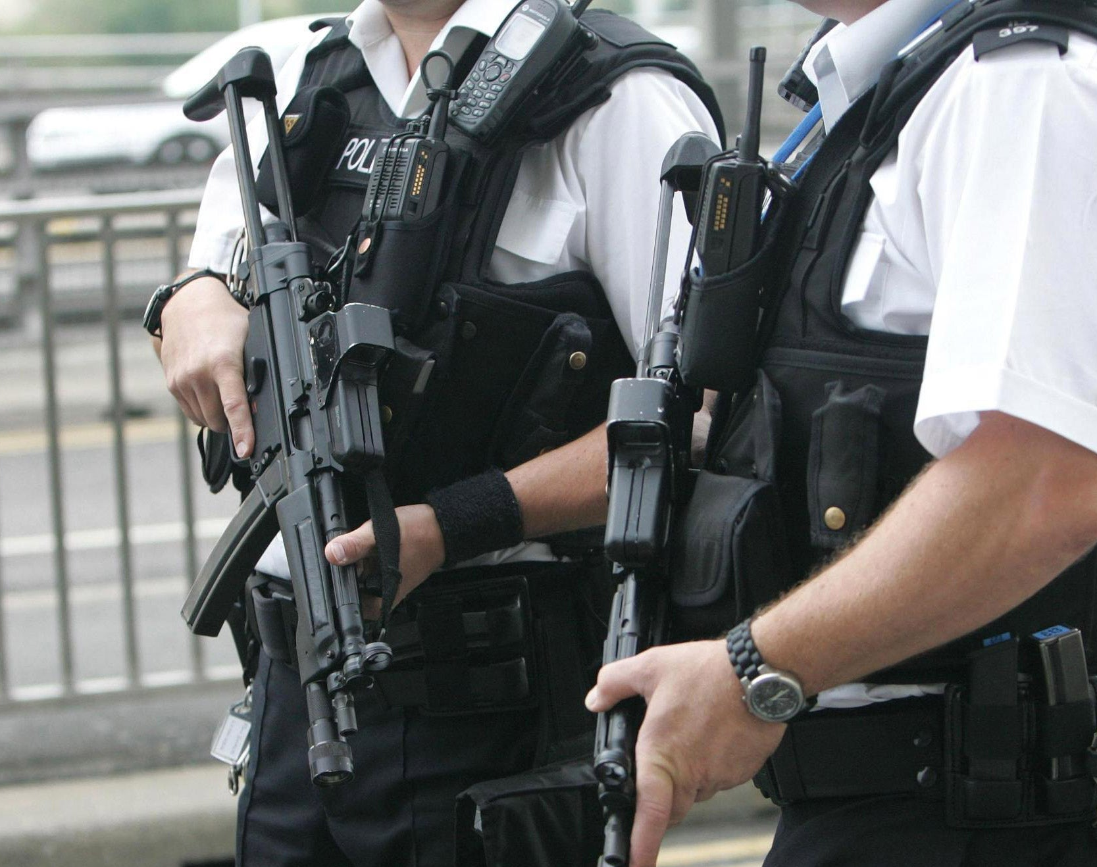
Investigate comprehensively a real-life case of abuse and analyse the victim's journey, the support they received or not and the outcomes of the case.
By Ieuan Bessant
2203188
BMPL6014

Slide 2
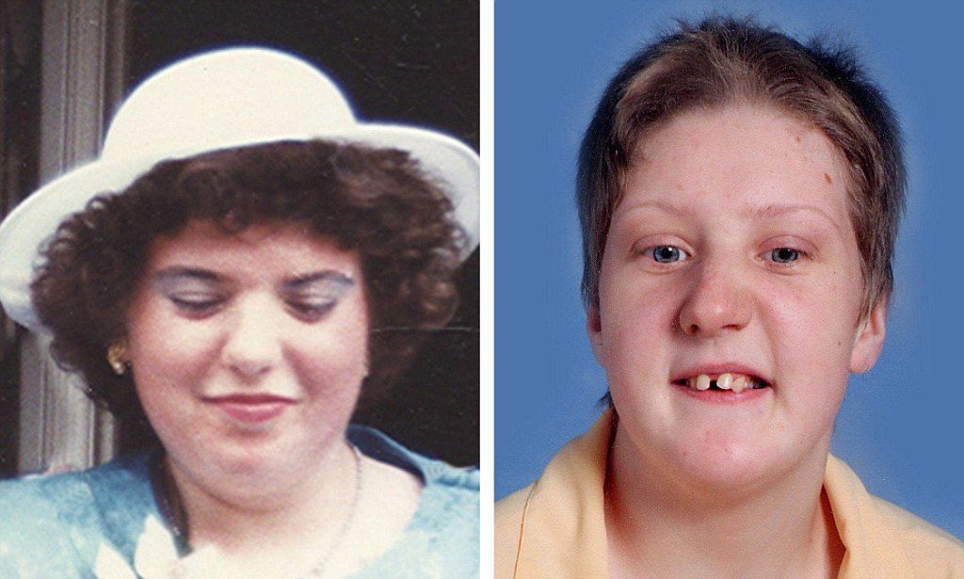
Fiona Pilkington and Francecca Hardwick

Slide 3
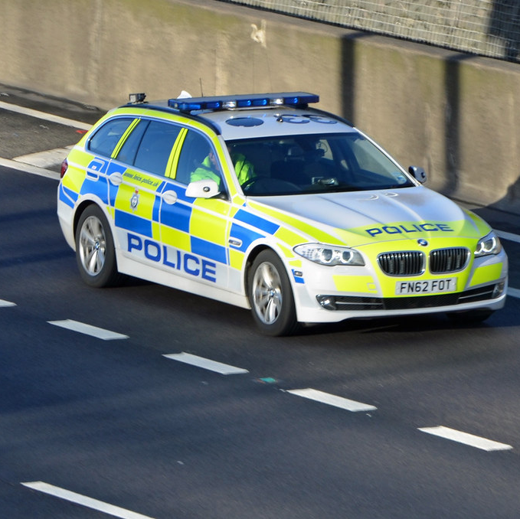
Fiona (38) and daughter Francecca Hardwick (18) and her brother Anthony (16)
Lived together in Earl Shilton area of Leicestershire area
Francecca had intelectual disability

Slide 4
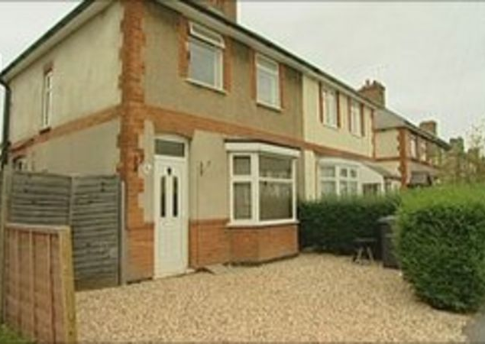
The Abuse
Both suffered horrendus torment and bullying at their home at the hands of a group of youths, including reports of;
Lighting fires outside home
Bullying of Franceccas brother Anthony in school as well as threats to his life
Throwing bottles and bricks at the house
Shouting verbal abuse and taunts at Fiona
Smashed windows
Anthony is locked in a shed at knifepoint by the gang
(BBC News, 2009)

Slide 5
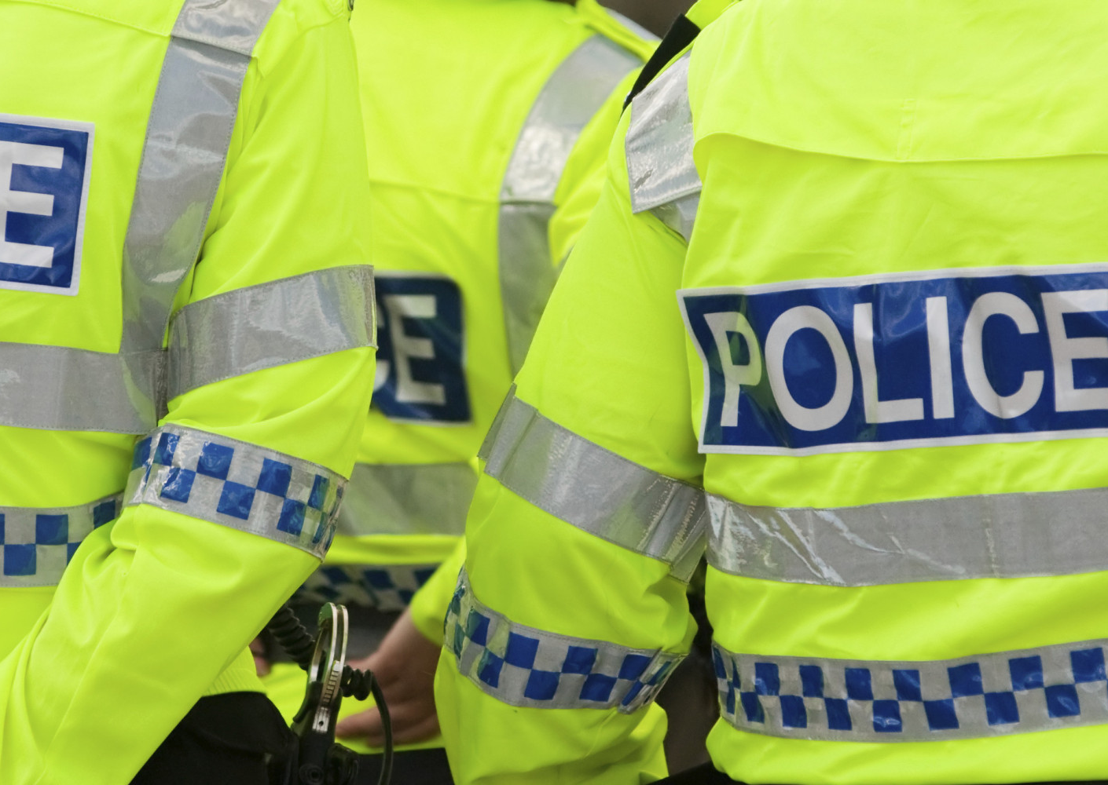
The Abuse
This abuse and harrassment started in 1997 and ended in 2007
Fiona set fire to her car with her and her daughter in it, killing herself and Francecca on October 23rd, 2007.
Leicstershire Police were contacted 33 times and wrote a diary documenting the abuse and harrassment
BBC News (2011)

Slide 6
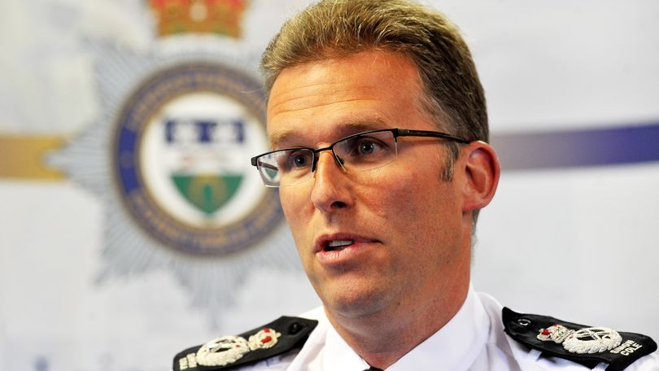
Failures of the police

Slide 7
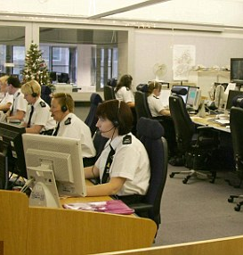
Failure 1 – Identifying repeat victimization
Police were contacted 33 times in 10 years however many calls went ignored
22nd June 2004, Police contacted about taunting of disabled daughter. Incident is closed after advice is given
Officers failed to identify repeat victimization of Francecca
Incidents were dealt with in isolation
'Level of Service received by Fiona fell far below expected standard'
(Independent Police Complaints Commission, 2009)

Slide 8
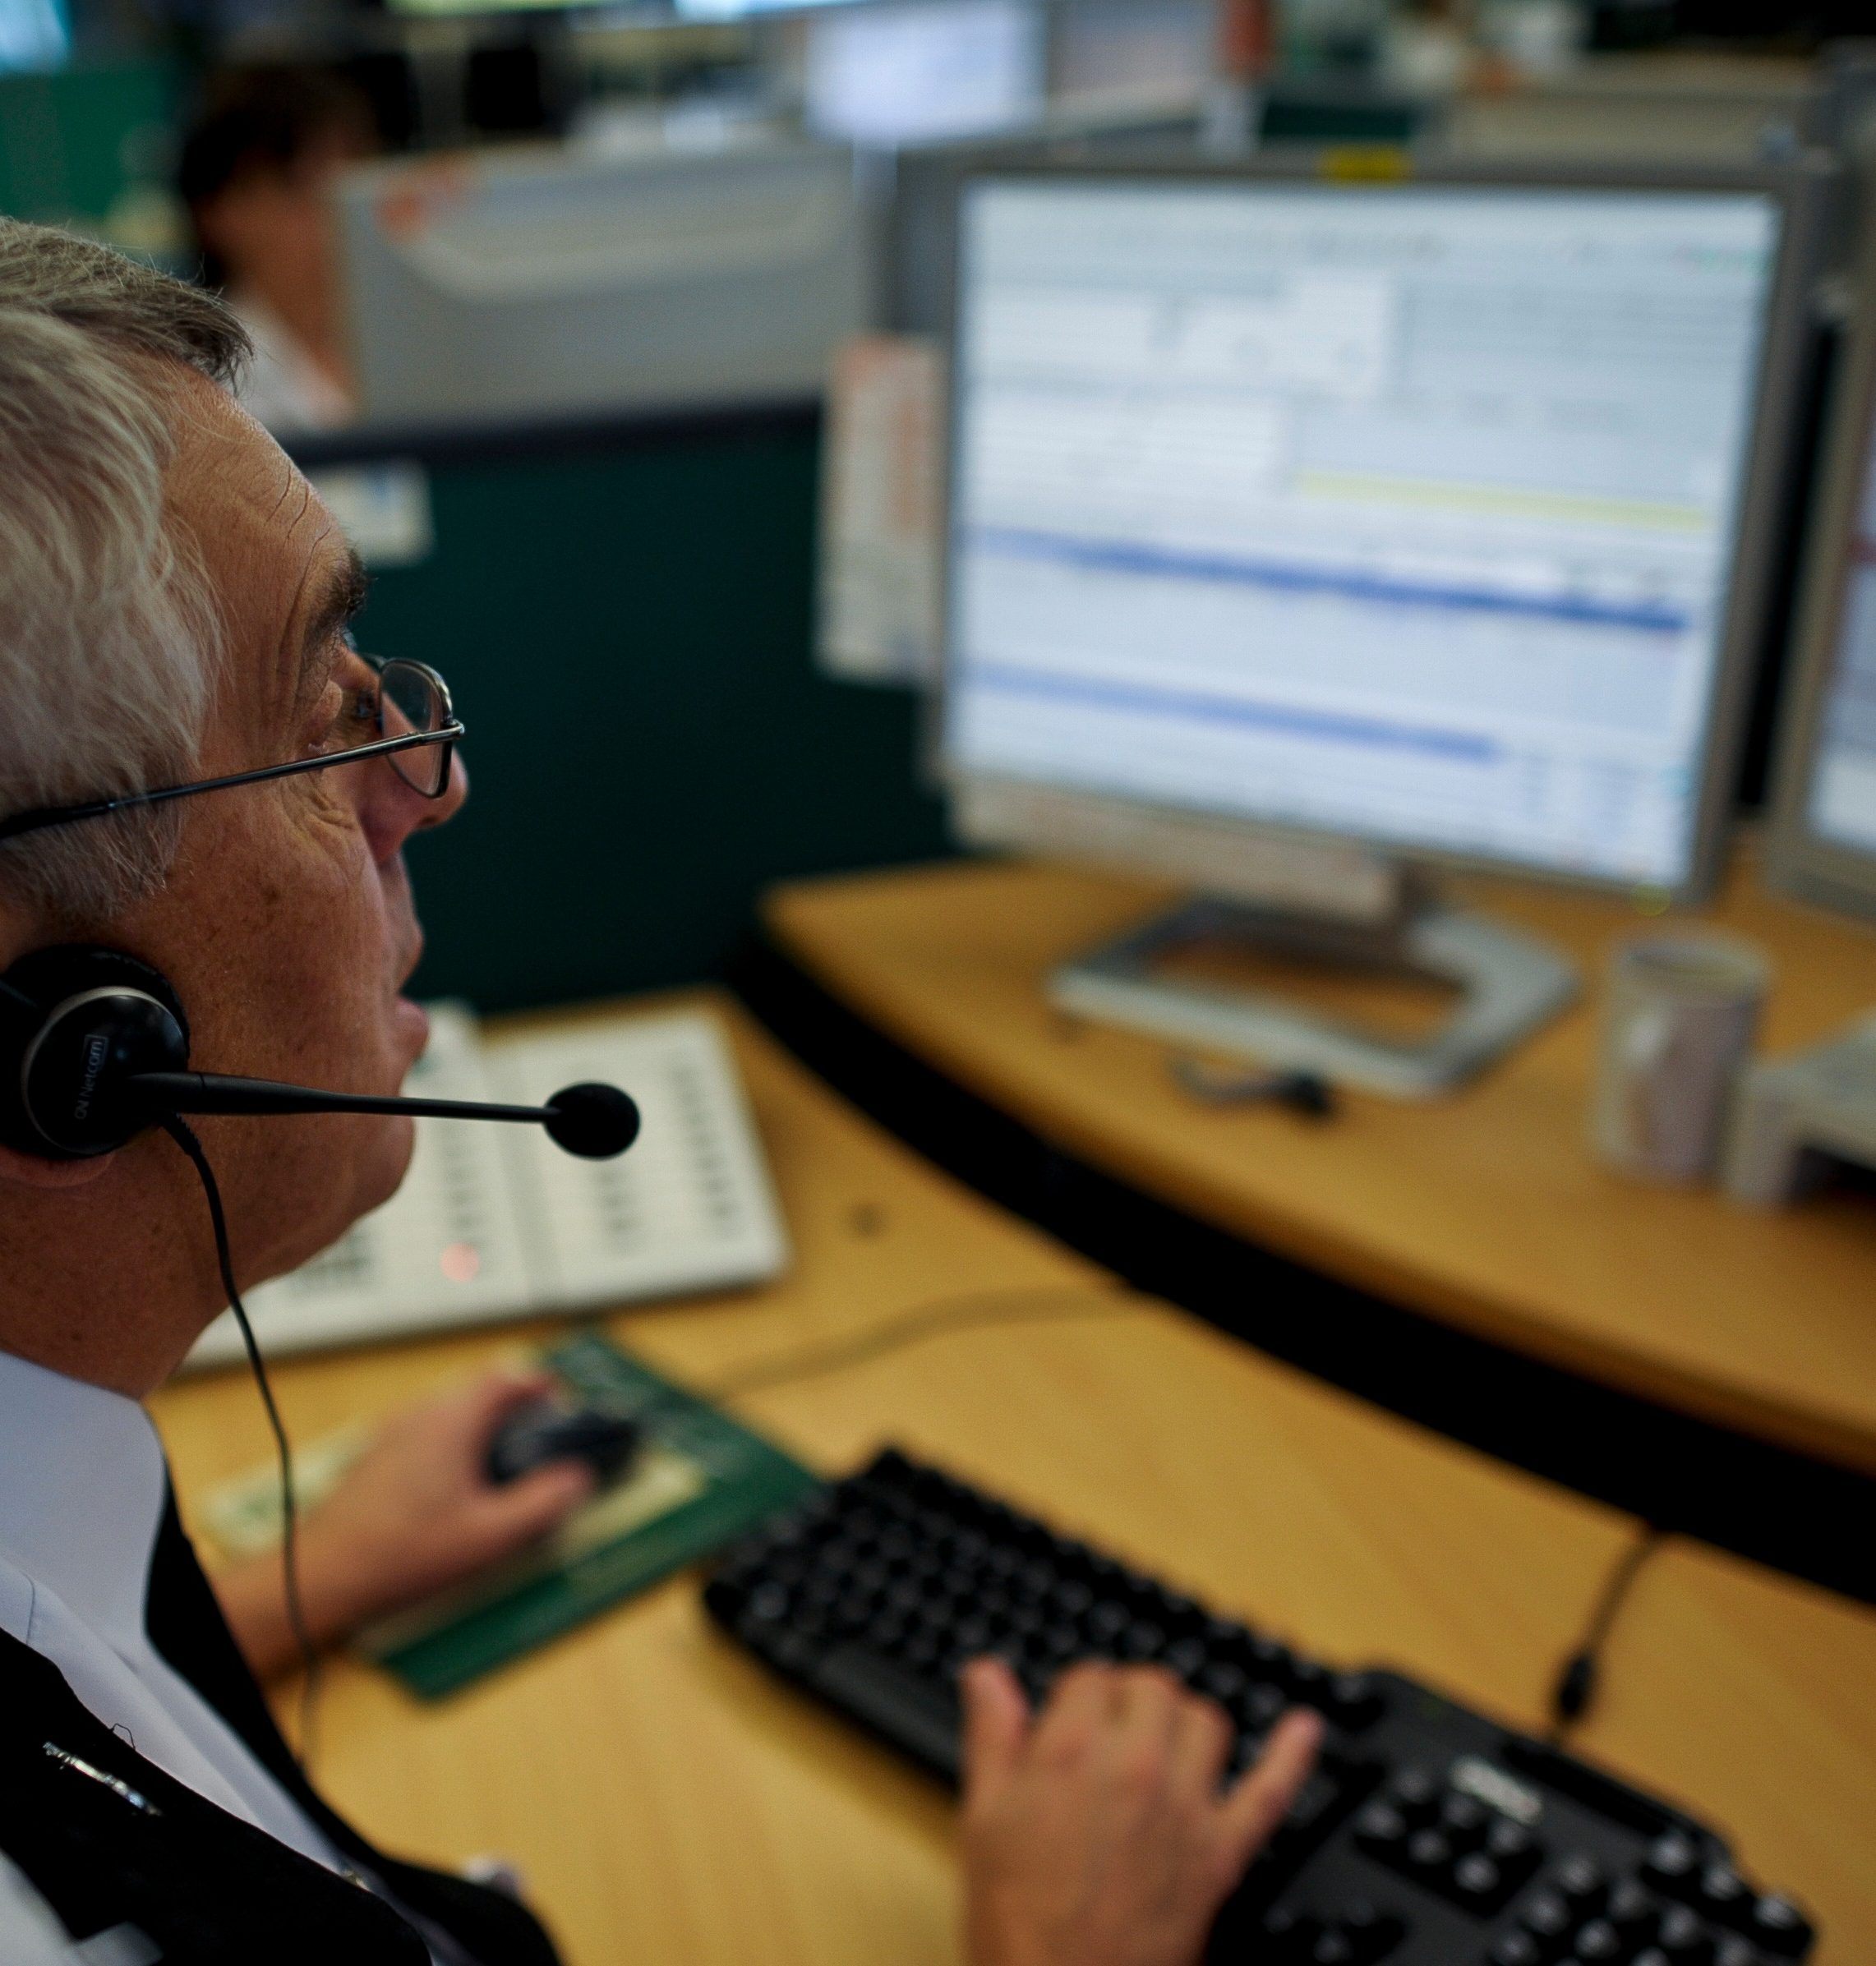
Failure 2 – Vulnerability
Failure to identify crimes as hate crime and not ASB
Failure to identify vulnerable victims due to disability and repeat victimization
Several incidents where robust action should have been taken by police officers
(Hussain 2011)
Had these things been done, the family could have been referred to partner agencies such as social services, housing or disability charities to better support them.

Slide 9
Offenders could have been dealt with earlier with better co-operation and information sharing between police and partner agencies
Disability charities could have been involved to offer support to the family
Schools offering in school or at home support to Anthony and Francecca
Police could have offered regular visits to provide support in the way of checkups on the family
Failure to identify family as vulnerable and to identify the repeat victimisation as hate crime and not ASB led to dropped standards of investigation and support
(Metropolitan Police Authority, 2011)

Slide 10
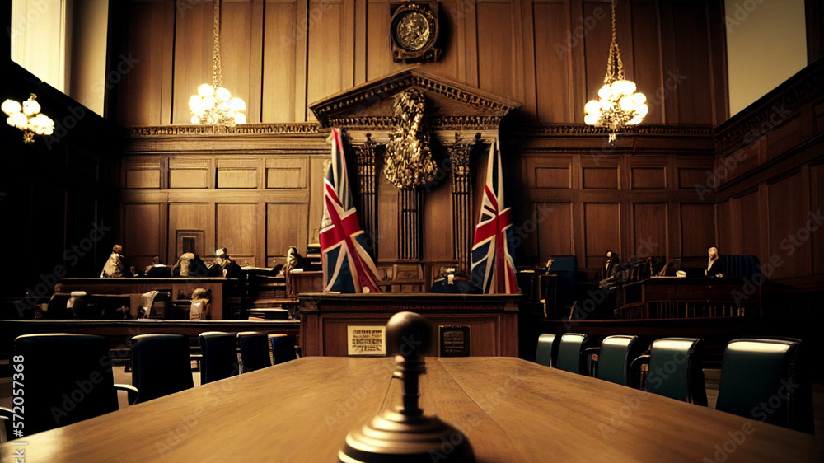
Outcomes of the Case

Slide 11

IPCC Investigation
Following this incident, the Independent Police complaints commission [IPCC] (2011) launched an investigation into the death of Fiona and Francecca and found the following:
Failure to identify family as vulnerable was core failing of Leicestershire police to implement effective means of support to the family
Events were dealt with in Isolation and not taken seriously
Changes were recommended by the IPCC including:
Improve information sharing
Definition of Vulnerable needs to extend to circumstances
Clearer guidelines to determine different between ASB and harassment

Slide 12
Serious Case Review
Leicester, Leicestershire and Rutland Safeguarding Adults’ Board (2008)
Found critical failures by other local agencies to proivde support to Fiona her family during the 10 year attack they suffered
Criticised agencies including:
Leicestershire Local Council
Hinckley and Bosworth Council
Local Police
Failure of agencies to refer them to Social Services

Slide 13

These failures prevented Fiona and her family from accessing the correct support during the 10-year period of abuse and could have prevented their deaths

Slide 14

What changes were made?

Slide 15

Adult referral and co-ordination team
Form by Leicestershire police after death of Fiona and Francecca
Improve response and suppport given to hate crime on vulernable adults
Improve relationships with partner agencies such as Age UK and Mencap to better improve response to adult hate crime
Better define hate crime against ASB to improve response
(Safeguarding Matters, 2017)

Slide 16

Antisocial Behaviour, Crime and Policing Act, 2014
Informed by the IPCC inquiry
Changed attitudes on ASB to encourage officers to take it more seriously
Place victims of ASB at core of response
Places responsibility on Local Authorities to put systems in place to reduce ASB
More power to these local authorities

Slide 17
Conclusion
Police dealt with incidents in isolation
Failed to identify family as vulnerable
Failure to identify hate crime not ASB
Other services failed to act and implement support plan
These failures and lack of action prevented the proper support such as house visits or contact with social services being provided to Fiona, Francecca and Anthony.

Slide 18
Reference List
Anti-social Behaviour, Crime and Policing Act 2014, c 12. Available at: Anti-social Behaviour, Crime and Policing Act 2014 (Accessed: 15 January 2025).
BBC News. (2011) 'Fiona Pilkington officers face misconduct proceedings', 24 May. Available at: Fiona Pilkington officers face misconduct proceedings - BBC News (Accessed: 15 January 2025).
BBC News. (2009) 'Timeline: Abuse of car death pair' 28 September. Available at: BBC NEWS | England | Leicestershire | Timeline: Abuse of car death pair (Accessed: 15 January 2025).
Hussain, D. (2011) IPCC investigation finds alarming failings in Pilkington case. Available at: Police Professional | IPCC investigation finds alarming failings in Pilkington case (Accessed: 15 January 2025).
Independent Police Complaints Commission. (2009) IPCC report into the contact between Fiona Pilkington and Leicestershire Constabulary 2004-2007, 2009/016872. Available at: ipcc_report-fiona-pilkington-leicestershire.pdf (Accessed: 15 January 2025).
Leicestershire, Leicestershire and Rutland Safeguarding Adults Board. (2008) 'Executive Summary of Serious Case Review in relation to A and B', Available at: Microsoft Word - Final _full doc_ - LLR SAB SCR A B.doc (Accessed: 15 January 2025).
Metropolitan Police Authority (2011) Safeguarding Adults and Anti-Social Behaviour (learning from Pilkington and Hardwick). Available at: MPA: Committees: Communities, Equalities and People Committee reports - 06-Jan-11 (10) (Accessed: 15 January 2025).
Safeguarding Matters (2011) 500 referrals to Pilkington unit each month. Available at: 500 referrals to Pilkington unit each monthSafeguarding Matters | Safeguarding Matters (Accessed:15 January 2025).

