Slide 1
Creating Candidate Concept Solution
Revision with Spreadsheet!
(Level 5 pick up version)
No Great Thing is Created Suddenly
Epictetus AD 55-135
Notes:
Now we will move on to cover the processes for MANAGING RISK.
Part 02 of the Handbook, particularly Section 9.4.
Key activities of recognising what Hazards might apply, exploring and understanding them and then controlling the Risks.

Slide 2


Epictetus
AD 55-135
"No great thing is created suddenly."
This is a quote by Epictetus.
He is known to have been associated with numerous other thought-provoking quotes on these topics like;
“How incessant and great are the ills with which a prolonged old age is replete.”

Slide 3
WHAT NEXT ??
… Design !
Can we get on with designing stuff now PLEASE??!!
Notes:
This cartoon contains a serious message!
Designers are eager to design things… they generally do not like ‘faffing about’ doing things in teams which seem pedantic and ultra-systematic!
There must be infrastructural pressure in place to ensure that these ‘other’ activities are done thoroughly, at the right time.
Design reviews should do this, with specific deliverables baked into the process gateways.

Slide 4
This cartoon contains a serious message!
Designers are eager to design things… they generally do not like ‘faffing about’ doing things in teams which seem pedantic and ultra-systematic!
There must be infrastructural pressure in place to ensure that these ‘other’ activities are done thoroughly, at the right time.
Design reviews should do this, with specific deliverables baked into the process gateways.

Slide 5
Where are we? BAE Systems’ Design System Process (RFCD)
Customer
Needs and Expectations
Design System
User
Requirements
System Requirements
Build and Check Requirements
System
Design
Definition
Subsystem
Requirements

Slide 6
Creating Candidate Solution Concept (C)
Principles
The Principles of the Perform Creating Candidate Solution Concepts process are:
A number of viable candidate solution concepts should be considered.
The chosen solution concept should be identified from the candidates by employing an appropriate analytical approach.
The selected solution concept should be agreed with all interested parties.
Objective
The identification, assessment and selection of solution concepts is an integral part of the Engineering Lifecycle and the Creating Candidate Solution Concepts process should be used:
To ensure the widest practicable range of solution options is created in response to a requirement.
To support the progressive down-select of options to the point where full engineering resources can be confidently invested to detailing the selected solution.
To ensure that the selection process for design options adequately considers the full range of design drivers, both from a Customer and Enterprise viewpoint.
To ensure the Enterprise retains full traceability of selection and de-selection rationale for future reference.
Verification
The performance of this process should be verified with Design Review and quality audits.
Extracted from LM0502-03

Slide 7
A Systems Approach to Design
Objective
The identification, assessment and selection of solution concepts is an integral part of the Engineering Lifecycle and the Creating Candidate Solution Concepts process should be used:
To ensure the widest practicable range of solution options is created in response to a requirement.
To support the progressive down-select of options to the point where full engineering resources can be confidently invested to detailing the selected solution.
To ensure that the selection process for design options adequately considers the full range of design drivers, both from a Customer and Enterprise viewpoint.
To ensure the Enterprise retains full traceability of selection and de-selection rationale for future reference.

Slide 8
A Holistic Approach to Arriving at the “best” Solution
Idea
Idea
Idea
Idea
Idea
Idea
Idea
Idea
Idea
Idea
Idea
Idea
Idea
Idea
Idea
Idea
Idea
Idea
Idea
Idea
Idea
Idea
Idea
Idea
Idea
Idea
Idea
Idea
Idea
Idea
Idea
Idea
Idea
Idea
Idea
Idea
Idea
Idea
Idea
Idea
Idea
Idea
Idea
Idea
Divergent Thinking
Convergent Thinking
System
Requirements
Functions
and Performance
Measures
Concept
Concept
Concept
Concept
Concept
Solution
Concept(s)
CONCEPT
SELECTION
Evaluate the whole system concepts to identify the “best”
CONCEPT GENERATION
Use functionality as a means of handling complexity yet simultaneously ensuring whole system coverage to generate all possible functional solutions
CONCEPT INTEGRATION
From the set of all possible solutions determine those combinations that form a whole system concept

Slide 9


Functions the heart of the Systems Approach
Translate Stakeholder Requirements into
I Want
FUNCTIONALITY
It Works!
Translate Functionality into
system solution

Slide 10
Concept Generation
Idea
Idea
Idea
Idea
Idea
Idea
Idea
Idea
Idea
Idea
Idea
Idea
Idea
Idea
Idea
Idea
Idea
Idea
Idea
Idea
Idea
Idea
Divergent Thinking
Convergent Thinking
System
Requirements
Functions
and Performance
Measures
Solution
Concept(s)
CONCEPT
SELECTION
Evaluate the whole system concepts to identify the “best”
CONCEPT GENERATION
Use functionality as a means of handling complexity yet simultaneously ensuring whole system coverage to generate all possible functional solutions
CONCEPT INTEGRATION
From the set of all possible solutions determine those combinations that form a whole system concept

Slide 11
Function Means Analysis
What is it?
  a tool for generating, capturing, selecting and documenting system design concepts.
Why do it?
  Function Means analysis uses the uncovered generic and other functionality to ensure the holistic generation of candidate system concepts
How to do it
  Function Means Analysis has two stages:
    Stage 1:Concept Generation: a divergent thinking activity where the functions of the system are considered in turn and the means of achieving those functions identified
    Stage 2:Concept Integration and Selection: a convergent thinking activity that identifies whole system concepts

Slide 12
Function Means Analysis Process
Stage 1
Stage 2

Slide 13
Step 1: Identify Functionality
To undertake a Function Means Analysis requires knowledge of the functionality of the system. The functionality should be:
  Complete i.e. encompass the whole of the system
  At the same level of generality
These rules are not rigid. Indeed, Function Means Analysis can help to check whether the system functionality is complete.
Very few systems are unprecedented and therefore a check can be made to ensure that the current system solution sits within the means identified – if not then perhaps we are missing some functionality
Once identified the functions should be entered in the Function column of the Function Means Table

Slide 14
Step 2: For each Function Generate Solutions
Taking each function in turn, the team should identify and record in the table ALL the POSSIBLE means of achieving that function
Quantity rather than quality is the aim at this point and a good rule of thumb is to aim for 9 ideas per function. This assumes 3 conventional, 3 extreme and 3 with high potential. Ridiculous, silly, impractical ideas should not be shot-down, ridiculed, or ignored – write them down
If it is difficult to generate solutions to functions:
    The function my be a pseudo-function like “generate style” these either need rewriting as “proper” functions or removing
    The function description may be at too high a level and needs to be decomposed into a number of lower level functions for which design options can be explored

Slide 15
Tracer Example Function Means Analysis
Solutions (means) to Functionality
Tracer Functionality from QFD

Slide 16
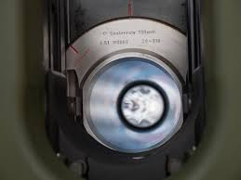
Exercise: FMA Stage 1
Demonstration
Construct a Function Means Chart for the case study problem - consider all solutions
Time: 30 minutes

Slide 17
Introduction to Concept Integration and Selection
The first stage of Function Means Analysis provides a large number of potential functional solutions. The task now is to:
  Generate a number of complete candidate solution concepts frequently referred to as design or concept system solutions – this is called Concept Integration

Slide 18
Concept Integration
The purpose of Concept Integration is to arrive at a number of potential whole system solution concepts
  We often use the word integration to mean just the final “physical” integration of a system – but the decisions we are about to make are fundamentally integration decisions and poor choices at this point in time, will have detrimental effects on the physical integration of the system
Assuming that the concept generation has been done by Function Means Analysis, there are a number of strategies for Concept Integration
  Identify the “best” means for each function
    cannot guarantee an optimal system solution
  Consider every permutation from the function means analysis
    will take too long
  Reduce the number of options and develop a limited number of potential whole concept solutions
This last strategy can be accomplished using the Function Means Chart

Slide 19
Function Means Analysis Process
Stage 1
Stage 2

Slide 20
Step 3: Determine Selection/De-selection Criteria
What is required at this step are some key criteria that can be used to quickly eliminate or promote the solutions documented in the Function Means Table
The aim is to remove the obvious “sore-thumbs”
A good starting point for the criteria is the primary WHATs from the QFD 1. These are customer facing and therefore deselecting functional solutions that do not meet these will ensure that only “compliant” ideas are carried forward
The general recommendation here is between 3 and 6 criteria. Too many criteria can make the process time consuming. The drawback, of course, with few criteria is that those that are selected have a significant impact on the selected system solution – the wrong criteria leads to the wrong solution
A simple example: consider a domestic toaster. The User Requirements might be:
User Requirements for a Domestic Toaster
Even toasting
Quick
Affordable
Easy to use
Attractive
Reliable
Easy to clean
Energy Efficient
4 slices at once
Etc.
Key requirements that can be used to deselect functional solutions those that are easy to apply like:
Even Toasting
Affordable
Easy to clean
Energy Efficient
Requirements like “Attractive” and “Reliable” are less easy to apply – at this stage.

Slide 21
Step 4: Use the criteria to de-select from the Table
The criteria, determined in the previous step, are now systematically applied to the removal of candidate functional solutions
The aim here is to remove approximately 50% quickly, i.e. the obvious “sore thumbs”
As functional solutions are removed a note should be made of the criteria and reasoning that led to their removal
Over arguing at this point is counter productive – functional solutions that generate “excessive” debate should be retained

Slide 22
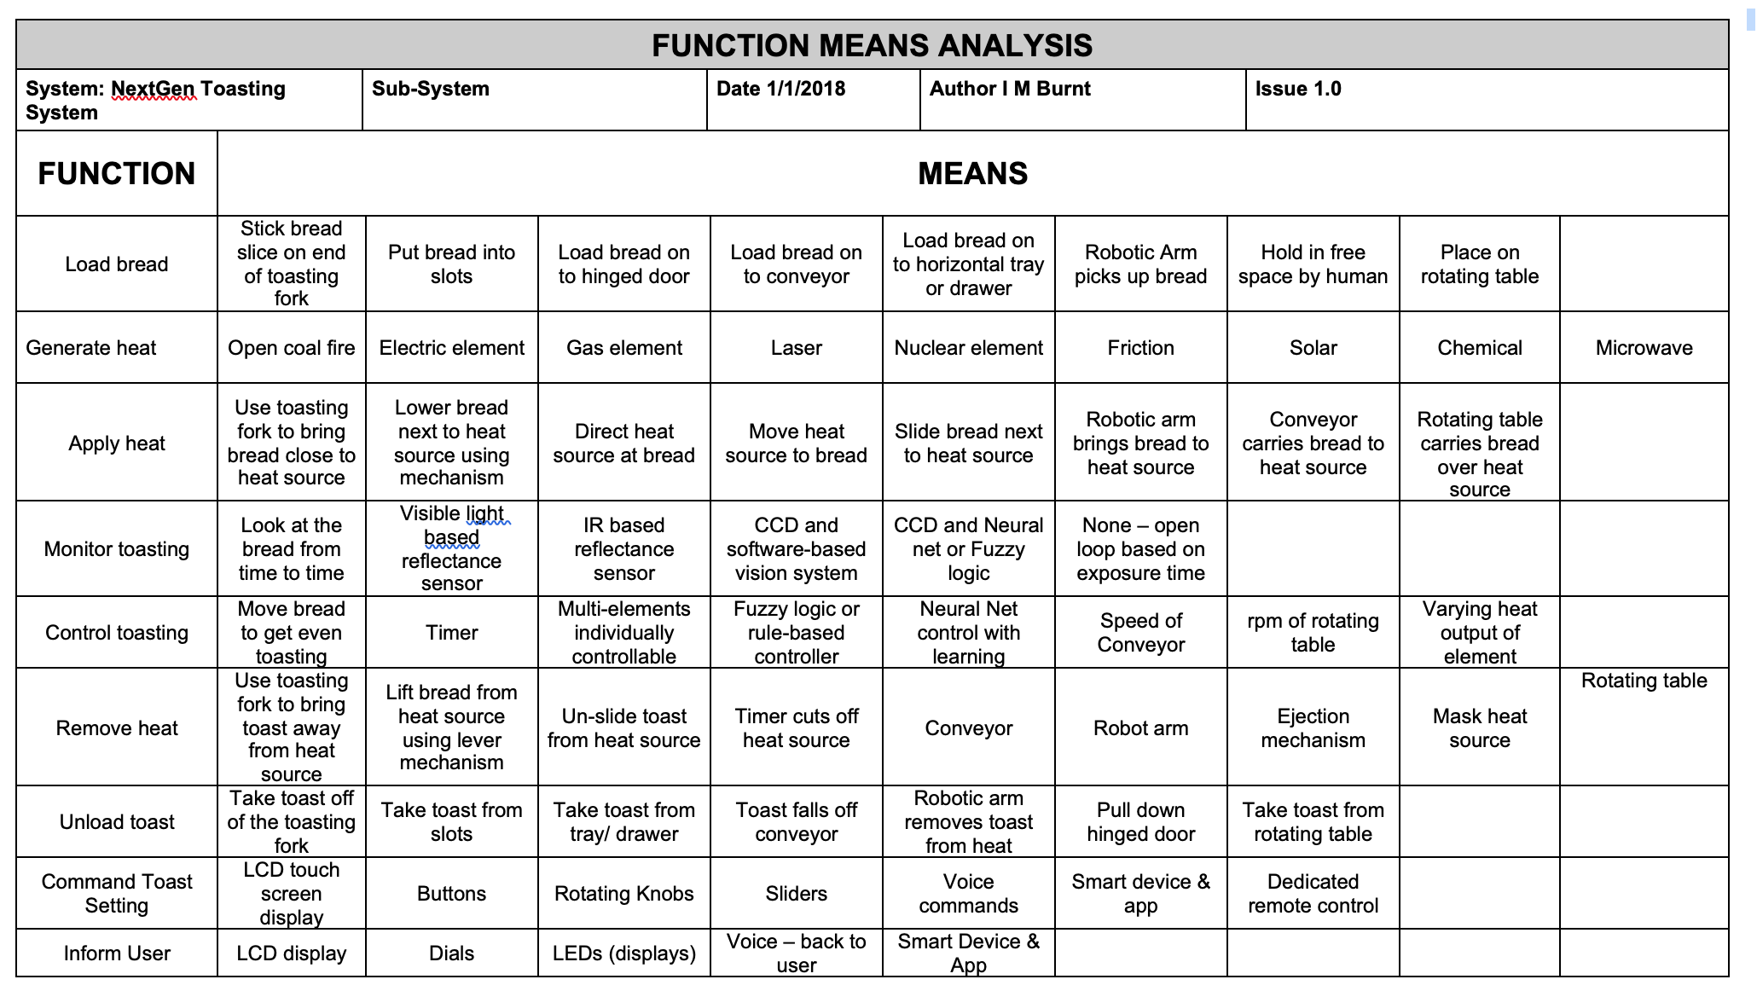
Toaster Example
Key:
✘ Even Toasting
✕ Affordable
✶ Easy to clean
❋ Energy Efficient
✘
✕
✕
✘
✘
✕
✕
✘
✕
✶
✘
✘
❋
✕
✕
✘
✕
✕
✘
✘
✕
✘
✘
✕
✕
✕
✕
✕
✕

Slide 23
Step 5: Review Remaining Options to Generate Potential Whole System Concept Solutions
With the “trees removed” the task now is to determine potential whole system concepts
A simple approach here is to plot routes through the table that represent complete system concepts
For any given function as many means as necessary can be selected for a particular whole system concept – note though if several solutions are necessary, it could be a consequence of the function being at too abstract! In such situations it is worth considering decomposing the high-level function into lower-level functions
Selecting the “routes” can be based on technologies that are compatible or avoid incompatibilities
The aim should be to generate as many whole system concepts as realistically possible – common sense should also prevail

Slide 24
Toaster Example
Key:
✘ Even Toasting
✕ Affordable
✶ Easy to clean
❋ Energy Efficient
✘
✕
✕
✘
✘
✕
✕
✘
✕
✶
✘
✘
❋
✕
✕
✘
✕
✕
✘
✘
✕
✘
✘
✕
✕
✕
✕
✕
✕

Slide 25
Tracer Example Function Means Analysis
Tracer Functionality from QFD
Solutions (means) to Functionality

Slide 26
Exercise: Concept Integration
Demonstration
Consider your Munition Function Means Table
Identify 3-6 de-selection criteria and apply them to your Function Means Table to eliminate non-compliant functional solutions
Review the remaining potential functional solutions to create two potential whole concept system solutions for the case study Munition
Prepare a sketch of the concept.
Time: 45 Minutes

Slide 27
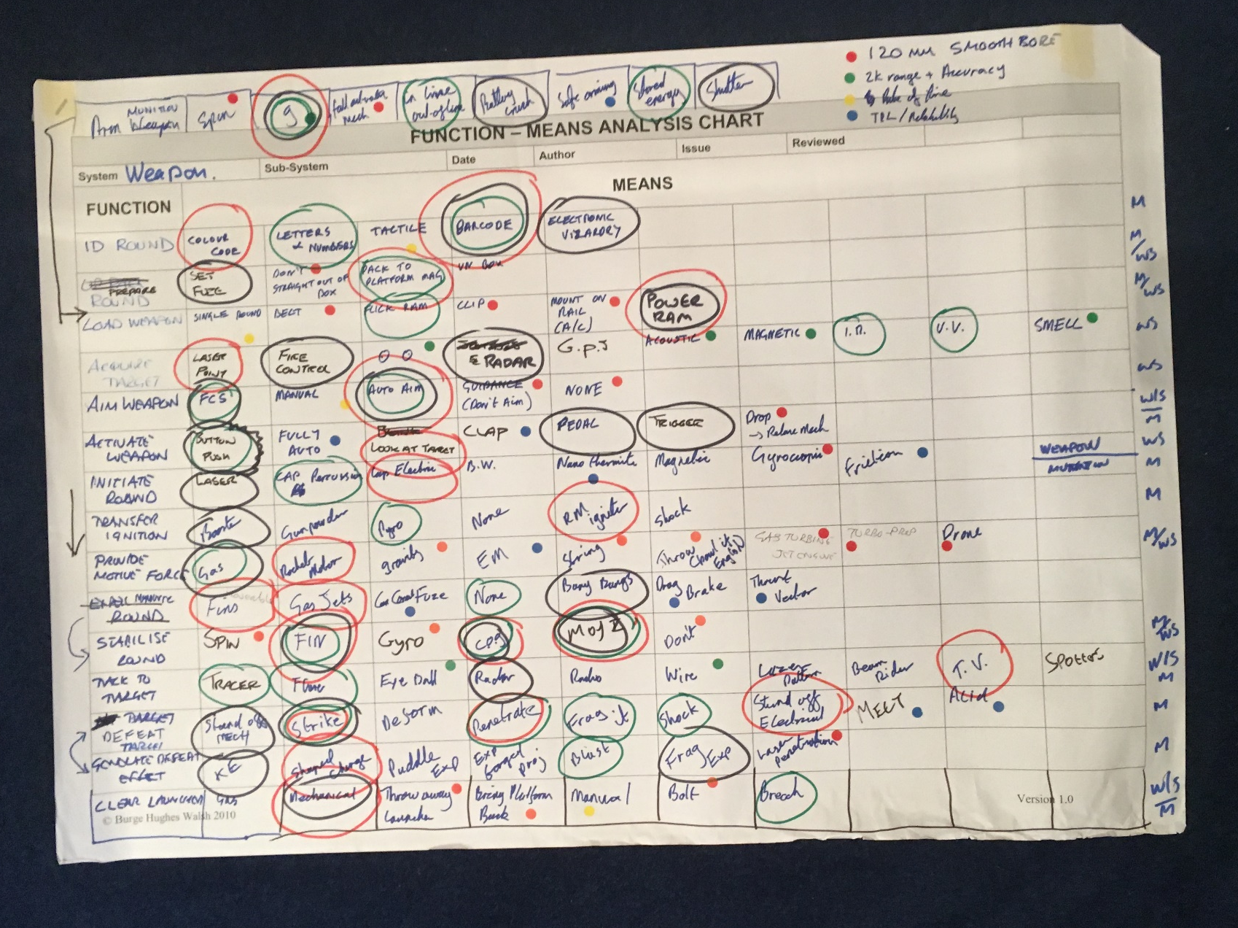
A Model Answer!
De-slection criteria

Slide 28
Summary: FMA
Pros
Simple to use
Allows the design problem to be logically broken down into manageable elements for which solution options can be easily found
When used with an open mind is extremely powerful for identifying and recording “all” possible design options
The Function Means Table allows all the design options to be displayed simultaneously allowing for easier review
Applicable at any level of design
Visual and structured tool for the systematic identification of whole concept solutions
Captures in a simple way the justified design rationale
Encourages team discussion and consensus decision making
Cons
Getting the functions at the correct level of abstraction in order to explore solution choices
The outcome can be a significant number of options which must be combined together
Sometimes viewed as too simplistic and therefore not a serious tool
Ensuring the “best” de-selection criteria
High level concepts can incorporate many “means”
Tips
Manage the number of functions to 15 – 20
If a function doesn’t yield many solutions check that it is not too abstract
Don’t exclude solutions during the first phase
Consider using diagrams to explain ideas
Check the table contains any existing system designs
Use the User/Stakeholder requires for the de-selection

Slide 29
The Next Step
The next step, having identified a number of candidate whole system concept solutions, is to “work up” the concepts to allow them to be evaluated
This involves:
  Sketching out the physical layout or architecture
  Producing concept drawings – to show what a concept looks like
  Defining the concept of operation – the Use Case or Use Cases for the concept
  Performing “back of the envelope” calculations to determine performance aspects of each concept
  Identifying the solution dependent and architectural functionality necessary as a consequence of the functional solution choices
This last point is very important as it will necessarily introduce design iteration

Slide 30
A Concept Design
Function Means Analysis is a very powerful tool for identifying and capturing potential functional solutions. It also allows the creation of potential candidate system design concepts. However, to down-select, from those candidates it is necessary to add detail by generating concept designs like that shown below:
Such diagrams should be prepared for each candidate system design concept

Slide 31
Munition Architecture and Subsystems
The nature of the selected munition design mean it has 4 distinct subsystems
Shell
Fin Assembly
Fuze
Case & Charge
Note: Not all systems are like this where the architecture and subsystems are obvious. However, irrespective of how the architecture is determined, what is important are the interfaces between the various subsystems.

Slide 32
Remember there is more to a system than its Generic Functionality
The generic system functionality is not the complete set of system functionality – a system can have functionality that is not generic:
Solution Dependent Functionality: A particular generic function solution may require further solution specific functionality.
Legislation Dependent Functionality: legislation requires us to incorporate additional functionality.
Architectural Functionality: At the system level the collected functional solutions require further functionality typically to support, align, contain and protect.
Emergent Functionality: Functionality aimed at managing Unwanted Behaviour. Usually relates to informing the user of failure situations
So far we have identified solutions to just the generic functionality (and perhaps through FFMEA emergent functions/solutions) to create a number of concept designs
Our choice of solutions will lead to the need to include further solutions to support our choices. If I choose an electric motor as a motivator, I will have to provide an electric power source – a battery for example. These supporting solutions have functionality – solution dependent functionality
The need for architectural elements will also become apparent. These elements have functionality – architectural functionality

Slide 33
We Iterate the Design
Whenever we identify additional solutions (either supporting or architectural), they can be treated as Non-functional Implementation Requirements and used to identify further functions (Functional Requirements) for which alternative solutions can be explored (new rows to add to the Function Means Table)
We should also update all our earlier work (Use Case, Functional Model, QFD 1 etc.)
Functions
Functions
Solutions
Solutions
Functions
Solutions
Functions
Increasing maturity
of knowledge about the Stakeholders’ requirements, System Requirements
and system/product information

Slide 34
We Iterate the Design
Whenever we identify additional solutions (either supporting or architectural), they can be treated as Non-functional Implementation Requirements and used to identify further functions (Functional Requirements) for which alternative solutions can be explored (new rows to add to the Function Means Table)
We should also update all our earlier work (Use Case, Functional Model, QFD 1 etc.)
Functions
Functions
Solutions
Solutions
Functions
Solutions
Functions
Increasing maturity
of knowledge about the Stakeholders’ requirements, System Requirements
and system/product information

Slide 35
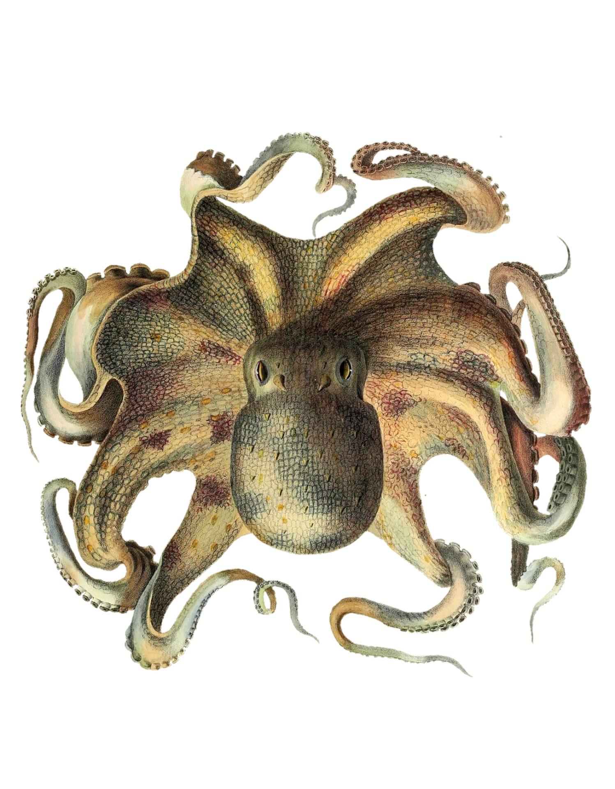



Concept Selection
(and evaluation)

Slide 36
Concept Selection/Evaluation
The purpose of Concept Integration is to identify many alternate potential complete system solutions
The purpose of Concept Selection/Evaluation is to arrive at the best possible and feasible system solution from the candidate list or at least eliminate the weaker options
A very useful tool is the Pugh Matrix

Slide 37
The Pugh Matrix
What is it?
The Pugh Matrix is useful when comparing a number of alternatives and for finding which best meets a set of requirements/criteria
Why do it?
To quickly identify the best concept or eliminate the weaker ones
When to use it?
Whenever attempting to decide between a number of alternate system concept designs
Particularly useful when there is relatively large number of key customer requirements/criteria
Who Does it?
Best performed by a team that includes all interested disciplines and functions

Slide 38
Pugh Matrix Process- How to do it
STEP 1: Determine evaluation – selection criteria
STEP 2: Select “standard” design concept for comparison
STEP 3: Compare options against “standard” and determine total score
STEP 4: Undertake qualitative optimization through consideration of hybrid concepts
STEP 5: Evaluate criteria weighting and sensitivity analysis
STEP 6: Evaluate results for a decision

Slide 39
How to Do it: Steps 1 to 3
Step 1:
Determine suitable evaluation criteria. The customer facing requirements particularly the key Non-Functional System Requirements are sensible. It is important that these should be supplemented by other stakeholder requirements - criteria that reflect other stakeholder views – particularly those of the business
It is vey important to have a clear definition of each criterion
Step 2:
One design concept is selected to be the “standard”. All criteria are scored ‘S’ for “Standard”. If appropriate, a good choice is to use the previous design for the standard because it exists and therefore its performance should be well known
Step 3:
Compare each design concept against the “standard”, “requirement by requirement” and decide a “pair-wise score with
  S = same
  + = better
  - = worse
Can use ++ for much better and - - for much worse. Record decisions and rationale
Sum the +’s and –’s to determine the Total Score
Always record rationale behind decisions

Slide 40
How to Do it: Step 4
Step 4:
Having scored each candidate design option, consider hybrids by combining where possible the best from each alternative. This is a form of qualitative optimisation.
Concept BC – a hybrid between Concepts B and C

Slide 41
How to do it: Steps 5 & 6
If you do have weightings – don’t use them for the first pass to rank system solutions. Use them on the second pass – if the system solution ranking order is unchanged you have evidence of a robust decision.
Step 5:
The ability of the Pugh Matrix to discriminate between concepts can be improved by weighting the criteria
The weighting is usually a simple 1 to 5 scale with 1 of the lowest importance and 5 of the highest
It is also possible to perform a simple sensitivity analysis to assess the impact of small variations in the weightings – i.e. conclusions should be insensitive to small variations in the weightings
Step 6:
Make the decision and record reasons behind decisions. Quite often there is no clear “winner” but there is often a clear “loser” in such cases perform a sanity check (does the decision make sense) and remove the losing option.

Slide 42
Double Check
The strength and weakness of the Pugh Matrix is the pairwise comparison against a standard. We need to be consistent in our judgments
If we judge option A to be + (better) than the standard and option B to be – (worse). To be consistent Option A must be what compared to B?
A good consistency check is having found a winner that is not the standard, it is good practice to make it the standard, redo the pairwise comparison to test consistency, the ranking should be the same!

Slide 43
Exercise: Pugh Matrix
Demonstrator!
Use a Pugh Matrix to make a final selection for your munition concept
Time: 30 Minutes

Slide 44
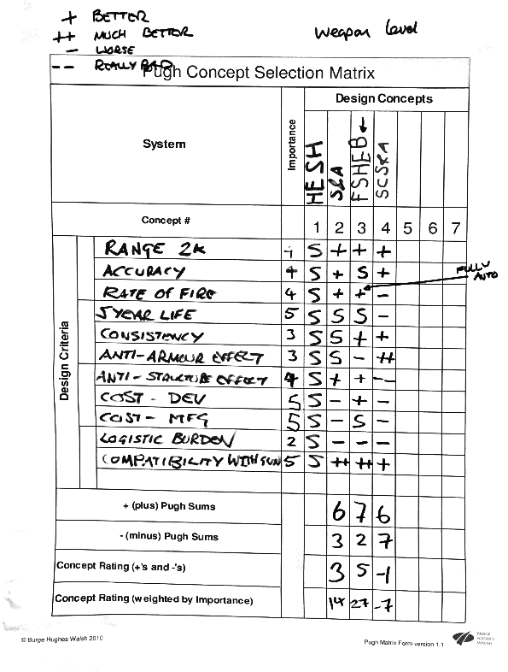
A Model Answer

Slide 45
Summary: Pugh Matrix
Pros
Provides a rapid assessment of alternative whole concepts
Can use stakeholder requirements to give greater confidence of compliance
Can help develop hybrid system concepts (qualitative optimisation)
Cons
Temptation to use too many requirements slowing down the process
Objective subjectivity! Can select criteria, weightings and scores to obtain any result!
Often no clear winner (but eliminates the weaker options)
Can be treated as a “handle turning” process without thinking

Slide 46
What Now
We have just selected our basic system concept(s)
We are about to do some detailed engineering and analysis to “work-up” the design in more detail so we can specify the sub-systems
This will involve determine sizes, selecting materials, performing stress analysis, etc.
Before we do we should just check the selected concept design will meet its requirements – we need to verify the design concept.

Slide 47
A key tool for Verifying the design concept is:
QFD 1
QFD 2
Design Requirements.
QFD 3
Solution Requirements
QFD 4

Realisation Requirements

Assurance Requirements
Customer Requirements

Design Requirements.

Solution Requirements
Realisation Requirements
Design Requirement Targets
Solution Requirement Targets
Realisation Requirement Targets
Assurance Requirement Targets

Slide 48
Quality Function Deployment Phase 2
What is it?
QFD 2 is concerned with capturing the translation of System Design Requirements into Solution Requirements
It can be used to:
  Verify the selected whole concept solution is compliant with the System Design Requirements
  Help define lower-level sub-system requirements
  Help identify Critical Design Parameters

Slide 49
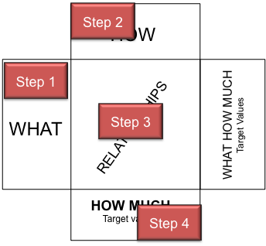
QFD 2 Process
QFD 2 uses the same basic process as for QFD 1
The process steps relate to completing one of the “rooms”
It can take several weeks to complete a room!
Step 1: Identify the chart WHAT list requirements
QFD 2: Transfer System Design Requirements
Step 2: Translate WHAT requirements into measurable HOW requirements
QFD 2: Translate Design Requirements into Design Solutions
Step 3: Determine relationships between WHAT and HOW requirements
QFD 2: Determine relationships between Design and Solution requirements
Step 4: Determine HOW MUCH for HOW requirements
QFD 2: Determine Sub-System Requirements

Slide 50
Step 1: Transfer Technical Requirements
The HOWs and HOW MUCHs of QFD 1 are the basis for the WHATs for QFD 2.
QFD 2
System Design
Requirements
QFD 1
The “list” of functions should be complete as possible, including those found during design iterations i.e. including solution dependent, architectural functions

Slide 51
Step 2: Translate into Solution Requirements
HOW
The WHATs of QFD 2 are the HOWS of QFD 1 which now require further definition in terms of the system solution
This is achieved by reference to the concept system solution, adding further decisions as necessary – architectural and supporting solutions
If we have performed a Function Means Analysis, then the translation can be taken directly from the FMA table as a route through the table
The selected concept system solution is written in the HOWs room.
If there are several candidate system solutions then either
  Several QFD 2 can be generated – one for each whole system concept
  A single QFD 2 created with multiple whole system concepts
Solutions
WHAT
Design Solution
Technical
Design
Requirements
Solution
Solution
Solution
Solution
Solution
Function
Function
QFD 1 HOWs
Function
Notes:
This slide shows the second stage of QFD 1 translating the customer requirements into technical requirements that are measurable. In other words HOW we intend to satisfy WHAT the customer requires.
The process is to consider each customer “what” in turn and translate this into technical requirements. These technical requirements should not specify solutions but remain general. Typically this is done by consideration of the functionality or features.
A key point to note here that some of the technical translations may well come from the customer requirement. This is very typical in defence products because the customer has set ideas about what they require.

Slide 52
Step 3: Determine HOW-WHAT Relationship Matrix
HOW
Design Solutions
WHAT
Technical
Design
Requirements
This method allows complex
relationships between the system functionality and system solutions to be depicted and easily interpreted
It also permits cross-checking.
Blank or sparse rows or columns indicate places where the translation of WHATs into HOWS is inadequate
If the QFD 2 is derived from the Function Means Analysis, then the leading diagonal will contain strong relationships. What is of interest is the off diagonal terms! They indicate potential emergent properties, interactions or interfacing issues.
Solution
Function
Blank or Sparse column
Blank or Sparse row
STRONG relationship
MEDIUM relationship
WEAK relationship

Slide 53
Tracer Example
QFD 2
Tracer
Solution from Function Means
Functional Requirements
from QFD 1
Relationships
Will the Solutions
deliver the functional requirements?
Tracer Specification
Importance of solutions

Slide 54
Exercise: QFD 2
Note: The intent here is to introduce QFD2. At this point new functions may have been identified – in reality they should be included in the QFD 2
Demonstrator.
For the case study exercise transfer functions and a system solution from the Function Means Analysis
Complete the relationship matrix and identify any interesting features
Time: 20 Minutes

Slide 55
Look for “Structure”
We should examine the resultant relationship matrix for “structure” as this will show how the system functionality is provided by the solutions and vice versa. It can help in the management of key design aspects

Slide 56
Step 4: Flow Down Targets and Ceilings
HOW MUCH is Enough?
The fourth element of the QFD 2 chart is flowing down the WHAT-HOW MUCHs to give a set of target values for the chosen the design solution
These are design characteristics/ parameters and targets for for the solutions and specify how good they have to be in order to satisfy the customer
If we are dealing with a system then the HOW MUCHs are sub-system specifications
If we are dealing with components or parts then the HOW MUCHs are the part specifications
At higher system levels the HOW MUCHs may be a simple flow-down, but at the lower levels it will be necessary to undertake detailed design work to obtain the desired information to complete the HOW MUCHs
HOW
WHAT
WHAT
HOW MUCH
HOW MUCH

Slide 57
Flowing Requirements Down
The relationships indicate that a particular design requirement target value needs to be appropriately “flowed-down” to define the solution requirement target values
What goes in the HOW MUCH boxes depends on the “level” of the system under consideration. If we are dealing with a big system at a high level then each box will contain Subsystem Requirements
What goes in the HOW MUCH boxes depends on the “level” of the system under consideration. If we are dealing with a big system at a high level then each box will contain a Subsystem Requirements

Slide 58
Tracer Example
QFD 2
Tracer
Solution from Function Means
Functional Requirements
from QFD 1
Relationships
Will the Solutions
deliver the functional requirements?
Tracer Specification
Importance of solutions

Slide 59
HESH QFD2

Slide 60
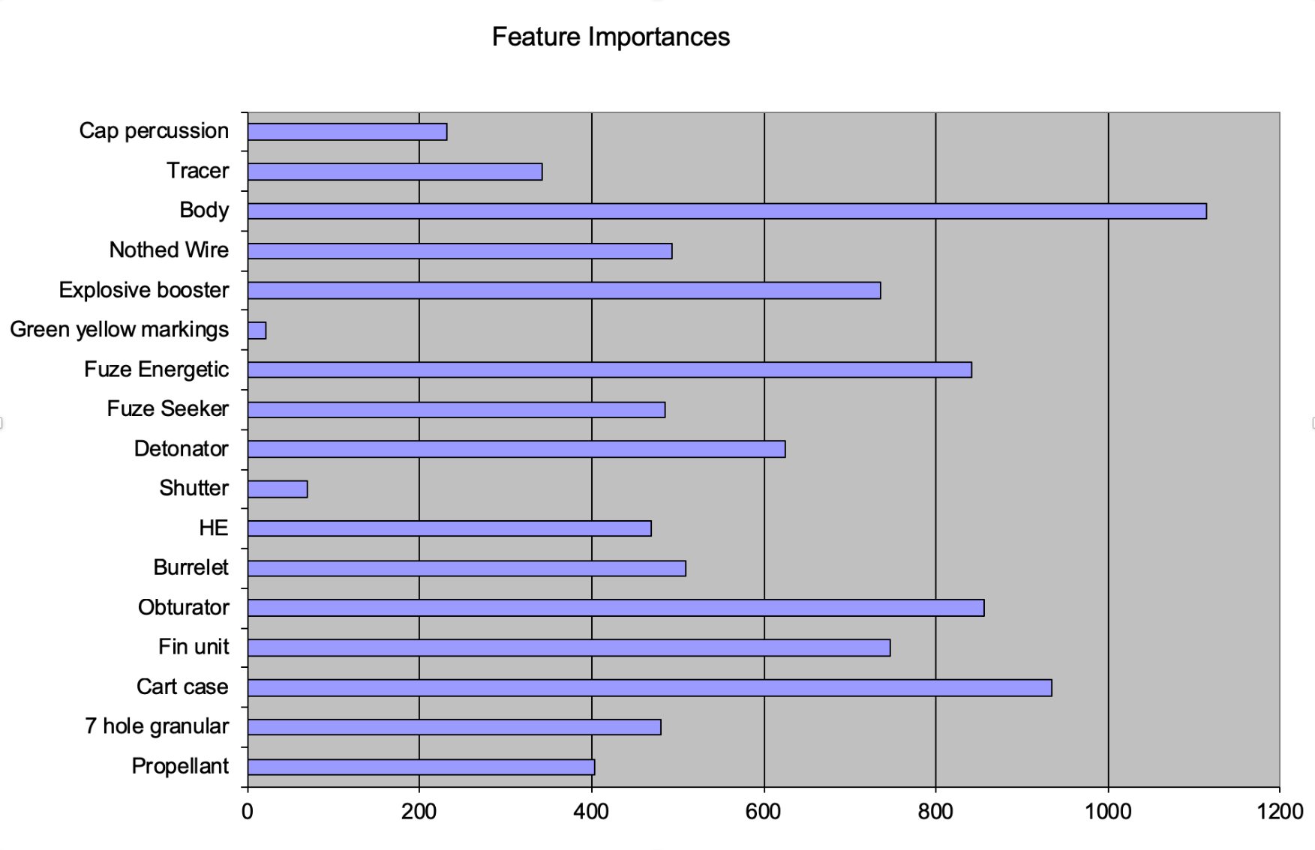
Critical Design Features
The QFD 2 can inform the critical design features

Slide 61
Sub-System Requirements
QFD 2 can help us develop Sub-System requirements - in fact the Sub-System requirements SHOULD be ready and waiting

Slide 62
QFD 2 Summary
Pros
Validates that system concept solutions are compliant with the System Design Requirements
Identifies potential system interactions that could result in undesirable emergent behaviour or integration issue
Identifies key/critical design features
Helps in the correct and complete flow-down of requirements to subsystem and ultimately component level
Helps manage requirements and trade-offs
Cons
If several concepts system exist requires the development of several QFD 2
Can take time to complete, particularly the flow-down of HOW MUCH requirements
Tips
Manage the detail – we design in levels, so restrict the QFD to 20x20
Take time to define clearly the functions and the corresponding functional solutions
Complete the relationship matrix is a single half-day session
Delegate the generation of subsystem requirements but review as a team
The actual target values for the design solutions are unlikely to be complete (TBD) until we have undertaken the detailed design

Slide 63
Start here after recap.

Slide 64
A Concept Design
Function Means Analysis is a very powerful tool for identifying and capturing potential functional solutions. It also allows the creation of potential candidate system design concepts. However, to down-select, from those candidates it is necessary to add detail by generating concept designs like that shown below:
Such diagrams should be prepared for each candidate system design concept

Slide 65
Exercise: Concept Integration
As a class
Perform a functional analysis to determine additional functionality
What are the proposed solutions?
Time: 20 Minutes

Slide 66
Example
The Concept Design
Requires additional solution dependent, emergent and architectural functionality – for example:
REGULATE MOTIVE FORCE
SEAL SYSTEM (PRESSURE)
REMOVE HEAT (FROM SYSTEM)
ALIGN INITIATING SYSTEM
SUPPORT FINS
Solution Dependent
Emergent
Architectural

Slide 67
Generic Functionality QFD 1

Slide 68
Generic Functionality QFD 1
Generic Functions

Slide 69
Generic + Solution Dependent and Architectural Functionality QFD 1
Generic Functions + Solution Dependent + Architectural Functions

Slide 70
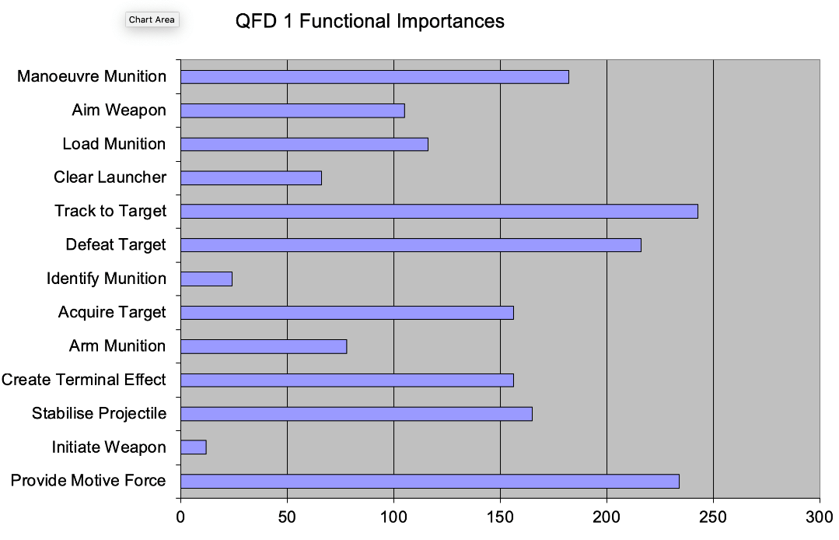
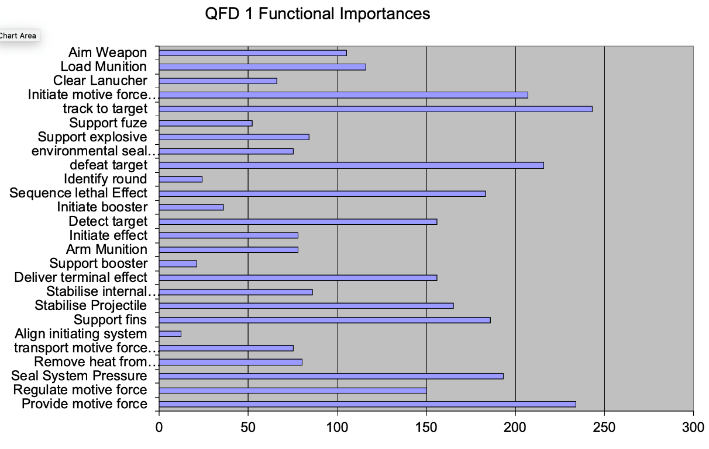
Update Functional Importance
Solution Dependent functionality can also be important especially if it contributes to important generic functionality
It is important, however, to review the calculated importance's to understand why certain functions are important and what impact they will have on the User/Stakeholder.
Design Book Functional Importances for the Case Study Generic Functionality
Design Book Functional Importances for the Case Study Generic+ Solution dependent and Architectural Functionality

Slide 71
Designing System and Specifying Subsystems
“To find out what happens to a system when you interfere with it you have to interfere with it.”
George Box

Slide 72
Update Functional Importance
Solution Dependent functionality can also be important especially if it contributes to important generic functionality
It is important, however, to review the calculated importance's to understand why certain functions are important and what impact they will have on the User/Stakeholder.
Design Book Functional Importances for the Case Study Generic Functionality
Design Book Functional Importances for the Case Study Generic+ Solution dependent and Architectural Functionality

Slide 73
System Design and Optimisation
The performance of a system will be influenced by a number of system design parameters – the variables that the designer selects to achieve the desired level of performance
The challenge for the system designer is to find the best target or nominal values for the system design parameters in order to meet or, better still, exceed the requirements.
For example if fin stabilization is selected
The terminal performance will depend upon the design parameters
  Number of Fins
  Fin configuration
    Leading edge angle
    Fin area
    Fin aspect ratio
    Fin thickness
    etc.
  Fin Material
  etc.

Slide 74
So Far…..So good
We have a set of functions
  That are checked against customer requirements
We have a set of solutions
  That are checked against the functional set
This has allowed us to identify key subsystems and components so we can pass on a specification to our manufacturer……
We also need to understand the sensitivity of the design….
One last investigation before we move forwards.

Slide 75
Solution Space and Design Space
The Function Means Table displays “all” the potential solution to the “design” problem stated by the functional requirements - it is the SOLUTION SPACE.
Having selected a concept solution we now move into the DESIGN SPACE
Having selected a concept solution we now move into the DESIGN SPACE

Slide 76
The Design Space?
Consider a simple system with just 2 design parameters
System
Performance
changing X₁ and X₂ will put “you” on a different part of the “mountain”
Mapping geography of the “mountain” is called Characterising the Design Space
Design
Parameter X₂
Design
Parameter X₁

Slide 77
Where is the best Place to be?
System
Performance
Required
Customer
Performance
Design
Parameter X₂
Design
Parameter X₁

Slide 78
The Best Place – the Global Optimum?
Having found the global optimum we can “work backwards to specify the target values for the design parameters
System
Performance
Target Value of X₂
Required
Customer
Performance
Design
Parameter X₂
Design
Parameter X₁
Target Value of X₁

Slide 79
All Systems are Subject to Noise?
In practice, the design target value will not be met for many reasons it will be subject to variation – we call this variation NOISE
Variation in Performance
Required
Customer
Performance
Variation in X₂ due to noise
Variation in X₁ due to noise
This design is sensitive to variation and its performance will frequently fall short of the customers expectation
What can be done to reduce the variation in performance?

Slide 80
The Classic Strategy: Tighten Tolerances
Variation in Performance
Required
Customer
Performance
Set Tight Tolerances for X₂
Set Tight Tolerances for X₁
The classic reaction to a sensitive design is to set tighter tolerances. This does work but often comes at a great cost.

Slide 81
Achieving Design Robustness
A Robust Optimum
Variation in Performance
New Nominal Value for X₂
New Nominal Value for X₁
This design is less sensitive to variation and will consistently meet the customers expectation

Slide 82
Designing System and Specifying Sub-systems (D)
Verify System Solution concept against Design Requirements
From Function Means Analysis and Pugh Matrix
From QFD 1 or Function Means Analysis
Quality Function Deployment 2
Design FMEA
Determine Critical Failures and Causes
P-Diagram
Critical Solution Elements
Identify Design and Noise Parameters
What-Why Table
Determine Critical Design and Noise Parameters
There is another activity, not included on this diagram, to search the design space to find the best nominal values
Update QFD 2

Slide 83
Determine Critical Design Parameters and Noise Variables
We need to find out which design parameters are sensitive to which noise factors
To achieve this we need to identify:
  the system response that relates to the critical customer requirements
  the design parameters
  the noise parameters
We use a Parameter Diagram

Slide 84
Qualitative Robustness and Critical Parameter Analysis
Parameter Diagram
Purpose:
To identify the critical design parameters and the dominant sources of variation (Noise) that could result in a non-robust design.
Approach
It is important to approach this activity in a disciplined and structured way. This can be achieved through using:
  The P-Diagram to identify, categorise and document those factors that affect the performance of system outputs
  The What Why Table to prioritise the identified factors for quantitative analysis
  The Design FMEA to identify, document and prioritise potential failure modes, effects and causes
Design Failure Mode and
Effects Analysis
What Why Table

Slide 85
The P (Parameter) Diagram
What is it?
A simple diagrammatic tool that allows a team to identify and capture the various factors (parameters) that influence the performance of a system output – in particular the factors that influence robustness.
Why do it?
Sensitive “cliff-edge” designs are unacceptable to customers and users
  they are a classic example of one of the three types of undesirable emergent behaviour.
However, all variation is caused and by consideration of the causes and their contribution can provide information to iterate the design and make it robust against the variation.

Slide 86
Parameter Diagram: The Factors
Transfer Function
Y = f (Ms, Ns, Zs)
Parameters that cannot be, or chosen not to be, controlled by the designer. They cause the response Y to deviate from the target specified by the Signal Factor M
N
Noise
Factor
The required performance characteristics of the system?
M
Signal
Factor
System
Output Y
Any potential unwanted behaviour
Side Effects
Parameters set by the user to set or command the intended value for the output of the system
Z
Control
Factor
Parameters that can be freely specified by the designer.
In fact it is the designer’s responsibility to determine the best values

Slide 87
P-Diagram Process
Step 1: Identify the output (Y) of the system
Step 2: Identify the Signal Factors (M)
Step 3: Identify the Control Factors (Z)
Step 4: Identify the Noise Factors (N)
Step 5: Identify side effects
Optional but very useful

Slide 88
P-Diagram – Example for Vehicle Braking
Step 1: Identify the output (Y) of the system
  The output is defined in terms of the ideal function of the system, subsystem, component or feature. It is a measurable characteristic of the function – that often relates to what the user requires and may be expressed in those terms.
Output Y
Stopping Distance
Braking System
Note: If we have several outputs for a system we should consider constructing a P-Diagram for each output. These should be compared to identify whether they can be combined.
Notice the output here relates to the whole system (the car) and what’s important to the user

Slide 89
Example for Vehicle Braking
Step 2: Identify signal factors (M)
  How does the user instruct the system to command the intended value for the output of the system. They are susceptible to the effects of one or more of the noise factors.
Signal Factor M
Force on the
break pedal
Output Y
Stopping Distance
Braking System

Slide 90
Example for Vehicle Braking
Step 3: Identify the control factors (Z)
  What are the parameters that the designer has CONTROL over that will cause the output (Y) to vary?
Signal Factor M
Force on the
break pedal
Output Y
Stopping Distance
Braking System
Control Factors Z
Pad material
Pad area
Applied pad force
Calliper type
Disk thickness
Disk material
Disk surface finish
etc
Design Parameters that could be Control Factors but are chosen by the designer not to be become Noise Factors. That is, you may not be able, or wish, to change the nominal value of a design parameter, but you may nevertheless wish to include VARIATION in the parameter in a robustness assessment.
It is important to understand the scope of the system of interest to determine which design parameters are to included as Control Factors and which are not since this influences the classification of parameters as design parameters or noise parameters, and indeed which type of noise

Slide 91
Example for Vehicle Braking
Step 4: Identify the Noise Factors (N)
  What are the parameters that cannot be, (or chosen not to be), controlled by the designer but will affect the ability of the control factors to achieve the required output.
Noise Factors
Manuf. Variation
Assembly Variation
Variation in friction coefficient
Road Surface Condition
Vehicle Loading
Ambient Temperature
Wear of pad over time
Vehicle speed
etc.
Signal Factor M
Force on the
break pedal
Braking System
Output Y
Stopping Distance
Control Factors Z
Pad material
Pad area
Applied pad force
Calliper type
Disk thickness
Disk material
Disk surface finish
Etc.

Slide 92
Example for Vehicle Braking
Step 5: Identify side effects
  What are the “side effects” that might be experienced by the user?. These are often undesirable emergent behaviour, that relates to the specific technology chosen to fulfil the function of the system.
Noise Factors
Manuf. Variation
Assembly Variation
Variation in friction coefficient
Road Surface Condition
Vehicle Loading
Ambient Temperature
Wear of pad over time
Vehicle speed
etc.
Signal Factor M
Force on the
break pedal
Braking System
Output Y
Stopping Distance
Control Factors Z
Pad material
Pad area
Applied pad force
Calliper type
Disk thickness
Disk material
Disk surface finish
etc
Side Effects
Brake dust
Brake “squeal”
Brake “judder”
Skidding
Heat

Slide 93
Noise the Causes of Variation
Although there are many causes of variation they can be put into three groups:
External: The environment and the load under which a system must function are the two main external sources of variation
    Temperature, humidity, vibration
    Operator usage
Unit-to-Unit Variation: The variation in a manufacturing process leads to variation in the system from unit-to-unit
    Manufacturing Variation
      Differences in torque on a fastener
      Differences in diameter from machining
      Raw material variation
    Measurement System Variation
      Calibration
      Gauge Repeatability & Reproducibility
Deterioration: As time passes the system characteristics can change leading to a deterioration in performance
Noise can also be categorised in terms of how it affects the output. It can either be direct or indirect

Slide 94
Indirect and Direct Noise Factors
Some noise factors are simply variation in the design parameters. They are indirect factors noise factors
Other noise factors do not influence the design parameters directly, but influence the output in their own right – they are called direct noise factors
Since indirect noise factors are simply variation in design parameters it is relatively easy to assess their impact via simulation or hardware experimentation
It is also important to assess the impact of variation* in direct noise factors on performance.
* In defining a nominal design, account should (must) be taken of the expected level of direct noise factors. For example the mean vehicle loading for a braking system design and the variation around that expected value.
Notes:
Type A: corrosion, leading to changes in dimensions and/or specific material properties
Type B: angle of incident air in gas turbine compressor; variation in this will influence the output characteristics of the blades, whilst not changing any design parameters directly.

Slide 95
Indirect Noise Factors
Some noise factors impact on the system to cause ...
Noise
Factors Z
Signal
Factor M
Output Y
Braking System
... Undesirable variation in system performance
Control
Factors Z
The effect of Indirect Noise Factors can be determined by varying the design parameters. Their inclusion is implicit
... the control factors to deviate from their design set point, resulting in ...

Slide 96
Direct Noise Factors
Some noise factors impact on the system to directly cause ...
Noise
Factors Z
Signal
Factor M
Output Y
... Undesirable variation in system performance
Braking System
Control
Factors Z
The affect of Direct Noise Factors can only be determined by including them explicitly in the analysis

Slide 97
Cascading P-Diagrams
Side effects can feedback and become sources of noise to subsystem
Side effects can interact with other systems. Systems Engineering tools like Function Flow Diagrams, QFD and FMEA can help find them
Braking System
Side Effects
Brake Dust
Heat
Vibration
Caliper Piston System
Other System
Side Effects
Leakage of brake fluid

Slide 98
Example: Consistent Light: Robust to Variation?

Slide 99
Exercise: P-Diagram
As a class
Consider your Munition Concept
Construct a P-Diagram for the output of Precision and Accuracy
Time: 30 Minutes
This can be very difficult for the whole munition concept…..
We eat the elephant a little at a time

Slide 100
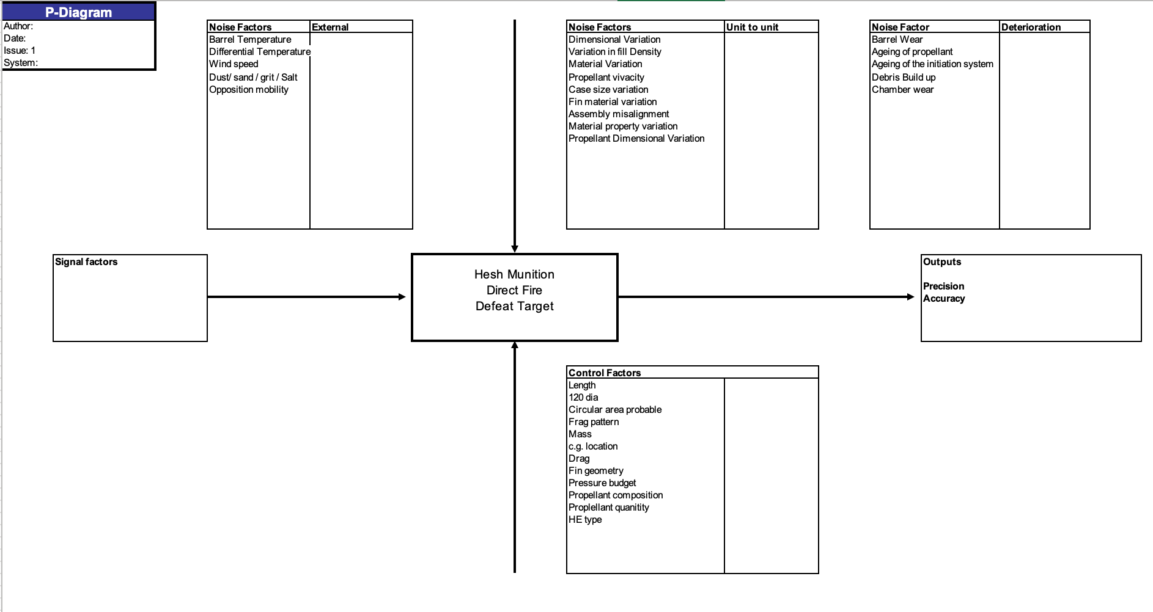
Case Study Example P-Diagram

Slide 101
P - Diagram - Summary
Pros
Straightforward to use
Promotes discussion
Captures external sources of Noise that can directly or indirectly affect system behaviour
Identifies potential “side effects” – unwanted behaviours
Cons
Often results in many factors – but it is what it is!
Difficultly in bounding the “situation”
Tips
Use a team to identify the various factors
Take time to decide what’s in and what’s out of scope
Clearly Define the output
Be detailed and specific when defining the Noise and Control Factors

Slide 102
Prioritising Control and Noise Factors
It is not uncommon for a P-Diagram to identify 50-100 noise factors and 20-50 control factors (design parameters)
It is not possible to study all of these, nor is it necessary as the Pareto principle often applies (80% of the variation is due to 20% of the Noise factors)
Our task is therefore to determine which of the identified noise factors are the most likely – this can be achieved using a What-Why Table

Slide 103
What-Why Table
What is it?
The What-Why table allows a design team to assess which factors are most likely to influence the robustness of a nominal design
Certain indirect noise factors will only influence certain design parameters (control factors). This relationship is not evident in a P-diagram but can be captured through the construction of a What-Why table
How to do it
Each noise factor is assessed as to how much variation it might cause around the nominal value of each design parameter (control factor)
Noise factors with no relationship to any design parameter (control factors) are direct noise factors and are dealt with separately.

Slide 104
Process for Constructing a What-Why Table
Step 1:
Using the P-diagram, the Design Parameters (Control Factors) are listed down the left hand side of the table and all Noise Factors are listed across the top
Step 2:
Each Design Parameter (Control Factor) is given a weighing in terms of the strength of it’s potential EFFECT on the selected output Y. In other words:
  How sensitive do we think the output is to variation in this design parameter ? -
  If the design parameter varies, within its expected range, will we see a little or a lot of variation in the output?
  Typically a 1,3,9 scale is used (blank=no effect,1 = little effect, 3 =moderate 9 = strong effect)
Step 3:
The body of the table is populated by rating how the expected variation in each Noise Factor will change the value of the Design Parameter and thereby affect its ability to achieve the required target output. The question is: “Does the variation in the Noise Factor cause variation in the Design Parameter?” If yes – by how much?
  Typically a 1,3,9 scale is used (blank=no effect,1 = little effect, 3 =moderate 9 = strong effect)
Step 4:
The values from step 3 and 4 are multiplied together and summed by row and column to enable prioritisation.
Notes:
The primary output is the one we’re trying to optimise (e.g. stress/life)
The secondary outputs are then the constraints (e.g. cost, mass)

Slide 105
Extract from a What and Why table for a Braking System
Highlights those control factors most susceptible to sources of variation
The expected manufacturing variation will have a strong effect on the Rotor Thickness
Noise
Unit to Unit Variation
Deterior-
External Variation
Factors
ation
Influence
Wear
Environment
Customer Usage
Control
on Output
Raw Mat'l
Mfg
Assy
over
Factors
Time
Temp
Water
Contam.
Vehicle
Vehicle
Road
load
speed
condition
Rotor
3
9
9
3
63
thickness
Dimen-
Pad area
9
9
3
1
109
sional
Caliper
3
3
3
1
19
Length
Material
Surface
9
9
3
9
9
270
Properties
Finish
81
117
9
54
48
81
81
0
0
0
Allows prioritisation of influential control parameters. If this is team judgement only – may wish to perform trials to quantify influence
Noise Factors that have no impact on the Control Factors are likely to be DIRECT
Identifies sources of variation with most influence over the performance of the design

Slide 106
Exercise: What-Why
As a class
Construct a What-Why Table to determine the critical Munition Design Parameters and Noise Factors
Time: 20 Minutes

Slide 107
Dealing with Direct Noise Factors
The noise factors ‘vehicle load’, ‘vehicle speed’ and ‘road conditions’ do not affect the Design Parameters but do influence its ability to meet stopping distance specifications consistently
If we were creating a nominal design we could consider these direct Noise Factors in our engineering analysis. For example, to find the right pad area to deal with the expected values of the direct noise factors, and then do a robustness assessment to appreciate what happens to stopping distance when these factors vary.
To do the latter we use a table to qualitatively assess the importance of variation in the noise factors in affecting variation in the output(s)
We identify these from the What-Why Table as the Noise Factors that have empty cells
Empty cells – potential Direct Noise Factor
Notes:
e.g. variation in mass of the car could be expected to be relatively large, so it’s anticipated impact on the stopping distance could be at least moderate.
variation in vehicle speed, although it has a strong influence on the stopping distance if it changes a lot, is likely to fluctuate only a little around its set value (e.g. 40mph +/-2), so it’s impact will be low, relative to variation in other noise factors.
Some cars have cruise control, for example, which virtually eliminates this source of variation.
Road conditions have a wide and uncontrollable variation, and could have a significant impact on stopping distance.

Slide 108
Dealing Direct Noise Factors
 | Direct Noise Factors
 | Variation in Vehicle Load | Variation in vehicle speed around signal factor level | Variation in Road conditions
Influence on Y=stopping distance | 4 | 1 | 9
This can be added to the What Why table

Slide 109
Modified What-Why Table for a Braking System
Noise
Unit to Unit Variation
Deterior-
External Variation
Factors
ation
Influence
Wear
Environment
Customer Usage
Control
on Output
Raw Mat'l
Mfg
Assy
over
Factors
Time
Temp
Water
Contam.
Vehicle
Vehicle
Road
load
speed
condition
Rotor
3
9
9
3
63
thickness
Dimen-
Pad area
9
9
3
1
109
sional
Caliper
3
3
3
1
19
Length
Material
Surface
9
9
3
9
9
270
Properties
Finish
System Output
Indirect
81
117
9
54
48
81
81
0
0
0
Stopping distance
Direct
4
1
9

Slide 110
Exercise: Direct Noise Factors
Demonstration
Identify the direct noise factors and construct a Direct Factor Robustness Assessment Table to determine the critical Noise Factors
Time: 20 Minutes

Slide 111
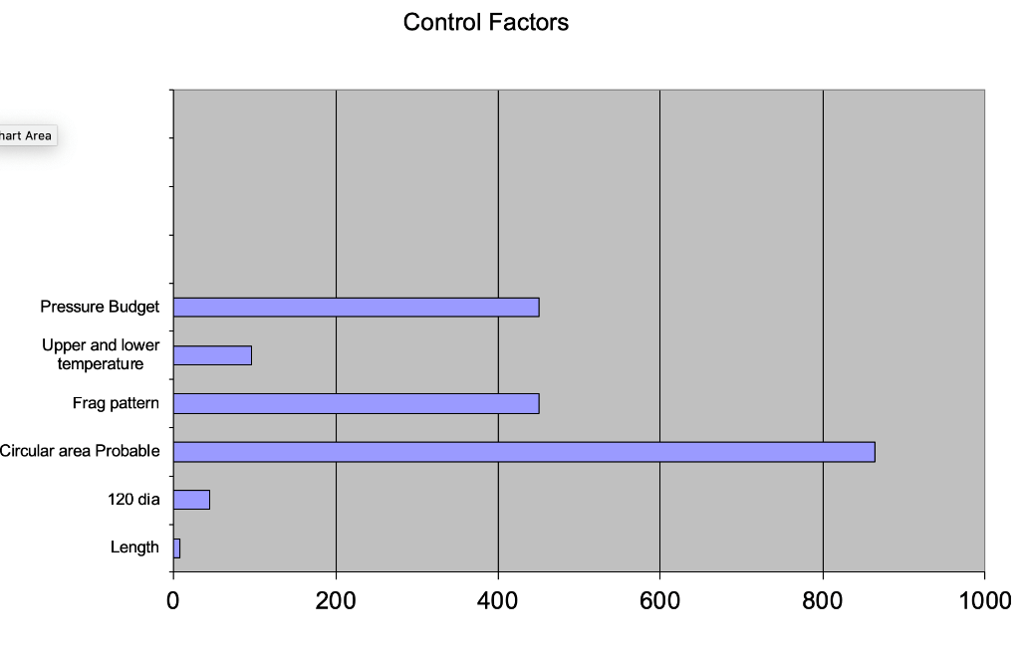
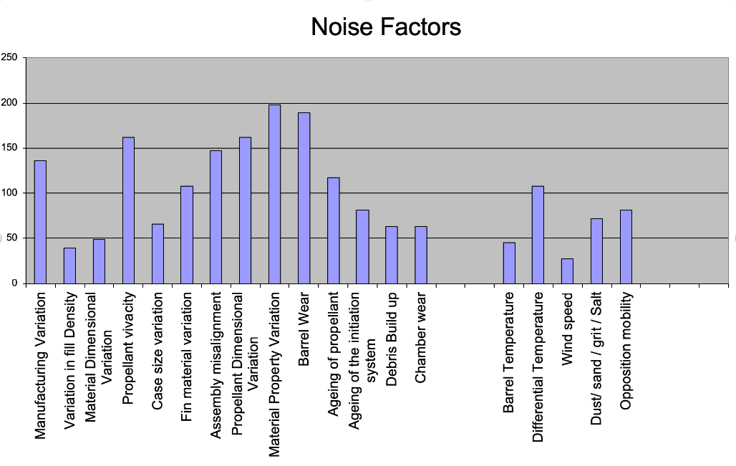
Case Study Example What Why Table

Slide 112
Summary: What Why Table
Pros
Can help systematically reduce the number of design parameters/noise factors for further consideration
Can capture and record design experience
Encourages team discussion and consensus decision making
Cons
Objective subjectivity! can select criteria, weightings and scores to obtain any result!
Can be treated as a “handle turning” process without thinking
Relies on a complete P-Diagram
Tips
Use a team to identify the various factors
Clearly define the:
  Output
  Control Factors
  Noise Factors
Check the outcome with experience

Slide 113
Dividing up the problem
At this stage we COULD go back a re-run the design QFD 1 and QFD 2 and extract important subcomponents for further analysis.
However…We have a mix of levels of functions in our analysis. We will need to specify these properly to ensure the design works.
We need a way of breaking the solution down further before we go to component level.
We will look at the architecture if the munition. Find out the purpose of each subsystem
Then evaluate the components of the subsystem

Slide 114
Munition Architecture and Subsystems
The nature of the selected munition design mean it has 4 distinct subsystems
Shell
Fin Assembly
Fuze
Case & Charge
Note: Not all systems are like this where the architecture and subsystems are obvious. However, irrespective of how the architecture is determined, what is important are the interfaces between the various subsystems.

Slide 115
N Squared

