Slide 1
Virtual LAN
Lecture 3

Slide 2
Objectives
Role of VLANs in a converged network.
Role of trunking VLANs in a converged network.
Configure VLANs on the switches in a converged network topology.
Troubleshoot the common software or hardware misconfigurations associated with VLANs on switches in a converged network topology.

Slide 3
Before VLAN

Slide 4
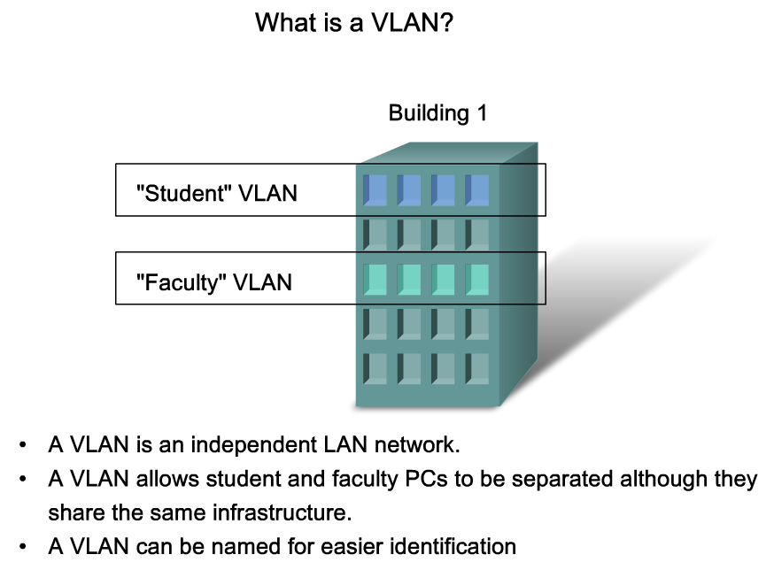
Role of VLANs in a Converged Network
A VLAN allows a network administrator to create groups of logically networked devices that act as if they are on their own independent network, even if they share a common infrastructure with other VLANs.
Notes:
Graphic 3.1.1.2

Slide 5
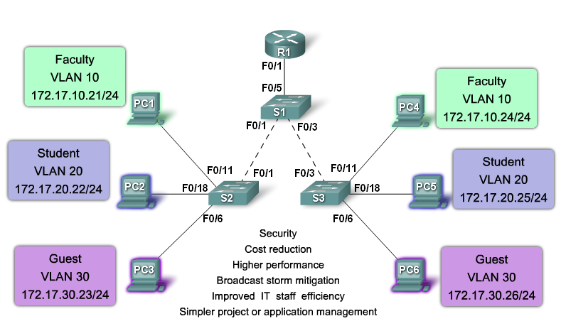
Role of VLANs in a Converged Network
Benefits of VLAN
Security
Cost Reduction
Higher performance
Broadcast storm mitigation
Improved IT staff efficiency
Simpler project or application management
Notes:
Graphic 3.1.1.2

Slide 6
VLAN Characteristics

Slide 7
VLAN Types
Data VLAN
Default VLAN
Native VLAN
Management VLAN

Slide 8
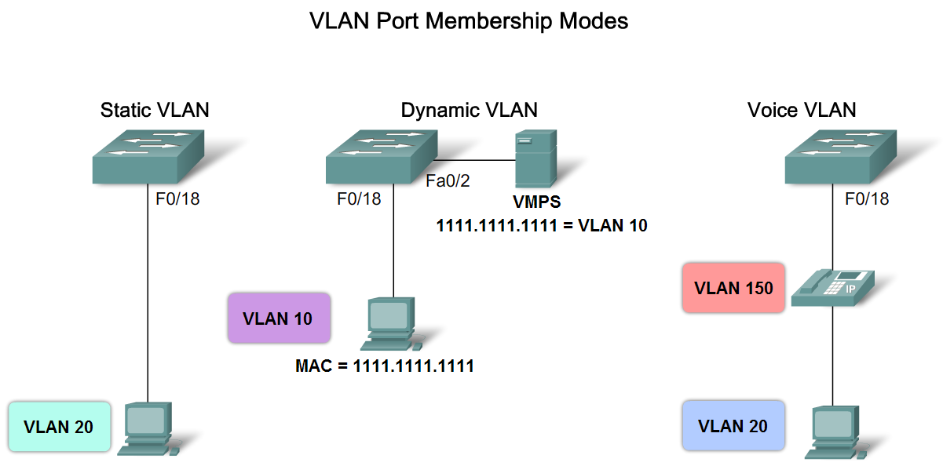
VLAN Port membership modes
Notes:
Graphic 3.1.3.1

Slide 9
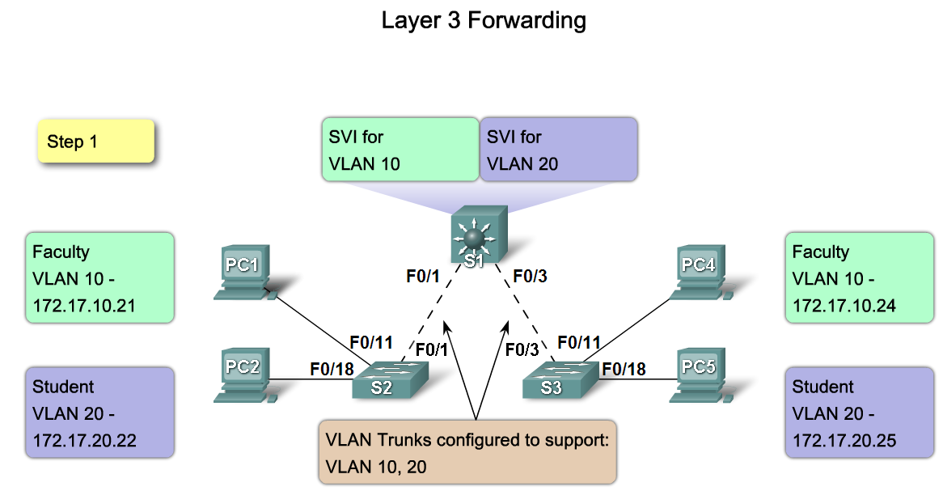
Broadcast Domains
Notes:
Graphic 3.1.4.3

Slide 10
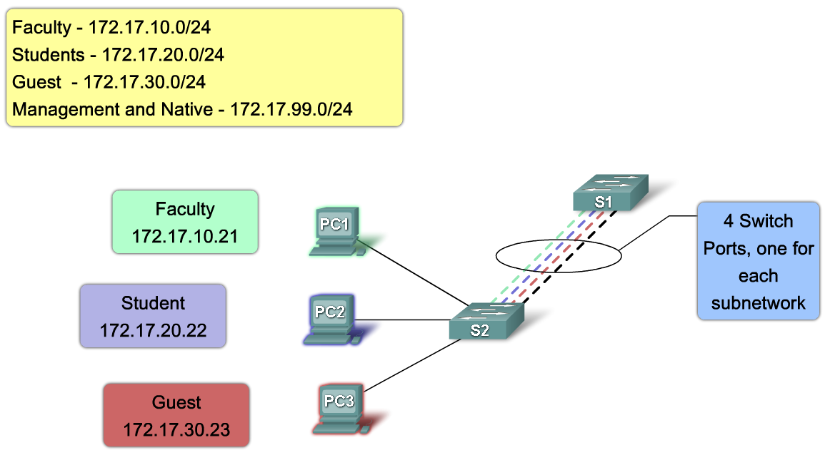
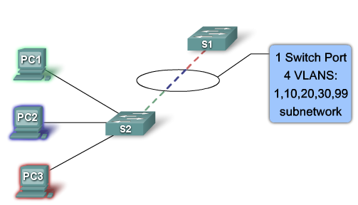
VLAN Trunking
A trunk is a point-to-point link between two network devices that carries more than one VLAN. A VLAN trunk allows you to extend the VLANs across an entire network. Cisco supports IEEE 802.1Q for coordinating trunks on Fast Ethernet and Gigabit Ethernet interfaces.
Without VLAN trunk
With VLAN trunk

Slide 11
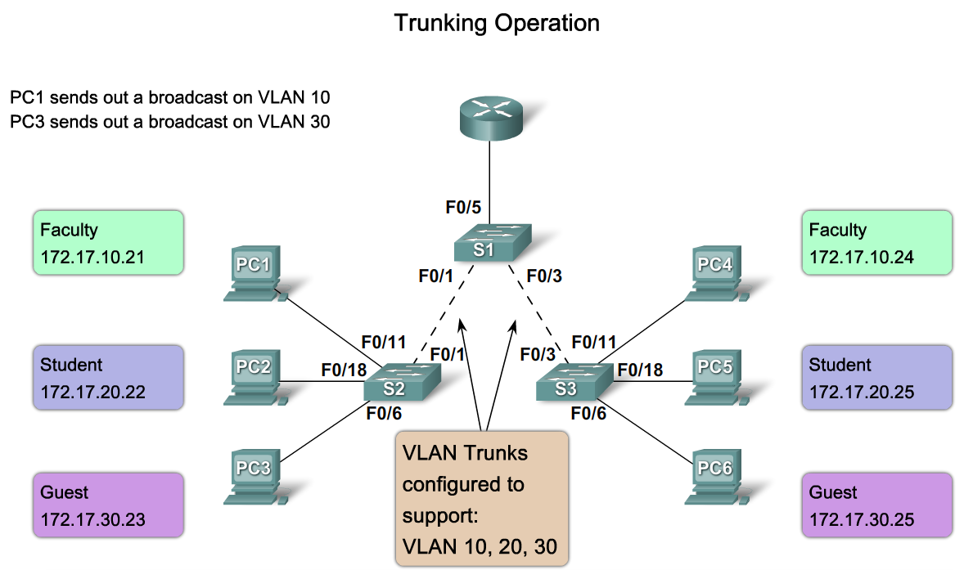
Trunking Operation
Notes:
Use graphic 3.2.2.1

Slide 12
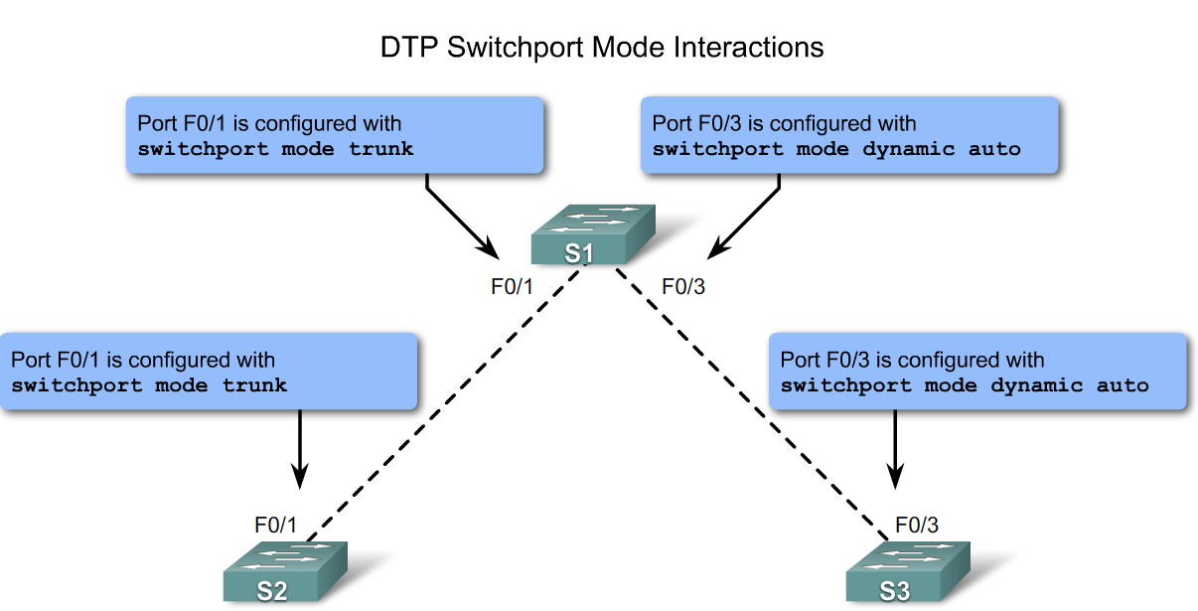
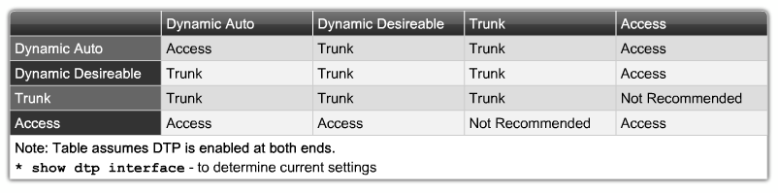
Switch Port Trunking
Notes:
Graphic 3.2.3.1

Slide 13
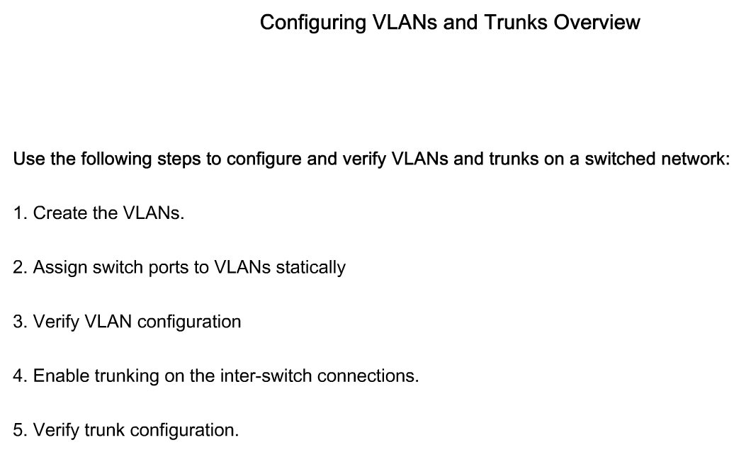
Configure trunks and VLANs
Notes:
Graphic 3.3.1.1

Slide 14
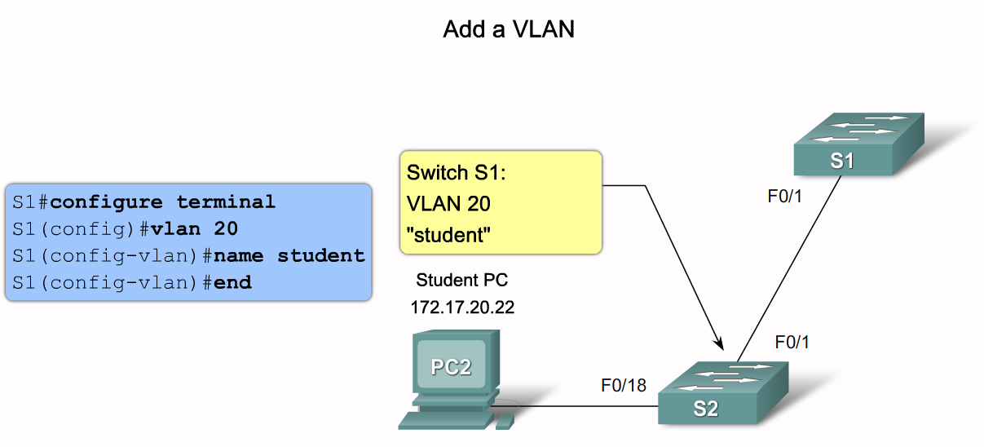
Cisco IOS commands to create a VLAN
Notes:
Graphic 3.3.2.1 ( if space is an issue use the example)
Graphic 3.3.2.2 (use example graphic)

Slide 15
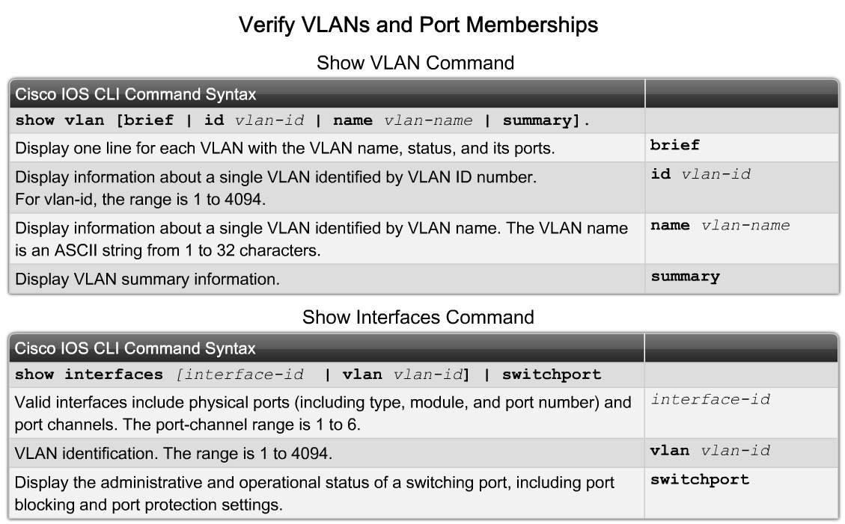
Cisco IOS commands to manage VLANs
Notes:
Graphic 3.3.3.1 (syntax)
Graphic 3.3.3.2

Slide 16
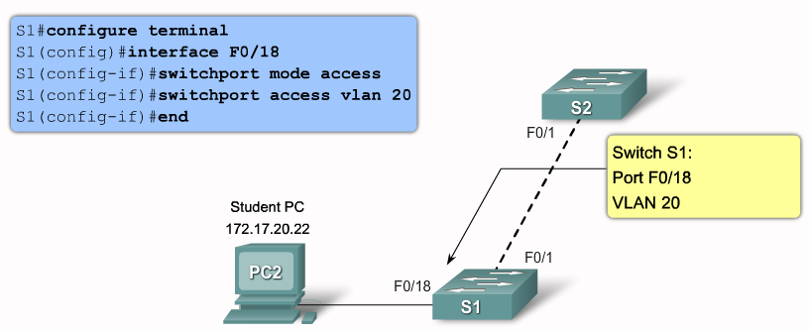
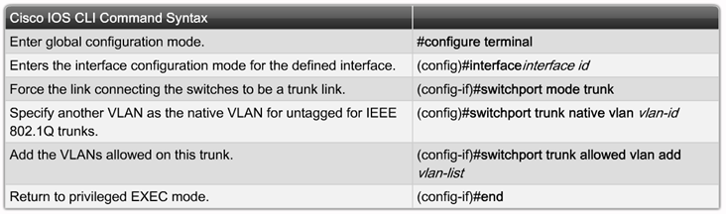
Assign Switch port to VLAN
Notes:
Graphic 3.3.4.1

Slide 17
Common Problems with VLANs and trunks
Notes:
Graphic 3.4.1.1

Slide 18
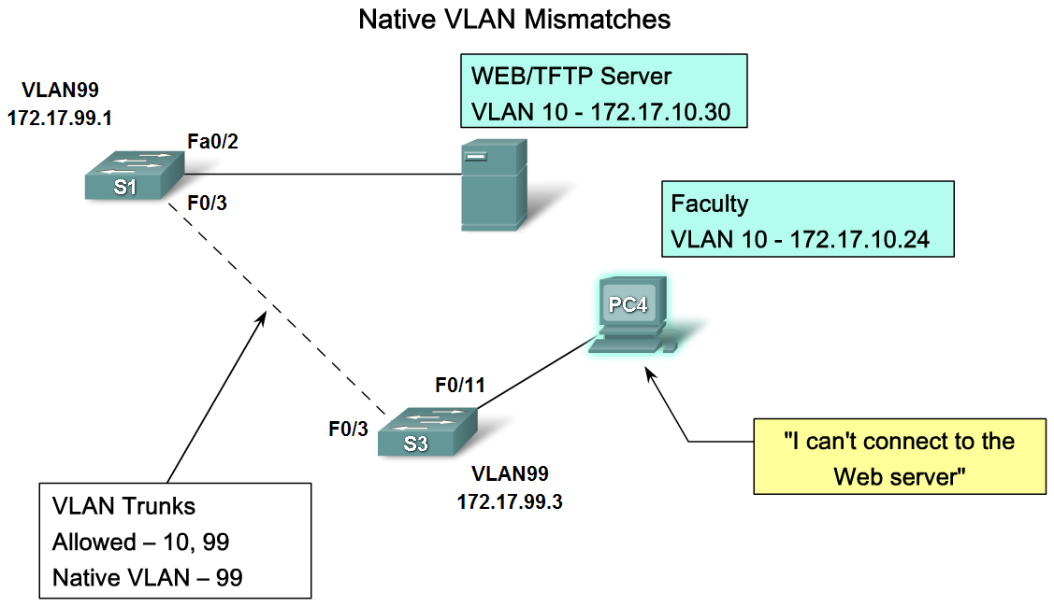
Troubleshooting Common Problems with VLANs
Notes:
Graphic 3.4.1.2
Graphic 3.4.1.3

Slide 19
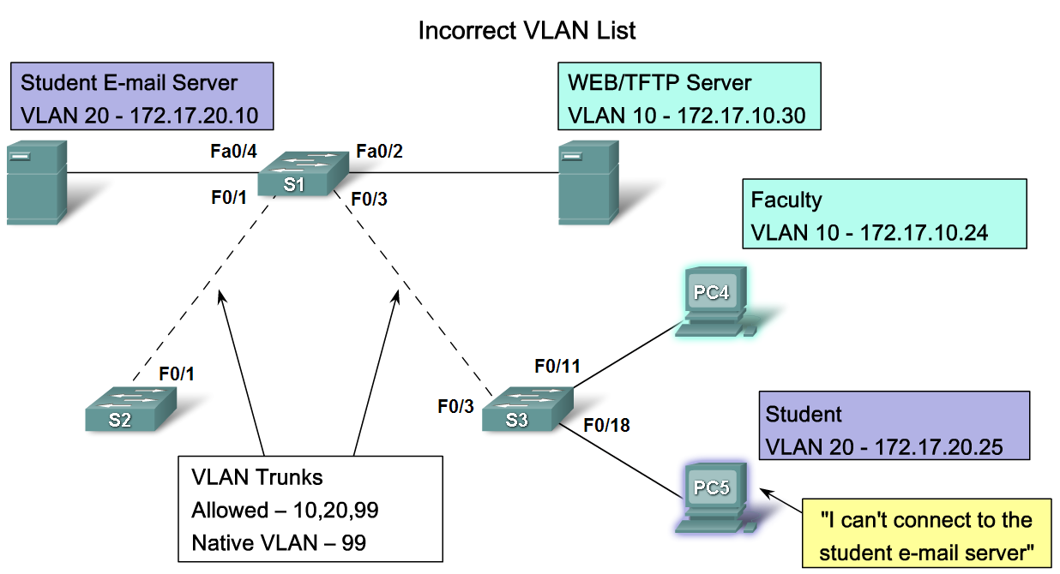
Troubleshoot Common Software or Hardware Misconfigurations Associated with VLANs
Notes:
Graphic 3.4.1.4

Slide 20
Summary
VLANS
Types of Traffic on a VLAN include
Communication between different VLANs requires the use of
Trunks
IEEE 802.1Q
Troubleshooting

