Slide 1




Effective Team Communication Supporting New Staff & Placement Students At Morgan Hotel.
Ayesha Amir
2306141
Specialist Placement: Leading Staff Development
BMGM6003
Antoinette Milne

Slide 2

Manager Approval
I discussed this training idea with manager (Chelsea) at Morgan Hotel
Manager agreed that communication during busy service needs improvement
They confirmed that new staff and placement students often struggle to communicate confidently
The manager approved this training session to support staff development and improve service quality

Slide 3
The purpose of this training session:
Help everyone communicate more clearly with each other during busy service
Make it easier for new staff and placement students to settle in and feel supported
Build confidence so every team member feels comfortable asking questions and sharing ideas
Encourage a friendly and supportive team environment
Make sure we deliver great service together and work efficiently as a team
Understand the different ways team members learns.
According to Mamqi (2023), research from Gallup shows that when companies invest in training their employees, staff perform better and work more confidently, which can increase company profit by about 11%

Slide 4

Why Is This Training IS Important
According to Mamaqi (2023) Training is very important for employees because it helps them improve their skills, knowledge, work performance and help the company grow.
Learn New Skills and improving in work
More Confidents and Motivated
Team Communicate and work together better
More profit and keep employees together.
Training is not for new staff; it helps all employees to learn something new.

Slide 5
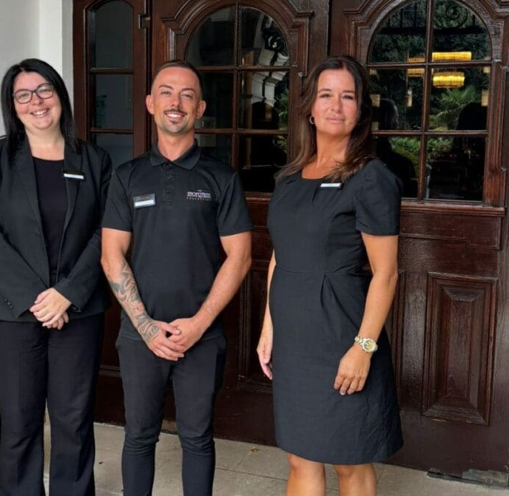
Avoid Mistakes and Ensure Smooth Service
Example: If new staff or placement students are not properly guided about the menu ingredients, it can cause miscommunication between customers, kitchen staff, and service staff.
If we guide new staff and students properly, it can reduce stress, increase confidence, and create stronger teamwork.
Benefits:
More efficient service
Happier staff
Positive customer feedback and reviews

Slide 6

Staff Performance Analysis
During my placement, I noticed that communication sometimes became difficult, especially when the restaurant was very busy.
Staff were under pressure, which led to mistakes when entering orders into the system.
New staff were not always confident about the menu and often didn’t ask questions when they were unsure.
This lack of confidence sometimes caused confusion and small errors during service.
As a result, service became slower and more stressful for the team.
In some cases, this affected customers, as they experienced delays or received incorrect orders.
Overall, it showed how important clear communication and proper training are for smooth service.

Slide 7
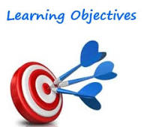
Learning Objectives
By the end of this session, You will be able to:
Communicate clearly and confidently with employees in Restaurant.
Support New staff and Placement student effectively
Recognise the different learning styles and adapt communication
Contribute to a friendly and efficient team environment.

Slide 8
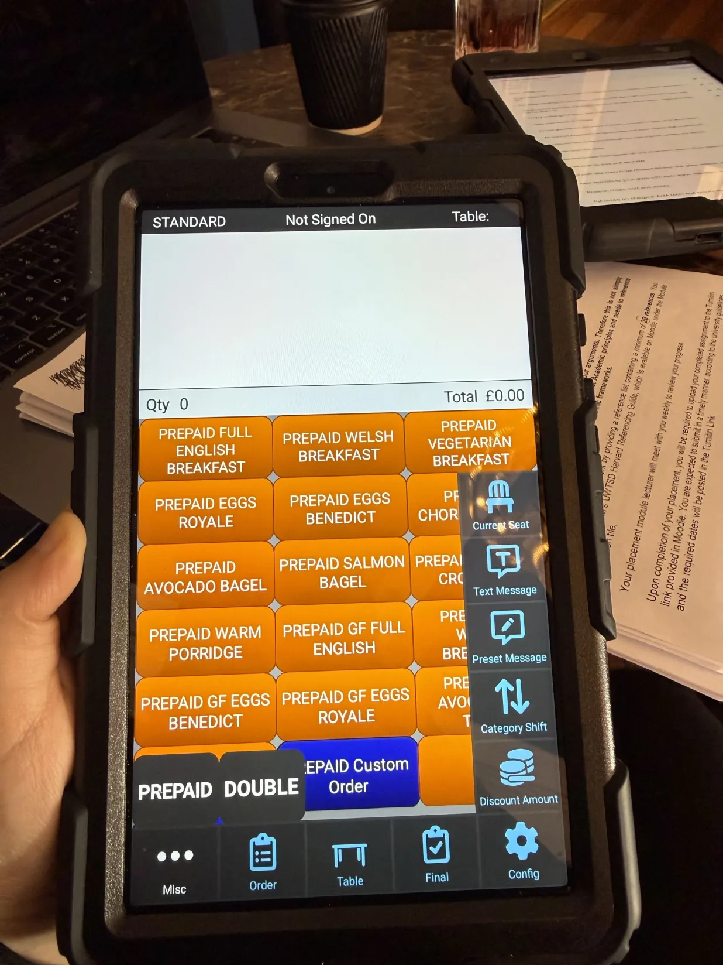
What is Effective Communication?
According to Emerson College (2024) “Effective communication is the process of exchanging ideas, thoughts, opinions, knowledge, and data so that the message is received and understood clearly and purposefully.”
Clarity – The communication message has been easy understand
Listening – paying attention to what other people has said.
Feedback – checking the message was understood
Respect – speaking politely and professionally
Non-verbal communication – the body language, eye contact and tone of voice.
Notes:
Clarity- A supervisor clearly tells a new staff member:
“Table 5 ordered Full Breakfast 2 eggs, 2 sausage no black pudding but no mushroom but extra potato rosti ”
Because the message is clear and simple, the staff and kitchen understand the order correctly and avoid mistakes.

Slide 9
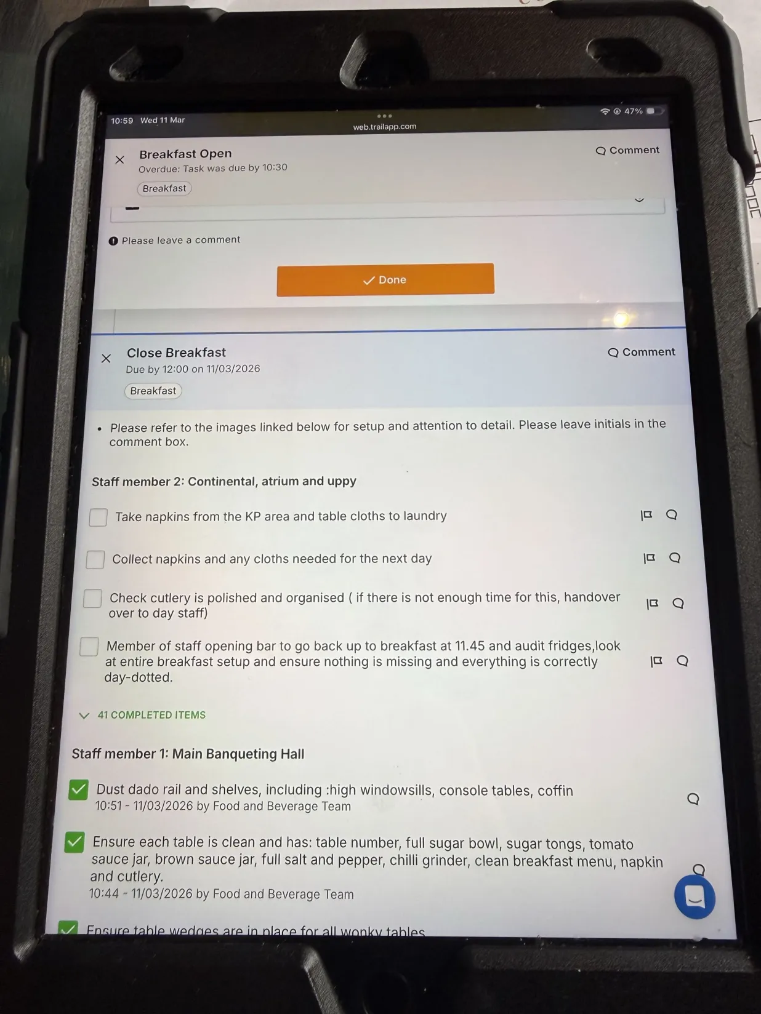
Why communicate matters?
Using the app properly can really make a big difference in a restaurant. It makes things easier for staff and helps the service run more smoothly. When orders are put in correctly, there’s less confusion, and it helps the front of house and kitchen team stay on the same page.
This comes down to training staff showing them how to use the app and how to handle tasks while service is busy. When staff feel confident using the system, their communication becomes quicker, clearer, and more organised.
It also helps to keep small notes on the side or use a simple checklist with table numbers. During busy times, this can be a lifesaver and makes sure nothing gets missed, like special requests or extra items.
And most importantly, not leaving things until the last minute is key. Keeping everything updated in real time helps avoid delays, reduces stress, and keeps the whole service flowing smoothly.
Pocket Touch App
Trail App

Slide 10
Why Effective Communication is Important?
To improve understanding and clarity, effective communication ensures that everyone is on the same page.
To enhance teamwork, good communication helps team members work well together and support each other.
Clear communication allows team members to share ideas, helping them make better and smarter decisions.
Good communication builds trust and helps the team get along better.
Clear communication reduces misunderstandings between staff and the kitchen.
Taking time to listen helps staff understand each other better.

Slide 11

Area to be improve
Lack of Clear communication during service.
In a busy restaurant, communication between team members is very important. When communication is not clear, mistakes can happen during service.
New Staff and placement students may feel unsure
New staff and placement students may feel unsure. They are often nervous about asking questions or communicating with others. This can happen when they do not fully understand the menu, service procedures, or their responsibilities.
Impact on team and service
Slower Service
Stress for team members
Mistakes in orders
Low customer satisfaction
Notes:
During my placement, I observed that communication is very important during busy service. However, new staff and placement students sometimes feel unsure about their tasks or hesitate to ask questions. This can cause small misunderstandings between the kitchen and service team. Because of this, I identified team communication and support for new staff as an area that could be improved through training.

Slide 12
Communication Tools in THE RESTUARANT
WhatsApp:
After every shift, WhatsApp is used to communicate with the head management team. Staff share information about any problems during service and the number of customers served. This helps keep management updated and improves future planning.
Suggested Improvement:
One change I would suggest is introducing a dedicated communication app for placement students and new staff once they join the hotel. This will help them stay informed about daily activities, understand what is expected, and feel more connected with the team.
Other tools we can use is that we get staff to use trail app most often and get task done during day and make them feel confidences and this will help them to ask more often question and sometime get them into pairs because some new staff or new placement students feel shy or not sure what to do.
Task/Trail App:
Another useful tool is encouraging staff to use a task or trail app regularly. This helps staff complete daily tasks efficiently and builds their confidence. It also encourages them to ask questions and stay engaged in their work.
Team Support (Pairing Staff):
New staff or placement students can sometimes feel shy or unsure about what to do. Pairing them with experienced team members can improve communication, help them learn faster, and make them feel more comfortable.
Training Videos / Audio Support:
Having videos or audio guides that explain how everything works in the restaurant would be very helpful, especially for new staff. These can be available in different languages so everyone can understand easily. The videos can show where things are located and explain how the restaurant operates on a day to day. This helps staff feel more confident and reduces confusion during their shifts.

Slide 13
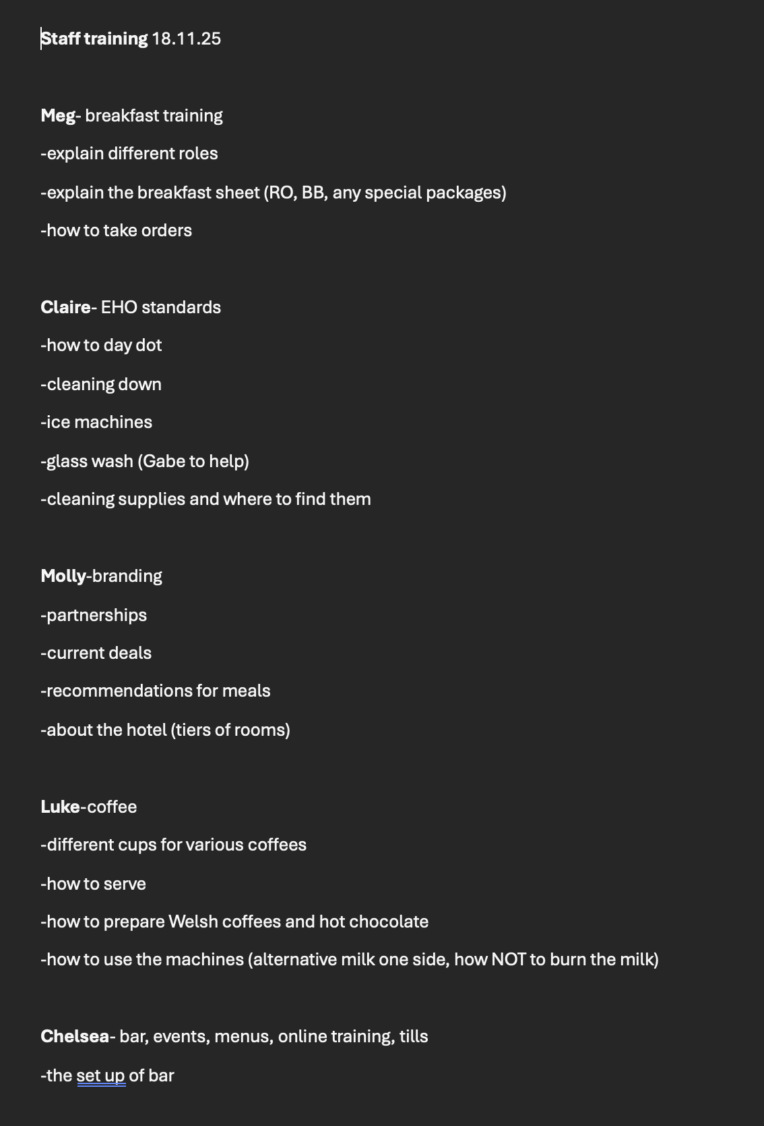
Weekly staff training is important, so everyone understands new laws, hotel procedures, and updates from management. It also helps the team prepare for upcoming events, know what to order, and stay informed. This is why training should be held every week or every two weeks.
Last staff training was on 18.11.25
(Morgans Hotel, 2026)

Slide 14
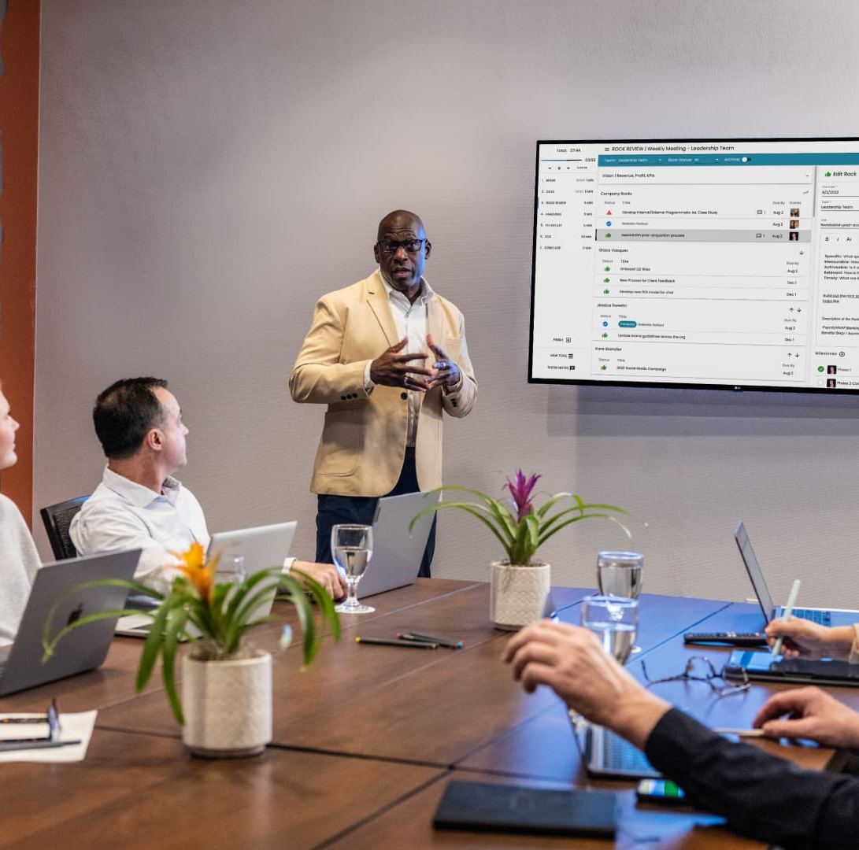
According to Blau, (2021) “With the understanding that communication is key, we instituted weekly “pod” meetings so that team members can openly talk about issues or ask questions. with an end goal of identifying solutions to those problems or answers to those questions. These meetings improved communication and allowed staff to get to know each other better. We instituted weekly departmental manager meetings to increase transparency and ensure that all staff receive clear communication about practice changes.”
It is important to have weekly meetings for new staff so they can get updates, learn about hotel procedures, and discuss any issues. They can give feedback, which helps improve the hotel, as mentioned in their training.
Notes:
Weekly team meetings allow staff to share problems and ask questions, helping find solutions together. This improves communication, teamwork, and helps everyone stay updated with any changes.

Slide 15
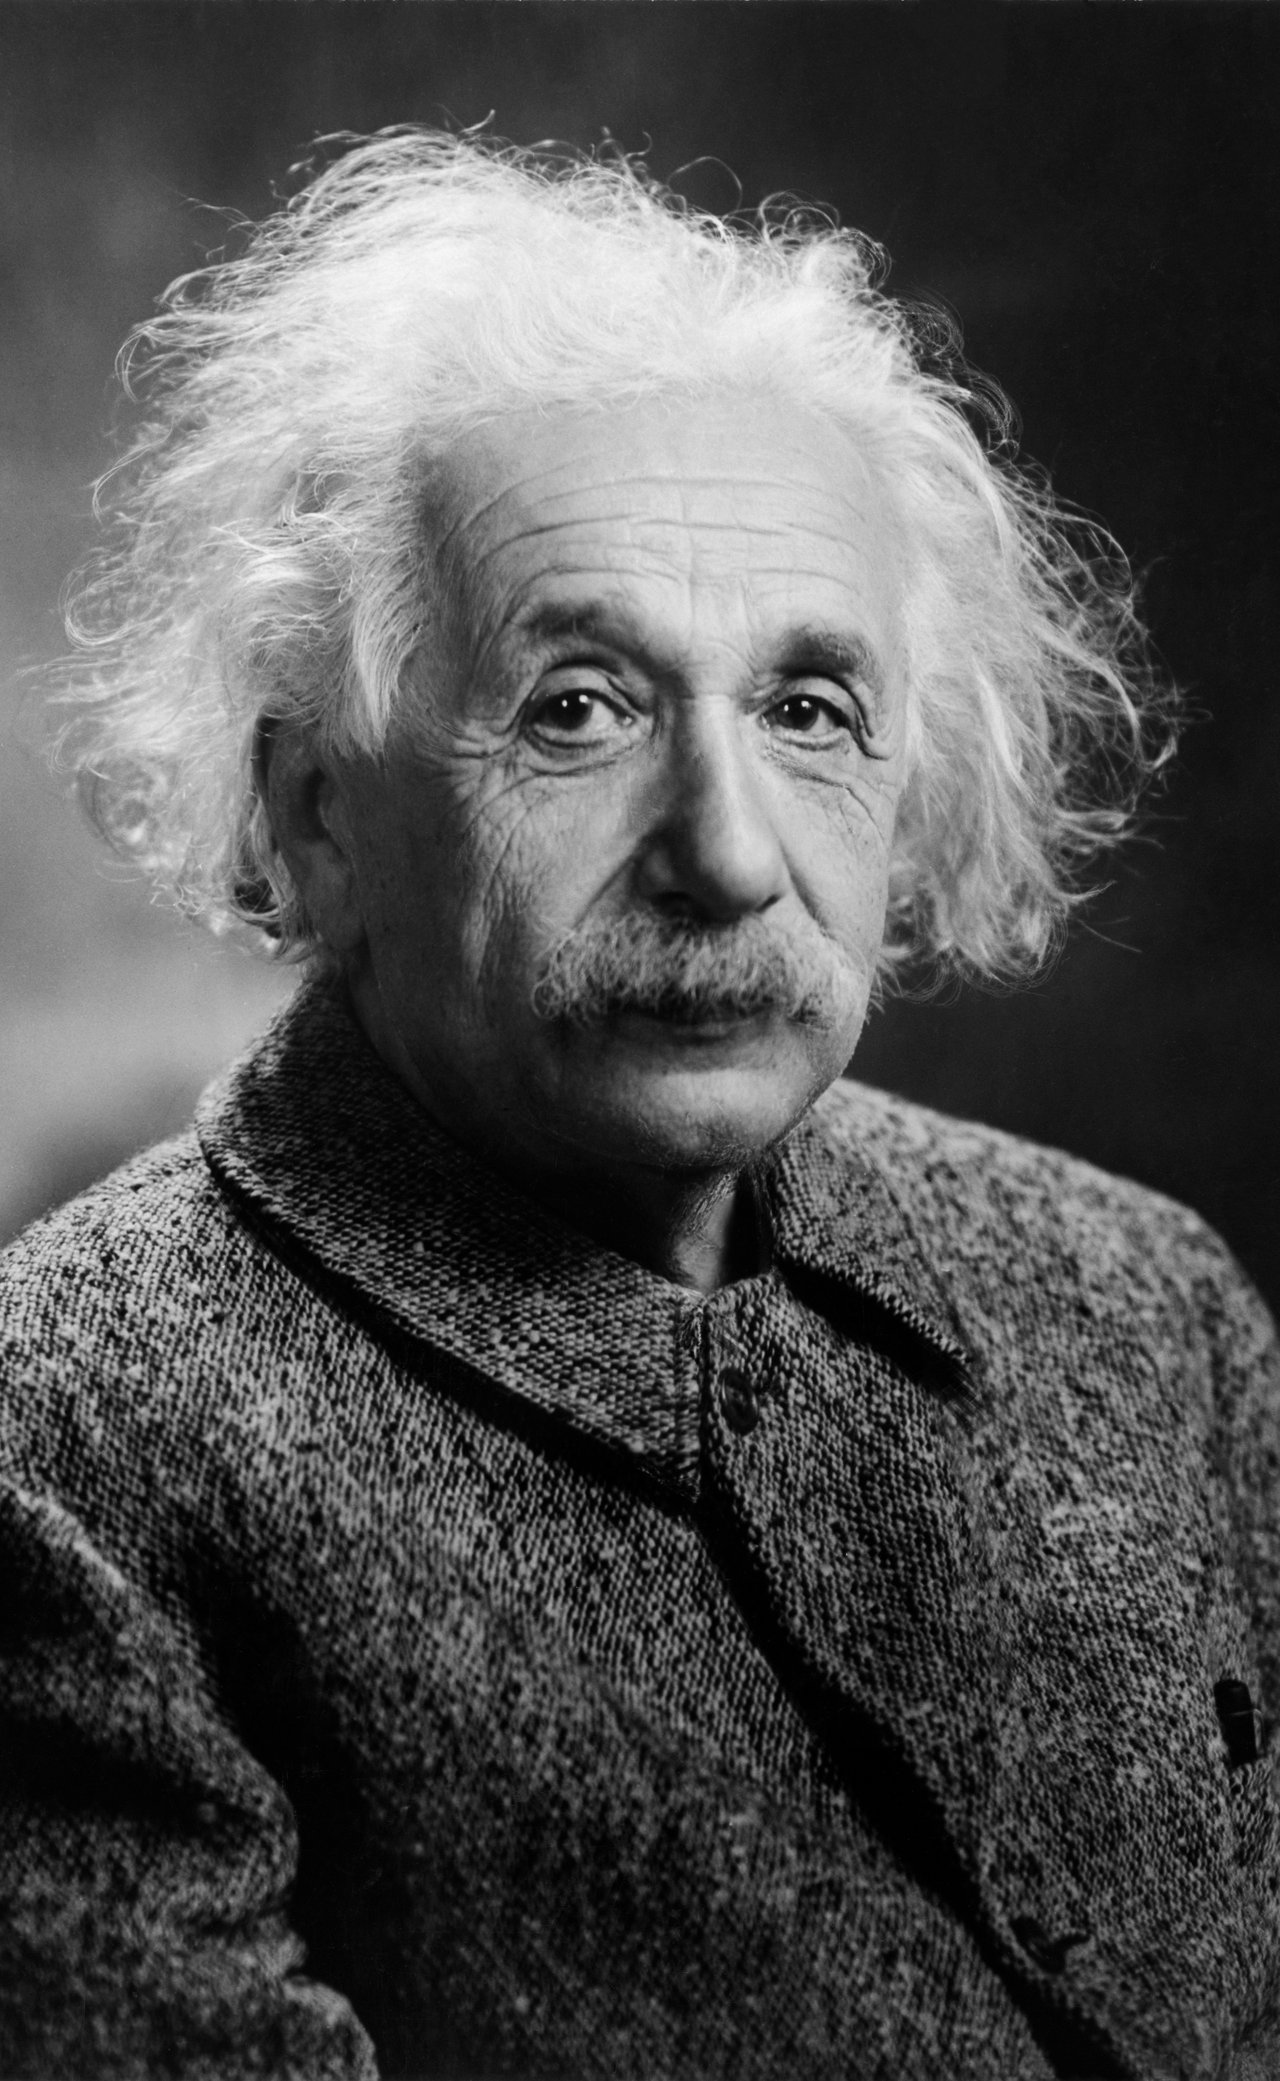
Communication problem
From a research I found. According to Albert Einstein “We cannot solve our problems with the same thinking we used when we created them”. By this he means to solve a problem, we must think differently or try a new approach.
If a team in the restaurant is having a communication problem during service, they are using the same communication style, the problem will continue. But instead, if they change the way they communicate (Training, instruction or team briefing) the problem could be improving.
(Digiovanna, 2024).

Slide 16
Staff Training Activities
Staff could use those activities to improve on the communication, by using those:
Role play -
Staff will practise taking orders and communicating with kitchen staff
App Practice (Pocket Touch)
Staff will practise entering orders correctly during a simulated busy service
Pair Work
New staff will be paired with experienced staff to improve confidence
Group Discussion
Staff will share challenges and suggest solutions

Slide 17
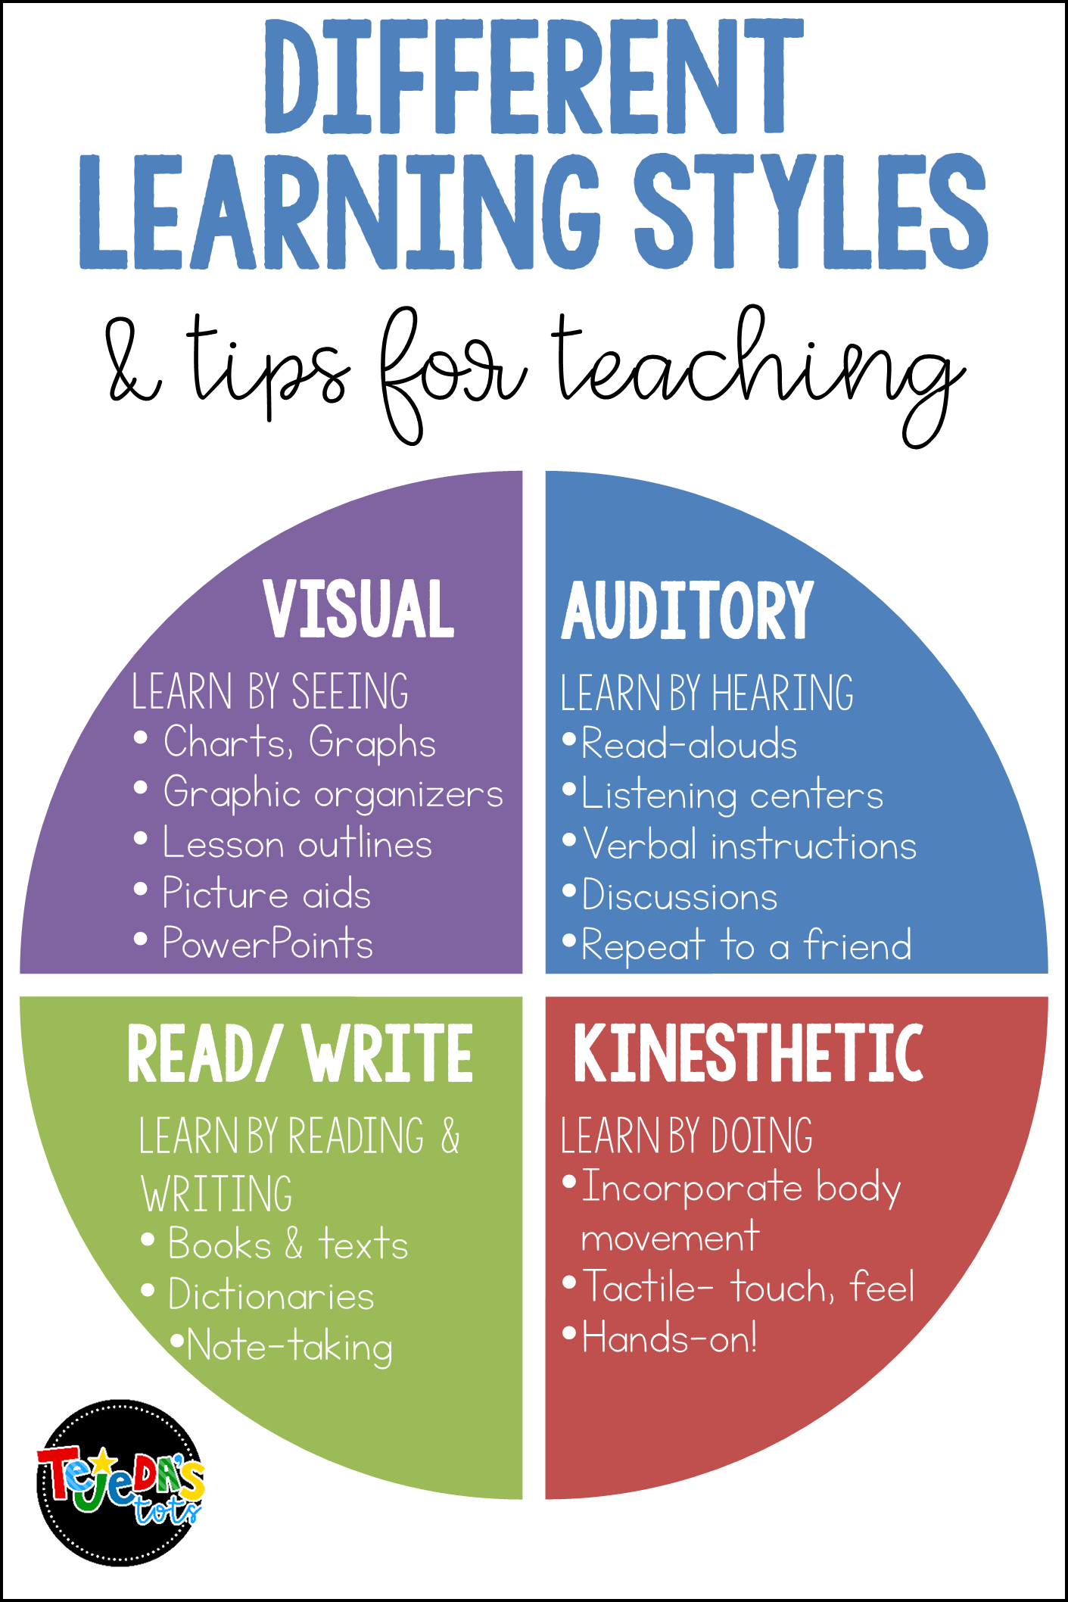
4 Different Learning Styles

Slide 18



Learning Styles
Every person learns differently. Some people learn best by writing notes, others prefer listening to audio recordings and reviewing them at home. Some may prefer watching videos or demonstrations to understand how things work.

Slide 19
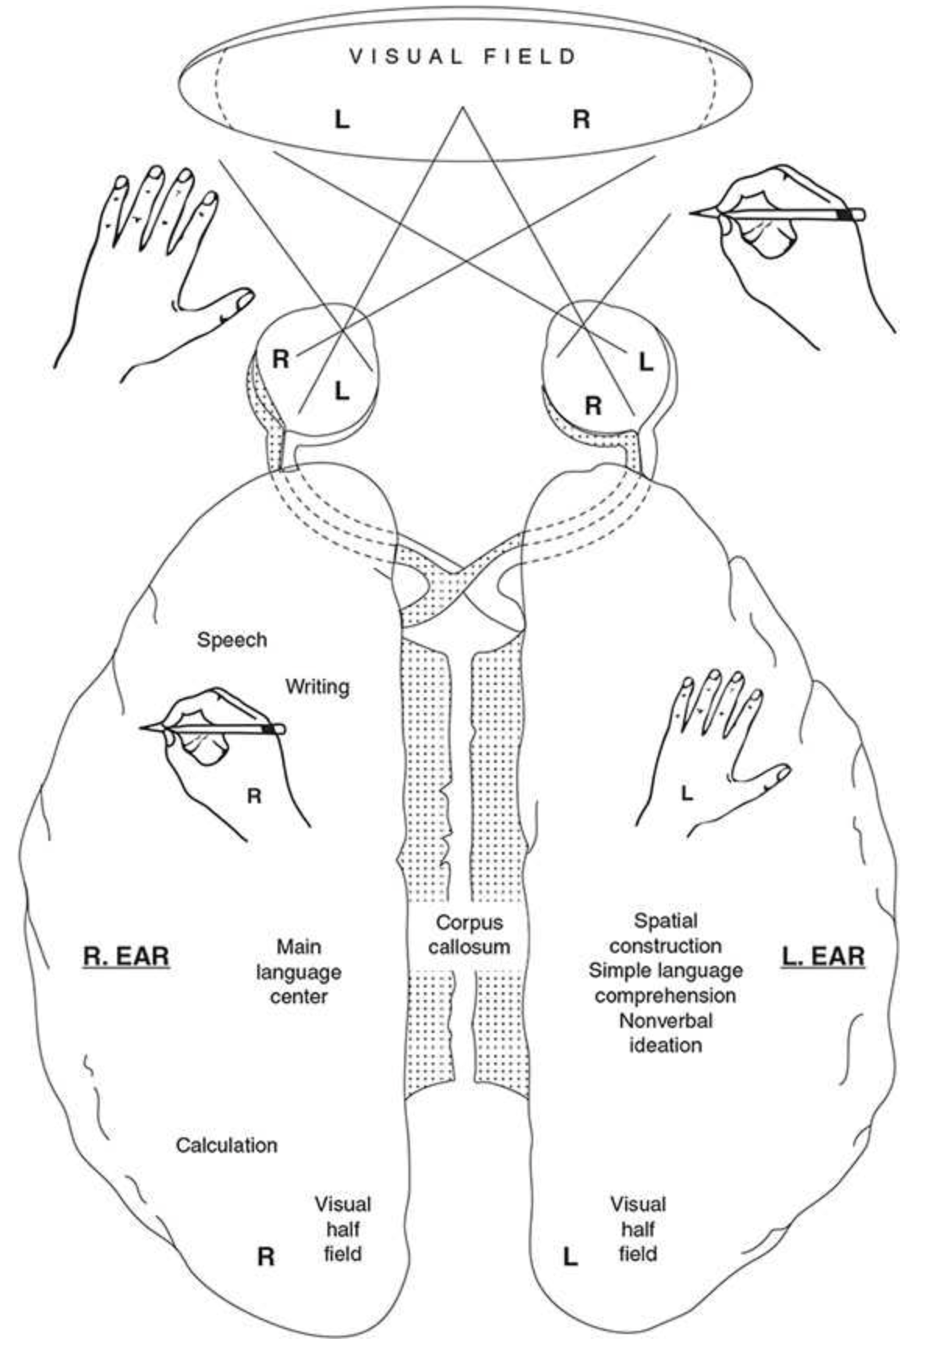
According to Kolb (2015, p.62) the brain is divided into two halves, called the left and right hemispheres, and how each side has different functions but works together. Information from what we see is split into two parts, where the left visual field is processed by the right side of the brain and the right visual field is processed by the left side. Each hemisphere also controls the opposite side of the body, meaning the left brain controls the right hand and the right brain controls the left hand. The left side of the brain is mainly responsible for language, including speech, writing, and calculation, while the right side focuses more on spatial awareness and non-verbal thinking. Both sides are connected by a structure called the corpus callosum, which allows them to communicate and share information. Overall, the diagram shows how the brain is specialised but still works as one system.
Notes:
Left hemisphere (left side of brain):
Language (speech, writing)
Maths and calculation
Main communication center
Right hemisphere (right side of brain):
Spatial skills (understanding space, shapes)
Non-verbal thinking (images, ideas)
Basic language understanding

Slide 20
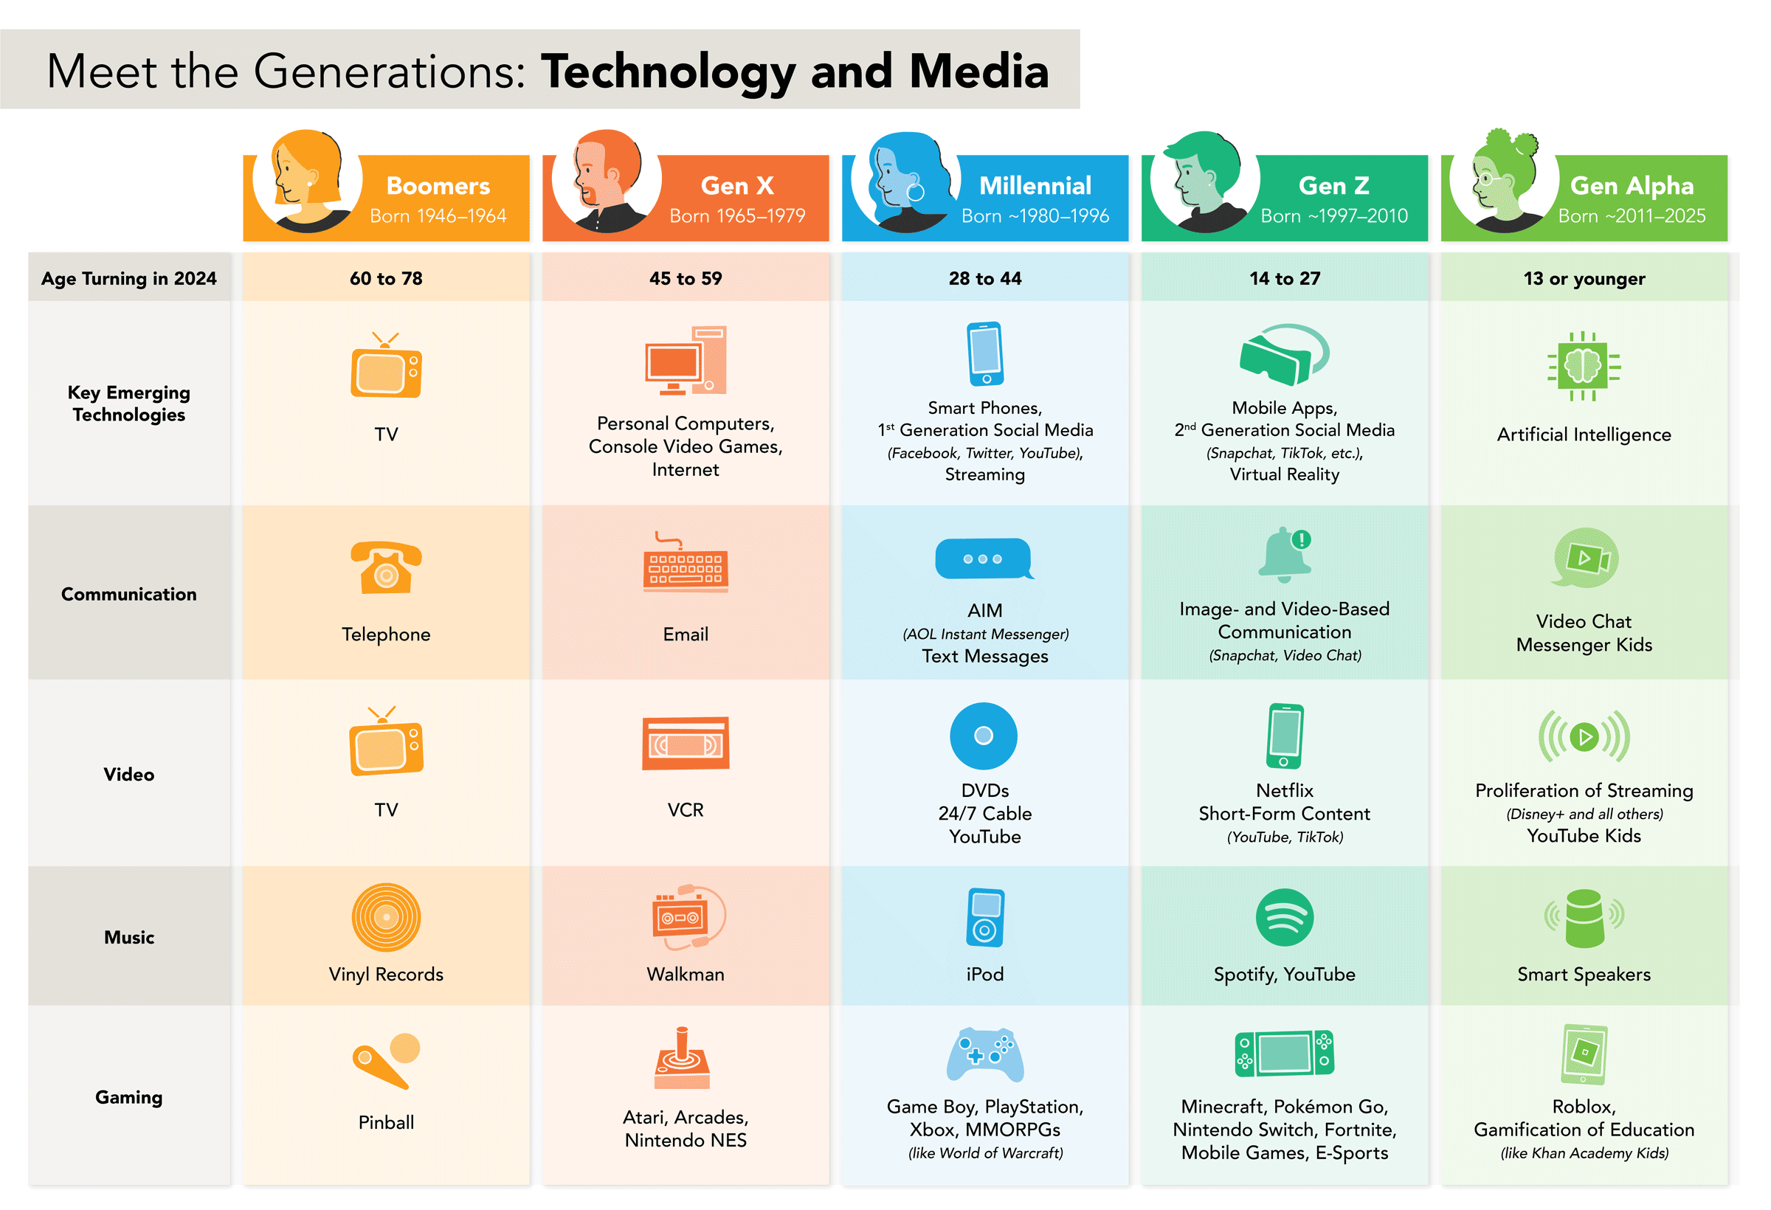
Generation
(C3, 2024)

Slide 21
Generation y/Z
According to BBC (2019)
Generation Y, they are described as ‘Lazy’ characteristics include:
confident
curious
questioning authority
Generation Z, “this group is young, and has never known a life without tech. Some of their characteristics include:
ambitious
digital-natives
Confident”

Slide 22


Generations
Older Generations
Pen and Paper
Willing to wait for answer
Reading
Generations Z
Digital Recording / Apps
Instant feedback
Video games, Social Media
Notes:
Older Generations: They grew up sitting in a desk with a notebook and a pen, writing down what the teacher said by hand.
Gen Z: They often find writing by hand too slow. They prefer to record the lecture on their phone, take a photo of the whiteboard, or use apps to keep track of information.
Older Generations: They are used to a "wait and see" world—waiting a week for a grade or 24 hours for a return phone call.
Gen Z: Because of Google and instant messaging, they are used to getting answers in seconds. If a teacher or a website takes too long to respond, they get frustrated.
Older Generations: Their brains are "wired" to read long books and follow a straight line of thought from start to finish (Linear processing).
Gen Z: Because they grew up with video games and social media, their brains are better at processing many images at once. They can scan a screen and find what they need instantly, but they might struggle more with long, boring texts (Visual processing).

Slide 23

According to Cilliers (2017), Generation Z is the digital generation, having grown up in a world with
the internet and technology all around them. They “live and breathe” technology,
which affects how their brains work and how they prefer to learn.
According to Picton, (2023) Generation Z is known for being practical and flexible. They like to try new ways of learning and working. By meaning is that Gen Z, they prefer using apps, videos, pictures, and social media to share ideas, learn, and collaborate. Because they are comfortable with these tools, they can communicate faster and more creatively than previous generations.

Slide 24
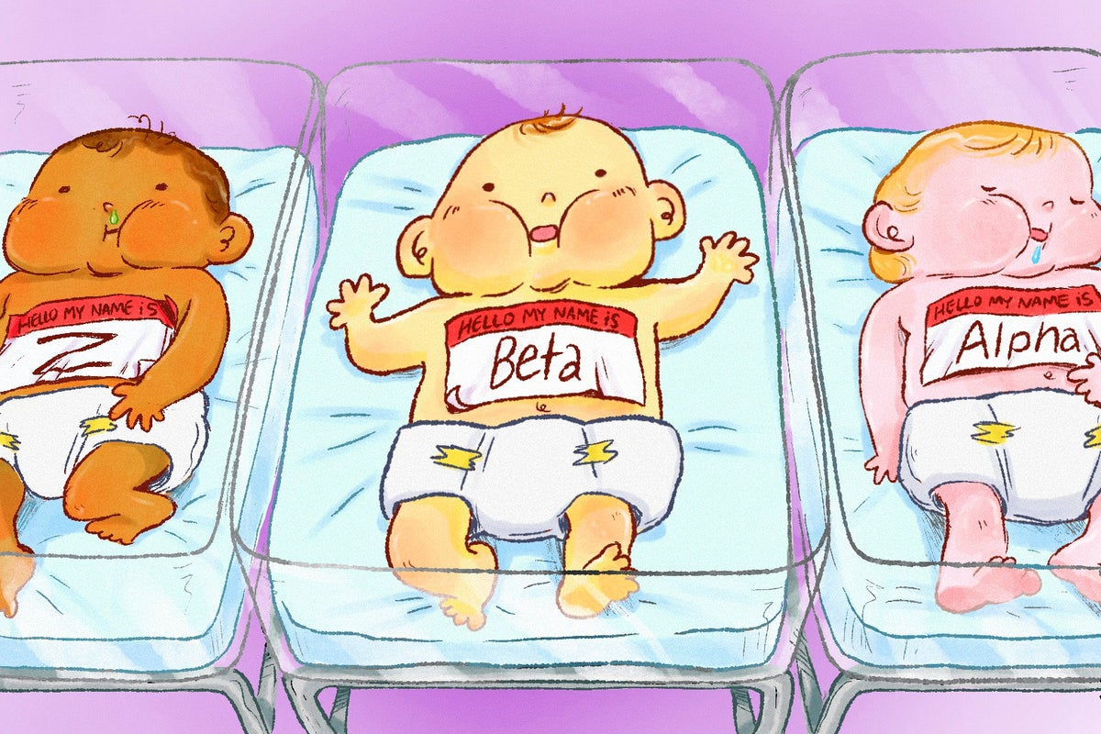
Generation Z , Alpha and beta
Generation Z, Alpha, and Beta have grown up with technology, so they feel very comfortable using it in everyday life.
In restaurants, they prefer using things like QR codes, apps, digital training, and online meetings instead of In person.
They like fast and simple systems, Just quick clicks, not long waiting times.
They also enjoy apps or tools that are a bit fun and interactive, such as social media style features or small activities that keep them engaged.
These types of tools can also help improve their communication skills in a modern way.
They prefer flexible working styles rather than strict routines.
They usually don’t respond well to heavy pressure or overwhelming workloads, so a supportive and balanced environment works better for them.

Slide 25

Ai
According to Kim et al. (2024), AI is technology that allows computers or machines to think, learn, and make decisions like humans. It can analyse large amounts of data and help businesses make better decisions.
Using AI could be beneficial for hotel breakfast service:
Guest information all in one place: Instead of a paper list, an online system can show guest names, room numbers, whether breakfast is paid or included, and any special requests.
Automatic payment checking: The system will automatically show if a guest has paid for breakfast or if the charge should go to the room.
AI predictions for breakfast: The system can predict how many guests are coming each morning, helping the kitchen prepare the right amount of food.
Benefits for staff and kitchen:
Saves time during service
Reduces errors
Reduces stress for staff
Improves communication between kitchen and service staff, leading to smoother service

Slide 26

Action Plan
Weekly communication training sessions
Encourage staff to use apps correctly every shift
Pair new staff with experienced team members
Regular feedback from staff and management
Monitor service performance and reduce errors
Assign Responsibility
Providing more guidance’s
Assign responsibility to supervisors and senior staff to support communication during service
Provide clear guidance and instructions to new staff to build their confidence.
Hold short team briefings before each shift to share important information

Slide 27


Thank You

Slide 28
Refeerences:
BBC (2019). Millennials, Baby Boomers or Gen Z: Which One Are You and What Does It mean? [online] BBC Bitesize. Available at: https://www.bbc.co.uk/bitesize/articles/zf8j92p [Accessed 12 Mar. 2026].
Blau, S. (2021). A Focus on Our Staff. Oncology Issues, [online] 36(5), p.2. doi:https://doi.org/10.1080/10463356.2021.1967660.
C3 (2024). Meet the Generations. [online] C3. Available at: https://c3brandmarketing.com/meet-the-generations/ [Accessed 12 Mar. 2026].
Cilliers, E.J. (2017). The challenge of teaching generation Z. [online] ResearchGate. Available at: https://www.researchgate.net/publication/312659039_The_challenge_of_teaching_generation_Z [Accessed 13 Mar. 2026].
DiGiovanna, J.M. (2024). Questions are the answer - Powerful Questions to Build Team Trust, Engagement, and Psychological Safety. [online] LinkedIn. Available at: https://www.linkedin.com/learning/powerful-questions-every-leader-should-ask-to-enhance-team-communication/questions-are-the-answer?u=77966930 [Accessed 8 Mar. 2026].
Emerson College (2024). Effective Communication. [online] Human Resources. Available at: https://hr.emerson.edu/hc/en-us/articles/27645268739475-Effective-Communication#h_01HSGQCEVW01JEF354DJV9VGZ7 [Accessed 7 Mar. 2026].
Kim, H., Kam, K., Shin, S. and Li, J. (2024). Artificial Intelligence in Hospitality and Tourism: Insights From Industry Practices, Research Literature, and Expert Opinions. Journal of Hospitality & Tourism Research, [online] 49(2). doi:https://doi.org/10.1177/10963480241229235.
Kolb, D. (2015). Experiential learning: Experience as the source of learning and development. 2nd ed. [online] Upper Saddle River, New Jersey: Pearson Education, Inc, p.62. Available at: https://librarysearch.uwtsd.ac.uk/discovery/fulldisplay?docid=alma99100119857302421&context=L&vid=44WHELF_UWTSD:44WHELF_UWTSD_VU1&lang=en&adaptor=Local%20Search%20Engine&section=items [Accessed 12 Mar. 2026].
Mamaqi, E. (2023). The Role of Trainings in the Development and Enhancement of Work Performance in the Public and Private Sector. Interdisciplinary Journal of Research and Development, [online] 10(1 S1), pp.107–107. doi:https://doi.org/10.56345/ijrdv10n1s115.
Morgans Hotel (2026). Morgans Hotel – Luxury Rooms in the Heart of Swansea. [online] Morgans Hotel. Available at: https://www.morganshotel.co.uk/ [Accessed 5 Mar. 2026].
Picton , R.B. (2023). Mind The Gap. [online] London South Bank University. Available at: https://openresearch.lsbu.ac.uk/download/20b52120200e01ca049711cdf627b00d5e2e11222e1dbb890b20f000321ad692/2718430/MindtheGapThesissubmission15.09.23v2.pdf [Accessed 14 Mar. 2026].

Slide 29
Ai acknowledge
I acknowledge the use of ChatGPT (www.chatgpt.com) on 5 March 2026 to check my grammar and spelling, as well as to help me understand the assessment requirements in a simplified way to guide my research.
I used the following prompt(s):
Please check my text for grammar and spelling errors.
Explain the main points of the assessment in simpler terms to aid my research.

