Slide 1
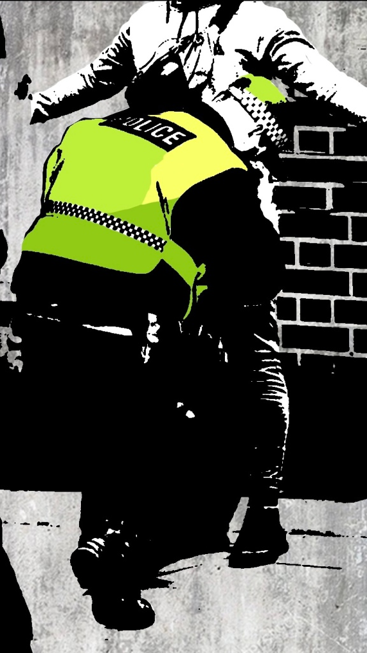
'Demonstrate a systematic knowledge and understanding on why it is essential that the police use the stop search powers fairly and the impact upon modern society and policing when this is not done effectively.'
Lauren Evans
2101181
https://iaingould.co.uk/2021/11/26/police-abuse-of-stop-and-search-powers/

Slide 2
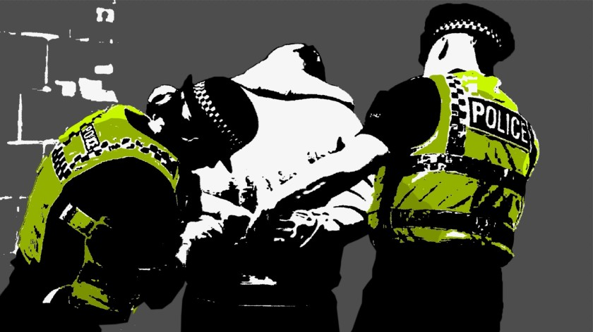
What is meant by stop and search?
Section 1 - Police and Criminal Evidence Act 1984
A police constable may detain any person or vehicle or anything which is in or on a vehicle, in any place to which the public has access,
If he or she has reasonable grounds for suspecting that stolen or prohibited articles, prohibited fireworks or bladed or sharply pointed articles will be found,
Any such article found during a search may be seized
(UK Government, 2023)
https://iaingould.co.uk/2022/01/21/police-misuse-of-stop-search-powers-a-vicious-circle/

Slide 3
The history
Stop and Search was first used to allow police the power to stop anyone they deemed as 'suspicious'
Home Secretary, William Whitelaw, commissioned the Scarman Report following the riots, acknowledging evidence for disproportional use of powers and recognising what lead to the outbreak
The overuse of these 'sus law' powers directly led to the Brixton Riots of 1981
These 'sus laws' were notoriously used by the Met Police in the 1980s during 'Operation Swamp' to crack down on street crime in Brixton
Police and Criminal Evidence Act (PACE) 1984 created a new code of police behaviour based off recommendations in the Scarman Report
The operation mainly targeted young, black men, with officers making nearly 1,000 stops over 6 days
(StopWatch, 2022)

Slide 4
Stop and search powers
Exercise by police officers of statutory powers to search a person or a vehicle without first making an arrest and the need for a police officer to make a record of a stop or encounter
Police and Criminal Evidence Act 1984 (PACE)
Code A
(UK Government, 2023)

Slide 5
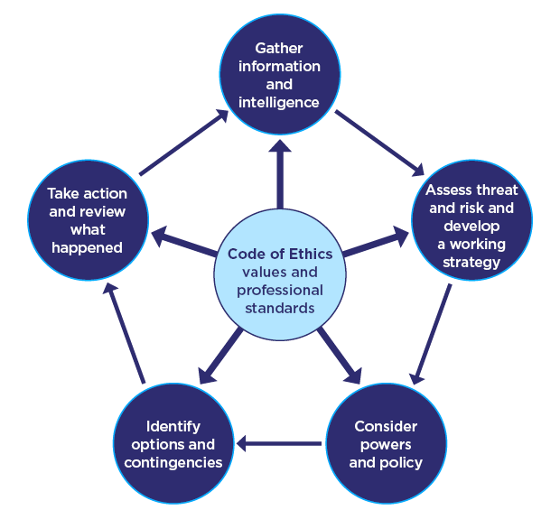
How do we make it fair and Effective?
National Decision Model
Fundamental in all policing decisions
(College of Policing, 2014)
Everything police do must be:
Justified
Proportionate
Legal
Accountable
Necessary
Ethical
https://www.college.police.uk/app/national-decision-model/national-decision-model

Slide 6
What happens?
Establishing Reasonable Grounds
(SHACKS/BAITK)
Provide Information
Grounds
Object
Warrant Card
Identity
Station
Entitlement
Legislation
You are detained for the purpose of a search...
Search
Jacket
Outerwear
Gloves
(Iain Gould, 2020)
(College Of Policing, 2016)

Slide 7
When do we use stop and search?
"The primary purpose of stop and search powers is to enable officers to allay or confirm suspicions about individuals without exercising their power of arrest."
UK Government, 2013

Slide 8
Why does it matter how stop and search is used?
When used appropriately and proportionally, such procedures can uphold the law and maintain peace.
Public trust in the police is essential.
Public intelligence is essential.
"Stop and search can play an important role in the detection and prevention of crime and using the powers fairly makes them more effective."
UK Government, 2013

Slide 9
Value of using powers correctly
Policing by consent is upheld leading to:
Police legitimacy
Public trust
Less confrontation
Reassurance – contribution to arrests
However:
No clear link regarding the impact of stop and search on crime
Stop and search tends to be less productive the more the power is used.
(College Of Policing, 2016)
(Miller and Others, 2000)

Slide 10

Consequences of an improper stop and search
Alarm and distress
Distrust in the police
Discourages voluntary public engagement
Evidence found may be challenged
"Any misuse of the powers is likely to be harmful to policing and lead to mistrust of the police...If the provisions of the Code are not followed during a search to which it applies, any evidence obtained during the search may be open to challenge."
UK Government, 2013
(Myhill and Quinton, 2011)

Slide 11
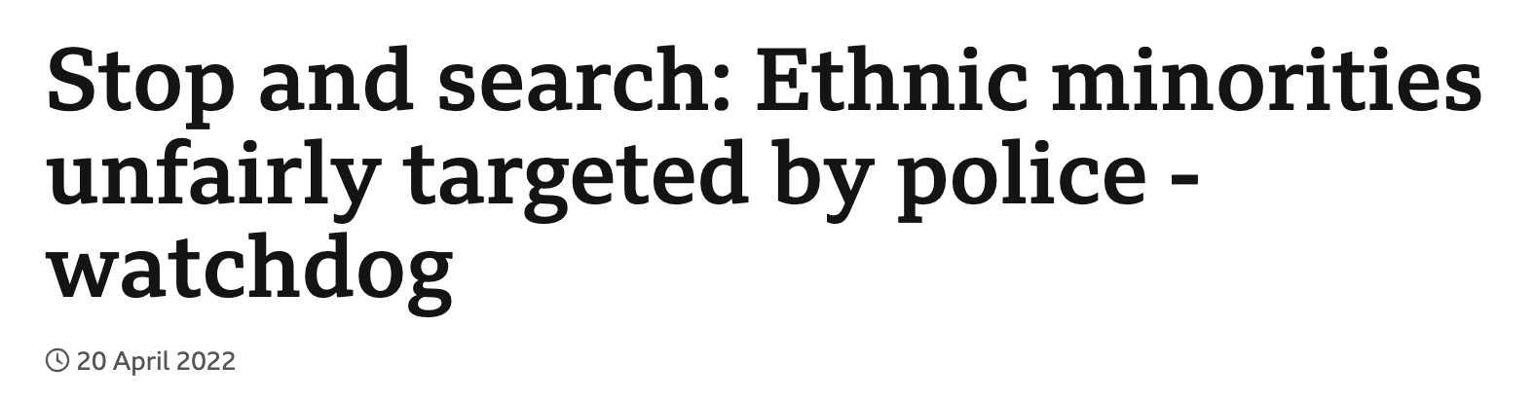
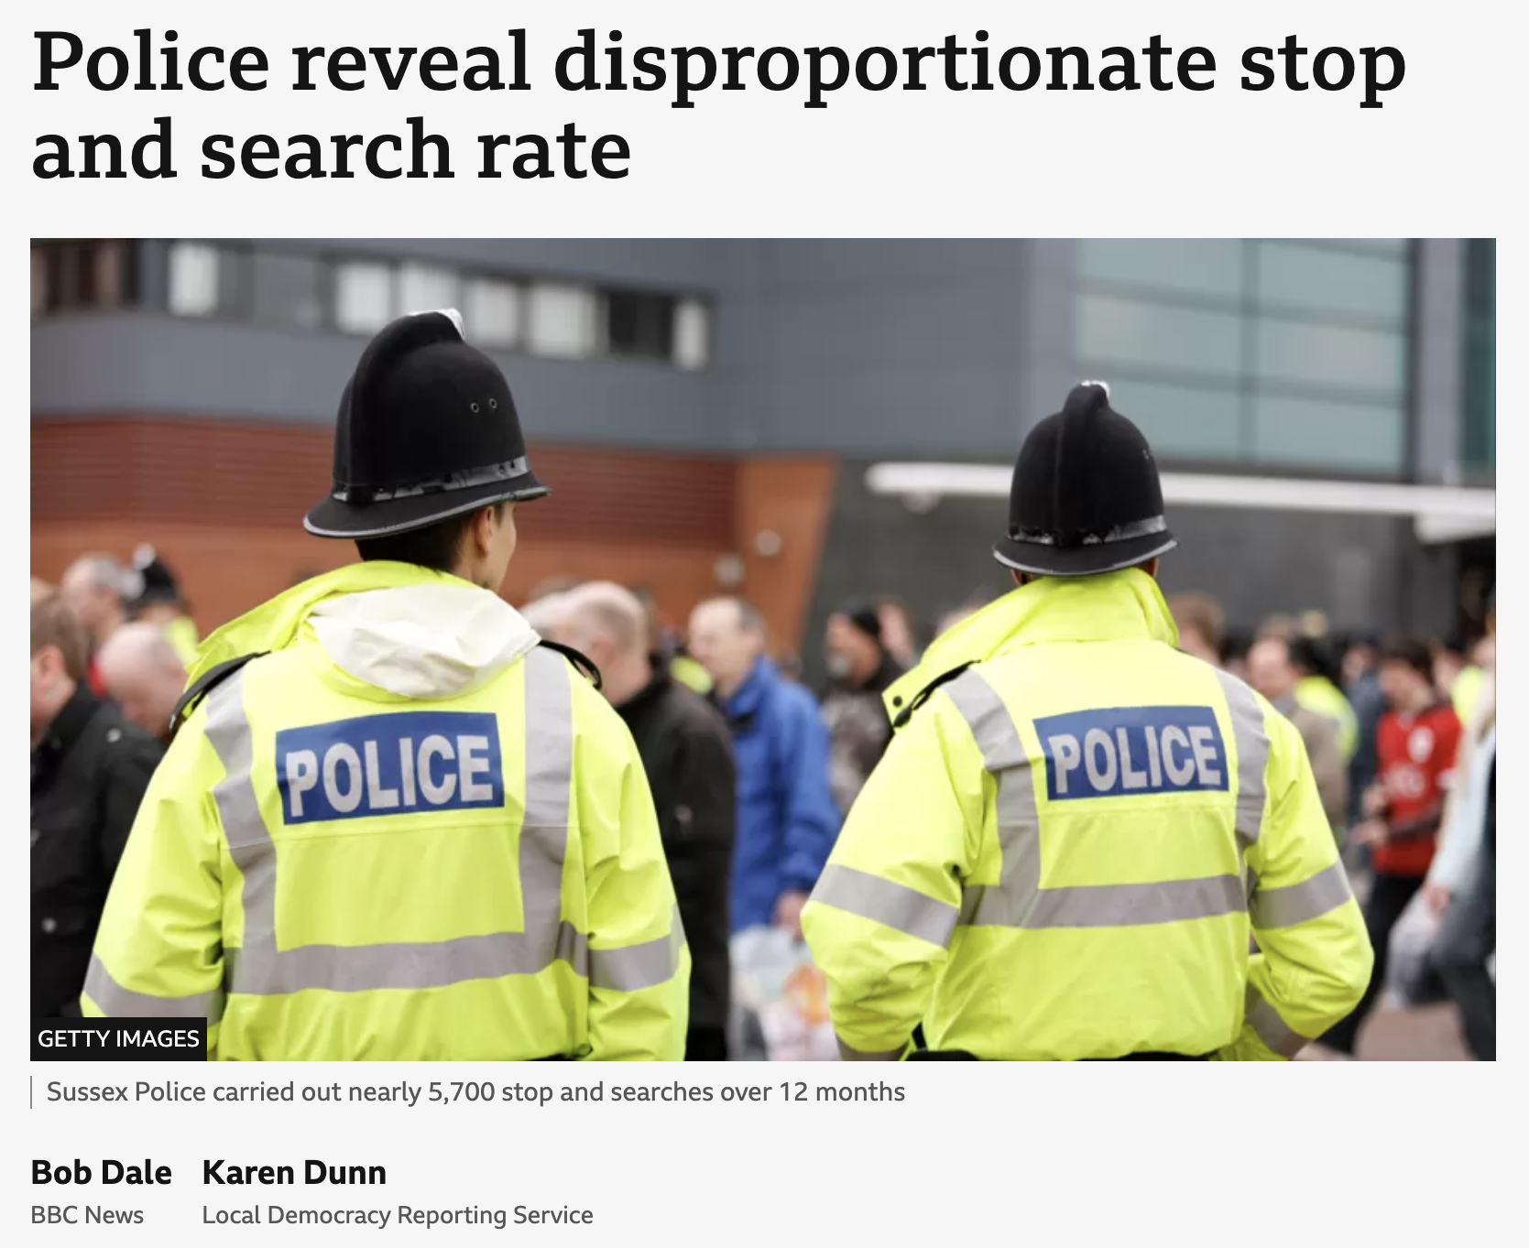

News articles
(BBC News, 2022)
(BBC News, 2023)
https://www.bbc.co.uk/news/uk-61167875
https://www.bbc.co.uk/news/uk-england-london-67084111
https://www.bbc.co.uk/news/articles/c9ejz9xzy3go

Slide 12
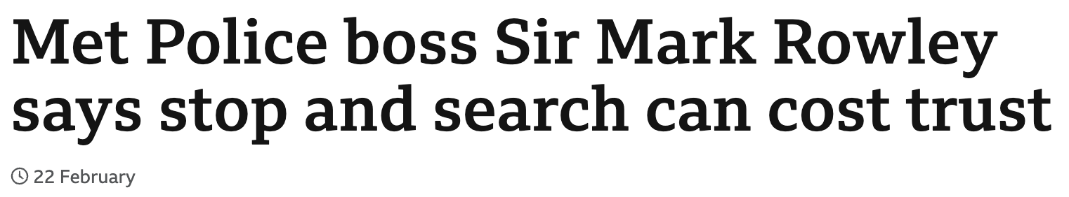
(BBC News, 2023)
https://www.bbc.co.uk/news/uk-england-london-64733390
"It has a value but it also has a cost if done badly."
Sir Mark Rowley, 2023

Slide 13
Any Questions?

Slide 14
Bibliography
College Of Policing (2014). National Decision Model. [online] College of Policing. Available at: https://www.college.police.uk/app/national-decision-model/national-decision-model [Accessed Oct. 2023].
College of Policing (2016). Fair. [online] College of Policing. Available at: https://www.college.police.uk/app/stop-and-search/fair [Accessed Oct. 2023].
College of Policing (2017). Stop and Search. [online] College of Policing. Available at: https://www.college.police.uk/app/stop-and-search/stop-and-search [Accessed Oct. 2023].
College of Policing (2015). Fair cop 2: Organisational justice, behaviour and ethical policing. [online] Available at: https://assets.college.police.uk/s3fs-public/2022-04/Fair-cop-2-%20organisational-justice-behaviour-and-ethical-policing.pdf [Accessed Oct. 2023].
Dale, B. and Dunne, K. (2023). Sussex Police 8.8 Times More Likely to Stop and Search Black People. [online] BBC News. Available at: https://www.bbc.co.uk/news/articles/c9ejz9xzy3go [Accessed Oct. 2023].
Gould, I. (2020). The GOWISELY Procedure and Unlawful Stop and Search. [online] Iain Gould- Actions Against the Police Solicitor. Available at: https://iaingould.co.uk/2020/09/14/the-gowisely-procedure-and-unlawful-stop-and-search/ [Accessed Oct. 2023].
Home Office (2013). Police and Criminal Evidence Act 1984 (PACE) Codes of Practice. [online] GOV.UK. Available at: https://www.gov.uk/guidance/police-and-criminal-evidence-act-1984-pace-codes-of-practice [Accessed Oct. 2023].
Home Office (2014). Revised Code of Practice for the Exercise by: Police Officers of Statutory Powers of Stop and Search Police Officers and Police Staff of Requirements to Record Public Encounters Police and Criminal Evidence Act 1984 (PACE) -Code a. [online] Available at: https://assets.publishing.service.gov.uk/media/5a74e216e5274a59fa715b3e/PaceCodeAWeb.pdf [Accessed Oct. 2023].
legislation.gov.uk (1984). Police and Criminal Evidence Act 1984. [online] Legislation.gov.uk. Available at: https://www.legislation.gov.uk/ukpga/1984/60/section/1 [Accessed Oct. 2023].
Low, H. (2023). Met Police Boss Sir Mark Rowley Says Stop and Search Can Cost Trust. BBC News. [online] 22 Feb. Available at: https://www.bbc.co.uk/news/uk-england-london-64733390 [Accessed Oct. 2023].
StopWatch. (2022). PACE Section 1 Factsheet. [online] Available at: https://www.stop-watch.org/what-we-do/research/section-1-factsheet/#:~:text=section%2060%20factsheet).- [Accessed Oct. 1023].
UK Government (2011). Police Powers to Stop and search: Your Rights. [online] GOV.UK. Available at: https://www.gov.uk/police-powers-to-stop-and-search-your-rights [Accessed Oct. 2023].
UK Government (2023). PACE Code a 2023 (accessible). [online] GOV.UK. Available at: https://www.gov.uk/government/publications/pace-code-a-2023/pace-code-a-2023-accessible [Accessed Oct. 2023].
Watts, D. (2023). What Is Policing by Consent ? [online] Ministry of Injustice. Available at: https://ministryofinjustice.co.uk/what-is-policing-by-consent/#:~:text=It%20is%20a%20concept%20rooted [Accessed Oct. 2023].

